Slide 1

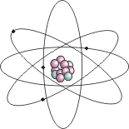
ATOMS
A SELF-GUIDED COMPUTER ACTIVITY

Slide 2
Welcome to Atoms
This is a Self-Guided lesson on Atoms. In this computer activity you will be creating your own Study Guide.
Feel free to complete this lesson at your own pace.
Please follow all instructions carefully.
Ask your teacher if you need any help.

Slide 3

Atoms Part 1
In Part 1 of this activity you will learn about the Atomic - Molecular Theory of Matter. You will also learn about scientists and how they have gathered evidence about atoms.
Please complete your Study Guide as you proceed!

Slide 4

Atomic - Molecular Theory of Matter
The Atomic - Molecular Theory of Matter states that all matter is composed of small, fast moving particles called atoms. These atoms can join together to form molecules.
This theory is really thousands of individual theories that provide evidence for the whole theory.

Slide 5
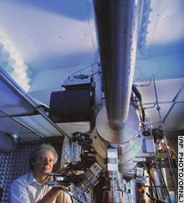
Matter
Since the atom is too small to be seen even with the most powerful microscopes, scientists rely upon models to help us to understand the atom.
Believe it or not this is a microscope. Even with the world’s best microscopes we cannot clearly see the structure or behavior of the atom.

Slide 6
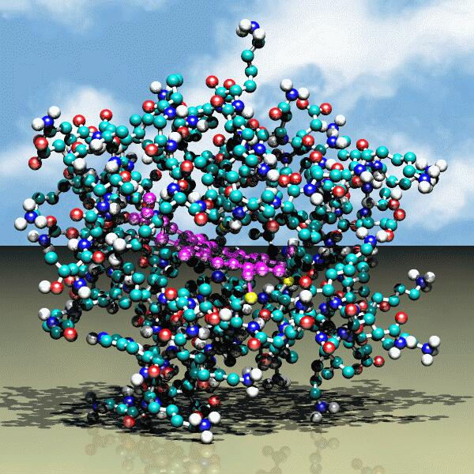
Scientific Models
Scientists create models to help them to visualize complex properties, structures or behaviors. Since the atom is so small, scientists must gather Indirect Evidence to develop their models.
This is a model of a very complex molecule made of many different kinds of atoms. Each colored ball represents an atom of a different element.

Slide 7
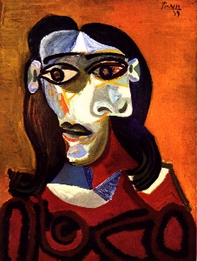
What should a Model look like?
Scientific models may not always look like the actual object. A model is an attempt to use familiar ideas to describe unfamiliar things in a visual way.
This is a painting of a young woman by Pablo Picasso. Does it actually look like a young woman?

Slide 8
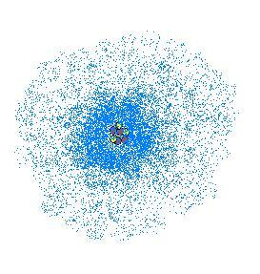
Is this really an Atom?
Many of the models that you have seen may look like the one below. It shows the parts and structure of the atom. Even though we do not know what an atom looks like, scientific models must be based on evidence.
The model above represents the most modern version of the atom.
(Artist drawing)

Slide 9
Indirect Evidence
Indirect Evidence is evidence gathered without being able to directly observe the object. The Atomic - Molecular Theory of Matter is based upon a vast amount of indirect evidence gathered over a long period of time. Just like pieces being added to a puzzle, each new bit of information gives us a better understanding of atoms.

Slide 10
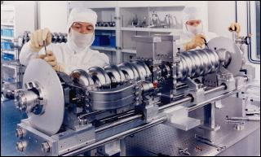
How can Indirect Evidence be Gathered?
Click here to visit a lab where actual scientific research on atoms is conducted.
Answer the questions in your Study Guide about the example of Indirect Evidence.

Slide 11
Can a Model be Changed?
A model can be changed as new information is collected.
From the early Greek concept to the modern atomic theory, scientists have built upon and modified existing models of the atom.

Slide 12

Where did it all begin?
The word “atom” comes from the Greek word “atomos” which means indivisible.
The idea that all matter is made up of atoms was first proposed by the Greek philosopher Democritus in the 5th century B.C.

Slide 13
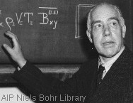
History of the Atom
The concept of atoms as proposed by Democritus remained relatively unchanged for over 2,000 years. In the late 18th century new discoveries were made that led to a better understanding of atoms and chemistry. Many scientists since that time have contributed new evidence for the Atomic - Molecular Theory.
Click on the picture of Niels Bohr to visit a website to learn more about important scientists and how our models of the atom have changed.
Niels Bohr is one of many scientists that have given us a better understanding of Atoms.

Slide 14
You have finished Part 1 of this program. See the teacher for the materials to begin Part 2.
Good JOB!

Slide 15

Atoms Part 2
In Part 2 of this activity you will learn about the particles within the atom. You will visit more websites to learn about the structure and behavior of the atom.
Check your Study Guide for Instructions!

Slide 16
Atomic Structure
Nucleus - the central portion of the atom. Contains the protons and neutrons.
Electron Cloud - area around the nucleus where electrons are found. Electrons are arranged within the electron cloud in energy levels (Energy levels are sometimes called shells or orbits).

Slide 17
Subatomic Particles
Proton - positive charged particle found in the nucleus. Mass = 1 amu. (a.m.u - Atomic Mass Unit)
Neutron - particle with no charge. Found in the nucleus. Mass = 1 amu.
Electron - negative charged particle found within the electron cloud . Mass = 1/1836 amu.

Slide 18
Why are all Atoms are Electrically Neutral?
Normally in an atom the number of electrons within the electron cloud is equal to the number of protons in the nucleus. The positive and negative charges cancel each other out. Therefore, the atom is said to be electrically neutral.
If an atom gains or loses electrons the atom is no longer neutral . This can happen if the atom absorbs or releases energy The atom is then called an ION.
IMPORTANT
In all ATOMS the number of positively charged protons is always equal to the number of negatively charged electrons.

Slide 19
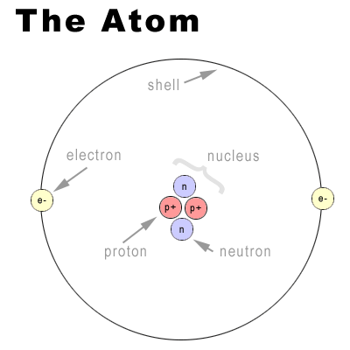
Make a diagram of the Helium atom in your Study Guide.

Slide 20

Now you are off to Jolly Old’ England!
Now you will visit a website from England to learn about Atomic Structure. Be sure to follow the instructions in your Study Guide.
Click here to visit a website at the BBC _x000b_(British Broadcasting Company)

Slide 21
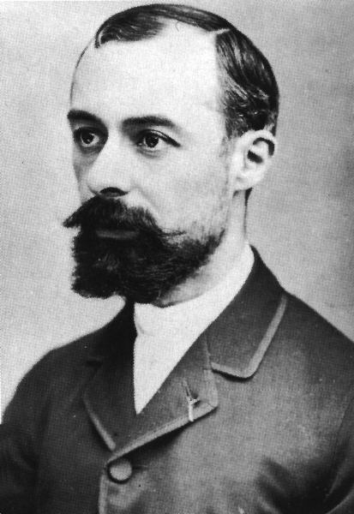
Isotopes
All atoms of an element have the same number of protons but the number of neutrons can vary. Atoms with the same number of protons and differing numbers of neutrons are called ISOTOPES.
Some Isotopes are unstable. The nucleus of unstable atoms do not hold together well. Radioactive decay is the process whereby the nucleus of unstable isotopes release fast moving particles and energy.
The discovery of Radioactivity almost happened by accident. Click on the picture of Henri Becquerel to learn about his discovery.

Slide 22
You have now completed the Atoms PowerPoint. See the teacher for further instructions.
Great Job!!

Slide 23
This powerpoint was kindly donated to www.worldofteaching.com
http://www.worldofteaching.com is home to over a thousand powerpoints submitted by teachers. This is a completely free site and requires no registration. Please visit and I hope it will help in your teaching.

