Slide 1
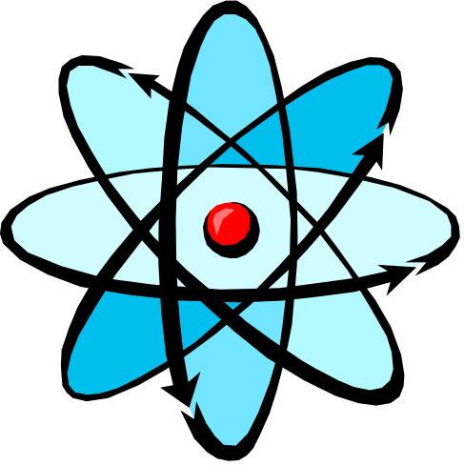
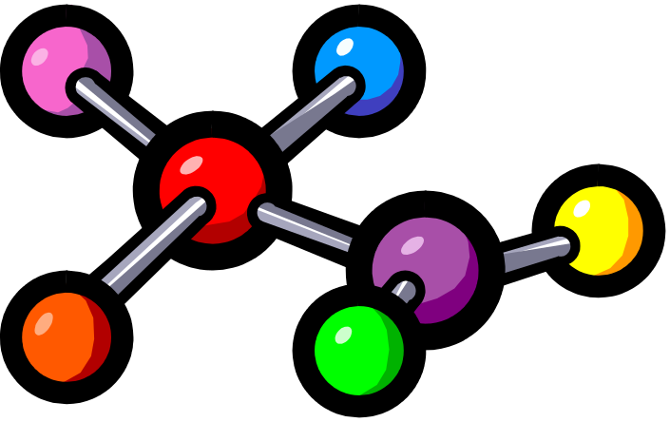
Atoms, Molecules and Ions
Chapter 2
Copyright © The McGraw-Hill Companies, Inc. Permission required for reproduction or display.

Slide 2
Dalton’s Atomic Theory (1808)
Elements are composed of extremely small particles called atoms. All atoms of a given element are identical. The atoms of one element are different from the atoms of all other elements.
Compounds are composed of atoms of more than one element. The relative number of atoms of each element in a given compound is always the same.
Chemical reactions only involve the rearrangement of atoms. Atoms are not created or destroyed in chemical reactions.
2.1

Slide 3
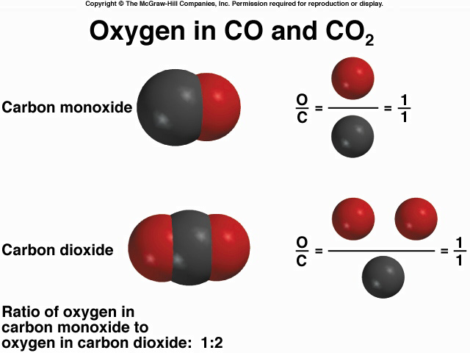
2
Law of Multiple Proportions
2.1

Slide 4
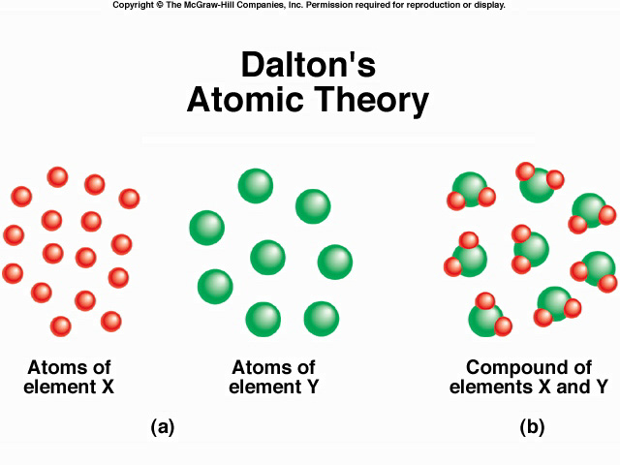
16 X
+
8 Y
8 X₂Y
Law of Conservation of Mass
2.1

Slide 5
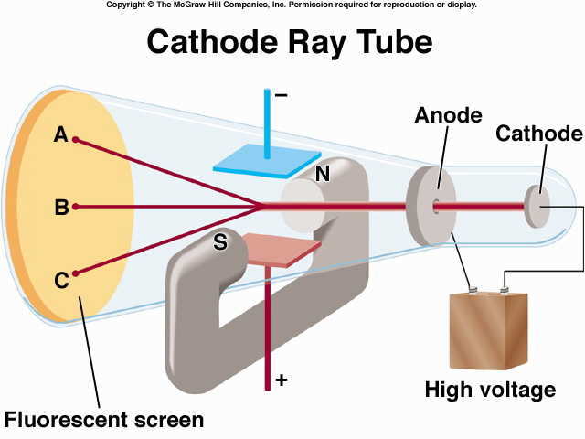
J.J. Thomson, measured mass/charge of e⁻
(1906 Nobel Prize in Physics)
2.2

Slide 6
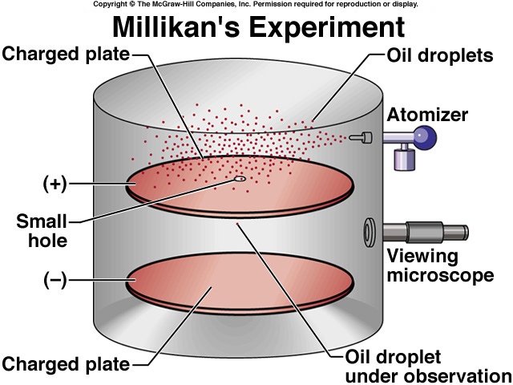
Measured mass of e⁻
(1923 Nobel Prize in Physics)
e⁻ charge = -1.60 x 10⁻¹⁹ C
Thomson’s charge/mass of e⁻ = -1.76 x 10⁸ C/g
e⁻ mass = 9.10 x 10⁻²⁸ g
2.2

Slide 7
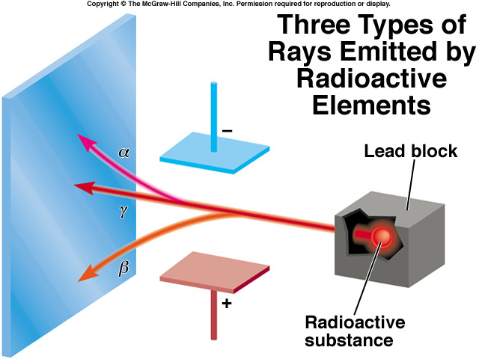
(Uranium compound)
2.2

Slide 8
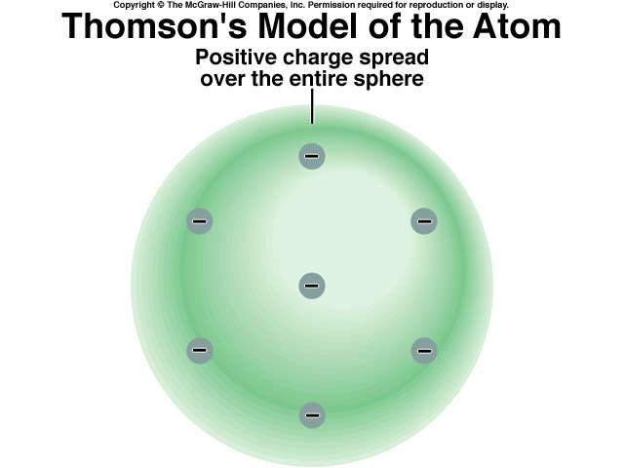
2.2

Slide 9
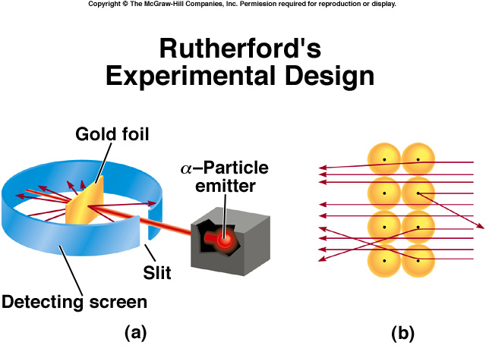
(1908 Nobel Prize in Chemistry)
particle velocity ~ 1.4 x 10⁷ m/s
(~5% speed of light)
atoms positive charge is concentrated in the nucleus
proton (p) has opposite (+) charge of electron
mass of p is 1840 x mass of e⁻ (1.67 x 10⁻²⁴ g)
2.2

Slide 10
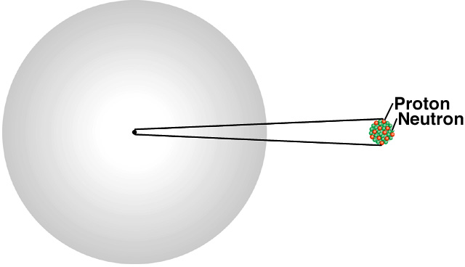
Rutherford’s Model of
the Atom
atomic radius ~ 100 pm = 1 x 10⁻¹⁰ m
nuclear radius ~ 5 x 10⁻³ pm = 5 x 10⁻¹⁵ m
If the atom is the Houston Astrodome
Then the nucleus is a marble on the 50 yard line
2.2

Slide 11


Chadwick’s Experiment (1932)
H atoms - 1 p; He atoms - 2 p
mass He/mass H should = 2
measured mass He/mass H = 4
α + ⁹Be
¹n + ¹²C + energy
neutron (n) is neutral (charge = 0)
n mass ~ p mass = 1.67 x 10⁻²⁴ g
2.2

Slide 12
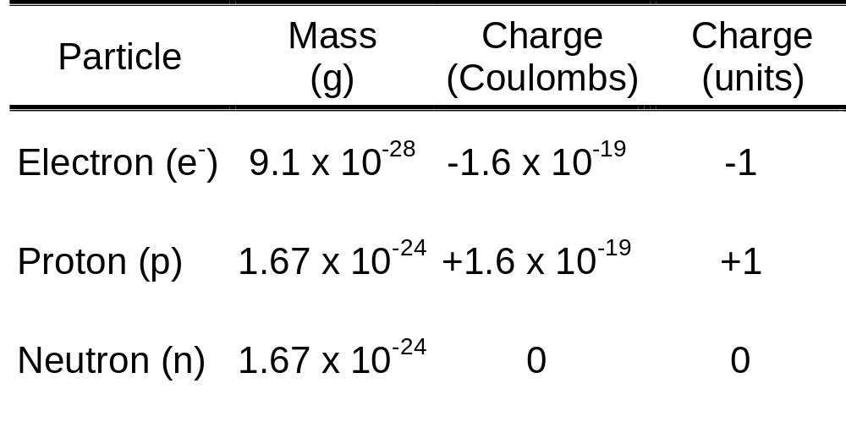
Subatomic Particles (Table 2.1)
mass p = mass n = 1840 x mass e⁻
2.2

Slide 13
Atomic number (Z) = number of protons in nucleus
Mass number (A) = number of protons + number of neutrons
= atomic number (Z) + number of neutrons
Isotopes are atoms of the same element (X) with different numbers of neutrons in the nucleus
Mass Number
A
X
Element Symbol
Atomic Number
Z
1
2
3
H
H (D)
H (T)
1
1
1
235
U
238
U
92
92
2.3

Slide 14
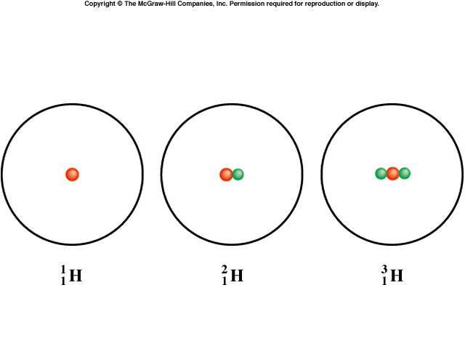
2.3

Slide 15
Do You Understand Isotopes?
How many protons, neutrons, and electrons are in
14
C
?
6
6 protons, 8 (14 - 6) neutrons, 6 electrons
How many protons, neutrons, and electrons are in
11
C
?
6
6 protons, 5 (11 - 6) neutrons, 6 electrons
2.3

Slide 16
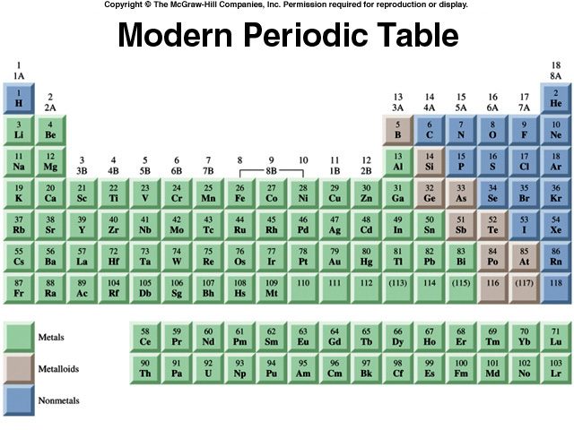
Alkali Earth Metal
Alkali Metal
Period
Noble Gas
Group
Halogen
2.4

Slide 17
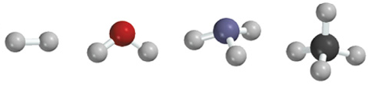
A molecule is an aggregate of two or more atoms in a definite arrangement held together by chemical bonds
H₂
H₂O
NH₃
CH₄
A diatomic molecule contains only two atoms
H₂, N₂, O₂, Br₂, HCl, CO
A polyatomic molecule contains more than two atoms
O₃, H₂O, NH₃, CH₄
2.5

Slide 18
An ion is an atom, or group of atoms, that has a net positive or negative charge.
cation – ion with a positive charge
If a neutral atom loses one or more electrons
it becomes a cation.
Na
11 protons
11 electrons
11 protons
10 electrons
Na⁺
anion – ion with a negative charge
If a neutral atom gains one or more electrons
it becomes an anion.
Cl
17 protons
17 electrons
17 protons
18 electrons
Cl⁻
2.5

Slide 19

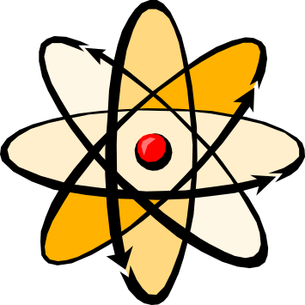
A monatomic ion contains only one atom
Na⁺, Cl⁻, Ca²⁺, O²⁻, Al³⁺, N³⁻
A polyatomic ion contains more than one atom
OH⁻, CN⁻, NH₄⁺, NO₃⁻
2.5

Slide 20
Do You Understand Ions?
27
Al
3⁺
How many protons and electrons are in
?
13
13 protons, 10 (13 – 3) electrons
How many protons and electrons are in
78
Se
2-
?
34
34 protons, 36 (34 + 2) electrons
2.5

Slide 21
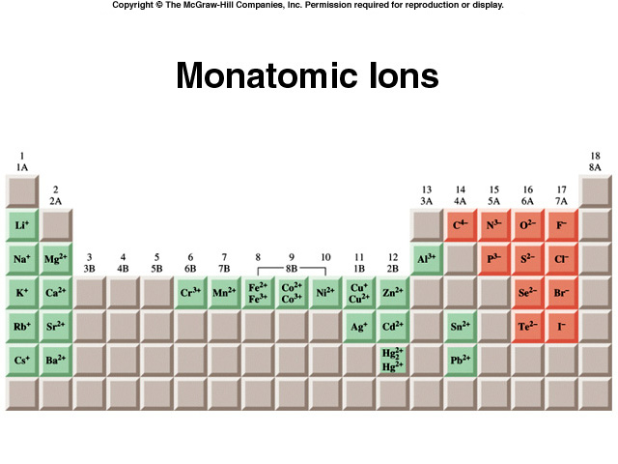
2.5

Slide 22
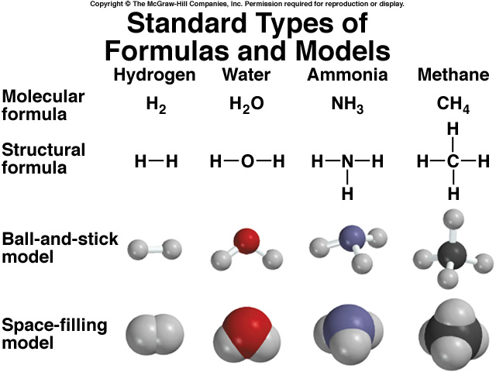
2.6

Slide 23
A molecular formula shows the exact number of atoms of each element in the smallest unit of a substance
An empirical formula shows the simplest
whole-number ratio of the atoms in a substance
molecular
empirical
H₂O
H₂O
C₆H₁₂O₆
CH₂O
O₃
O
N₂H₄
NH₂
2.6

Slide 24
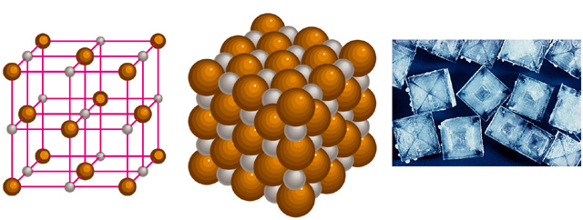
ionic compounds consist of a cation and an anion
the formula is always the same as the empirical formula
the sum of the charges on the cation and anion in each formula unit must equal zero
The ionic compound NaCl
2.6

Slide 25
Formula of Ionic Compounds
2 x +3 = +6
3 x -2 = -6
Al₂O₃
Al³⁺
O²⁻
1 x +2 = +2
2 x -1 = -2
CaBr₂
Ca²⁺
Br⁻
1 x +2 = +2
1 x -2 = -2
Na₂CO₃
Na⁺
CO₃²⁻
2.6

Slide 26
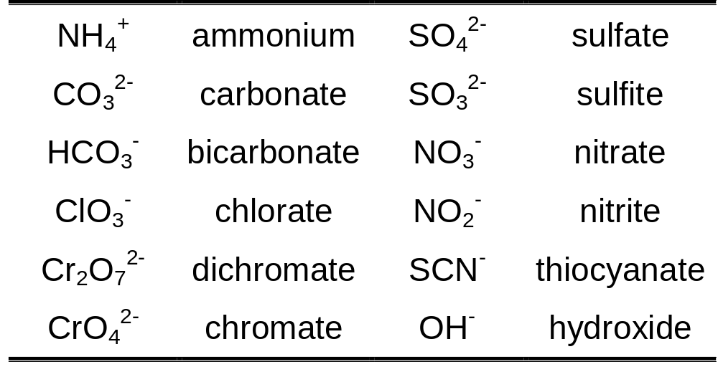
Some Polyatomic Ions (Table 2.3)
2.7

Slide 27
Chemical Nomenclature
Ionic Compounds
  often a metal + nonmetal
  anion (nonmetal), add “ide” to element name
BaCl₂
barium chloride
K₂O
potassium oxide
Mg(OH)₂
magnesium hydroxide
KNO₃
potassium nitrate
2.7

Slide 28
Transition metal ionic compounds
  indicate charge on metal with Roman numerals
FeCl₂
2 Cl⁻ -2 so Fe is +2
iron(II) chloride
FeCl₃
3 Cl⁻ -3 so Fe is +3
iron(III) chloride
Cr₂S₃
3 S⁻² -6 so Cr is +3 (6/2)
chromium(III) sulfide
2.7

Slide 29
Molecular compounds
  nonmetals or nonmetals + metalloids
  common names
    H₂O, NH₃, CH₄, C₆₀
  element further left in periodic table is 1st
  element closest to bottom of group is 1st
  if more than one compound can be formed from the same elements, use prefixes to indicate number of each kind of atom
  last element ends in ide
2.7

Slide 30


Molecular Compounds
HI
hydrogen iodide
NF₃
nitrogen trifluoride
SO₂
sulfur dioxide
N₂Cl₄
dinitrogen tetrachloride
NO₂
nitrogen dioxide
TOXIC!
N₂O
dinitrogen monoxide
Laughing Gas
2.7

Slide 31
An acid can be defined as a substance that yields
hydrogen ions (H⁺) when dissolved in water.
HCl
  Pure substance, hydrogen chloride
  Dissolved in water (H⁺ Cl⁻), hydrochloric acid
An oxoacid is an acid that contains hydrogen, oxygen, and another element.
HNO₃
nitric acid
H₂CO₃
carbonic acid
H₂SO₄
sulfuric acid
2.7

Slide 32
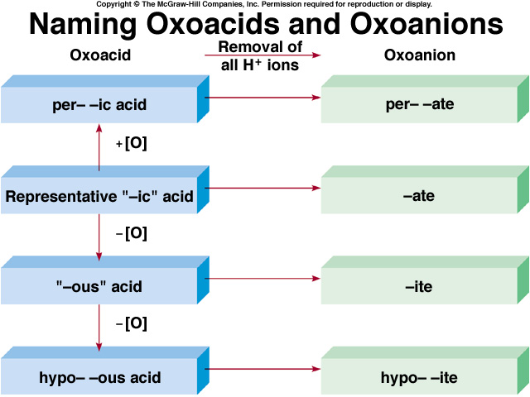
2.7

Slide 33

A base can be defined as a substance that yields
hydroxide ions (OH⁻) when dissolved in water.
NaOH
sodium hydroxide
KOH
potassium hydroxide
Ba(OH)₂
barium hydroxide
2.7

Slide 34
This powerpoint was kindly donated to www.worldofteaching.com
http://www.worldofteaching.com is home to over a thousand powerpoints submitted by teachers. This is a completely free site and requires no registration. Please visit and I hope it will help in your teaching.

