Slide 1
The Binomial Theorem
Digital Lesson

Slide 2
Binomial Expansions
The binomial theorem provides a useful method for raising any binomial to a nonnegative integral power.
Consider the patterns formed by expanding (x + y)^{n}.
(x + y)⁰ = 1
1 term
(x + y)¹ = x + y
2 terms
(x + y)² = x² + 2xy + y²
3 terms
(x + y)³ = x³ + 3x²y + 3xy² + y³
4 terms
(x + y)⁴ = x⁴ + 4x³y + 6x²y² + 4xy³ + y⁴
5 terms
6 terms
(x + y)⁵ = x⁵ + 5x⁴y + 10x³y² + 10x²y³ + 5xy⁴ + y⁵
Notice that each expansion has n + 1 terms.
Example: (x + y)¹⁰ will have 10 + 1, or 11 terms.
Copyright © by Houghton Mifflin Company, Inc. All rights reserved.

Slide 3
Patterns of Exponents in Binomial Expansions
Consider the patterns formed by expanding (x + y)^{n}.
(x + y)⁰ = 1
(x + y)¹ = x + y
(x + y)² = x² + 2xy + y²
(x + y)³ = x³ + 3x²y + 3xy² + y³
(x + y)⁴ = x⁴ + 4x³y + 6x²y² + 4xy³ + y⁴
(x + y)⁵ = x⁵ + 5x⁴y + 10x³y² + 10x²y³ + 5xy⁴ + y⁵
1. The exponents on x decrease from n to 0.
The exponents on y increase from 0 to n.
2. Each term is of degree n.
Example: The 5th term of (x + y)¹⁰ is a term with x⁶y⁴.”
Copyright © by Houghton Mifflin Company, Inc. All rights reserved.

Slide 4


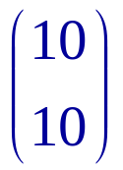
Binomial Coefficients
The coefficients of the binomial expansion are called binomial coefficients. The coefficients have symmetry.
(x + y)⁵ = x⁵ + 5x⁴y + 10x³y² + 10x²y³ + 5xy⁴ + y⁵
1
1
The first and last coefficients are 1.
The coefficients of the second and second to last terms
are equal to n.
Example: What are the last 2 terms of (x + y)¹⁰ ? Since n = 10, the last two terms are 10xy⁹ + 1y¹⁰.
The coefficient of x^{n–r}y^{r} in the expansion of (x + y)^{n} is written or _{n}C_{r} .
So, the last two terms of (x + y)¹⁰ can be expressed
as ₁₀C₉ xy⁹ + ₁₀C₁₀ y¹⁰ or as xy ⁹ + y¹⁰.
Copyright © by Houghton Mifflin Company, Inc. All rights reserved.

Slide 5
Pascal’s Triangle
The triangular arrangement of numbers below is called Pascal’s Triangle.
1
0th row
1 1
1st row
1 + 2 = 3
1 2 1
2nd row
1 3 3 1
3rd row
6 + 4 = 10
1 4 6 4 1
4th row
1 5 10 10 5 1
5th row
Each number in the interior of the triangle is the sum of the two numbers immediately above it.
The numbers in the n^{th} row of Pascal’s Triangle are the binomial coefficients for (x + y)^{n} .
Copyright © by Houghton Mifflin Company, Inc. All rights reserved.

Slide 6









Example: Pascal’s Triangle
Example: Use the fifth row of Pascal’s Triangle to generate the sixth row and find the binomial coefficients , , ₆C₄ and ₆C₂ .
5th row 1 5 10 10 5 1
6th row
1
6
15
20
15
6
1
₆C₀ ₆C₁ ₆C₂ ₆C₃ ₆C₄ ₆C₅ ₆C₆
= 6 = and ₆C₄ = 15 = ₆C₂.
There is symmetry between binomial coefficients.
_{n}C_{r} = _{n}C_{n–r}
Copyright © by Houghton Mifflin Company, Inc. All rights reserved.

Slide 7
Example: Pascal’s Triangle
Example: Use Pascal’s Triangle to expand (2a + b)⁴.
1
0th row
1 1
1st row
1 2 1
2nd row
1 3 3 1
3rd row
1 4 6 4 1
4th row
(2a + b)⁴ = 1(2a)⁴ + 4(2a)³b + 6(2a)²b² + 4(2a)b³ + 1b⁴
= 1(16a⁴) + 4(8a³)b + 6(4a²b²) + 4(2a)b³ + b⁴
= 16a⁴ + 32a³b + 24a²b² + 8ab³ + b⁴
Copyright © by Houghton Mifflin Company, Inc. All rights reserved.

Slide 8
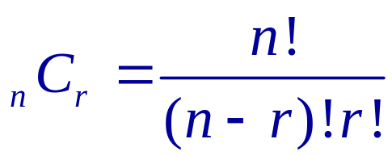
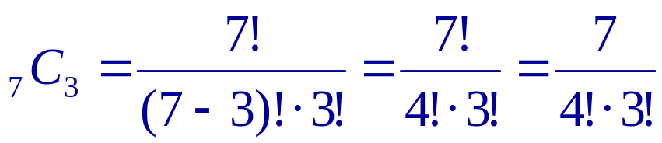
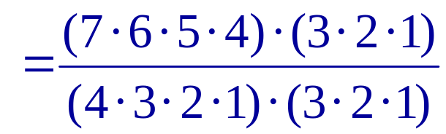
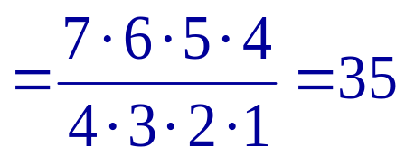
Formula for the Binomial Coefficients
The symbol n! (n factorial) denotes the product of the first n positive integers. 0! is defined to be 1.
1! = 1
4! = 4 • 3 • 2 • 1 = 24
6! = 6 • 5 • 4 • 3 • 2 • 1 = 720
n! = n(n – 1)(n – 2) … 3 • 2 • 1
Formula for Binomial Coefficients For all nonnegative integers n and r,
Example:
Copyright © by Houghton Mifflin Company, Inc. All rights reserved.

Slide 9
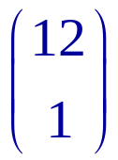

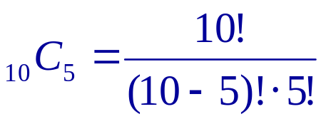
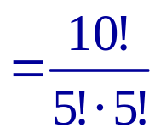
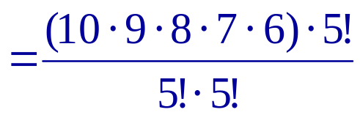
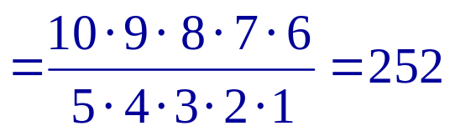
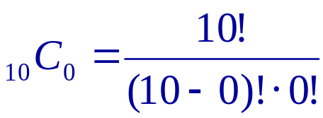
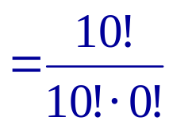
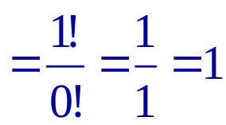
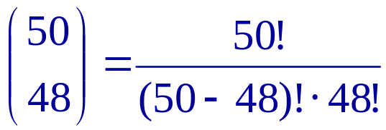
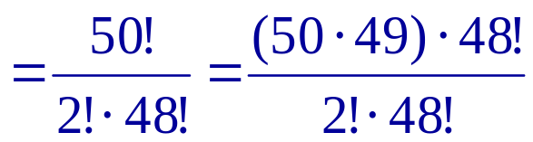
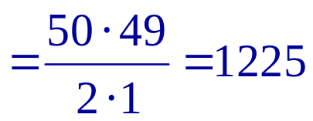
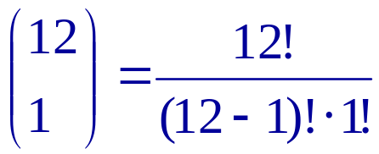
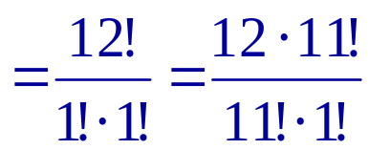
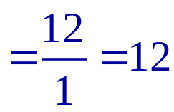
Example: Binomial coefficients
Example: Use the formula to calculate the binomial coefficients
₁₀C₅, ₁₅C₀, and .
Copyright © by Houghton Mifflin Company, Inc. All rights reserved.

Slide 10
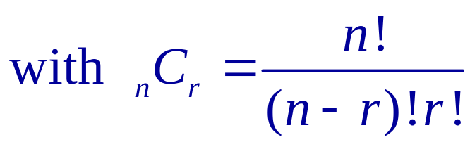
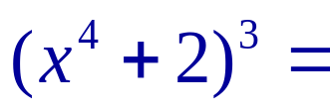
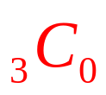
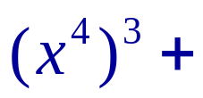
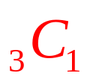
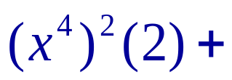
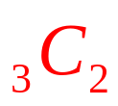
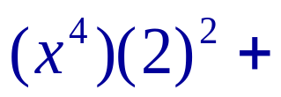

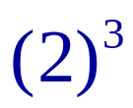




Definition: Binomial Theorem
Binomial Theorem
Example: Use the Binomial Theorem to expand (x⁴ + 2)³.
Copyright © by Houghton Mifflin Company, Inc. All rights reserved.

Slide 11


Definition: Binomial Theorem
Although the Binomial Theorem is stated for a binomial which is a sum of terms, it can also be used to expand a difference of terms.
Simply rewrite
(x + y) ^{n} as (x + (– y)) ^{n}
and apply the theorem to this sum.
Example: Use the Binomial Theorem to expand (3x – 4)⁴.
Copyright © by Houghton Mifflin Company, Inc. All rights reserved.

Slide 12
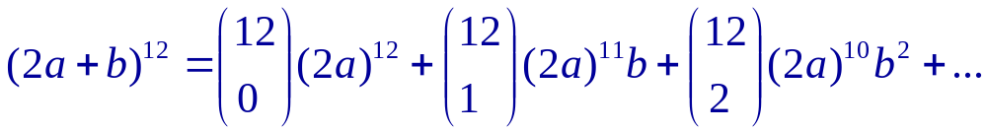
Example:Using the Binomial Theorem
Example: Use the Binomial Theorem to write the first three
terms in the expansion of (2a + b)¹² .
Copyright © by Houghton Mifflin Company, Inc. All rights reserved.

Slide 13
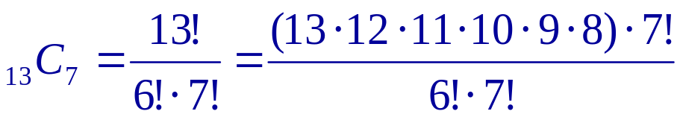
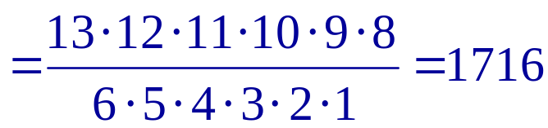
Example: Find the nth term
Example: Find the eighth term in the expansion of (x + y)¹³ .
Think of the first term of the expansion as x¹³y ⁰ . The power of y is 1 less than the number of the term in the expansion.
The eighth term is ₁₃C₇ x ⁶ y⁷.
Therefore, the eighth term of (x + y)¹³ is 1716 x ⁶ y⁷.
Copyright © by Houghton Mifflin Company, Inc. All rights reserved.

