Slide 1

Ionic, Covalent, and Metallic bonding

Slide 2
How Elements Bond
2
Bond Formation
The positive sodium ion and the negative chloride ion are strongly attracted to each other.
This attraction, which holds the ions close together, is a type of chemical bond called an ionic bond.

Slide 3

How Elements Bond
2
Bond Formation
The compound sodium chloride, or table salt, is formed.
A compound is a pure substance containing two or more elements that are chemically bonded.

Slide 4
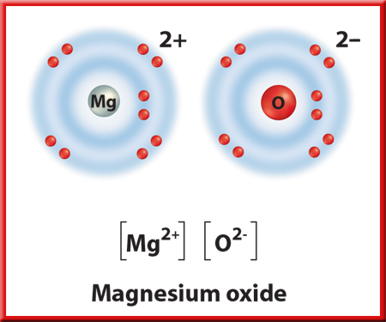
How Elements Bond
2
More Gains and Losses
Can elements lose or gain more than one electron?
The element magnesium, Mg, in Group 2 has two electrons in its outer energy level.
Magnesium can lose these two electrons and achieve a completed energy level.

Slide 5
How Elements Bond
2
More Gains and Losses
Some atoms, such as oxygen, need to gain two electrons to achieve stability.
The two electrons released by one magnesium atom could be gained by a single atom of oxygen.
When this happens, magnesium oxide (MgO) is formed.

Slide 6
How Elements Bond
2
Convalent Bonds—Sharing
Some atoms are unlikely to lose or gain electrons because the number of electrons in their outer levels makes this difficult.
The alternative is sharing electrons.

Slide 7
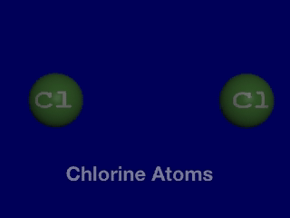
How Elements Bond
2
The Convalent Bond
The chemical bond that forms between nonmetal atoms when they share electrons is called a covalent bond.
Click image to view movie.

Slide 8
How Elements Bond
2
The Convalent Bond
Shared electrons are attracted to the nuclei of both atoms.
They move back and forth between the outer energy levels of each atom in the covalent bond.
So, each atom has a stable outer energy level some of the time.

Slide 9
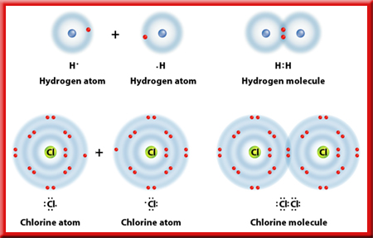
How Elements Bond
2
The Convalent Bond
The neutral particle is formed when atoms share electrons is called a molecule

Slide 10
How Elements Bond
2
The Convalent Bond
A molecule is the basic unit of a molecular compound.

Slide 11
How Elements Bond
2
The Convalent Bond
You can see how molecules form by sharing electrons in this figure.

Slide 12
This powerpoint was kindly donated to www.worldofteaching.com
http://www.worldofteaching.com is home to over a thousand powerpoints submitted by teachers. This is a completely free site and requires no registration. Please visit and I hope it will help in your teaching.

