Slide 1
Chemical compounds - covalent (molecular) and ionic
Chemical formulas
elemental analysis, empirical formulas
Molar masses with empirical formulas --> chemical formula
Expressing chemical equations
Stoichiometric calculations
Limiting Reactant : determines amount of product formed
Theoretical yields vs actual yields

Slide 2
Chemical Bonding
A chemical bond results from strong electrostatic interactions between two atoms.
The nature of the atoms determines the kind of bond.
COVALENT bonds result from a strong interaction between NEUTRAL atoms
Each atom donates an electron resulting in a pair of electrons that are SHARED between the two atoms

Slide 3
For example, consider a hydrogen molecule, H₂. When the two hydrogen, H, atoms are far apart from each other they do not feel any interaction.
As they come closer each “feels” the presence of the other.
The electron on each H atom occupies a volume that covers both H atoms and a COVALENT bond is formed.
Once the bond has been formed, the two electrons are shared by BOTH H atoms.

Slide 4

An electron density plot for the H₂ molecule shows that the shared electrons occupy a volume equally distributed over BOTH H atoms.
Electron Density for the H₂ molecule

Slide 5
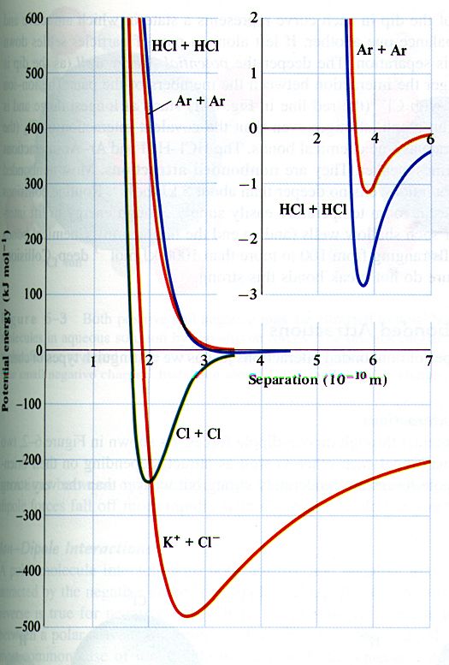
Potential energy (kJ/mol)
Separation (Å)

Slide 6
It is also possible that, as two atoms come closer, one electron is transferred to the other atom.
The atom that gives up an electron acquires a +1 charge and the other atom, which accepts the electron acquires a –1 charge.
The two atoms are attracted to each other through Coulombic interactions – opposite charges attract – resulting in an IONIC bond.
Animation

Slide 7
Potential energy (kJ/mol)
Separation (Å)

Slide 8
What factors determine if an atom forms a covalent or ionic bond with another atom?
The number of electrons in an atom, particularly the number of the electrons furthest away from the nucleus determines the atom’s reactivity and hence its tendency to form covalent or ionic bonds.
These outermost electrons are the one’s that are more likely to “feel” the presence of other atoms and hence the one’s involved in bonding i.e. in reactions.
Chemistry of an element depends almost entirely on the number of electrons, and hence its atomic number.

Slide 9
THE PERIODIC TABLE
By the late 1800’s it was realized that elements could be grouped by similar chemical properties and that the chemical and physical properties of elements are periodic functions of their atomic numbers – PERIODIC LAW.
The arrangements of the elements in order of increasing atomic number, with elements having similar properties placed in a vertical column, is called the PERIODIC TABLE.

Slide 10
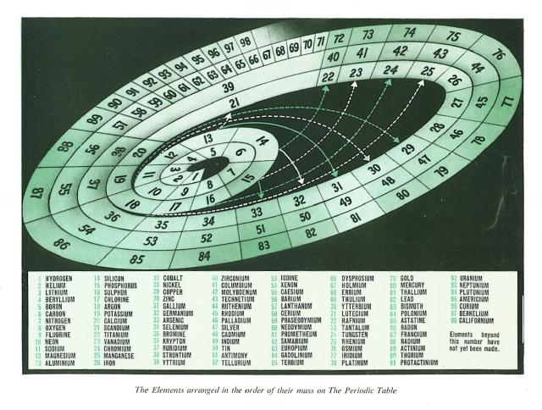

Slide 11
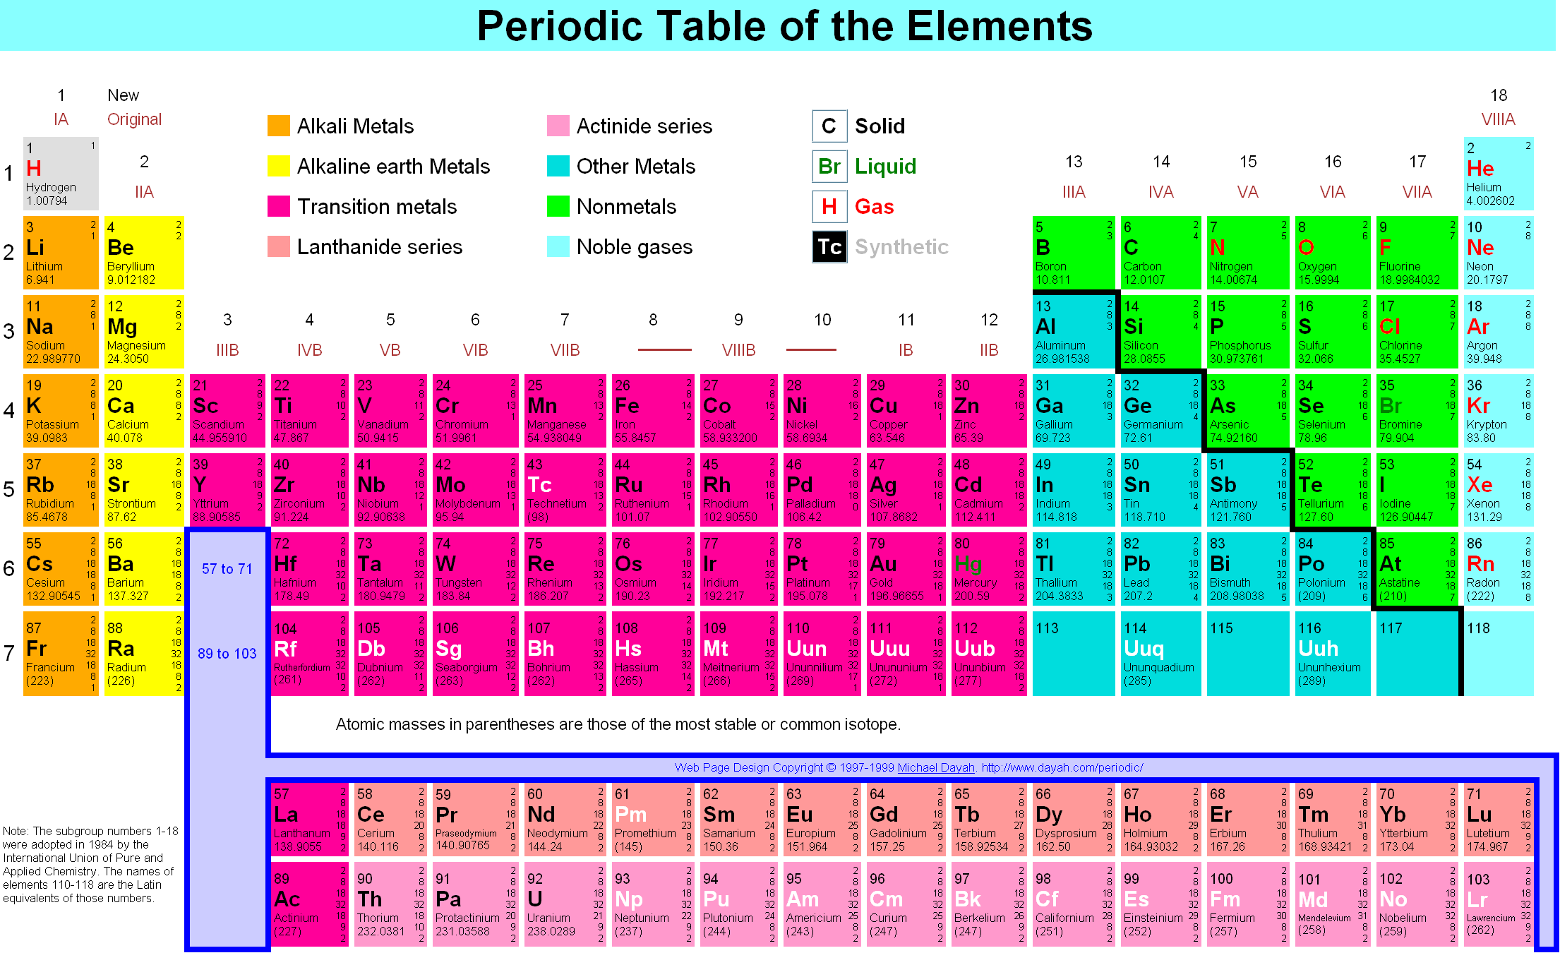

Slide 12
Columns are called GROUPS (FAMILIES) and rows are called PERIODS.
Elements in a group have similar chemical and physical properties.

Slide 13
The total number of electrons within a group is different, increasing in number down a group
However, the number of electrons furthest away from the nucleus, called the OUTER or VALENCE electrons is the same for all elements in a group.

Slide 14
Groups are referred to by names, which often derive from their properties
I – Alkali metals; II – Alkaline Earth metals
VII – Halogens; VIII – Noble gases
The elements in the middle block are called TRANSITION ELEMENTS

Slide 15
Elements in the A group are diverse; metals and non-metals, solids and gases at room temperature.
The transition elements are all metals, and are solids at room temp, except for Hg.
Among the transition elements are two sets of 14 elements - the LANTHANIDES and the ACTINIDES

Slide 16
Physical and Chemical properties such as melting points, thermal and electrical conductivity, atomic size, vary systematically across the periodic table.
Elements within a column have similar properties

Slide 17
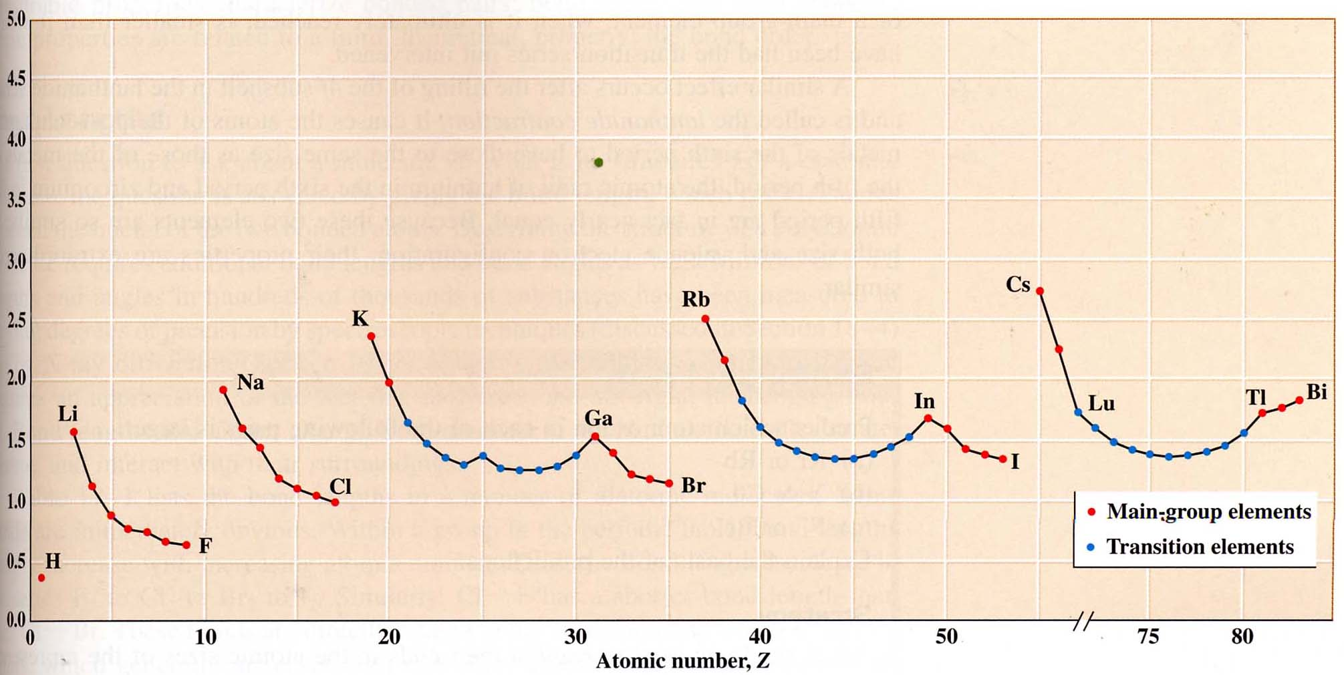
Atomic radius (Å)

Slide 18
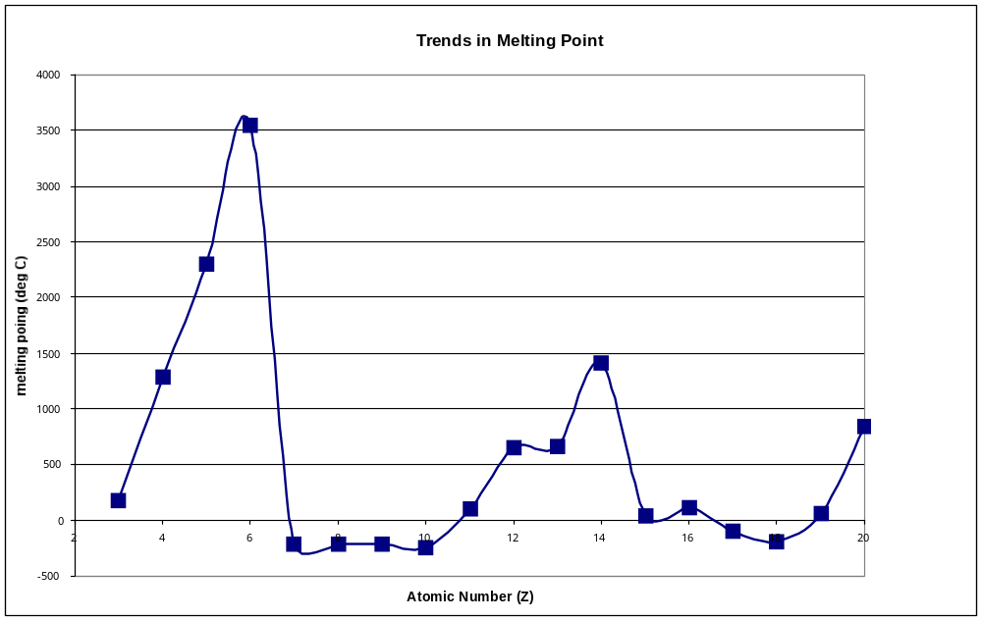
C
B
Si
Be
Al
Ca
Mg
Li
Na
S
P
Cl
K
N
O
F
Ne
Ar

Slide 19
A “zig-zag” division of the table divides metals from non-metals.
Elements to the left of the zig-zag line are metals (except for hydrogen, which is unique) and to the right are non-metals.
Elements along the border have intermediate properties and are called metalloids.
TABLE

Slide 20
Electronegativity
The type of bond formed between a pair of atoms is determined by the ability of the atoms to attract electrons from the other.
A positively charged ion (CATION) is formed when an atom looses one or more electrons and a negatively charged ion (ANION) is formed when an atom accepts one or more electrons.
For a free, isolated atom its ability to loose an electron is measured by its IONIZATION ENERGY, while the ability to gain an electron is measured by its ELECTRON AFFINITY

Slide 21
The average of these two properties for isolated atoms define the atom’s ELECTRONEGATIVITY which measures the tendency of one atom to attract electrons from another atom to which it is bonded.
For example, Metallic elements loose electrons (to form positive ions) more readily than non-metallic elements
Metallic elements are hence referred to as being more ELECTROPOSITIVE that non-metals.
Non-metals are more ELECTRONEGATIVE compared to metals

Slide 22
The periodic table’s arrangement results in a separation of metals from non-metals (metallic nature increasing to the left and down, non metallic increasing right and up).
This allows for a comparative scale for the electronegativity of elements.
TABLE

Slide 23
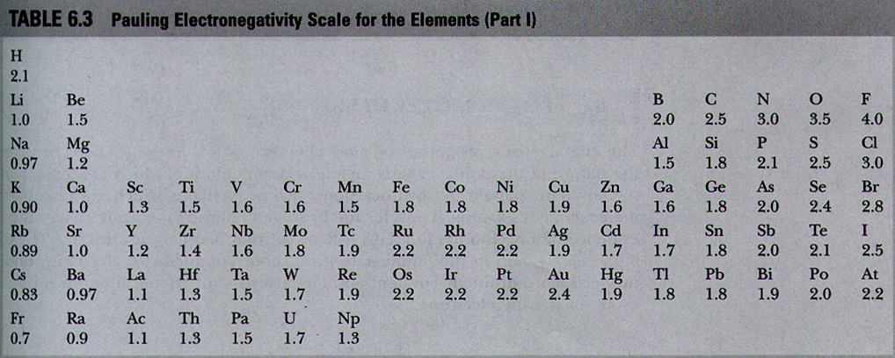
Electronegativity Scale
Fluorine is the most electronegative element, and francium the least electronegative.
TABLE

Slide 24
Large differences in electronegativity between two bonded atoms favor the transfer of electrons from the less electronegative (more electropositive) atom to the more electronegative atom resulting in a bond between the two atoms that is IONIC.
Smaller differences result in a more equitable “sharing” of electrons between the bonded atoms, resulting in a COVALENT bond between the two atoms.
The kinds of bonds formed between elements (covalent vs ionic) can be determined by comparing electronegativity of the two elements.
TABLE

Slide 25
Na and Cl form ionic bonds.
Na gives up an electron and Cl accepts the electron to form Na⁺ and Cl⁻.
As differences between electronegativity between the two bonding elements decreases, there is more equitable sharing of electrons and the elements form covalent bonds.

Slide 26
Based on the position of elements in the periodic table, we can determine the kind of bond formed
Generally:
Nonmetallic element + nonmetallic element → Molecular compound
Molecular compounds are typically gases, liquids, or low melting point solids and are characteristically poor conductors. Examples are H₂O, CH₄, NH₃.
TABLE

Slide 27
Generally,
Metallic compound + nonmetallic compound → IONIC compound
Ionic compounds are generally high-melting solids that are good conductors of heat and electricity in the molten state.
Examples are NaCl, common salt, and NaF, sodium fluoride.
TABLE

Slide 28
NAMING COMPOUNDS
The chemical formula represents the composition of each molecule.
In writing the chemical formula, in almost all cases the element farthest to the left of the periodic table is written first.
So for example the chemical formula of a compound that contains one sulfur atom and six fluorine atoms is SF₆.
If the two elements are in the same period, the symbol of the element of that is lower in the group (i.e. heavier) is written first e.g. IF₃.

Slide 29
In naming covalent compounds, the name of the first element in the formula is unchanged.
The suffix “-ide” is added to the second element.
Often a prefix to the name of the second element indicates the number of the element in the compound
SF₆ – sulfur hexafluoride
P₄O₁₀ – tetraphosphorous decoxide
CO – carbon monoxide
CO₂ – carbon dioxide

Slide 30
The binary compounds of hydrogen are special cases. They were discovered before a convention was adopted and hence their original names have stayed
Water H₂O is not called dihydrogen monoxide
Hydrogen forms binary compounds with almost all non-metals except the noble gases.
Example
HF - hydrogen fluoride
HCl - hydrogen chloride
H₂S - hydrogen sulfide

Slide 31
Organic molecules (containing C) have a separate nomenclature
The molecular formulas for compounds containing C and H (called hydrocarbons) are written with C first. Example, CH₄, C₂H₆, etc.

Slide 32
BINARY IONIC COMPOUNDS
Compounds formed by elements on opposite sides of the periodic table which either give up (left side) or take up electrons (right side).
Depending on the atom, there can be an exchange of more than one electron resulting in charges greater than ±1.

Slide 33
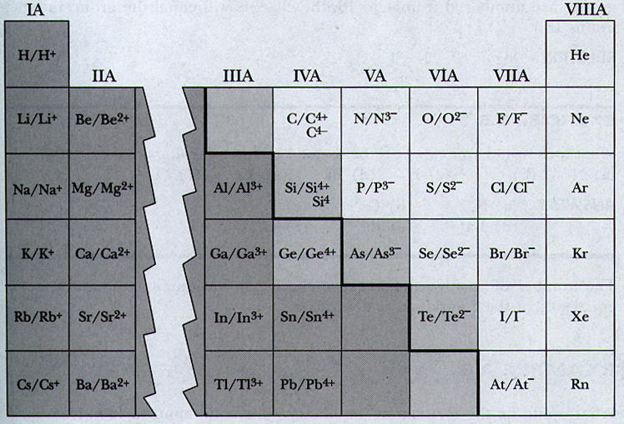
Group IA – alkali metals – loose 1 e⁻ to form +1 (Na⁺)
Group II A– alkaline earth metals –loose 2 e⁻ to form +2 (Ca⁺²)
Group III A– loose three e⁻ to form +3 (Al⁺³)
Group IV A– loose four e⁻ to form +4 (Sn⁺⁴)
Group V A– accept three e⁻ to form –3 (N⁻³)
Group VI A– accept two e⁻ to form –2 (O⁻²)
Group VIIA – accept one e⁻ to form –1 (Cl⁻¹)

Slide 34
Naming IONIC compounds
Anions – suffix – “ide”
So Cl⁻ is chloride
Oxygen O²⁻ is OXIDE
S²⁻ is SULFIDE
Cations
For Na⁺, Ca²⁺, the name of the ion is the same except refer to the ion.
So SODIUM ION or SODIUM CATION
NaCl - sodium chloride
CaCl₂ - calcium chloride

Slide 35
Covalent, charged compounds - MOLECULAR IONS
Positive Molecular Ions
End the name with “ium” or “onium”
NH₄⁺ is ammonium, H₃O ⁺ is hydronium
Negative Molecular Ions
-
NO₃ - NITRATE
2-
SO₄ - SULFATE
-
NO₂ - NITRITE
3-
PO₄ - PHOSPHATE

Slide 36
Transition Elements
The transition elements are chemically quite different from the metals in the “A” block, due to differences in electronic configuration
For example, Fe can loose two or three electrons to become Fe²⁺ and Fe³⁺, respectively.

Slide 37
To identify the charge of Fe in a compound the following nomenclature is used.
Fe²⁺ is iron(II)
Fe³⁺ is iron (III)
So iron(III) chloride is FeCl₃
An older scheme differentiated between the lower and higher charge by ending the name of the element with “ous” to indicate the lower charge and “ic” for the higher.
ferrous chloride => FeCl₂
ferric chloride => FeCl₃
However, this convention does not indicate the numerical value of the charge.

Slide 38
This powerpoint was kindly donated to www.worldofteaching.com
http://www.worldofteaching.com is home to over a thousand powerpoints submitted by teachers. This is a completely free site and requires no registration. Please visit and I hope it will help in your teaching.

