Slide 1
The groups, and electron dot diagrams

Slide 2
Why do atoms combine?
1
Element Families
Elements can be divided into groups, or families.
Each column of the periodic table contains one element family.
Hydrogen is usually considered separately, so the first element family begins with lithium and sodium in the first column.

Slide 3
Why do atoms combine?
1
Element Families
Just as human family members often have similar looks and traits, members of element families have similar chemical properties because they have the same number of electrons in their outer energy levels.
Notes:
Cinda, this was supposed to be on the previous slide, but it didn’t fit.

Slide 4
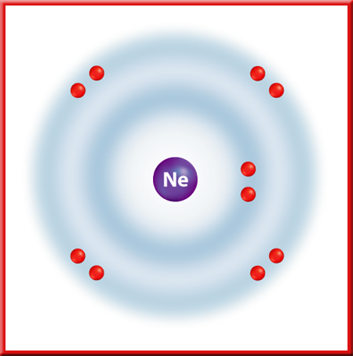
Why do atoms combine?
1
Noble Gases
Neon and the elements below it in Group 18 have eight electrons in their outer energy levels.
Their energy levels are stable, so they do not combine easily with other elements.

Slide 5
Why do atoms combine?
1
Noble Gases
At one time these elements were thought to be completely unreactive, and therefore became known as the inert gases.
When chemists learned that some of these gases can react, their name was changed to noble gases. They are still the most stable element group.

Slide 6
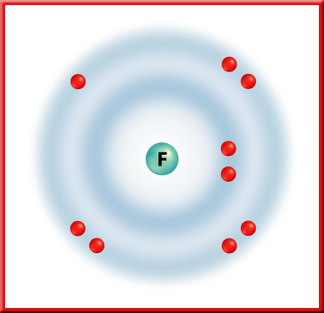
Why do atoms combine?
1
Halogens
The elements in Group 17 are called the halogens.
Fluorine is the most reactive of the halogens because its outer energy level is closest to the nucleus.

Slide 7
Why do atoms combine?
1
Halogens
The reactivity of the halogens decreases down the group as the outer energy levels of each element’s atoms get farther from the nucleus.

Slide 8
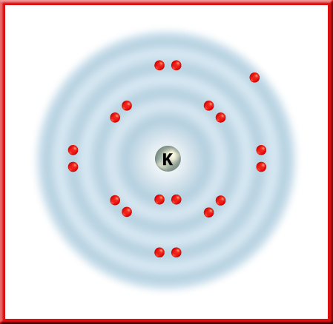
Why do atoms combine?
1
Alkali Metals

Slide 9
Why do atoms combine?
1
Alkali Metals
The alkali metals form compounds that are similar to each other.
Alkali metals each have one outer energy level electron.
It is this electron that is removed when alkali metals react.
The easier it is to remove an electron, the more reactive the atom is.
Unlike halogens, the reactivities of alkali metals increase down the group.

Slide 10
Why do atoms combine?
1
Electron Dot Diagrams
If you want to see how atoms of one element will react, it is handy to have an easier way to represent the atoms and the electrons in their outer energy levels.
You can do this with electron dot diagrams.
An electric dot diagram is the symbol for the element surrounded by as many dots as there are electrons in its outer energy level.

Slide 11

Why do atoms combine?
1
How to Write Them
The dots are written in pairs on four sides of the element symbol.
Start by writing one dot on the top of the element symbol, then work your way around adding dots to the right, bottom, and left.

Slide 12
Why do atoms combine?
1
How to Write Them
Add a fifth dot to the top to make a pair. Continue in this manner until you reach eight dots to complete the level.

Slide 13
Why do atoms combine?
1
Using Dot Diagrams
Now that you know how to write electron dot diagrams for elements, you can use them to show how atoms bond with each other.
A chemical bond is the force that holds two atoms together.
Atoms bond with other atoms in such a way that each atom becomes more stable. That is, their outer energy levels will resemble those of the noble gases.

Slide 14
Section Check
1
Question 1
Electrons are now known to swarm around the nucleus of an atom in a configuration known as the _______.
A. electron circle
B. electron cloud
C. electron configuration
D. electron swarm

Slide 15
Section Check
1
Answer
The answer is B. The “cloud” includes all the regions where an electron might be found.

Slide 16

Section Check
1
Question 2
What information can you learn from this diagram?

Slide 17
Section Check
1
Answer
This image is an example of an electron dot diagram. It tells you that nitrogen contains five electrons in its outer energy level.

Slide 18
Section Check
1
Question 3
The _______ an energy level is from the nucleus, the _______ electrons it can hold.
A. closer, more
B. closer, less
C. farther, less
D. farther, more

Slide 19
Section Check
1
Answer
The answer is D. The farthest shells contain the greatest number of electrons.

Slide 20
This powerpoint was kindly donated to www.worldofteaching.com
http://www.worldofteaching.com is home to over a thousand powerpoints submitted by teachers. This is a completely free site and requires no registration. Please visit and I hope it will help in your teaching.

