Slide 1
The Periodic Table
Chapter 6

Slide 2

Why is the Periodic Table important to me?
The periodic table is the most useful tool to a chemist.
You get to use it on every test.
It organizes lots of information about all the known elements.

Slide 3

Pre-Periodic Table Chemistry …
…was a mess!!!
No organization of elements.
Imagine going to a grocery store with no organization!!
Difficult to find information.
Chemistry didn’t make sense.

Slide 4
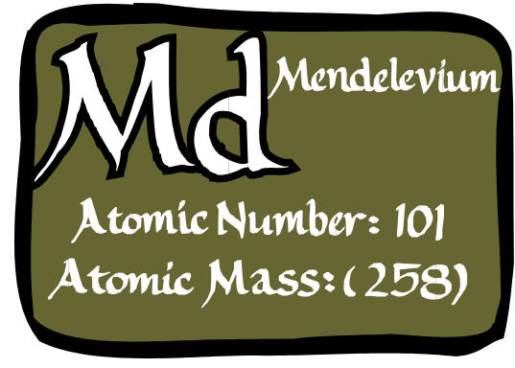
Dmitri Mendeleev: Father of the Table
HOW HIS WORKED…
Put elements in rows by increasing atomic weight.
Put elements in columns by the way they reacted.
SOME PROBLEMS…
He left blank spaces for what he said were undiscovered elements. (Turned out he was right!)
He broke the pattern of increasing atomic weight to keep similar reacting elements together.

Slide 5
The Current Periodic Table
Mendeleev wasn’t too far off.
Now the elements are put in rows by increasing ATOMIC NUMBER!!
The horizontal rows are called periods and are labeled from 1 to 7.
The vertical columns are called groups are labeled from 1 to 18.

Slide 6
Groups…Here’s Where the Periodic Table Gets Useful!!
Elements in the same group have similar chemical and physical properties!!
(Mendeleev did that on purpose.)
Why??
They have the same number of valence electrons.
They will form the same kinds of ions.

Slide 7

Families on the Periodic Table
Columns are also grouped into families.
Families may be one column, or several columns put together.
Families have names rather than numbers. (Just like your family has a common last name.)

Slide 8
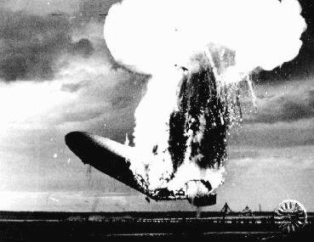
Hydrogen
Hydrogen belongs to a family of its own.
Hydrogen is a diatomic, reactive gas.
Hydrogen was involved in the explosion of the Hindenberg.
Hydrogen is promising as an alternative fuel source for automobiles

Slide 9

Alkali Metals
1st column on the periodic table (Group 1) not including hydrogen.
Very reactive metals, always combined with something else in nature (like in salt).
Soft enough to cut with a butter knife

Slide 10

Alkaline Earth Metals
Second column on the periodic table. (Group 2)
Reactive metals that are always combined with nonmetals in nature.
Several of these elements are important mineral nutrients (such as Mg and Ca

Slide 11
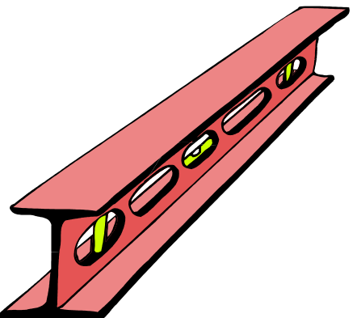


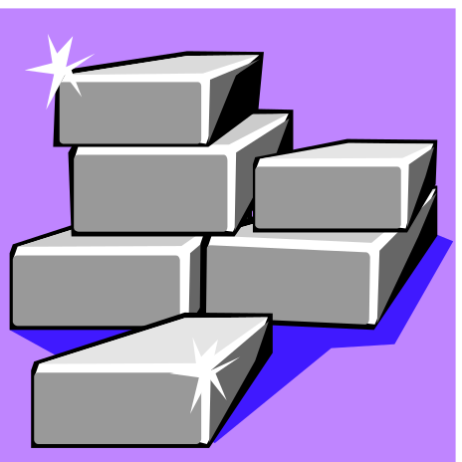
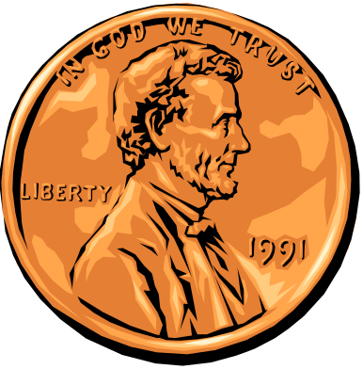
Transition Metals
Elements in groups 3-12
Less reactive harder metals
Includes metals used in jewelry and construction.
Metals used “as metal.”

Slide 12

Boron Family
Elements in group 13
Aluminum metal was once rare and expensive, not a “disposable metal.”

Slide 13

Carbon Family
Elements in group 14
Contains elements important to life and computers.
Carbon is the basis for an entire branch of chemistry.
Silicon and Germanium are important semiconductors.

Slide 14

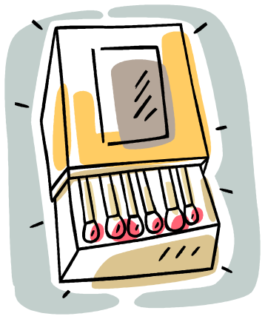

Nitrogen Family
Elements in group 15
Nitrogen makes up over ¾ of the atmosphere.
Nitrogen and phosphorus are both important in living things.
Most of the world’s nitrogen is not available to living things.
The red stuff on the tip of matches is phosphorus.

Slide 15

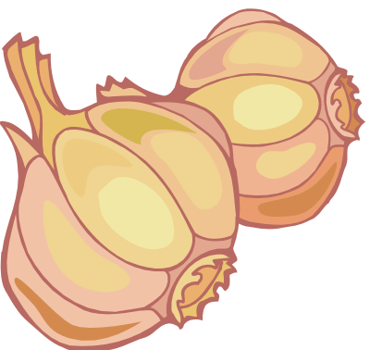
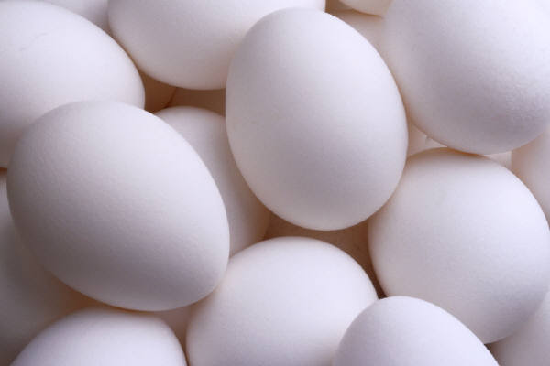
Oxygen Family or Chalcogens
Elements in group 16
Oxygen is necessary for respiration.
Many things that stink, contain sulfur (rotten eggs, garlic, skunks,etc.)

Slide 16

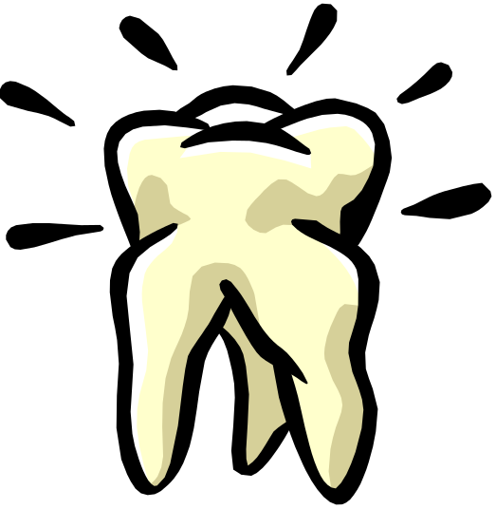
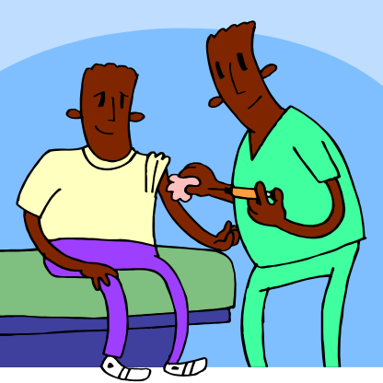
Halogens
Elements in group 17
Very reactive, volatile, diatomic, nonmetals
Always found combined with other element in nature .
Used as disinfectants and to strengthen teeth.

Slide 17
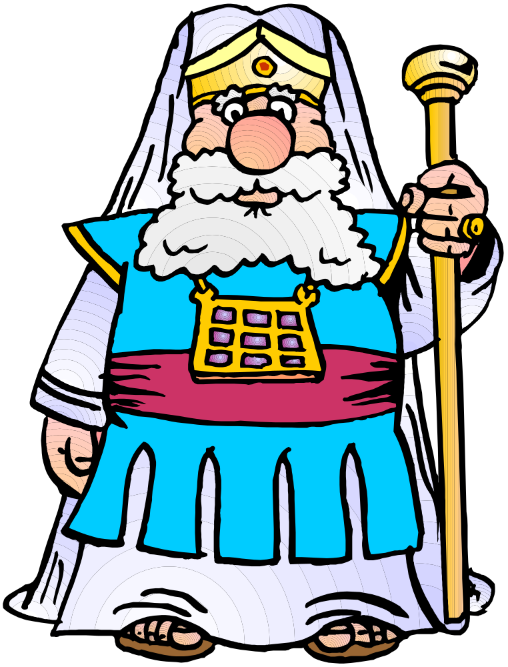
The Noble Gases

Slide 18

The Noble Gases
Elements in group 18
VERY unreactive, monatomic gases
Used in lighted “neon” signs
Used in blimps to fix the Hindenberg problem.
Have a full valence shell.

Slide 19
This powerpoint was kindly donated to www.worldofteaching.com
http://www.worldofteaching.com is home to over a thousand powerpoints submitted by teachers. This is a completely free site and requires no registration. Please visit and I hope it will help in your teaching.

