Slide 1
Pressure
Learning Outcomes
know that pressure depends on both force and area.
I can calculate the pressure under any object.
http://www.pstramway.com/video.asp

Slide 2
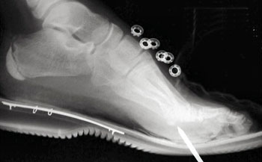
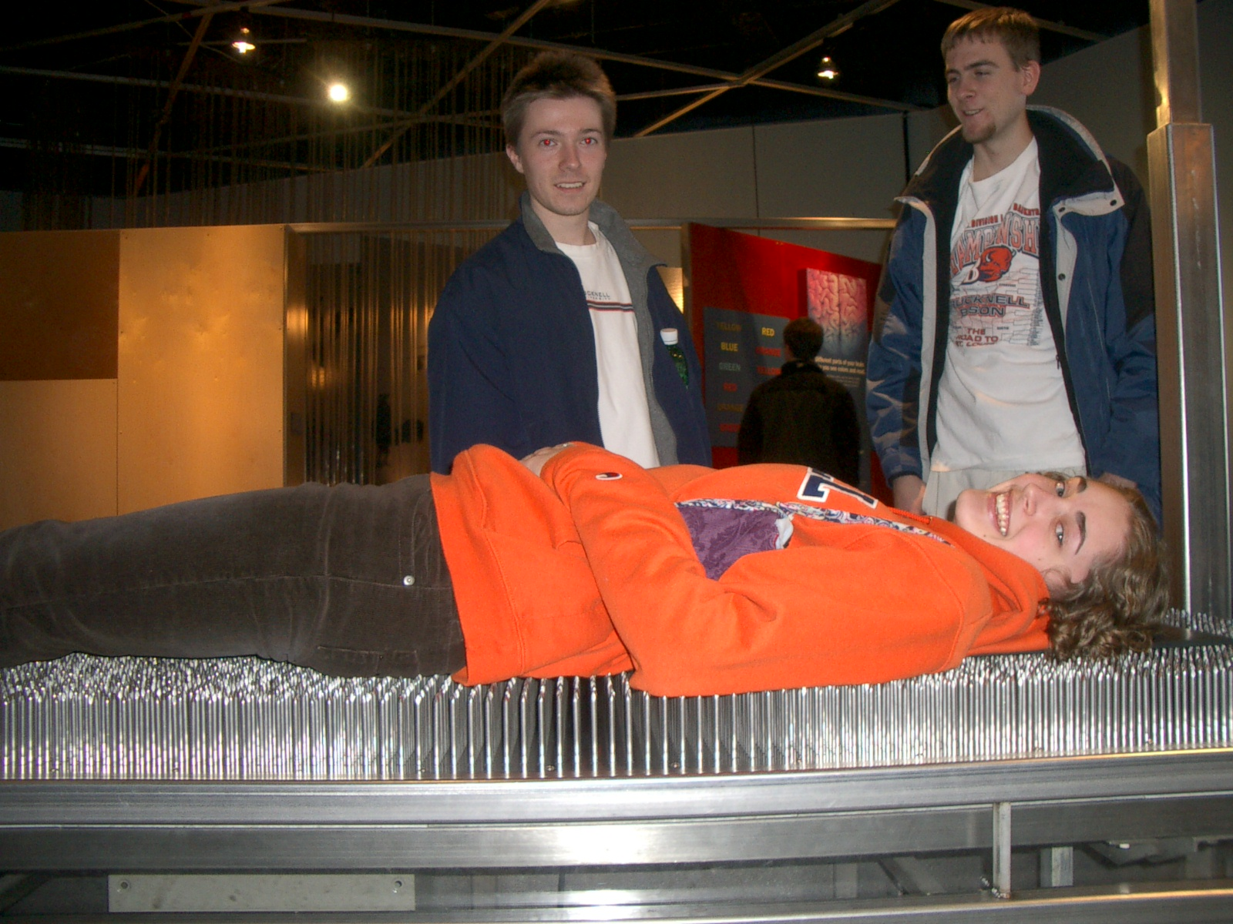



Slide 3
Pressure Experiment
100g
I think the bigger mass will sink further
I think a bigger area will stop the mass sinking
SAND

Slide 4
Pressure
Pressure is the amount of force applied to a known area.
We can calculate it using the equation
  Pressure = Force (N) / Area (m²)
We can reduce pressure by reducing the size of the
force or increasing the size of the area.

Slide 5
This powerpoint was kindly donated to www.worldofteaching.com
http://www.worldofteaching.com is home to over a thousand powerpoints submitted by teachers. This is a completely free site and requires no registration. Please visit and I hope it will help in your teaching.

