Slide 1
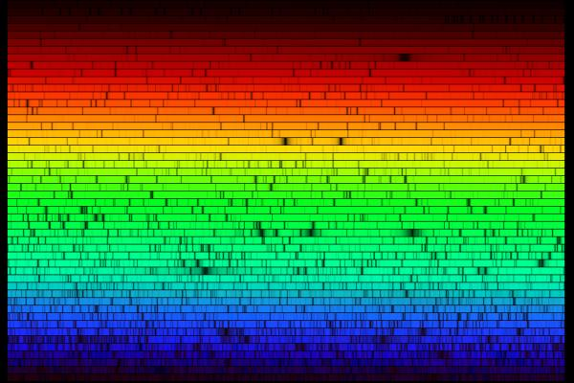
Spectral Lines
Celestial Fingerprinting
Visit www.worldofteaching.com
For 100’s of free powerpoints

Slide 2
Goals
From light we learn about
  Composition
  Motion

Slide 3
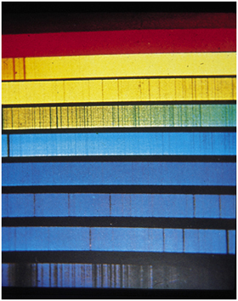
Continuum Spectra
The Sun
A Continuum Spectrum:
  Light emitted across a continuous range of wavelengths.
A thermal spectrum is a continuum spectrum.
  But what are these?

Slide 4
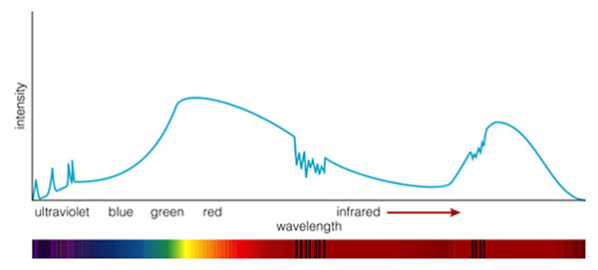
A Spectrum
Emission lines
Absorption lines
Continuum
A spectrum = the amount of light given off by an object at a range of wavelengths.

Slide 5
Continuum Concept Test
The sun shines on a cold airless asteroid made of black coal. What light from the asteroid do we detect?
  No light at all.
  Some reflected visible light.
  Some reflected visible, plus emitted visible light.
  Some reflected visible, plus emitted infrared light.
  Some reflected visible, plus emitted visible and emitted infrared light.

Slide 6
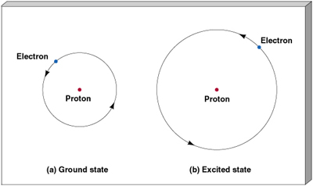
Spectral Line formation?
Electron has different energy levels: Floors in a building.
Lowest is called the Ground State.
Higher states are Excited States.

Slide 7
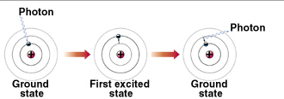
Changing Levels
If you add the RIGHT amount of energy to an atom, the electron will jump up energy floors.
If the electron drops down energy floors, the atom gives up the same amount energy.
From before, LIGHT IS ENERGY: E = hc/λ

Slide 8
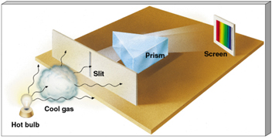
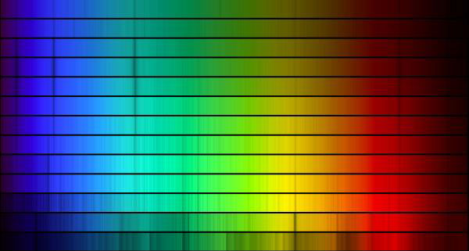
Kirchhoff’s Laws
Light of all wavelengths shines on an atom.
Only light of an energy equal to the difference between “floors” will be absorbed and cause electrons to jump up in floors.
The rest of the light passes on by to our detector.
We see an absorption spectrum: light at all wavelengths minus those specific wavelengths.

Slide 9
Absorption Lines
Pass light at all wavelengths through low density gas.
Pass this light through our spectrometer.
We see the continuum spectrum.
Now it’s MISSING certain wavelengths.

Slide 10
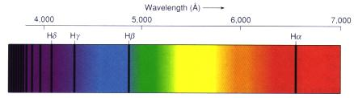
Absorption
Dark hydrogen absorption lines appear against a continuous visual spectrum, the light in the spectrum absorbed by intervening hydrogen atoms
Compare with the emission spectrum of hydrogen.
From "Astronomy! A Brief Edition," J. B. Kaler, Addison-Wesley, 1997.

Slide 11
Kirchhoff’s Laws Cont…
Excited electrons, don’t stay excited forever.
Drop back down to their ground floors.
Only light of the precise energy difference between floors is given off.
This light goes off in all directions.
From a second detector, we see these specific energy wavelengths: an emission spectrum.

Slide 12
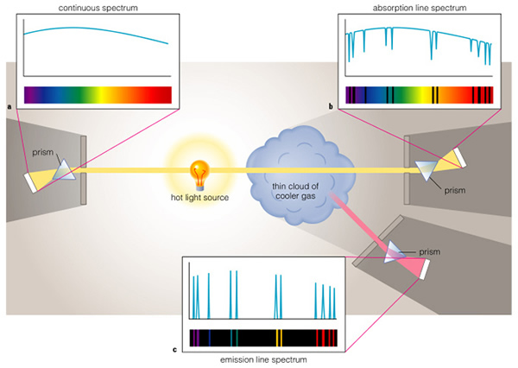
Continuum, Absorption, Emission

Slide 13
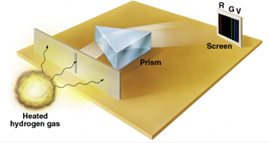
Spectral Lines
Heat low density gas and it will glow.
Pass the light through a slit to get a narrow source.
Pass light from the slit through a prism.
Spectrometer
Get multiple images of the slit, each at a different wavelength.
These “lines” are the element’s “finger print”.

Slide 14
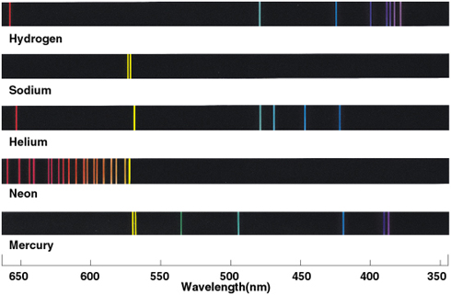
Emission Lines
Every element has a DIFFERENT finger print.

Slide 15
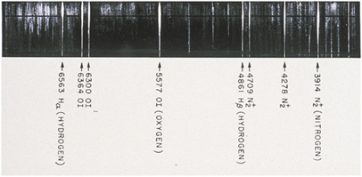
Multiple elements
Gases, stars, planets made up of MANY elements have spectra which include ALL of the component spectral lines.
It’s the scientist’s job to figure out which lines belong to which element.

Slide 16
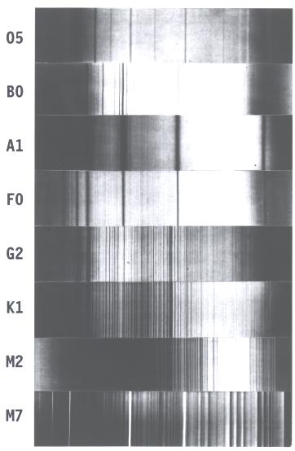
Different stars, different spectra
Hot
Different stars have different types of spectra.
Different types of spectra mean different stars are made of different elements.
Stellar Spectra
Cool
Annals of the Harvard College Observatory, vol. 23, 1901.

Slide 17
To Sum Up…
EVERY element has a SPECIAL set of lines.
  Atom’s fingerprint.
Observe the lines and you identify the component elements.
Identify:
  Absorption spectrum
  Emission emission
  Learn about the environment of the element

Slide 18
Concept Test
The sunlight we see is thermal radiation caused by the extreme heat of the sun’s surface. However, the very top thin layer of the sun’s surface is relatively cooler than the part below it. What type of spectrum would you expect to see from the sun?
  A continuous spectrum.
  A continuous spectrum plus a second, slightly redder continuous spectrum.
  A continuous spectrum plus a second slightly bluer continuous spectrum.
  A continuous spectrum plus an emission spectrum.
  A continuous spectrum plus an absorption spectrum.

Slide 19
The Sun
HOT
You
Cooler
Low Density
Courtesy of NOAO/AURA

Slide 20
Helium
The element Helium (He) was first discovered on the Sun by its spectral lines.

Slide 21
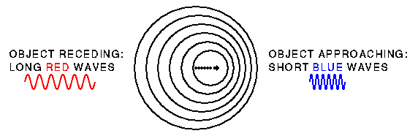
Doppler Shift
Larry Sessions:
Image from: http://imagine.gsfc.nasa.gov/YBA/M31-velocity/doppler-shift-derive-2.html
The Doppler Effect and Sonic Booms

Slide 22
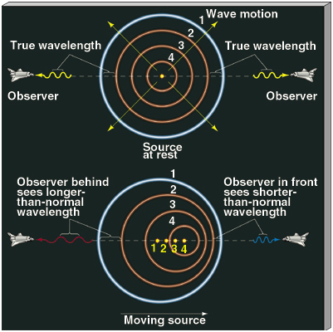
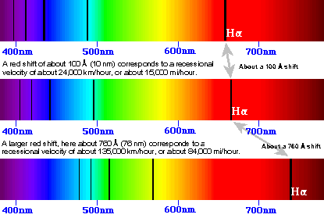
Doppler Shift
The greater the velocity the greater the shift.

Slide 23
Concept Test
Larry Sessions:
Wav: http://www.kettering.edu/~drussell/Demos/doppler/carhorn.wav
A car passes by blaring its horn. What do you hear?
  A constant tone.
  A tone that goes back and forth between high and low frequency.
  A constant tone of lower intensity.
  Two constant tones, one of higher frequency and one of lower frequency.
  One tone going from smoothly from low to high intensity.

Slide 24
Concept Test
I spin an object emitting a constant tone over my head. What do I hear?
  A constant tone.
  A tone that goes back and forth between high and low frequency.
  A constant tone of lower intensity.
  Two constant tones, one of higher frequency and one of lower frequency.
  One tone going from smoothly from low to high intensity.

Slide 25
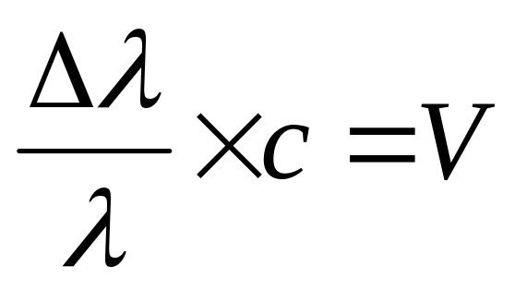
So Now…
From the presence and position of Spectral Lines we can know:
  Composition (H, He, H₂O, etc.)
  Movement through space (towards or away)
  How fast?

