Slide 1



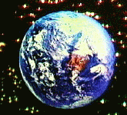

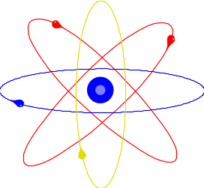
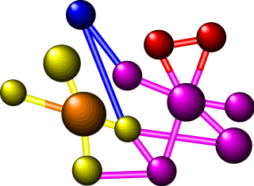

WAVES: SOUND & LIGHT
© 2000 Microsoft Clip Gallery
Waves carry energy from one place to another
Visit www.worldofteaching.com
For 100’s of free powerpoints

Slide 2

NATURE OF WAVES
© 2000 Microsoft Clip Gallery
Waves (Def.) – A wave is a disturbance that transfers energy.
Medium – Substance or region through which a wave is transmitted.
Speed of Waves – Depends on the properties of the medium.

Slide 3

SAMPLE LESSON: Light & the Electromagnetic Spectrum
By D. L. Power
Revised 1/20/01
© 2000 Microsoft Clip Gallery

Slide 4
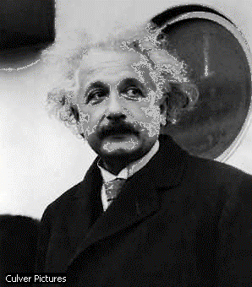
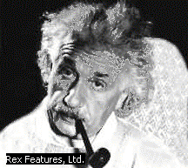
Albert Einstein

Slide 5
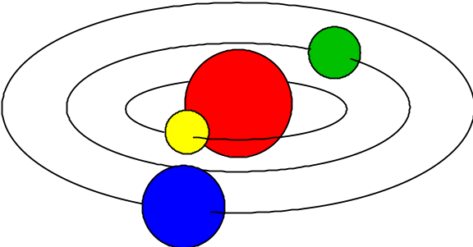
LIGHT: What Is It?
© 2000 Microsoft Clip Gallery
Light Energy
  Atoms
    As atoms absorb energy, electrons jump out to a higher energy level.
    Electrons release light when falling down to the lower energy level.
  Photons - bundles/packets of energy released when the electrons fall.
Light: Stream of Photons
© 2000 Microsoft Clip Gallery

Slide 6
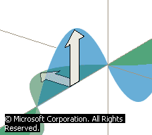
Electromagnetic Waves
Speed in Vacuum
  300,000 km/sec
  186,000 mi/sec
Speed in Other Materials
  Slower in Air, Water, Glass
© 2000 Microsoft Clip Gallery

Slide 7
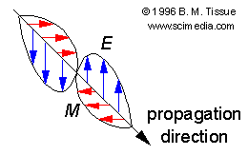
Transverse Waves
© 2000 Microsoft Clip Gallery
Energy is perpendicular to direction of motion
Moving photon creates electric & magnetic field
  Light has BOTH Electric & Magnetic fields at right angles!

Slide 8
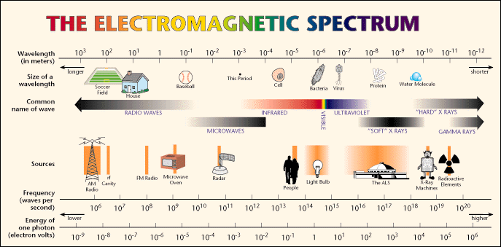
Electromagnetic Spectrum
© 2000 Microsoft Clip Gallery

Slide 9
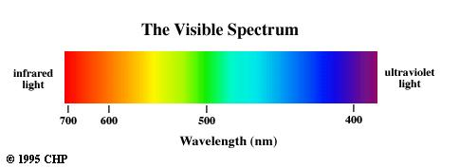
Electromagnetic Spectrum
Visible Spectrum – Light we can see
  Roy G. Biv – Acronym for Red, Orange, Yellow, Green, Blue, Indigo, & Violet.
  Largest to Smallest Wavelength.

Slide 10

Electromagnetic Spectrum
Invisible Spectrum
  Radio Waves
    Def. – Longest wavelength & lowest frequency.
    Uses – Radio & T.V. broadcasting.
© 2000 Microsoft Clip Gallery

Slide 11
Modulating Radio Waves
© 2000 Microsoft Clip Gallery
Modulation - variation of amplitude or frequency when waves are broadcast
  AM – amplitude modulation
    Carries audio for T.V. Broadcasts
    Longer wavelength so can bend around hills
  FM – frequency modulation
    Carries video for T.V. Broadcasts

Slide 12
Short Wavelength Microwave
Invisible Spectrum (Cont.)
  Infrared Rays
    Def – Light rays with longer wavelength than red light.
    Uses: Cooking, Medicine, T.V. remote controls

Slide 13
Electromagnetic Spectrum
Invisible spectrum (cont.).
  Ultraviolet rays.
    Def. – EM waves with frequencies slightly higher than visible light
    Uses: food processing & hospitals to kill germs’ cells
    Helps your body use vitamin D.

Slide 14
Electromagnetic Spectrum
Invisible Spectrum (Cont.)
  X-Rays
    Def. - EM waves that are shorter than UV rays.
    Uses: Medicine – Bones absorb x-rays; soft tissue does not.
    Lead absorbs X-rays.

Slide 15
Electromagnetic Spectrum
Invisible spectrum (cont.)
  Gamma rays
    Def. Highest frequency EM waves; Shortest wavelength. They come from outer space.
    Uses: cancer treatment.

Slide 16
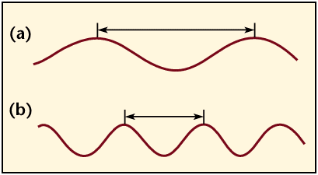
LIGHT: Particles or Waves?
Wave Model of Light
  Explains most properties of light
Particle Theory of Light
  Photoelectric Effect – Photons of light produce free electrons
© 2000 Microsoft Clip Gallery

Slide 17
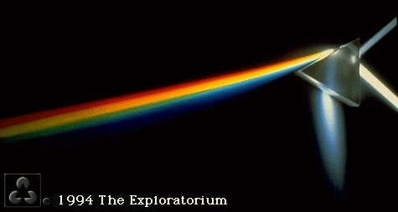
LIGHT: Refraction of Light
Refraction – Bending of light due to a change in speed.
  Index of Refraction – Amount by which a material refracts light.
  Prisms – Glass that bends light. Different frequencies are bent different amounts & light is broken out into different colors.

Slide 18
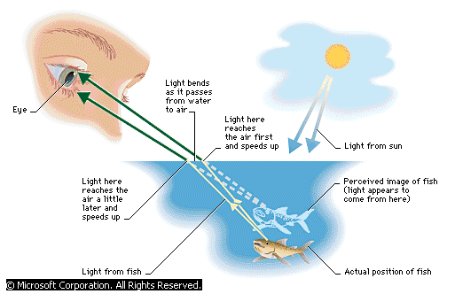
Refraction (Cont.)

Slide 19
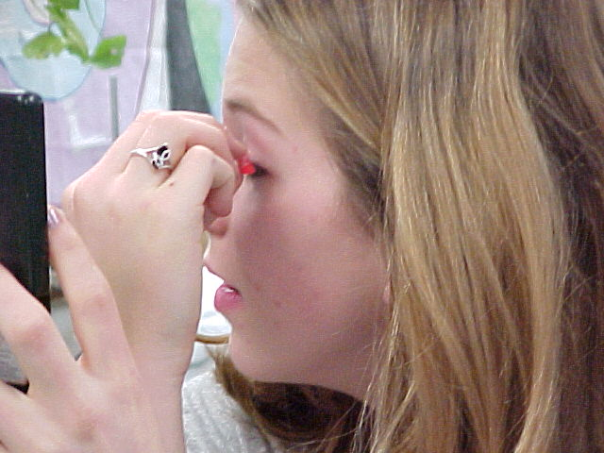
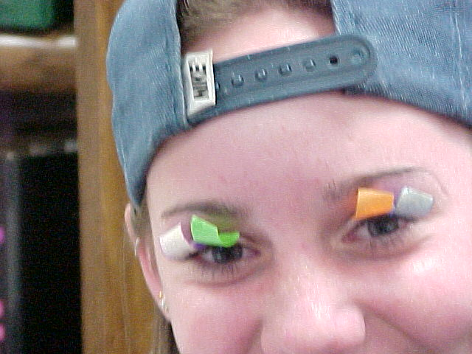
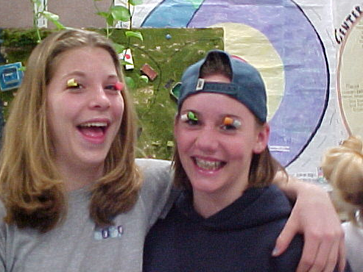
Refraction-Spectroscope Lab
Hey girls! The filters go on the Spectroscope, not on the lashes!
© 2000 D. L. Power

Slide 20

Color of Light
© 2000 Microsoft Clip Gallery
Transparent Objects:
  Light transmitted because of no scattering
  Color transmitted is color you see. All other colors are absorbed.
Translucent:
  Light is scattered and transmitted some.
Opaque:
  Light is either reflected or absorbed.
  Color of opaque objects is color it reflects.

Slide 21



Color of Light (Cont.)
Color of Objects
  White light is the presence of ALL the colors of the visible spectrum.
  Black objects absorb ALL the colors and no light is reflected back.
© 2000 Microsoft Clip Gallery

Slide 22

Color of Light (Cont.)
© 2000 Microsoft Clip Gallery
Primary Colors of Light
  Three colors that can be mixed to
  produce any other colored light
  Red + blue + green = white light
Complimentary Colors of Light
  Two complimentary colors combine
  to make white light-Magenta,Cyan,Yellow

Slide 23

How You See
© 2000 Microsoft Clip Gallery
Retina –
  Lens refracts light to converge on the retina. Nerves transmit the image
Rods –
  Nerve cells in the retina. Very sensitive to light & dark
Cones –
  Nerve cells help to see light/color

Slide 24

Paint Pigments
© 2000 Microsoft Clip Gallery
  Pigments absorb the frequency of
  light that you see
  Primary pigments
    Yellow + cyan + magenta = black
    Primary pigments are compliments
    of the primary colors of light.

Slide 25
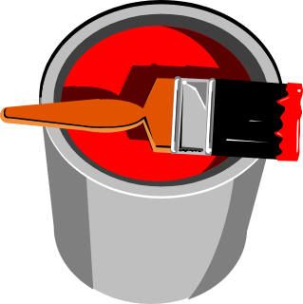

Complementary Pigments
© 2000 Microsoft Clip Gallery
Green, blue, red
Complimentary pigments are primary colors for light!
© 2000 Microsoft Clip Gallery

Slide 26


LIGHT & ITS USES
© 2000 Microsoft Clip Gallery
Sources of Light
  Incandescent light – light produced by heating an object until it glows.
© 2000 Microsoft Clip Gallery

Slide 27
LIGHT & ITS USES
© 2000 Microsoft Clip Gallery
Fluorescent Light –
  Light produced by electron bombardment of gas molecules
  Phosphors absorb photons that are created when mercury gas gets zapped with electrons. The phosphors glow & produce light.

Slide 28
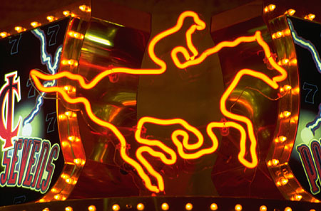
LIGHT & ITS USES - Neon
Neon light – neon inside glass tubes makes red light. Other gases make other colors.
© 2000 Microsoft Clip Gallery

Slide 29
LIGHT & ITS USES - Reflection
Reflection – Bouncing back of light waves
  Regular reflection – mirrors smooth surfaces scatter light very little. Images are clear & exact.
  Diffuse reflection – reflected light is scattered due to an irregular surface.

Slide 30

LIGHT & ITS USES:
Reflection Vocabulary
Enlarged –
  Image is larger than actual object.
Reduced –
  Image is smaller than object.
© 2000 Microsoft Clip Gallery
© 2000 Microsoft Clip Gallery

Slide 31
LIGHT & ITS USES:
Reflection Vocabulary
© 2000 Microsoft Clip Gallery
Erect –
  Image is right side up.
Inverted –
  Image is upside down.
© 2000 Microsoft Clip Gallery

Slide 32
LIGHT & ITS USES:
Reflection Vocabulary
Real Image –
  Image is made from “real” light rays that converge at a real focal point so the image is REAL
  Can be projected onto a screen because light actually passes through the point where the image appears
  Always inverted

Slide 33
LIGHT & ITS USES:
Reflection Vocabulary
Virtual Image–
  “Not Real” because it cannot be projected
  Image only seems to be there!

Slide 34

Light & Its Uses: Mirrors
Reflection Vocabulary
  Optical Axis – Base line through the center of a mirror or lens
  Focal Point – Point where reflected or refracted rays meet & image is formed
  Focal Length – Distance between center of mirror/lens and focal point
© 2000 Microsoft Clip Gallery

Slide 35
LIGHT & ITS USES: Mirrors
Plane Mirrors – Perfectly flat
  Virtual – Image is “Not Real” because it cannot be projected
  Erect – Image is right side up
© 2000 Microsoft Clip Gallery

Slide 36
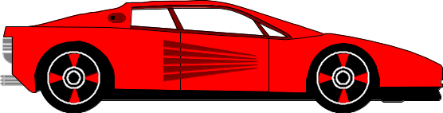
LIGHT & ITS USES: Mirrors
Reflection & Mirrors (Cont.)
  Convex Mirror
    Curves outward
    Enlarges images.
  Use: Rear view mirrors, store security…
CAUTION! Objects are closer than they appear!
© 2000 Microsoft Clip Gallery

Slide 37
LIGHT & ITS USES: Lenses
Convex Lenses
  Thicker in the center than edges.
  Lens that converges (brings together) light rays.
  Forms real images and virtual images depending on position of the object

Slide 38
LIGHT & ITS USES: Lenses
Object
Focal Point
Convex Lenses
Ray Tracing
  Two rays usually define an image
    Ray #1: Light ray comes from top of object; travels parallel to optic axis; bends thru focal point.
© 2000 D. L. Power
Lens

Slide 39
LIGHT & ITS USES: Lenses
Ray #1
Convex Lenses
Ray Tracing
  Two rays define an image
    Ray 2: Light ray comes from top of object & travels through center of lens.
© 2000 D. L. Power
Ray #2

Slide 40
LIGHT & ITS USES: Lenses
© 2000 D. L. Power
Concave Lenses –
  Lens that is thicker at the edges and thinner in the center.
  Diverges light rays
  All images are erect and reduced.

Slide 41

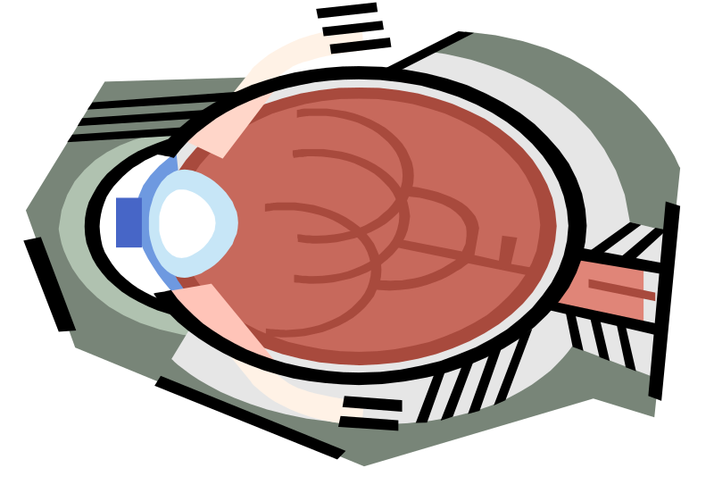
How You See
Near Sighted – Eyeball is too long and image focuses in front of the retina
Far Sighted – Eyeball is too short so image is focused behind the retina.
© 2000 Microsoft Clip Gallery
© 2000 Microsoft Clip Gallery

Slide 42
LIGHT & USES: Lenses
Concave Lenses –
  Vision – Eye is a convex lens.
    Nearsightedness – Concave lenses expand focal lengths
    Farsightedness – Convex lenses shortens the focal length.

Slide 43
LIGHT & USES: Optical Instruments
Cameras
Telescopes
Microscopes
© 2000 Microsoft Clip Gallery
© 2000 Microsoft Clip Gallery
© 2000 Microsoft Clip Gallery

Slide 44
LIGHT & USES: Optical Instruments
LASERS
  Acronym: Light Amplification by Stimulated Emission of Radiation
  Coherent Light – Waves are in phase so it is VERY powerful & VERY intense.

Slide 45
LIGHT & USES: Optical Instruments
LASERS
  Holography – Use of Lasers to create 3-D images
  Fiber Optics – Light energy transferred through long, flexible fibers of glass/plastic
  Uses – Communications, medicine, t.v. transmission, data processing.

Slide 46
LIGHT & USES: Diffraction
Diffraction – Bending of waves around the edge of a barrier. New waves are formed from the original. breaks images into bands of light & dark and colors.
Refraction – Bending of waves due to a change in speed through an object.

Slide 47
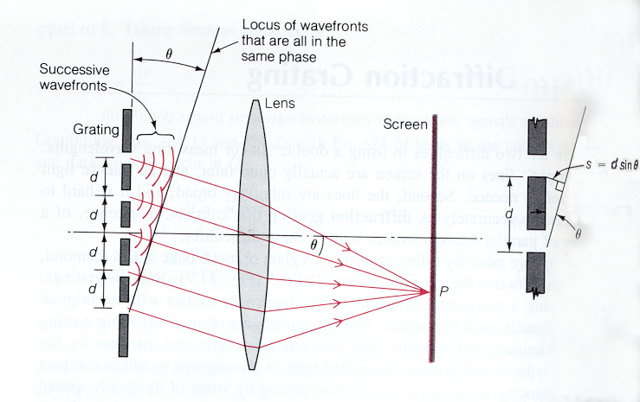
LIGHT & USES: Diffraction
© 2000 Microsoft Encarta
A diffraction grating. Each space between the ruled grooves acts as a slit. The light bends around the edges and gets refracted.

Slide 48
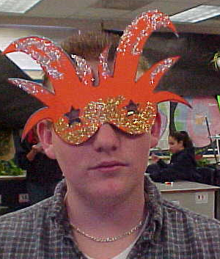
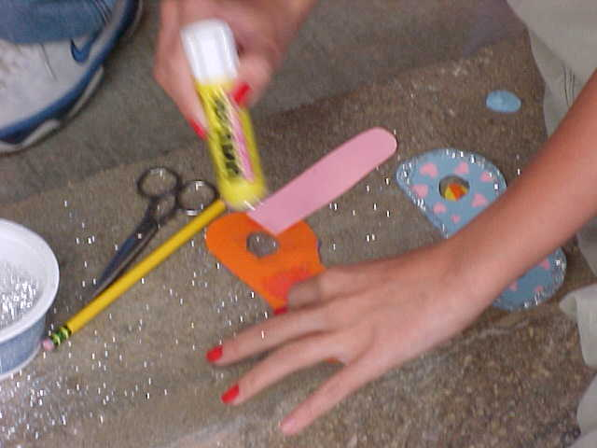
SAMPLE STUDENT PROJECT: Diffraction Grating Glasses (Pd. 1)
© 2000 D. L. Power
© 2000 D. L. Power

Slide 49
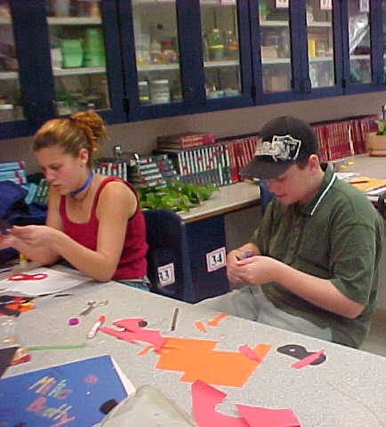
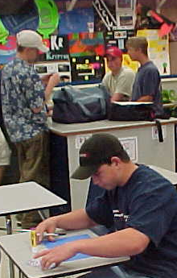
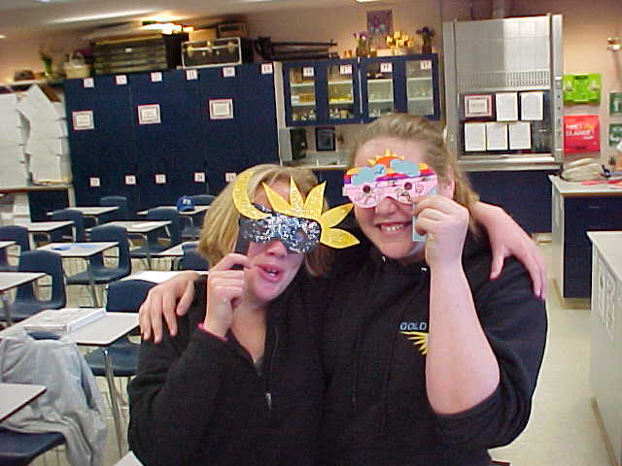
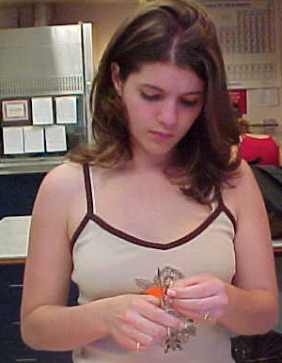
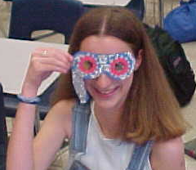
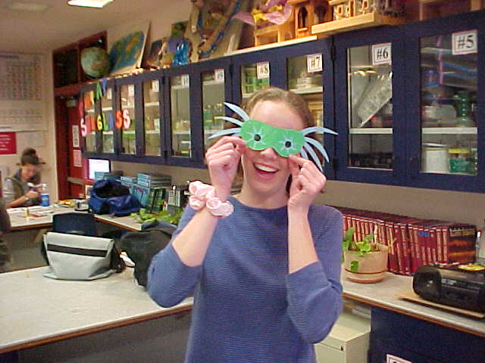
SAMPLE STUDENT PROJECT: Diffraction Grating Glasses (Pd. 3)
© 2000 D. L. Power

Slide 50
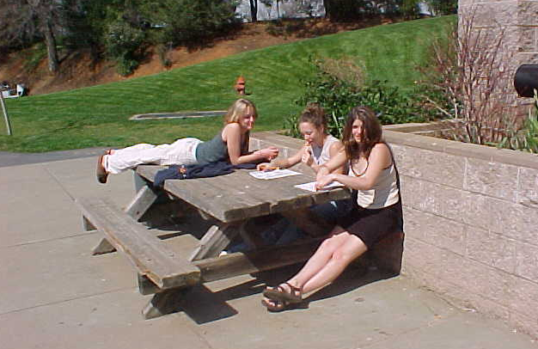
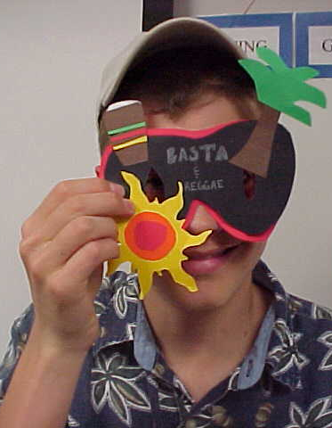
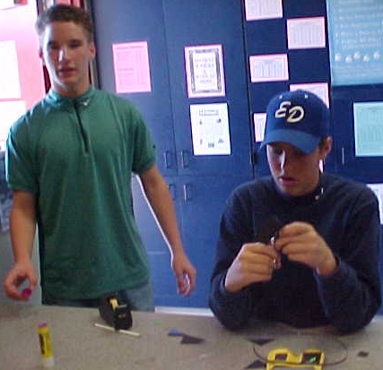
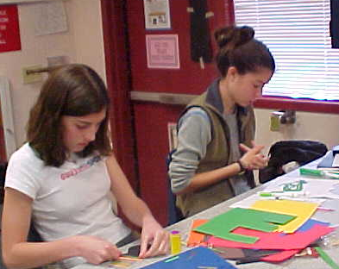
SAMPLE STUDENT PROJECT: Diffraction Grating Glasses (Pd. 3)
Hey girls,
are you hard at work or hardly working?
© 2000 D. L. Power

Slide 51
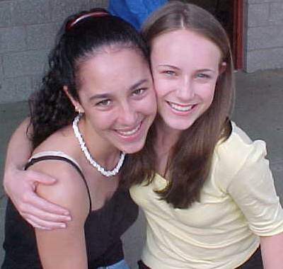
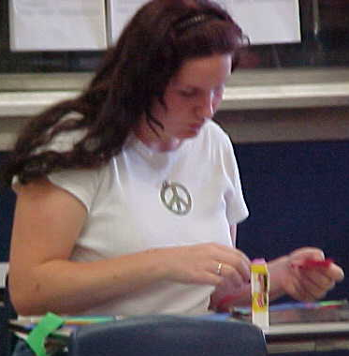
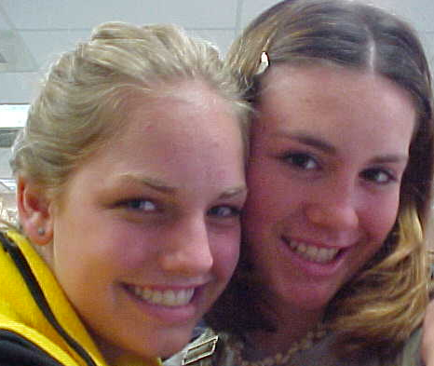
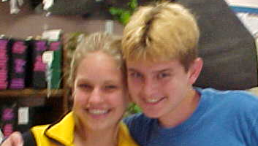
SAMPLE STUDENT PROJECT: Diffraction Grating Glasses (Pd. 5)
Note: There’s more posing than working!
© 2000 D. L. Power

Slide 52
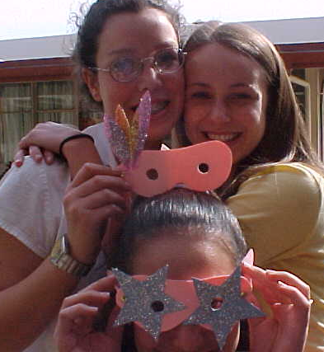
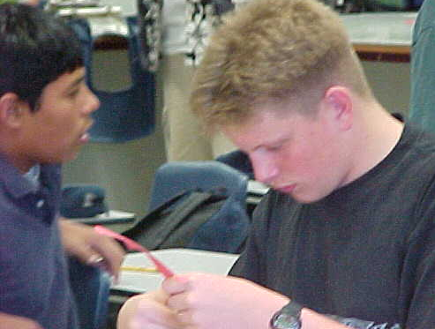
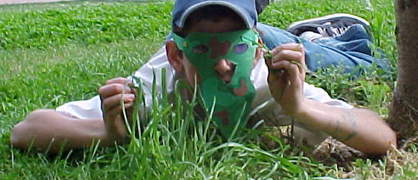
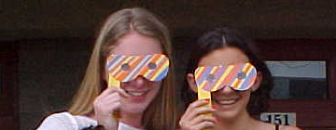
SAMPLE STUDENT PROJECT: Diffraction Grating Glasses (Pd. 5)
© 2000 D. L. Power

Slide 53
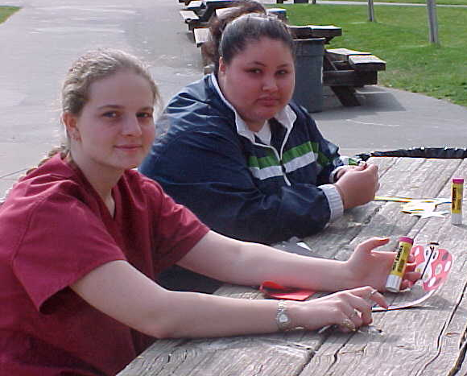
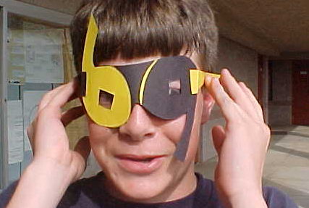
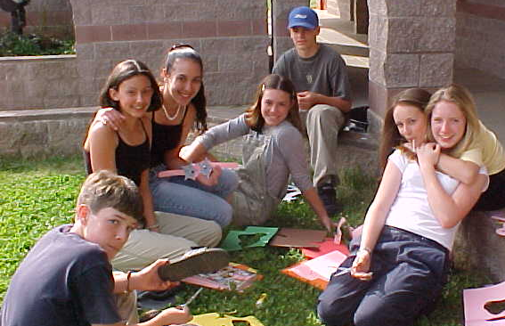
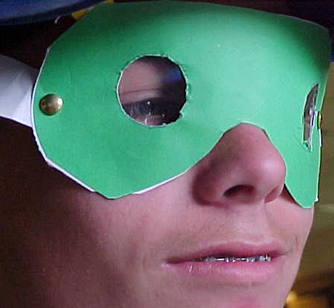
SAMPLE STUDENT PROJECT: Diffraction Grating Glasses (Pd. 5)
© 2000 D. L. Power

Slide 54
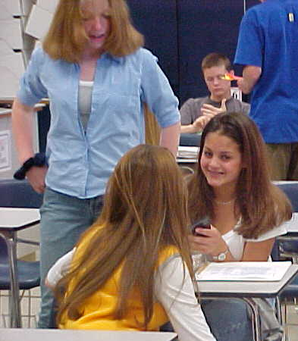
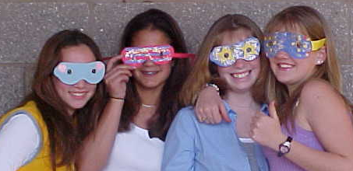
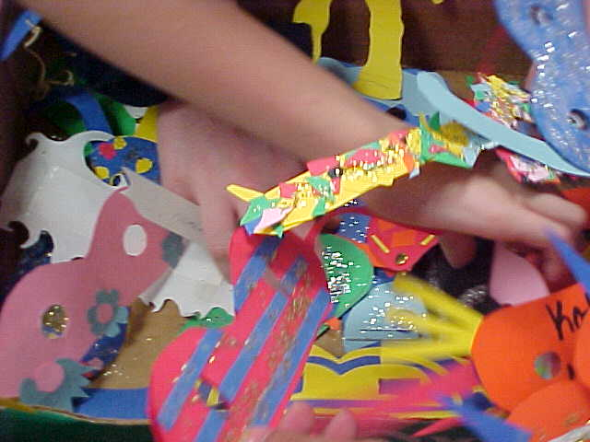
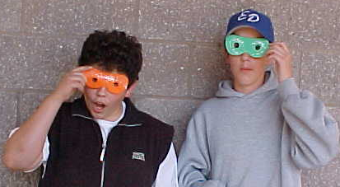
SAMPLE STUDENT PROJECT: Diffraction Grating Glasses (Pd. 6)
© 2000 D. L. Power

Slide 55
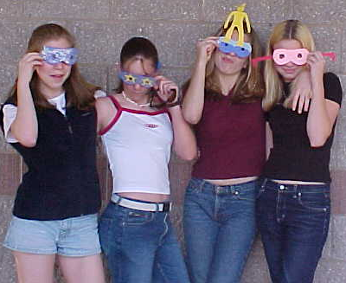



SAMPLE STUDENT PROJECT: Diffraction Grating Glasses (Pd. 6)
© 2000 D. L. Power

Slide 56
EVALUATION: State Standards
Waves carry energy from one place to another
Identify transverse and longitudinal waves in mechanical media such as spring, ropes, and the earth (seismic waves)
Solve problems involving wavelength, frequency, & speed.
.

Slide 57
EVALUATION: State Standards
Radio waves, light, and x-rays are different wavelength bands in the spectrum of electromagnetic waves whose speed in vacuum is approximately 3x10 m/sec
Sound is a longitudinal wave whose speed depends on the properties of the medium in which it propagates.

Slide 58
EVALUATION: State Standards
Identify the characteristic properties of waves:
  Interference
  Diffraction
  Refraction
  Doppler Effect
  Polarization.

Slide 59
References
http://www.scimedia.com/chem-ed/light/em-spec.htm, updated 2/1/97
http://encarta.msn.com/find/Concise.asp?ti=06AFC000
http://www.lbl.gov/MicroWorlds/ALSTool/EMSpec/EMSpec2.html
http://www.lbl.gov/MicroWorlds/ALSTool/EMSpec/EMSpec.html
http://www.physics.sfasu.edu/astro/color.html#linkshttp://www.physics.sfasu.edu/astro/color.html#links
http://www.isc.tamu.edu/~astro/color.html

Slide 60
References
http://www.isc.tamu.edu/~astro/color.html
http://www.isc.tamu.edu/~astro/color.html
http://www.holo.com/holo/cmpany/laserart.htmlhttp://www.holo.com/holo/cmpany/laserart.html
http://www.holo.com/holo/book/book1.html#defhttp://www.holo.com/holo/book/book1.html#def
http://www.scimedia.com/chem-ed/light/em-rad.htm, updated 11/22/97

Slide 61
WORKS CITED
http://www.scimedia.com/chem-ed/light/em-rad.htm, updated 11/22/97
http://www.scimedia.com/chem-ed/light/em-spec.htm, updated 2/1/97
http://encarta.msn.com/find/Concise.asp?ti=06AFC000
http://www.lbl.gov/MicroWorlds/ALSTool/EMSpec/EMSpec2.html
http://www.lbl.gov/MicroWorlds/ALSTool/EMSpec/EMSpec.html
http://www.physics.sfasu.edu/astro/color.html#linkshttp://www.physics.sfasu.edu/astro/color.html#links
http://www.isc.tamu.edu/~astro/color.html
http://www.isc.tamu.edu/~astro/color.html
http://www.isc.tamu.edu/~astro/color.html
http://www.holo.com/holo/cmpany/laserart.htmlhttp://www.holo.com/holo/cmpany/laserart.html
http://www.holo.com/holo/book/book1.html#defhttp://www.holo.com/holo/book/book1.html#def

Slide 62

The End…
© 2000 Microsoft Clip Gallery

