Slide 1
BFSI Onboarding Software
Diagrams

Slide 2
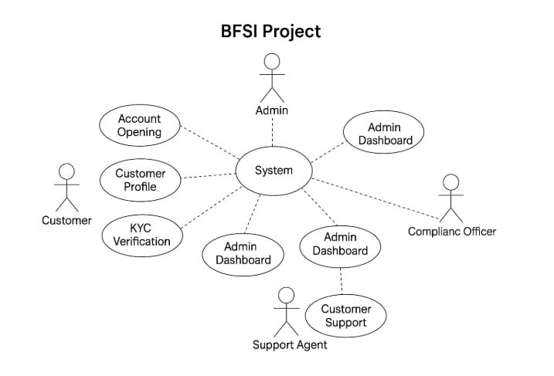

Slide 3
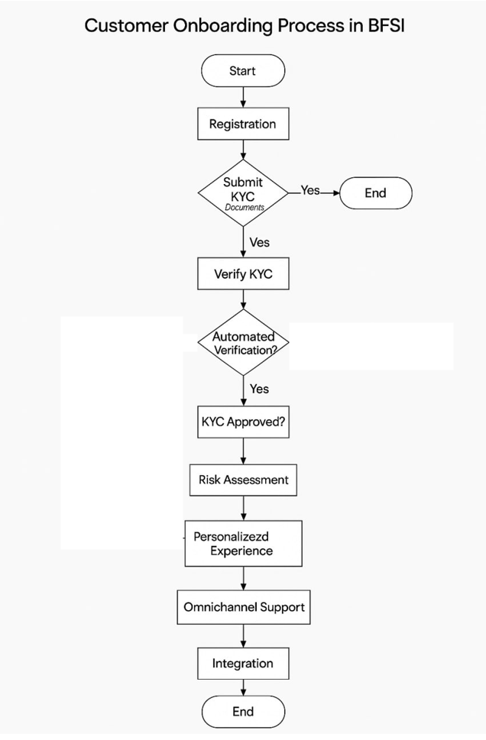
Activity Diagram

Slide 4
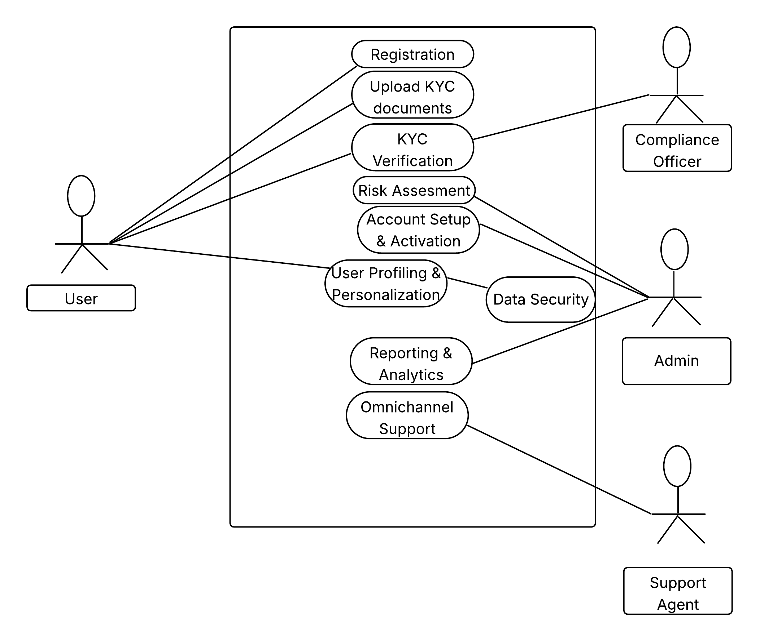
Use Case Diagram

Slide 5
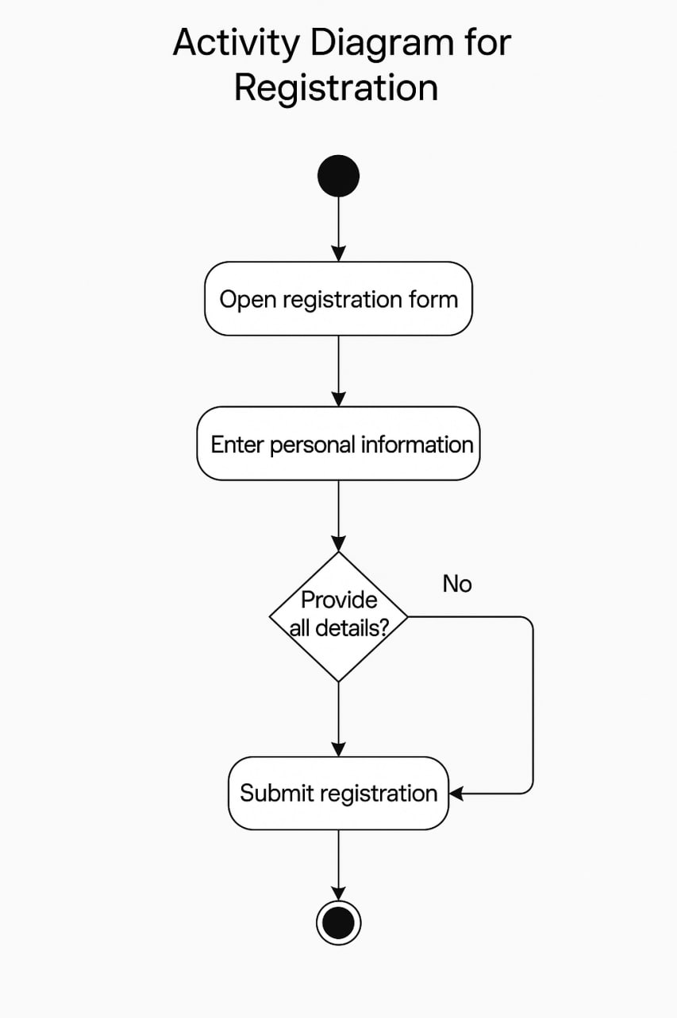

Slide 6
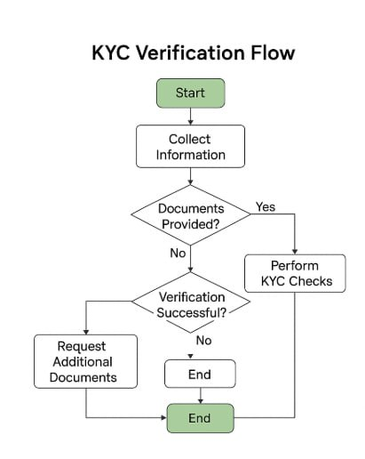

Slide 7
