Slide 1
Global Life Expectancy Analysis using Machine Learning and Power BI

Slide 2
CONTENTS / AGENDA
1. Executive Summary – Insights & Recommendations
2. Business Problem Overview
3. Objective of the Study
4. Solution Approach
5. Data Dictionary
6. Solution Design & Methodology
7. Data Preprocessing
8. Exploratory Data Analysis (EDA)
9. Model Development
10. Model Evaluation & Performance Evaluation
11. Model Comparison & Selection
12. Dashboard Development & Visualization
13. Conclusion & Recommendations

Slide 3
1. EXECUTIVE SUMMARY
Life expectancy is a key indicator of a country’s health, economic stability, and development. Countries with better healthcare, higher income levels, and improved education tend to have higher life expectancy, while those facing economic and health challenges show lower lifespan.
This project focuses on analyzing global life expectancy data and identifying the major factors influencing it.
Data preprocessing and analysis were performed using Python, and a machine learning regression model was developed to predict life expectancy. An interactive Power BI dashboard was also created to visualize trends, comparisons, and relationships between variables.
The analysis shows strong relationships between economic, educational, and health factors and life expectancy. The dashboard helps in understanding these patterns clearly and supports data-driven decision-making.
Key Insights
Countries with higher GDP tend to have significantly higher life expectancy
Education (schooling) shows a strong positive relationship with lifespan
Adult mortality has a strong negative impact on life expectancy
Countries with high HIV/AIDS cases show reduced life expectancy
Developed countries consistently outperform developing countries in lifespan
BMI and health indicators influence life expectancy moderately
Vaccination rates (Polio, Diphtheria) are associated with improved life expectancy
Economic and healthcare factors together play the most important role

Slide 4
Recommendations
Increase healthcare investment to reduce mortality and improve life expectancy
Control infectious diseases like HIV/AIDS to prevent lifespan reduction
Improve education access to enhance life expectancy
Focus on GDP growth to improve living standards and healthcare
Reduce infant and adult mortality through public health programs
Strengthen vaccination programs (Polio, Diphtheria, etc.)
Promote healthy lifestyle and balanced nutrition
Use data-driven decision-making for better policy planning

Slide 5
2. Business Problem Overview
Life expectancy varies significantly across different countries due to differences in economic conditions, healthcare facilities, education levels, and disease prevalence. Countries with strong economies and better healthcare systems tend to have higher life expectancy, while developing countries face challenges such as high mortality rates and limited access to medical facilities.
The main challenge is identifying the key factors that influence life expectancy and understanding how these factors interact with each other. Traditional analysis methods are often time-consuming and do not provide clear insights into complex relationships within the data.
Therefore, there is a need for a data-driven approach that can:
Analyze large-scale global health data efficiently
Identify major factors affecting life expectancy
Understand differences between developed and developing countries
Predict life expectancy using machine learning models
Provide clear insights through visualization for better decision making
This project addresses these challenges using data analytics, machine learning, and an interactive Power BI dashboard.

Slide 6
3. Objective of the Study
The main objective of this project is to analyze global life expectancy data and identify the key factors that influence it. By using data analytics and machine learning techniques, the study aims to understand how economic, educational, and health-related variables affect life expectancy across different countries.
The project also focuses on building a predictive model and visualizing insights through an interactive dashboard to support better decision-making.
Objectives:
To analyze global life expectancy data across countries and years
To identify key factors affecting life expectancy
To study the impact of GDP, education, and health indicators
To preprocess and clean the dataset for analysis
To build a machine learning model to predict life expectancy
To visualize insights using Power BI dashboard
To compare developed and developing countries
To support data-driven decision making

Slide 7
4. SOLUTION APPROACH
To understand and analyze life expectancy, a set of key questions were considered during the study. These questions help in identifying important patterns, relationships, and factors that influence life expectancy across different countries.
The analysis focuses on examining economic, educational, and health-related variables and understanding their impact using data analytics and machine learning techniques.
The following questions were addressed:
How has life expectancy changed over time across developed-developing countries?
Which 10 countries have the highest life expectancy?
Which 10 countries have the lowest life expectancy?
What is the distribution between developed and developing countries?
Are vaccination rates (Polio and Diphtheria) improving over time?
Does higher GDP lead to higher life expectancy?
How does education (schooling) affect lifespan?
What is the impact of HIV/AIDS on life expectancy and mortality?
Is there a relationship between BMI and life expectancy?
Which group (developed or developing) consumes more alcohol?

Slide 8
5. DATA DICTIONARY
➤ Country: Name of the country for which health and economic data is recorded.
➤ Year: The year in which the data values were collected.
➤ Status: Development status of the country (Developing or Developed).
➤ Life Expectancy: Average number of years a person is expected to live at birth.
➤ Adult Mortality: Number of deaths per 1000 population between the ages of 15 and 60.
➤ Infant Deaths: Number of infant deaths per 1000 live births.
➤ Alcohol: Average alcohol consumption per capita (in liters).
➤ Percentage Expenditure: Percentage of government expenditure spent on healthcare.
➤ Hepatitis B: Percentage of immunization coverage against Hepatitis B.
➤ Measles: Number of reported measles cases in the country.
➤ BMI: Average Body Mass Index of the population

Slide 9
➤ Under-Five Deaths: Number of deaths under the age of five per 1000 population.
➤ Polio: Percentage of polio immunization coverage.
➤ Total Expenditure: Total healthcare expenditure as a percentage of GDP.
➤ Diphtheria: Percentage of diphtheria immunization coverage.
➤ HIV/AIDS: Death rate per 1000 population due to HIV/AIDS.
➤ GDP: Gross Domestic Product per capita of the country.
➤ Population: Total population of the country.
➤ Thinness (1–19 years): Percentage of thinness among children aged 1–19 years.
➤ Thinness (5–9 years): Percentage of thinness among children aged 5–9 years.
➤ Income Composition of Resources: Index representing income distribution and resource availability.
➤ Schooling: Average number of years of schooling in the country.

Slide 10
6. Solution Design & Methodology
DATA COLLECTION
Handled missing values
Corrected data types and inconsistencies
Imported Life Expectancy dataset into Python
Reviewed structure, columns, and data types
DATA CLEANING
Encoded categorical variables
Selected important features
MODEL DEVELOPMENT
FEATURE ENGINEERING
Trained model on processed dataset
Predicted life expectancy
Evaluated using performance
Compared predicted vs actual values
Selected best-performing model
Exported cleaned dataset to Power BI
Created interactive dashboard
Visualized trends and relationships
MODEL EVALUATION
DASHBOARD DEVELOPMENT
INSIGHTS & RECOMMENDATIONS
Identified key factors affecting life expectancy
Generated insights from dashboard
Provided data-driven recommendations

Slide 11
7. Data Preprocessing
Before building the model, the dataset was carefully prepared to ensure accuracy, consistency, and suitability for machine learning.
• Removed irrelevant and unnecessary columns that were not required for analysis and model building.
• Verified dataset structure and corrected column names for better consistency and readability.
• Checked for missing and null values across all features and handled incomplete records to maintain data quality.
• Converted all attributes into appropriate data types (numeric and categorical formats).
• Encoded categorical variables into numerical format to make them suitable for machine learning models.
• Selected important features and separated independent variables (features) and dependent variable (Life Expectancy).
• Removed duplicate records to ensure each entry is unique and avoid data redundancy.
• Split the dataset into training and testing sets using an 80:20 ratio.
• Validated the dataset after preprocessing to ensure correctness and consistency.
• Prepared the final processed dataset for machine learning model training and evaluation.
• Exported the cleaned dataset to CSV format for Power BI visualization and dashboard development..

Slide 12
8. EXPLORATORY DATA ANALYSIS (EDA)
Data In Hand
The present study uses a Life Expectancy Dataset containing global health, economic, and social indicators collected from various countries.
The dataset includes country-wise information such as economic conditions, health factors, mortality rates, and education levels, which are used to analyse patterns and predict life expectancy.
Key variables in the dataset include:
• Life Expectancy (Target Variable) • GDP • Schooling • Adult Mortality • BMI • Alcohol Consumption • HIV/AIDS • Polio Vaccination • Diphtheria Vaccination • Status (Developed / Developing Country)
The dataset is used to analyse relationships between health, economic, and social factors and their impact on life expectancy across different countries.
The cleaned and processed dataset is further utilized for machine learning model development and visualization through a Power BI dashboard for better insights and decision-making.

Slide 13
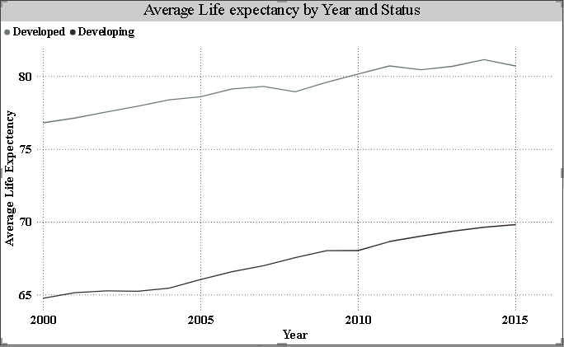
1) Life Expectancy Trend Over Time
This analysis focuses on understanding how life expectancy has changed over time across developed and developing countries.
• Life expectancy has steadily increased for both developed and developing countries over the years.
• Developed countries consistently show higher life expectancy compared to developing countries.
• Developing countries show gradual improvement, indicating better healthcare and living conditions.

Slide 14
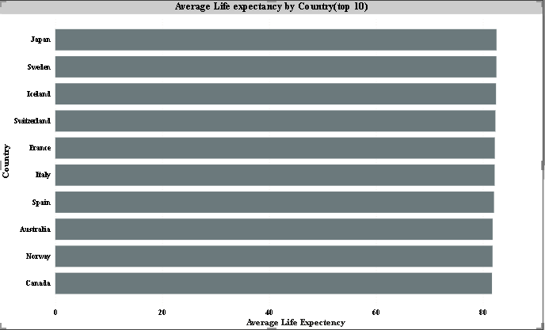
2) Top 10 Countries with Highest Life Expectancy
This analysis identifies the countries with the highest average life expectancy.
• Countries like Japan, Sweden, Iceland, and Switzerland rank among the highest in life expectancy.
• Most of these countries are developed nations with strong healthcare and living standards.
• High life expectancy in these countries reflects better healthcare systems, nutrition, and quality of life.

Slide 15
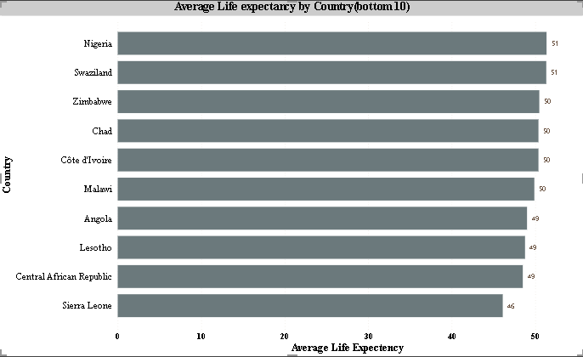
3) Bottom 10 Countries with Lowest Life Expectancy
This analysis identifies the countries with the lowest average life expectancy.
• Countries such as Sierra Leone, Central African Republic, and Lesotho have the lowest life expectancy.
• Most of these countries are developing nations facing economic and healthcare challenges.
• Low life expectancy is mainly influenced by high mortality rates, diseases, and limited healthcare access.

Slide 16
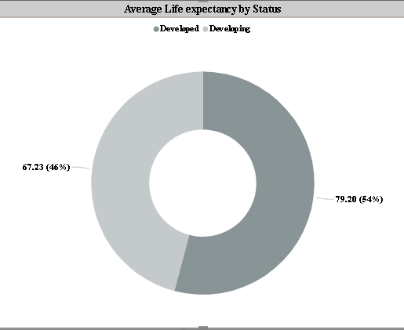
4) Distribution between Developed and Developing Countries
This analysis shows the distribution of life expectancy between developed and developing countries.
• Developed countries have a higher average life expectancy compared to developing countries.
• Developing countries account for a lower life expectancy due to economic and healthcare limitations.
• The distribution highlights a clear gap between developed and developing nations in terms of lifespan.

Slide 17
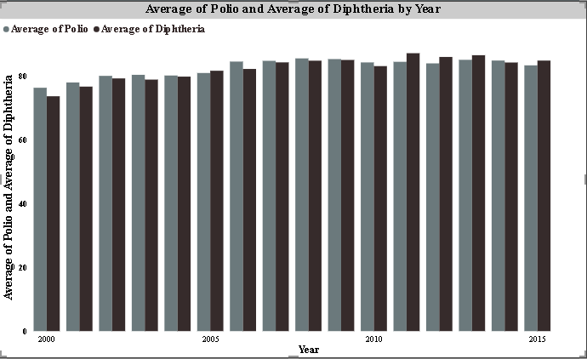
5) Vaccination Trends (Polio and Diphtheria)
This analysis examines whether vaccination rates have improved over time.
• Vaccination rates for both Polio and Diphtheria show a steady increase over the years.
• The trend indicates improved healthcare awareness and immunization programs.
• Higher vaccination coverage contributes to better health outcomes and increased life expectancy.

Slide 18
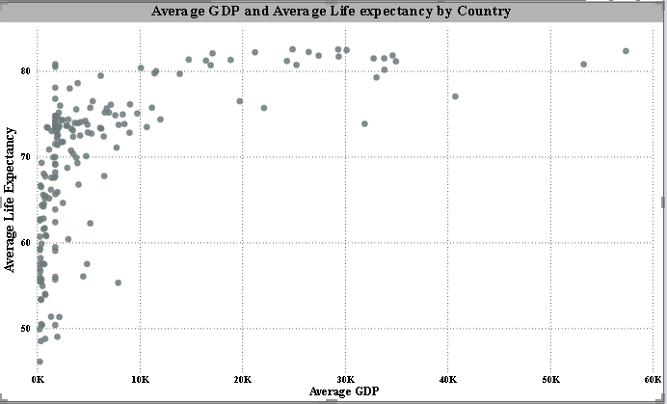
6) Relationship between GDP and Life Expectancy
This analysis examines whether higher GDP leads to higher life expectancy.
• There is a positive relationship between GDP and life expectancy across countries.
• Countries with higher GDP generally show higher life expectancy levels.
• This indicates that better economic conditions contribute to improved healthcare and living standards.

Slide 19
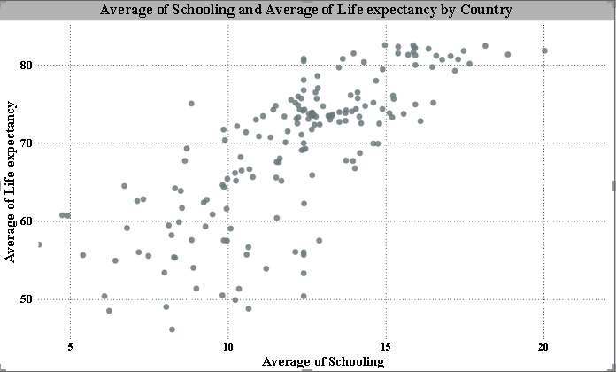
7) Impact of Education (Schooling) on Life Expectancy
This analysis examines how education levels affect life expectancy.
• There is a strong positive relationship between schooling and life expectancy.
• Countries with higher years of schooling tend to have higher life expectancy.
• Education improves awareness, lifestyle, and access to better healthcare, leading to longer lifespan.

Slide 20
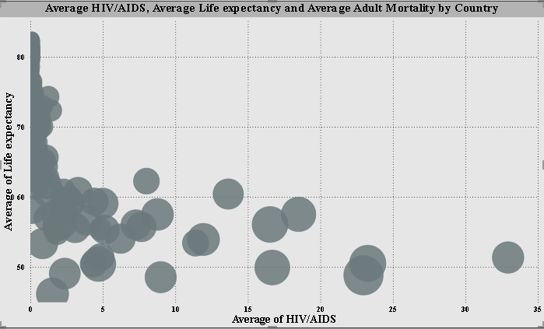
8) Impact of HIV/AIDS on Life Expectancy and Mortality
This analysis examines how HIV/AIDS affects life expectancy and adult mortality.
• Higher HIV/AIDS rates are associated with lower life expectancy across countries.
• Countries with high HIV/AIDS prevalence tend to show higher adult mortality rates.
• This indicates that HIV/AIDS has a significant negative impact on population health and lifespan.

Slide 21
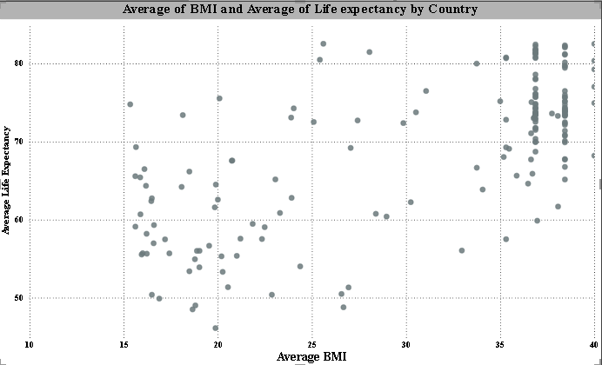
9) Relationship between BMI and Life Expectancy
This analysis examines the relationship between BMI and life expectancy.
• There is a moderate positive relationship between BMI and life expectancy.
• Countries with higher BMI levels tend to show slightly higher life expectancy.
• However, the relationship is not very strong, indicating other factors also influence lifespan.

Slide 22
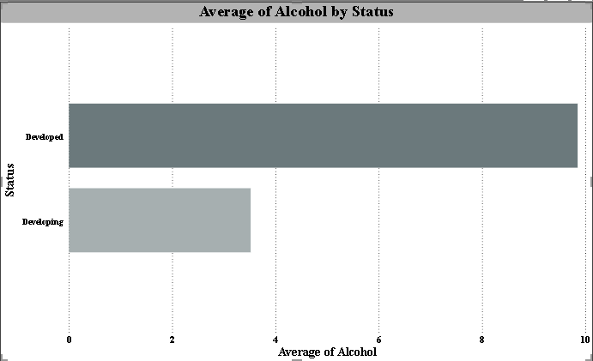
10) Alcohol Consumption by Country Status
This analysis examines alcohol consumption between developed and developing countries.
• Developed countries show higher alcohol consumption compared to developing countries.
• Developing countries have relatively lower alcohol consumption levels.
• This difference reflects lifestyle patterns and socio-economic conditions across countries.

Slide 23
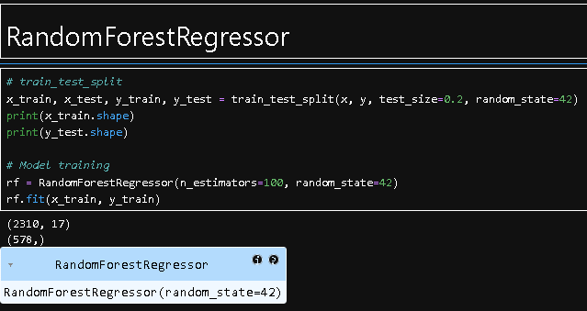
9. MODEL DEVELOPMENT
Model Selection
The objective of this study is to predict life expectancy based on economic, health, and social indicators.
The following machine learning regression algorithms were implemented:
Linear Regression, Decision Tree Regressor , Random Forest Regressor
The target variable used in the model is: Life Expectancy
Random Forest was selected as the primary model due to its higher accuracy and ability to handle complex, non-linear relationships between variables.

Slide 24
Data Preparation
• Independent variables (features) and dependent variable (Life Expectancy) were separated.
• Categorical variables such as Status were converted into numerical format using encoding.
• Relevant features such as GDP, Schooling, Mortality, BMI, and Diseases were selected.
• The dataset was divided into 80% training data and 20% testing data.
Model Training
• All models were trained using the prepared training dataset.
• The models learned relationships between health, economic, and social factors and life expectancy.
• The trained model predicts life expectancy for given input variables.

Slide 25
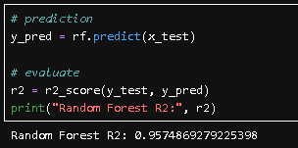
10. MODEL EVALUATION & PERFORMANCE ANALYSIS
Model Performance
The performance of the model was evaluated using the R² Score.
Random Forest achieved an R² score of approximately 0.95, indicating strong predictive performance.
Performance Interpretation
• The model accurately predicts life expectancy based on selected features.
• Predicted values are close to actual values, indicating good model performance.
• Random Forest performs better due to its ability to handle complex relationships.
• The model helps in understanding key factors affecting life expectancy and supports data-driven decisions.

Slide 26
11. MODEL COMPARISON & SELECTION
Model Comparison
Different regression models were compared based on their predictive performance using the R² Score.
• Linear Regression – Basic performance (R² ≈ 0.82)
• KNN Regressor – Moderate performance (R² ≈ 0.90)
• Decision Tree Regressor – Good performance (R² ≈ 0.91)
• SVR – Moderate performance (R² ≈ 0.87)
• Random Forest Regressor – Highest performance (R² ≈ 0.95)
Final Model Selection
• Random Forest Regressor was selected as the final model.
• It achieved the highest R² score among all models.
• It effectively handles complex and non-linear relationships between variables.
• It provides more accurate and reliable predictions compared to other models.

Slide 27
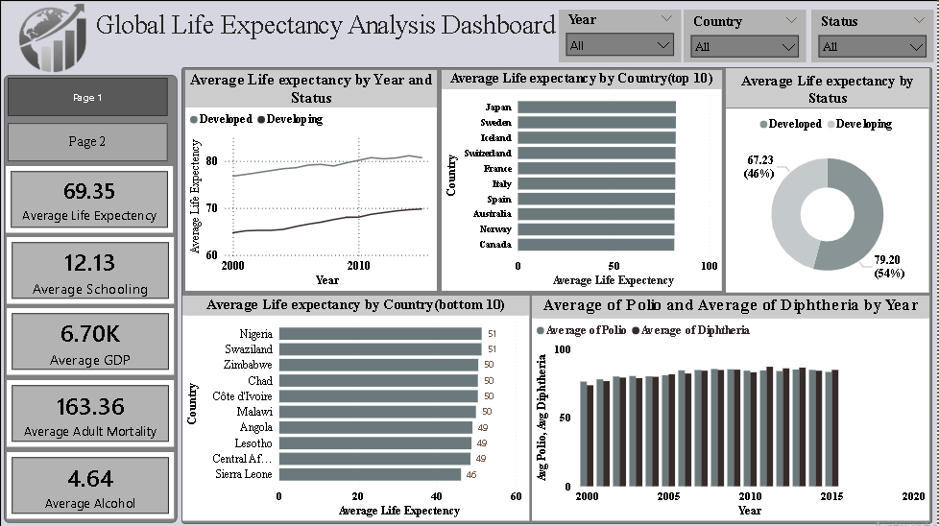
12. Dashboard Development & Visualization

Slide 28
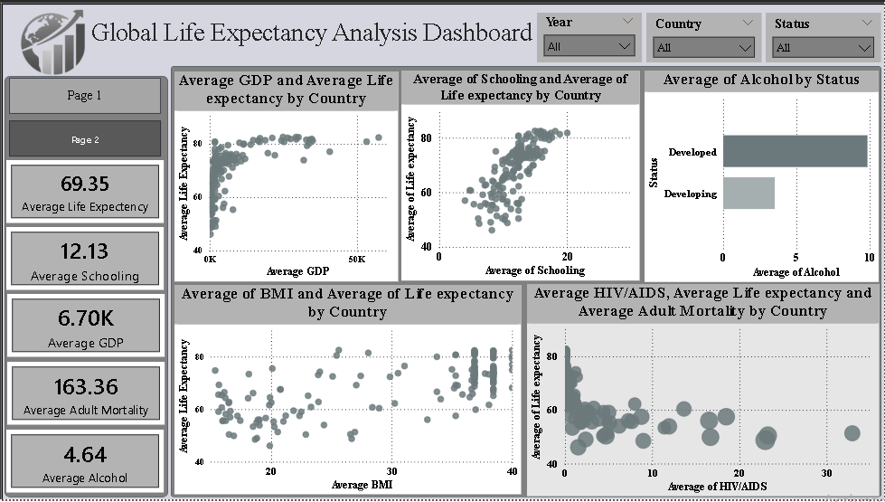

Slide 29
13. Conclusion & Recommendations
CONCLUSION
The project focused on analyzing life expectancy across countries using machine learning and data visualization techniques. The dataset included various economic, health, and social indicators such as GDP, schooling, mortality, and disease factors.
After data preprocessing and analysis, it was observed that life expectancy is strongly influenced by factors like GDP, education level, and healthcare conditions. Countries with better economic status and higher education levels tend to have higher life expectancy, while high mortality rates and diseases such as HIV/AIDS negatively impact lifespan.
Different machine learning models were implemented and compared, and the Random Forest model achieved the best performance with a high R² score. The model was able to accurately predict life expectancy based on input features.
A Power BI dashboard was developed to visualize trends, comparisons, and key insights. The dashboard helps in understanding patterns across countries and supports data-driven decision-making.
Overall, the project demonstrates that data analytics and machine learning can effectively help in understanding and predicting life expectancy and identifying key factors that influence it.

Slide 30
RECOMMENDATIONS
• Increase healthcare investment to improve life expectancy and reduce mortality rates.
• Strengthen vaccination programs (Polio, Diphtheria) to prevent diseases.
• Improve access to education, as schooling has a strong impact on lifespan.
• Focus on economic growth (GDP) to enhance living standards and healthcare quality.
• Implement awareness programs to reduce the impact of diseases like HIV/AIDS.
• Use data-driven approaches for policy planning and decision-making.

