Slide 1
Category review: Chips
June 2020
Retail Analytics
Brand note: If client logo is not required, use alternate title page layout right click slide thumbnail > Layout > Title

Slide 2
Notes:
To view Privacy video explaining how important data privacy is to Quantium, please click here: https://www.youtube.com/watch?v=Zq1QDAkoRzU
or here Q:\Company Reference\Brand & Design\Brand videos\Q Privacy.mp4
At Quantium, we believe that data is the behavioural footprint of humanity and that it has to be treated with the utmost care and responsibility.
Histories, attitudes, indeed lives are stored within it in ways that aren’t always apparent – and that’s what makes its potential so powerful.
To work with it responsibly, sensitively, we set ourselves the highest data privacy protection and governance standards.
We have spent 17 years perfecting privacy-by-design and secure-by-design principles. Central to this is not holding any personally identifiable information about people –
we neither receive it, and put the necessary protections in place to be unable to decipher it.
Every aspect of handling data is safeguarded: from its de-identification, to its encryption – data security is paramount and of the highest grade.
We pride ourselves on gaining the trust of iconic organisations around the world through years of securely working with their data,
and in turn the trust that builds with their stakeholders.

Slide 3
Executive summary
01
Task 1
The analysis of customer purchasing behavior reveals that Older Singles/Couples, Retirees, and Older Families generate the highest sales, while New Families contribute the least. Among brands, Kettle ($390K, 79K units), Smiths ($224K, 60K units), and Doritos ($240K, 53K units) lead in sales, while French Fries and Sunbites are the least popular. Older Families & Retirees prefer Kettle and Smiths, while Young Singles & Families favor Doritos, Pringles, and Thins. Premium customers buy more Kettle and Smiths, while Budget customers lean towards Doritos and Pringles. The best-selling chip is Dorito Corn Chip Supreme 380g ($39K sales, 6.1K units), while Kettle Mozzarella Basil & Pesto 175g is the highest-selling by quantity. Marketing efforts should focus on Target Older Families & Retirees with premium Kettle and Smiths promotions. Bundle Doritos & Pringles for Young Singles & Families. Increase promotional campaigns for low-performing brands (e.g., Woolworths Salsa).
Increase Kettle & Smiths stock in high-demand stores. Reduce shelf space for underperforming brands.
Offer discounts for premium buyers on Kettle & Smiths. Encourage budget customers with Doritos and Pringles bulk-buy incentives.
02
Task 2
The trial campaign was conducted at three stores (77, 86, and 88), with control stores selected based on similarity in total sales, quantity sold, and transactions using Pearson correlation and Euclidean distance. Store 88 showed a significant increase in total sales, number of customers, and average sales per customer, outperforming its control store, despite a slight decline in average purchases per customer. Store 86 experienced some sales growth and an increase in customers but underperformed compared to its control store, indicating minimal impact. Store 77 showed no major difference in purchasing behavior or sales trends compared to its control stores, though there were some fluctuations during the trial period. Overall, while the campaign led to positive outcomes for Store 88, the results were inconclusive for Stores 77 and 86, suggesting that the strategy needs further refinement before a broader rollout.

Slide 4
01
CATEGORY
Customer Segmentation & Preferred Brands
Sales Performance & Top-Selling Products
Market Trends: Customer Behavior & Brand Success

Slide 5

📌 Customer Segmentation & Sales Contribution:
Older Singles & Retirees generate the highest sales.
New Families contribute the least.
📌 Top-Selling Brands & Products:
Kettle, Smiths, and Doritos are the top 3 best-selling brands.
Dorito Corn Chip Supreme 380g is the best-selling product by revenue.
Kettle Mozzarella Basil & Pesto 175g has the highest units sold.
📌 Customer Preferences & Buying Behaviour:
Premium customers buy more Kettle & Smiths
Budget customers prefer Doritos & Pringles.
Young Singles & Families favour Doritos, Pringles, and Thins.
📌 Recommendations:
Increase premium promotions for Kettle & Smiths.
Bundle Doritos & Pringles for budget-conscious customers.
Optimize stock levels based on demand trends.

Slide 6

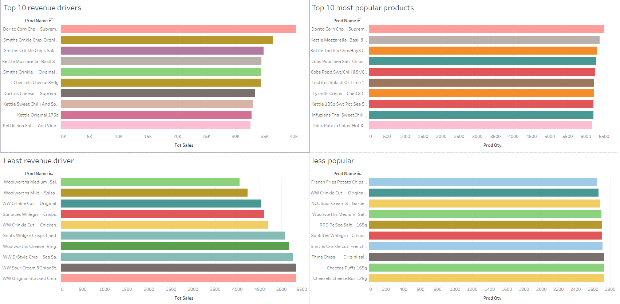
GENERAL chips-based ANALYTICS

Slide 7

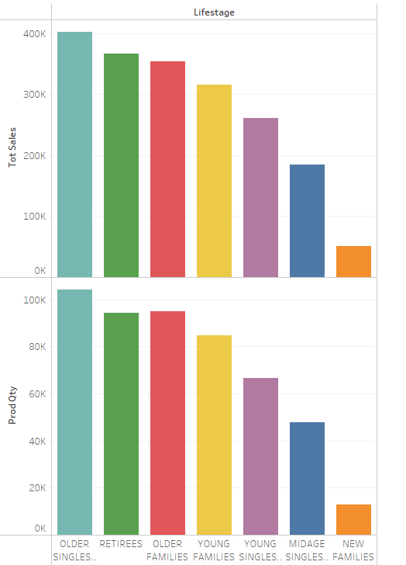
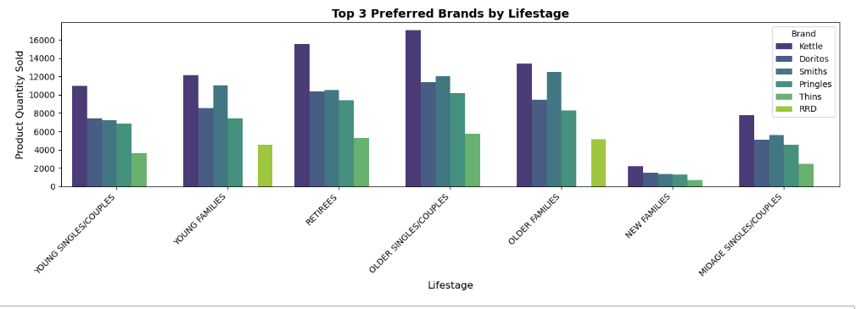
Editable (delete this)
Customer segment Sales & Product Popularity

Slide 8
02
Trial store performance
The trial campaign was conducted in three stores (77, 86, and 88), with control stores selected based on sales trends, transaction volume, and customer behavior. Store 88 showed the most significant improvement, with a notable increase in total sales, customer count, and average sales per customer, indicating a strong positive response to the campaign. Store 86 experienced moderate growth in sales and new customers, but its overall performance was still slightly lower than its control store, making the impact inconclusive. Store 77 showed minimal change compared to its control stores, with no significant improvement in sales or purchasing behavior, though there were minor fluctuations during the trial period. Overall, the campaign had mixed results, with Store 88 demonstrating the most promising outcome, while the other stores showed limited impact.

Slide 9
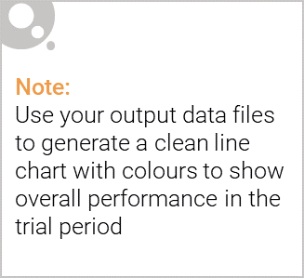
Control store vs Trial stores
🔍 Store-by-Store Comparison
1️⃣ Store 77 (Trial) vs. Control Stores (35, 41, 167)
Total Sales: Similar to control stores, with no major increase.
Number of Purchasing Customers & Total Purchases: Some fluctuations, but no clear uplift beyond natural variations.
Conclusion: Campaign had little to no significant impact on sales growth.
2️⃣ Store 88 (Trial) vs. Control Store (229)
Total Sales: Significantly higher than the control store, indicating a strong campaign effect.
More Customers & Higher Average Sales per Customer: Customers not only bought more but spent more per purchase.
Conclusion: Campaign was highly successful in Store 88, leading to real growth in sales and customer engagement.
3️⃣ Store 86 (Trial) vs. Control Store (147)
Total Sales: Slightly higher than the control store, but not by a large margin.
Number of Customers Increased, But Average Sales Per Customer Stayed Similar: More people purchased, but they spent about the same as before.
Conclusion: Moderate impact, but not a clear campaign success like Store 88.

Slide 10
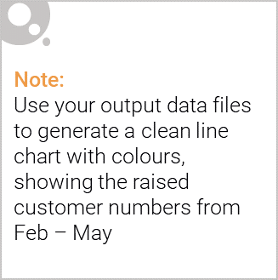
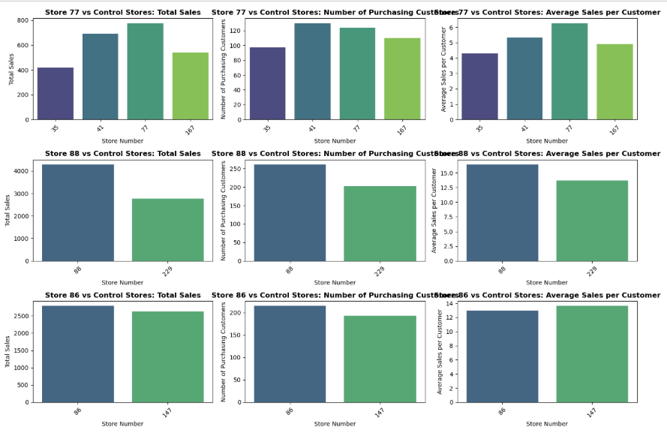
Performance of trail stores to its respected control store

Slide 11
Conclusion & Recommendations
The customer analytics revealed that Kettle, Smiths, and Doritos are the most preferred brands across different life-stages. Older customers favor premium brands like stock adjustments to maximize sales.
The trial store analysis showed mixed results. Store 88 saw significant sales growth, proving the campaign’s success. Store 86 had moderate improvements, while Store 77 showed no noticeable difference compared to its control stores, indicating the campaign had minimal impact there.
Recommendations
✅ Enhance targeted marketing:
Promote premium brands (Kettle, Smiths) to older customers.
Offer bundle deals on Doritos & Pringles to attract younger consumers.
✅ Optimize store inventory:
Increase stock for top-selling brands in high-performing stores.
Reduce shelf space for low-selling brands to improve efficiency.
✅ Refine the campaign strategy:
Identify factors that led to Store 88’s success and apply them to other locations.
Test alternative promotional methods in underperforming stores (e.g., localized offers, in-store displays).

