Slide 1

MINIOR PROJECT-6th SEM Under the Guidance of Prof . Shivaling Hungund
Smart Agriculture Powered by Intelligence Robot
Department of Electronic and Communication,
KLE Technological University’s Dr. M. S. Sheshgiri College of Engineering and Technology, Belagavi

Slide 2
Details of the Team
Div: |  | B
Sl. No. | Name |  | SRN.
1 | SANSKRUTI MIRAJKAR |  | 02FE22BEC084
2 | SHRAMAN KANTHI |  | 02FE22BEC092
3 | SWATI PATIL |  | 02FE22BEC112
4 | DARSHAN MODEKAR |  | 02FE22BEC119

Slide 3
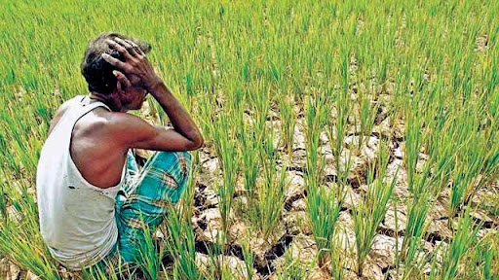
PROBLEM FACED BY FARMERS
In traditional farming, seed sowing is mostly done manually, which is time-consuming, physically tiring, and often results in uneven seed placement. Many farmers rely on personal experience or local advice to choose crops, which may not suit current soil or weather conditions—leading to poor yield. Additionally, farmers face increasing challenges due to labor shortages and high costs during sowing seasons, making the process inefficient and expensive.
Manual Sowing Time: ~12 hours per acre
Seed Wastage (Traditional): ~25% due to irregular spacing
Wrong Seed Selection: Contributes to ~20–30% yield reduction
Labor Cost (Traditional): ₹3000–₹4000 per acre during sowing season

Slide 4
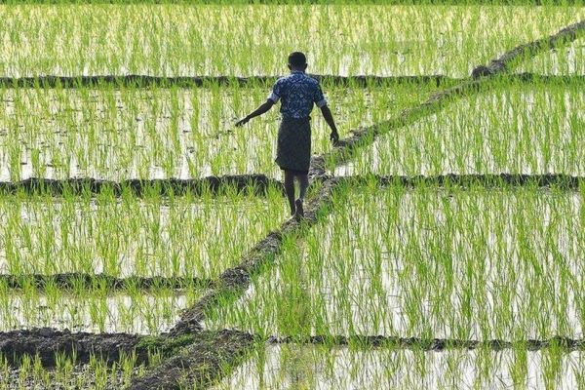
OUR PROPOSED SOLUTION
Smart agriculture uses robotics and AI/ML to tackle traditional farming challenges like labor shortages, unpredictable weather, and inefficient resource use.
Intelligent robots with sensors and platforms like ThingSpeak monitor crop health and soil conditions in real time.
Precision farming leverages data-driven insights for efficient crop management and sustainable practices.
The integration of robotics and agriculture enhances productivity, minimizes environmental impact, and ensures a resilient food system.

Slide 5
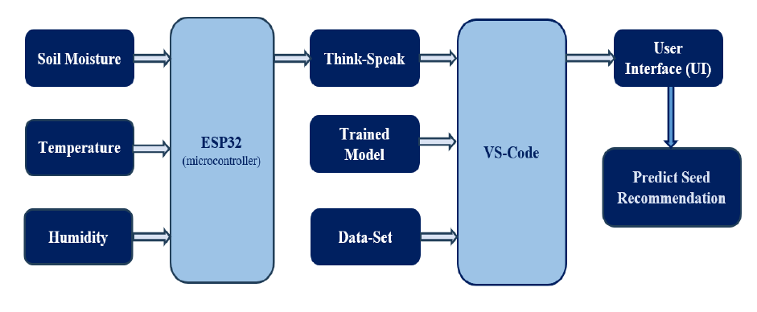
FUNCTIONAL BLOCK DIAGRAM

Slide 6
FUNCTIONAL BLOCK DIAGRAM
Seed Sowing System
Motor Driver
Arduino UNO
(microcontroller)
Measure Distance
Vehicle Control
Seed Sowing Mechanism
Seed Sowing

Slide 7
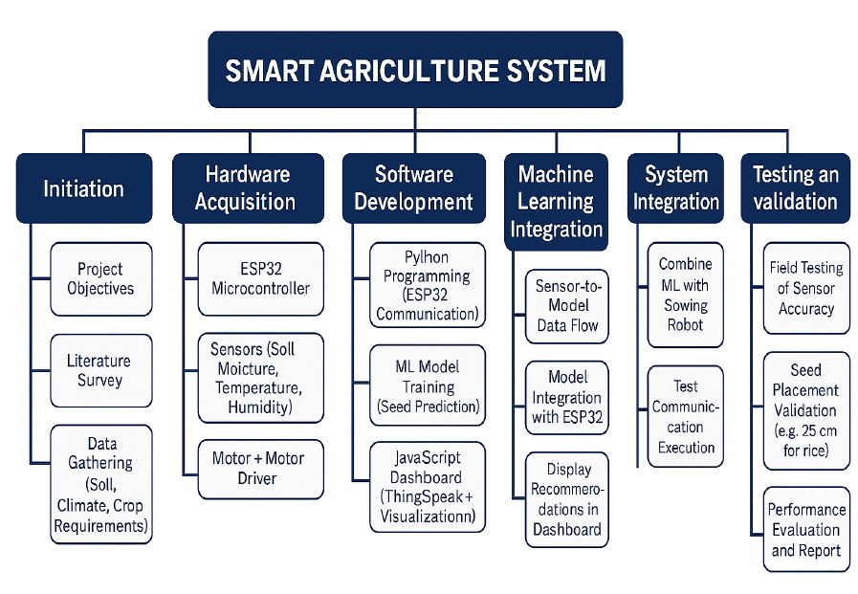
WORK BREAKDOWN STRUCTURE (WBS)

Slide 8
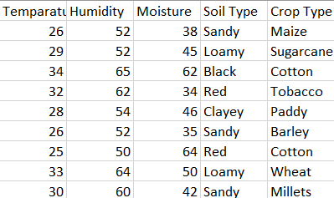
SEED PLACEMENT AND CROP DATASET
SL NO. | CROP | DISTANCE REQUIRED | DISTANCE
1. | Barley | 15-20 cm | Approx 20 cm
2. | Cotton | 30-45 cm | Approx 40 cm
3. | Groundnut | 10-15 cm | Approx 15 cm
4. | Maize | 20-25 cm | Approx 25 cm
5. | Rice | 20-25 cm | Approx 25 cm
6. | Wheat | 10-15 cm | Approx 15 cm
7. | Pulse | 15 cm | Approx 15 cm
Seed Placement
Crop Placement

Slide 9
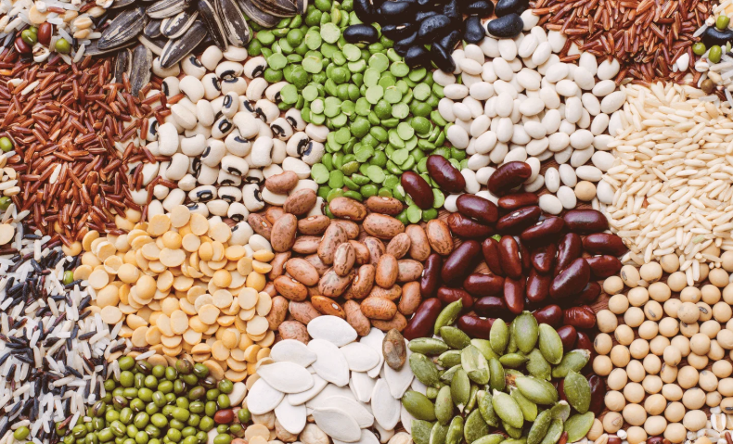
SPECIFICATION AND IDENTIFICATION
HARDWARE REQUIREMENT
ESP32 & Arduino UNO : Core AI processing unit.
DC Motors + Wheels : Movement of robot.
Motor Driver: Controls motor.
Servo Motor : Control Seed Dispenser.
Battery : 3.7 Lithium Ion Battery.
Sensors : Humidity, Temperature, Moisture.
SOFTWARE REQUIREMENT
AI/ML Model - To analyze sensor data and recommend suitable crops based on soil type using a trained machine learning model.
Arduino IDE - Implementation of code.
ThingSpeak – Predicting the parameters.
VS Code

Slide 10
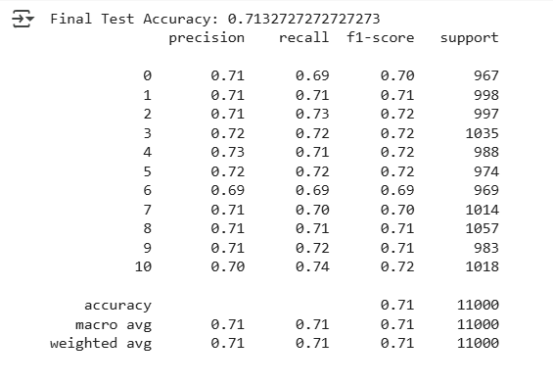
MODEL TRAINING
The dataset has 55,001 entries with 4 features: temperature (°C), humidity, soil moisture, and crop type label.
Crop types include rice, wheat, maize, etc.
Data preprocessing involved normalizing features and handling missing values.
The dataset was split: 80% for training, 20% for testing.
A Random Forest model was trained, achieving about 70% accuracy.
The trained model is saved as a .pkl file for use in a JavaScript interface

Slide 11
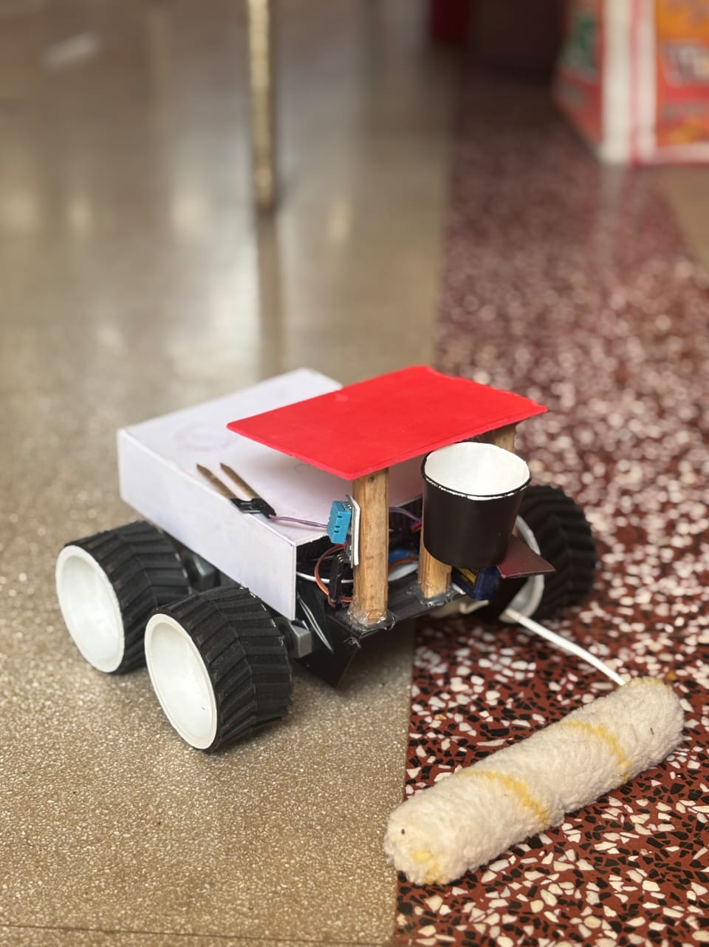
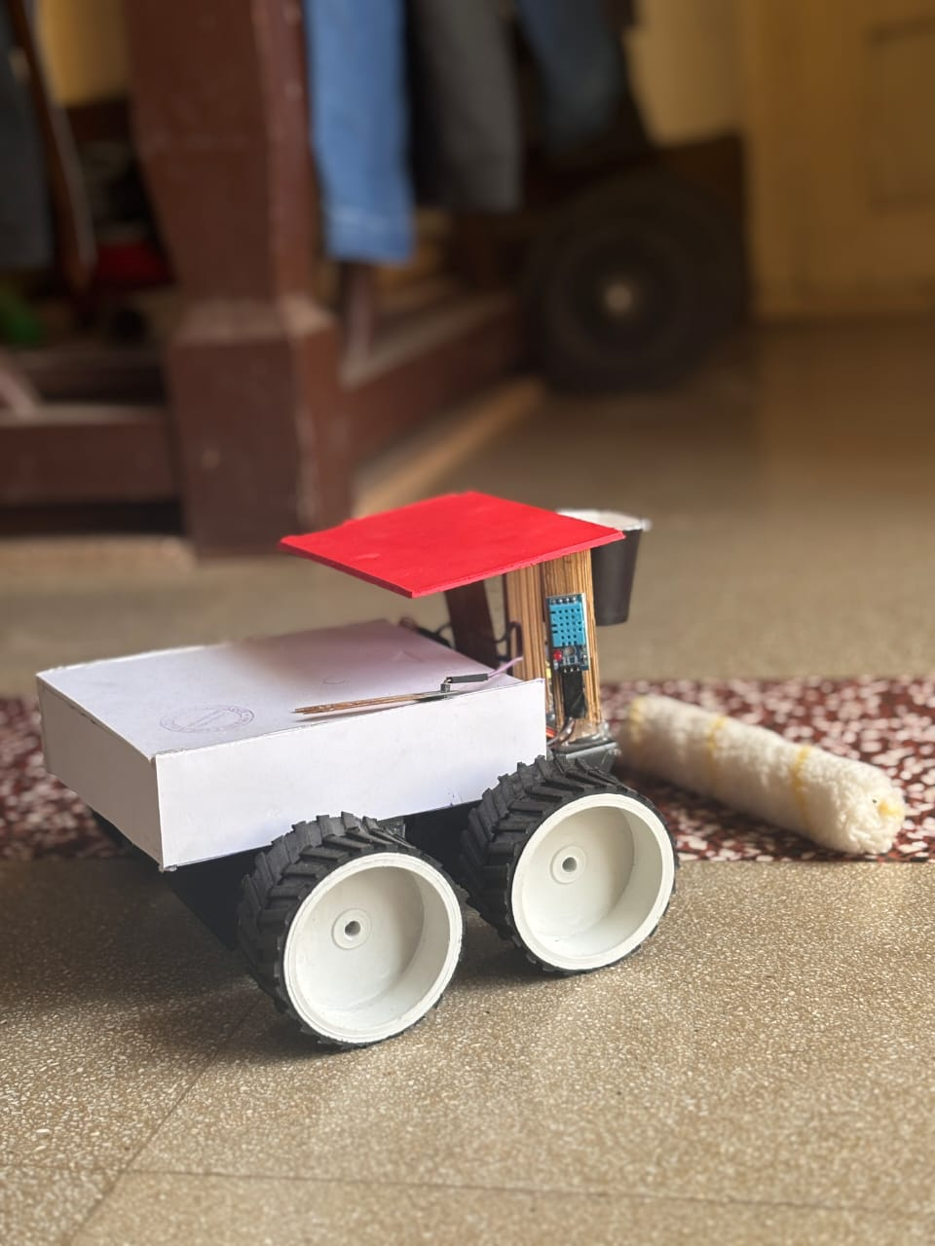
DEMOSTRASTION OF THE RESULT
HARDWARE IMPLEMENTATION

Slide 12
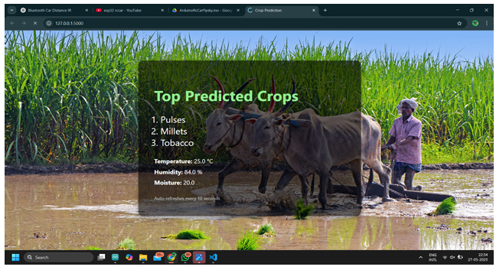
DEMOSTRASTION OF THE RESULT
SOFTWARE IMPLEMENTATION

Slide 13
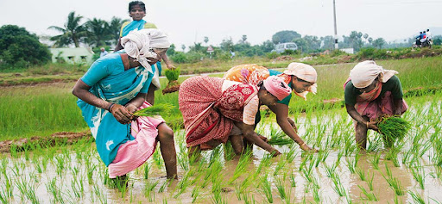
CONCLUSION
Smart Agriculture System: Combines IoT, machine learning, and automation for crop prediction and seed sowing.
Real-time Data Use: Uses soil moisture, temperature, and humidity to recommend suitable crops with ~70% accuracy.
Interface: JavaScript-based UI connected to ESP32 via ThingSpeak for user-friendly recommendations.
Autonomous Seed Sowing: Low-cost vehicle uses motor timing instead of sensors for precise seed placement.
Scalable & Affordable: Designed for small/medium-scale farmers, promoting sustainable and efficient farming.

Slide 14
THANK-YOU

