Slide 1
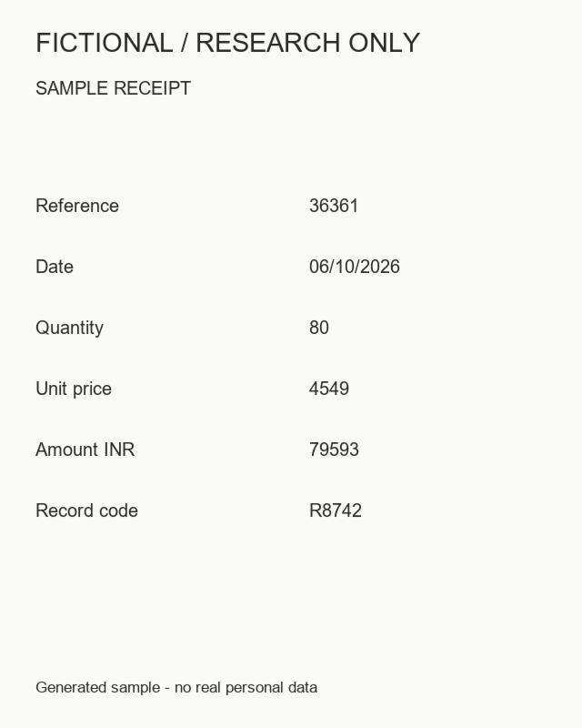
DOCGUARD
01
KIET Deemed to be University
DocGuard
Document tampering
localization
CNN and Transformer comparison
Synthetic receipt used in the experiment
Deep Learning and GenAI · CS312B
B.Tech CS · Semester 5 · Section D
Notes:
Introduce the team and project. This is a research prototype using synthetic documents. No production fraud detection claim.

Slide 2
DOCGUARD
02
The team
Deep Learning and GenAI · CS312B
Shrashti Agarwal
2400290120240
Saumya Tiwari
2400240120230
Subrat Singh
2400290120250
KIET Deemed to be University / B.Tech CS / Semester 5 / Section D
Notes:
DocGuard, CS312B, KIET Deemed to be University. All measurements are preliminary synthetic dataset results. Source: local experiment artifacts.

Slide 3
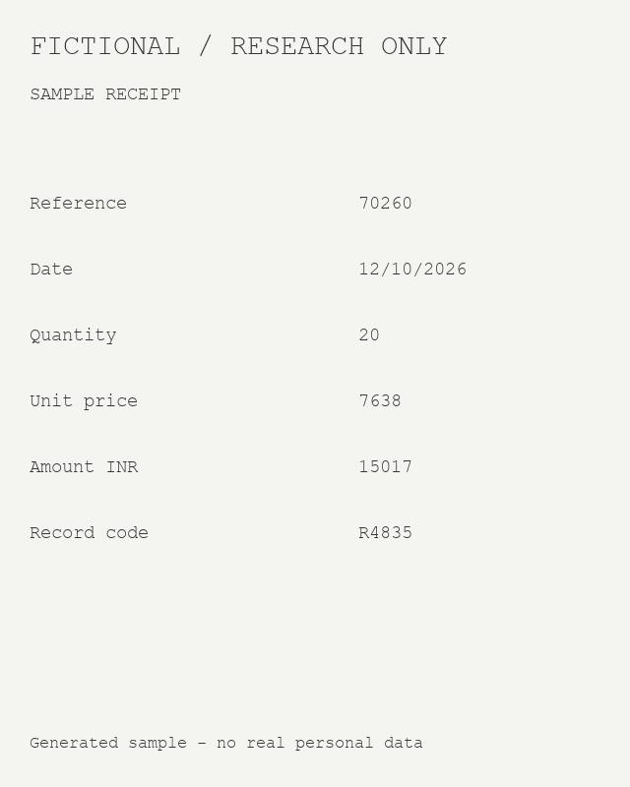
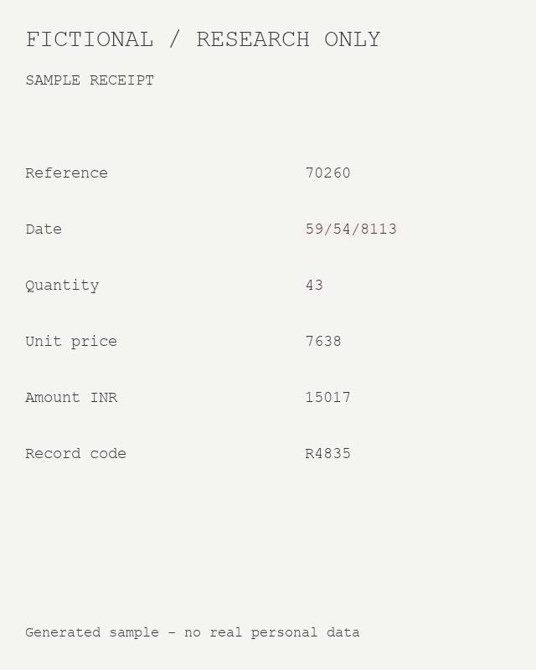
DOCGUARD
03
Where did the document change?
The review needs a location, not just a page label.
Task
Predict a mask
for suspicious
regions.
Controlled study on
fictional receipts.
Original
Edited
Notes:
DocGuard, CS312B, KIET Deemed to be University. All measurements are preliminary synthetic dataset results. Source: local experiment artifacts.

Slide 4
DOCGUARD
04
The review pipeline
A local workflow from upload to downloadable evidence.
01
02
03
04
→
→
→
Document
Preprocess
Segment
Review
Image or PDF
Selected page
Normalize
160 × 200
CNN or MiT B0
Pixel scores
Overlay and heatmap
PNG · PDF · ZIP
Notes:
Inference runs on local CPU. Thresholds were selected on validation data and fixed during test evaluation. Predicted area is not a fraud probability.

Slide 5
DOCGUARD
05
1,200 images. One controlled benchmark.
600 fictional source receipts, each with an authentic and edited version.
840
180
180
Training images
Validation images
Test images
Source identities and layout configurations are disjoint across splits.
Four fonts · six editable fields · rectangular edit masks
JPEG and blur acquisition variation applied to both labels
Notes:
DocGuard, CS312B, KIET Deemed to be University. All measurements are preliminary synthetic dataset results. Source: local experiment artifacts.

Slide 6
DOCGUARD
06
Two routes to a pixel mask
The same data split and output task; different feature extractors.
Compact CNN
MiT B0 Transformer
30,081
3,349,377
parameters
parameters
Local feature extraction
Encoder and decoder with skip connections
ImageNet pretrained encoder
Custom multiscale binary decoder
Notes:
CNN inspired by U-Net, not the full original U-Net. Transformer uses nvidia/mit-b0 with a custom decoder, not an untouched official SegFormer head. Frozen and full fine tuning were evaluated. References: https://arxiv.org/abs/1505.04597 ; https://arxiv.org/abs/2105.15203 ; https://huggingface.co/nvidia/mit-b0 . No GAN was trained.

Slide 7
DOCGUARD
07
Training kept the comparison controlled
Preliminary CPU runs on a laptop.
3
160 × 200
8
Epochs per model
Input width × height
Batch size
Binary cross entropy + positive document Dice loss
Seed 42 · checkpoint and thresholds selected on validation data
Longer, higher resolution Colab experiments are planned, not executed.
Notes:
DocGuard, CS312B, KIET Deemed to be University. All measurements are preliminary synthetic dataset results. Source: local experiment artifacts.

Slide 8
DOCGUARD
08
CNN led the preliminary pixel F1 results
Higher is better. Global metrics on 180 held out test images.
0.2460
Best pixel F1
Compact CNN
Pretraining alone did not
improve this experiment.
Notes:
Actual global pixel F1 values: CNN 0.2460103262, frozen Transformer 0.2194730745, full fine tuned Transformer 0.2288149574. Source deliverables/model_comparison.json. Native editable chart.

Slide 9
DOCGUARD
09
False positives remain the main barrier
Authentic pages incorrectly flagged by the current document rule.
90 / 90
77 / 90
CNN · 100% false flags
Fine tuned Transformer · 85.6%
Flag rule: predicted foreground ≥ 0.1% of the model grid.
Highlighted area is not a fraud probability.
Notes:
DocGuard, CS312B, KIET Deemed to be University. All measurements are preliminary synthetic dataset results. Source: local experiment artifacts.

Slide 10
DOCGUARD
10
The evidence behind the comparison
Precision, recall and IoU explain the weak localization results.
Model | Precision | Recall | F1 | IoU
CNN | 0.1878 | 0.3565 | 0.2460 | 0.1403
Frozen Transformer | 0.1330 | 0.6283 | 0.2195 | 0.1233
Fine tuned Transformer | 0.1691 | 0.3538 | 0.2288 | 0.1292
Low precision means many highlighted pixels are false positives.
Notes:
Source runs/*/test_metrics.json and deliverables/model_comparison.json. Aggregate pixel counts, not per-image averaged accuracy.

Slide 11
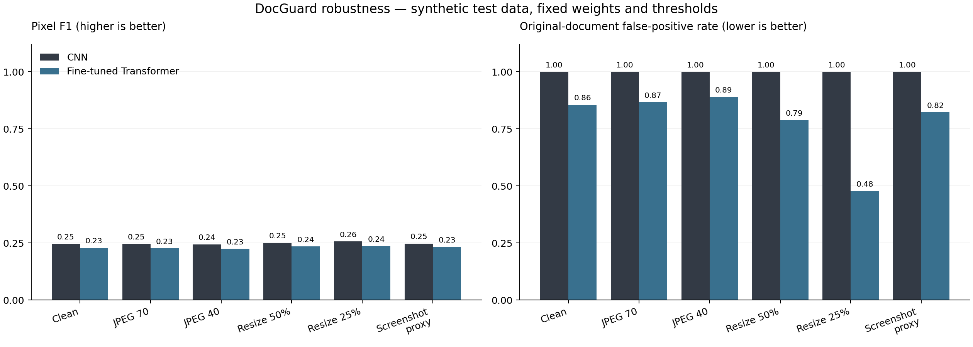
DOCGUARD
11
Robustness across six conditions
Fixed weights and validation thresholds; high false positives remain.
The screenshot condition is simulated. Small F1 gains do not establish reliability.
Notes:
DocGuard, CS312B, KIET Deemed to be University. All measurements are preliminary synthetic dataset results. Source: local experiment artifacts.

Slide 12
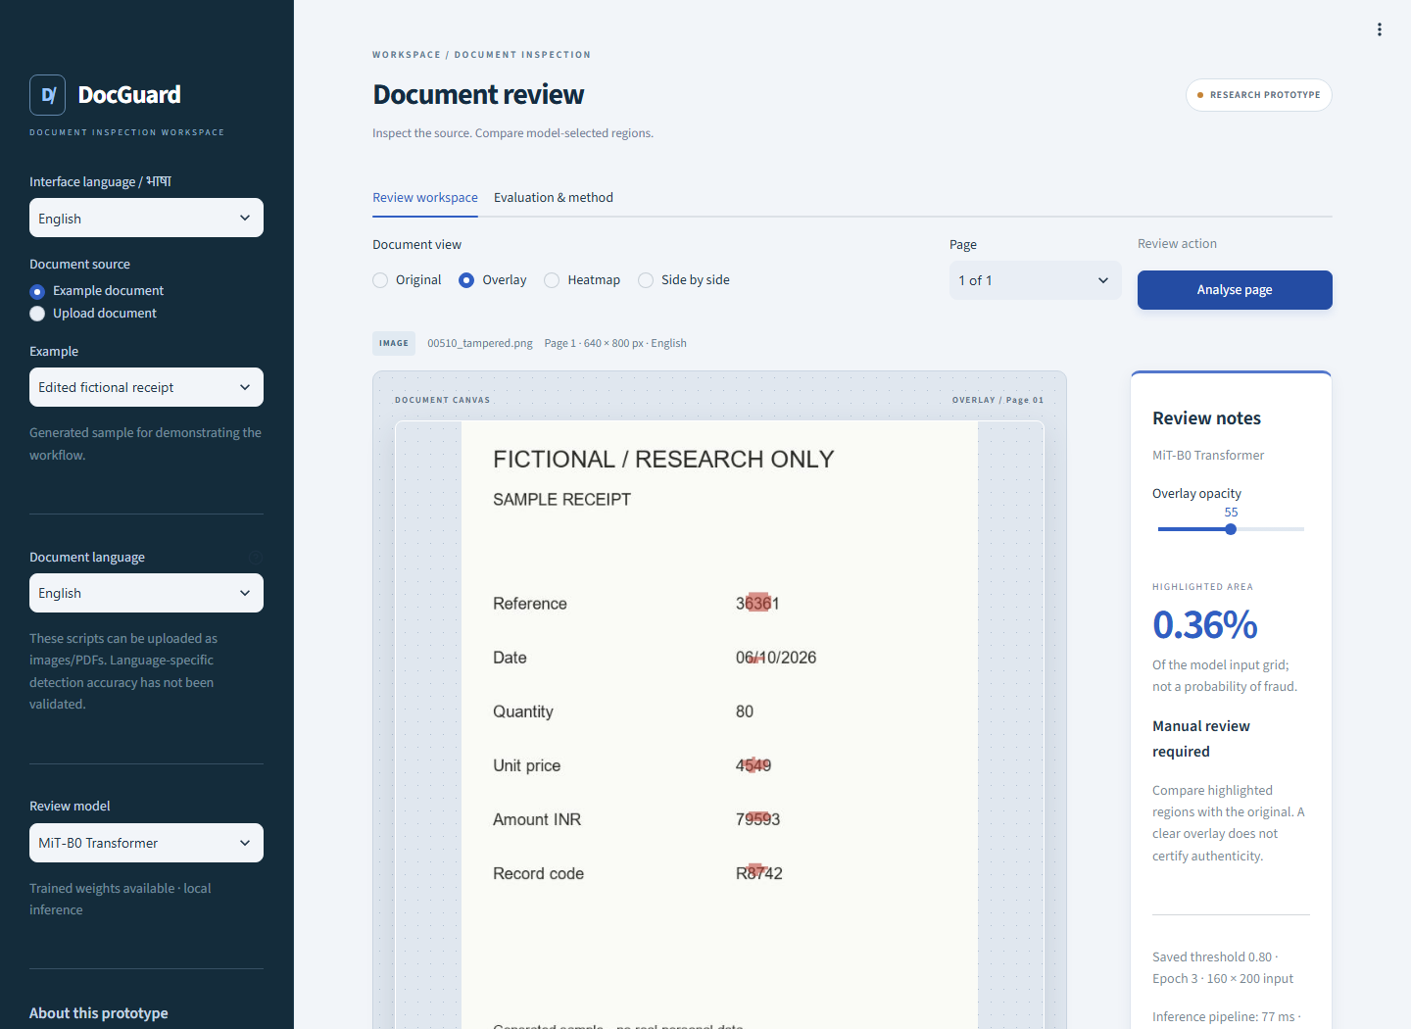
DOCGUARD
12
A complete document review workspace
Image and PDF upload · model comparison · exportable review evidence
Local CPU
Overlay
Heatmap
Side by side
PNG
PDF
Review ZIP
Notes:
DocGuard, CS312B, KIET Deemed to be University. All measurements are preliminary synthetic dataset results. Source: local experiment artifacts.

Slide 13
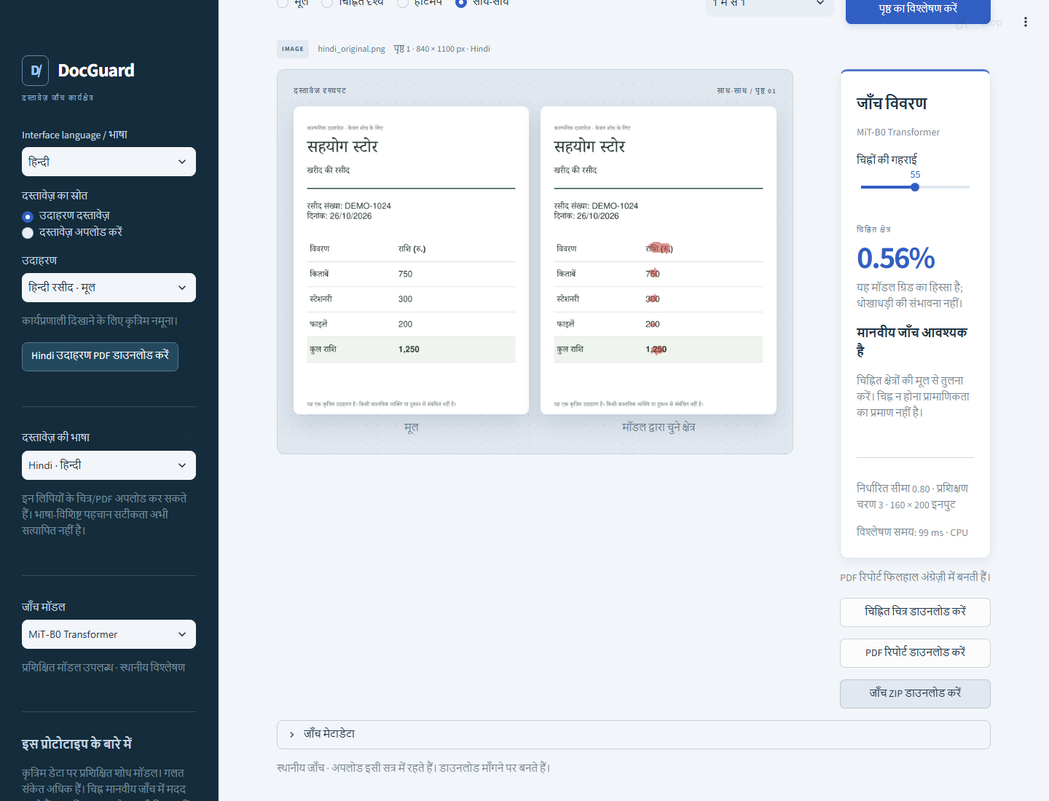
DOCGUARD
13
Regional languages in one review
The current document and results stay available when the interface switches.
English
Hindi
Marathi
Tamil
Bengali
Hindi PDF examples included.
No OCR or translation.
Language accuracy is unvalidated.
Notes:
DocGuard, CS312B, KIET Deemed to be University. All measurements are preliminary synthetic dataset results. Source: local experiment artifacts.

Slide 14
DOCGUARD
14
Demonstration and next steps
A reproducible project with a measured, clearly stated limitation.
Live demonstration
Next experiments
Analyse an edited receipt
Compare both model overlays
Upload a Hindi PDF and export
Explain an authentic false positive
Licensed real documents
Higher resolution and longer training
Independent calibration
Real camera and scanner evaluation
14 unit checks passed · 14 browser flows · 7 language checks
Notes:
These are proposed next steps, not achieved improvements. CPU forward medians: CNN 19.70 ms and Transformer 34.65 ms, four threads, batch one, three warmups and twenty repeats; not end to end app timings. Repository https://github.com/Shrashti1234/Docguard. Architecture references https://arxiv.org/abs/1505.04597 and https://arxiv.org/abs/2105.15203 .

