Slide 1
DOCGUARD / CS312B
DocGuard
Document tampering localization
CNN and Transformer comparison
Deep Learning and GenAI | CS312B
B.Tech CS | Semester 5 | Section D
Shrashti Agarwal · 2400290120240
Saumya Tiwari · 2400240120230
Subrat Singh · 2400290120250
KIET Deemed to be University 1

Slide 2
DOCGUARD / CS312B
The problem
A page label does not explain where an edit occurred.
Goal: predict suspicious regions and make them reviewable.
Scope: controlled research on synthetic receipts.
Real document detection accuracy is not established.
KIET Deemed to be University 2

Slide 3
DOCGUARD / CS312B
From document to review
Upload image or PDF → select page
Normalize and resize → CNN or Transformer
Pixel scores → fixed validation threshold
Overlay and heatmap → PNG, PDF and ZIP exports
KIET Deemed to be University 3

Slide 4
DOCGUARD / CS312B
A controlled synthetic dataset
600 fictional receipt sources → 1,200 images
840 train / 180 validation / 180 test
Source identities and layout configurations are disjoint.
Authentic and edited images share acquisition variation.
Masks label edited rectangles, not individual characters.
KIET Deemed to be University 4
Notes:
Source: docs/DATASET.md and data/synthetic_v2. DocTamper was considered but not used.

Slide 5
DOCGUARD / CS312B
Two segmentation approaches
Compact CNN
30,081 parameters; local feature extraction and skip connections.
MiT B0 Transformer plus custom multiscale decoder
3,349,377 parameters; ImageNet pretrained encoder.
Compared frozen encoder and full fine tuning. No GAN trained.
KIET Deemed to be University 5
Notes:
Architecture references: https://arxiv.org/abs/1505.04597 and https://arxiv.org/abs/2105.15203. Encoder: https://huggingface.co/nvidia/mit-b0. Custom decoder differs from official SegFormer head.

Slide 6
DOCGUARD / CS312B
Training and fair evaluation
Three CPU epochs | 160 × 200 input | batch 8 | seed 42
Binary cross entropy plus positive document Dice loss.
Checkpoint and thresholds selected on validation data.
Global pixel precision, recall, F1 and IoU on 180 test images.
Planned longer Colab training has not been executed.
KIET Deemed to be University 6

Slide 7
DOCGUARD / CS312B
Actual test results
Model | Precision | Recall | F1 | IoU
CNN | 0.1878 | 0.3565 | 0.2460 | 0.1403
Frozen Transformer | 0.1330 | 0.6283 | 0.2195 | 0.1233
Fine tuned Transformer | 0.1691 | 0.3538 | 0.2288 | 0.1292
The Transformer did not outperform CNN global pixel F1.
KIET Deemed to be University 7
Notes:
Sources: deliverables/model_comparison.json and runs/*/test_metrics.json. Global aggregate pixel metrics, not averaged per-image accuracy.

Slide 8
DOCGUARD / CS312B
False positives are the main limitation
Authentic test pages incorrectly flagged
CNN: 90 / 90 · 100%
Fine tuned Transformer: 77 / 90 · 85.6%
Flag rule: at least 0.1% of model pixels predicted positive.
Highlighted area is not a fraud probability.
KIET Deemed to be University 8

Slide 9
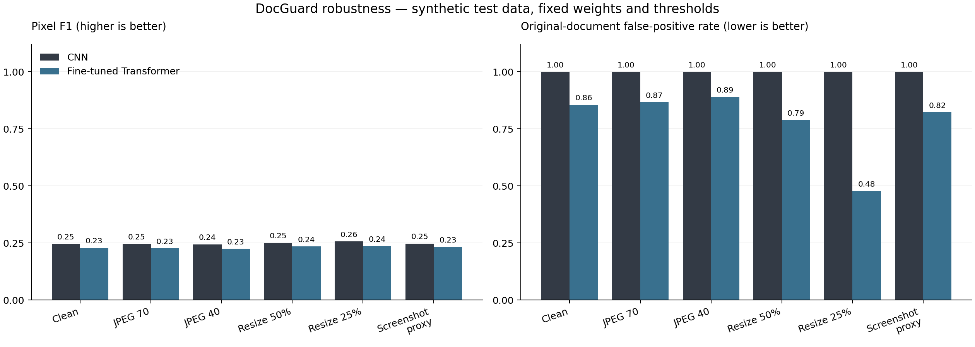
DOCGUARD / CS312B
Robustness under acquisition changes
JPEG, down and up resizing, and simulated screenshot acquisition.
KIET Deemed to be University 9
Notes:
Source: deliverables/robustness/results.json. Fixed weights and thresholds, 180 images per condition per model. Screenshot proxy is simulated.

Slide 10
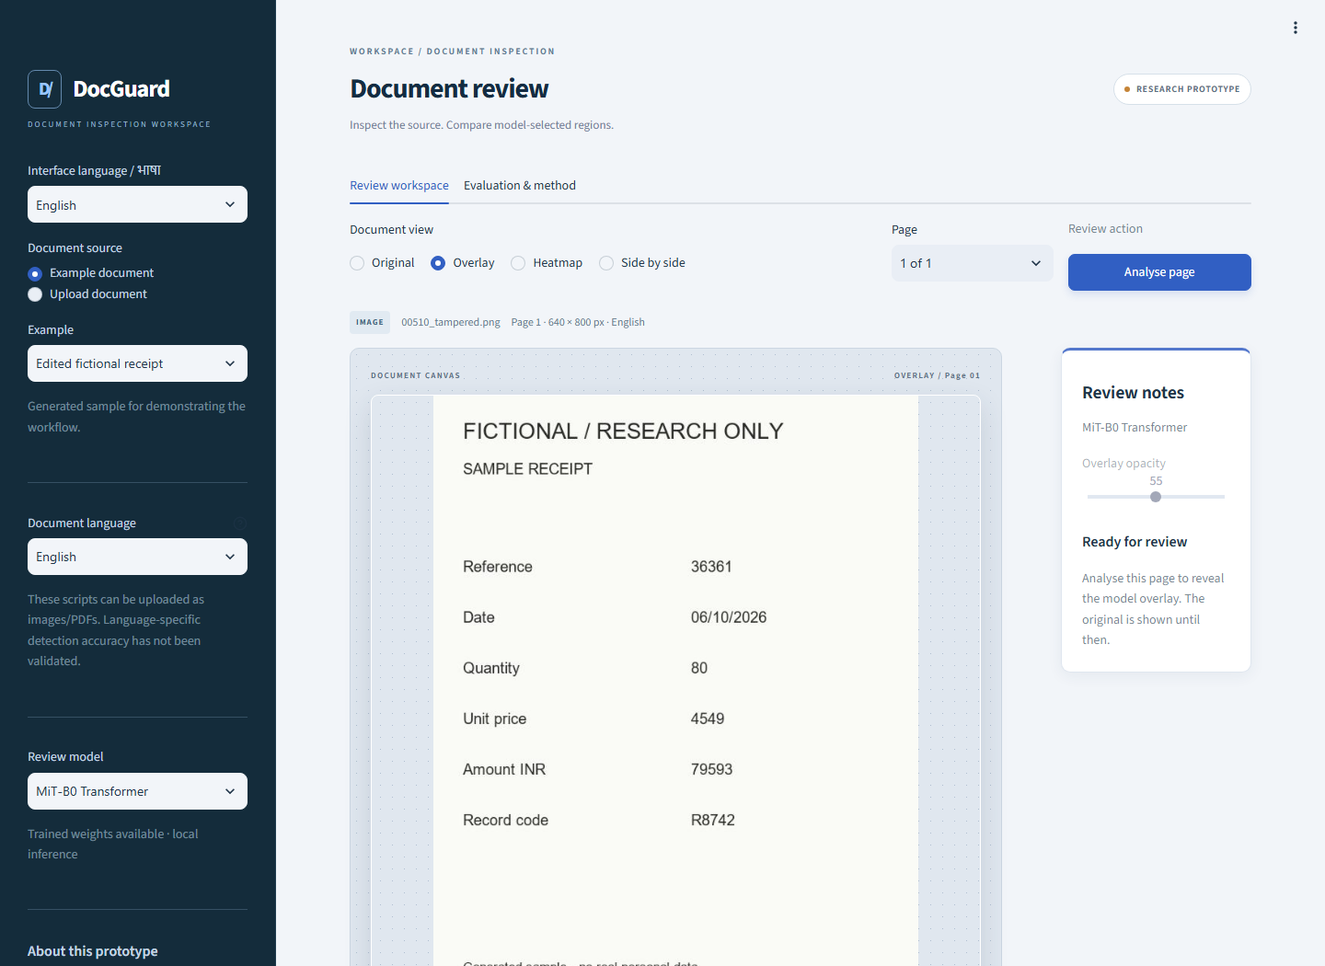
DOCGUARD / CS312B
A working local review application
KIET Deemed to be University 10

Slide 11
DOCGUARD / CS312B
Regional language workflow
Interface: English, Hindi, Marathi, Tamil and Bengali.
Hindi PDF and regional language examples are included.
Language switches preserve the current review.
No OCR or translation is performed.
Language specific detection accuracy remains unvalidated.
KIET Deemed to be University 11

Slide 12
DOCGUARD / CS312B
Five minute demonstration
1. Analyse an edited English sample using CNN.
2. Compare the Transformer overlay.
3. Upload the supplied Hindi PDF.
4. Switch interface language and export the review.
5. Explain an authentic page false positive.
KIET Deemed to be University 12
Notes:
Use docs/TEAM_SETUP_AND_VIVA.md. Never interpret positive area as probability or present this prototype as certification.

Slide 13
DOCGUARD / CS312B
Verification and reproducibility
14 unit checks passed.
14 browser flows and 7 language checks passed.
Source, trained weights, splits and metrics are supplied.
CPU model forward medians: CNN 19.70 ms; Transformer 34.65 ms.
These timings exclude application and PDF processing.
KIET Deemed to be University 13
Notes:
Timing: CPU four threads, batch one, three warmups, twenty repetitions. Test evidence in deliverables/app_preview.

Slide 14
DOCGUARD / CS312B
What the project establishes
A reproducible CNN and Transformer experiment.
A complete local document review workflow.
A clear account of weak detection performance.
Next: licensed real documents, higher resolution,
longer training and independent calibration.
KIET Deemed to be University 14
Notes:
References: https://arxiv.org/abs/1505.04597 ; https://arxiv.org/abs/2105.15203 ; https://huggingface.co/nvidia/mit-b0 . Repository https://github.com/Shrashti1234/Docguard. Proposed improvements are not measured results.

