Slide 1

IBM AICT PROJECT
Eco Lifestyle Agent
Presented By:
College Name & Department :
Shravan Dipak Shinde
MIT Academy of Engineering, Pune Computer Science and Engineering

Slide 2
OUTLINE
Problem Statement
Technology used
Wow factor
End users
Result
Conclusion
Future scope
Git-hub Link
IBM Certificate

Slide 3
Problem Statement
People face challenges in adopting sustainable practices due to lack of tailored guidance, product awareness, and understanding of local eco-policies.
Proposed Solution:
An AI-powered Eco Lifestyle Agent that leverages NLP and RAG to provide personalized sustainability suggestions, product recommendations, and region-specific eco-tips.

Slide 4
IBM cloud lite services
Natural Language Processing (NLP)
Retrieval Augmented Generation (RAG)
IBM Granite model
TECHNOLOGY USED

Slide 5
IBM Cloud Watsonx AI Studio
IBM Cloud Watsonx AI runtime
IBM Cloud Agent Lab
IBM Granite foundation model
IBM CLOUD SERVICES USED

Slide 6
- Personalized eco-tips based on user queries
- Region-specific recycling guides & schemes
- Product recommendations from verified sources
- Natural language interaction interface
- Promotes small eco actions with big impact
- Encourages long-term sustainability behavior
WOW FACTORS

Slide 7
- Environment-Conscious Citizens
- Educational Institutions
- Government & NGOs
- Green-Tech Companies
- Sustainability Advocates
END USERS

Slide 8
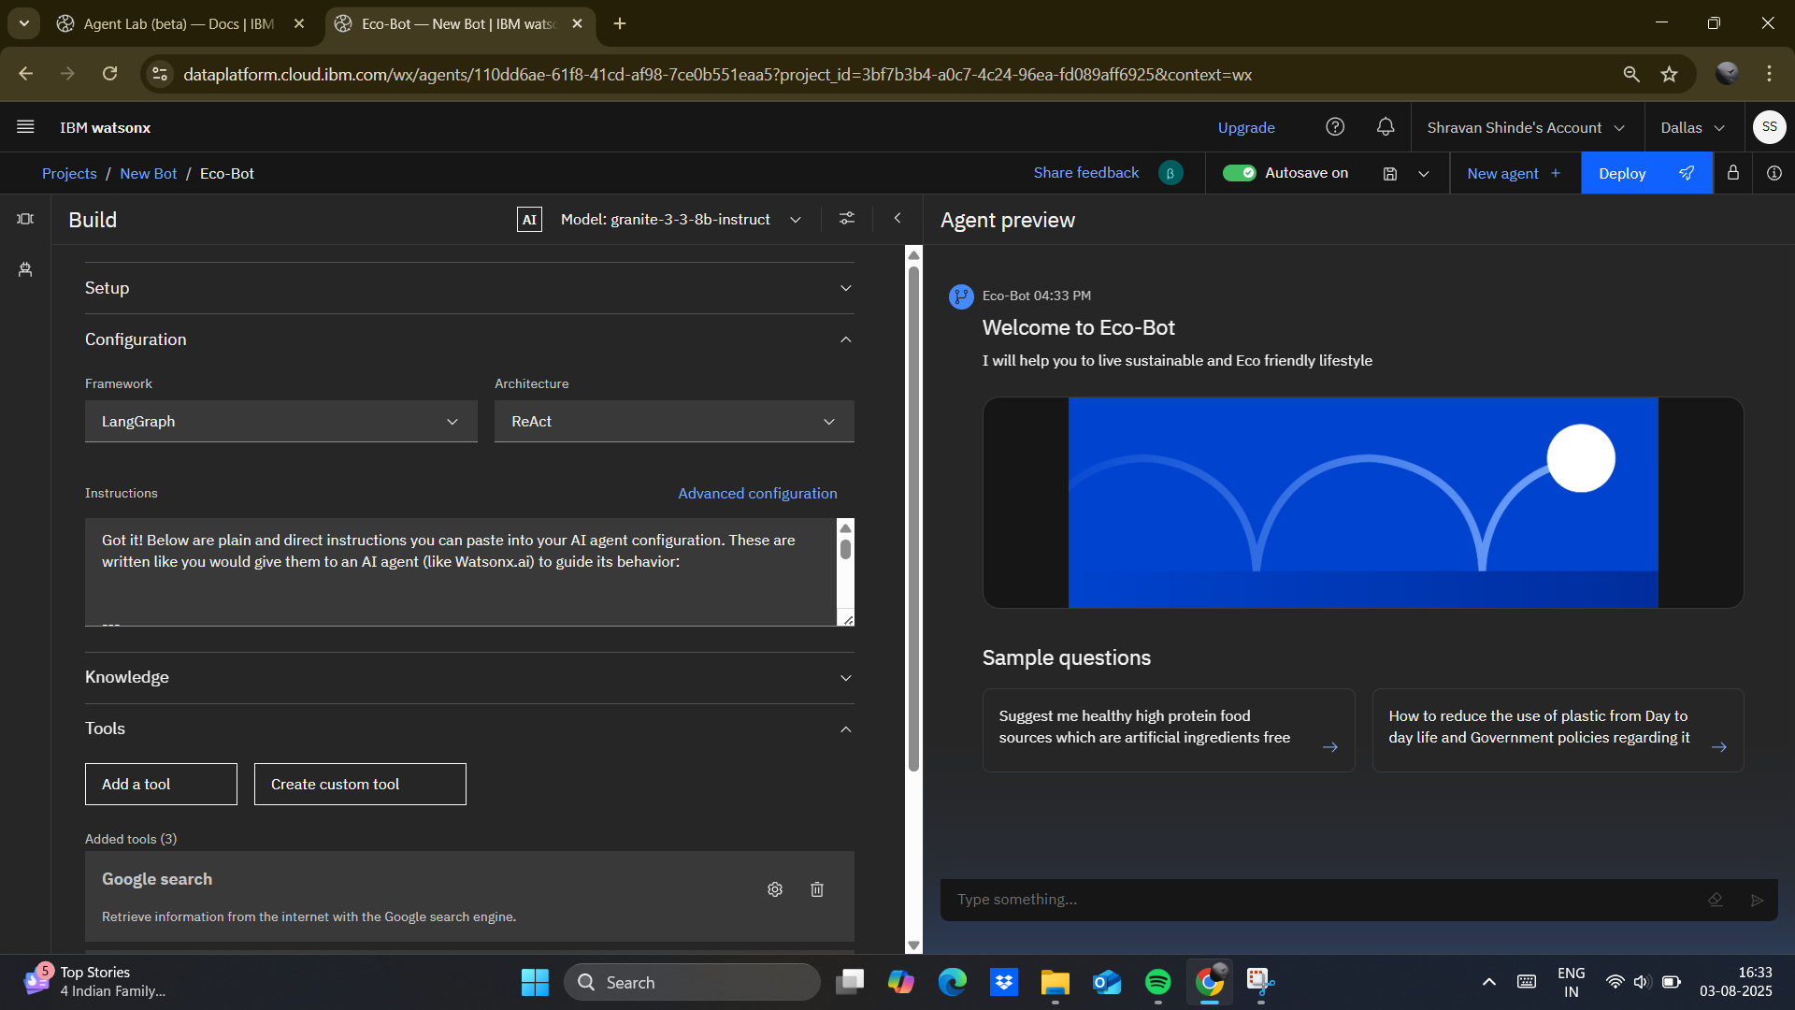
RESULTS

Slide 9
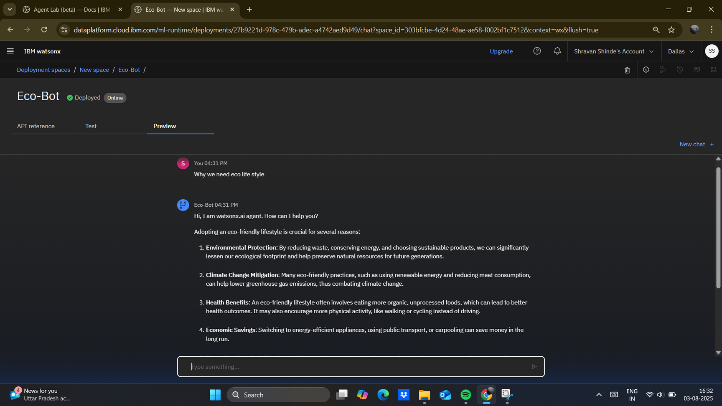
RESULTS

Slide 10
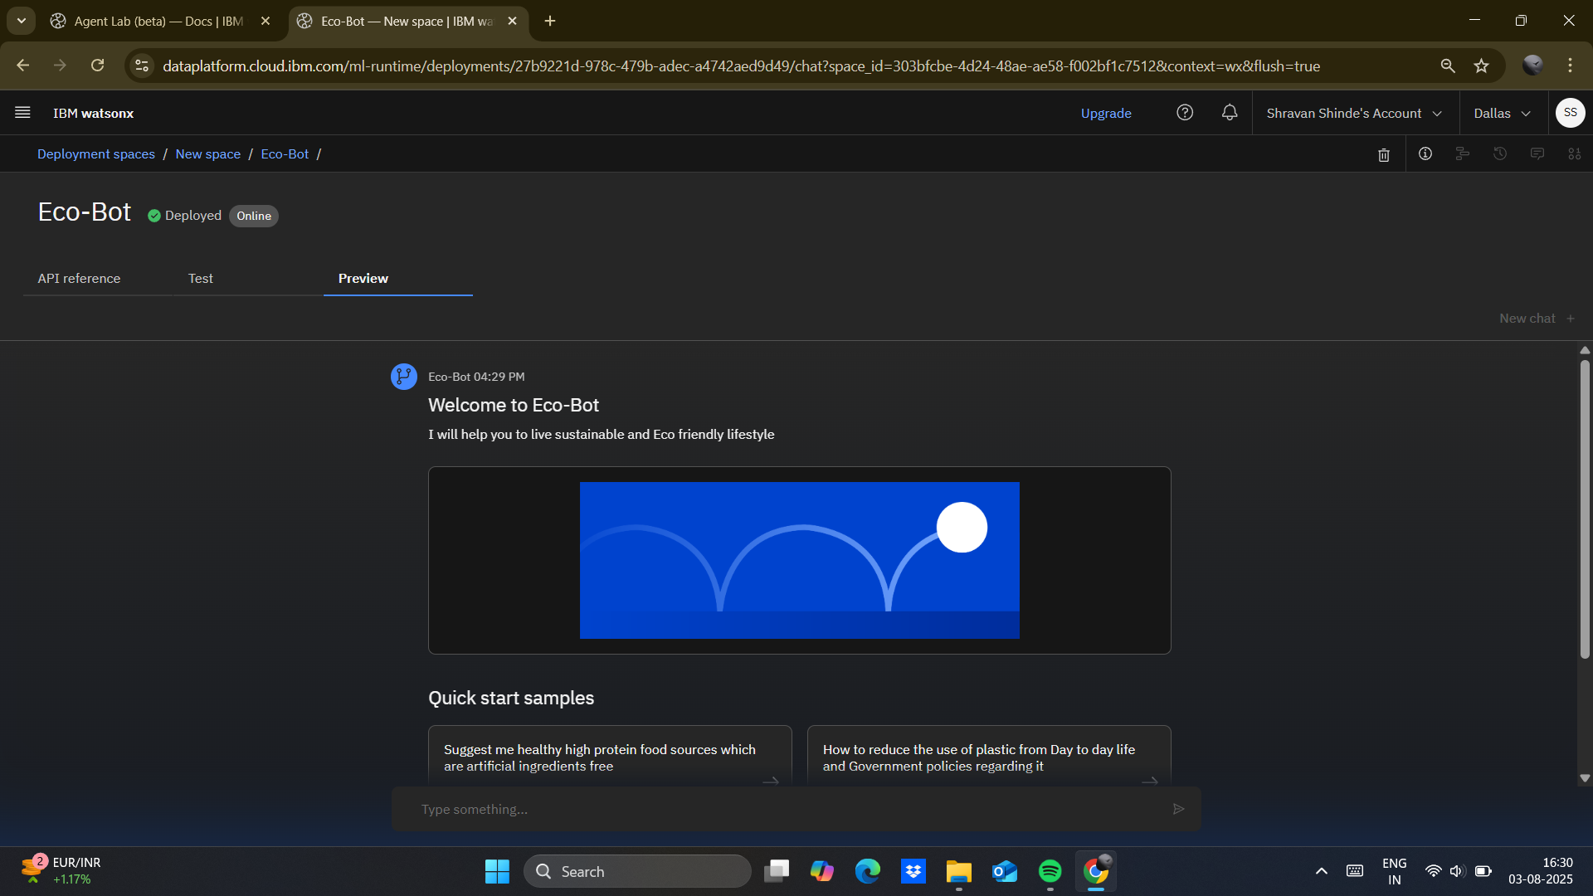
RESULTS
Deployed AI Agent

Slide 11
- Offers real-time sustainable lifestyle advice
- Reduces complexity of eco decisions
- Encourages actionable green habits
- Supports environmental literacy and policy awareness
- Promotes individual empowerment for global impact
CONCLUSION

Slide 12
FUTURE SCOPE
- Voice-Powered Eco Assistant
- Localized Multilingual Support
- Integration with Green Retail Platforms
- Carbon Footprint Tracking
- Community-Based Challenge Features
- Policy Update Notifications

Slide 13
Git hub lik :
https://github.com/Shravan2976/IBM-Eco-Bot.git

Slide 14
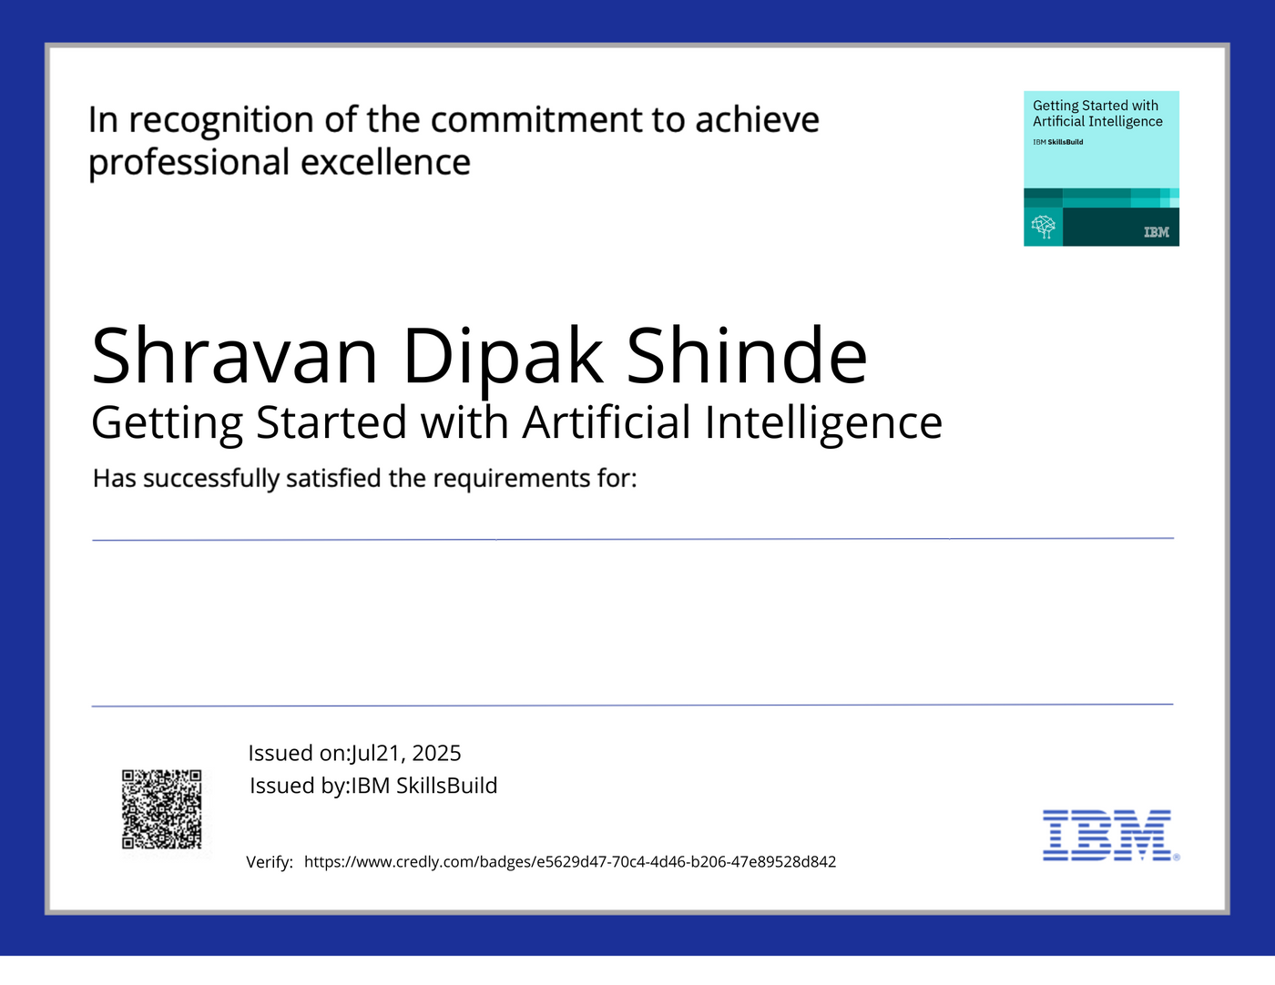
IBM Certifications

Slide 15
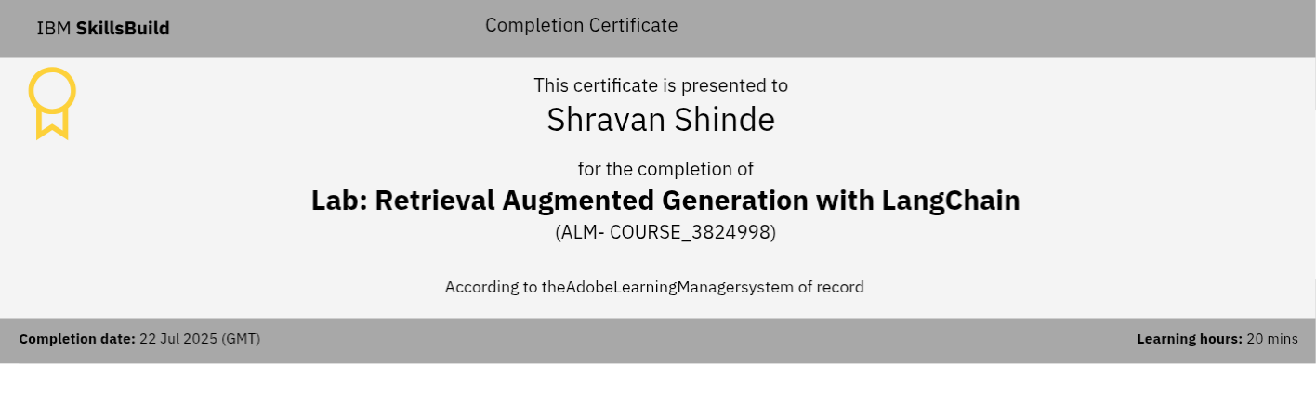

Slide 16
THANK YOU

