Slide 1

TELECOMMUNICATION

Slide 2
ABOUT ME
I AM BANDI SHRAVAN
Worked as System Engineer at Infosys for 1.6 years
Learning Data Science gives us to recognize problems and develop solutions using the existing data.

Slide 3
PROBLEM STATEMENT
Customer churn has many challenges to face
To estimate how customer churn metrics can help improve customer retension

Slide 4
LIBRARIES USED
Pandas
Matplotlib
Stats

Slide 5
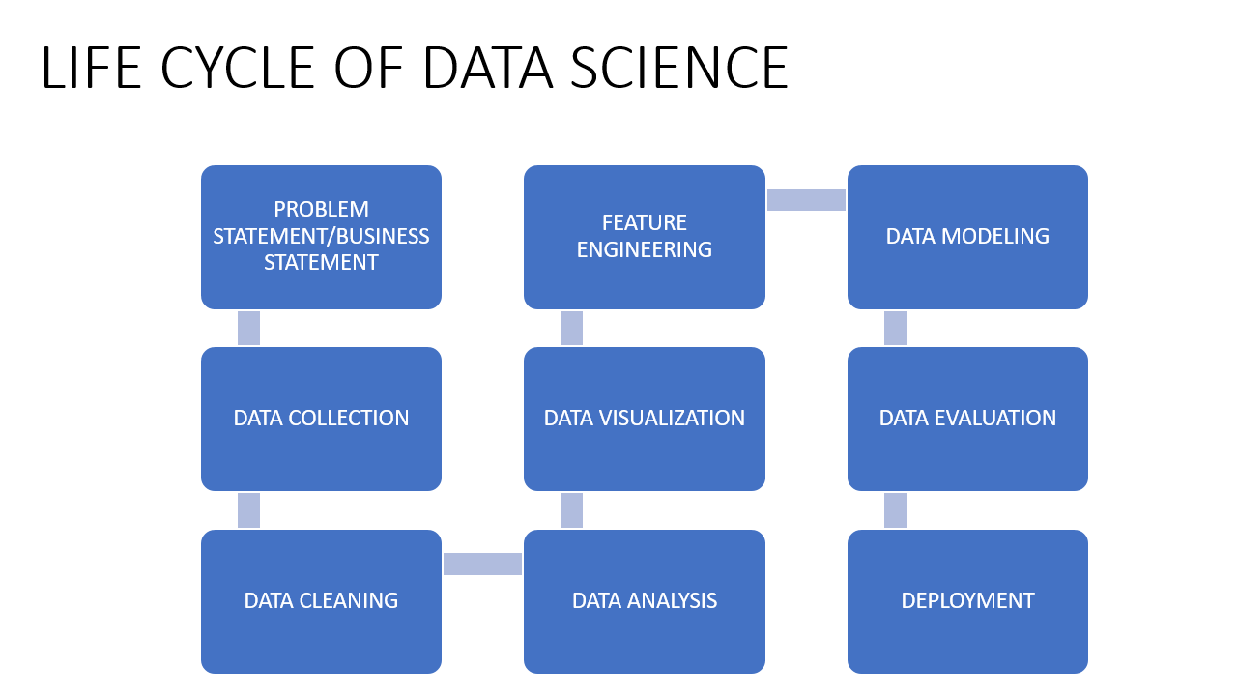

Slide 6
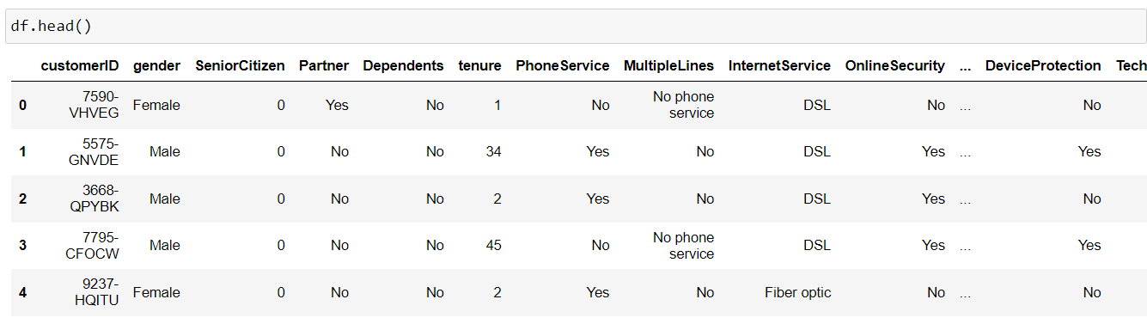
Dataset from Telecommunication

Slide 7
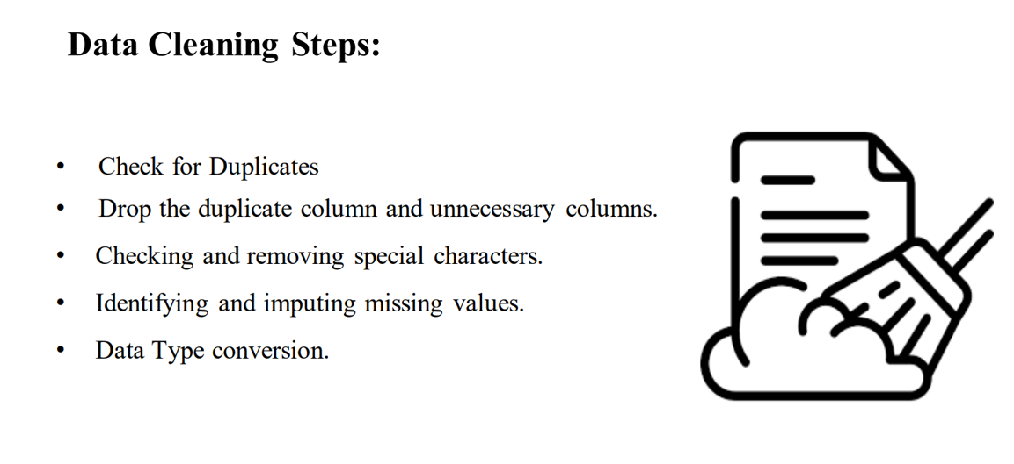

Slide 8
Data Cleaning Process:
Checked for missing values?
A) Yes, There are missing values in the given Data Frame
2) What is the shape of the data frame?
A) (7043,21)-> 7043 rows, 21 columns
3) Fix the Columns and Datatypes?
A) Yes everything is in proper order
4)How did you filed missing values?
A)Filled with median values

Slide 9
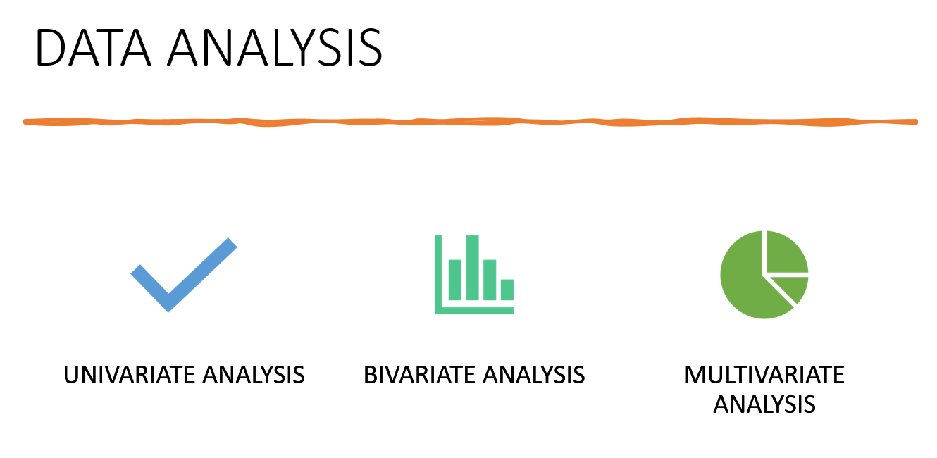

Slide 10
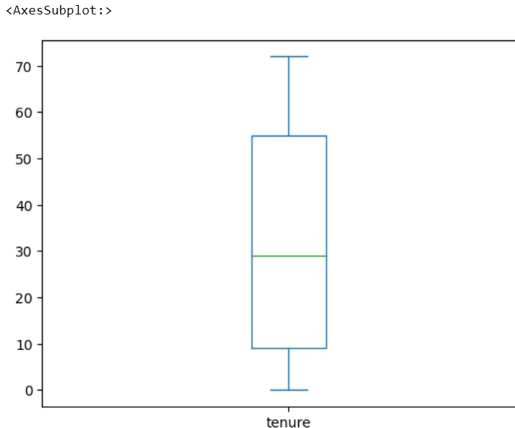
UNIVARIATE ANALYSIS
OBSERVATIONS
Tenure is in the range of 0-72.
Average tenure lies near to 32

Slide 11
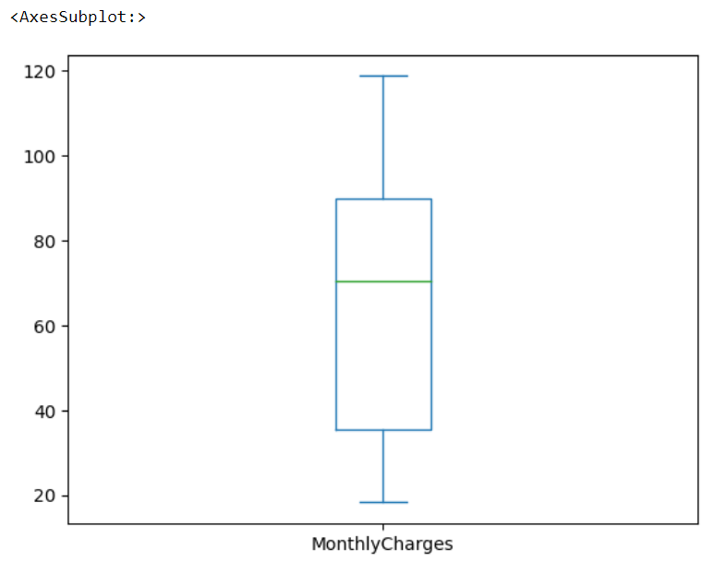
Observations
Monthly Charges lies between 18-118rs
Average monthly charges are around 64rs

Slide 12
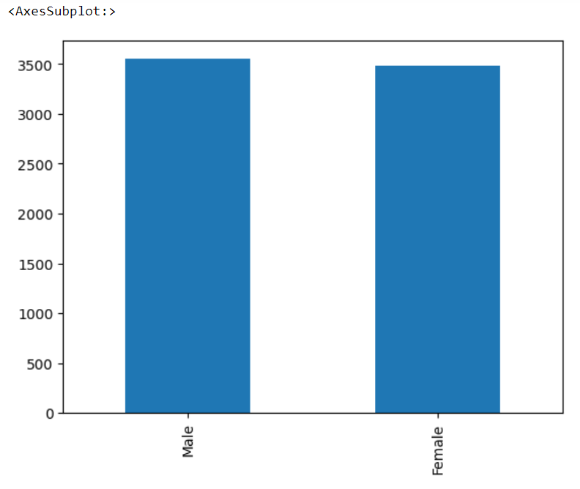
Univariate Analysis on gender column
Obseravtions
Here we can observe the member of male & female customers
Male 3555
Female 3488

Slide 13
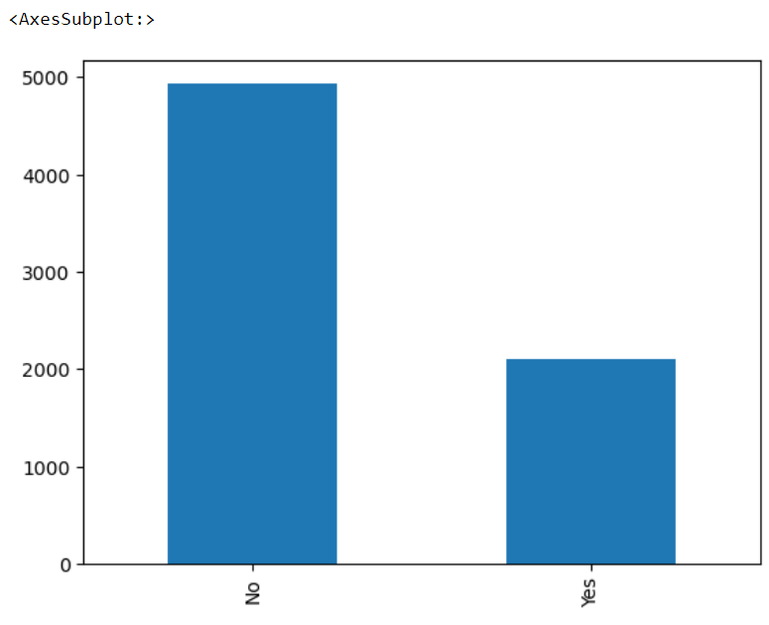
Analysis on Dependent Column
Observations:
Number of Dependents 2110
Number of independents are 4933

Slide 14
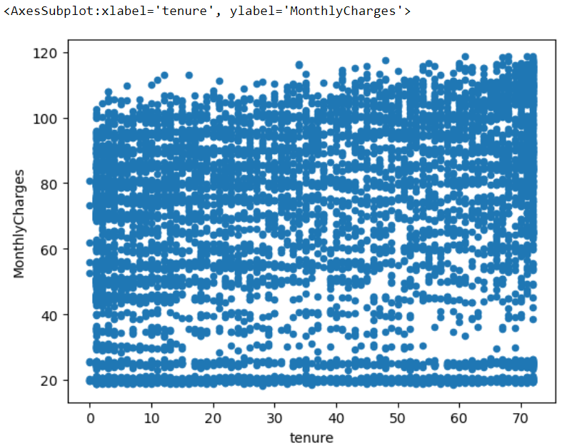
BIVARIATE ANALYSIS
Observation
Distrubutions of tenure with their monthly charges

Slide 15
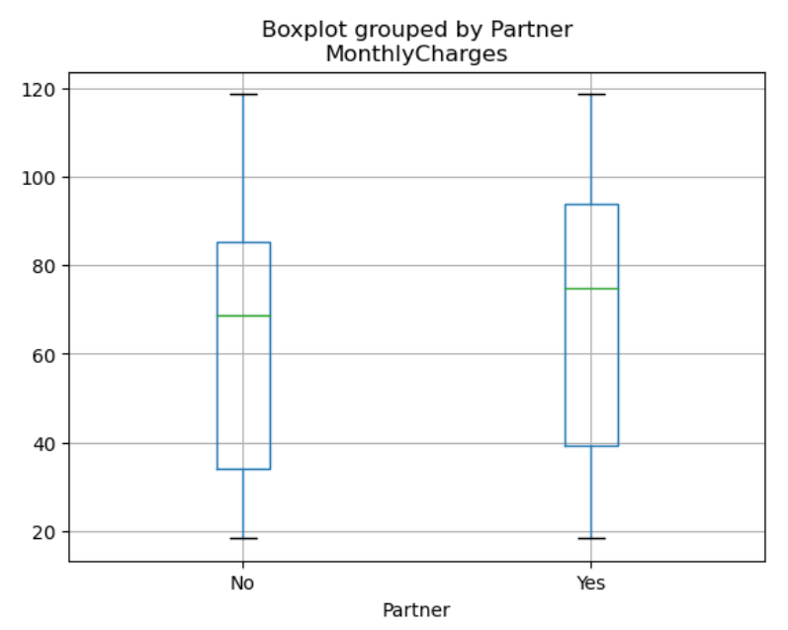
Partner vs MonthlyCharges
Observations
Here we can observe charges as per partner or without partner
With partner has high monthly charges

Slide 16
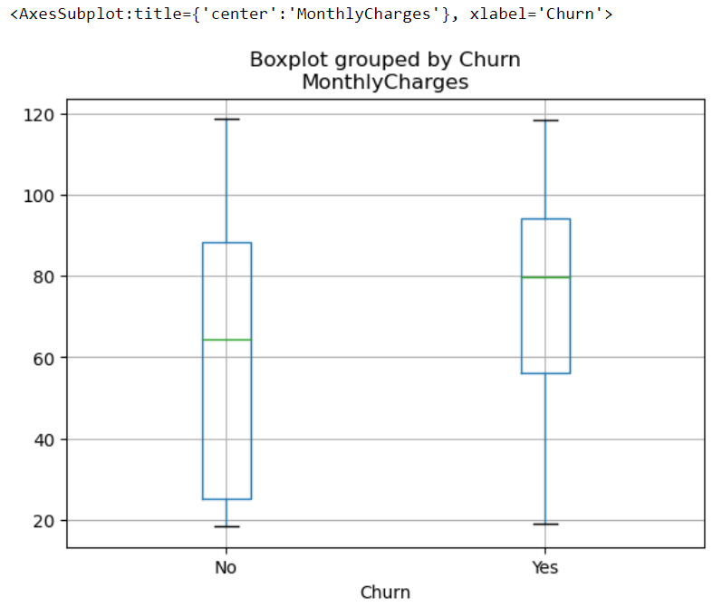
Churn vs MonthlyCharges
Observation
Customer churn as per the monthly charges
Where the Charges are high there is a probability of churn

Slide 17
CONCLUSIONS
Here we can obsereve the charges for each individuals accordingly
We concluded the charges according to the partner, senior citizen, Dependents
We checked about the customer churn

