Slide 1
SQL
Structured Query Language

Slide 2
What and why is sql?
What and types of databases?
What is rdmbs and diff. between dbms and rdbms?
What are the properties of rdbms?
Keys and constraints
ACID properties
RDBMS Language

Slide 3


Slide 4


Why sql?
What is database?
A database is an organized collection of data, so that it can be easily accessed and managed.
The main purpose of the database is to operate a large amount of information by storing, retrieving, and managing data.
There are many databases available like MySQL, Sybase, Oracle, MongoDB, Informix, PostgreSQL, SQL Server, etc.
We use structure query language
To communicate to databases
Data base server
client
SQL or Structured Query Language is used to operate on the data stored in a database.

Slide 5
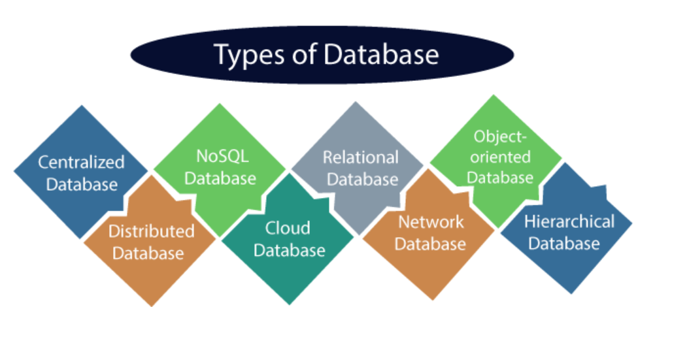

Slide 6
DBMS
RDBMS
Files
No security in data manipulation
No Relationships
Small data
Files/xml/…
Tables
ACID
Relationship exists
Large amount of data.
For org.
Mysql, sql server –MS, oracle SQL etc

Slide 7
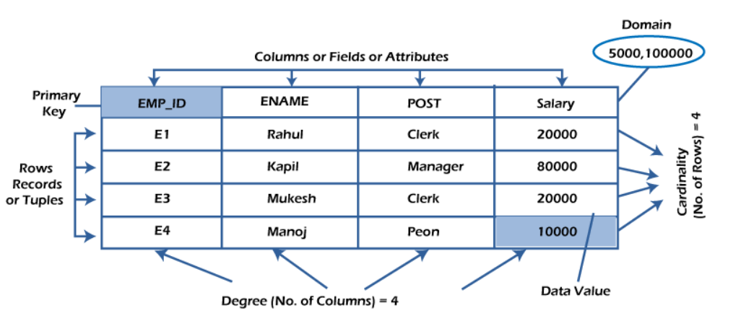
RDBMS
Table
Record or tuple
Field /column/attribute
Domain
Instance
Schema
Keys

Slide 8
Keys
Super Key
Candidate Key
Primary Key
Foreign key

Slide 9
Super key
Super key is a single key or a group of multiple keys that can uniquely identify tuples in a table.
Super Key can contain multiple attributes that might not be able to independently identify tuples in a table, but when grouped with certain keys, they can identify tuples uniquely.

Slide 10
Candidate Key
Candidate key is a single key or a group of multiple keys that uniquely identify rows in a table.
A Candidate key is a subset of Super keys and is devoid of any unnecessary attributes that are not important for uniquely identifying tuples.

Slide 11
Primary Key : A primary key is a column or a set of columns that uniquely identifies each row in the table. The primary key follows these rules:
A primary key must contain unique values. If the primary key consists of multiple columns, the combination of values in these columns must be unique.
A primary key column cannot have NULL values. Any attempt to insert or update NULL to primary key columns will result in an error.
A table can have one an only one primary key.

Slide 12
Foreign Key
A foreign key is a column or group of columns in a table that links to a column or group of columns in another table.
The foreign key places constraints on data in the related tables, which allows MySQL to maintain "referential integrity".

Slide 13
ACID Properties
Atomocity
Consistency
Isolation
Durability

Slide 14
Atomocity
It means if any operation is performed on the data, either it should be performed or executed completely or should not be executed at all.
In the case of executing operations on the transaction, the operation should be completely executed and not partially.
Example: debit and credit amount.

Slide 15
Consistency
The word consistency means that the value should remain preserved always.
In the case of transactions, the integrity of the data is very essential so that the database remains consistent before and after the transaction. The data should always be correct.

Slide 16
ISOLATION
The term 'isolation' means separation.
In DBMS, Isolation is the property of a database where no data should affect the other one and may occur concurrently.
In the case of transactions, when two or more transactions occur simultaneously, the consistency should remain maintained. Any changes that occur in any particular transaction will not be seen by other transactions until the change is not committed in the memory.

Slide 17
Durability
Durability ensures the permanency of something.
In DBMS, the term durability ensures that the data after the successful execution of the operation becomes permanent in the database. The durability of the data should be so perfect that even if the system fails or leads to a crash, the database still survives.

Slide 18
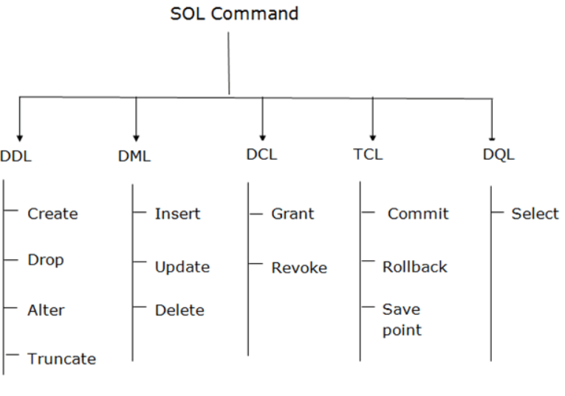
RDBMS Language
DDL – Data definition Language
DML – Data Manipulation Language
DCL – Data Control Language
TCL – transaction Control Language
SET autocommit=0;

Slide 19
DDL - DDL changes the structure of the table like creating a table, deleting a table, altering a table, etc. All the command of DDL are auto-committed that means it permanently save all the changes in the database.
Create: This command is used to create a new table or a new database.
Alter: This command is used to alter or change the structure of the database table.
Drop: This command is used to delete a table, index, or views from the database.
Truncate: This command is used to delete the records or data from the table, but its structure remains as it is.
Rename: This command is used to rename an object from the database.
Comment: This command is used for adding comments to our table.

Slide 20
DML - DML commands are used to modify the database. It is responsible for all form of changes in the database. The command of DML is not auto-committed that means it can't permanently save all the changes in the database. They can be rollback.
Insert: This command is used to insert the records into the table.
Update: This command is used to change/update the existing data in a table.
Delete: This command is used to delete one or all the existing records from the table.

Slide 21
DCL - DCL commands are used to grant and take back authority from any database user. Here are some commands that come under DCL:
Grant: This command allows user’s access privileges to the database.
Revoke: This command removes the accessibility of users from the database objects.

Slide 22
TCL - TCL commands can only use with DML commands like INSERT, DELETE and UPDATE only. These operations are automatically committed in the database that's why they cannot be used while creating tables or dropping them.
Commit: This command is used to save the transactions in the database.
Rollback: This command is used to restore the database to that state which was last committed.

Slide 23
DQL - DQL is used to fetch the data from the database.
Select: This command is used to retrieve or access the data from the database table.

