Slide 1
MACHINE LEARNING
Introduction
27 Dec 2024

Slide 2
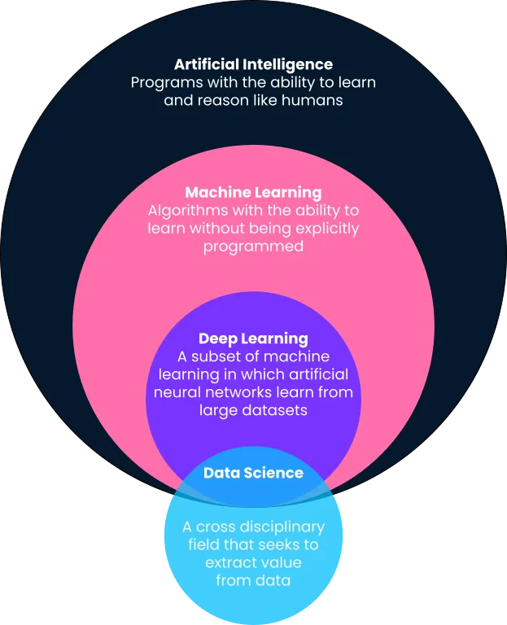
What is DS/ML/AI ?

Slide 3
Types of MAchine Learning
Machine Learning
Supervised
Learning
Unsupervised Learning
Unsupervised Learning
Classification
Regression
Clustering
Dimensional Reduction
Model-Free
Model-Based

Slide 4
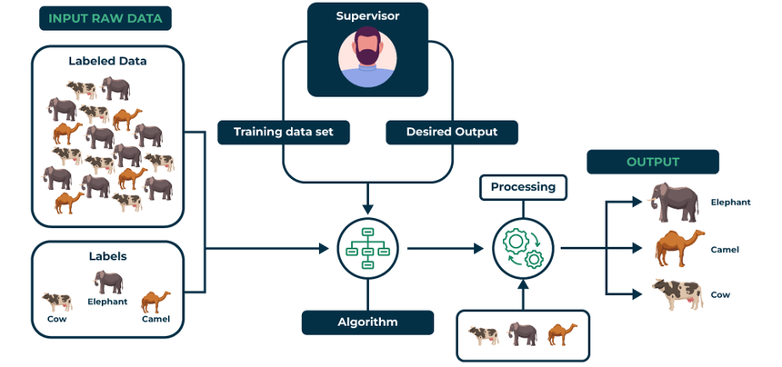
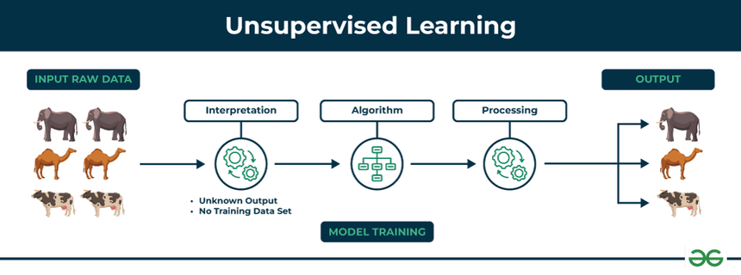
Supervised Learning
Unsupervised learning

Slide 5
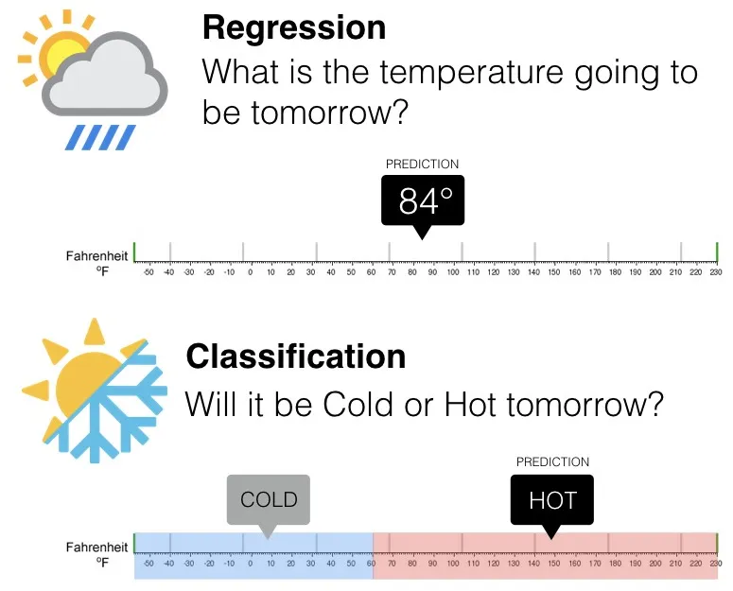
Classification vs Regression
Classification
Regression
Discrete outputs
Continuous Outputs
e.g., cat or dog
e.g., Predicting house price
Algorithms: Logistic Regression, Decision Trees
Algorithms: Linear Regression, Random forest regressor

Slide 6
Machine Learning Applications
Healthcare
Retail
Manufacturing
Applications
Finance
Transportation
Notes:
Finance - Fraud detection, stock price forecasting
Healthcare - Disease diagnosis, personalized medicine
Manufacturing - Predictive maintenance, quality control
Retail - Customer segmentation, demand forecasting
Transportation - Autonomous vehicles, traffic prediction

Slide 7
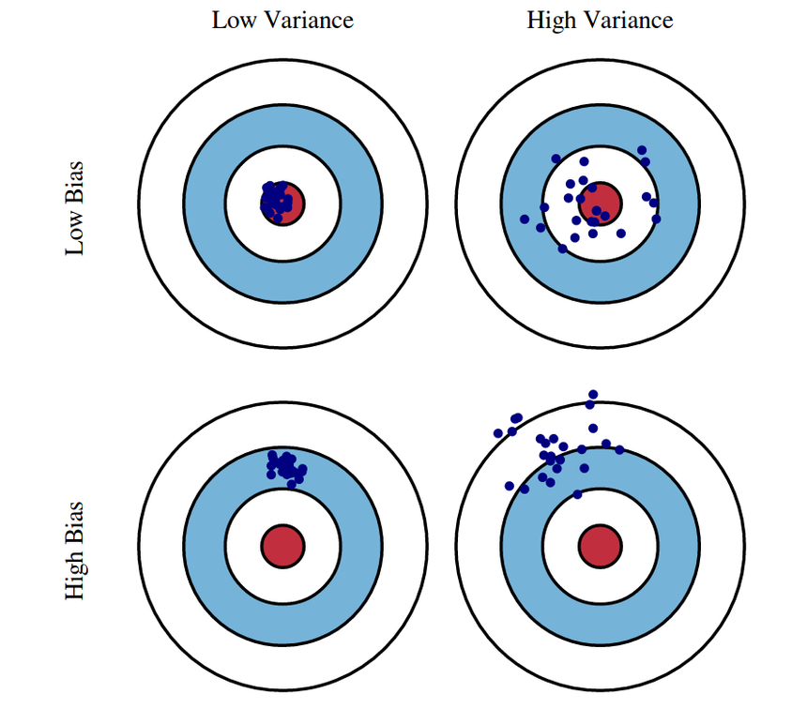
Evaluation Metrics
Bias:
Error due to simplifying assumptions.
Variance:
Error due to model sensitivity to small changes in data.
Notes:
Accuracy:
Percentage of correct predictions.
Formula: (True Positives + True Negatives) / Total Predictions
Precision:
Ratio of true positives to total predicted positives.
Formula: True Positives / (True Positives + False Positives)
Recall:
Ratio of true positives to actual positives.
Formula: True Positives / (True Positives + False Negatives)
Bias:
Error due to simplifying assumptions.
Variance:
Error due to model sensitivity to small changes in data.

Slide 8
Types of Evaluation Metrics
Classification Metrics
Regression Metrics
Accuracy
Mean Absolute Error
Precision
Mean Squared Error
Recall
Root Mean Squared Error
F1 Score
R squared

Slide 9
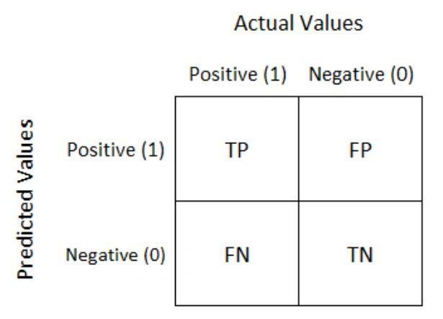
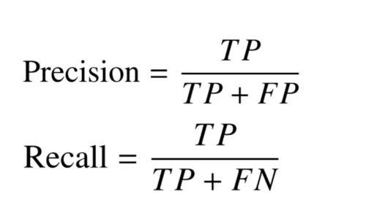
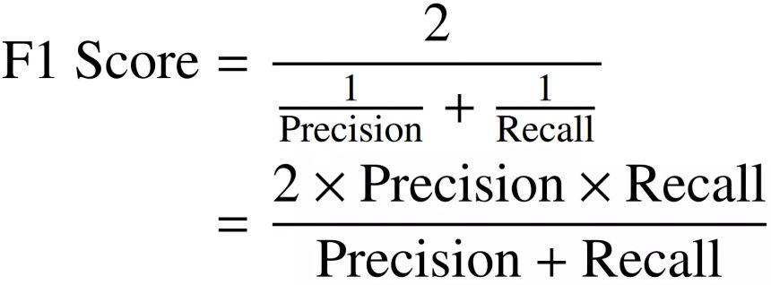
Classification Metrics

Slide 10
Quiz-1

Slide 11
Data Pre-Processing
Preparing raw data for analysis and machine learning.
Data Integration
Data Cleaning
Data Pre-Processing
Data Transformation
Data Reduction

Slide 12


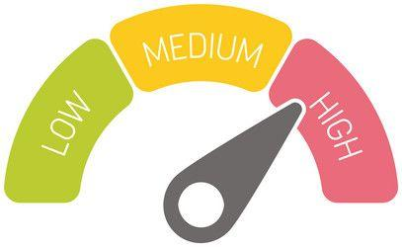
Types of Measurements:
Notes:
Continuous: Can take any value within a range (e.g., temperature, height)
Discrete: Countable values (e.g., number of people, number of items)
Interval: The difference between values is meaningful, but no true zero (e.g., temperature in Celsius or Fahrenheit)
Ratio: Similar to interval, but with a true zero point (e.g., weight, age)

Slide 13
Types of Variables Classification:
Nominal: Categories without order (e.g., Colors)
Ordinal: Categories with an order (e.g., Ratings)
Cardinal: Numerical values (e.g., Age, Height)
Notes:
Types of Variables Classification:
Nominal: Categories without order (e.g., Colors)
Ordinal: Categories with an order (e.g., Ratings)
Cardinal: Numerical values (e.g., Age, Height)

Slide 14
Concept of Correlation
Definition: Measures the relationship between variables.
Types of Correlation:
Positive Correlation: Both variables increase together.
Negative Correlation: One variable increases while the other decreases.
Examples:
Positive: Temperature and ice cream sales.
Negative: Distance traveled and fuel efficiency.

Slide 15
Exploratory Data Analysis (EDA)
Definition: Analyzing data sets to summarize main characteristics.
Techniques:
Pie Charts: Visualize proportions.
Bar Charts: Compare categorical data.
Histograms: Show data distribution.

Slide 16
Feature Engineering
Feature Engineering Basics
Data Issues:
Missing Data: Handling missing values (e.g., imputation, removal).
Data Bias: Identifying and mitigating biases in data.
Feature Selection:
Sampling: Choosing representative subsets of data.
Statistical Tests: ANOVA, Chi-Square test.
Visualization: Feature importance charts.

