Slide 1
Applied ML
Section 2

Slide 3
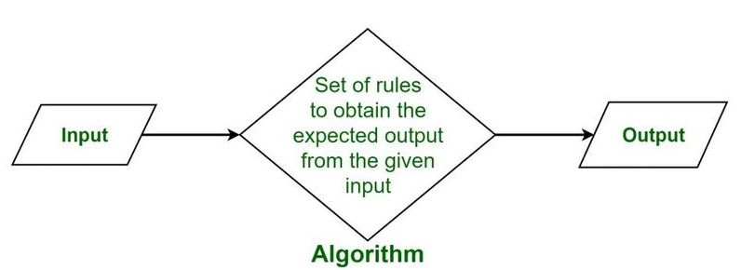
What is Algorithm?

