Slide 1
DS Careers
Section 6
Careers

Slide 2
contents
Data Science Roles
Role wise skills
Types of Projects
Profile Building

Slide 3
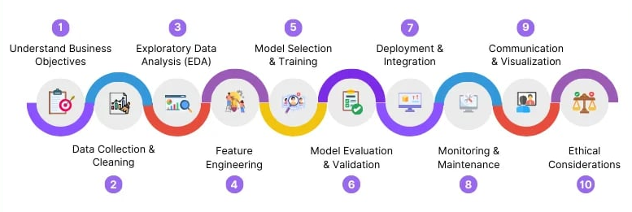
Data Science RESPONSIBILITIES

Slide 4
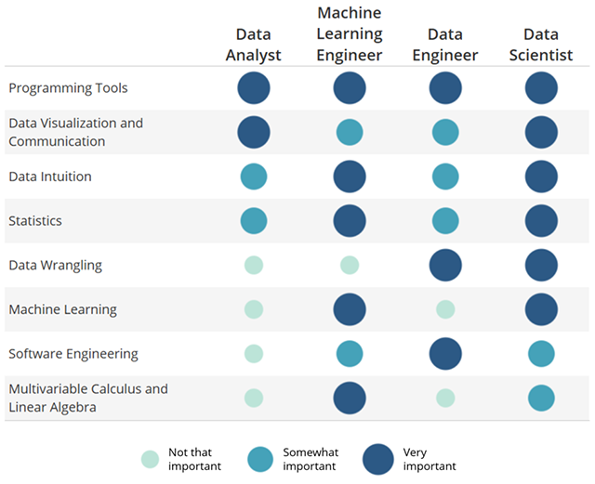
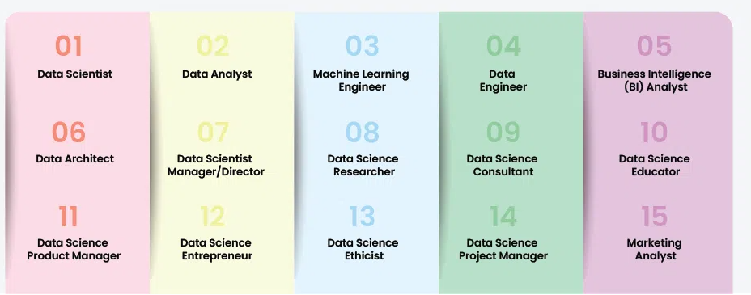
Data Science Roles

Slide 5
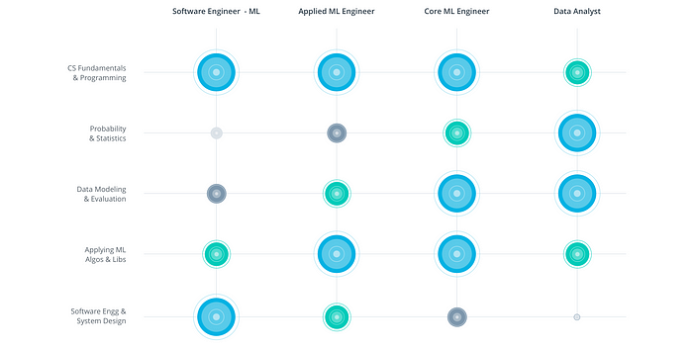
Machine learning Roles

Slide 6
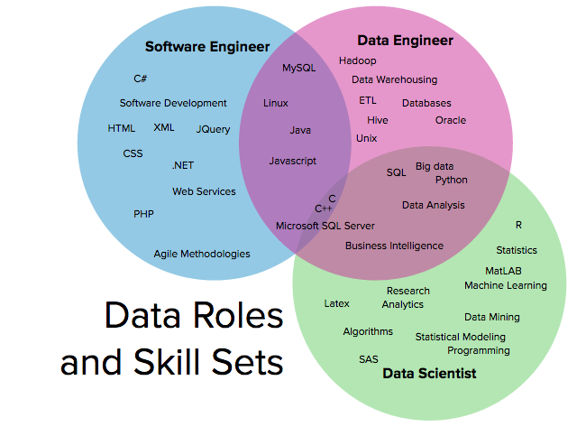
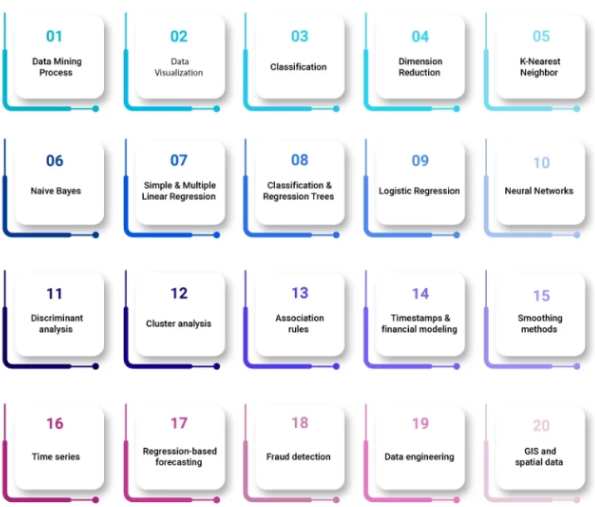
SKILLs

Slide 7
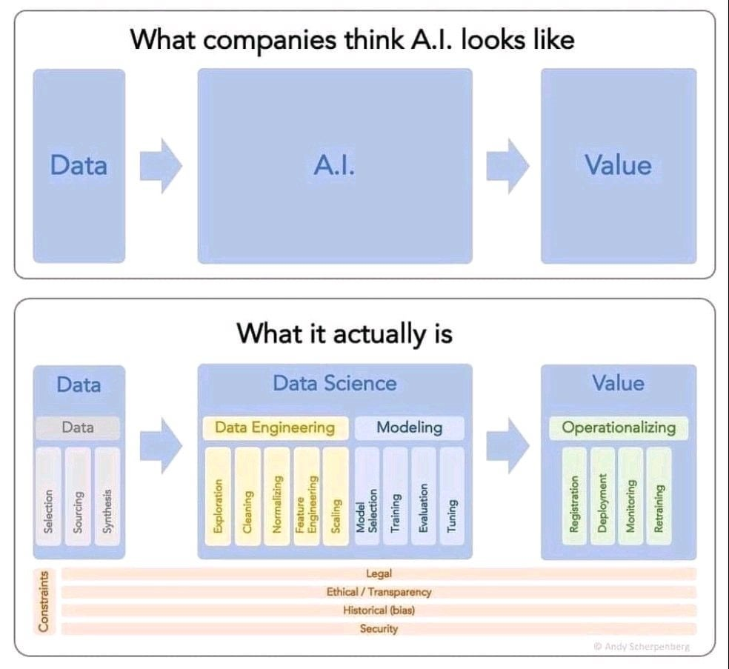

Slide 8
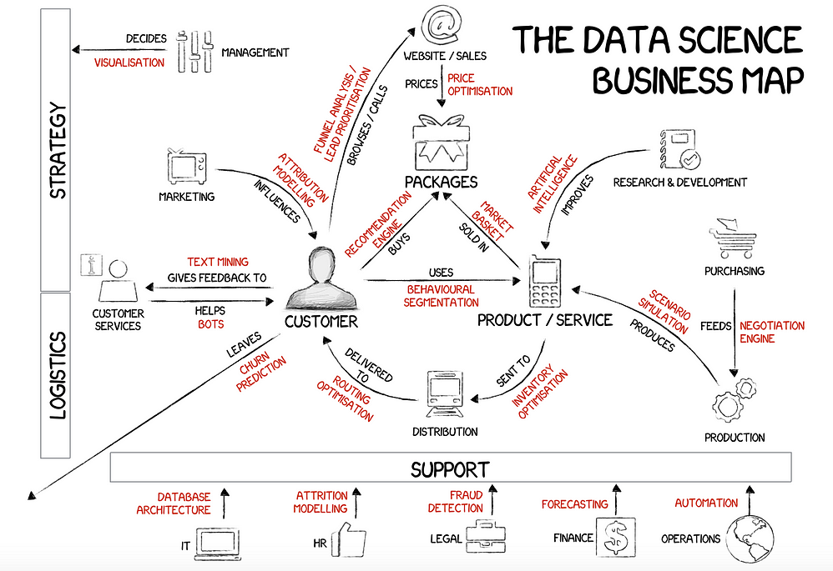
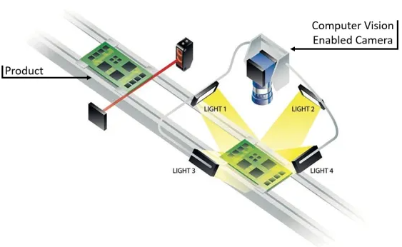
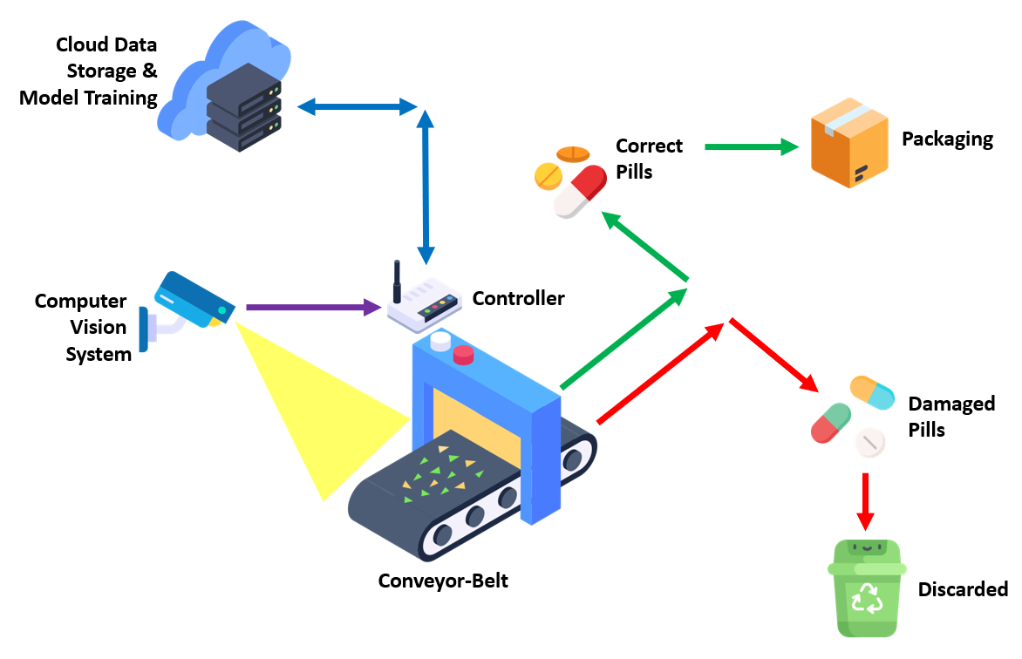
Industry projects

Slide 9
profile building skills
TOOLS
Python : Numpy, Pandas, Matplotlib
ML : Scikit- Learn, XGBoost
Computer Vision : OpenCV, Pillow
AI : PyTorch / TensorFlow
Gen AI : OpenAI-API , HuggingFace, LangChain
Cloud : AWS (SageMaker , S3) / Azure

Slide 10
profile building skills
CONCEPTS
Python : Data types, loops, OOPS
ML : Feature Engineering, Model Selection, Training Strategies, Evaluation Methods
Computer Vision : Awareness of algorithms (Classical Image Processing, Deep Learning)
AI : PyTorch (Data Generators, Training Pipelines, Hyper-paramters, Deployments)
Gen AI : Open LLM’s API Calling, LLM Selection, Fine-Tuning, Integrations
Cloud : Cloud Storage, Cloud Compute

Slide 11
Industry expectations
Project execution
Understanding of requirements and objectives
Following Best practices, Problem handling … etc
Cross-domain projects
Team work
Skill demonstrations
Basic Coding
Awareness of tools and frameworks

Slide 12
Profile building demonstration projects
Project on Data Structures & Classes
ML (Unsupervised, supervised, reinforcement, time series)
Used xx dataset trained on xx ML models, compared and achieved xx percent improvement compared to benchmark
Collected data of xx(real-life/ retail ) trained and deployed in xx
Retail Project (Actionable Insights, Customer segmentation/ lead scoring/ Propensity/ Recommendation … etc)
AI / Computer Vision
Worked with large xx tabular dataset trained xx MLP/1D Models, achieved xx compared to ML
Forecasted xx(sales/ inventory/ price) using RNN/LSTM
Trained xx(Object detector / segmentation model) on real world images and deployed in xx. With xx GPU
Identified defects with xx % (recall/ precision) for xx components
Gen-AI
Using BERT performed comment analysis / text segmentation … etc
Built a chat bot using xx Open LLM API, xx vector database and optimized xx routine process with xx accuracy. (Ex. Learning & Development bots for core subjects , based on textbook content)
Collected xx data from students, Finetuned xx SLM using xx(DPO/PPO..etc) for xx task, achieved higher performance than ChatGPT/Gemini/Mixtral.
Cloud deployments AWS(SageMaker Notebook, S3, Endpoints) CI/CD Pipelines

Slide 13
Profile building additional projects (CIRCUIT / CORE ENGINEERING BRANCHES)
Deployments in Edge Devices (Jetson / Raspberry PI … etc)
Training on sensory data (Temp, Humidity) using microcontrollers (Arduino … etc)
Integration with machines, automobiles
PROJECT IDEAS
Predicting human comfort index based on humidity and temperature
Self driving rover using computer vision road segmentation & people detection (within campus)
Smart decision making in IoT devices
Fault / Anomaly detection in sensors,
Robotic manipulation using face / hand / pattern detection.
Predicting engine mileage using mechanical parameters (Cylinder …etc)
Predictive maintenance of machines
Prediction of mechanical parameters (Strength, Hardness.. Etc ) based on material compositions
Quality inspection (Manufacturing defects) systems with industrial cameras/ Realtime application
Predicting optimal speed for efficient energy consumption based on load/ battery parameters … etc

Slide 14
Thank you

