Slide 1
Appliances Energy Prediction
Shravan Chintha
Shreyasi thota
Meghana tunga

Slide 2
Prediction Problem
Study the electricity consumption in daily home appliances such as washing machines, televisions, microwaves etc.
Predict the appliances usage of electricity based on various factors that could influence the consumption of electricity
Developing prediction models can be useful for many applications such as detecting abnormal energy usage patterns, determining energy demand, to use in building performance simulation etc.

Slide 3
Dataset
Source:
https://archive.ics.uci.edu/ml/datasets/Appliances+energy+prediction
UCI Machine Learning Repository
Number of Instances:19735
Number of Attributes: 29
Target variable: Appliances

Slide 4
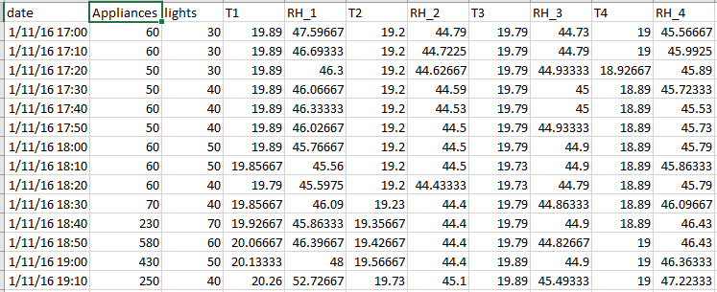
Dataset

Slide 5
Attributes
date time – represents the date and time when the temperature was calculated
Appliances - shows the energy utilization in Watts
lights - shows the energy utilization of light fixtures in the house in Watts
T1 - Temperature in kitchen area, in Celsius
RH_1- Humidity in kitchen area, in %
T2 - Temperature in living room area, in Celsius
RH_2- Humidity in living room area, in %
T3 - Temperature in laundry room area
RH_3 - Humidity in laundry room area, in %
T4 - Temperature in office room, in Celsius
RH_4 - Humidity in office room, in %
T5 - Temperature in bathroom, in Celsius
RH_5 - Humidity in bathroom, in %
T6 - Temperature outside the building (north side), in Celsius

Slide 6
Attributes
RH_6 - Humidity outside the building (north side), in %
T7 - Temperature in ironing room, in Celsius
RH_7 - Humidity in ironing room, in %
T8 - Temperature in teenager room 2, in Celsius
RH_8 - Humidity in teenager room 2, in %
T9 - Temperature in parent’s room, in Celsius
RH_9 - Humidity in parent’s room, in %
To - Temperature outside (from Chievres weather station), in Celsius
Pressure (from Chievres weather station) - in mm Hg
RH_out - Humidity outside (from Chievres weather station), in %
Wind speed (from Chievres weather station), in m/s
Visibility (from Chievres weather station), in km
Tdewpoint (from Chievres weather station), Â°C
rv1, Random variable 1
rv2, Random variable 2

Slide 7
Data Preprocessing
Removed random variables rv1, rv2 and Date fields that are not needed for the models developed here
Studied the data using pairwise plots
Observed that few of the predictors data is skewed and applied BoxCox transformation, centering and scaling methods to make the distribution less skewed
For example: skewness of predictor RH_3 is 0.4716, after applying above transformations, skewness decreased to

Slide 8

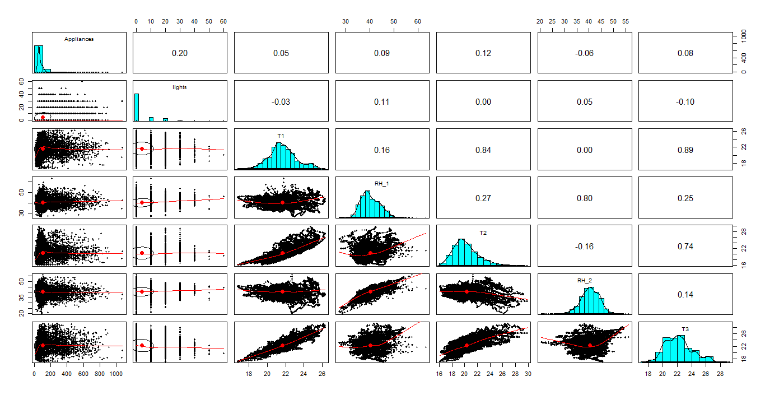
Data Preprocessing

Slide 9
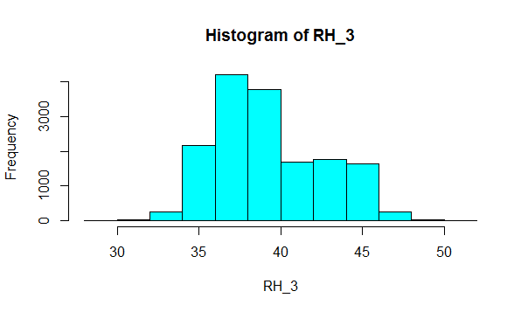
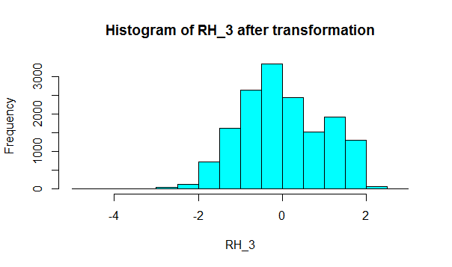
Data Preprocessing

Slide 10
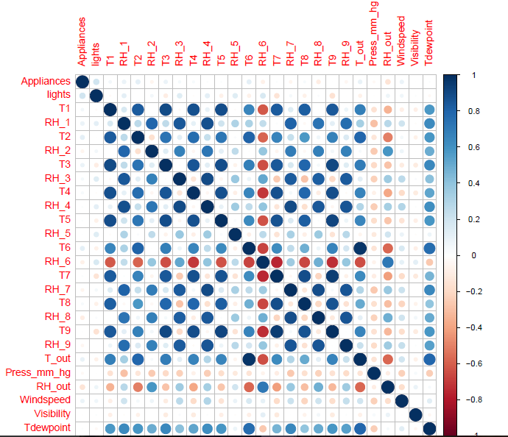

Slide 11
Data Preprocessing
Removed variable with correlation more than 0.8
After removing highly correlated variables, only 13 variables have remained for modeling
Remaining attributes:
Appliances, Lights, RH_2, T4, RH_5, RH_6, T8, RH_9, Press_mm_hg, RH_out, Windspeed, Visibility, Tdewpoint
Applying further modeling techniques to these attributes to find most important attribute that is influencing Appliances consumption very highly

Slide 12
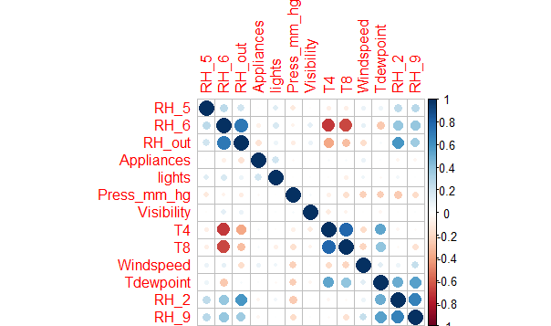

Slide 13
Linear Regression
Applied linear regression to the preprocessed data with 10 fold cross validation with 5 repeats

