Slide 1
STAT 515
Final Project

Slide 2
Data Set
Colleges offering Data Science courses in United States of America
Why this dataset?
As most of the students here are from Data Science major, thought it would be interesting!
Source: https://www.kaggle.com/datasets

Slide 3
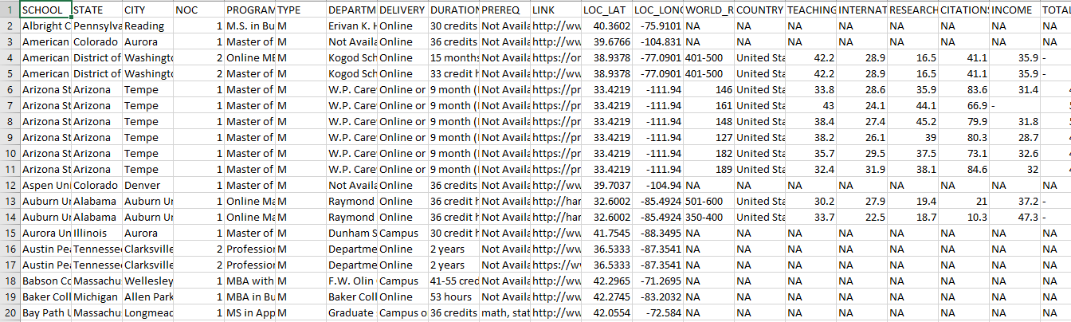
Initial Dataset

Slide 4
Pre-processing
Lot of missing values (NAs for around 280 rows)
Imputed missing values using mean imputation method
Adjusted DELIVERY column to have same value which mentioned differently in the dataset
Ex: Online, campus Campus, online Campus or Online
Campus or Online

Slide 5
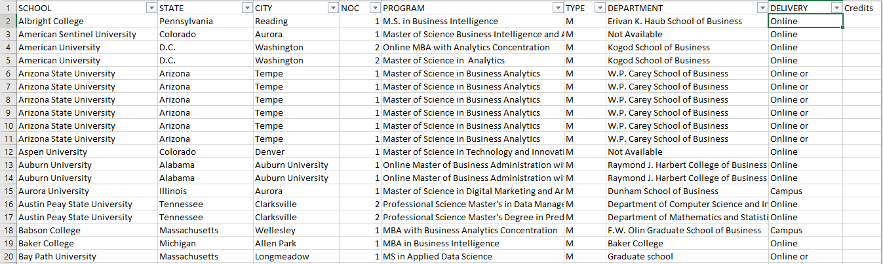
Dataset after pre-processing

Slide 6
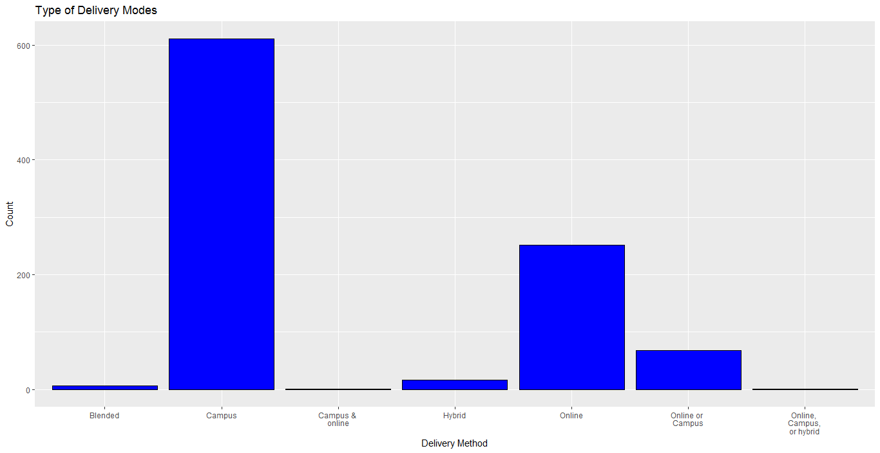
Types of Delivery Method

Slide 7
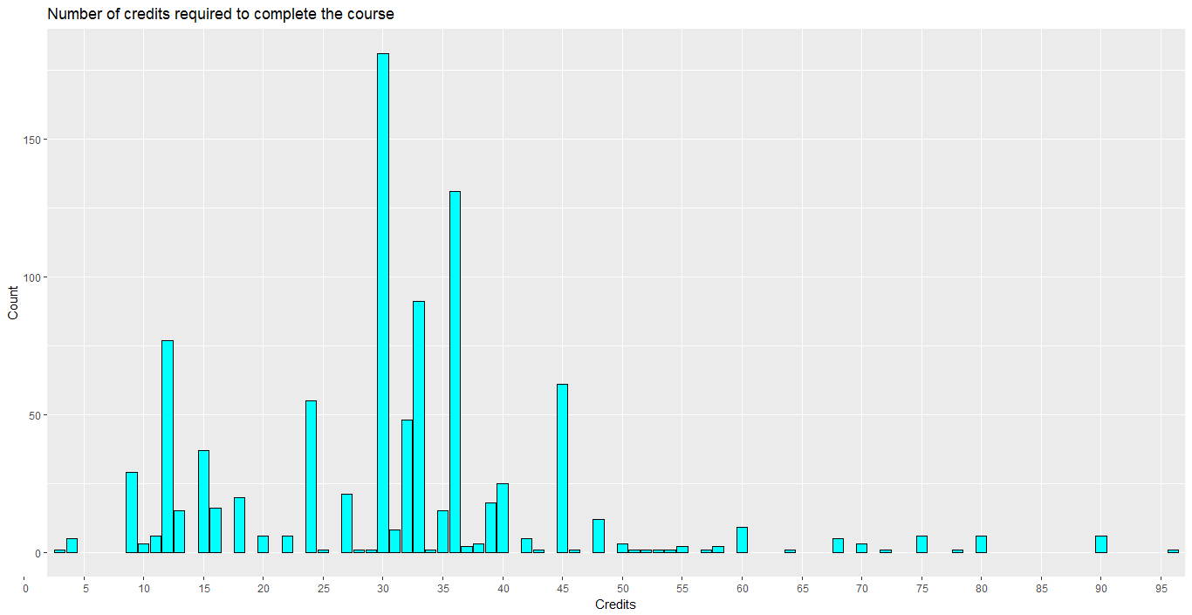

Slide 8
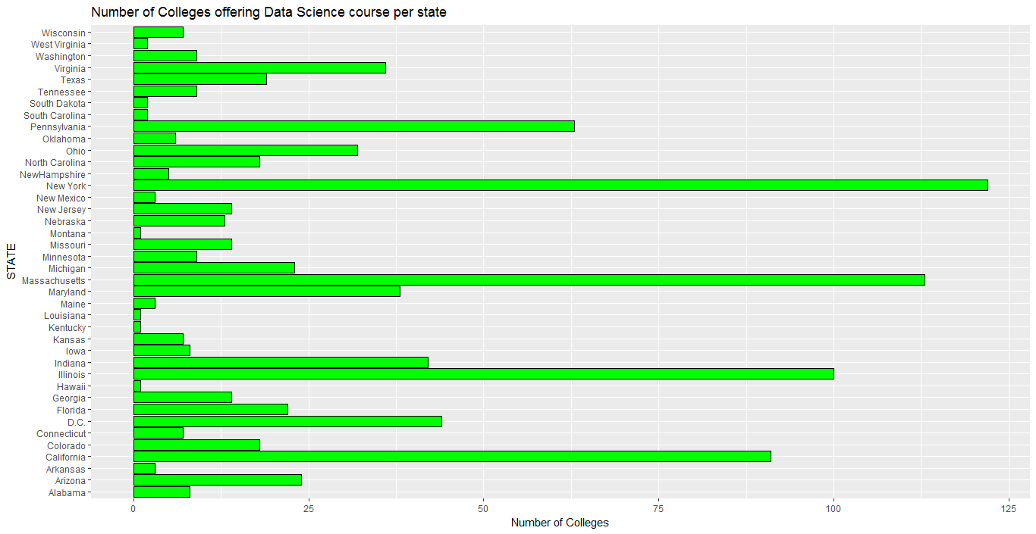

Slide 9
Universities in each state and their stats comparison per state

Slide 10
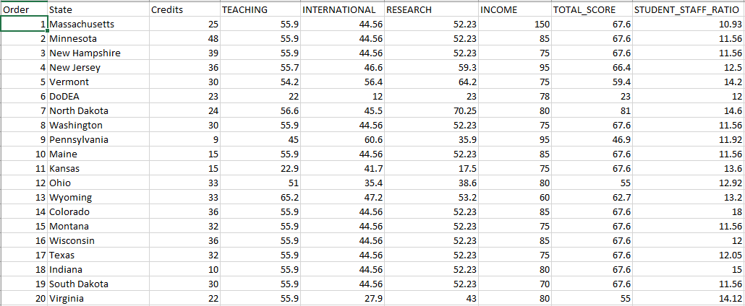
Dataset for Micro maps

Slide 11
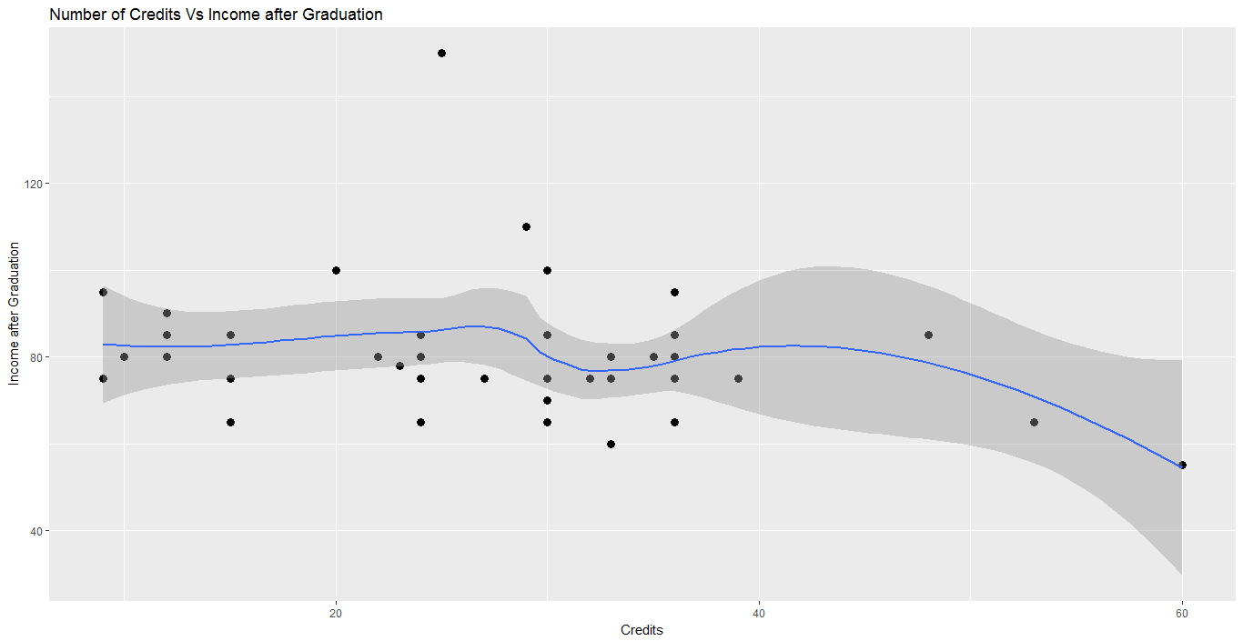

Slide 12
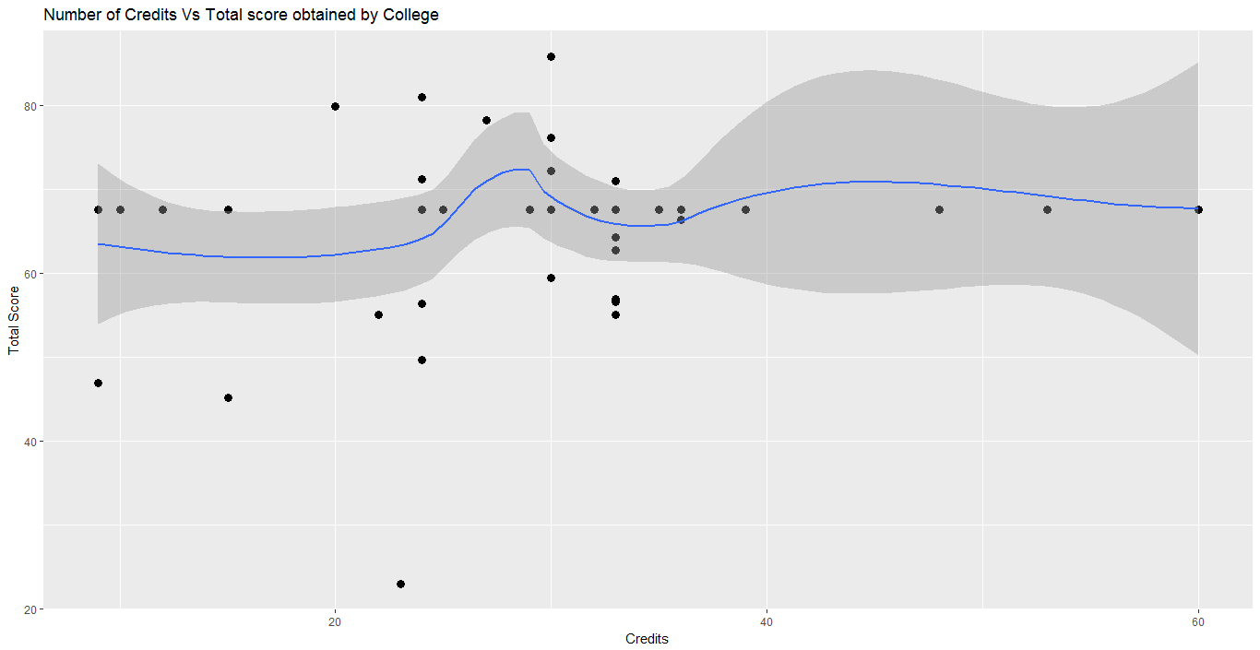

Slide 13
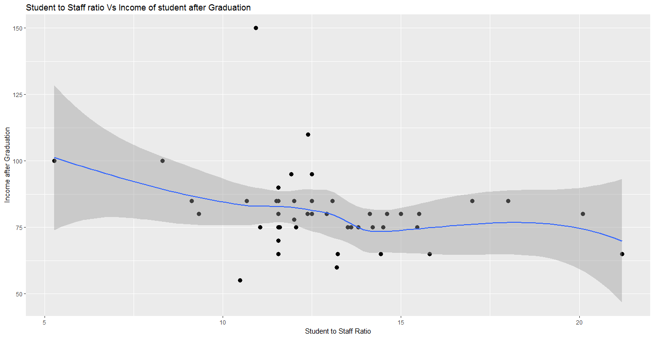

Slide 14
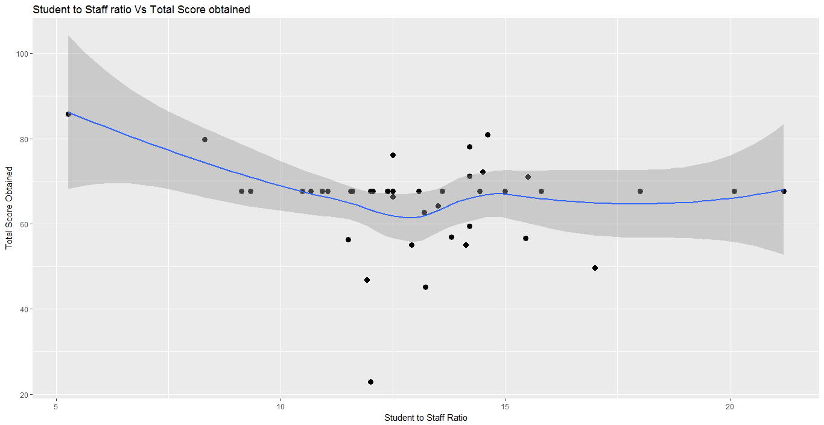

Slide 15
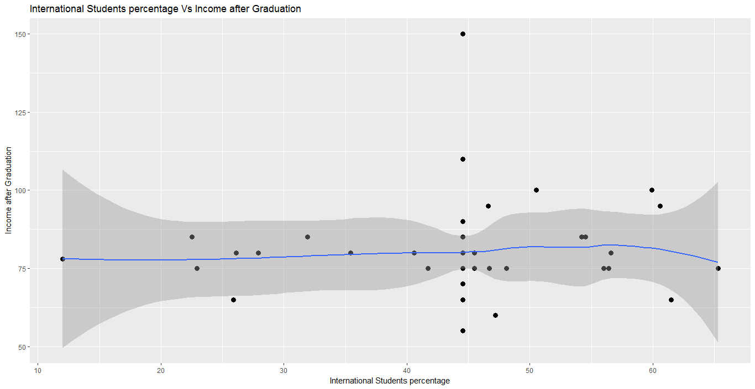

Slide 16
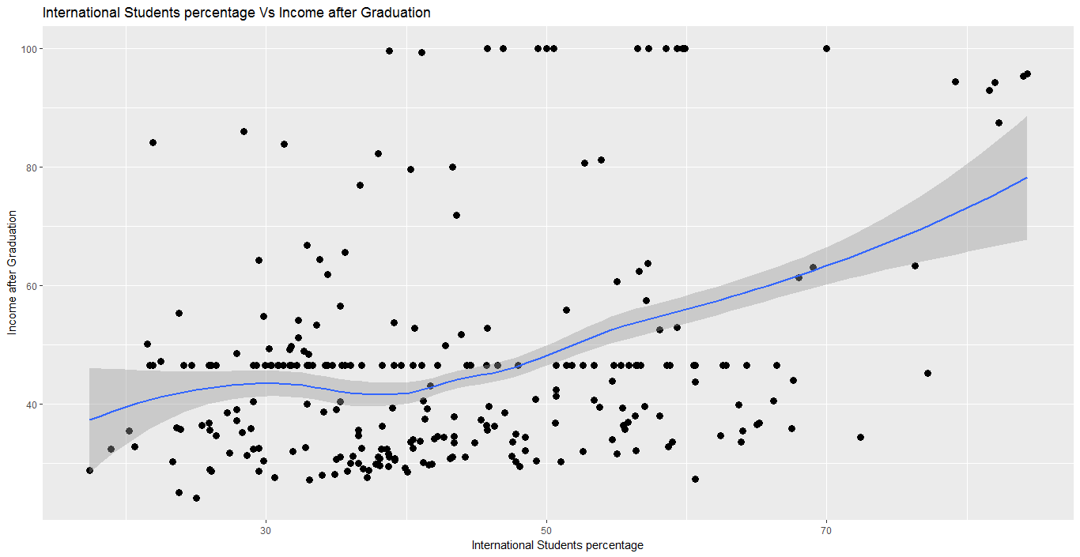

Slide 17
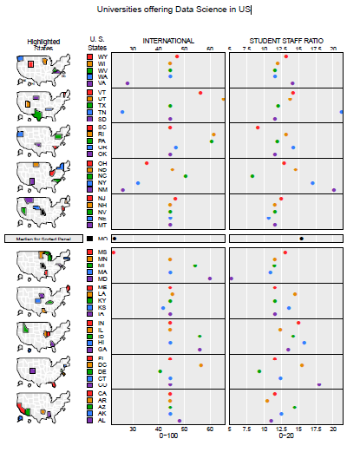

Slide 18
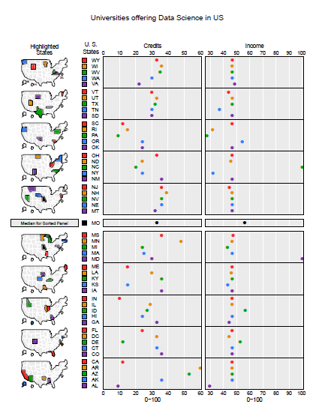

Slide 19
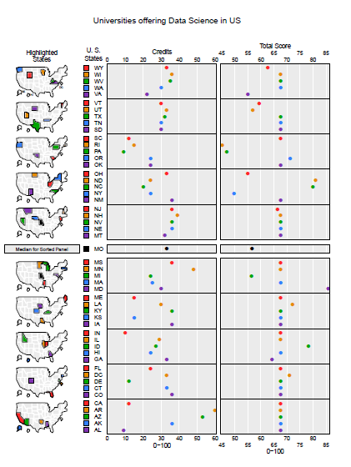

Slide 20
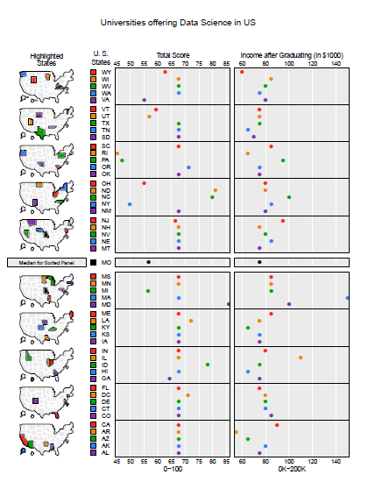

Slide 21
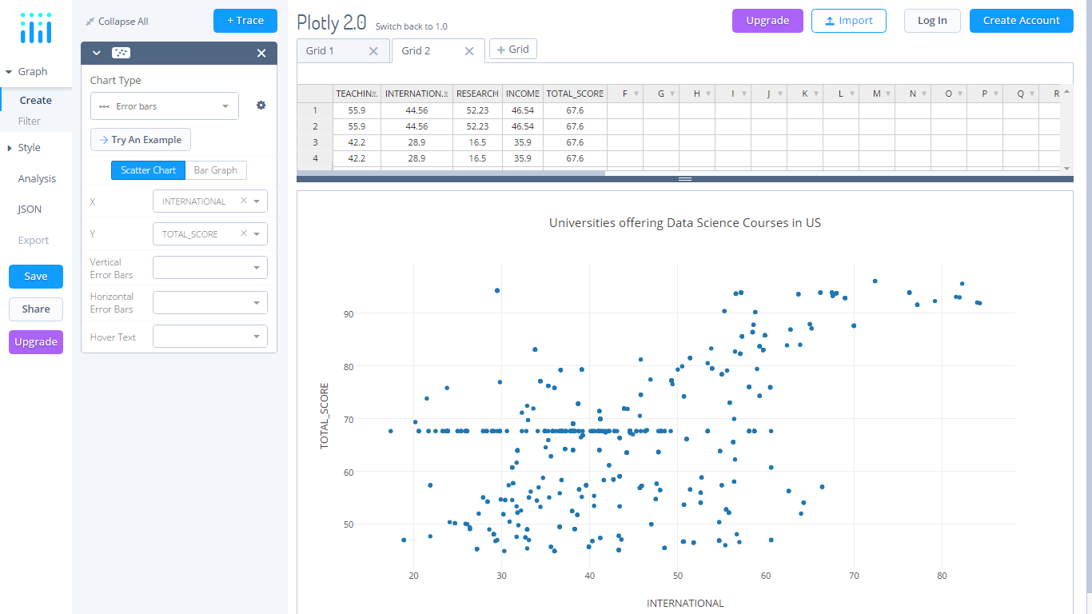

Slide 22
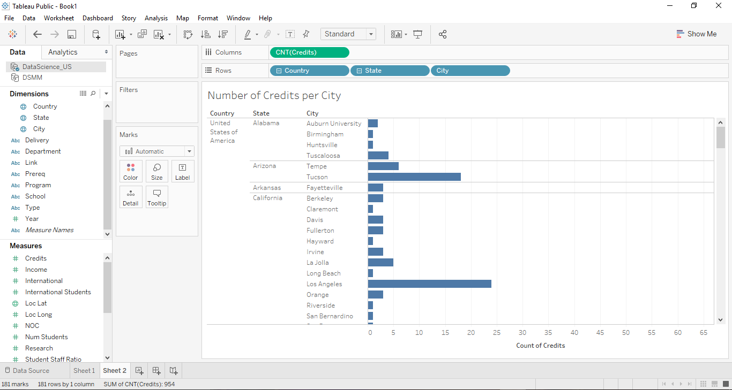

Slide 23
Thank you!

