Slide 1
Walmart SCT Hackathon Round 2
Codefellas

Slide 2
Problem Understanding
Our understanding of this problem statement is that we are supposed to predict whether ‘a specific Hard Disk Drive’ will fail to work in a specific time window, or not.
Solving this problem will result in a timely retrieval of data, before it is lost permanently due to disk failure.
It will also help in improving the efficiency of the system, as its downtime (freezing with not responding sign) will be reduced.
Various other business use cases with similar problems can be used for predicting equipment failures in manufacturing machinery such as conveyor belts, pumps, or predicting failures in power generation equipment such as turbines, generators, and transformers.

Slide 3
Data Processing
Attribute Name | Attribute Understanding | Attribute Use
Date | Contains the last known date on which a hard disk model was functioning. | For sorting chronologically.
Failure | Stores the information whether a specific HDD model was faulty since manufacturing. | For preprocessing and calculating if the disk was faulty since birth.
S.M.A.R.T. 5 (Raw) | Reallocated Sectors Count. It is the count of sectors found defective and have been reallocated to spare sectors by the disk’s firmware. | All the S.M.A.R.T. attributes were used to determine the probability of failure of the HDD. The greater the number in this column, the higher the probability of failure.
S.M.A.R.T. 188 (Raw) | Command Timeout tracks the number of times a drive was unable to execute a command due to a timeout.

Slide 4
Attribute Name | Attribute Understanding | Attribute Use
S.M.A.R.T. 187 (Raw) | Reported Uncorrectable Errors Count is the number of uncorrectable errors encountered by the hard disk during its operation. | All the S.M.A.R.T. attributes were used to determine the probability of failure of the HDD. The greater the number in this column, the higher the probability of failure.
S.M.A.R.T. 198 (Raw) | Offline Uncorrectable Sector Count is the total number of uncorrectable errors that occurred when reading or writing data from/to the disk's surface while the disk was offline (i.e., not actively in use).
S.M.A.R.T. 197 (Raw) | Current Pending Sector Count is the number of sectors awaiting remapping due to read errors.
Model | Contains the model-name of the manufactured hard disk. | Is used to keep track of the failure counts for Hard Disk Drive models.

Slide 5
Data Challenges and Insights
The first challenge was to recognize which columns were important to the prediction model. There were about 50 S.M.A.R.T. attribute count columns, both raw and normalized, as well as several data columns that stated information which was not pivotal to predicting the HDD model failures. In this step, we created an abstract about the data that we would need.
The next challenge was to clean the huge data (about 100k+ lines) and extract meaningful information from it. This was a necessary step, as the resultant data will form the basis of the AI model.
Blank Columns were another challenge that needed to be dealt with, as certain Hardware manufacturers recognized only some specific S.M.A.R.T. metrics, while other manufacturers did not recognize them at all. For example, WD has special S.M.A.R.T. metrics with IDs 194 and 193, while Seagate recognizes S.M.A.R.T. attributes 231 to 233.

Slide 6
Validating Data, Training Model, and Testing Model
Validating data is an important first step in the process of creating an AI model. In this step, we checked the integrity of data, which included verifying and removing any redundant data in the dataset, controlling data overflow by picking chunks of data at a time for prediction purposes, and checking the consistency of datatypes in specific columns across the picked chunk. The chunk size was 15% of the total data
Training the model is the second step in the process of building the AI model. To ensure the correct working of our model, it had to be trained to correctly recognize the failed HDDs and the working HDDs. However, we experienced a shortage of data which provided the number of failed HDDs. The total percentage of failed HDDs in the total dataset (2013 to 2023) is less than 1%. This meant that we had to improvise some edge cases by ourselves, so that the AI model does not fail.

Slide 7
After training the model correctly, Testing the model was the final step. For this purpose, we selected the 2019 dataset, as we found this dataset to contain the greatest number of failed HDD models, which really helped in testing and training our AI model.
For testing purposes, we tested samples of data from all quarters of 2019, and out model turned out to have a precision percentage of about 93%.
Since we're dealing with time-series data, we used the most recent 30% of the dataset for testing and the remaining 70% for training without shuffling the data. This ensures that we train on past data to predict future data.

Slide 8
Feature Engineering
Feature Name | Feature Understanding | Feature Significance
Model | Contains the model-name of the manufactured hard disk. | Is used to keep track of the failure counts for Hard Disk Drive models.
Recall | Identifies the proportion of Hard Disk Drives that were predicted to be failed by our AI Model, out of the total number of failed Hard Disk Drives. | This is used as a metric to measure the reliability of our model.
Precision | Identifies the proportion of Hard Disk Drives that were predicted to be passed by our AI Model, out of the total number of passed Hard Disk Drives. | This is used as a metric to measure the reliability of our model.
Accuracy | Counts the number of outcomes (failing or not) that were correctly predicted through our AI model. | This is used as a metric to measure the reliability of our model.

Slide 9
Feature Name | Feature Understanding | Feature Significance
Label | The label contains the two types of testcases stated in the Dataset, i.e., 0 for HDD model that is good by birth or 1 for HDD model is bad by birth. | It is used to define the different scenarios in which our AI model will predict data. If Label is 0, then other metrics than the label itself factor in to predict the outcome. If the label is 1, then the label itself will be looked at primarily.
F1 | Contains the F1 score of the precision model | It is a metric used to evaluate the accuracy of a classification model. It is the harmonic mean of precision and recall, providing a single score that balances both measures.
Support | It refers to the number of instances or samples in the dataset that belong to each class or label, i.e., with 0 label, how many samples of a specific model of HDD were processed, and the same for models with label 1. | It is used to showcase the range of data covered by our AI model

Slide 10
Model Building
Choice of Model:
Supervised learning techniques such as Random Forest and XGBoost were chosen for predicting hard disk failure based on S.M.A.R.T attributes.
These models were selected due to their effectiveness in handling complex datasets and their ability to provide high accuracy in classification tasks.
Models Explored:
Tree-based classifiers: Random Forest and XGBoost were explored for individual hard disk models.
Unsupervised learning techniques: DBSCAN and K-Means were experimented with for clustering hard drives into groups of failing and non-failing drives.

Slide 11
Anomaly detection techniques were also explored as a novel approach for hard disk failure prediction.
However, unsupervised learning techniques performed poorly compared to supervised learning due to the nature of the dataset and the complexity of the prediction task.
Reasons for Choice:
High F1 scores were achieved for all hard disk models trained using tree-based classifiers, indicating their effectiveness in predicting failure.
Supervised learning models provided better accuracy and performance compared to unsupervised learning techniques, making them the preferred choice for this task.

Slide 12
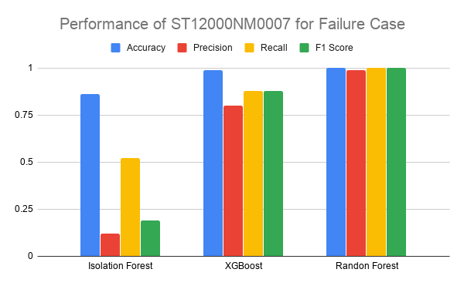
Model Evaluation
The model’s accuracy is defined using the following measures:
Recall: Recall, also known as sensitivity or true positive rate, measures the proportion of actual positive cases that were correctly identified by the model. It is calculated as the ratio of true positives to the sum of true positives and false negatives.

Slide 13
Precision: Precision, also referred to as positive predictive value, indicates the proportion of true positive predictions among all positive predictions made by the model. It is calculated as the ratio of true positives to the sum of true positives and false positives.
F1: F1 score is the harmonic mean of precision and recall, providing a balance between the two metrics. It considers both false positives and false negatives and is calculated as 2 * (precision * recall) / (precision + recall). It is useful for evaluating models when there is an imbalance between the classes or when both precision and recall are important.

Slide 14
Forecast window cutoffs:
Our forecast window cutoff is set at 15 days.
This means that we predict whether a hard disk will fail within the next 15 days based on our model.
We selected this window for several reasons:
The size of our dataset is significant, with over 100 GB of data spanning multiple years. With such a large dataset, a shorter forecast window allows us to focus on more recent data, which may be more relevant for predicting failures.
A 15-day window strikes a balance between capturing short-term trends and providing actionable predictions. It allows for timely intervention or maintenance if a failure is predicted within this period.
Overall, the 15-day forecast window provides a practical and efficient timeframe for predicting hard disk failures based on our dataset characteristics and computational considerations.

Slide 15
Accuracy metrics of the working solution
The matrix has five rows and five columns, which suggests that the classification model is attempting to distinguish between five different classes (ST12000NM0007, ST4000DM000, ST8000NM0055, ST8000DM002, and TOSHIBA MQ01ABF050).
The diagonal elements of the matrix represent the number of instances that were correctly classified by the model. For example, the model correctly classified 14 instances as ST12000NM0007, and 35 instances as ST4000DM000.
The off-diagonal elements represent the number of instances that were misclassified by the model. For example, the model misclassified 2 instances as ST12000NM0007 when they were ST4000DM000, and 1 instance as ST8000NM0055 when it was ST8000DM002.
The row totals represent the number of instances that belong to each class. For example, there are a total of 26 instances that belong to the ST8000NM0055 class.

Slide 16
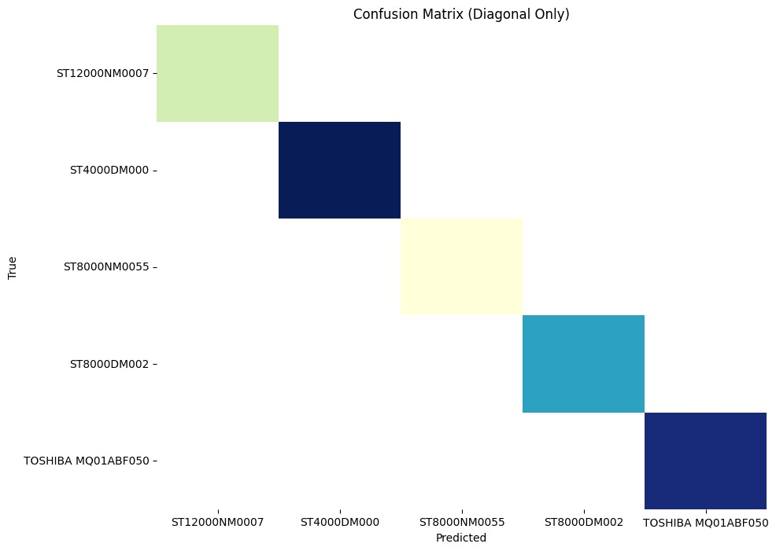
The column totals represent the number of instances that were predicted to belong to each class. For example, the model predicted that there are a total of 35 instances that belong to the ST4000DM000 class.
The overall accuracy of the model can be calculated as the sum of the diagonal elements divided by the sum of all elements in the matrix. In this case, the overall accuracy is (14+35+28+33+36)/150 = 0.93 or 93%.

Slide 17
Conclusion
Further Directions to Improve:
Explore transfer learning: Investigate methods to apply transfer learning techniques to hard disk failure prediction. Transfer learning allows the model to retain its performance when applied to new or unseen models that it was not specifically trained on.
Develop a standardized dataset: Work on creating a dataset where critical features necessary for failure prediction are reported consistently across all manufacturers. This standardized dataset would ensure that the model can generalize well to different hard disk models without the need for individual training.

Slide 18
Anything Thought of and Not Implemented:
Implementation of transfer learning: While transfer learning was considered as a potential approach, it was not implemented due to resource constraints or complexity in adapting existing models to new data.
Creation of a standardized dataset: Although the idea of developing a standardized dataset was proposed, it was not executed due to challenges in gathering data from various manufacturers and ensuring consistency in reporting critical features.

Slide 19
Concluding Remarks:
The exploration of transfer learning and standardized datasets represents promising avenues for improving hard disk failure prediction.
While these approaches were not implemented in the current study, they remain viable options for future research and development in the field of predictive maintenance for hard disk drives.
Continued efforts in these directions could lead to more robust and efficient models for identifying potential hard disk failures, ultimately enhancing data center reliability and minimizing downtime.
We gave this project out best, and it took a lot of effort to build it in just 34 hours. We hope you liked it.

Slide 20
THANK YOU!

