Slide 1



Easwari Engineering College
Hazardous Waste Management & Tracking System
I2311CSC503R – Full Stack Development
Information Technology
PRESENTED BY
Shravan. J - 310624205252
Under the guidance of
Ms Sai Lakshmi

Slide 2
CONTENTS :
      Title
      Abstract
      Introduction
      Literature survey
      Existing system and Disadvantages
      Proposed system and Advantages
      System requirements
      System Architecture
      References

Slide 3


ABSTRACT
The Hazardous Waste Management & Tracking System is a web-based platform developed to facilitate the systematic management and traceability of hazardous waste. The system connects laboratories, industries, transporters, treatment facilities, and administrators through a centralized platform, enabling end-to-end tracking from waste registration and collection to transportation, treatment, and final disposal. It maintains records of waste quantities, shipment details, regulatory documents, and operational activities while automatically identifying quantity discrepancies, transportation delays, missing documents, and reported incidents. Real-time notifications are generated to inform responsible users of critical events and required actions, while a custom AI-based voice alert mechanism provides dynamically generated notifications for critical and emergency situations. The system also includes an investigation module that enables administrators to review discrepancies, request explanations, evaluate supporting evidence, and resolve violations. Role-based access control, QR-based tracking, and audit logs further enhance security, transparency, and accountability. Overall, the proposed system aims to improve the efficiency, traceability, compliance, and safety of hazardous waste management.

Slide 4
INTRODUCTION
Hazardous waste generated by laboratories and industries requires proper handling, transportation, treatment, and disposal to prevent risks to human health and the environment. Traditional waste management processes often depend on manual records and communication between different organizations, which can result in delays, inaccurate quantity records, missing documents, and limited traceability. The Hazardous Waste Management & Tracking System is proposed as a centralized web-based solution to digitally manage the complete lifecycle of hazardous waste. The system connects waste-generating organizations, transporters, treatment facilities, and administrators through role-based portals. It provides real-time tracking, document management, QR-based identification, automated monitoring, and audit logging. The system can detect issues such as quantity mismatches, transportation delays, missing documents, and incidents, and notify the responsible users through real-time alerts. A custom AI-based voice notification system further improves the response to critical and emergency events by generating dynamic voice alerts. An investigation module allows administrators to review discrepancies, request explanations, examine supporting evidence, and record resolutions or violations. Thus, the proposed system provides a more transparent, traceable, efficient, and proactive approach to hazardous waste management.

Slide 5
LITERATURE SURVEY :
AUTHOR | YEAR | DESCRIPTION | PROS | CONS
Ahmad et al. | 2021 | Proposed blockchain-based waste management for secure tracking and traceability. | Improves transparency, security, and traceability. | Complex implementation and higher cost.
Gopalakrishnan et al. | 2021 | Developed a blockchain-based model for waste collection, transportation, and management. | Supports transparent and efficient waste tracking. | Requires technical infrastructure and maintenance.
Bamakan et al. | 2022 | Studied blockchain applications for healthcare waste management and regulatory processes. | Provides end-to-end traceability and accountability. | Integration with existing systems is challenging.
Jiang et al. | 2023 | Reviewed blockchain applications and challenges in waste management systems. | Enhances data integrity and transparency. | Scalability and large-scale adoption remain challenges.
Ajakwe et al. | 2025 | Explored IoT and blockchain integration for environmental monitoring. | Enables real-time monitoring and secure data management. | Sensor coverage and implementation cost can be limitations.

Slide 6
EXISTING SYSTEM :
Hazardous waste management is commonly handled using manual records, spreadsheets, and separate systems for collection, transportation, treatment, and disposal. Tracking between laboratories, transporters, treatment facilities, and administrators is often not centralized. Quantity verification, document management, and compliance monitoring may require manual checking, while delays and discrepancies may not be detected immediately.
Hazardous waste management is often handled through manual records and separate systems.
Waste collection, transportation, treatment, and disposal information may be maintained independently.
Real-time tracking of waste movement is limited.
Quantity verification is often performed manually, making discrepancies difficult to detect quickly.
Missing documents and compliance records may not be identified immediately.
Communication between laboratories, transporters, facilities, and administrators can be delayed.

Slide 7
DISADVANTAGES :
Manual Data Management – Paper-based or separate records can lead to data entry errors and difficulty in maintaining information.
Limited Real-Time Tracking – Waste movement and shipment status may not be monitored continuously.
Quantity Mismatch Detection – Differences between collected and received quantities may require manual verification.
Delayed Alerts – Critical issues such as delays, missing documents, and incidents may not be reported immediately.
Poor Traceability – Tracking the complete journey of hazardous waste across different organizations can be difficult.
Limited Investigation Support – Existing approaches may not provide a centralized mechanism to investigate discrepancies and maintain supporting evidence.
Lack of Proactive Monitoring – Users generally need to check the system manually instead of receiving automatic alerts for important events.
Fragmented Communication – Laboratories, transporters, facilities, and administrators may use separate methods to communicate and exchange information.

Slide 8
PROPOSED SYSTEM :
The proposed Hazardous Waste Management & Tracking System is a centralized web-based platform that digitally manages the complete hazardous waste lifecycle from registration to final disposal. It connects laboratories, industries, transporters, treatment facilities, and administrators through role-based portals. The system provides real-time tracking, QR-based identification, automated monitoring, quantity mismatch detection, compliance management, and digital document handling. It also includes an AI-based voice alert system that provides dynamic voice notifications for critical and emergency events. Administrators can investigate discrepancies, request explanations, review supporting evidence, and record resolutions or violations.

Slide 9
ADVANTAGES :
Centralized Management – All waste-related information is maintained in one platform.
Real-Time Tracking – Monitors waste throughout collection, transportation, treatment, and disposal.
Automated Alerts – Detects delays, mismatches, missing documents, and incidents automatically.
AI Voice Notifications – Provides immediate voice alerts for critical and emergency situations.
QR-Based Tracking – Enables quick identification and verification of waste shipments.
Investigation Management – Allows administrators to investigate discrepancies and review evidence.
Improved Compliance – Helps maintain required documents, records, and regulatory activities.
Audit Trail – Records important actions and status changes for transparency and accountability.

Slide 10
SYSTEM REQUIREMENTS & SPECIFICATIONS
HARDWARE SPECIFICATIONS:
PROCESSOR : Intel Core i3 / AMD Ryzen 3 or above
RAM : 4 GB Minimum
HARD DISK : 20 GB Free Space
INPUT DEVICE : Standard Keyboard & Mouse
MONITOR : Minimum Resolution 1366 × 768
INTERNET : Stable Internet Connection
SOFTWARE SPECIFICATIONS:
OPERATING SYSTEM : Windows 10 / 11 or above
FRONTEND : React.js, HTML5, CSS3, JavaScript
BACKEND : Node.js, Express.js
DATABASE : MongoDB
DEVELOPMENT PLATFORM : Visual Studio Code
VERSION CONTROL : Git / GitHub
ADDITIONAL TOOLS : REST API, Socket.IO, QR Code, AI Voice/TTS

Slide 11
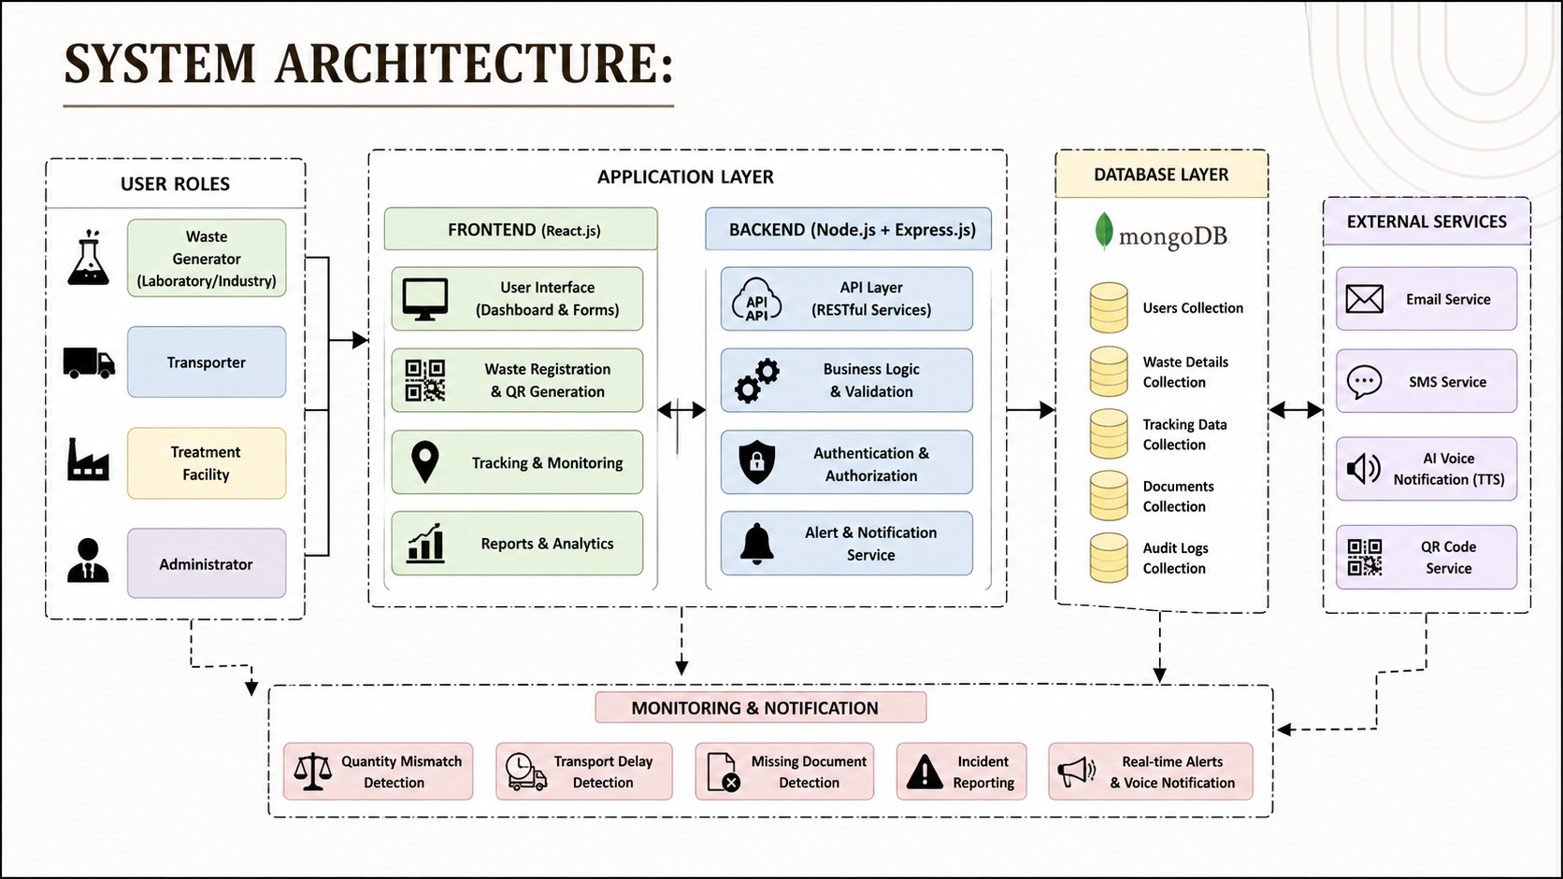

Slide 12

REFERENCES :
R. W. Ahmad, K. Salah, R. Jayaraman, I. Yaqoob, and M. Omar, “Blockchain for Waste Management in Smart Cities: A Survey,” IEEE Access, vol. 9, pp. 131520–131541, 2021.
S. M. H. Bamakan, P. Malekinejad, and M. Ziaeian, “Towards Blockchain-Based Hospital Waste Management Systems: Applications and Future Trends,” Journal of Cleaner Production, vol. 349, 131440, 2022.
P. Jiang, L. Zhang, S. You, Y. V. Fan, R. R. Tan, J. J. Klemeš, and F. You, “Blockchain Technology Applications in Waste Management: Overview, Challenges and Opportunities,” Journal of Cleaner Production, vol. 421, 138466, 2023.
I. U. Ajakwe, S. O. Ajakwe, J.-M. Lee, and D.-S. Kim, “Internet-of-Things-Blockchain Integration in Environmental Pollution Monitoring Data Management: Trends and Techniques,” International Journal of Environmental Science and Technology, vol. 22, pp. 16123–16142, 2025.

Slide 13
THANK YOU !

