Slide 1
MOBILE COMPUTING SERVICES TO SUPPORT FLOOD DISASTER APP

Slide 2
INDEX
Abstract
Objective of project
Problem Statement
Scope And Motivation
Introduction
Literature survey
Existing Method
Disadvantages
Proposed method
Advantages
Project Flow
Hardware and Software Requirements
Architecture
Modules
UML Diagram
Output Screens
Conclusion
Future Work
References

Slide 3
ABSTRACT
The project aims to provide a comprehensive mobile application that streamlines disaster response and relief efforts during flood emergencies. This application facilitates seamless interaction among donors, supporters, users, and administrators to enhance coordination and aid distribution. Donors can register, log in, view requests for assistance, and accept these requests, ensuring timely and efficient support. Supporters are also enabled to register, log in, view, and accept requests, adding an additional layer of support to the relief efforts. Users can register, log in, add requests for aid, and track their request history, allowing them to receive the necessary help quickly and transparently. The Admin role is crucial in verifying the profiles of supporters and requests before making them visible to donors, ensuring the authenticity and legitimacy of all interactions within the application. This mobile application aims to leverage technology to facilitate real-time communication, improve the efficiency of disaster response, and ensure that aid reaches those in need promptly. By integrating registration, authentication, and request management features, the application provides a robust platform for managing flood disaster relief efforts, ultimately helping to save lives and reduce the impact of such emergencies on affected communities.
Keywords: : Healthcare, Trainers, Doctors, Users, Interaction, Wellness

Slide 4
OBJECTIVE OF PROJECT
The objective of this project is to develop a mobile application that enhances flood disaster relief efforts by providing a centralized platform for coordination and communication among donors, supporters, users, and administrators. The application aims to streamline the registration, login, and request management processes, ensuring timely and verified assistance. It will facilitate real-time updates and efficient resource allocation, reducing delays and improving the overall effectiveness of disaster response. By leveraging mobile computing services, the project seeks to minimize the impact of floods on affected communities and ensure that aid reaches those in need promptly.

Slide 5
PROBLEM STATEMENT
The current flood disaster relief system suffers from significant inefficiencies due to manual coordination, fragmented communication, and lack of real-time updates. These issues result in delayed aid delivery, difficulty in verifying the authenticity of requests and supporters, and ineffective resource allocation. There is an urgent need for a centralized, streamlined platform to enhance the coordination, transparency, and efficiency of disaster response efforts.

Slide 6
SCOPE
The scope of this project encompasses the development and deployment of a mobile application designed to support flood disaster relief efforts. The application will include features for donor, supporter, user, and admin roles, each with specific functionalities such as registration, login, request management, and profile verification. The system will provide real-time updates, streamline communication, and enhance coordination among all parties involved. This application aims to improve the efficiency, transparency, and effectiveness of disaster response, ensuring timely and accurate delivery of aid to flood-affected individuals and communities.

Slide 7
MOTIVATION
The motivation behind this project lies in the need to provide a more efficient and coordinated approach to disaster relief during floods. Floods often result in widespread devastation, and timely aid is crucial to minimizing their impact on affected communities. By leveraging technology, the application enables faster, more transparent interactions between all parties involved, ensuring that resources are allocated effectively and that help reaches those who need it most in a timely manner.

Slide 8
INTRODUCTION
This project presents a mobile application designed to enhance disaster response and relief efforts during flood emergencies. The app facilitates seamless communication and coordination among donors, supporters, users, and administrators, ensuring that aid reaches affected communities swiftly. By integrating features such as registration, authentication, and request management, the application improves the efficiency and transparency of the disaster relief process, making it easier to manage resources and support those in need.

Slide 9
LITERATURE SURVEY
Date | Title | Authors | Outcomes
20-21 January 2023 | Flood Management System Using Cloud Computing and Internet-of-Things | Himanshu Rai Goyal, Sachin Sharma | Designed a wastewater system using IoT to prevent urban flooding and reduce disaster damage by 40%.
18-19 July 2017 | Video surveillance system for realtime flood detection | K. Priya Menon, L. Kala | Developed a video surveillance and mobile app for flood detection and alerts, reducing disaster impact.
10-13 October 2014 | Flooding through the lens of mobile phone activity | David Pastor-Escuredo, Alfredo Morales-Guzmán, et al. | Used mobile data to monitor flood impacts and improve early warning systems for better disaster response.
17-19 August 2017 | Smart flood disaster prediction system using IoT & neural networks | Swapnil Bande, Virendra V. Shete | Created IoT and ANN-based system to monitor and predict floods, enhancing flood management reliability.
21-25 September 2007 | Study on Decision Support System of Flood Disaster | Qing Yang, Qiang Zhang | Proposed a DSS for flood emergency management covering pre, during, and post-disaster phases.

Slide 10
Existing method:
The existing system for flood disaster relief often relies on manual coordination, fragmented communication, and inefficient resource allocation. This approach leads to delays in assistance, difficulty in verifying the authenticity of requests and supporters, and a lack of real-time updates. The absence of a centralized platform hinders effective collaboration among donors, supporters, and users, reducing the overall effectiveness of disaster response efforts.

Slide 11
Disadvantages in Existing method:
Manual and fragmented communication causes delays and hinders the timely delivery of aid, leading to potential gaps in disaster response.
Absence of a centralized platform prevents real-time updates and efficient tracking of requests, reducing overall response effectiveness

Slide 12
Proposed method:
The proposed system is a mobile application designed to enhance flood disaster relief efforts through efficient coordination and communication. The application features role-specific functionalities for donors, supporters, users, and administrators. Donors and supporters can register, log in, view, and accept requests for assistance. Users can register, log in, add aid requests, and track their request history. Administrators are responsible for verifying supporter profiles and requests before they are visible to donors. The system ensures real-time updates, streamlined resource allocation, and transparent interactions, significantly improving the efficiency and effectiveness of disaster response and relief operations.
.

Slide 13
Advantages of Proposed method:
Manual and fragmented communication causes delays and hinders the timely delivery of aid, leading to potential gaps in disaster response.
Absence of a centralized platform prevents real-time updates and efficient tracking of requests, reducing overall response effectiveness.

Slide 14
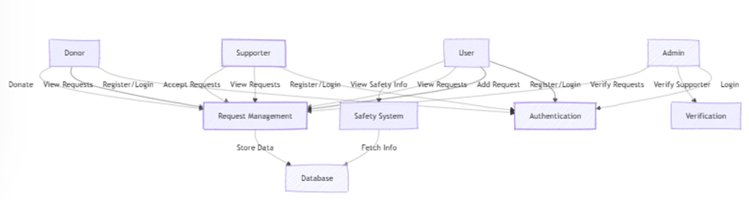
Propose System Flow

Slide 15
HARDWARE & SOFTWARE REQUIREMENTS
SOFTWARE REQUIREMENS
Operating System - Windows 10
JDK - Java(kotlin)
SDK - Android
IDE - Android studio
Database - my SQL

Slide 16
HARDWARE & SOFTWARE REQUIREMENTS
HARDWARE REQUIREMENTS
Processor - I3/Intel Processor
RAM - 8 GB
Hard Disk - 1TB

Slide 17
Modules
USERS: Users can Register, Login, Add Request for assistance, view their request History, and access real-time information on the Safety of flood-affected areas. This comprehensive set of features ensures users receive timely help and stay informed about safety measures during flood disasters.
ADMIN: Admin can Login, Verify Supporter Profiles, and Verify Requests. Only after verification will the requests be visible to Donors, ensuring that all aid efforts are legitimate and authenticated, enhancing the overall trust and efficiency of the disaster relief process.
SUPPORTERS: Supporters can Register, Login, View Requests, and Accept Requests. This allows supporters to actively participate in disaster relief efforts, providing timely and necessary assistance to those affected by floods, ensuring a coordinated and efficient response.
DONORS: Donors can Register, Login, View Requests, and Accept Requests. This enables donors to efficiently contribute to flood disaster relief efforts by directly addressing the needs of affected individuals and ensuring timely support and resource allocation.

Slide 18
UML DIAGRAMS
Use Case Diagram:
A use case diagram in the Unified Modeling Language (UML) is a type of behavioral diagram defined by and created from a Use-case analysis. Its purpose is to present a graphical overview of the functionality provided by a system in terms of actors, their goals (represented as use cases), and any dependencies between those use cases. The main purpose of a use case diagram is to show what system functions are performed for which actor. Roles of the actors in the system can be depicted.

Slide 19
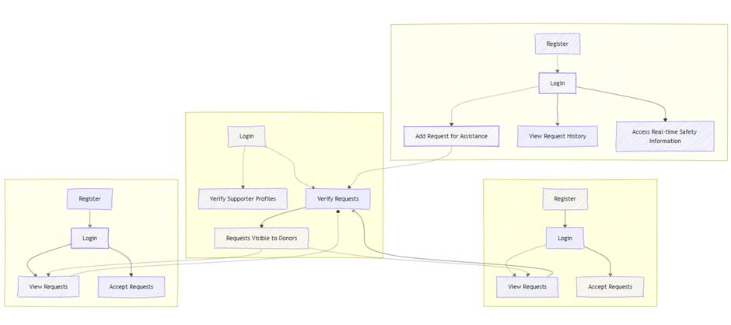
UML DIAGRAMS
Figure: Use Case Diagram

Slide 20
UML DIAGRAMS
Class Diagram:
In software engineering, a class diagram in the Unified Modelling Language (UML) is a type of static structure diagram that describes the structure of a system by showing the system's classes, their attributes, operations (or methods), and the relationships among the classes. It explains which class contains information.

Slide 21
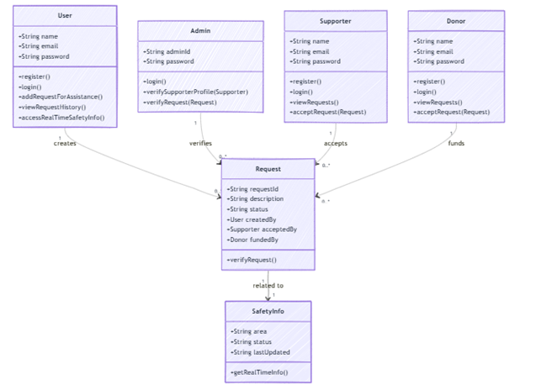
UML DIAGRAMS
Figure: Class diagram

Slide 22
UML DIAGRAMS
Sequence Diagram:
A sequence diagram in Unified Modelling Language (UML) is a kind of interaction diagram that shows how processes operate with one another and in what order. It is a construct of a Message Sequence Chart. Sequence diagrams are sometimes called event diagrams, event scenarios, and timing diagrams.

Slide 23
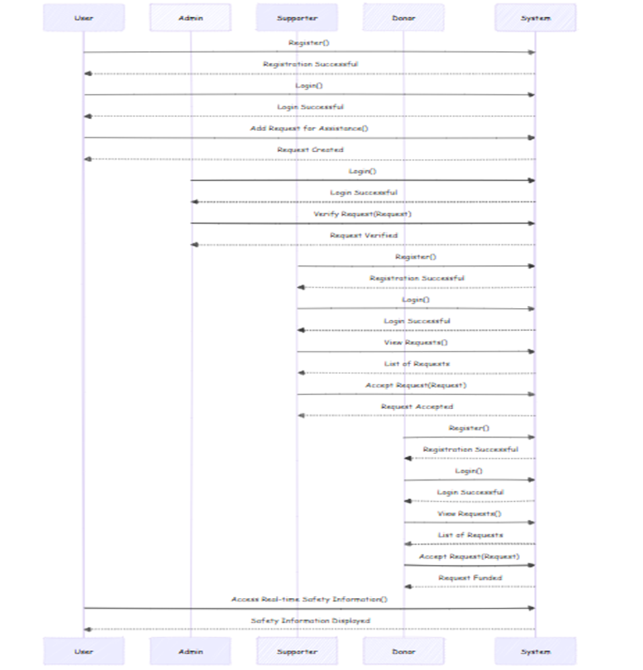
UML DIAGRAMS
Figure: Sequence diagram

Slide 24
UML DIAGRAMS
Collaboration Diagram:
In collaboration diagram the method call sequence is indicated by some numbering technique as shown below. The number indicates how the methods are called one after another. We have taken the same order management system to describe the collaboration diagram. The method calls are similar to that of a sequence diagram. But the difference is that the sequence diagram does not describe the object organization whereas the collaboration diagram shows the object organization.

Slide 25
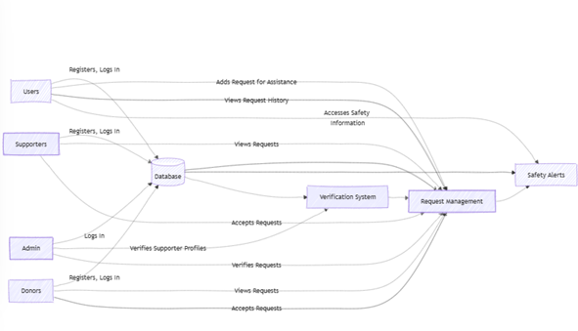
UML DIAGRAMS
Figure: Collaboration diagram

Slide 26
UML DIAGRAMS
Activity Diagram:
Activity diagrams are graphical representations of workflows of stepwise activities and actions with support for choice, iteration and concurrency. In the Unified Modelling Language, activity diagrams can be used to describe the business and operational step-by-step workflows of components in a system. An activity diagram shows the overall flow of control.

Slide 27
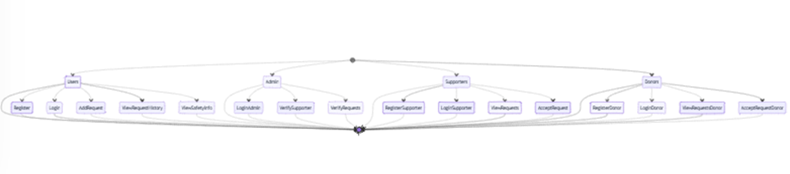
UML DIAGRAMS
Figure: Activity diagram

Slide 28
UML DIAGRAMS
Component Diagram:
A component diagram, also known as a UML component diagram, describes the organization and wiring of the physical components in a system. Component diagrams are often drawn to help model implementation details and double-check that every aspect of the system's required functions is covered by planned development.

Slide 29
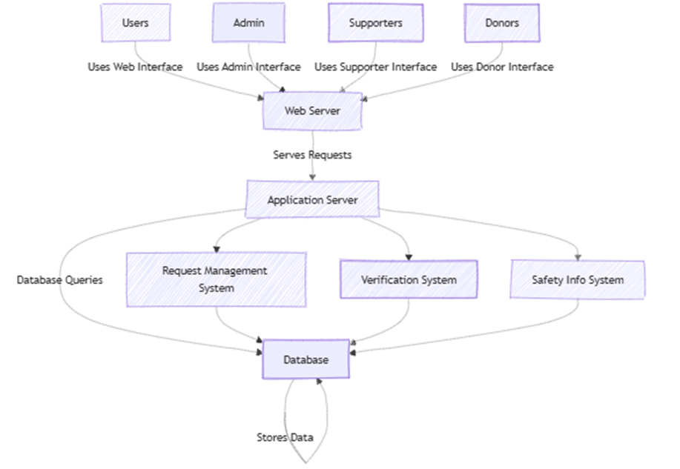
UML DIAGRAMS
Figure: Component diagram

Slide 30
UML DIAGRAMS
ER Diagram:
An Entity–relationship model (ER model) describes the structure of a database with the help of a diagram, which is known as Entity Relationship Diagram (ER Diagram). An ER model is a design or blueprint of a database that can later be implemented as a database. The main components of E-R model are: entity set and relationship set.
An ER diagram shows the relationship among entity sets. An entity set is a group of similar entities and these entities can have attributes. In terms of DBMS, an entity is a table or attribute of a table in database, so by showing relationship among tables and their attributes, ER diagram shows the complete logical structure of a database. Let’s have a look at a simple ER diagram to understand this concept.

Slide 31
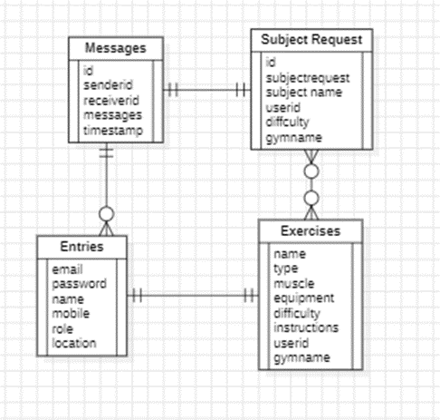
UML DIAGRAMS
Figure: ER diagram

Slide 32
UML DIAGRAMS
DFD Diagram:
A Data Flow Diagram (DFD) is a traditional way to visualize the information flows within a system. A neat and clear DFD can depict a good amount of the system requirements graphically. It can be manual, automated, or a combination of both. It shows how information enters and leaves the system, what changes the information and where information is stored. The purpose of a DFD is to show the scope and boundaries of a system as a whole. It may be used as a communications tool between a systems analyst and any person who plays a part in the system that acts as the starting point for redesigning a system.

Slide 33
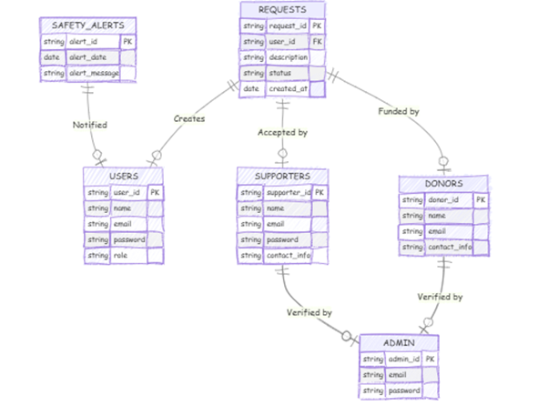
UML DIAGRAMS
Figure: Context Level diagram

Slide 34
CONCLUSION
In conclusion, this mobile application provides a vital platform for managing disaster relief efforts during flood emergencies. Through its user-friendly interface, donors, supporters, and users can engage in a streamlined process to request and provide aid. The inclusion of an administrator role ensures the legitimacy of interactions, fostering a secure environment for all participants. This comprehensive approach enhances the effectiveness of disaster response and ensures that critical aid is delivered promptly to those in need.

Slide 35
FUTURE ENHANCEMENT
Future enhancements to the application could focus on incorporating more advanced features to further improve the disaster relief process. For example, integrating real-time tracking systems could allow users to monitor aid distribution more efficiently. Additionally, expanding the app’s functionality to include multilingual support would ensure wider accessibility. Another potential improvement could be adding predictive analytics to optimize resource allocation based on historical data, enhancing the overall effectiveness of relief operations during floods.

Slide 36
REFERENCES
[1] Flood Management System Using Cloud Computing and Internet-of-Things || Himanshu Rai Goyal, Sachin Sharma || 20-21 January 2023
[2] Video surveillance system for realtime flood detection and mobile app for flood alert || K. Priya Menon; L. Kala || 18-19 July 2017.
[3] Flooding through the lens of mobile phone activity || David Pastor-Escuredo; Alfredo Morales-Guzmán; Yolanda Torres-Fernández; Jean-Martin Bauer; Amit Wadhwa; Carlos Castro-Correa || 10-13 October 2014.
[4] Smart flood disaster prediction system using IoT & neural networks || Swapnil Bande; Virendra V. Shete || 17-19 August 2017
[5] Study on Decision Support System of Flood Disaster Based on the Overall Process Emergency Management || Qing Yang; Qiang Zhang || 21-25 September 2007

