Slide 1
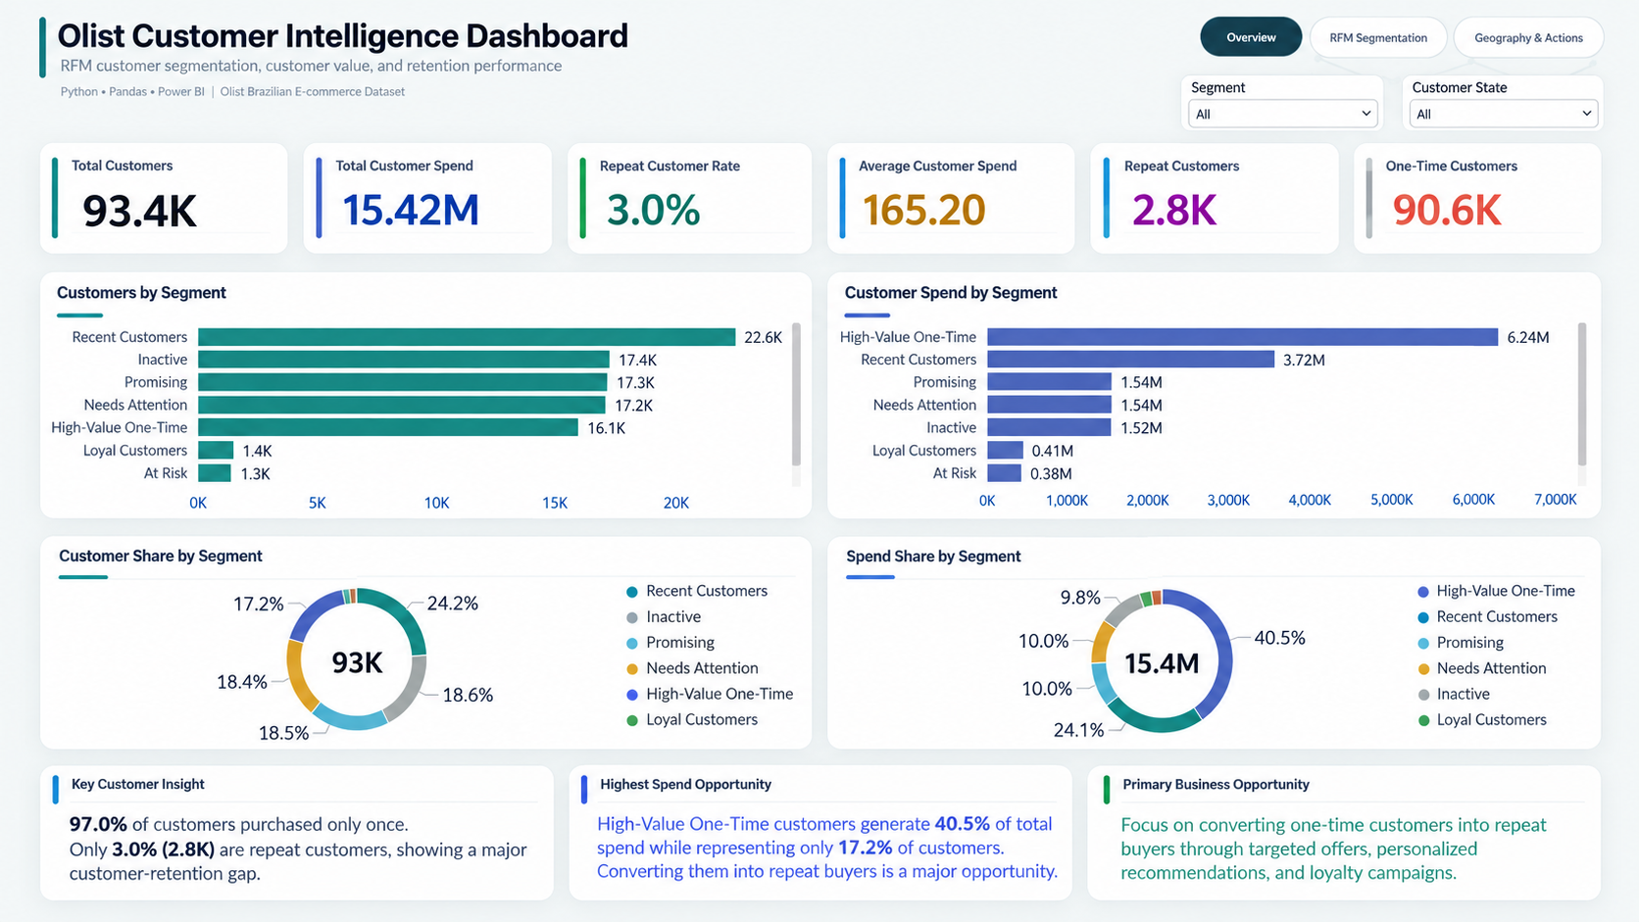
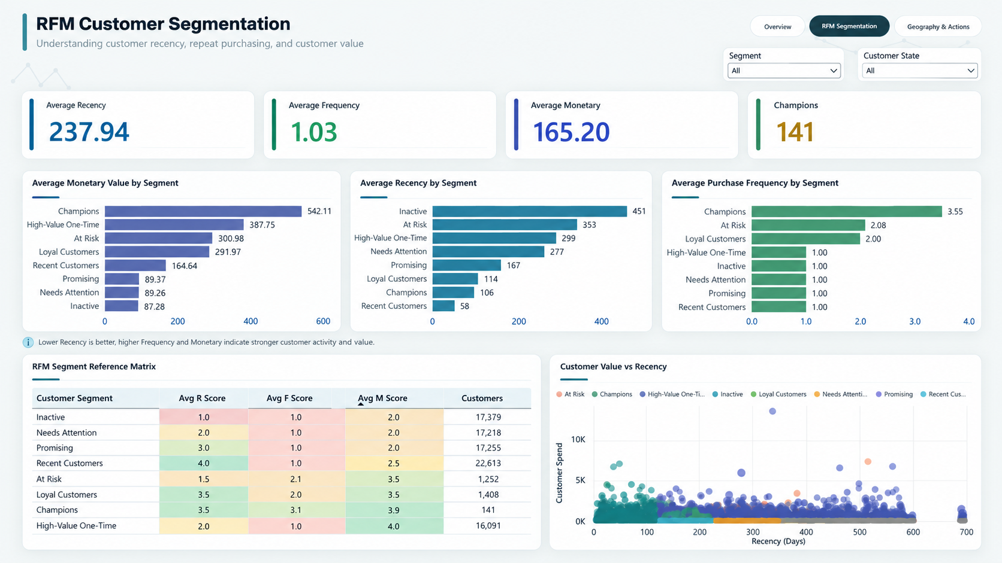
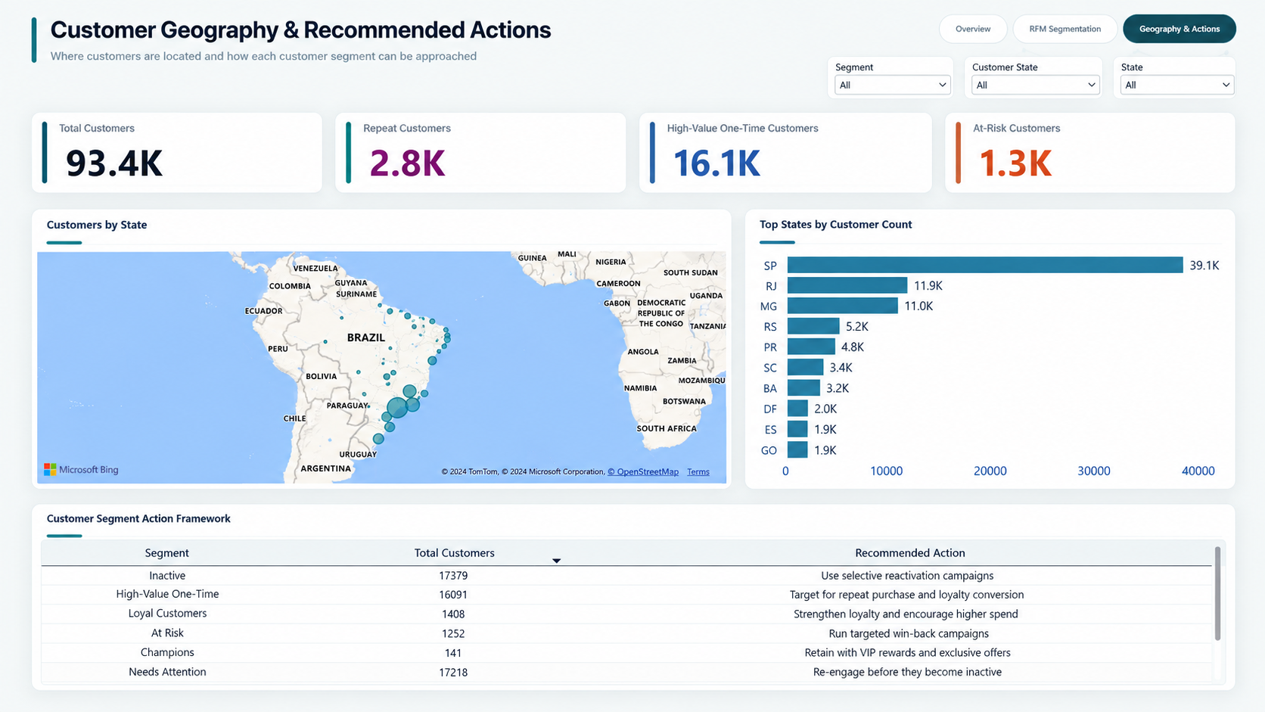
Olist Customer Intelligence
RFM Customer Segmentation using Python + Power BI
End-to-end analytics project: 9 raw datasets → cleaning & validation → RFM model → customer segments → business actions dashboard.
Customers
Repeat Rate
Total Spend
93.4K
3.0%
15.42M
Portfolio-ready deliverables
Jupyter Notebook
Processed CSV
Power BI PBIX
Dashboard Screenshots

Slide 2
One-minute story
What the project proves to a recruiter or stakeholder
Problem → Insight → Action
Final customers
Repeat customers
Repeat rate
Business problem
Olist has thousands of customers. The business needs to know which customers are recent, repeat, high-value, at-risk, or inactive.
What I built
An end-to-end customer intelligence workflow using Python for data preparation and RFM scoring, then Power BI for interactive reporting.
Business outcome
Segment-specific recommendations: convert high-value one-time buyers, protect Champions, win back At Risk customers.
93,357
2,801
3.0%
Key analytical finding
High-Value One-Time customers are only 17.2% of customers but generate 40.5% of historical customer spend.
That group is not “loyal” yet — they purchased once — but they represent the strongest conversion opportunity.
Technical stack
Portfolio proof
Interview angle
Python • Pandas
Power BI • DAX
RFM • Data Validation
Notebook + PBIX
Final CSV
3 dashboard pages
Explains why
not just what
was built
Olist Customer Intelligence | Python + Power BI | RFM Segmentation

Slide 3
Business problem & objectives
Turn e-commerce transaction history into customer-level business decisions
Business question
Analytical objective
Dashboard objective
How can Olist identify customers who are recent, repeat, high-value, at-risk, or inactive — and assign a relevant business action to each group?
Build a customer-level dataset with Recency, Frequency and Monetary behavior, then convert it into interpretable customer segments.
Create a management-ready Power BI report that shows customer health, segment value, geography and recommended actions.
What success looks like
01
Clean data pipeline
02
Defensible methodology
03
Useful segmentation
04
Decision dashboard
Raw relational CSVs correctly merged without duplicate inflation
Delivered orders only; payment rows aggregated before Monetary
RFM rules adapted to low repeat-purchase pattern
Insights shown as KPIs, segment comparisons, geography and actions
Olist Customer Intelligence | Python + Power BI | RFM Segmentation

Slide 4
Data & workflow
How the project moves from 9 raw files to a dashboard-ready customer table
End-to-end pipeline
9 raw CSVs
Python/Pandas
Customer 360
Power BI/DAX
Business output
Customers, orders, payments, products, sellers, reviews, geolocation
Load, inspect, validate, clean and merge relevant tables
One row per customer with R, F, M, segment, action, state/city
Measures, slicers, KPI cards, charts, map and action table
Retention opportunity + segment-specific recommendations
Raw orders
Delivered orders
Clean RFM rows
RFM customers
Final columns
99,441
96,478
96,477
93,357
12
Why this matters: the project demonstrates the real analyst workflow, not just a chart built on a pre-cleaned table.
Olist Customer Intelligence | Python + Power BI | RFM Segmentation

Slide 5
Data preparation decisions
The steps that make the numbers trustworthy
Quality checks & modeling choices
Before vs after
1
Delivered orders only
Cancelled, unavailable and incomplete statuses were excluded from RFM to avoid counting unsuccessful purchases.
103,886
99,440
payment rows
unique orders
2
Aggregated payments by order
Payments had 103,886 rows but 99,440 unique orders; multiple payment parts were summed first.
Grouped payment rows by order_id before merging.
3
Used customer_unique_id
This represents the same customer across purchases; final RFM table has one row per unique customer.
4
Reference date = dataset end + 1 day
Latest purchase was 2018-08-29; analysis date was set to 2018-08-30 for fair Recency.
Validation result
Final dataset: 93,357 customers
0 duplicate customers
0 missing values
Recency range: 1–695 days
5
Investigated missing payment
One delivered order had missing payment; excluded because Monetary could not be calculated reliably.
Olist Customer Intelligence | Python + Power BI | RFM Segmentation

Slide 6
RFM methodology
A simple, explainable customer behavior model
RFM meaning
Scoring approach
Why this is strong
Recency and Monetary
A top analytics project does not blindly copy RFM code. It adapts scoring to the data distribution and explains the choice.
R
Recency
How many days since the latest purchase?
Scored using quartile boundaries. Recency scoring is reversed so recent buyers get higher scores.
Lower raw Recency is better.
Frequency
Dataset reality:
90,556 of 93,357 customers made only one delivered purchase.
Therefore frequency needed business-rule scoring, not standard quartiles.
F
Frequency
How many delivered orders did the customer place?
Not scored by quartiles because 97% of customers purchased once. Custom bands were used.
Higher is better.
1 order
F=1
M
Monetary
2 orders
F=2
How much did the customer spend in total?
3–4 orders
F=3
Higher is better.
Interview-ready answer
5+ orders
F=4
“Frequency was heavily skewed, so I used custom bands while keeping R and M quantile-based.”
Olist Customer Intelligence | Python + Power BI | RFM Segmentation

Slide 7
Customer segmentation output
Eight behavior-based segments with recommended business action
Recent Customers
High-Value One-Time
Promising
Needs Attention
22,613
Recent, one-time
16,091
One purchase, high spend
17,255
Fairly recent, one-time
17,218
Less recent, one-time
Encourage second purchase
Convert to repeat buyers
Nurture with recommendations
Re-engage before inactive
Inactive
Loyal Customers
At Risk
Champions
17,379
Old, one-time
1,408
Recent repeat buyers
1,252
Repeat but not recent
141
Best repeat customers
Selective reactivation
Strengthen loyalty
Win-back campaigns
VIP rewards and retention
Segment interpretation
The segment names are not decorative. Each one connects customer behavior to a specific decision: retention, conversion, nurturing, re-engagement or selective reactivation.
This is the step where analysis becomes business action.
Olist Customer Intelligence | Python + Power BI | RFM Segmentation

Slide 8
Power BI dashboard design
Three pages designed for different decision levels
01
02
03
Executive Overview
RFM Segmentation
Geography & Actions
Customer health, spend, repeat behavior and key opportunities
Deep dive into Recency, Frequency, Monetary and segment logic
State-level customer distribution and segment-specific actions
KPI cards
Bar charts
RFM matrix
Scatter
Map
Top states
Donuts
Insights
Segment bars
Slicers
Action table
Slicers
Olist Customer Intelligence | Python + Power BI | RFM Segmentation

Slide 9
Executive insights
The numbers that matter most to business stakeholders
What the overview reveals
1
97.0% one-time customers
Repeat purchasing is very low in the observed dataset.
2
3.0% repeat customer rate
Only 2,801 of 93,357 customers made more than one delivered purchase.
3
40.5% spend from one group
High-Value One-Time customers are the strongest conversion opportunity.
Business interpretation
The problem is not simply “low sales.” The pattern is specific: many customers enter once, but very few return. The best near-term strategy is to prioritize second-purchase conversion for recent and high-value one-time customers.
Olist Customer Intelligence | Python + Power BI | RFM Segmentation

Slide 10
RFM deep dive
Why the segments make sense
Behavior patterns
Champions
Avg Frequency 3.55 and Avg Monetary 542.11 — rare but strongest behavior.
At Risk
Avg Frequency 2.08 but Avg Recency 353 days — previously engaged, now old.
Recent Customers
Avg Recency 57.5 days but Frequency 1 — good second-purchase target.
High-Value One-Time
M score strongest, F score weakest — high spend but not yet loyal.
Analytical maturity shown
The RFM matrix explains why a customer can be valuable but not loyal, recent but not repeat, or repeat but currently at risk. This helps the dashboard avoid one-size-fits-all marketing recommendations.
Olist Customer Intelligence | Python + Power BI | RFM Segmentation

Slide 11
Geography & actions
Where customers are concentrated and how the business can respond
Action framework
High-Value One-Time
Repeat-purchase and loyalty conversion
Recent Customers
Encourage second purchase
At Risk
Run targeted win-back campaigns
Champions
Retain with VIP rewards and exclusive offers
Inactive
Selective reactivation, not broad overspend
Why this page matters
Segmentation is more useful when connected to execution. The final page turns analytics into targeted actions by segment and geography, helping a business prioritize where to investigate campaigns first.
Olist Customer Intelligence | Python + Power BI | RFM Segmentation

Slide 12
Recommendations & next steps
What I would propose to the business
Second-purchase conversion
Win-back testing
Target Recent and High-Value One-Time customers with personalized offers and product recommendations.
Run controlled campaigns for At Risk customers because they have prior repeat behavior and higher monetary value.
1
2
Champion retention
Measure outcomes
Keep Champions engaged with exclusive offers, early access, or loyalty treatment because they are rare.
Track repeat rate, conversion from one-time to repeat, incremental spend, and campaign ROI by segment.
3
4
Important limitation
The dataset is historical and observational. Segment actions should be tested through campaigns and measured; RFM identifies opportunities, not guaranteed causality.
Olist Customer Intelligence | Python + Power BI | RFM Segmentation

Slide 13
What this project demonstrates
Why this is strong for a fresher Data Analyst portfolio
Data preparation
Analysis thinking
BI reporting
Loaded 9 raw CSVs
Checked shape, nulls, duplicates
Handled IDs and date types
Aggregated payment rows correctly
Defined RFM metrics
Adapted scoring to data skew
Built meaningful segments
Connected findings to action
Created 3-page dashboard
Built DAX measures
Used slicers and geography
Communicated KPIs and insights
Interview proof: I can explain the reasoning, not just the visuals.
Interview proof: I can explain the reasoning, not just the visuals.
Interview proof: I can explain the reasoning, not just the visuals.
Best portfolio message:
“I used RFM analysis to convert raw e-commerce transactions into actionable customer segments and built a Power BI dashboard for retention and marketing decisions.”
Olist Customer Intelligence | Python + Power BI | RFM Segmentation

Slide 14
Appendix: sources & project assets
What the work is based on
External references used
Final project files
Olist Brazilian E-Commerce Public Dataset
notebooks/
01_customer_segmentation_analysis.ipynb
Kaggle dataset with ~100K orders from 2016–2018 and multiple related CSVs.
data/processed/
olist_customer_segmentation_final.csv
RFM analysis definition
RFM groups customers by purchase recency, frequency and monetary value.
dashboard/
Olist_Customer_Intelligence_Dashboard.pbix
Power BI documentation
reports/
3 dashboard screenshots
Power BI supports cards, slicers, tables, maps, scatter plots and other report visuals.
docs/
data_dictionary.md
Suggested GitHub title: Olist Customer Intelligence & RFM Segmentation
References: Kaggle Olist Dataset; RFM analysis references; Microsoft Power BI documentation

