Slide 1

Team Details
Team name - Silicon Hackers
Team leader name - Shravana H S
Problem Statement - Indian Farmers Face a Triple Crisis: The 'Kilometre Gap', Motor Burnout, and The Cloud Gap.

Slide 2

Brief about the idea
Agri-Brain is a Local-First Edge AI platform running entirely on an AMD Ryzen Laptop. It connects to ESP32 microcontrollers in the field via MQTT, making real-time decisions without any internet. It is a brain transplant for the traditional farm.

Slide 3
Opportunities & USPs
Opportunities: Solving rural agricultural challenges with affordable, local AI.
How different is it from existing ideas?
Truly Offline AI — No Cloud. Every AI model runs locally. Zero monthly subscription.
Multi-Modal Intelligence in One Box: 5 AI engines coordinated by one gateway.
Voice Ledger in Local Languages: spoken commands (Kannada/Hindi) logic logging.
Motor Burnout Prevention: Acoustic AI shuts pump off before it burns.
How will it be able to solve the problem?
By providing a Rs 0-extra AI farm manager that works offline, speaks the local language, and protects livelihood 24/7.
USP:
40% Water Saved. Rs 15K+ Motor repair cost avoided. 3 hrs daily walking labour saved.

Slide 4
List of features offered by the solution
• Smart Irrigation Engine (10-grid sequential)
• Acoustic Motor Guard (Run-dry detection)
• Vision AI (Leaf Health, disease classification)
• Voice + NLP Ledger (Multi-language voice parsing)
• Soil Health Brain (Grid-level health score)
• Gemini AI Advisor (24/7 agricultural chatbot)

Slide 5
Process flow diagram or Use-case diagram
06:00 AM: ESP32 reads moisture, Agri-Brain auto-queues irrigation.
07:00 AM: Vision Brain detects leaf disease. Gemini suggests treatment.
10:00 AM: Voice command: "Irrigate Region 2". Valve opens. Ledger logs action.
02:00 PM: Pressure drops. Acoustic Brain triggers EMERGENCY SHUTDOWN.
06:00 PM: Soil Brain shows health scores.

Slide 6
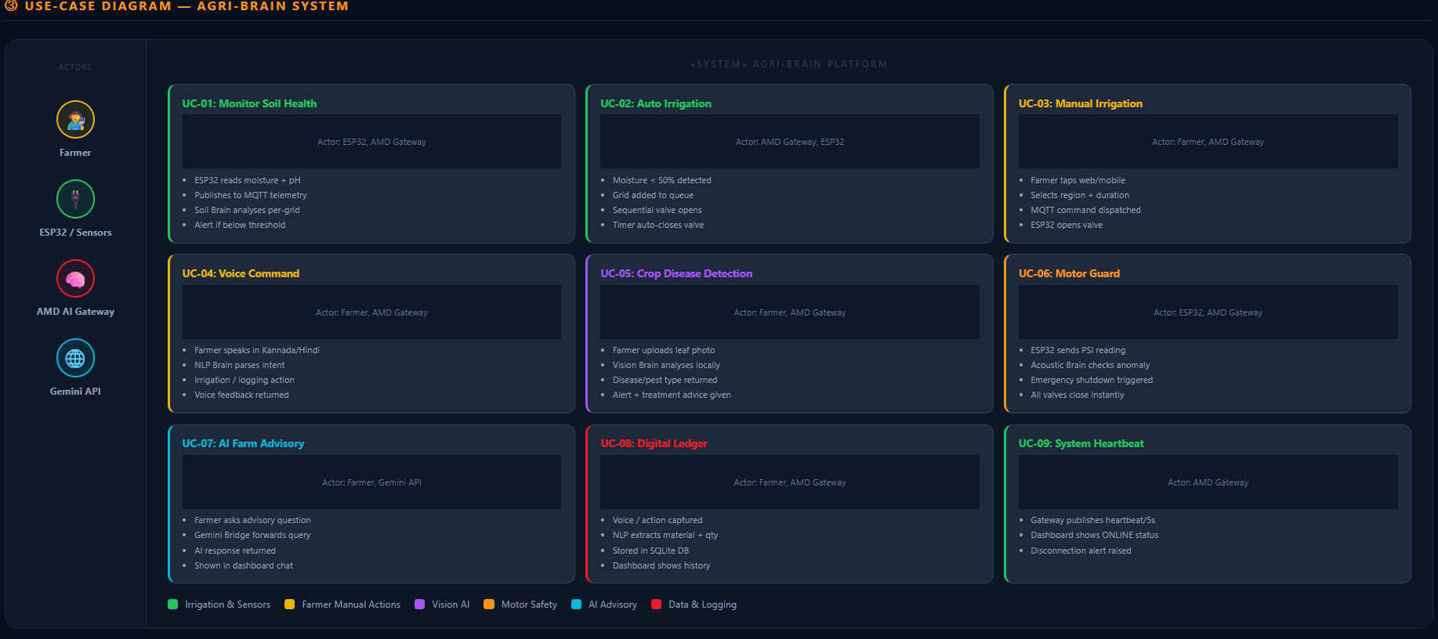

Slide 7
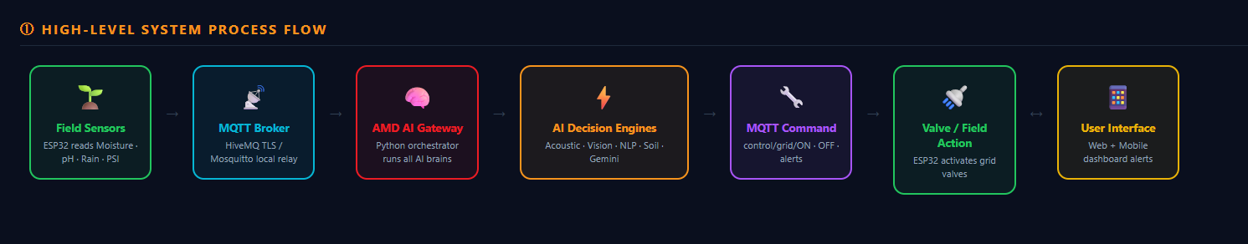
Wireframes/Mock diagrams of the proposed solution (optional)
Type here

Slide 8
Architecture diagram of the proposed solution
Layer 1: FIELD (ESP32, DHT22, Sensors, Solenoid Valves)
-> MQTT
Layer 2: COMMUNICATION (Mosquitto/HiveMQ)
-> MQTT
Layer 3: AMD AI GATEWAY (Irrigation, Acoustic, Vision, NLP, Soil, Gemini AI)
->
Layer 4: USER INTERFACE (Web Dashboard, Flutter Mobile App)

Slide 9
Technologies to be used in the solution
• Microcontroller: ESP32 + Arduino C++
• Simulation: Wokwi
• Communication: MQTT / Mosquitto / HiveMQ Cloud
• AI Gateway: Python 3
• Acoustic AI: acoustic_brain.py
• Vision AI: OpenCV / PIL
• NLP/Voice: nlp_brain.py + voice_brain.py
• Advisory AI: Google Gemini API
• Database: SQLite (farm_ledger.db)
• Web UI: HTML5/CSS3/Vanilla JS
• Mobile UI: Flutter (Dart)
• Compute: AMD Ryzen Laptop
• PCB: KiCad

Slide 10
Usage of AMD Products/Solutions
All five AI models (acoustic, vision, NLP, soil, advisory) run concurrently on an AMD Ryzen Laptop CPU. Multi-core architecture enables one dedicated thread per AI brain with near-zero latency, replacing cloud AI subscriptions. Local processing speed ensures life-saving features like sub-200ms emergency motor shutdown fire on time.
Future scalability roadmap uses AMD ROCm for GPU-accelerated frame analysis.

Slide 11
Estimated implementation cost (optional)
Estimated Per-Farm Hardware Cost:
ESP32 + Solenoid Valves (x10): Rs 3,500
Moisture + pH Sensors (x10): Rs 1,200
Local Wi-Fi Router: Rs 1,500
PCB Fabrication: Rs 800
Wiring + Enclosure: Rs 500
AMD Ryzen Laptop: Rs 0 (Existing)
Total Hardware Cost: ~Rs 7,500

Slide 12
Prototype Assets (Optional)
GitHub Public Repository Link:
https://github.com/ShravanaHS/Agri-Brain-AI-Orchestrated-Rural-Grid-A-ORG-
Demo Video Link: https://drive.google.com/file/d/1Ck_wTtQikj-M6UTONnekITmb1q8z6xfg/view?usp=sharing

Slide 13


