Slide 1
AMD SLINGSHOT 2026
Agri-Brain
AI-Orchestrated Rural Grid (A-ORG)
Solving the "Kilometre Gap" with Edge AI + AMD Ryzen™
TEAM
CHALLENGE
TRACK
STAGE
Shravana H S
AI / Edge Computing
AgriTech Innovation
Functional Prototype
AMD Slingshot 2026 | Agri-Brain Prototype Submission | shravanahs97@gmail.com
1 / 13

Slide 2
TEAM DETAILS
Built by One — Driven by Purpose
Shravana H S
Lines of Code
Field:
Electronics and Communication Engg. student
3,000+
Email:
shravanahs97@gmail.com
GitHub:
https://github.com/ShravanaHS/
AI Models Integrated
College:
Dayananda Sagar Academy of Technology and Management
5
Python
IoT/MQTT
Edge AI
Embedded C++
Web and app Dev
PCB Design
Days to Build
15
2 / 13

Slide 3
PROBLEM STATEMENT
Indian Farmers Face a Triple Crisis
The 'Kilometre Gap'
Farmers walk 5–10 km daily just to toggle irrigation valves manually, losing hours of productive time every single day.
Motor Burnout = Financial Ruin
When a pump runs dry, the motor burns. Replacing one motor costs a farmer their entire month's income — with zero warning.
The Cloud Gap
Existing 'smart agri' solutions require 4G/internet. In rural India, connectivity is not guaranteed — making cloud-dependent products useless.
3 / 13

Slide 4
ABOUT OUR IDEA
Agri-Brain: The Farm's Autonomous Nervous System
Agri-Brain is a Local-First Edge AI platform running entirely on an AMD Ryzen™ laptop. It connects to ESP32 microcontrollers in the field via MQTT, making real-time decisions with and without internet. It is a brain transplant for the traditional farm.
🌊
🧠
📵
Smart Irrigation
Multi-Modal AI
Offline-First
grid based sequential system triggered by live sensor data (soil moisture, pH etc..) using ESP32.
AI engines running simultaneously: acoustic, vision, NLP, soil, advisory(offline). gemini integration (online)
Most of the decisions made locally on AMD Ryzen™. Zero cloud dependency after setup.
4 / 13

Slide 5
ARCHITECTURE DIAGRAM
System Architecture (only for prototyping)
LAYER 1 — FIELD (ESP32 + Sensors)
LAYER 2 — COMMUNICATION (MQTT)
LAYER 3 — AMD AI GATEWAY (BRAIN)
LAYER 4 — USER INTERFACE
ESP32 Microcontroller
HiveMQ Cloud (TLS 8883)
Irrigation Queue Engine
Web Dashboard (HTML/CSS/JS)
DHT22 Moisture Sensors × 4 (based on gird)
Local Mosquitto Broker
Acoustic Motor Brain
Flutter Mobile App
pH Sensors × 4 (based on gird)
Topics: telemetry / control / voice / ledger
Vision AI (leaf disease)
Real-time grid map
⟷
⟷
⟷
4 × Solenoid Valves + Relays for driving (based on grid)
Bi-directional, QoS 1, Persistent
NLP + Voice Brain
AI chat panel
Motor Pressure Sensor (water sensor)
Soil Health Brain
Voice ledger
Gemini AI Advisor
5 / 13

Slide 6
DIFFERENTIATION
How Are We Different?
Truly Offline AI — No Cloud
Multi-Modal Intelligence in One Box
1
Every AI model runs locally on AMD Ryzen™. A power cut is the only thing that stops it.
2
5 specialist AI engines coordinated by one gateway — not 5 separate expensive products.
Voice Ledger in Local Languages
Motor Burnout Prevention
3
Farmer says 'Added 5kg Potash' in Kannada. The system logs it — zero typing required.
4
Acoustic AI listens to the pump and shuts it off before it burns. Saves ₹15,000+ per incident.
₹0 Extra Infrastructure
Grid Sequential Irrigation
5
Uses the farmer's existing laptop as the brain. No server rent, no monthly subscription.
6
Section-by-section watering maintains optimal pressure — 40% water saving vs. broadcast.
6 / 13

Slide 7
PROBLEM → SOLUTION
How Does It Solve the Problem?
Problem
Agri-Brain Solution
Module
Farmer walks 5–10 km to toggle valves
Web + Mobile app controls all valves remotely from anywhere on the farm
Irrigation Engine
Pump runs dry → motor burns
Acoustic AI monitors pressure PSI. Emergency shutdown triggers automatically
acoustic_brain.py
No internet → no smart agri
All AI runs on AMD Ryzen locally. MQTT via Mosquitto needs only a Wi-Fi router
Local Gateway
Crop disease spotted too late
Vision AI analyses leaf images and alerts before disease spreads to entire crop
vision_brain.py
Soil health is guesswork
pH + moisture per grid → soil_brain gives actionable grid-level advice
soil_brain.py
Literacy + language barrier
Voice commands in Kannada/Hindi; NLP parses intent and logs actions hands-free
voice_brain.py
7 / 13

Slide 8
UNIQUE SELLING PROPOSITION
The USP of Agri-Brain
"A ₹0-extra AI farm manager that works entirely offline, speaks your language, and protects your livelihood 24/7"
40%
₹15K+
3 hrs
Water Saved via precision grid irrigation
Motor repair cost avoided per incident
Daily walking labour saved per farmer
8 / 13

Slide 9
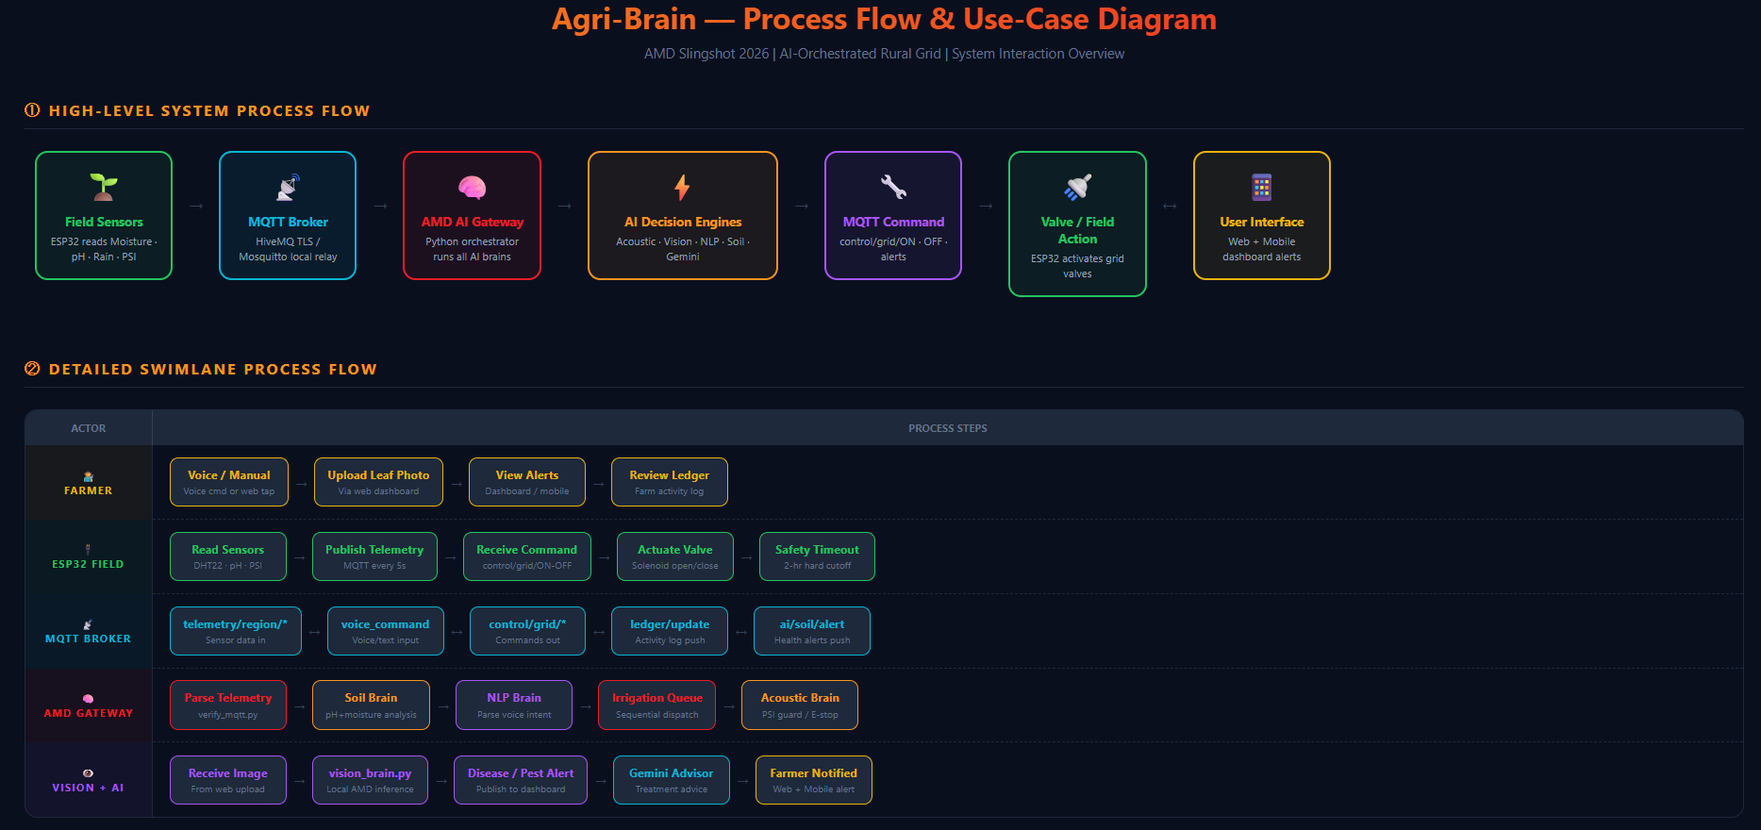

Slide 10
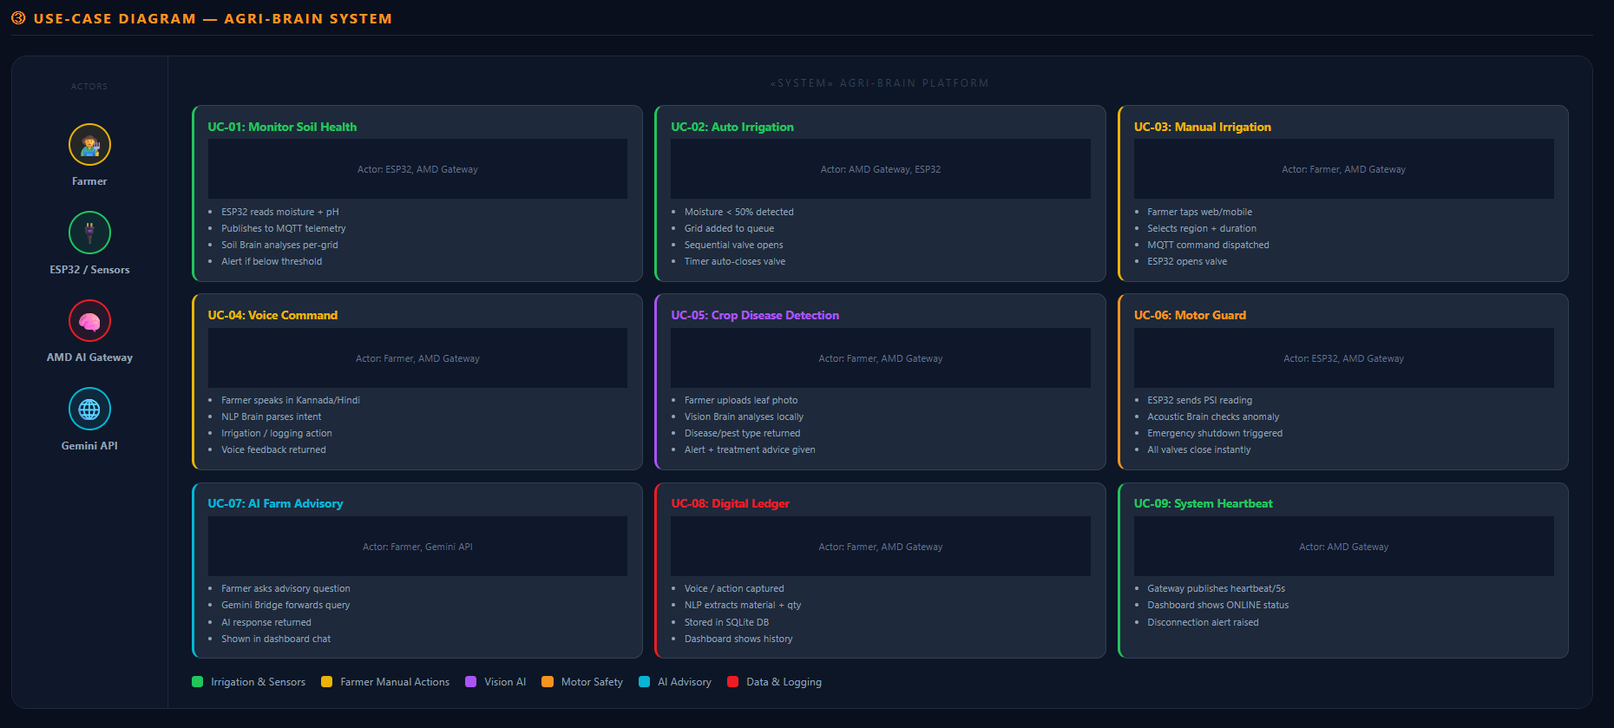

Slide 11
FEATURE LIST
Complete Feature Set
Smart Irrigation Engine
Acoustic Motor Guard
• grid sequential queue with configurable duration • Auto-trigger when humidity < threshold • Manual control via web/mobile/voice • 2-hour ESP32 hard safety timeout
• Real-time pump pressure PSI monitoring • Run-dry detection via pressure anomaly • Emergency shutdown — all valves OFF • Instant alert to dashboard + mobile
Vision AI — Leaf Health
Voice + NLP Ledger
• Early/Late Blight detection in tomatoes • Leaf Miner, Mite, Aphid pest detection • Nutrient deficiency via leaf colour • Processed locally on AMD Ryzen™
• Voice input in Kannada, Hindi, English • NLP parses action, material, quantity, grid • Persistent SQLite ledger (farm_ledger.db) • Hands-free irrigation via voice command
Soil Health Brain
Gemini AI Advisor
• Per-grid pH + moisture analysis • Actionable advice (Add lime / Reduce water) • Grid-level health score mapping
• 24/7 agricultural advisory chatbot • Crop rotation, water & pest advice • Integrated into web dashboard AI chat
9 / 13

Slide 12
USE-CASE & PROCESS FLOW
A Day in the Life of Agri-Brain
06:00 AM
Morning Sensor Report — ESP32 reads moisture + pH. Agri-Brain detects Grid 3 at 32% humidity → auto-queues irrigation.
07:00 AM
Farmer uploads leaf photo → Vision Brain detects Early Blight Stage 1. Gemini suggests treatment protocol.
10:00 AM
Voice command in Kannada: 'Irrigate Region 2 for 15 min'. NLP Brain parses it. Valve opens. Ledger logs action.
02:00 PM
Pressure PSI drops. Acoustic Brain triggers EMERGENCY SHUTDOWN. All 10 valves close. Motor is saved.
06:00 PM
Daily report: Soil Brain shows per-grid health scores. Dashboard summarises water used, alerts raised, entries logged.
10 / 13

Slide 13
TECHNOLOGIES USED
Technology Stack
Layer
Technology
Purpose
Microcontroller
ESP32 + Arduino C++
Field sensor reading, valve control, DHT22 sensors
Simulation
Wokwi
Zero-hardware ESP32 prototype validation
Communication
MQTT / HiveMQ Cloud (TLS 8883)
Bi-directional real-time telemetry & control
AI Gateway
Python 3 / paho-mqtt
Central orchestrator running all AI brains
Acoustic AI
acoustic_brain.py
Motor pressure anomaly detection & emergency shutdown
Vision AI
Python + OpenCV / PIL
Leaf disease and pest classification from images
NLP / Voice
nlp_brain.py + voice_brain.py
Multi-language voice command parsing
Advisory AI
Google Gemini API
Contextual 24/7 agricultural advice chatbot
Database
SQLite (farm_ledger.db)
Offline-first farm activity ledger
Web UI
HTML5 / CSS3 / Vanilla JS
Dashboard: irrigation control, grid map, AI chat
Mobile UI
Flutter (Dart)
Cross-platform mobile control app
Compute
AMD Ryzen™ Laptop
All AI inference — replaces cloud entirely
PCB
KiCad
Custom PCB design for field deployment
11 / 13

Slide 14
AMD PRODUCTS / SOLUTIONS
Why AMD Powers This?
AMD Ryzen™ — The Edge AI Brain
All five AI models (acoustic, vision, NLP, soil, advisory) run concurrently on AMD Ryzen™ CPU. Multi-core architecture enables one dedicated thread per AI brain with near-zero latency. This replaces an ₹8,000/month cloud AI subscription with a one-time local setup.
Local Processing → Zero Latency Safety Responses
When Acoustic Brain detects motor anomaly, EMERGENCY SHUTDOWN fires in <200 ms. A cloud-based system takes 2–5 seconds (round-trip). Those seconds mean a burnt motor. AMD's local processing speed makes this life-saving feature viable.
Scalability Path: AMD ROCm™ (Future)
Vision AI is designed for GPU acceleration. Future versions will use AMD Radeon™ + ROCm™ to run ResNet / EfficientNet crop-disease models with sub-100 ms inference. This enables real-time field video analysis at production scale.
12 / 13

Slide 15
COST & ROADMAP
Implementation Cost & Next Steps
Estimated Per-Farm Hardware Cost
Prototype → Production Roadmap
Phase 1: Wokwi + Cloud Broker
ESP32 + Solenoid Valves (×10)
₹3,500
✓ Done
10-grid simulation, AI gateway, HiveMQ integration
Moisture + pH Sensors (×10)
₹1,200
Phase 2: Premium Web Dashboard
Local Wi-Fi Router
₹1,500
✓ Done
Grid map, real-time telemetry, AI chat, voice ledger
PCB Fabrication (Custom)
₹800
Phase 3: Custom PCB Design
Optimizing for real world scenerio
Wiring + Enclosure
₹500
KiCad PCB for field-ready hardware deployment
AMD Ryzen™ Laptop (co-op)
₹0
Phase 4: Physical Field Pilot
Upcoming
Total Hardware Cost
~₹8,000
Deploy on real farm, integrate sensors, iterate AI models
Phase 5: AMD ROCm™ GPU Inference
Upcoming
Real-time video crop analysis with AMD Radeon™
🔗 https://github.com/ShravanaHS/Agri-Brain-AI-Orchestrated-Rural-Grid-A-ORG--
13 / 13

