Slide 1


Enterprise Employee Analytics
End-to-End Employee Data Management,
Data Warehousing & Analytics
5th Oct 2026
Subhaprada | Shravani | Keerthi
Python · MySQL · Streamlit · Aiven Cloud
The content of this presentation is proprietary and confidential information of v4c.ai. This presentation is not intended to be distributed to any third party without the prior written consent of v4c.ai

Slide 2
The business problem
Employee data is spread across operational systems
Scattered employee data
Operational records are hard to combine for analysis
Performance is hard to compare
No year-over-year view across departments
THE NEED
Centralized analytics and reporting on one trusted data foundation
OLTP → ETL → Warehouse → Dashboard
Attrition risk goes unseen
No early warning for who may leave
Projects get over-allocated
Overloaded teams are not visible

Slide 3
Project objectives
Eight goals, from data entry to cloud deployment
Employee management
Onboard, update, search
Project management
Create projects, assign staff
Performance reviews
Rate 1-5 with comments
ETL & warehouse
OLTP to star schema
1
2
3
4
Analytics
Window-function SQL
Attrition analysis
Risk score and bands
Bottleneck detection
Find over-allocated projects
Cloud deployment
Aiven + Streamlit Cloud
5
6
7
8

Slide 4
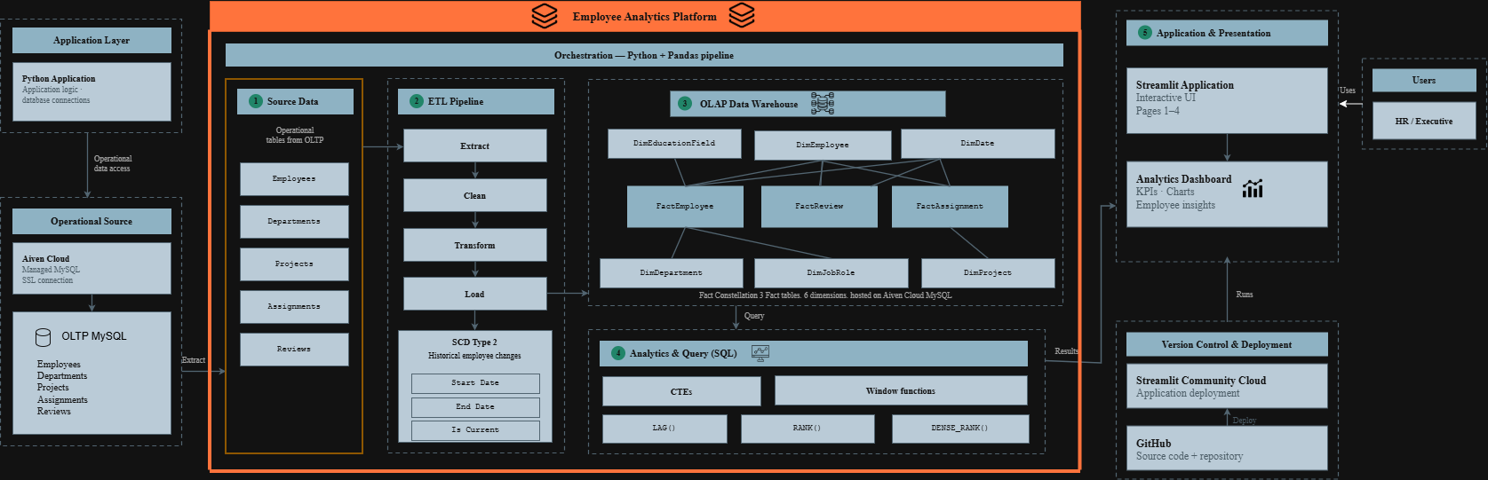
System architecture

Slide 5
Database & data warehouse design
Operational (OLTP) vs analytical (OLAP)
start_date · end_date · is_current (SCD Type 2)
OLTP: operations
Normalized tables: Employee, Project, Assignment, Reviews and lookups
Fast inserts and updates from the forms
DimEmployee *
FactEmployee
DimEducationField
DimDepartment
FactAssignment
DimProject
OLAP: analytics
Star schema: facts + dimensions
Surrogate keys on every dimension
DimEmployee is SCD Type 2
DimJobRole
FactReview
DimDate

Slide 6
ETL pipeline
python/etl_pipeline.py and SQL load scripts
Extract
Read employees, projects, assignments, reviews from OLTP
Transform
Remove duplicates and missing IDs, build SCD Type 2 versions
Load
Dimensions first, then fact tables into the warehouse
E
T
L
ETL verification: successful load
100,000
employees cleaned
3
DimDepartment
9
DimJobRole
6
DimEducationField
30
DimProject
1,096
DimDate
100,000
FactEmployee
26,508
FactAssignment
104,945
FactReview
Extra test records were added later during app testing

Slide 7
Application modules
Streamlit pages in app/pages/, one workflow for every action
Onboarding & update
Add employees
Dept, role or salary change creates an SCD2 version
Employee directory
Search by name or number
Filter by department
Projects
Create with status and owner department
Team view with team size
Assignments
Role and allocation %
Warns above 100% total
Reviews
Rating 1-5 and comments
History, synced to warehouse
Form → Validation (entities.py) → OLTP write + warehouse sync procedure → Commit or rollback
Live test: employee #100005 onboarded · Project 35 created · Assignment 40973 · Review 131085

Slide 8
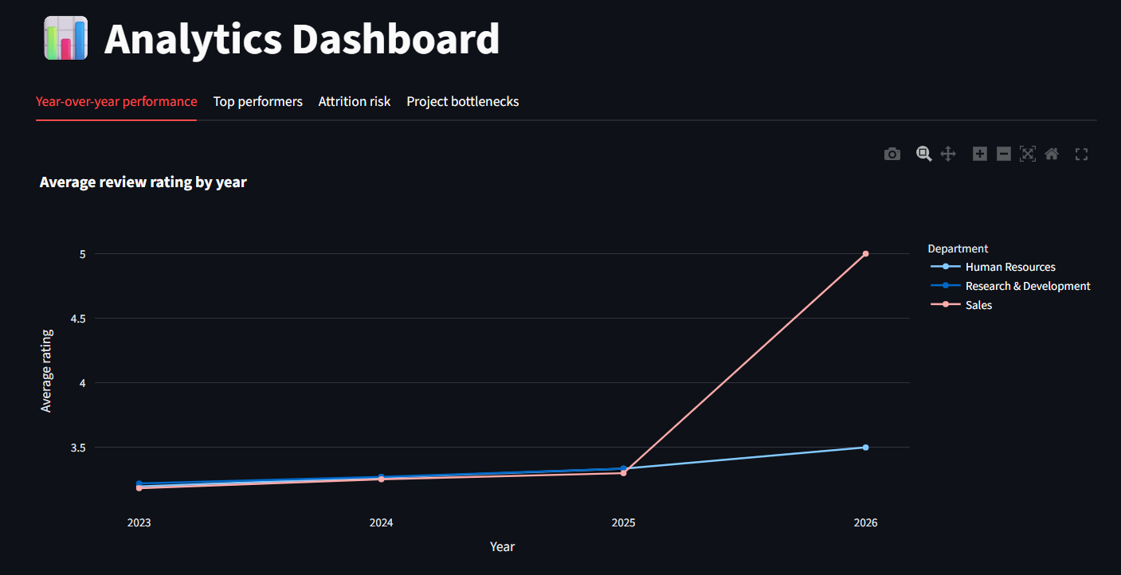
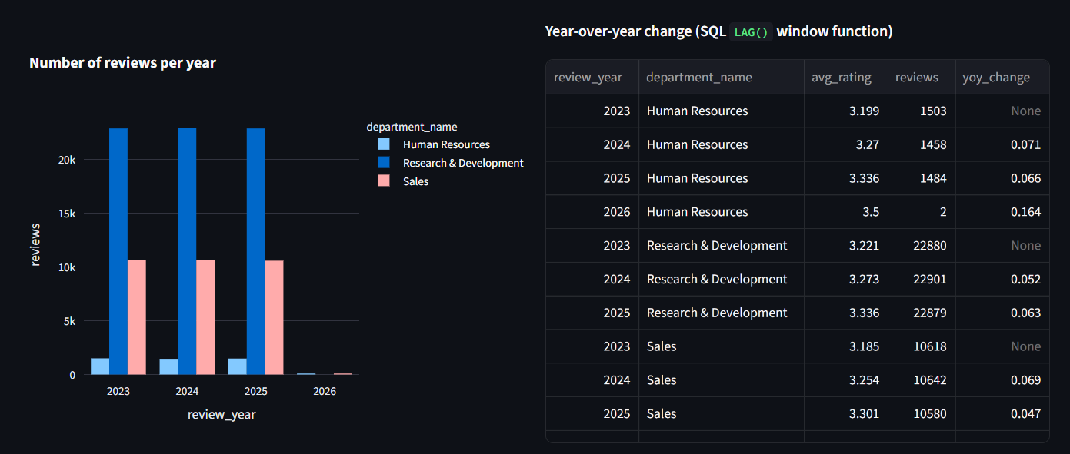
Analytics dashboard
app/pages/4_Analytics.py reads the warehouse
through AnalyticsManager
Year-over-year performance
LAG() compares each year with the previous one
1
Top performers by department
DENSE_RANK() in a CTE; ties share a rank
2
Attrition risk
CTE risk score 0 to 8: High / Medium / Low
3
Project bottlenecks
CTE + RANK() on over-allocated members
4

Slide 9
Key analytics: from data to decisions
What the business can do with each insight
Employee performance
Insight: Departments rising or falling year over year
Decision: Focus training and recognition
Top performers
Insight: Best employees in each department
Decision: Reward, retain, plan succession
Attrition risk
Insight: Who is likely to leave, and why
Decision: Act early on workload, pay, promotion
Project bottlenecks
Insight: Projects with over-allocated people
Decision: Rebalance allocation or add capacity
Live example: Performance Review Redesign ranked #1 bottleneck, 1,633 of 3,567 members over-allocated (45.8%)

Slide 10
Testing & validation
tests/smoke_test.py runs against the real databases
34
automated checks
ALL CHECKS PASSED
What it covers
Singleton + OLTP / OLAP connections
Entity validation
Onboarding + warehouse load
SCD Type 2 + rollback
Duplicate assignment, invalid rating
KPIs, LAG(), DENSE_RANK()
Attrition risk and bottlenecks
Verified live
✓ Onboarding
✓ Employee directory
✓ SCD Type 2 update
✓ Projects + assignment
✓ Review + history
✓ All 4 analytics
✓ OLTP and OLAP connect
✓ Cloud database

Slide 11
Cloud deployment
Live and tested end to end
GitHub
Code, feature branches, pull requests, main
Streamlit Community Cloud
Runs app/streamlit_app.py from main
Aiven MySQL
OLTP + OLAP databases
SSL-secured connection
TLS with the Aiven CA certificate
No secrets in code
Credentials in Streamlit Secrets; .env is git-ignored
Same code, local or cloud
Settings from env variables or Streamlit secrets
Live app (tested end to end): https://enterprise-employee-analytics-vwrm6uzkwr63wvwzj8fvdv.streamlit.app/

Slide 12
Conclusion & future scope
An end-to-end employee analytics platform
CONCLUSION
Operational data → ETL → data warehouse → analytics, deployed in the cloud and verified end to end.
Future scope
• Predictive attrition models
• Role-based authentication
• Scheduled, automated ETL
• More dashboards and KPIs
• Alerts for high-risk employees
• Project capacity planning
• CI/CD automation

Slide 13
Thank You!

