Slide 1
File Comparison & Card List Task Submission
Name: Shravani Pawar

Slide 2
Project Overview
Develop a responsive React application with:
File Comparison Feature (CSV/JSON)
Card List with Expandable Details
Technology Stack: React.js, Tailwind CSS, Axios, Papaparse

Slide 3
Features Implemented
File Comparison Feature
Upload two CSV/JSON files.
Compare data and highlight differences.
Display results in a structured UI.
Card List with Expandable Details
Fetch card data from an API.
Display summary with "Info" button.
Expandable section for full details.
Responsive Design
Works across desktop, tablet, and mobile.

Slide 4
Tools & Libraries Used
React.js - Core frontend framework
Tailwind CSS - Styling and responsiveness
Axios - API calls
Papaparse - CSV file parsing
Git & GitHub - Version control

Slide 5
Code Structure
App.jsx - Main entry point
FileComparison.jsx - Handles file uploads and comparison
CardList.jsx - Fetches and displays cards
index.css - Styling with Tailwind CSS

Slide 6
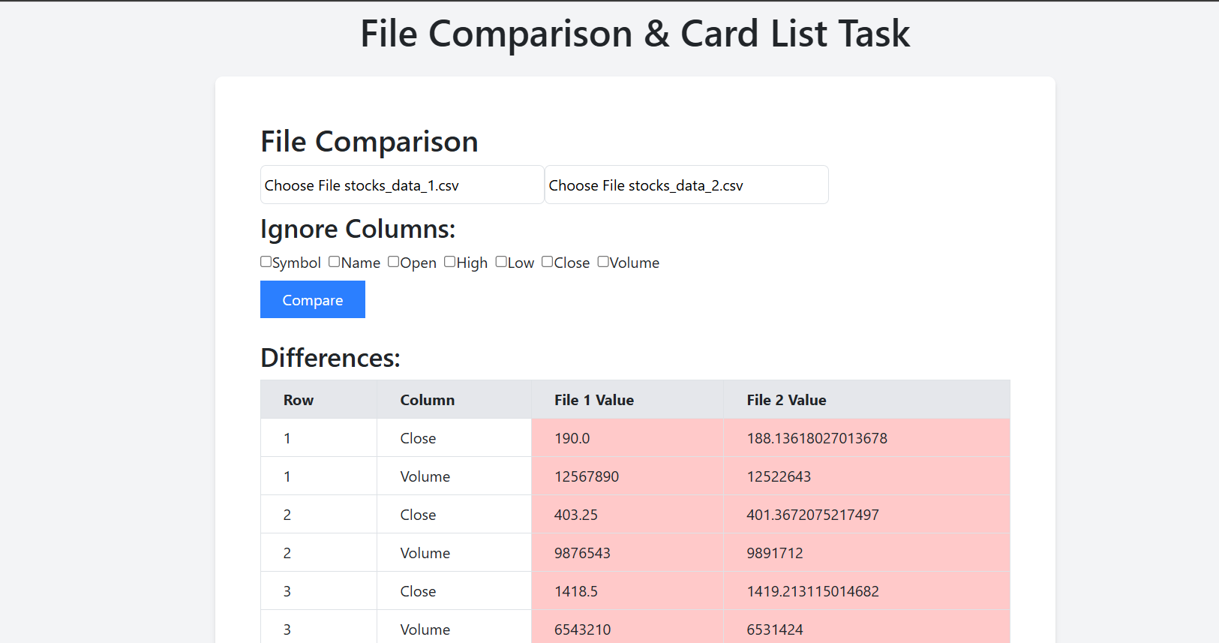
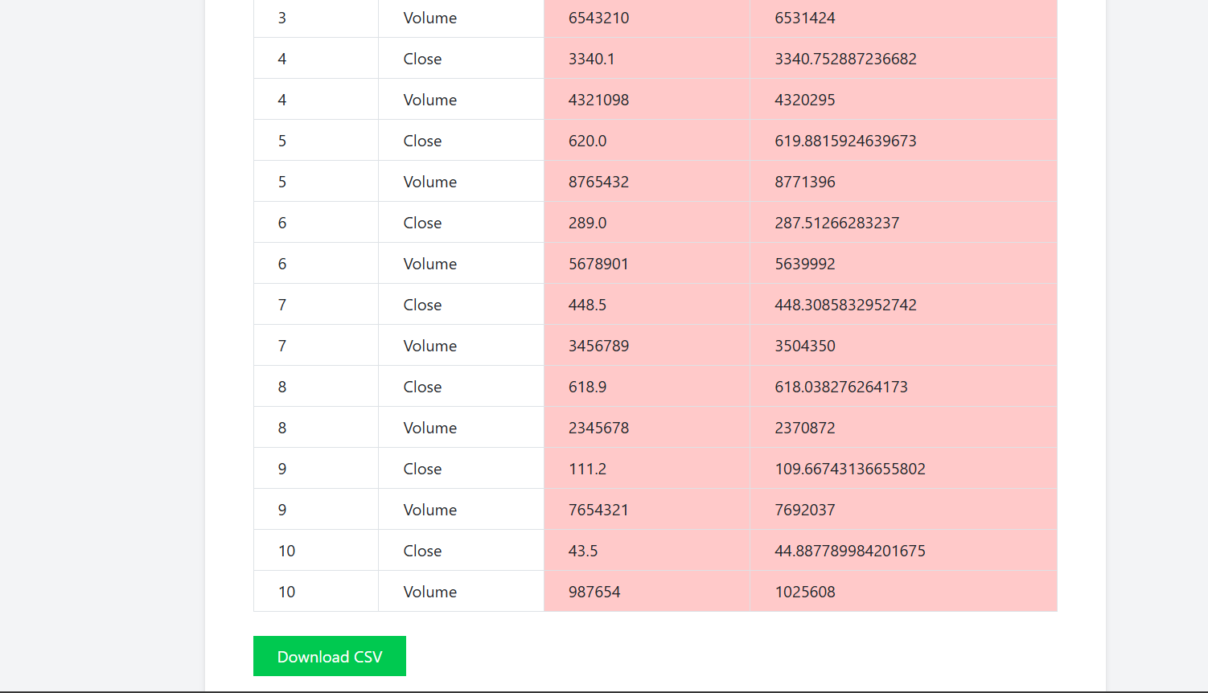
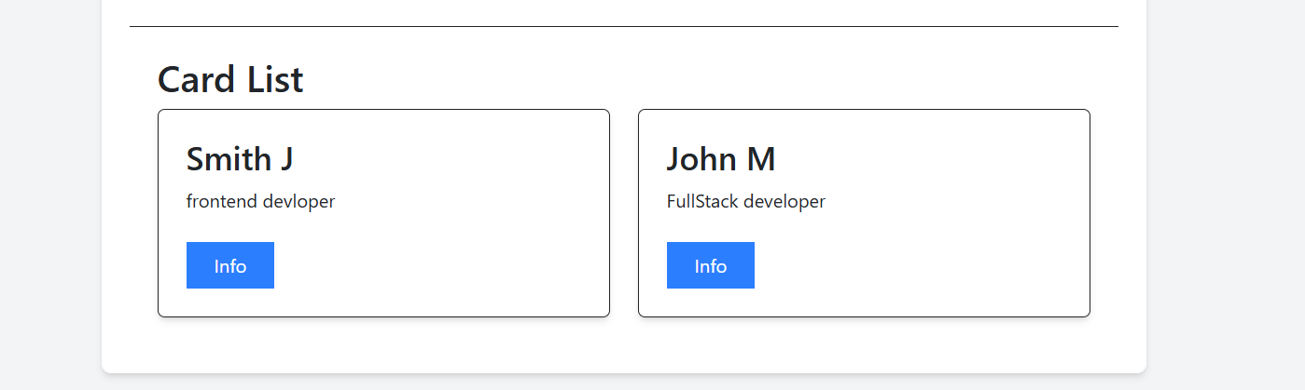
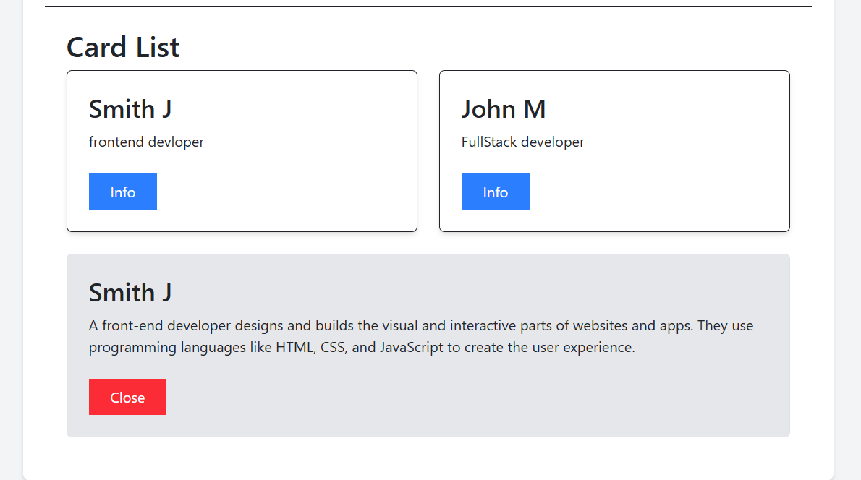
Demo Screenshots
Screenshot of File Upload & Comparison:-
Screenshot of Card List & Expandable Details

Slide 7
Challenges & Solutions
Handling Large CSV Files → Used Papaparse for efficient parsing.
Error Handling → Implemented alerts for invalid files & API failures.
API Integration → Used Axios with loading/error states.
UI Responsiveness → Flexbox & Grid with Tailwind CSS

Slide 8
Conclusion & Next Steps
Successfully implemented file comparison & API data display.
Future Improvements:
Add support for Excel files.
Implement a backend for advanced comparisons.
Thank You

