Slide 1

Introduction to Data Analytics in Business
Master in Applied Data Science Batch 2025
-
Project
-
“Decoding ESG:
Measuring Clarity and Greenwashing in Corporate Disclosures ”
Shravani Mahadeshwar, Vishwas Khandelwal, Padma Priya Botsa

Slide 2


Introduction
ESG disclosures are now mandatory and material to investors. Yet, many corporate ESG reports are criticized for vagueness and “greenwashing.”
Regulators (like the SEC) are tightening scrutiny on misleading sustainability claims.
Are ESG disclosures in official SEC filings becoming more transparent or more rhetorical?
01

Slide 3

Why This Study Matters
Companies publish detailed ESG sections, but most research focuses on scores and performance, not on how ESG is communicated in official filings. We bring a language-based perspective to assess ESG discourse.
01.
ESG (Environmental, Social, and Governance) reporting has become an integral part of corporate disclosures. Using Guided LDA topic modeling, we identified the most dominant ESG themes across Environmental, Social, and Governance pillars from SEC 10-K filings. This helped uncover the key sustainability topics companies emphasize and how their focus areas vary across ESG dimensions.
To evaluate the credibility of ESG communication, we developed a Greenwashing Risk Index (GRI) using NLP techniques. The index compares Overall ESG Content in each report with its Overall ESG Concreteness to quantify the balance between how much companies talk about ESG and how clearly, they communicate it.
“Greenwashing” is often discussed but rarely quantified. We created a Greenwashing Risk Index (GRI) to objectively measure the balance between ESG content and communication clarity.
02.
02
SEC 10-K filings are audited and legally binding, yet their ESG sections lack established assessments of linguistic integrity. In this study, we test this aspect to establish a baseline of credibility in ESG communication within formal reports.
03.

Slide 4
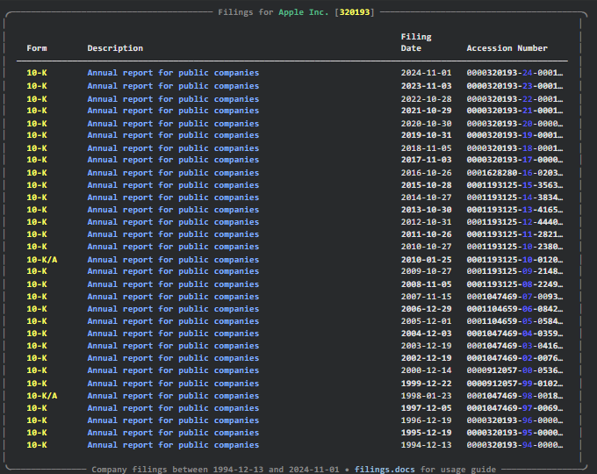
Data Source
Data extracted from the SEC EDGAR database using the edgar library in Python.
Queried filings by Company Ticker and Form Type = 10-K for all S&P 50 companies.
Collected key metadata: Ticker, Filing Date, Report Date, Accession Number, and Full Report Text.
Time period: 2015–2025 (ten years of filings).
Created a preliminary ESG keyword flag to identify reports mentioning ESG-related terms used only for checks, no filtering applied.
Produced a complete corpus of 10-K report texts for further NLP, topic modeling, and linguistic analysis.
03

Slide 5
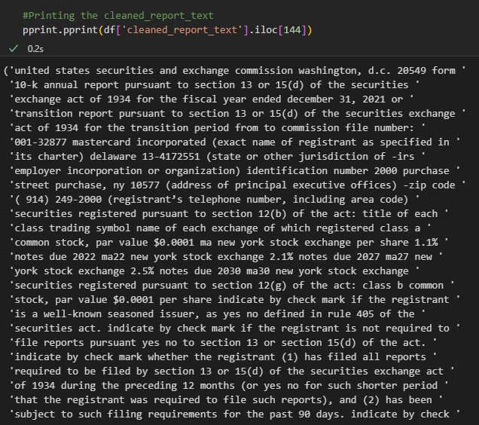
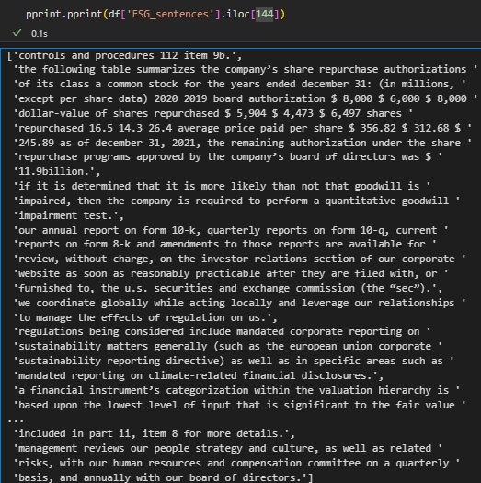
04
Data Justification
Why SEC 10-K Filings?
Legal, audited, and consistent → ensures data credibility.
Reflects regulatory ESG communication, not marketing material.
Enables year-over-year comparisons and cross-company benchmarking.
Shows how compliance has shaped ESG communication clarity.

Slide 6
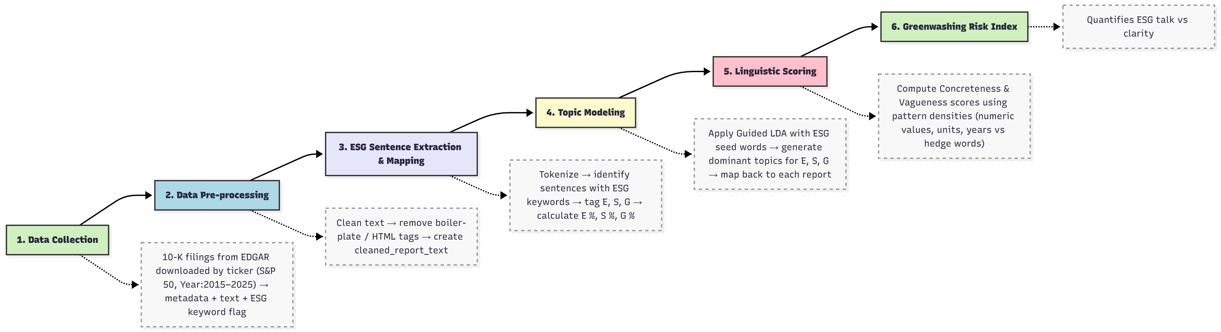
05
Methodology:

Slide 7
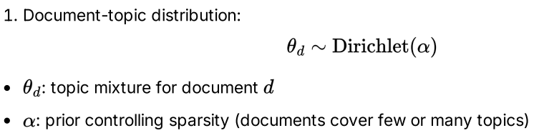

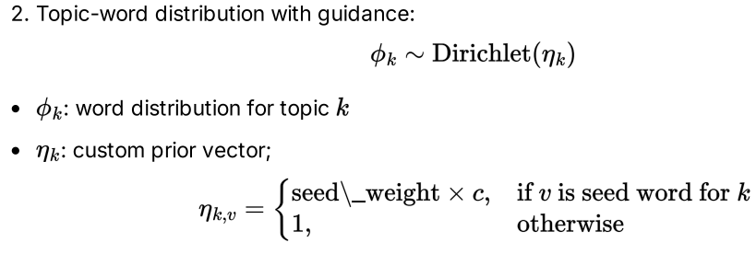
06
Mathematical Model: Guided LDA
Thynk Unlimited
-
Project

Slide 8


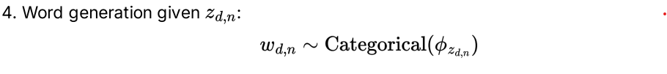
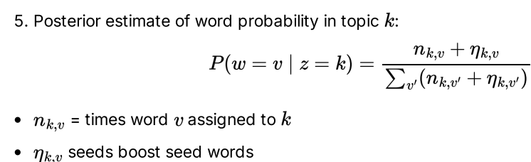
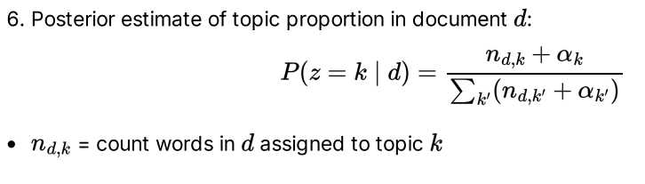
07

Slide 9
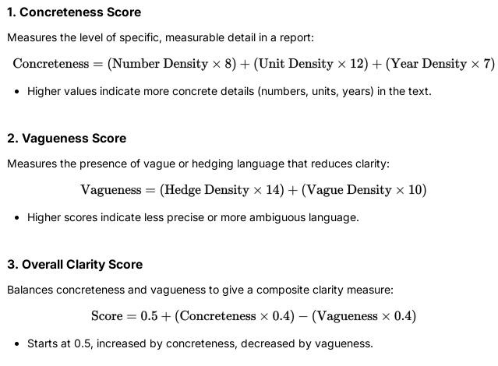

08
Linguistic Scoring & Derived Metrics

Slide 10
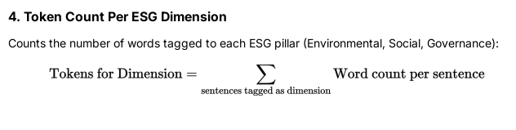

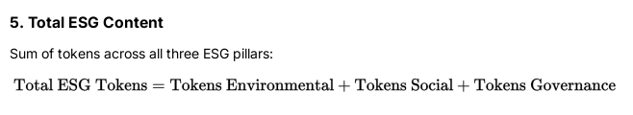
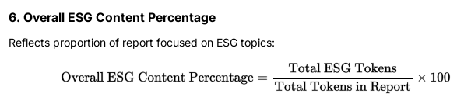
09

Slide 11
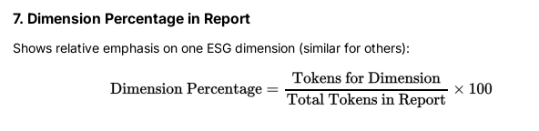
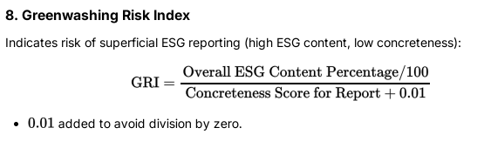

10

Slide 12
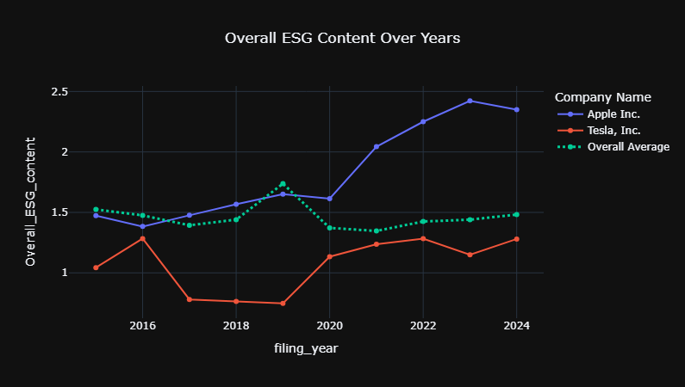
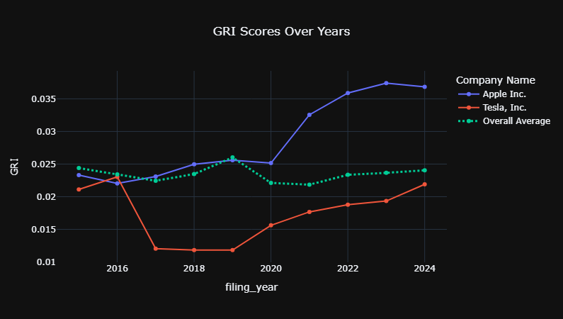
11
Results and Findings :

Slide 13
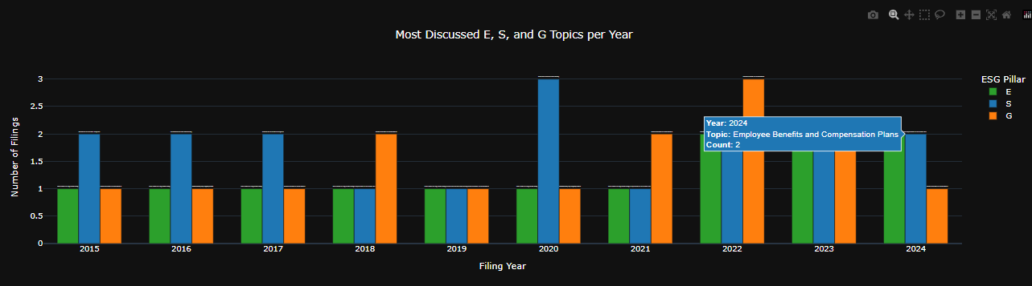
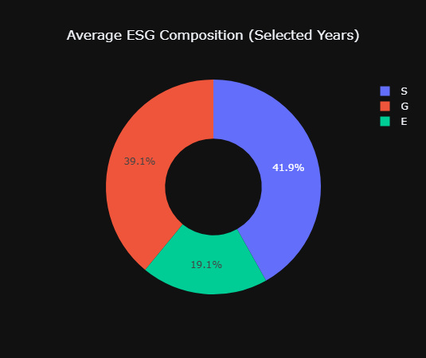
12

Slide 14

Conclusions
03
Within total ESG-related text,
22.4% pertains to Environmental,
31.1% to Social, and
46.4% to Governance topics.
Governance remains the most discussed pillar, reflecting its standardized nature and strong regulatory oversight in 10-K disclosures.
The average ESG content across all SEC 10-K filings (2015–2024) was 1.46% of total report text, and the average Greenwashing Risk Index (GRI) remained around 2.3%.
Both metrics were stable across years and sectors, indicating consistent and credible ESG communication with no signs of exaggerated or inflated disclosures.
01
04
Guided LDA revealed distinct, compliance-driven themes across pillars:
Environmental: Climate and Emissions Regulation and Compliance
Social: Diversity, Inclusion, and Executive Governance
Governance: Board Leadership and Internal Control
02
The average concreteness score across ESG content was 65.61%, indicating that nearly two-thirds of all ESG-related language is factual and measurable.
This demonstrates linguistic credibility and maturity in how companies communicate ESG in formal SEC filings.

Slide 15

Limitations and
Future Scope
Data Coverage: Filings for Berkshire Hathaway were unavailable; analysis therefore includes S&P 49 companies instead of 50.
Reporting Period: 2025 filings were not available for most companies and were excluded from analysis.
Source Limitation: Only 10-K reports were analyzed; results may differ for voluntary sustainability or CSR reports, which use less regulated language.
Scope for Future Work:
Extend the analysis to global filings or non-SEC markets.
Incorporate transformer-based models (BERT/BERTopic) for deeper contextual understanding.
Compare linguistic metrics (GRI, concreteness) with actual ESG performance indicators to link communication quality with outcomes.
14

Slide 16
Introduction to Data Analytics in Business
-
Project
-
Master in Applied Data Science Batch 2025
Thank You

