Slide 1

UNO Agent Arena
Machine Learning 2 - Group 1
Cui(Cathy) Yu
Shravani Mahadeshwar
Priya Botsa
Marc Hayes
Shaonan Feng
Di Yang

Slide 2
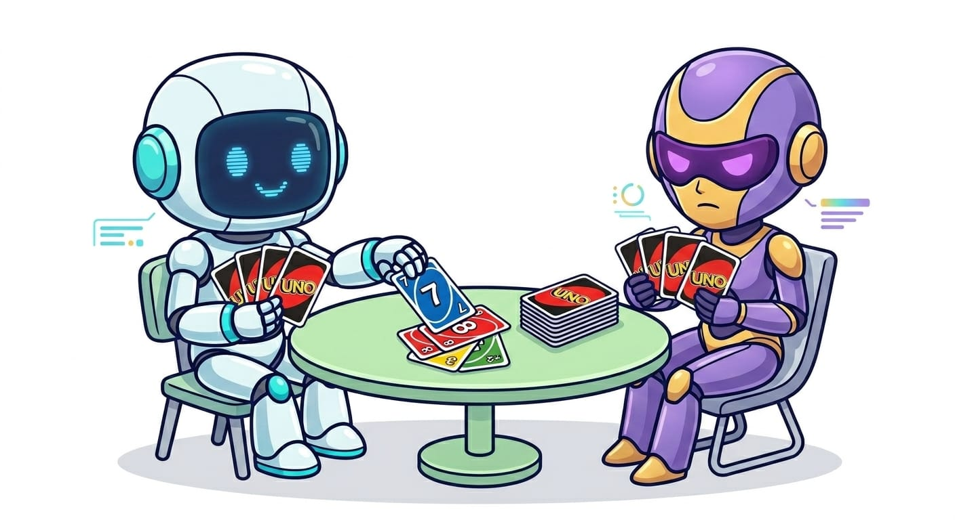
Objectives
Analyze performance of various agents (algorithms) playing UNO in a 2-player match (one versus one)
Is there an unbeatable agent?
Can you beat our UNO agents?

Slide 3
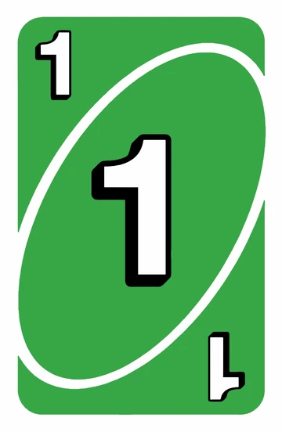
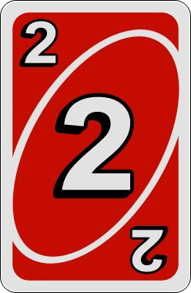
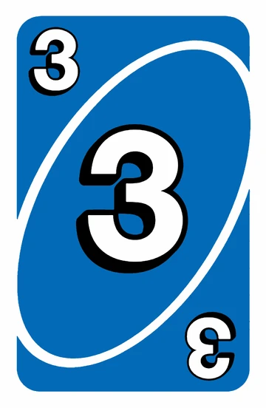
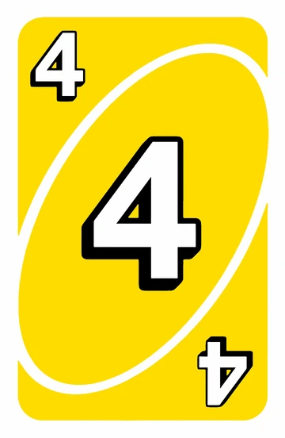
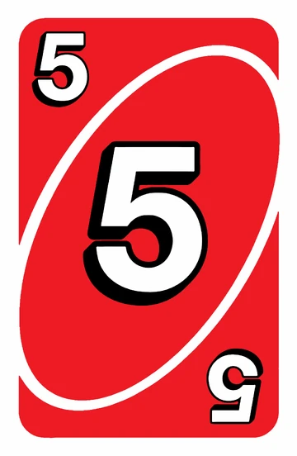
Contents
Uno rules & Game set up
Heuristic-Based Agents
Reinforcement Learning (RL) Agent
Information Set Monte Carlo Tree Search (ISMCTS) Agent
Analysis & Takeaways

Slide 4
Uno rules & Game set up

Slide 5
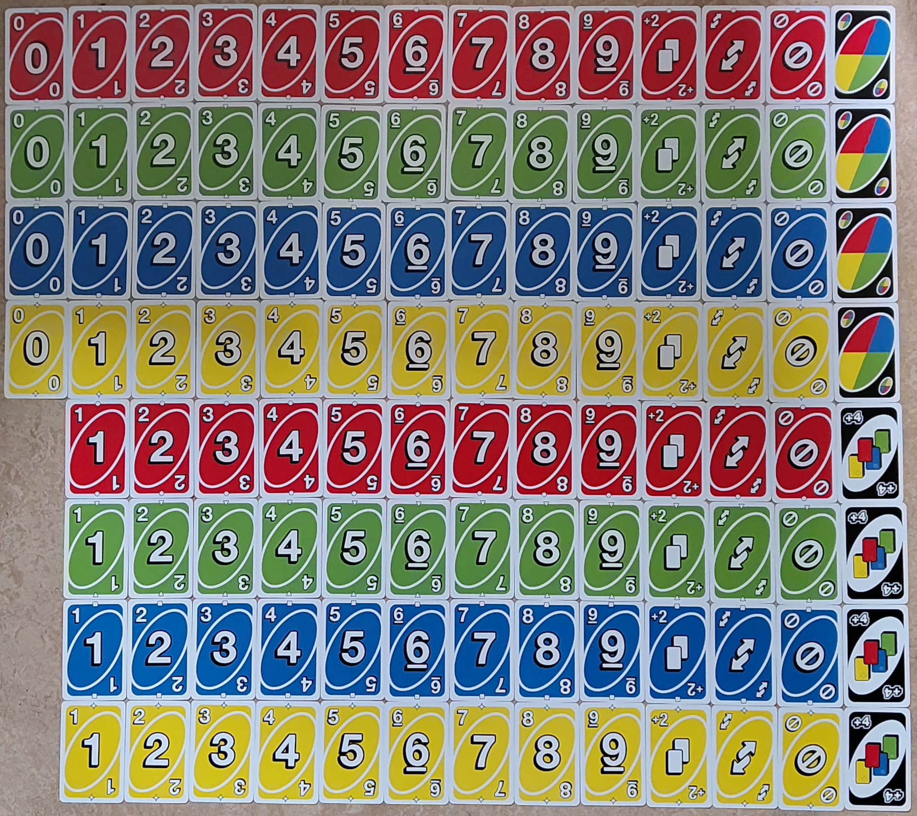
About The UNO® Card Game
Originally developed in 1971 by Merle Robbins
Acquired by Mattel on January 23, 1992
Available in 80+ countries
150+ million copies sold
A standard deck consists of 108 cards
Four colors: (Red ●, Green ▼, Blue ■, Yellow ✦) symbols for accessibility
Number Cards: Numbers 0-9, where 0 appears once, 1-9 twice per color
Action Cards: Draw Two (+2), Reverse (↗↙), Skip (ø), two copies each per color
Wild Cards: Wild and Wild Draw Four, four copies each
(112 with added cards like 3x Wild Customizable Cards and 1x Wild Shuffle Hands)

Slide 6
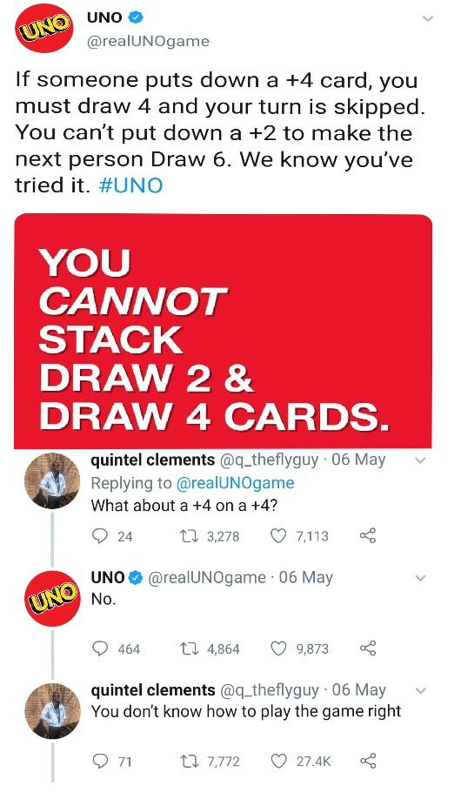
How UNO® Is Played
Setup:
Choose a dealer and shuffle cards. (No designated dealer in our program)
Deal 7 cards to each player.
Place the remaining cards FACEDOWN in the center of the table. This is the DRAW PILE.
Flip over the top card of the DRAW PILE and place it FACEUP to form the DISCARD PILE. If this is an Action Card, ignore it and flip over the next card.
The player to the left of the dealer goes first and play proceeds clockwise. (Player 1 is the starting player in our program)

Slide 7
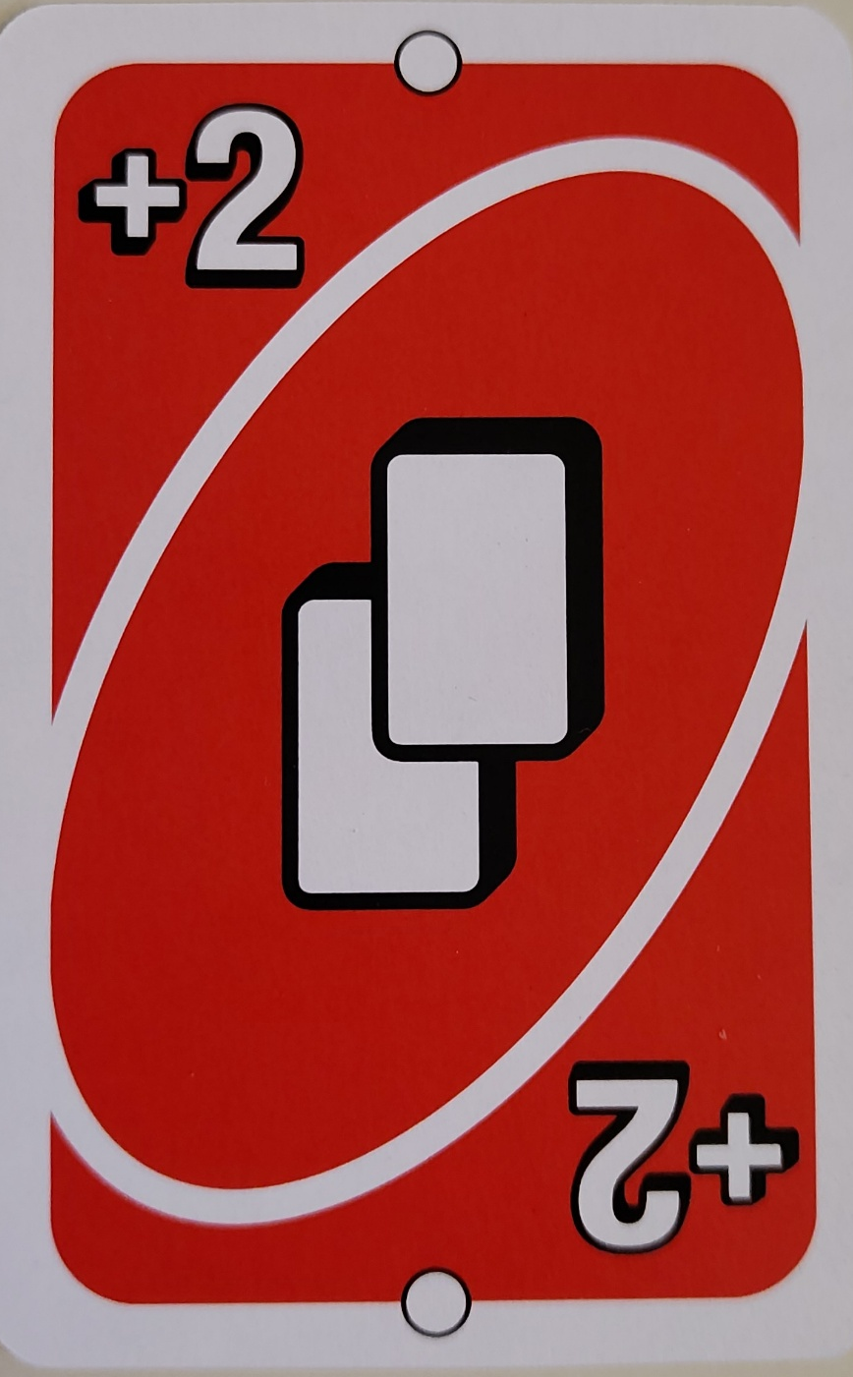
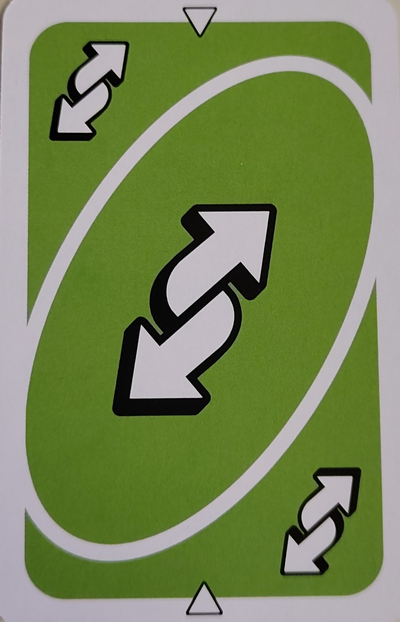
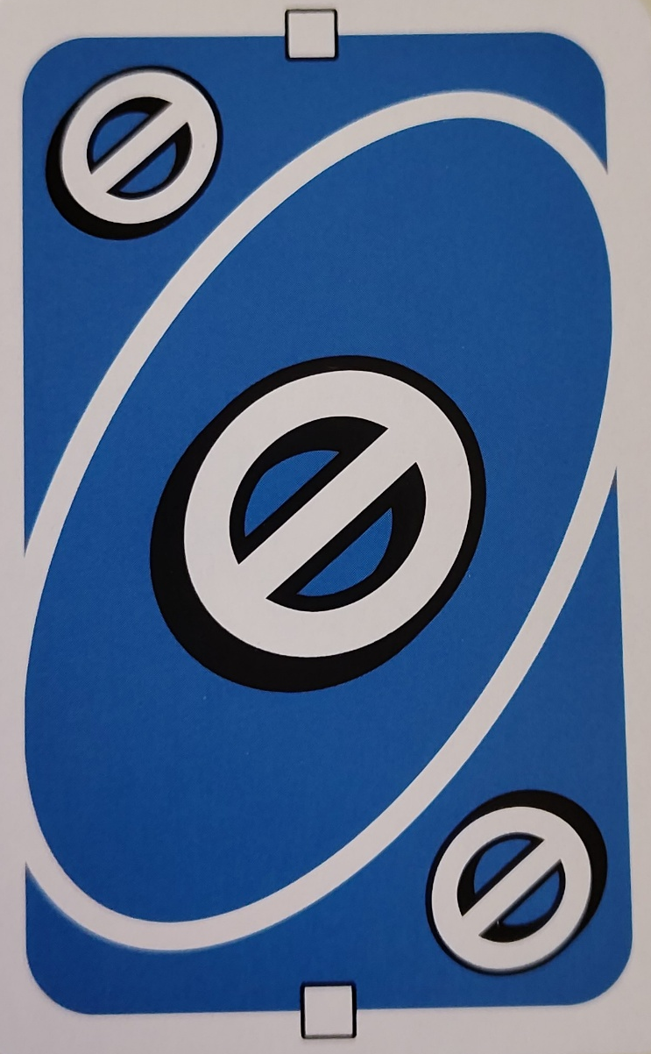
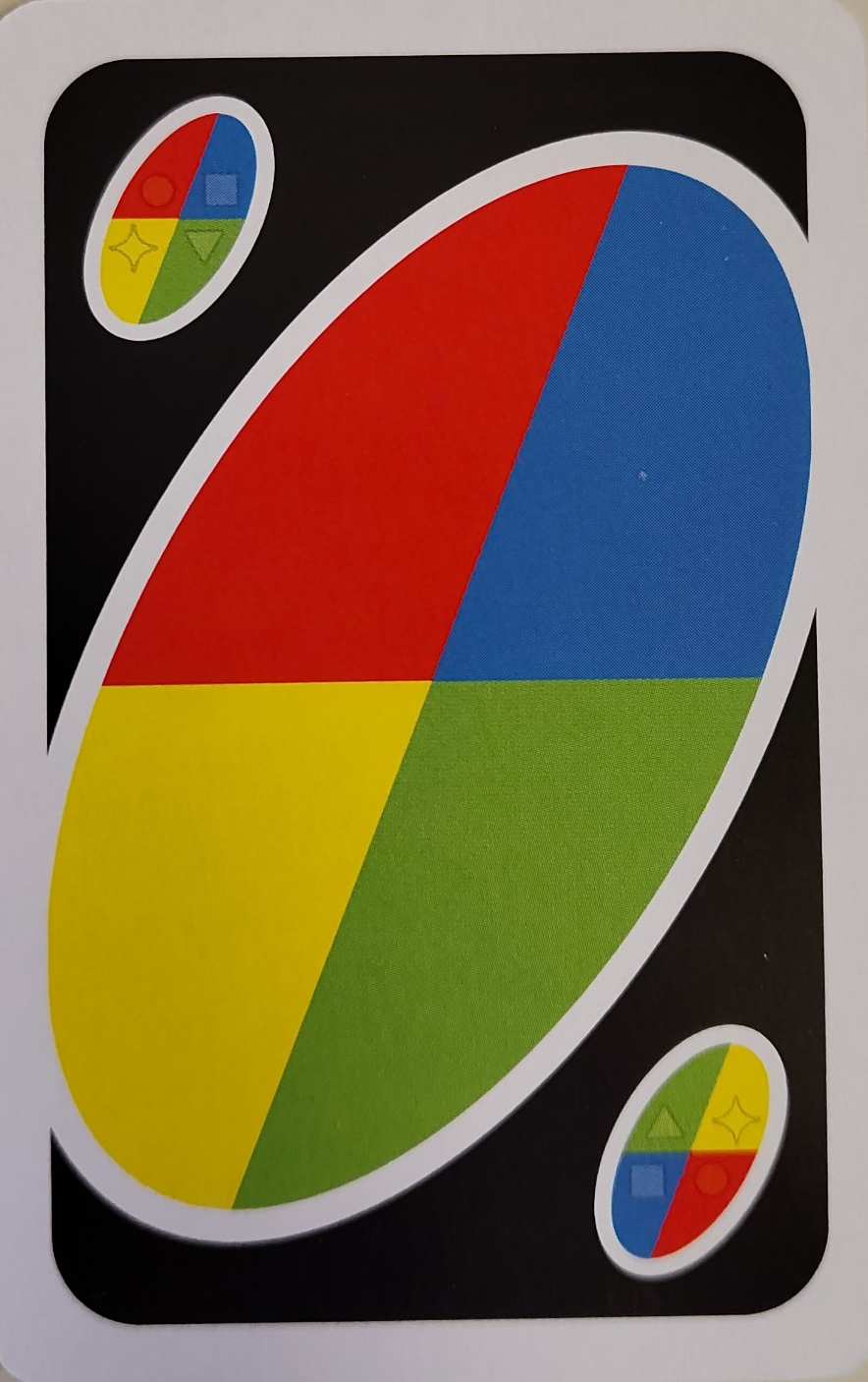
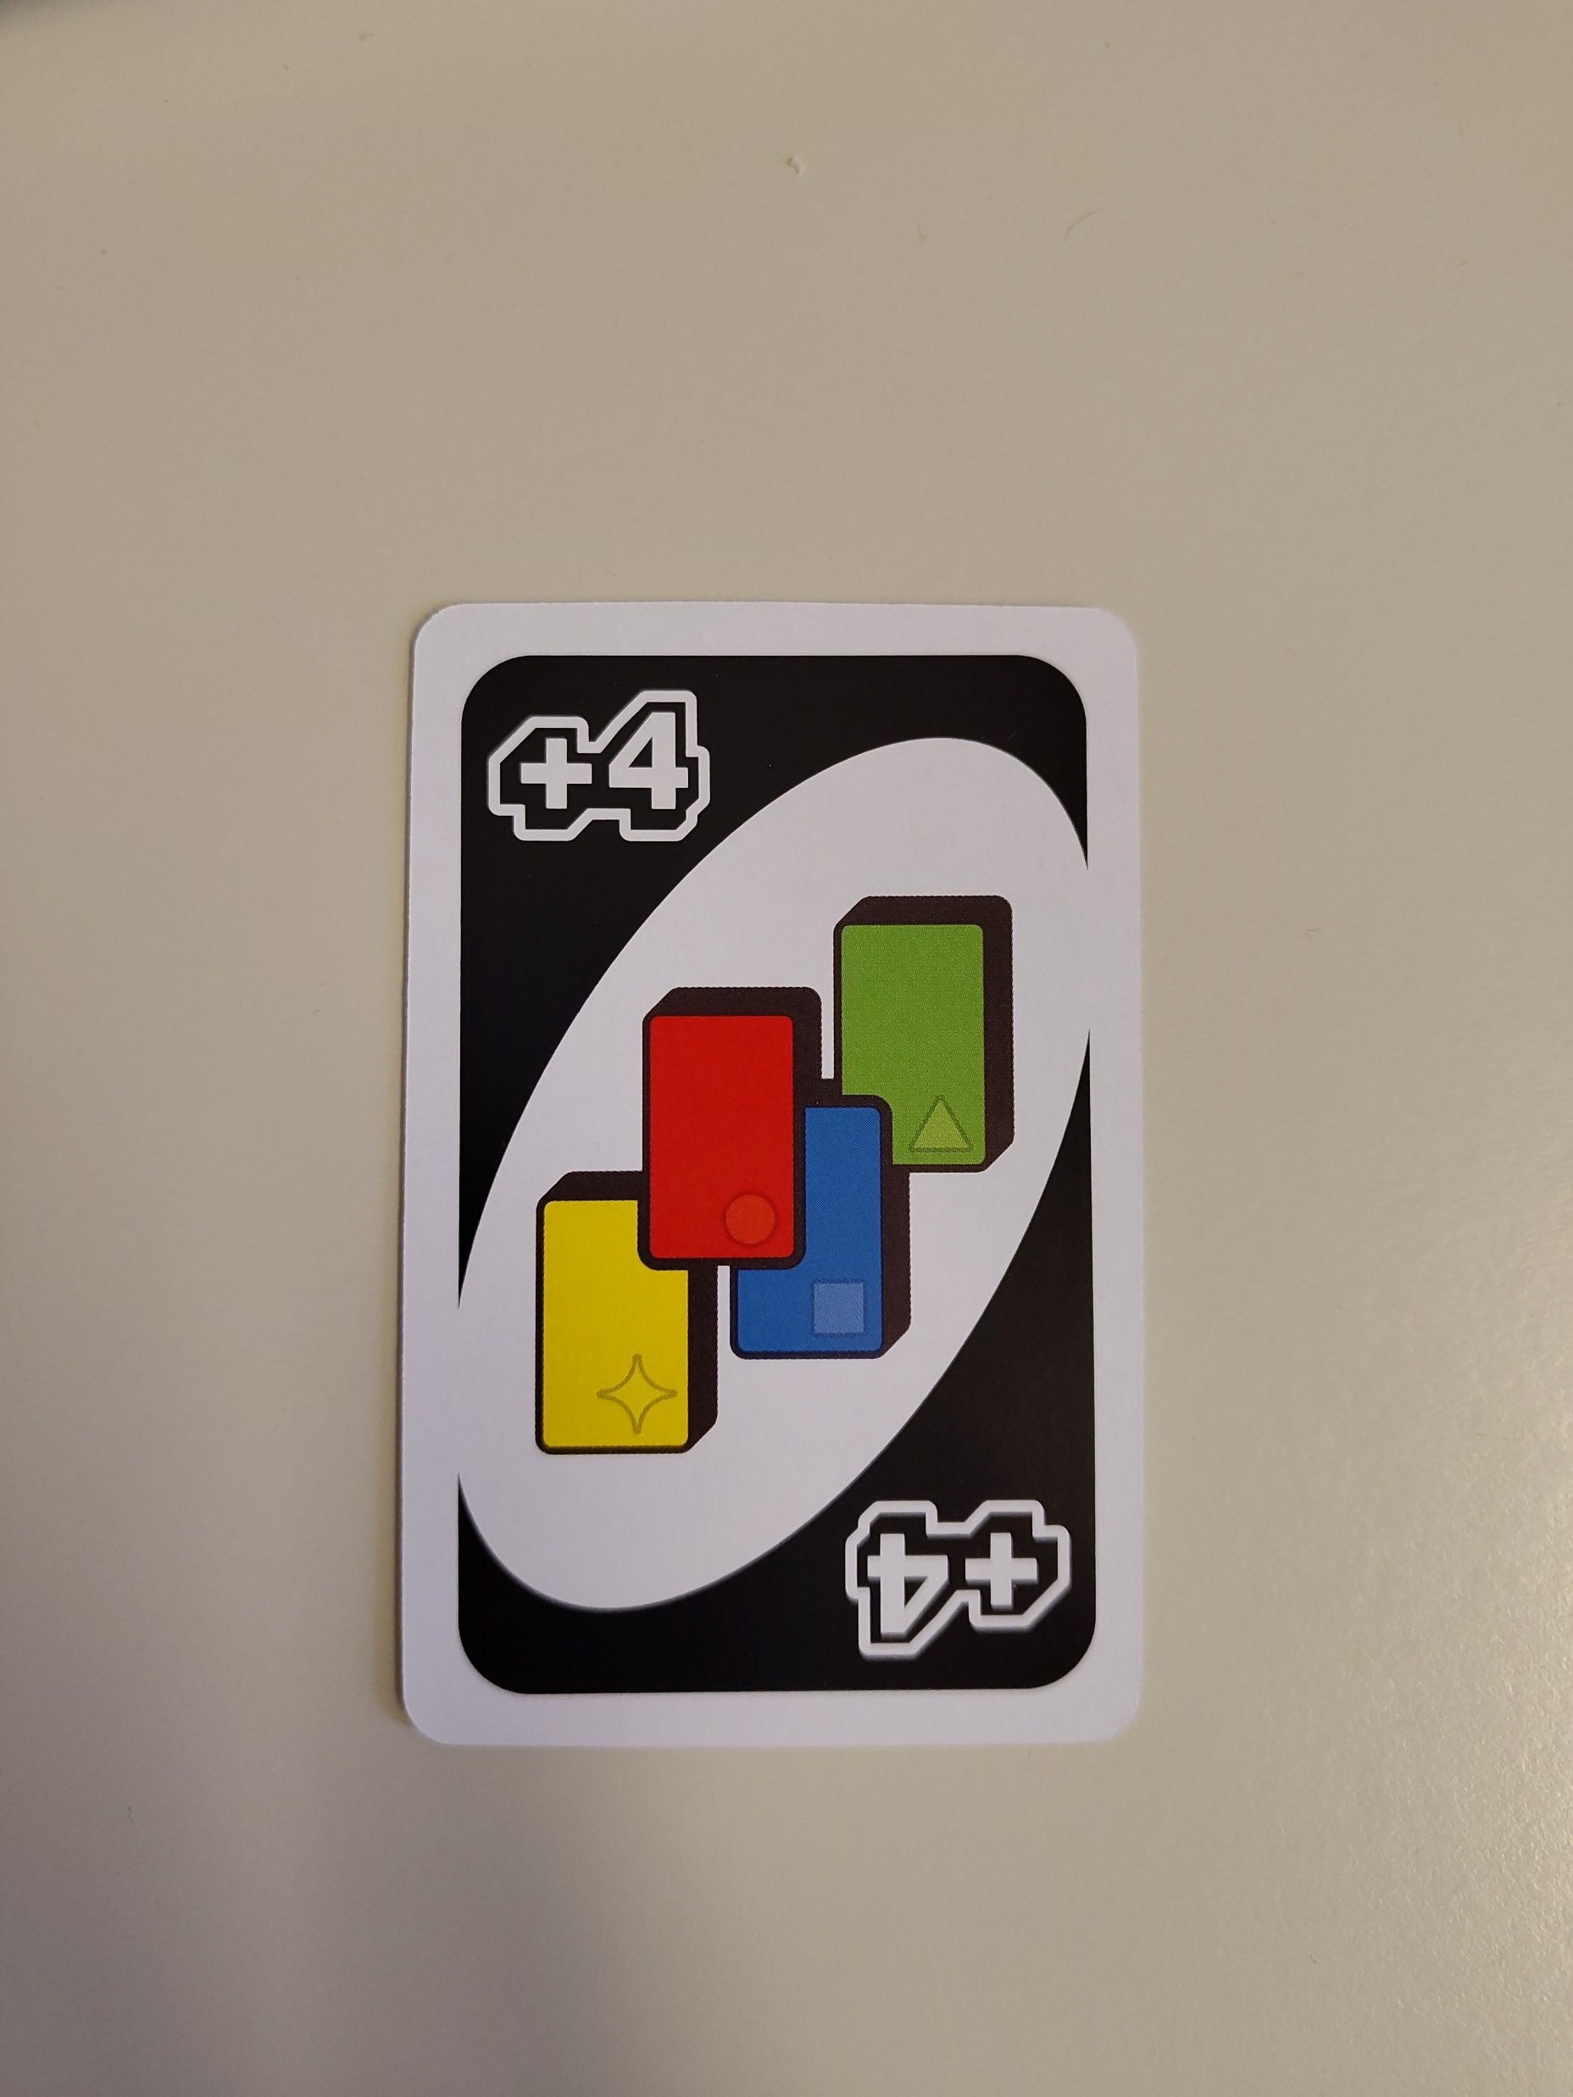
UNO® Action And Wild Cards
Draw Two (+2): When played, the next player must draw 2 cards and lose their turn
Reverse (↗↙): When played, the direction of the play is reversed. If play was moving clockwise, it now moves counterclockwise and vice versa.
In a two-player match the Reverse works like Skip.
Skip (ø): When played, the next player loses their turn.
Wild: This card matches anything so you can play it no matter what card is on the Discard Pile. When you play a Wild card, you also get to choose the color that continues play.
Wild Draw Four (+4): This card matches anything so you can play it no matter what card is on the Discard Pile. When played, the next player must draw 4 cards and lose their turn. This card is also a Wild card, so you get to choose the color that continues play. NOTE: No challenge mechanic! (explained in appendix)

Slide 8
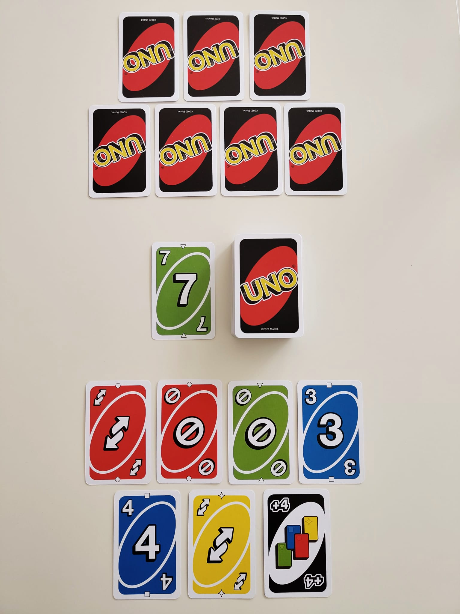
UNO® Gameplay Illustrations
Player 2
Discard Pile
Draw Pile
Player 1
Detailed text-based gameplay description in appendix

Slide 9
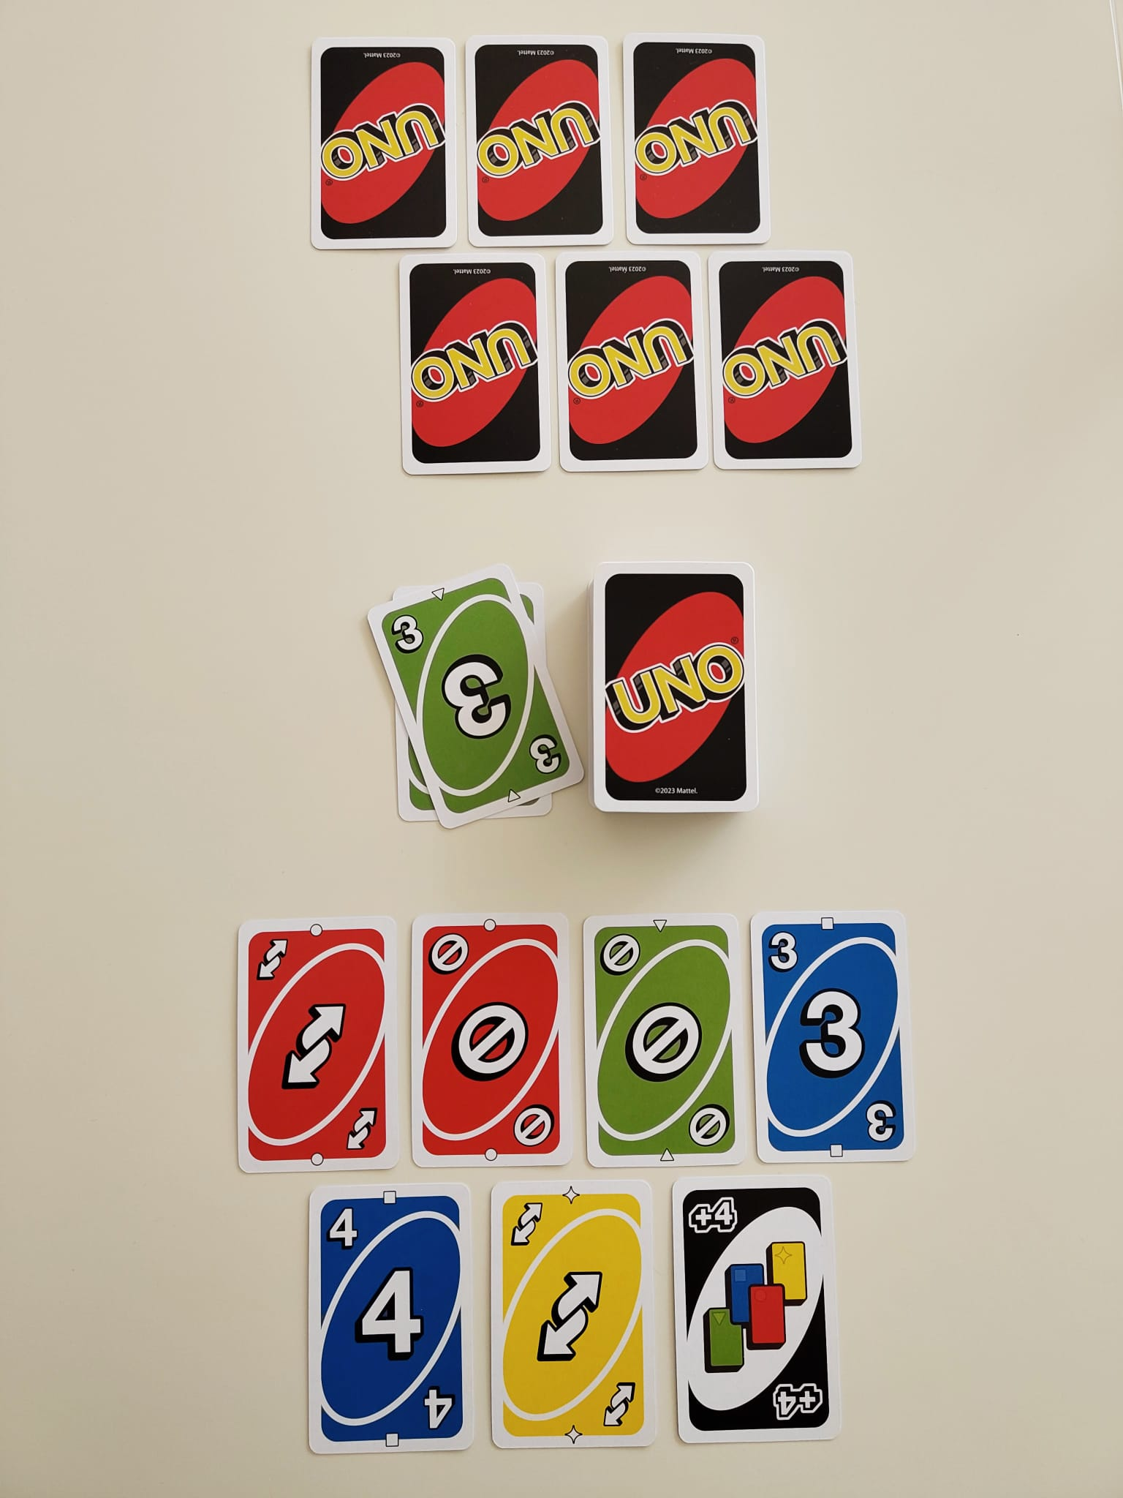
UNO® Gameplay Illustrations
Player 2 plays Green 3
Player 2
Player 1
Detailed text-based gameplay description in appendix

Slide 10
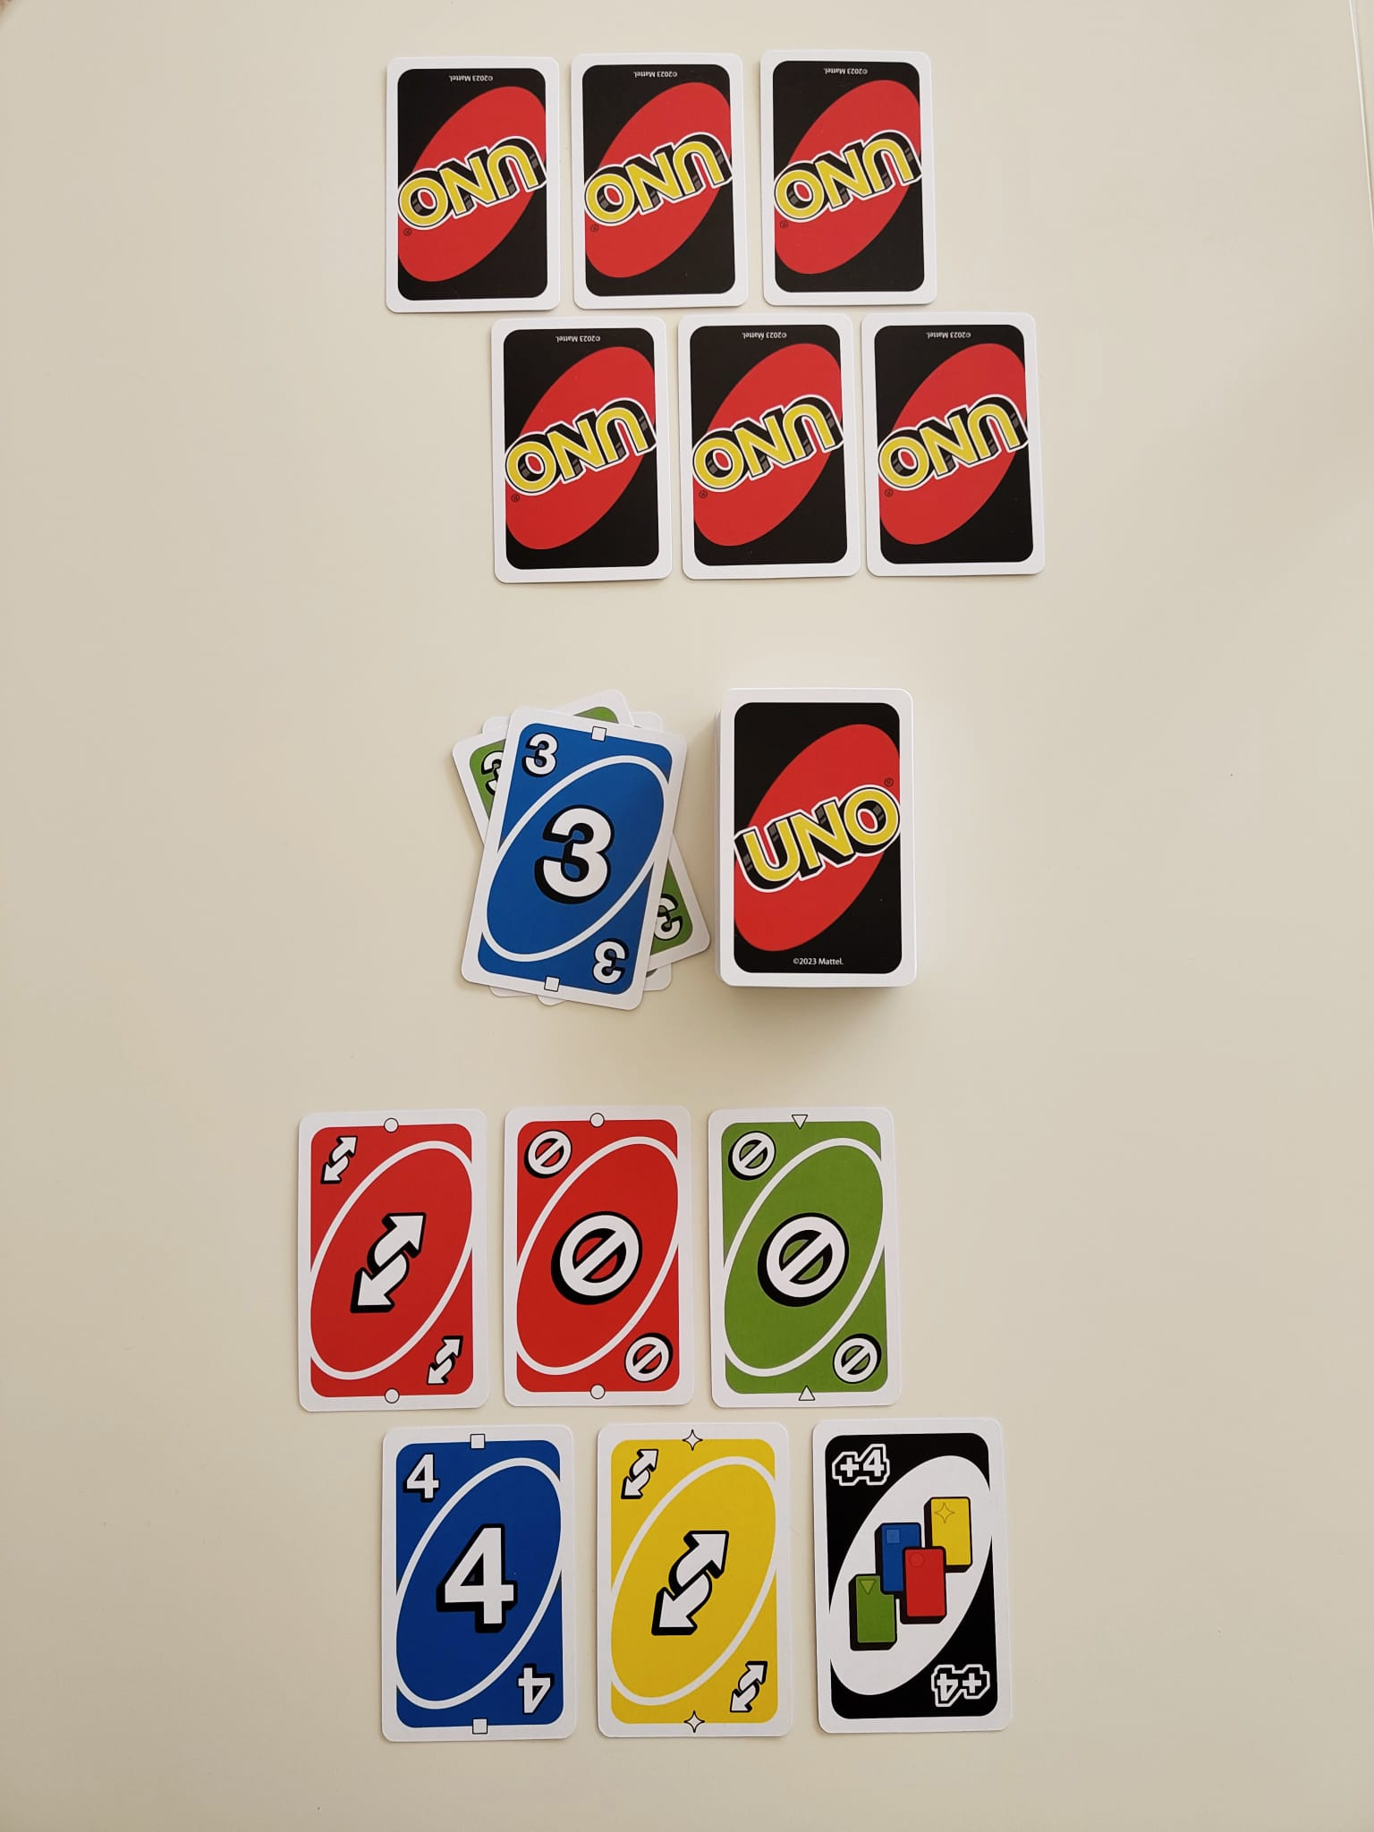
UNO® Gameplay Illustrations
Player 1 plays Blue 3
Player 2
Player 1
Detailed text-based gameplay description in appendix
Notes:
Different Color on Same Number

Slide 11
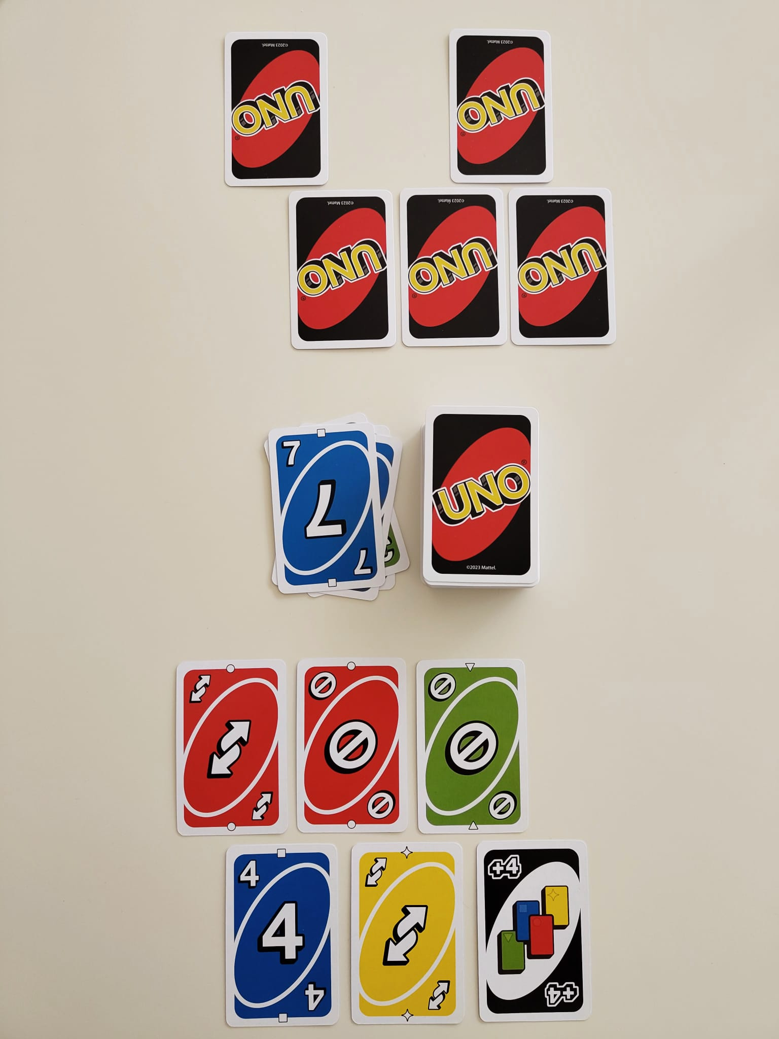
UNO® Gameplay Illustrations
Player 2 plays Blue 7
Player 2
Player 1
Detailed text-based gameplay description in appendix
Notes:
Different Number on Same Color

Slide 12
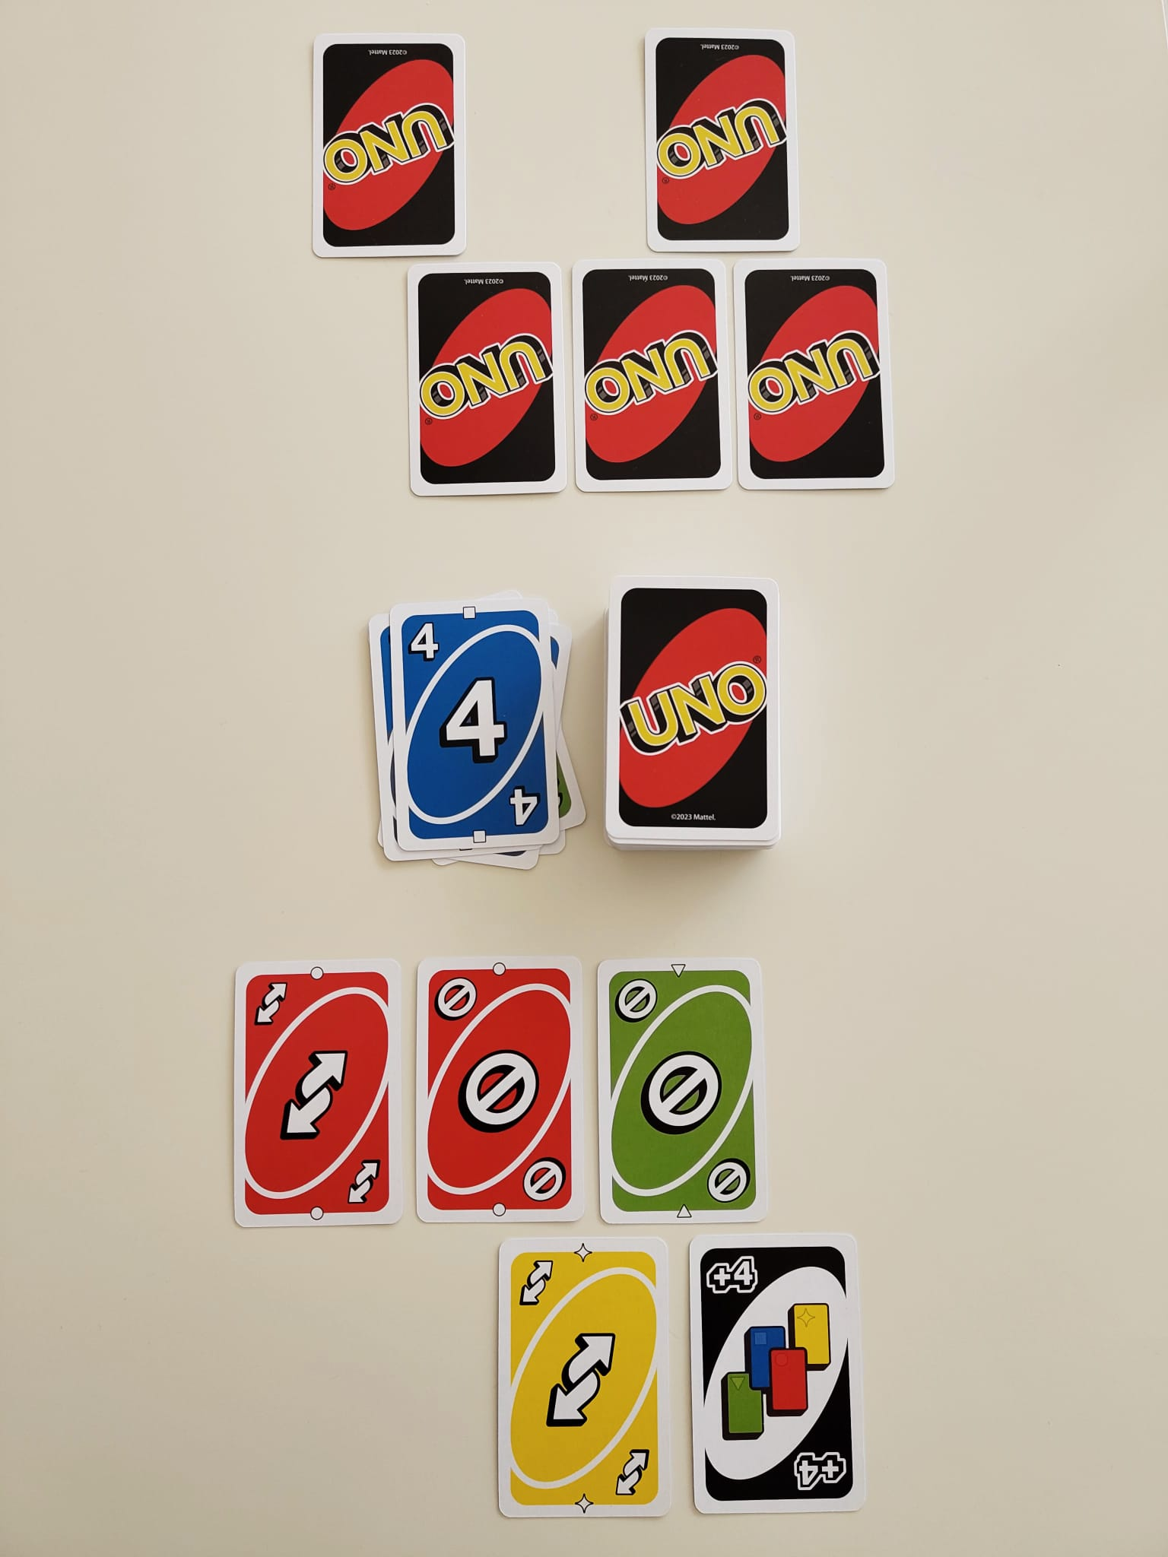
UNO® Gameplay Illustrations
Player 1 plays Blue 4
Player 2
Player 1
Detailed text-based gameplay description in appendix
Notes:
Different Color on Same Number

Slide 13
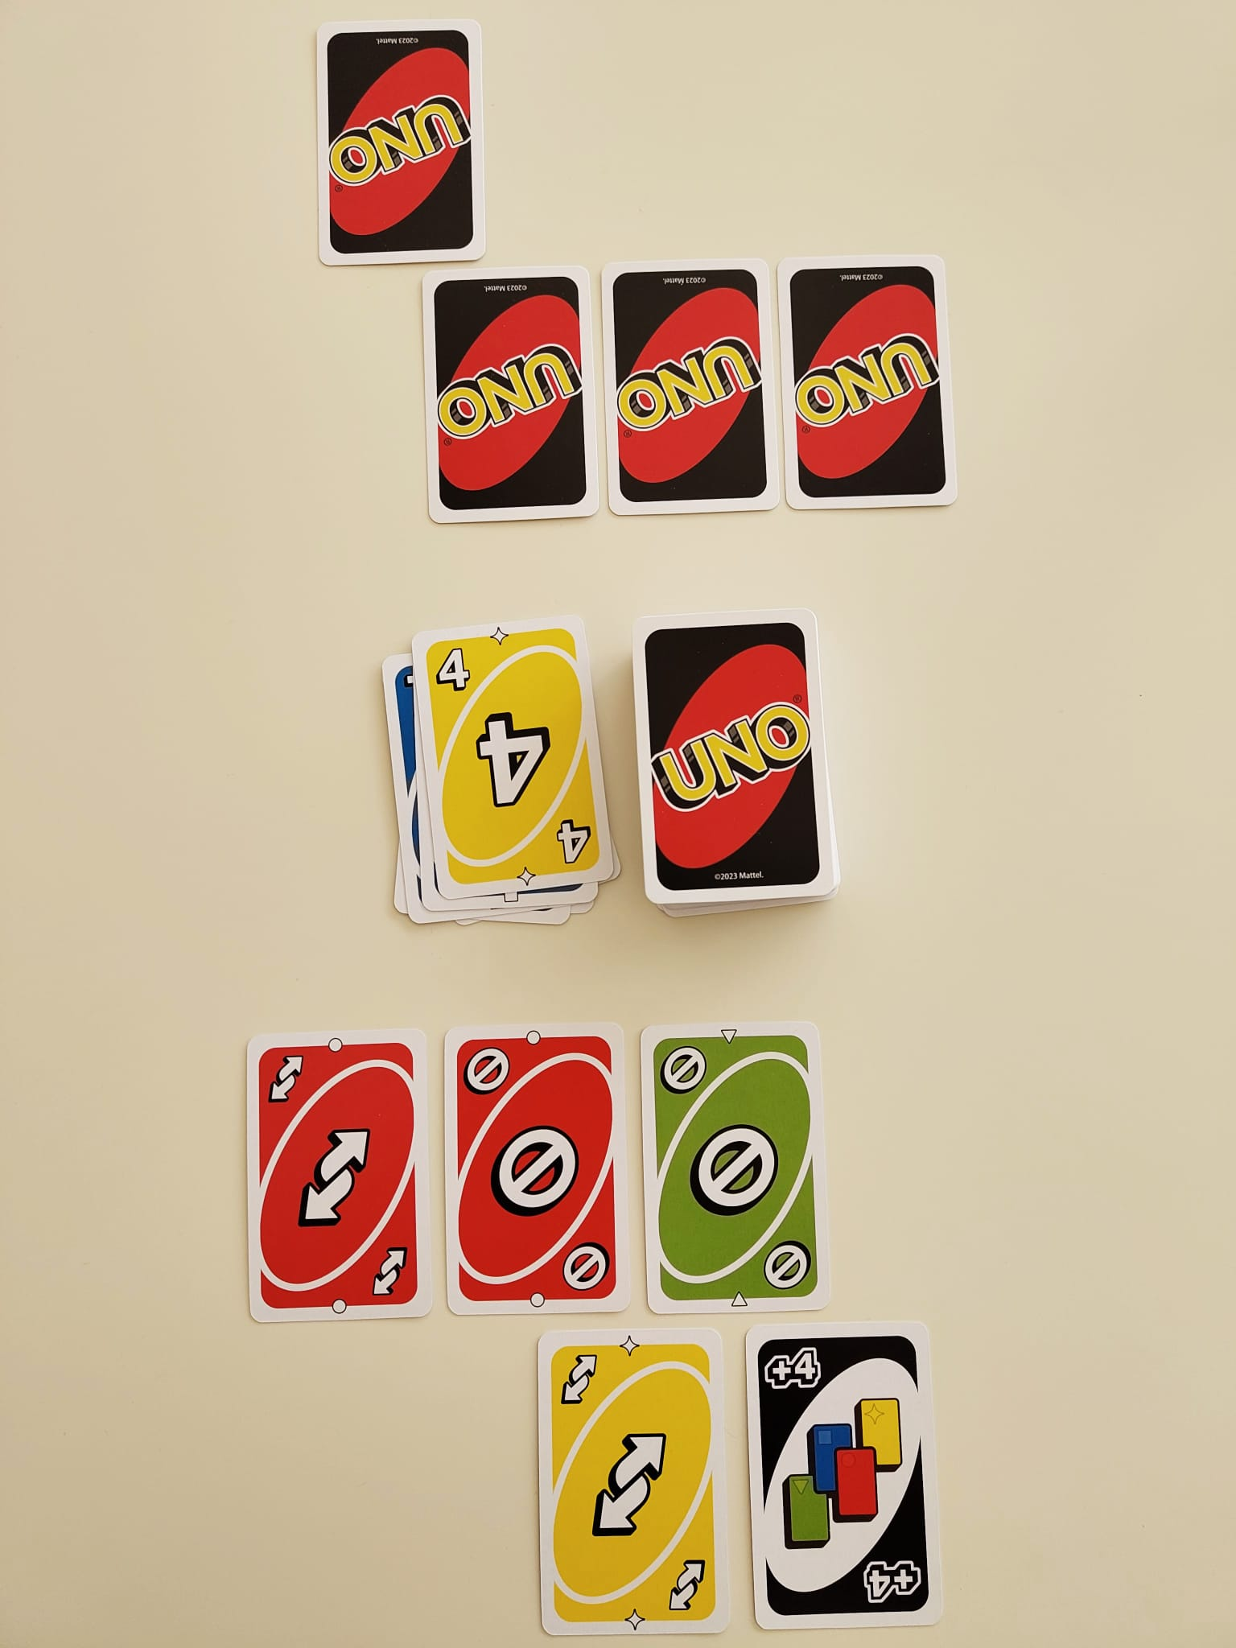
UNO® Gameplay Illustrations
Player 2 plays Yellow 4
Player 2
Player 1
Detailed text-based gameplay description in appendix
Notes:
Different Number on Same Color

Slide 14
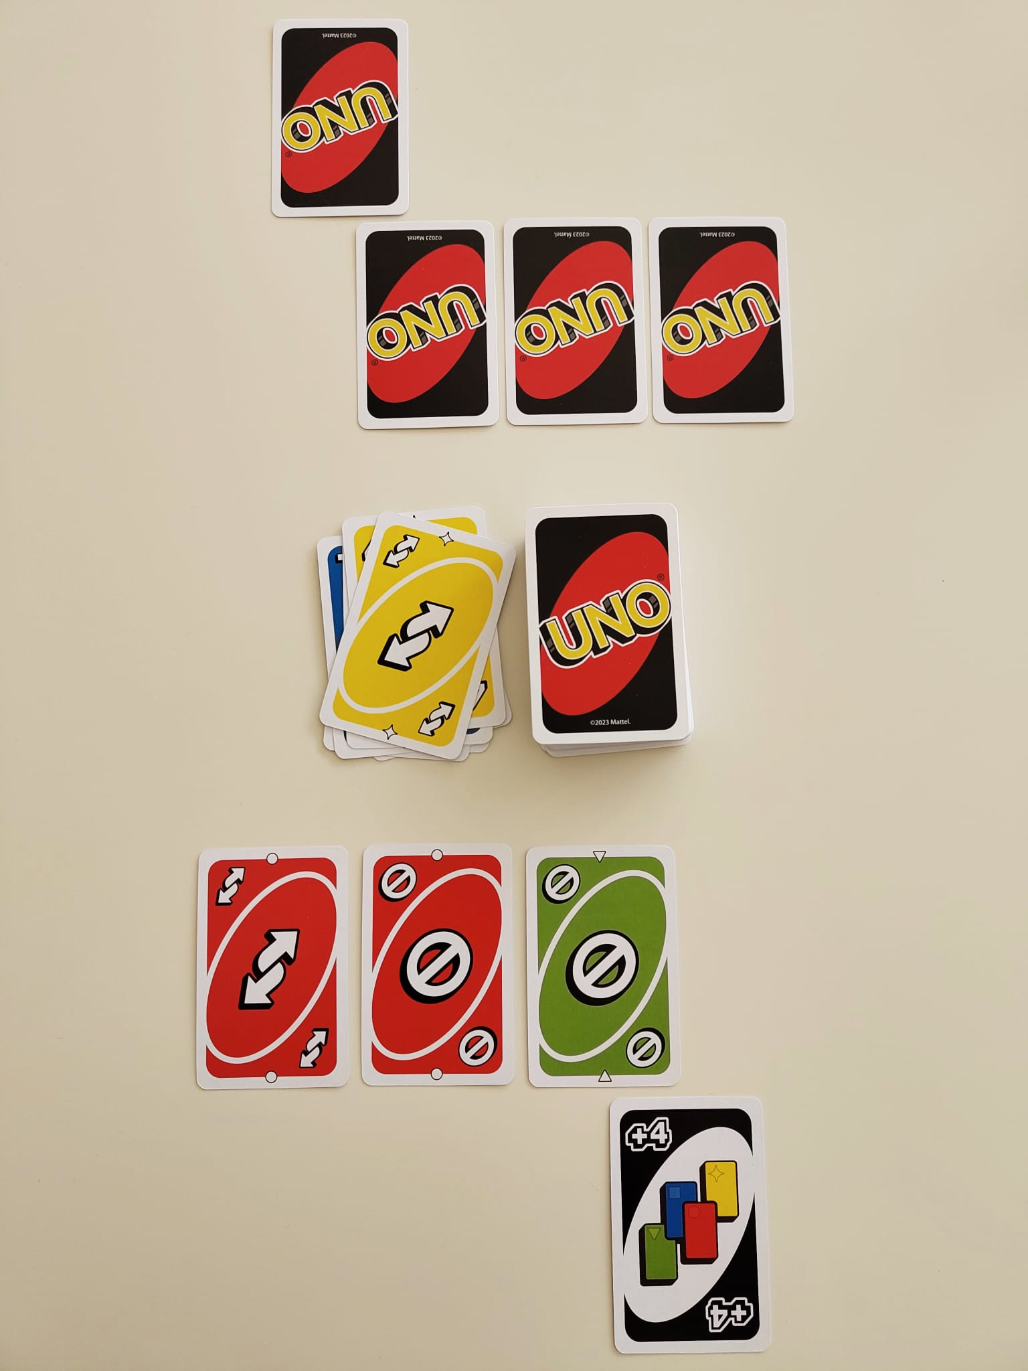
UNO® Gameplay Illustrations
Player 1 plays Yellow Reverse
Player 2
Player 1
Detailed text-based gameplay description in appendix
Notes:
Different Number/Symbol on Same Color

Slide 15
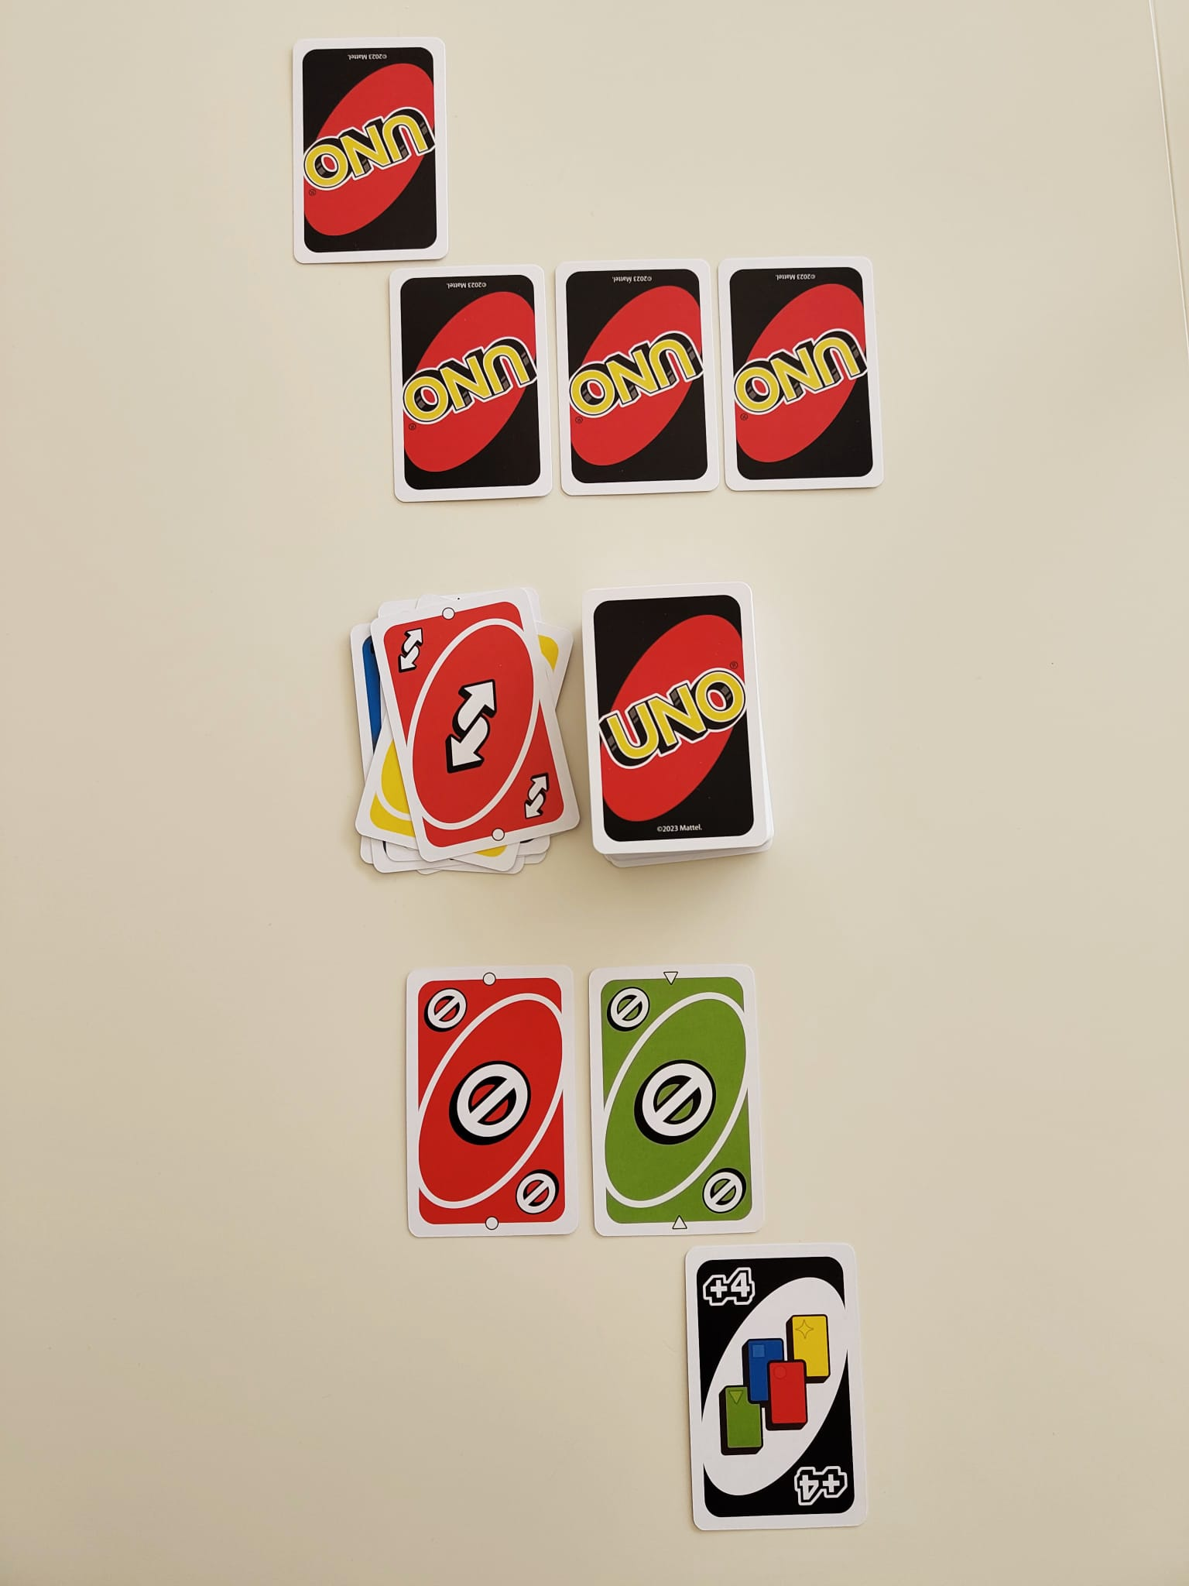
UNO® Gameplay Illustrations
Player 1 plays Red Reverse
Player 2
Player 1
Detailed text-based gameplay description in appendix
Notes:
Different Number/Symbol on Same Color

Slide 16
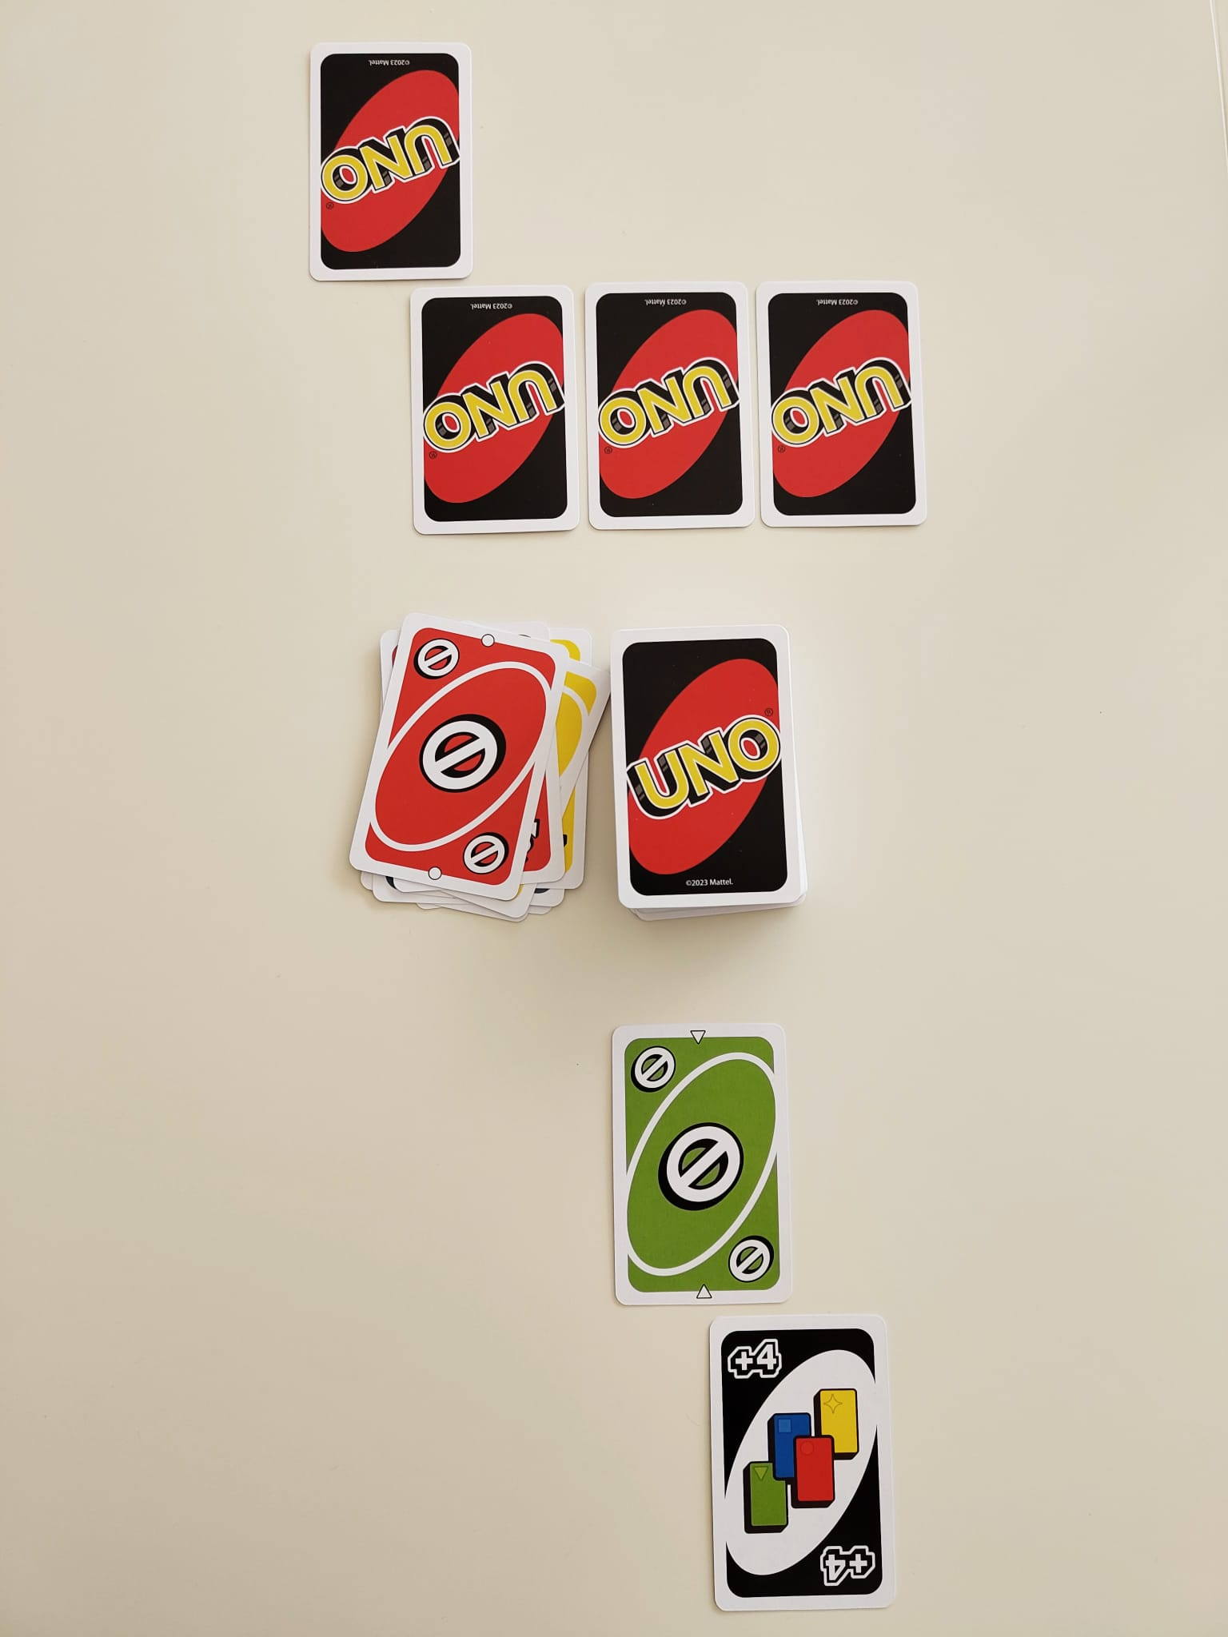
UNO® Gameplay Illustrations
Player 1 plays Red Skip
Player 2
Player 1
Detailed text-based gameplay description in appendix
Notes:
Different Number/Symbol on Same Color

Slide 17
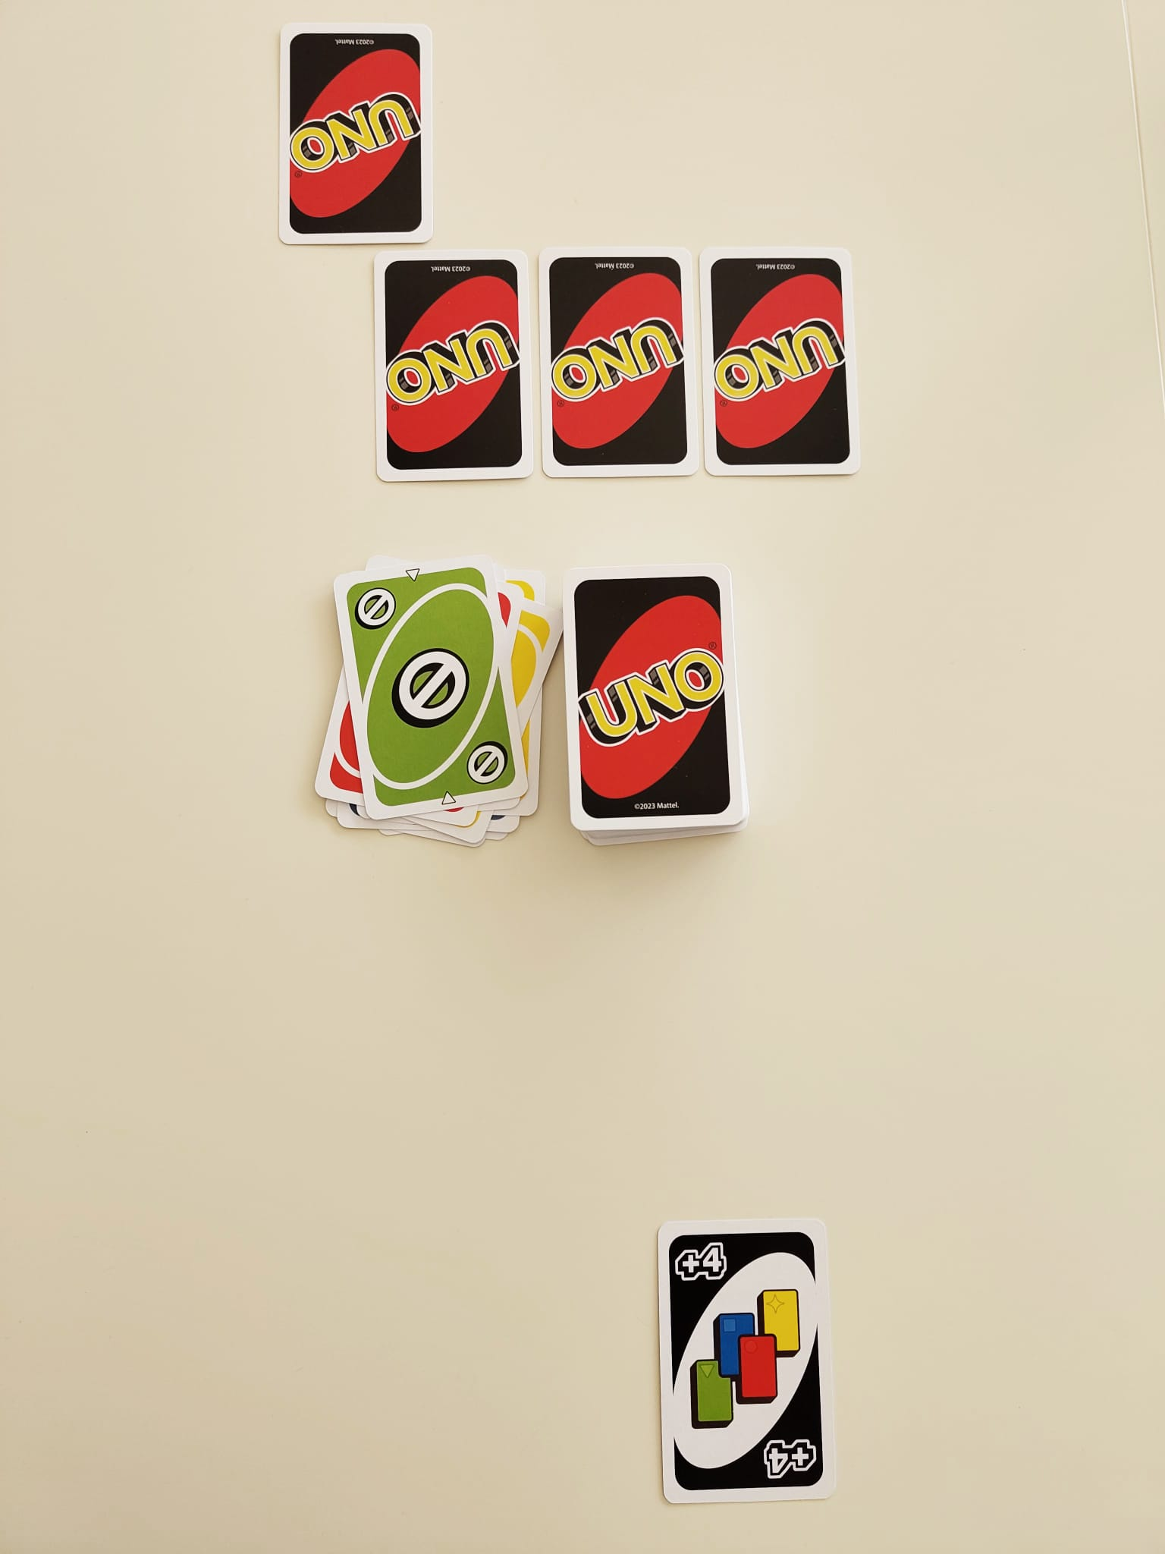
UNO® Gameplay Illustrations
Player 1 plays Green Skip
Player 1 calls out “UNO!”
Player 2
UNO !
Player 1
Detailed text-based gameplay description in appendix
Notes:
Different Number/Symbol on Same Color

Slide 18
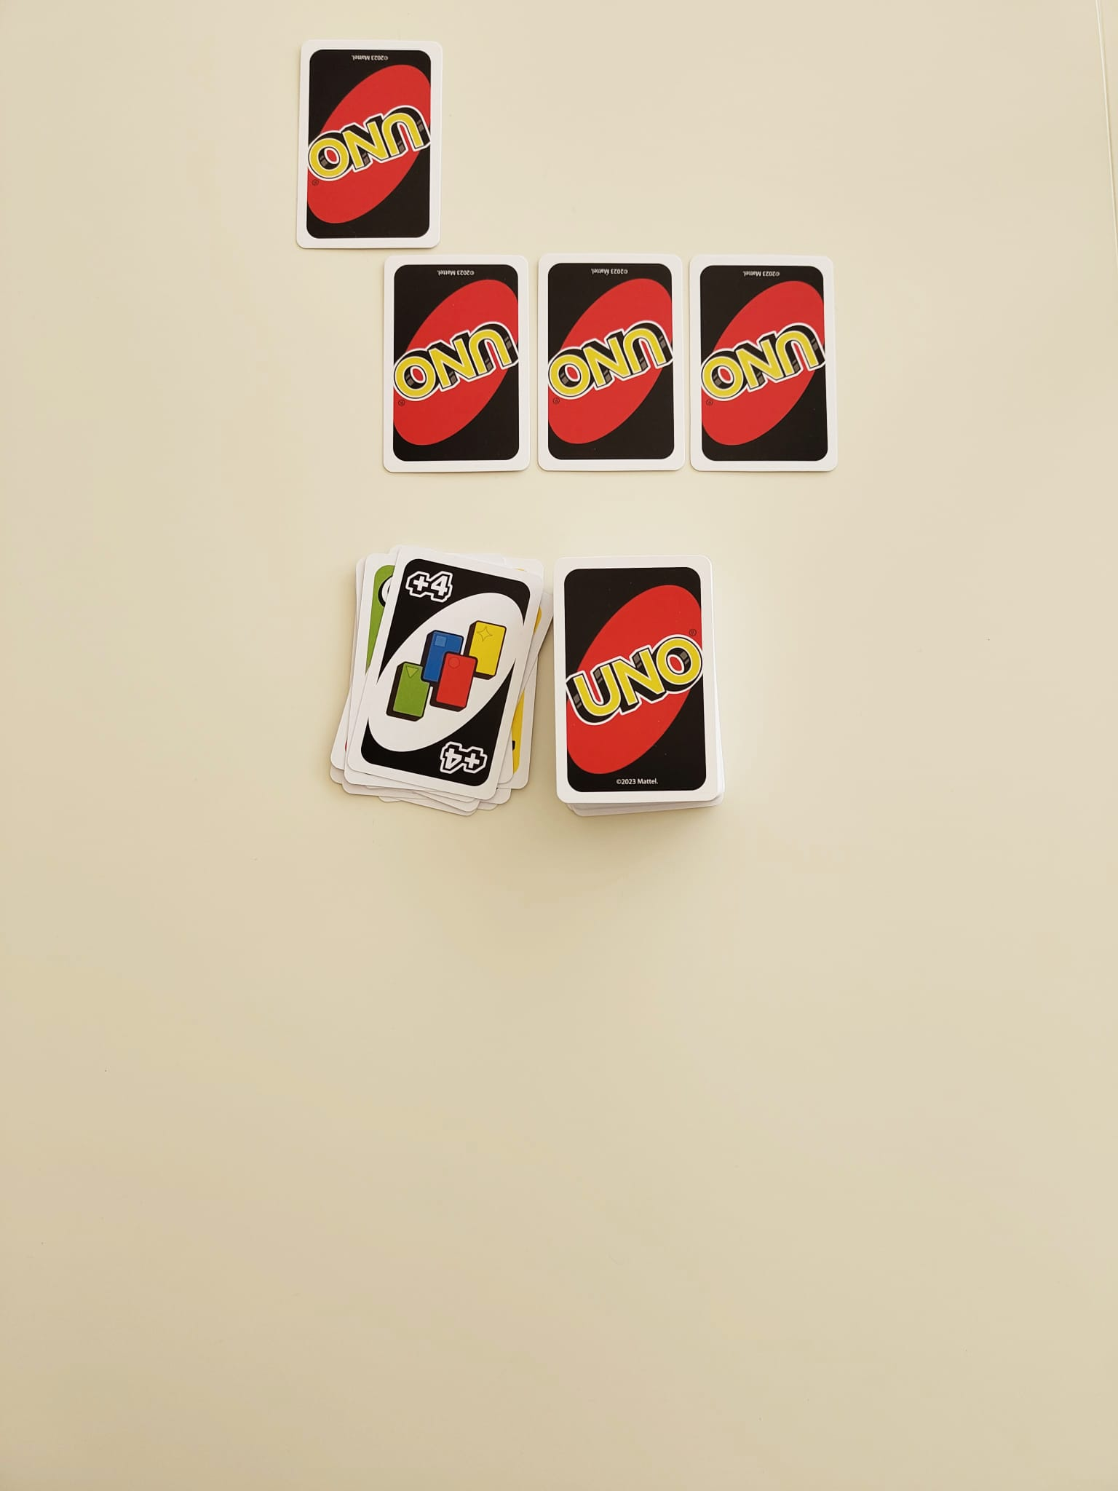
UNO® Gameplay Illustrations
Player 1 plays Wild Draw 4
Player 1 wins the match!
Player 2
Player 1
Detailed text-based gameplay description in appendix
Notes:
Different Number/Symbol on Same Color

Slide 19
Existing Research on Uno
Winning Uno With Reinforcement Learning
(Stanford University: O. Brown, D. Jasson, A. Swarnakar)
DQN and DeepSARSA outperform random UNO agents
DQN achieves highest win rate but converges slower than DeepSARSA
Reinforcement learning compared to rule-based play in UNO
(Stockholm University: Sara Nordström, Nils Ottosson)
RL models (DQN, NFSP, DMC) outperform simple rule-based agents
Rule-based strategy relies on simple heuristics and lacks adaptability
The complexity of UNO
(E. Demaine, M. Demaine, R. Uehara, T. Uno, Y. Uno)
Formal mathematical analysis of UNO’s computational complexity
Proves UNO decision-making is NP-complete (single player) / PSPACE-complete (2-player competitive) in several settings
Notes:
Winning Uno With Reinforcement Learning (Stanford University: O. Brown, D. Jasson, A. Swarnakar)
- The paper models UNO as a reinforcement learning problem with hidden information and delayed rewards
Used RLCard library to compare two RL approaches: DQN vs DeepSARSA
DQN achieved overall best performance
63.5% win rate against 2 other random agents in a 3-player match
39% win rate against DeepSARSA and a random agent in 3-player match
RL compared to rule-based play in UNO (by Sara Nordström & Nils Ottosson)
DQN (Deep-Q-Network), NFSP (Neural Ficticious Self-Play), DMC (Deep Monte Carlo)
RL-based UNO agents adapt better than static rule-based agents
DQN plateaued at approx. 100k training iterations. However, in testing there was a significant difference in performance with 100k vs 500k training iterations.
Both show only a slightly better payoff / winrate against the rule-based agent.
Rule-based baselines are significantly weaker than trained RL agents
Used RLCard library
The complexity of UNO (E. Demaine, M. Demaine, R. Uehara, T. Uno, Y. Uno)
NP-complete means Nondeterministic Polynomial time
meaning solutions are easy to verify but may be very difficult to find
models UNO as a combinatorial game theory problem rather than an RL problem
prove that even simplified single-player UNO is NP-complete
Two-player competitive UNO becomes PSPACE-complete, meaning optimal play is computationally very difficult
meaning the problem may require an enormous amount of memory (space) to solve optimally
PSPACE-complete problems involve not only a huge number of possible solutions, but also huge numbers of possible game states and future decisions

Slide 20
Strategies
Common Strategy
Game-Theory Optimal (GTO)
No single optimal strategy
Best play depends on game state
Decisions adapt to hidden information
GTO strategy is approximated using Information Set Monte Carlo Tree Search (ISMCTS)
ISMCTS-Handles hidden information by re-sampling the opponent's hand each simulation over a shared search tree
Comparison benchmark
Play number cards early
Use matching numbers to switch colors efficiently
Save Action & Wild cards for the endgame
Use Draw cards against low-card opponents
Chain Skip/Reverse for surprise finishes
Maintain colors the opponent draws on
Force colors the opponent likely lacks
Use draw cards when opponent near UNO
Control tempo by denying opponent turns
Notes:
Highlight / mention that we have implemented a rule-based agent [Greedy Bot] follows the “common” strategy.
The Greedy Bot has a “Threat Mode”, meaning once the opponent has 2 or less cards the agent will prioritize playing draw cards.

Slide 21
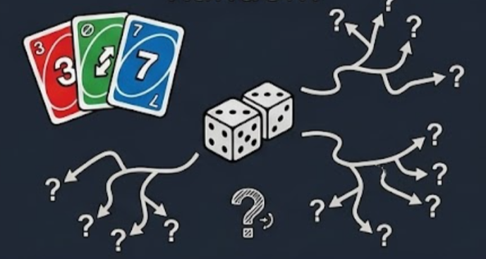
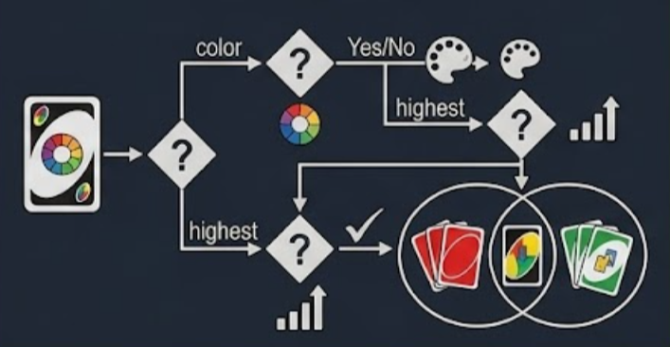
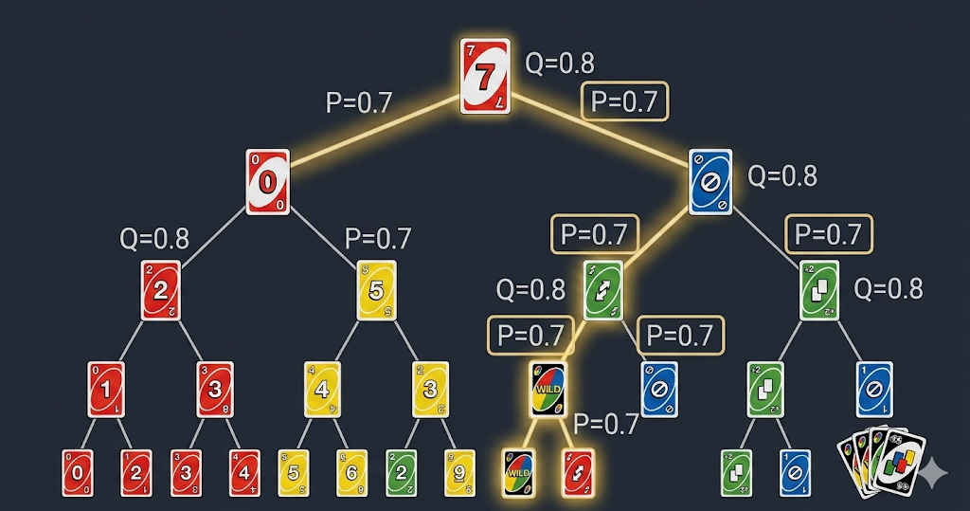
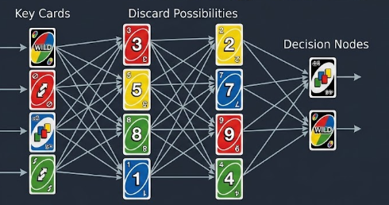
Agents
Random Agent
Greedy Rule Based Agent
VS
ISMCTS
RL Agent
*All visuals and architectures shown here are for illustrative and conceptual purposes only.
Notes:
Mention explicitly that for the remainder of the presentation when we refer to “ISMCTS” we mean “ISISMCTS” (Information Set Monte Carlo Tree Search)

Slide 22
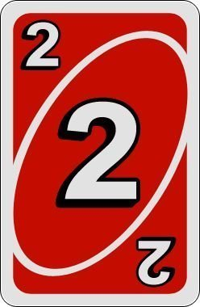
Heuristic-Based Agents

Slide 23
Heuristic Agents
For validation
Random Agent​
​
Anti-Greedy Agent
Inverted priority: Number >Reverse > Skip> +2 > Wild >+4
Wastes wilds early with random colors and no threat awareness.
Greedy Agent consistently wins, validating the heuristic strategy.
Anti-Greedy performs near Random Agent, giving no advantage over chance.
The agent selects a playable card completely at random from all valid options.
If the selected card is a wild card, the agent randomly chooses a color from Red, Green,
Blue, or Yellow.
Any agent ≤ random =no learning signal.
Random vs Random converges to ~50/50.
Greedy Rule Agent​
Threat Mode:
Switches when opponent has ≤2cards
Priority: +4 > +2 > Skip > Reverse > Wild > Number
Normal Mode:
Save wilds; play action cards first.
Priority: Skip > Reverse> High Number
Wild color:
Chooses the most frequent playable color.

Slide 24

Reinforcement Learning (RL) Agent

Slide 25
RL Agent – Framework
A 2-Player UNO is a sequential decision-making problem:
State
Action
Reward
Goal
Observe game state:
top card, active color, hand sizes, valid plays
Decide which available card to play according to per-card scoring
Receive reward from action
Accumulate the highest total reward across the whole game
Instead of been told how to play, the RL agent learns by trial and from the outcomes of the games.

Slide 26
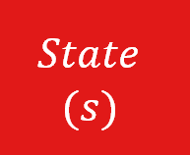



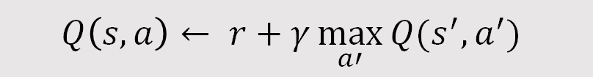
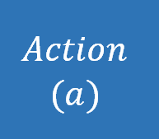
RL Agent – State & Action
DQN: maximize Q-value – $Q\left(s,a\right)← r+γ\max_{a′}{Q(s^{′}, a^{′})}$
$$State$$
$$(s)$$
54-float state vector,
Top card, current color, hand sizes, etc.
$$Q−Value$$
$$Q−Value$$
$$Q−Value$$
Expected future reward of action a in state s
$→Output (1)$
$$Input (75) →Hidden layer \left(128\right)→Hidden layer \left(64\right)→$$
$$Action$$
$$(a)$$
21-float card vector,
Candidate card’s color, type, value
$$Q\left(s,a\right)← r+γ\max_{a′}{Q(s^{′}, a^{′})}$$
The agent scores every legal card independently (per-card scoring) and plays the one with the highest Q-value

Slide 27


RL Agent – Reward and Training
Intermediate Reward
Terminal Reward
Reward
Design
Placing draw Two: + 0.2 / 0.5 (Threat)
Placing draw Four: + 0.3 / 0.4 (Threat)
Hand reduced: + 0.2 * cards shed
Win =+ 1
Loss =- 1
Draw =-0.5
$$Q−Value$$
★ Warm-Start (Behavioral Cloning)
Training
Curriculum
Phase 1
Start with 5,000 Greedy vs Greedy games → pre-trains network to imitate Greedy agent
Epsilon starts at 0.3 (instead of 1.0)
vs RandomAgent
0 – 4,999
$$Q\left(s,a\right)← r+γ\max_{a′}{Q(s^{′}, a^{′})}$$
Phase 2
5,000 – 19,999
vs Anti-Greedy Agent
★ Prioritized Replay Buffer
Samples by TD error — surprising turns seen more often
Epsilon: 0.3 → 0.05 over 100,000
Phase 3
vs 50% Greedy Agent & 50% Self
20,000 – 100,000

Slide 28

Information Set Monte Carlo Tree Search Agent (ISMCTS)

Slide 29
ISMCTS — Algorithm & UCB1
Hidden info → re-sample one possible world each iteration; share one tree across all samples.
Sample
Select
Expand
Rollout
Backprop
draw a plausible
opponent hand
walk tree by UCB1
on legal children
add one child for an untried legal action
play until terminal or depth
push result up;
visits & availability
What does ISMCTS mean?
UCB1 — availability-normalized
Single-Observer: model only player 0's information set;
Information Set: the set of true game states consistent with what we've seen.
Monte Carlo TS :tree search guided by simulated playouts (the 5-step loop above).
vs determinized UCT :fix one world before search; entire tree is biased toward that sample. ISMCTS resamples per iteration, averaging over uncertainty.
ucb1(c) = wins/visits
+ c · √( log(availability) / visits )
availability = times node was legal across
determinizations visits = times node was actually selected availability ≥ visits (always)
vs UCT: uses log(parent.visits) — ignores legality across determinizations
UCB (Upper Confidence Bound) A formula that balances trying new options vs sticking with what's worked.
UCT (Upper Confidence bounds applied to Trees) Applying UCB to tree search. Introduced by Kocsis & Szepesvári in 2006.

Slide 30
ISMCTS — Experimental Design
Vary one parameter at a time; isolate each effect against the same rule-based opponent(500 games).
c
c — exploration constant
n
num_simulations — search budget
{ 0.35, 0.7, 1.0, 1.41, 2.0, 3.0 }
{ 25, 50, 100, 200, 500 }
Centred on √2 ≈ 1.41 (UCT theoretical optimum); halves and doubles around it.
Doubling schedule to find the gain-curve elbow
d
rollout_depth — playout horizon
π
rollout_policy — playout π
{ 10, 20, 30, 50, 100, 150 }
{ random, rule }
Around UNO's ~31 plies / player; heuristic fallback past the depth limit.
Random gives unbiased trajectories; rule is a lightweight priority heuristic.
heuristic fallbackscore = 0.5 + 0.2 × (opponent_hand - my_hand) / (opponent_hand + my_hand)

Slide 31
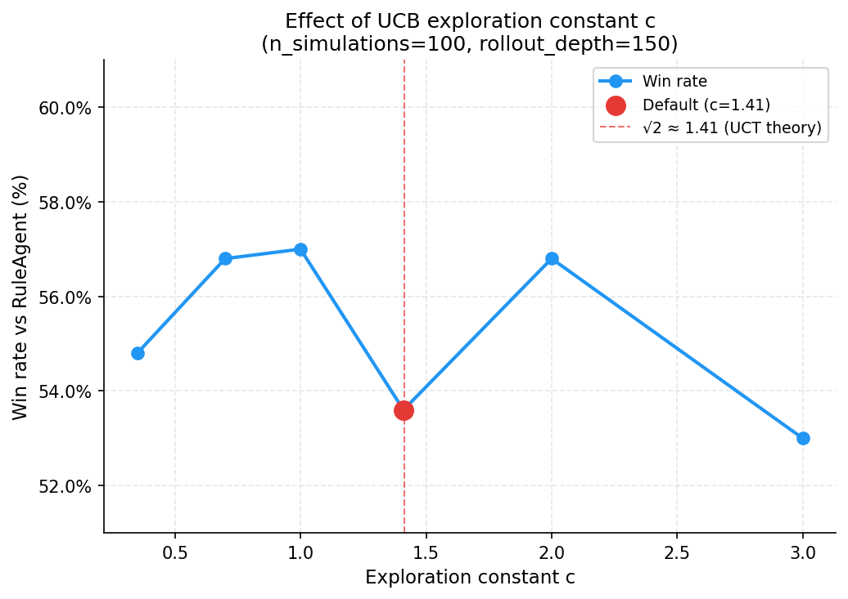
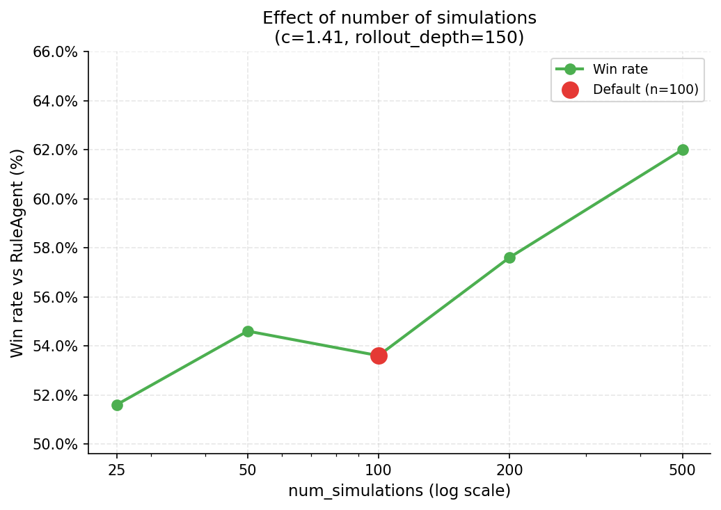
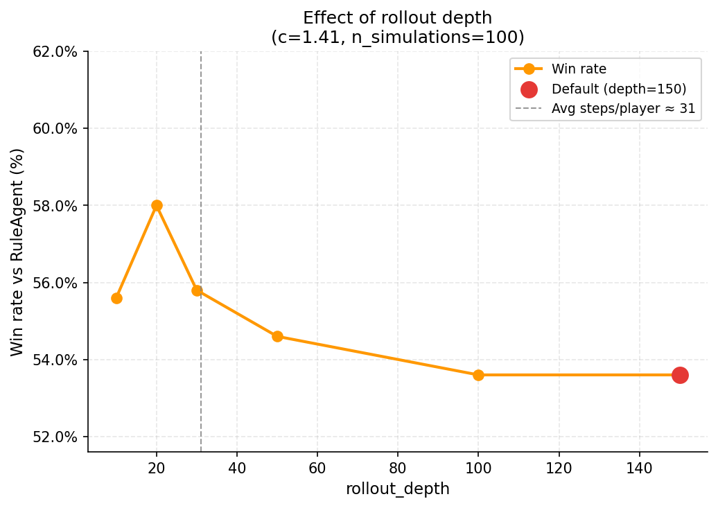
ISMCTS — 1D Sweep Results
c
num_simulations
rollout_depth
Peak 57.0 % at c = 1.0
flat in [0.7, 2.0]
Monotonic rise 51.6 % → 62.0 %
most sensitive
Peak 58.0 % at depth = 20
degrades after
Take-away
1D best: c = 1.0, num_simulations = 200, depth = 20→ 58.8 % vs Rule, 64.1 % vs Random (1000 games).

Slide 32
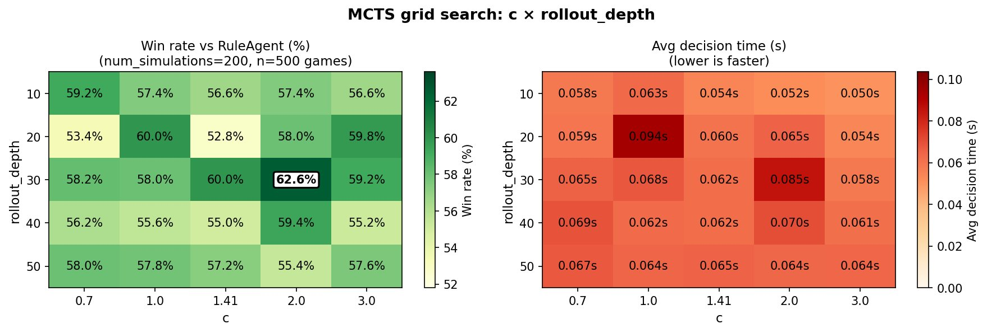
ISMCTS — Grid Search
One-at-a-time sweeps can't see how parameters interact; we run a 2-D grid to find out.
Take-away
2D best: c = 2.0, num_simulations = 200, depth = 30 → 59.8 % vs Rule, 63.3 % vs Random (1000 games).

Slide 33
Analysis & Takeaways

Slide 34
Analysis Logic
We evaluate agents across three dimensions :
1 - Performance
2 - Efficiency
3 - Fairness
Win Rate
Surviving Rounds
First-Mover Advantage
Proof of reliability
Evaluation Framework
ISMCTS as the
Near-GTO Baseline​
All agents compared against ISMCTS
ISMCTS simulates thousands of future game states per turn, serving as the closest approximation to a GTO strategy
Statistical Significance Testing
p-value & confidence interval
Win/loss → Binomial test;
Surviving rounds → Mann-Whitney U test
10,000 games
per matchup
95% confidence interval narrows to ±1%
Reliably detect small but real differences in agent performance
34
Notes:
Win/loss outcomes are binary and are therefore evaluated using a binomial test to assess whether the win probability significantly deviates from random chance.
Surviving rounds are continuous and non-normally distributed, making the Mann-Whitney U test appropriate for comparing distributions without assuming normality.

Slide 35
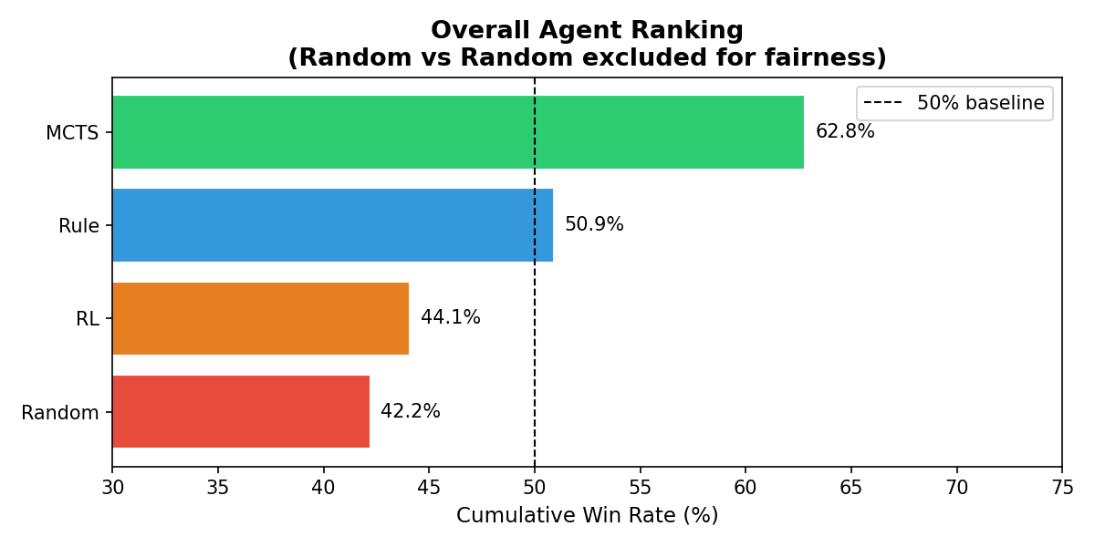
Overall Agent Ranking
ISMCTS significantly outperforming all others. No evidence of cyclic dominance is observed; instead, the agents exhibit a stable linear ranking: ISMCTS > Rule > RL > Random.
ISMCTS achieves the highest win rate (~62.8%), followed by Rule (~50.9%), while RL (~44.1%)
and Random (~42.2%) perform below the baseline.
Ag | TotalWins | TotalGames
ISMCTS | 18,834 | 30,000
Rule | 15,256 | 30,000
RL | 13,240 | 30,000
Random | 12,670 | 30,000

Slide 36
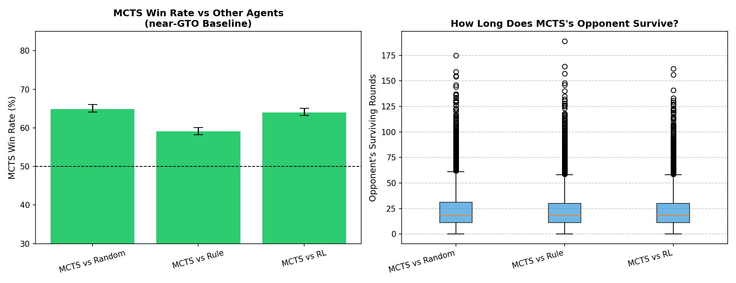
ISMCTS VS Other Agents
ISMCTS consistently outperforms all agents.
It shows a clear advantage over Random and RL (~65%), while the margin against the rule-based agent is smaller (~58–60%), indicating that rule-based strategies partially approximate optimal play.
Opponent survival rounds are similar across agents, with only minor differences, suggesting that performance differences are primarily reflected in win rates rather than game duration.

Slide 37
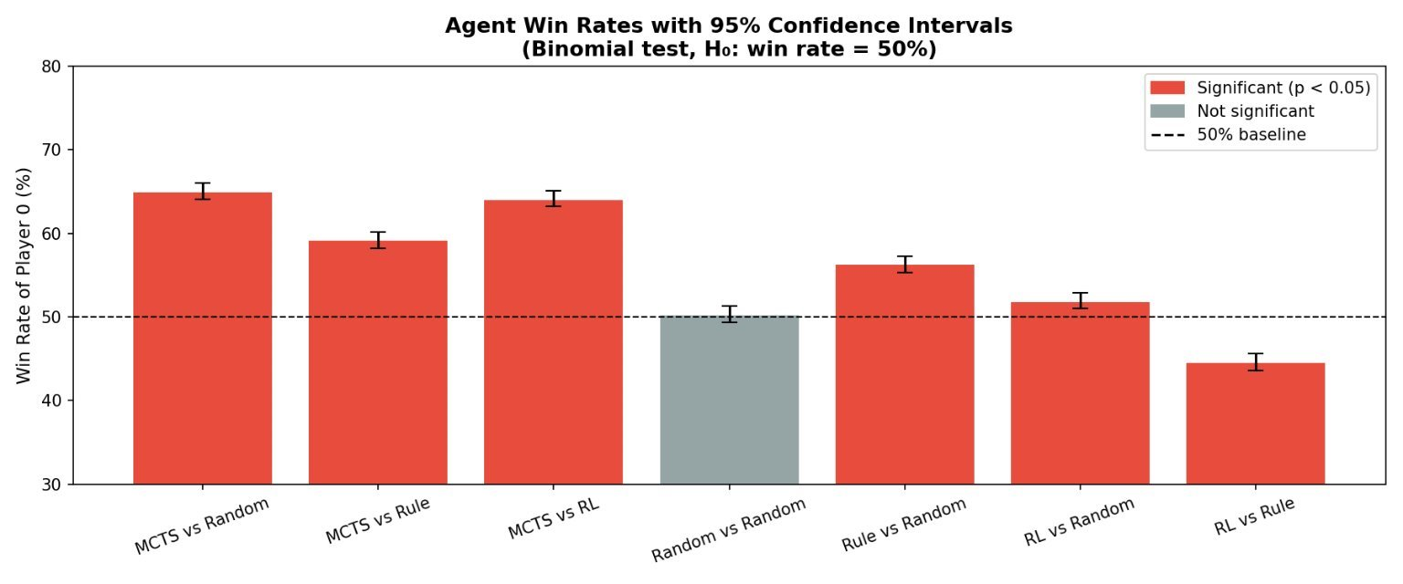
1 - Performance
Statistical testing confirms that ISMCTS shows statistically significant gains over all other agents.
Win Rate
RL exhibits consistent underperformance, confirming that its lower win rates reflect genuinely weaker policies rather than random variation.​
Rule outperforms Random, indicating that Rule-based heuristics provide a reliable improvement over uninformed play.

Slide 38
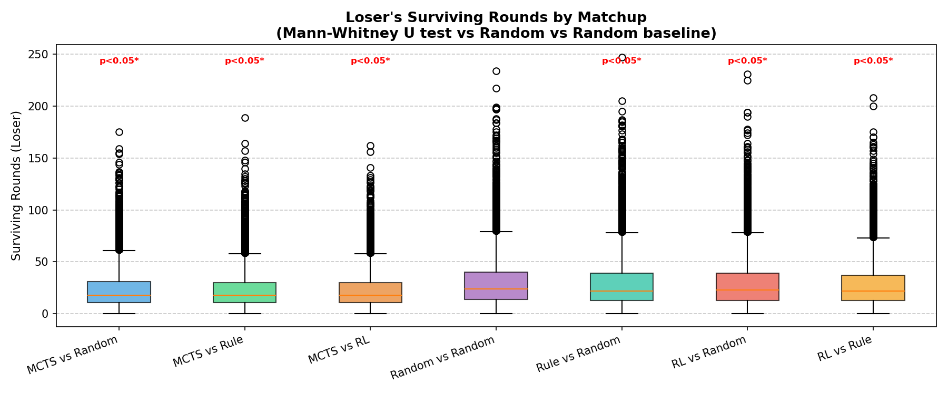
2 - Efficiency
ISMCTS consistently achieves shorter opponent survival times, indicating faster, more decisive gameplay with statistically reliable advantages.
Surviving
Rounds
Rule-based and RL agents show significantly longer opponent survival times (~29 rounds vs ~23 for ISMCTS), suggesting weaker control over game progression.
All pairwise differences are statistically significant (p < 0.05), confirming that survival rounds reliably reflect performance differences rather than random variation.
Matchup | Surv_ Avg | Surv_Std
ISMCTS vs Random | 23.7 | 18.3
ISMCTS vs Rule | 23.1 | 17.6
ISMCTS vs RL | 23.0 | 17.0
Rule vs Random | 29.4 | 24.2
RL vs Random | 29.5 | 23.1
RL vs Rule | 28.6 | 22.4

Slide 39
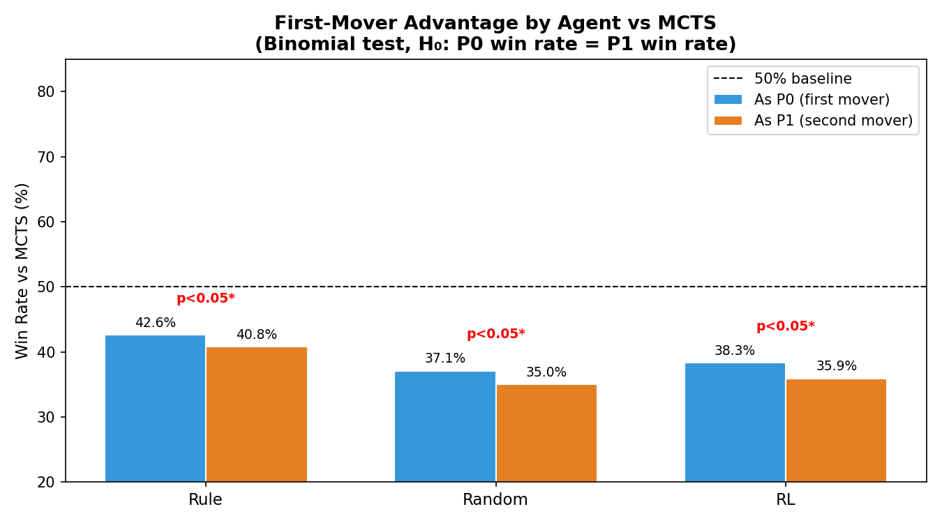
3 - Fairness
All agents exhibit a statistically significant first-mover advantage, indicating a systematic bias favoring the starting player.
First-Mover
Advantage
The magnitude of this advantage increases from Rule (1.2) to Random (2.1) and RL (2.4), suggesting that weaker or less structured agents are more sensitive to turn order.
This implies that stronger strategies are more robust to positional bias, while weaker agents rely more heavily on first-move advantage to perform competitively.
Agent | Advantage= P0 win rate – P1 win rate
Rule | 1.2
Random | 2.1
RL | 2.4
Notes:
The advantage ranking reflects sensitivity to turn order, not overall performance.
Although RL shows the highest first-move advantage, this does not indicate stronger performance. Instead, it reflects a higher dependency on turn order, suggesting weaker strategies rely more on positional bias.

Slide 40
Takeaways
Based on the results across performance, efficiency, and fairness, we can summarize the key findings as follows:
1. ISMCTS > Rule > RL > Random
ISMCTS is the strongest agent, consistently outperforming others with statistically significant advantages over Random and RL, and Rule.
2. Performance differences are driven primarily by win rates rather than game duration, with ISMCTS achieving faster and more decisive outcomes while maintaining similar survival variability.
3. Game dynamics are not perfectly fair: a statistically significant first-move advantage exists for all agents, with weaker strategies (Random, RL) being more sensitive to turn order than stronger ones.

Slide 41

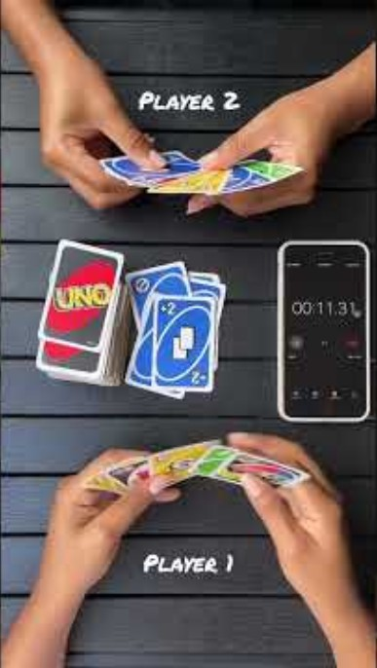
Notes:
Generate QR code at: https://www.qrcode-generator.de/
Picture size 5.88” x 5.88” ; align middle & move slightly to the right ; Soft Edges (25 point)

Slide 42
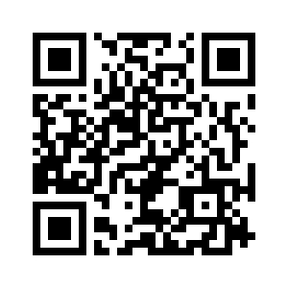
Compete against our UNO agents!
Scan the QR-code!
Or visit the link：https://uno-matchup.streamlit.app/
Notes:
Generate QR code at: https://www.qrcode-generator.de/
Picture size 5.88” x 5.88” ; align middle & move slightly to the right ; Soft Edges (25 point)

Slide 43
Limitations
The current system only supports 2-player UNO, limiting multiplayer strategy complexity.
The RL agent uses a relatively simple DQN architecture, which restricts long-term strategic learning.
The ISMCTS agent achieves the best performance but requires significantly higher computation time.
Hidden information is approximated through sampling, so opponent behavior cannot be modeled perfectly.
Evaluation mainly focuses on win rates and average turns rather than broader strategic metrics.
Future Scope
Extend the environment to support full multiplayer UNO gameplay.
Improve the RL agent using advanced methods such as PPO, Double DQN, or Transformer-based models.
Combine ISMCTS with neural networks to create stronger hybrid agents.
Add opponent modeling so agents can adapt to different play styles.
Expand benchmarking with Elo ratings, statistical testing, and richer evaluation metrics.

Slide 44
References
https://www.unorules.com/
https://en.wikipedia.org/wiki/Uno_(card_game)
Winning UNO With Reinforcement Learning https://web.stanford.edu/class/aa228/reports/2020/final79.pdf
Reinforcement learning compared to rule-based play in UNO https://www.diva-portal.org/smash/record.jsf?pid=diva2%3A1955734&dswid=-5242
The Complexity of UNO https://www.researchgate.net/publication/45906238_The_complexity_of_UNO
Cowling, P. I., Powley, E. J., & Whitehouse, D. (2012). Information Set Monte Carlo Tree Search. IEEE Transactions on Computational Intelligence and AI in Games, 4(2), 120–143.
Kocsis, L., & Szepesvári, C. (2006). Bandit Based Monte-Carlo Planning. ECML 2006, Lecture Notes in Computer Science, vol. 4212, pp. 282–293.
Notes:
Cut, because repetitive website (just a different page)
- https://www.unorules.com/uno-trivia-stuff-and-facts/
- https://www.unorules.com/best-strategies-to-win-uno/

Slide 45
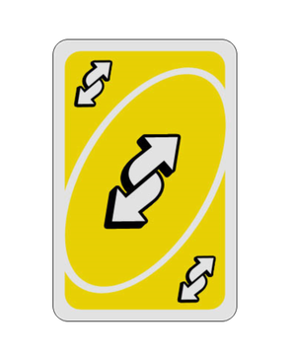
Thank you for your attention!
Now it’s your turn
Do you have any questions?
Feedback?

Slide 46
Appendix

Slide 47
UNO® Gameplay
On your turn, you try to get rid of all your cards by playing ONE CARD onto the Discard Pile.
If you HAVE a matching card, you may PLAY IT on the Discard Pile.
You can only play a card if it matches at least one attribute of the top card on the Discard Pile: it’s color, number, or symbol
If you played an action card it does something special (see next slide)
If you DO NOT HAVE a matching card, DRAW ONE CARD from the draw pile
If your new card can be played (see above), then you may play it now.
You may choose to draw a card, even if you have a playable card in your hand.
Once you have only one card in your hand you must yell “UNO”.
If someone catches you and calls out “UNO” before you, then you must draw two cards.

Slide 48
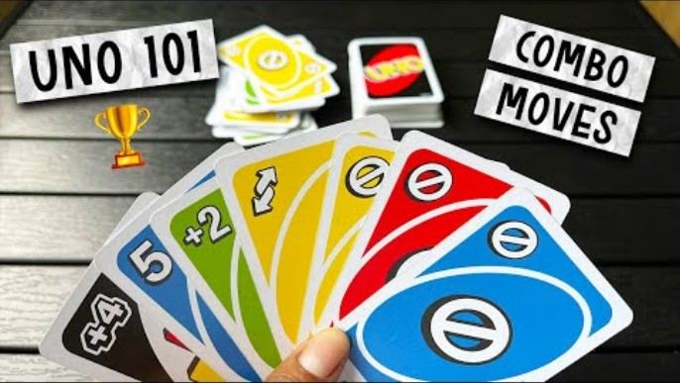
Another UNO® Match

Slide 49
Wild Draw Four – Challenge Mechanic
Wild Draw Four
This card matches anything so you can play it no matter what card is on the Discard Pile. However, there’s a catch: you can only play a Wild Draw 4 if you DO NOT HAVE ANY CARD IN YOUR HAND THAT MATCHES THE COLOR OF THE DISCARD PILE.
When played, the next player has two options: Draw 4 cards and lose their turn OR challenge.
If the player challenges you, then you must show them your entire hand to confirm whether or not you have a card that matches the color of the discard pile – Wild cards are considered a match, too.
If you DO NOT have a card that matches color: the challenger draws 6 cards instead of 4 and loses their turn.
If you DO have a card that matches color: YOU must draw 4 cards and they draw none.
This card is also a Wild card, so you get to choose the color that continues play (regardless of the outcome of any challenge).

Slide 50
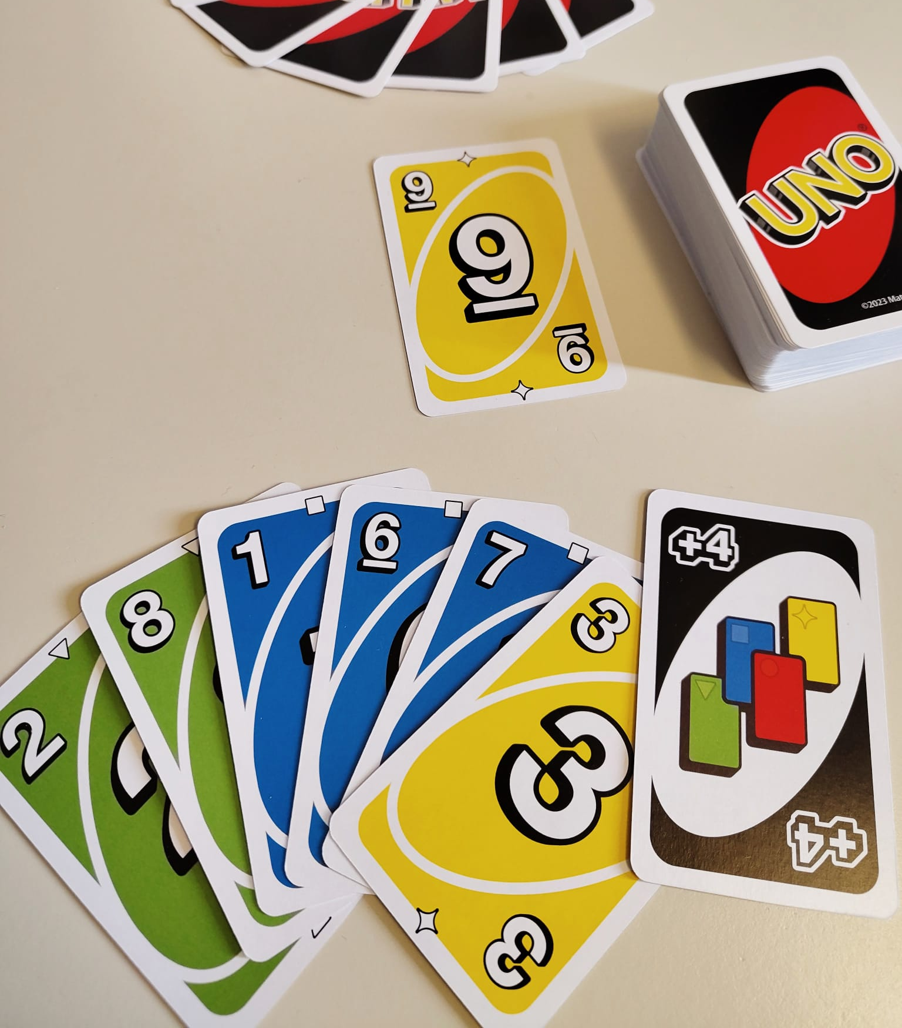
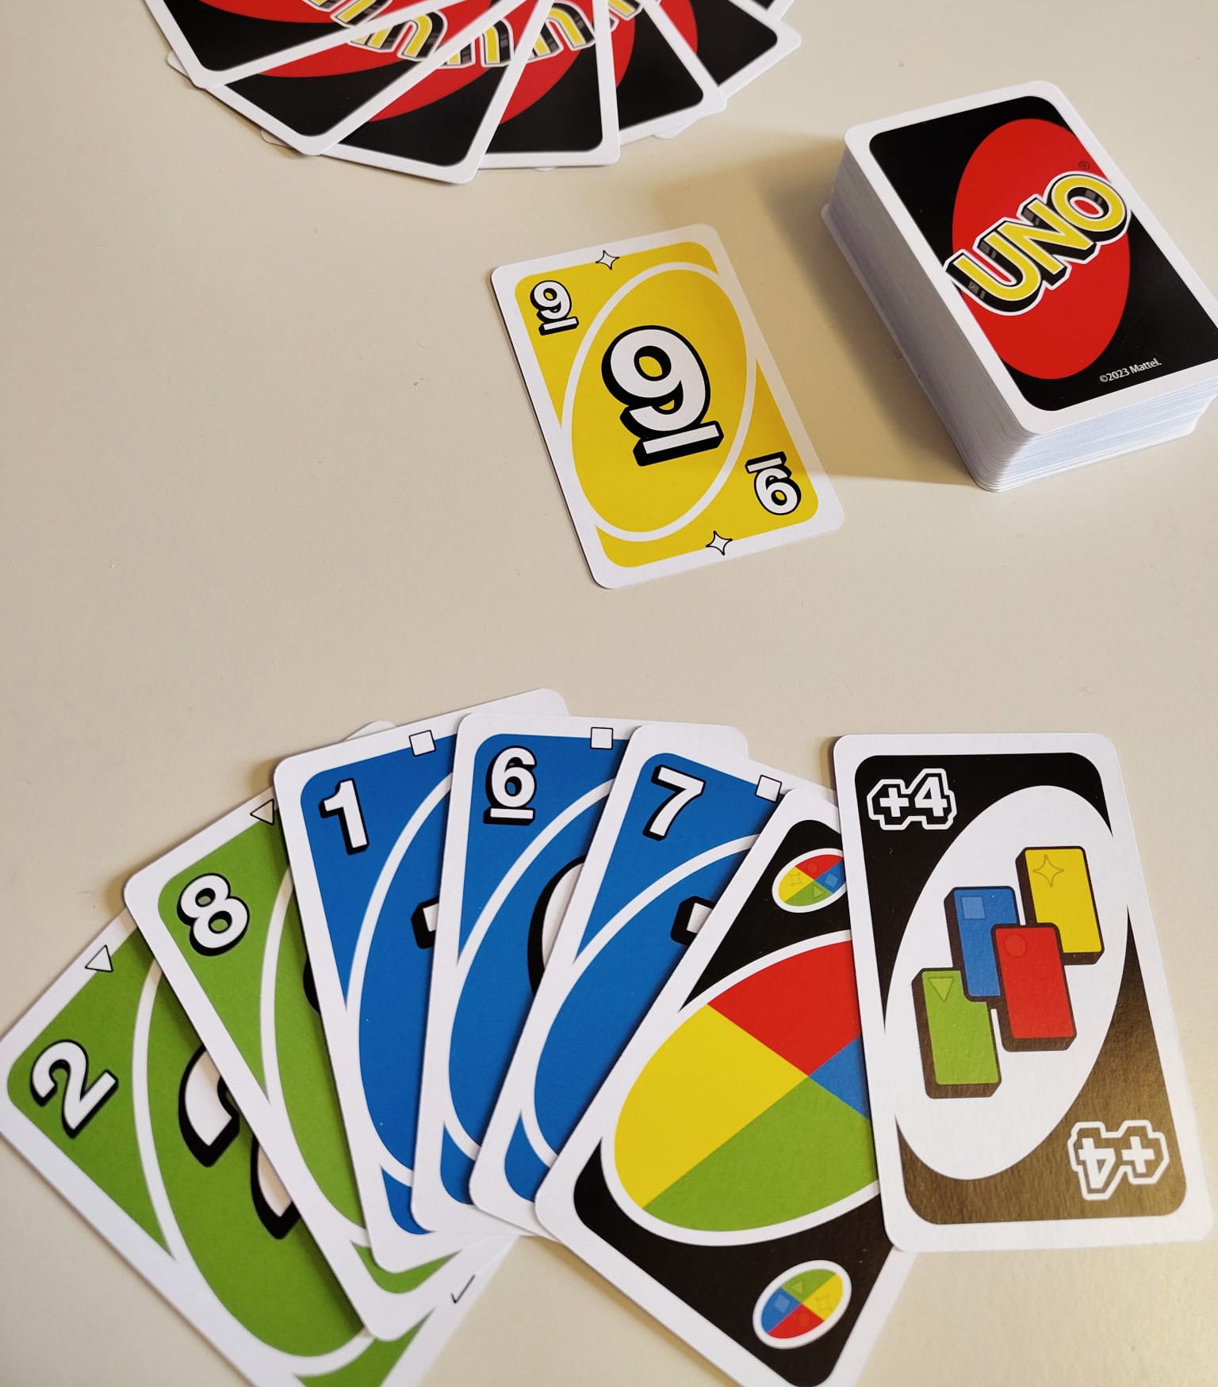
Wild Draw Four – Illegal Plays
An illegal play occurs when you have a card matching the color of the card on the discard pile OR you have a wild card.
As a result, your Wild Draw Four (+4) card could be successfully contested by your opponent.
Illegal play because the player is holding a color matching card (yellow 3) in their hand.
Illegal play because the player is holding a wild card in their hand.
A wild card is considered a match, too.

Slide 51
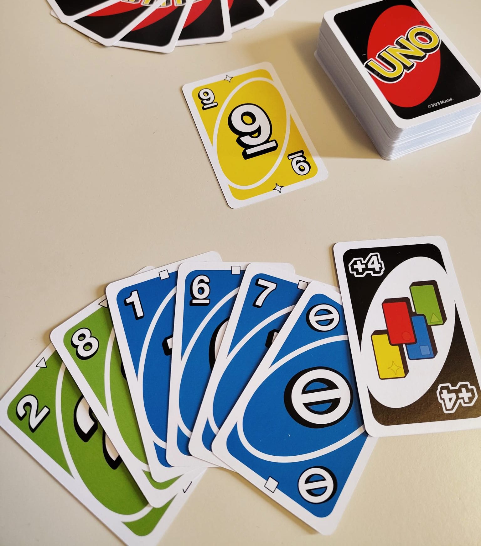
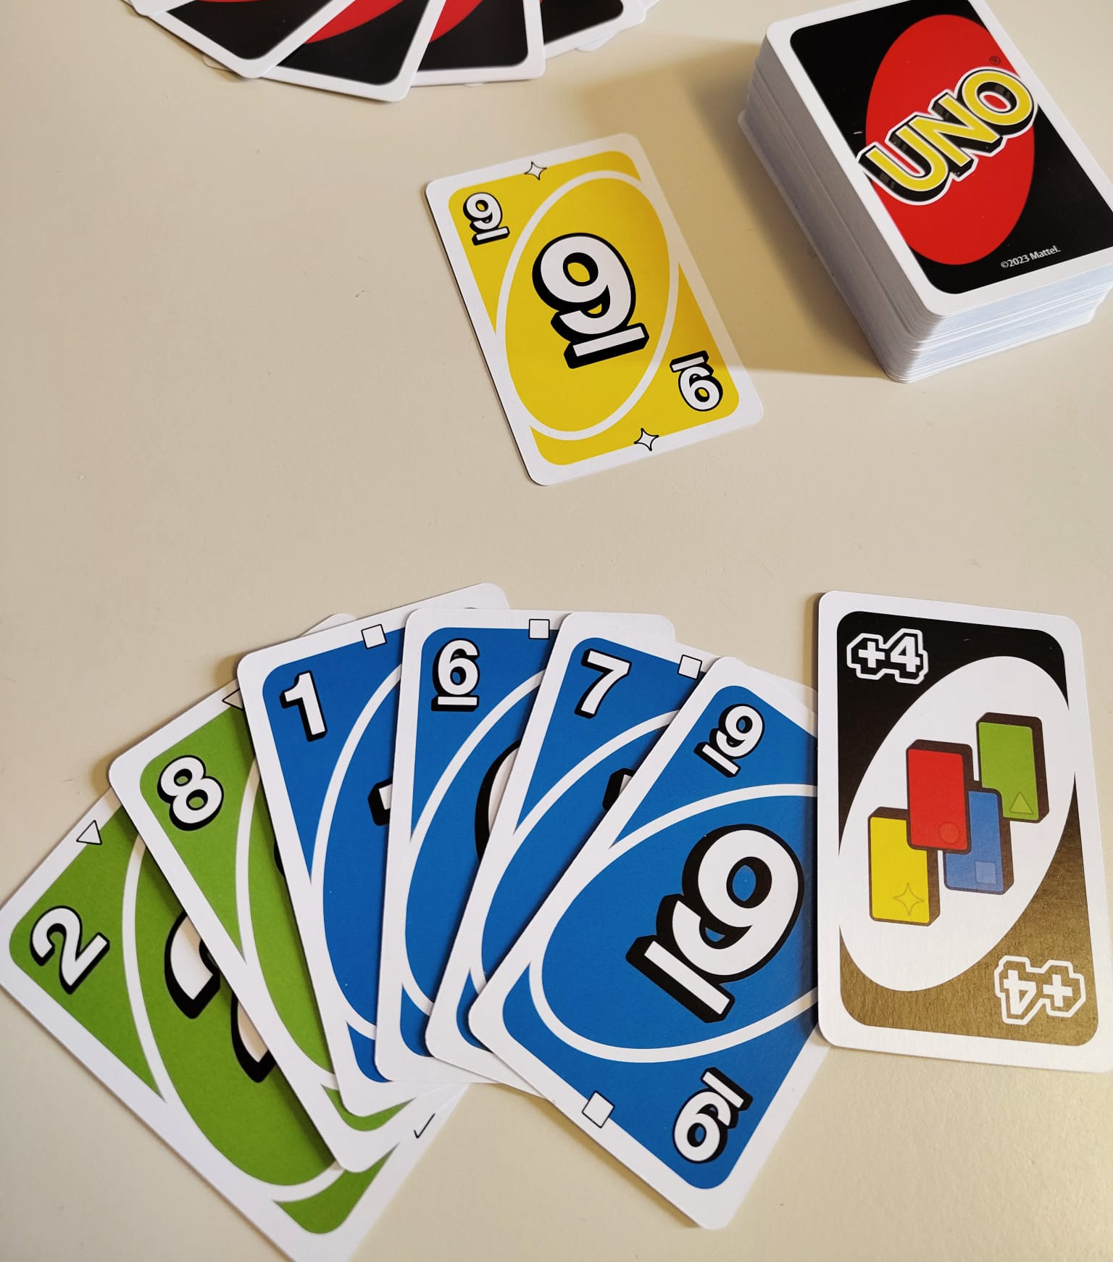
Wild Draw Four – Legal Plays
A legal play of the Wild Draw Four (+4) card is any play when the player does not hold a card matching the color of the top card on the discard pile.
Challenging these plays would result in +6 draw for the opponent.
Even though the player could play the blue 9 this play is legal.
This is because the rule only regards color, not number or symbol.

