Slide 1
Predictive Sports Analytics
Framework for IPL Match
Intelligence & Balanced Team Generation
Shravani Manik Ghadge | ADT24SESM0137
Guide: Prof. Rohit Raskar | May 2026

Slide 2
INDEX
Introduction
Literature Review
Objectives
Methodology
Model selection & Training
Application Deployment
Result &Discussion
Limitation & Future Scope
References

Slide 3
I
Introduction
Data Science meets the Game of Cricket

Slide 4
Introduction
Chapter I
The Indian Premier League (IPL)
One of the world's most data-intensive T20 cricket tournaments — active since 2007
Every ball generates rich data: runs, wickets, partnerships, strike rates & match context
Small strategic decisions in T20 cricket can drastically influence final results
Sports organisations increasingly leverage analytics for tactical planning & player selection
Module 1
Module 2
Module 3
Win Probability
Prediction
Smart Team
Builder
Statistical
Analysis
Predictive Sports Analytics Framework for IPL | Shravani Ghadge | MIT ADT University

Slide 5
II
Literature Review
Building on prior research in cricket analytics

Slide 6
Literature Review
Chapter II
2006
Bailey & Clarke —
Bailey and Clarke introduced early statistical modelling techniques for analysing cricket performance and player contributions using historical match data
2011
Lemmer —
Lemmer identified important player evaluation metrics such as strike rate, economy rate, wickets, and consistency in limited-overs cricket
2014
Sankaranarayanan et al. —
This study applied machine learning techniques to predict cricket match outcomes using historical IPL match data
2001
Breiman — Random Forest —
Breiman introduced Random Forest, an ensemble learning algorithm that improves prediction accuracy and handles complex feature relationships.
2016
Chen & Guestrin — XGBoost —
Chen and Guestrin developed XGBoost, an advanced boosting algorithm known for fast processing and high prediction performance
Predictive Sports Analytics Framework for IPL | Shravani Ghadge | MIT ADT University

Slide 7
III
Objectives
Three core analytical goals

Slide 8
Project Objectives
Chapter III
01
Win Probability Prediction
Predict real-time winning chances during second innings using runs required, wickets in hand, overs remaining, current & required run rate.
02
Smart Team Builder
Recommend an optimal playing XI for a new IPL franchise by analysing batting averages, strike rates, economy rates, wickets & fielding records.
03
Statistical Analysis
Use hypothesis testing & EDA to uncover hidden patterns — toss advantage, venue influence, team consistency & player performance stability.
Predictive Sports Analytics Framework for IPL | Shravani Ghadge | MIT ADT University

Slide 9
IV
Methodology
Data collection, preprocessing, feature engineering & EDA

Slide 10
Methodology Overview
Chapter IV
1
2
3
4
Data
Collection
Data
Preprocessing
Feature
Engineering
EDA &
Visualisation
Kaggle IPL
2008–2025
ball-by-ball
Duplicates, missing
values, team names,
type conversion
Runs left, balls left,
CRR, RRR, match
phase, batting score
Top scorers, wickets,
team trends,
season patterns
Dataset: 500,000+ ball-by-ball deliveries · IPL seasons 2008–2025 · Source: Kaggle · Target variable: batting_won (1 = chase win, 0 = loss)
Predictive Sports Analytics Framework for IPL | Shravani Ghadge | MIT ADT University

Slide 11
Data collection & Data preprocessing:
Chapter IV
Data collection:
278000 rows, 63 variables.
Data Description:
The dataset includes match information such as:
Match ID
Season
Batting Team
Bowling Team
Runs Scored
Wickets
Overs and Balls
Venue
Toss Winner
Match Winner
Data preprocessing:
Removed duplicate and missing records
Standardized inconsistent team and player names
Converted categorical variables into numerical
Converted columns into appropriate data types
Performed feature scaling
Feature Engineering:
Runs Required = Target − Current Score
Balls Remaining = 120 − Balls Bowled
CRR = Current Score ÷ Overs Completed
RRR = Runs Required ÷ Overs Remaining
Strike Rate = (Runs ÷ Balls Faced) × 100
Predictive Sports Analytics Framework for IPL | Shravani Ghadge | MIT ADT University

Slide 12
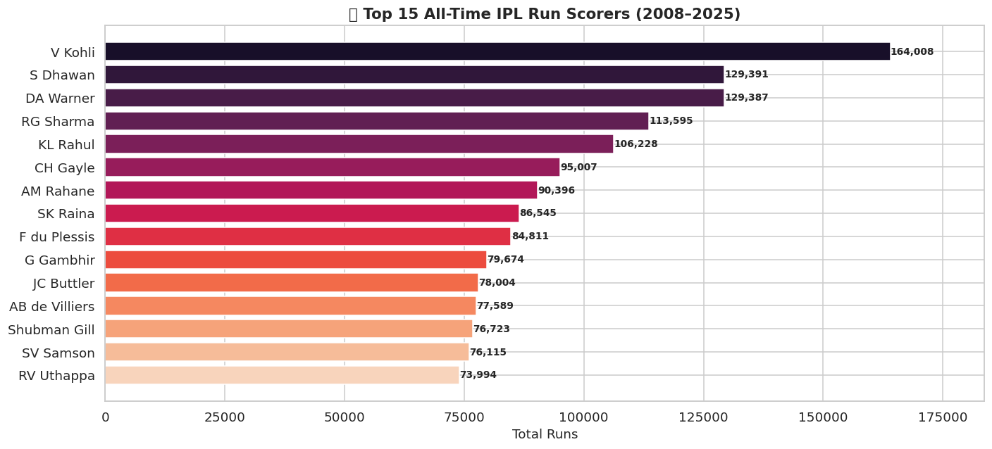
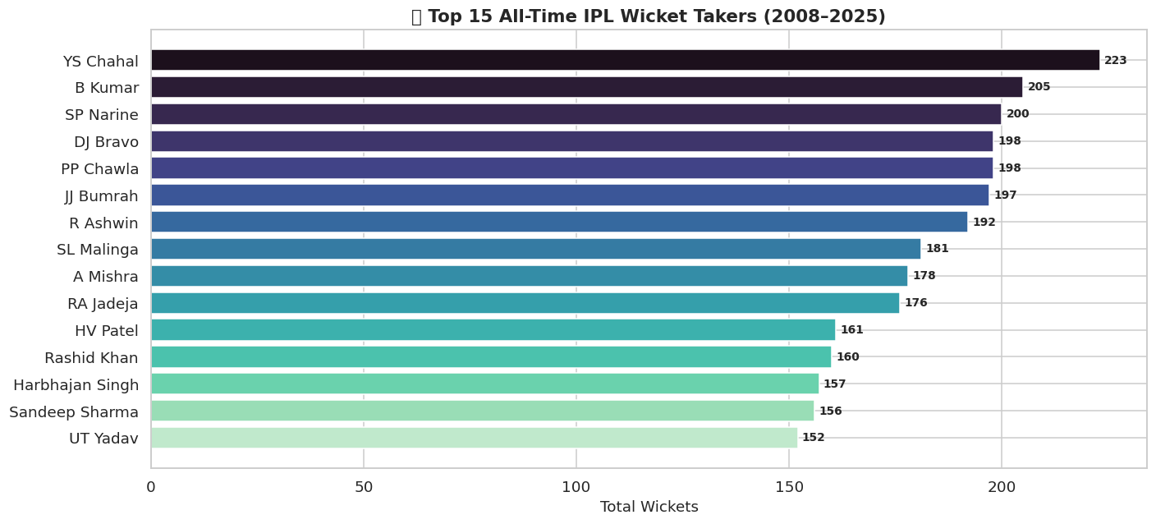
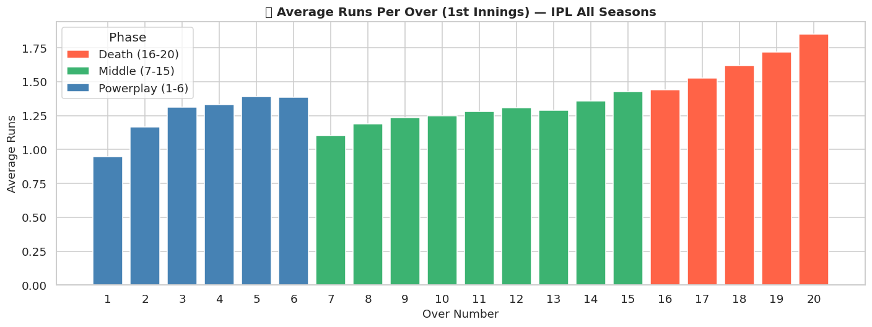
Exploratory Data Analysis:
Chapter IV
Interpretation:
V Kohli leads with 164,008 runs; S Dhawan (129,391) and DA Warner (129,387) compete for 2nd place — a gap of just 4 runs
Powerplay: gradual rise reaching peak in overs 5–6. Middle overs: steady. Death overs (16–20): exponential rise — over 20 nearly doubles over 1
YS Chahal tops at 223 wickets; B Kumar (205) and SP Narine (200) are only other 200+ wicket bowlers; tight cluster in top 10

Slide 13
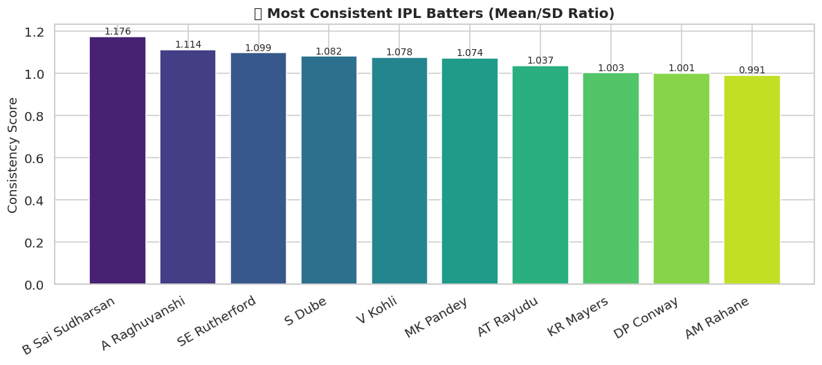
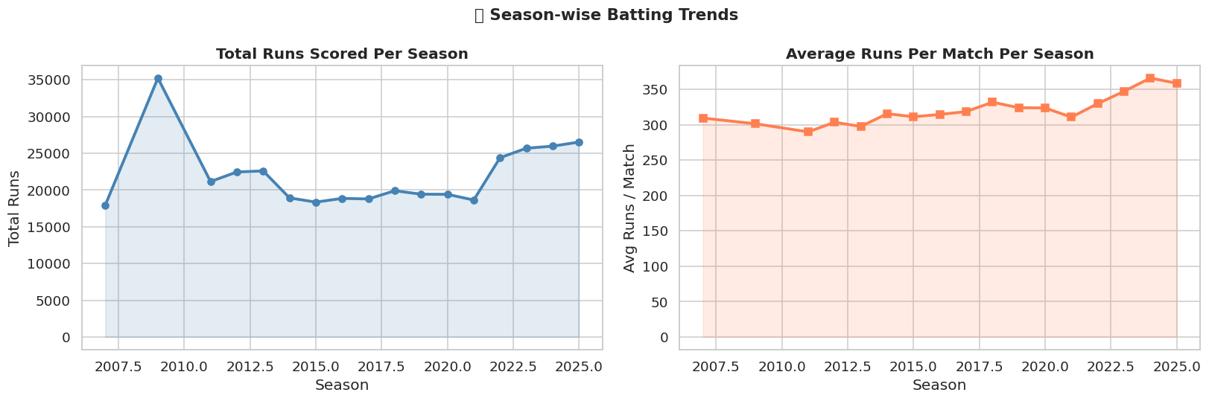
EDA Highlights
Chapter IV
Season Trends (2007–25)
Post-2022 surge in total runs due to league expansion. Average per match rose from 290–310 to 350+ by 2024–25
Most Consistent Batter
B Sai Sudharsan tops the Mean/SD consistency ratio chart (1.176) — higher ratio = more predictable output
Predictive Sports Analytics Framework for IPL | Shravani Ghadge | MIT ADT University

Slide 14
V
Model Selection & Training
8 algorithms evaluated — KNN emerges as best performer

Slide 15
Models Compared
Chapter V
Logistic Regression
K-Nearest Neighbours
✓ BEST MODEL
Decision Tree
Naïve Bayes
Random Forest
XGBoost
SVM (Linear)
LightGBM
Predictive Sports Analytics Framework for IPL | Shravani Ghadge | MIT ADT University

Slide 16
KNN Model Performance
Chapter V
Why KNN?
97%
0.97
Classifies match outcome by comparing to nearest similar historical matches
Accuracy
AUC-ROC
Uses Euclidean distance across match-state features
0.97
0.97
Train/test split: 80% / 20% with stratified sampling
Precision
F1-Score
Five-Fold Cross-Validation ensures robust generalisation
Most Important Features
Runs Left
Balls Left
Required Run Rate
Wickets Remaining
Confusion Matrix Highlights
Correct: 12,709 (Bowling wins) + 13,390 (Batting wins) = 26,099 correct out of 26,781 test samples
Errors: 349 + 333 — nearly equal false positives & negatives → no class bias
Predictive Sports Analytics Framework for IPL | Shravani Ghadge | MIT ADT University

Slide 17
VI
Application & Deployment
Interactive Gradio-based IPL Smart Analytics System

Slide 18
IPL Smart Analytics System
Chapter VI
Built with Gradio — 3 Interactive Modules: application
🎯 Win Predictor
🏏 Team Builder
📊 Dashboard
› Select batting & bowling teams
› Click 'Build Recommended XI'
› Top run scorers & wicket takers
› Enter target, current score
› View role-wise squad (WK, Openers, MO, AR, Bowlers)
› Input balls bowled & wickets fallen
› Player composite scores shown
› Get live win probability for both sides
Example: MI (100/3 in 60 balls, target 180 vs CSK) → Win Prob: MI 100%
Predictive Sports Analytics Framework for IPL | Shravani Ghadge | MIT ADT University

Slide 19
Smart Team Builder — Recommended XI
Chapter VI
Active Seasons 2023–2025 | Data-Driven Squad
1
KL Rahul
Wicketkeeper
7
SP Narine
All-Rounder
2
Shubman Gill
Opener
8
Noor Ahmad
All-Rounder
3
V Kohli
Opener
9
JJ Bumrah
Bowler
4
B Sai Sudharsan
Middle-order Batter
10
CV Varun
Bowler
5
DP Conway
Middle-order Batter
11
Mohammed Siraj
Bowler
6
RD Gaikwad
Middle-order Batter
Predictive Sports Analytics Framework for IPL | Shravani Ghadge | MIT ADT University

Slide 20
VII
Result & Discussion
Key findings from ML models and statistical tests

Slide 21
Results — Statistical Analysis
Chapter VI
Hypothesis Testing Outcomes
Toss Impact Analysis
Chasing vs Batting First
Chi-Square Test: χ² = 6.83, p = 0.009
→ REJECT H₀ — Toss significantly affects outcome
65.4% of captains choose to field first
Toss winner wins ~50–52% of matches
Two-Sample T-Test: t = −4.09, p < 0.001
→ REJECT H₀ — Significant difference found
Chasing team win rate: 53.4%
Batting first win rate: 44.9%
164K
223
350+
60%+
V Kohli — All-time
IPL top scorer
YS Chahal — Most
wickets ever
Avg runs/match
(2024–25 season)
Gujarat Titans
win percentage
Predictive Sports Analytics Framework for IPL | Shravani Ghadge | MIT ADT University

Slide 22
VIII
Limitations & Future Scope
Current constraints and roadmap ahead

Slide 23
Limitations & Future Scope
Chapter VIII
⚠ Current Limitations
🚀 Future Scope
No real-time data feeding (offline dataset only)
Live ball-by-ball prediction via Flask/Streamlit APIs
Weather, pitch & player fitness not captured
Add pitch, weather & injury report features
Model misses momentum shifts & star-player impact
Deep learning: LSTM / RNN for sequential patterns
Team builder uses only post-2023 seasons
Expand team builder with auction price & age
Batting position approximated by overs played
Mobile & web app for fans & analysts
No auction budget constraints in team selection
Player head-to-head & partnership analytics
Predictive Sports Analytics Framework for IPL | Shravani Ghadge | MIT ADT University

Slide 24
IX
References
Key literature supporting this work

Slide 25
References
Chapter IX
1
Banerjee et al. (2019) — Innovative ranking strategy for IPL team formation. arXiv:1908.01725
2
Verma et al. (2022) — Balanced squad for IPL using modified NSGA-II. IEEE Access.
3
Gokul & Sundararaman (2023) — Determining playing XI based on opposition squad. J. Sports Analytics.
4
Dey et al. (2024) — Optimising IPL squad: mathematical framework. IJDATS, 16(3), 311–340.
5
Lamsal & Choudhary (2018) — Predicting IPL match outcomes using machine learning. arXiv:1809.09813
6
Malhotra (2022) — Auction prices & economic value creation of IPL cricketers. J. Sports Analytics.
7
Bhatnagar (2024) — FanCric: Multi-agent framework for fantasy cricket teams. arXiv:2410.01307
8
Ganesh (2026) — Simulation-based optimisation of batting order & bowling plans in T20. arXiv.
Predictive Sports Analytics Framework for IPL | Shravani Ghadge | MIT ADT University

Slide 26
Thank You
Questions & Feedback Welcome
Shravani Manik Ghadge • ADT24SESM0137
M.Sc. Applied Statistics (Data Science) | MIT ADT University, Pune | May 2026
Guide: Dr. Rohit Raskar | Co-Guide: Dr. Pratibha Jadhav

