Slide 1



INTRODUCTION • MILESTONE 3 •
THREE MAJOR COMPONENTS
Failure Prediction AI
AI Strategic Recommendation Engine
Strategic, risk-based, market, technical, financial and operational advice.
Startup & Project Risk Analyzer
Recommendations & Strategic Reasoning
Risk Mitigation & Improvement Engine
Milestone 3 turns the outputs of the earlier stages (project information, risk score, SWOT and feasibility) into clear actions: what the problem is, why it matters, what to do about it, and how that action reduces the risk.
A mitigation strategy for every major risk, plus practical improvements.
LangGraph Agent Workflow
Six connected nodes sharing one state, from input to final response.
Notes:
Introduce the project: Failure Prediction AI, a Startup & Project Risk Analyzer. Milestone 1 collects project and market information; Milestone 2 does risk assessment, scoring, SWOT and feasibility. Milestone 3 (weeks 5-6) takes those outputs and generates recommendations and mitigation strategies. Three components: the AI Strategic Recommendation Engine, the Risk Mitigation & Improvement Engine, and the LangGraph Agent Workflow.

Slide 2




Tech Stack
Simple, beginner-friendly tools for the Milestone 3 build
Python
Streamlit
Google Gemini
CORE LANGUAGE
WEB DASHBOARD
LLM REASONING
Modular files, one per engine, with clear function names and comments.
Tabs for Project Input, Risk Assessment, Recommendations and Dashboard.
Generates the strategic recommendations. Key is read from an environment variable.
LangGraph
SQLite
AGENT WORKFLOW
LOCAL DATABASE
Six nodes pass one shared state object from input to final response.
Stores projects, risks, recommendations, mitigations and improvements. No external server needed.
2 / 7
Notes:
Walk through the five building blocks. Python for the modular backend, Streamlit for the dashboard tabs, Gemini for strategic reasoning (API key comes from an environment variable and is never hard-coded), LangGraph for the agent workflow, and SQLite as a local database. Mention Demo Mode: without an API key the app still works and clearly labels output as Demo Mode.

Slide 3

System Flow
One shared state travels through six LangGraph nodes
1
2
3
4
5
6
7
Input
Project Analysis
Risk Analysis
Strategic Recommendation
Mitigation Strategy
Improvement Suggestions
Final Response
Project info +
Milestone 2 outputs
analyze_
project
analyze_
risks
generate_
recommendations
generate_
mitigation
generate_
improvements
generate_
final_response
Shared state object Every node reads the same state and adds its output, so the final response combines the results of all nodes.
LLM reasoning
Demo Mode fallback
Nodes call llm_service.py for Gemini. The key comes from the GEMINI_API_KEY environment variable.
With no API key the workflow still completes using sample responses, labelled Demo Mode.
3 / 7
Notes:
Explain the pipeline: Input, Project Analysis, Risk Analysis, Strategic Recommendation, Mitigation Strategy, Improvement Suggestions, Final Response. Each step is a separate LangGraph node (analyze_project, analyze_risks, generate_recommendations, generate_mitigation, generate_improvements, generate_final_response). A shared state object connects them, and the final node combines everything.

Slide 4
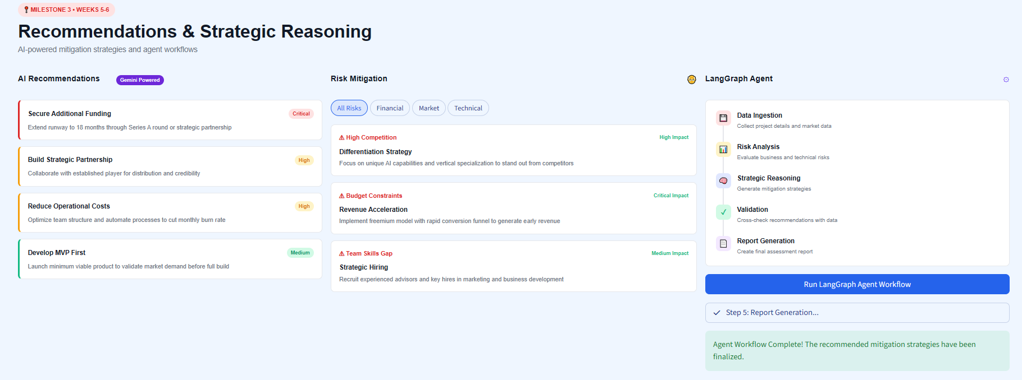
Working
Milestone 3: Recommendations & Strategic Reasoning in the running app
1
AI Recommendations
Action cards ranked Critical, High or Medium, e.g. Secure Additional Funding (Critical).
2
Risk Mitigation
Filter by All, Financial, Market or Technical. High Competition maps to a Differentiation Strategy.
3
LangGraph Agent
LANGGRAPH AGENT STEPS
One click runs the five agent steps, then confirms the workflow is complete.
Data Ingestion
Risk Analysis
Strategic Reasoning
Validation
Report Generation
4 / 7
Notes:
Live-demo talking points for Milestone 3 only. 1) AI Recommendations, Gemini powered: cards ranked Critical / High / Medium. 2) Risk Mitigation: filter by category and see the mitigation for each risk, e.g. High Competition -> Differentiation Strategy. 3) LangGraph Agent: click Run LangGraph Agent Workflow, the panel steps through Data Ingestion, Risk Analysis, Strategic Reasoning, Validation and Report Generation, and finishes with the Agent Workflow Complete message.

Slide 5
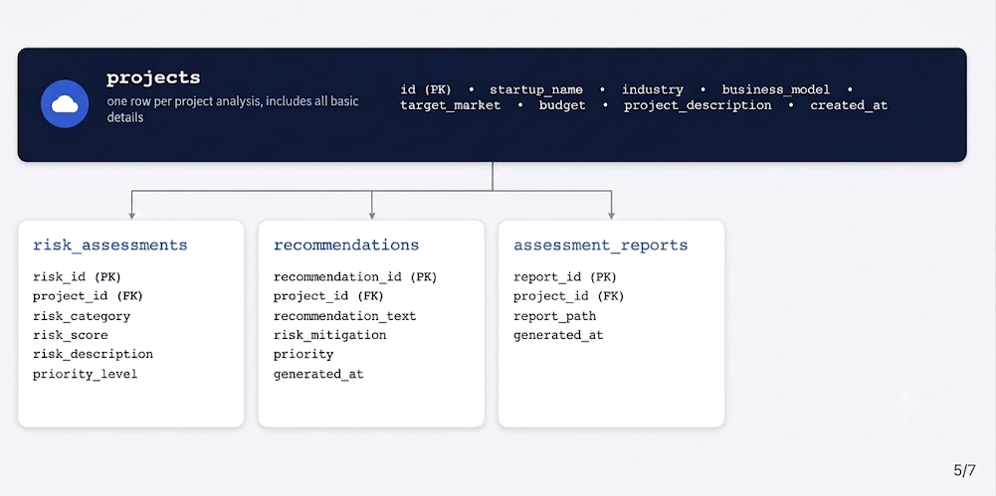
Database Strucrtue
Notes:
The prototype uses a simple local SQLite database so it runs in Replit without any external server. The projects table holds the project information, risk score, feasibility and the analysis date/time. Four child tables link back through project_id: risks, recommendations, mitigation_strategies and improvement_suggestions. Fields follow what the app stores for each result type (for example mitigation: strategy, preventive action, contingency action, priority).

Slide 6
Code
Modular Python files, with the LangGraph workflow at the centre
app.py
Streamlit dashboard and tabs
workflow.py (simplified)
config.py
Settings; reads API key from env
from langgraph.graph import StateGraph, END
nodes = [analyze_project, analyze_risks,
generate_recommendations, generate_mitigation,
generate_improvements, generate_final_response]
graph = StateGraph(ProjectState) # shared state
for fn in nodes:
graph.add_node(fn.__name__, fn)
for a, b in zip(nodes, nodes[1:]):
graph.add_edge(a.__name__, b.__name__)
graph.set_entry_point("analyze_project")
graph.add_edge("generate_final_response", END)
result = graph.compile().invoke(state)
database.py
SQLite setup, save and load
models.py
Data models and shared state
llm_service.py
Gemini calls and Demo Mode
recommendation_engine.py
Strategic, risk-based advice
mitigation_engine.py
Mitigation per identified risk
improvement_engine.py
Improvement suggestions
workflow.py
LangGraph nodes and graph
requirements.txt
Python dependencies
README.md
How to run, add API key
Each node reads the shared state, adds its output and hands it on.
6 / 7
Notes:
Left: the project structure, one file per responsibility. config.py reads the API key from an environment variable, llm_service.py handles Gemini and Demo Mode, and the three engine files produce recommendations, mitigations and improvements. Right: a simplified view of workflow.py, where the six nodes are registered on a LangGraph StateGraph with a shared state and linked in order from analyze_project to generate_final_response.

Slide 7

CLOSURE • MILESTONE 3
WHAT MILESTONE 3 DELIVERS
From risk scores to actionable strategy
AI recommendations connected to the identified risks
A mitigation strategy for every major risk, with preventive and contingency actions
Milestone 3 links every identified risk to a clear recommendation, a mitigation strategy and an improvement action, powered by Gemini and orchestrated with LangGraph.
Improvement plan across product, market, technical, financial, operational and marketing
LangGraph workflow of six nodes sharing one state
Thank you
Demo Mode without an API key, and results saved in SQLite
Questions?
Notes:
Wrap up: Milestone 3 delivers AI recommendations tied to identified risks, mitigation strategies with preventive and contingency actions, an improvement plan, a six-node LangGraph workflow with shared state, a Demo Mode that works without an API key, and stored results in SQLite. Thank the audience and open for questions.

