Slide 1

PostgreSQL Triggers
Presented By:
Princilin A
Hemali V
Shravani B

Slide 2
Agenda
Introduction
Purpose of Triggers
Types of Triggers
How to create Triggers
Advantages and Disadvantages of Triggers
Conclusion & Best Practices
Assignment demo in PostgreSQL

Slide 3
Definition
PostgreSQL triggers are specialized user-defined functions that are activated automatically when a specified event related to a table occurs.
Automating Database Actions for Efficient Data Management

Slide 4
Purpose of Triggers?
✅ Data Integrity
✅ Automation
✅ Auditing
✅ Security

Slide 5
Real-World Use Cases
✅ Logging changes in banking transactions
✅ Automatically archiving old records
✅ Enforcing security policies
✅ Updating denormalized data

Slide 6
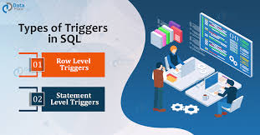
Types of Triggers
🔹 Before Triggers: Execute before an operation.
- Validate/Modify data before enter into DB
- BEFORE trigger returns NULL, the operation may be aborted or modified accordingly.
🔹 After Triggers: Execute after an operation.
- logging, auditing, or enforcing additional constraints
🔹 Instead of Triggers: Used for views

Slide 7
How Triggers worK
Trigger Components:
Event: INSERT, UPDATE, DELETE
Timing: BEFORE, AFTER, INSTEAD OF
Scope: FOR EACH ROW | FOR EACH STATEMENT
Action: Function to execute

Slide 8
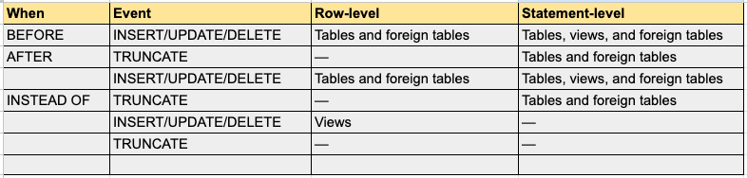
Trigger TYPES may be used on tables, views, and foreign tables

Slide 9
How to create Triggers in PostgreSQL:
Step 1. Create Or Replace Trigger Function Syntax
CREATE OR REPLACE FUNCTION trigger_function()
RETURNS TRIGGER
AS $$
BEGIN
-- trigger logic, this can include an insert trigger
END;
$$ LANGUAGE PLPGSQL

Slide 10
Step 2. Associate the Trigger With a Table
CREATE TRIGGER trigger_name
{BEFORE | AFTER} { event }
ON table_name
[FOR [EACH] { ROW | STATEMENT }]
EXECUTE PROCEDURE trigger_function

Slide 11
Dropping PostgreSQL Triggers
DROP TRIGGER trigger_name; # for an existing trigger
OR
DROP TRIGGER [ IF EXISTS ] trigger_name
ON table_name [ CASCADE | RESTRICT ]

Slide 12
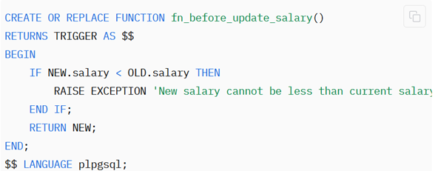
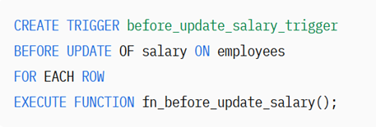
Example 1: Using BEFORE Triggers

Slide 13
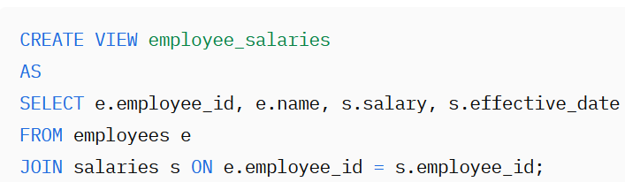
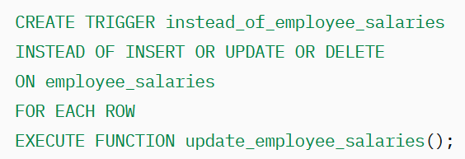
Example 2: INSTEAD OF Triggers (Views)

Slide 14
Alter, disable, enable triggers
ALTER TRIGGER Syntax: Rename/ Dependent on DB extension
ALTER TRIGGER trigger_name ON tabel_name
RENAME TO new_trigger_name
2. DISABLE TRIGGER Syntax: Temporarily stop
ALTER TABLE table_name
DISABLE TRIGGER [trigger_name|ALL]
3. ENABLE TRIGGER Syntax: Resume
ALTER TABLE table_name
ENABLE TRIGGER [trigger_name | ALL]

Slide 15
Advantages/UNIQUE FEATURES
PostgreSQL supports triggers for the TRUNCATE event.
Statement-level triggers can be defined on views in PostgreSQL.
PostgreSQL needs a user-defined function to be set as the trigger action.
Flexible and Versatile.

Slide 16
Disadvantages
Complex:
Be aware of the triggers and understand their logic to predict data changes accurately.
Performance Overhead:
Excessive use of triggers can lead to performance issues.

Slide 17
Best Practices for Using Triggers
✅ Keep logic simple
✅ Avoid excessive triggers
✅ Ensure no conflict with constraints
✅ Use statement-level triggers for bulk operations.
✅ Document triggers
✅ Optimize performance

Slide 18
Conclusions
Triggers help automate actions, maintain integrity, and enhance security.
To create a trigger on a table, the user must have the TRIGGER privilege on the table and EXECUTE privilege on the trigger function.
If you create multiple triggers on the same object for the same event, those triggers will be fired in alphabetical order by name.

Slide 19
References
https://neon.tech/postgresql/postgresql-triggers
https://www.postgresql.org/docs/current/sql-createtrigger.html
https://www.geeksforgeeks.org/postgresql-trigger/
https://www.enterprisedb.com/postgres-tutorials/everything-you-need-know-about-postgresql-triggers
https://estuary.dev/blog/postgresql-triggers/
https://www.tutorialspoint.com/postgresql/postgresql_triggers.htm
THANK YOU

