Slide 1

HR METRICS ATLAS: UNDERSTANDING WORKFORCE PATTERNS
TEAM MEMBER NAMES: SHRAVANI PAI, PRADEEPTHI,
KANISHK THAKUR, KUNAL KHATRI

Slide 2
TABLE OF CONTENTS
01
Overview
02
Key Performance Indicator (KPI)
03
Dashboard Images
04
Insights
05
Thank You

Slide 3

OVERVIEW
Our project integrates comprehensive HR datasets into Power BI for enhanced understanding and analysis. Leveraging Power BI's robust analytics capabilities, we illuminate critical insights into workforce dynamics, performance metrics, and organizational trends. This data-driven approach enables informed decision-making, fostering a proactive HR strategy aligned with organizational objectives. By harnessing Power BI's visualization prowess, we empower stakeholders with intuitive, actionable insights to optimize human capital management and drive sustainable business growth.

Slide 4
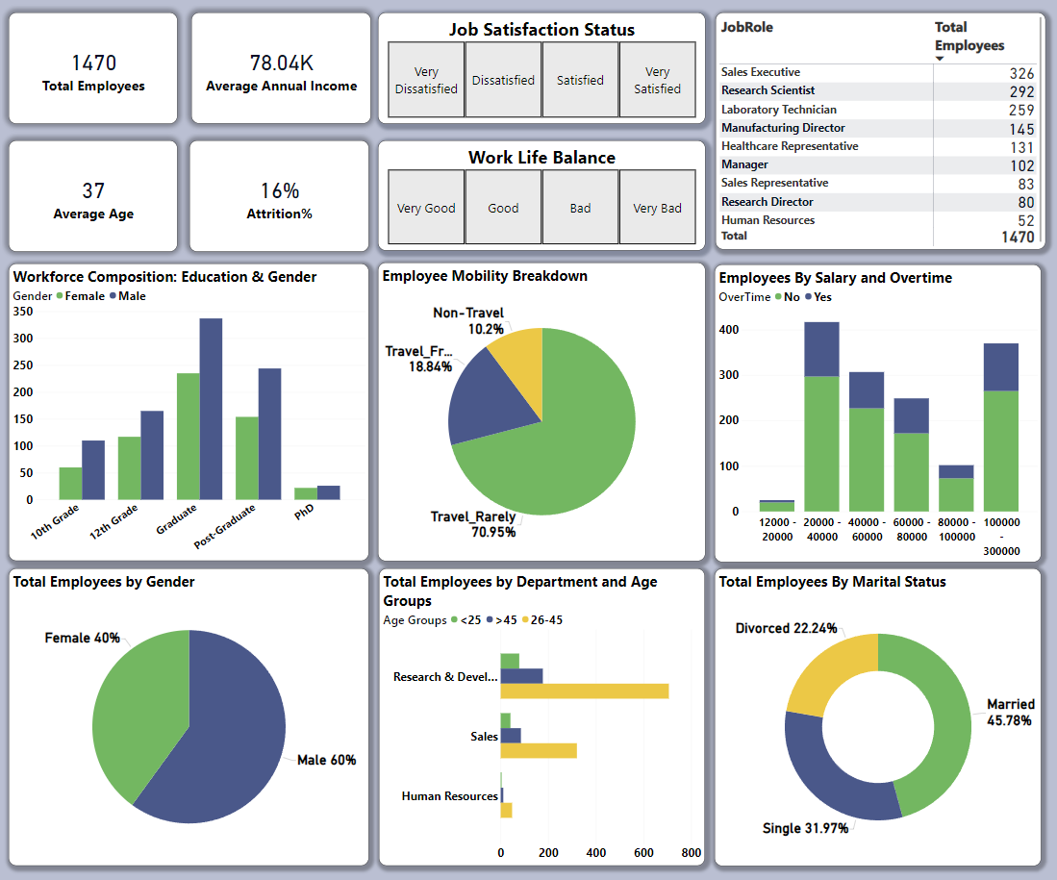
Key Performance
Indicator

Slide 5
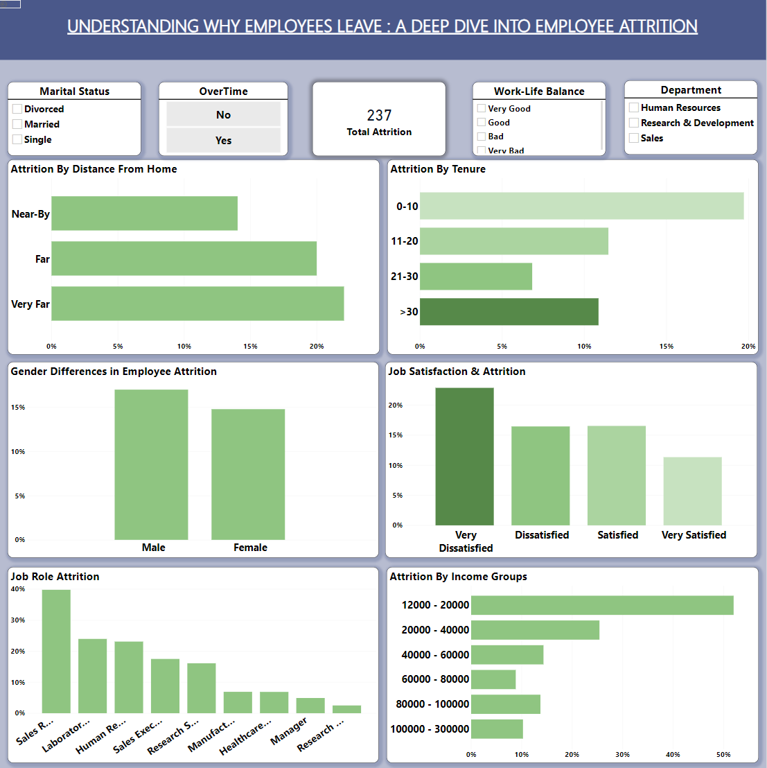
Dashboard Images

Slide 6
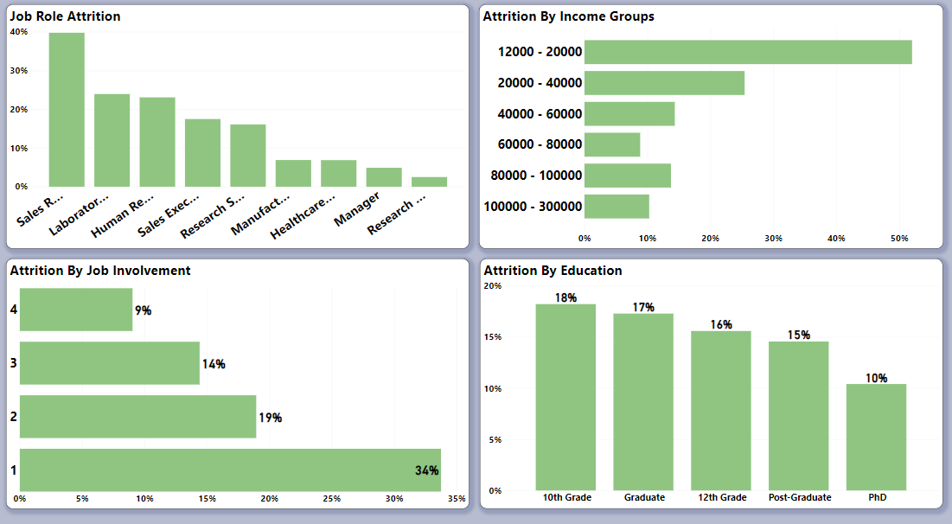

Slide 7

INSIGHTS
Value 1
Value 2
As per observations, people who commute to work from far distances have higher rates of attrition. To reduce the travel stress on employees the organizations should either offer them nearby places to stay or arrange for transport facilities.
Attrition rates are higher among employees with lower levels of education(10th and 12th grade). Our suggestion would be that the organization improve their training and development programs and also sponsor higher education for employees with potential .
Value 3
Value 4
Value 5
Value 6
The employees who have been with the company for less than 10 yrs are seen to have a higher attrition trend. Reasons could include improper treatment, low salary hikes etc. Our suggestion would be developing a good onboarding program and fostering a positive company culture which can increase the retention rates of the organization.
Employees who work overtime and live far away have higher attrition rates. Flexible work hours should be encouraged and remote working should also be introduced for these employees.
As observed in the employee demographics , the employees who earn lower salary are doing more overtime. Understand why these employees are working overtime , and analyze how work is divided among people to reduce the overtime hours of the employees.
We've observed a valuable connection between employee engagement and retention. Our data suggests that individuals who feel more involved in their roles show lower attrition rates. To foster a thriving and committed workforce, we might explore initiatives that encourage deeper employee involvement and cultivate a more invested and passionate atmosphere..

Slide 8


THANK YOU

