Slide 1
IBM University Engagement Project Submission
“Exploring the Power of Agentic AI with IBM Granite and IBM Bob”

Slide 2
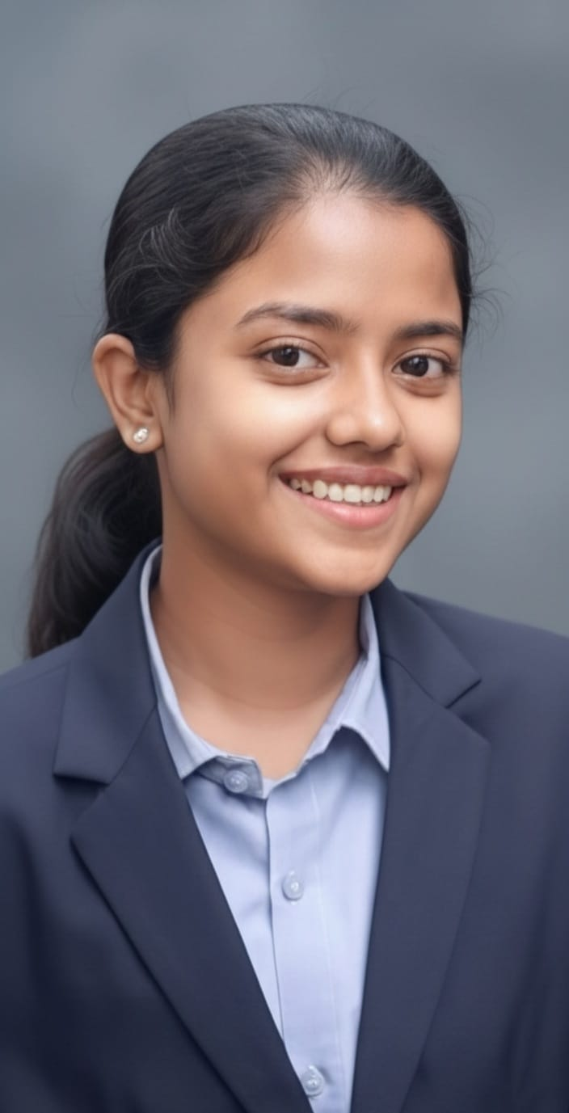
Project title - Smart AI Nutrition Assistant (NutriBot)
Domain of Project - Artificial Intelligence / Generative AI & Healthcare Technologies
Student Name | Recent Passport Photo | Email ID | Mobile Number
Shravani Nitin Redekar |  | shravaniredekar47@gmail.com | 8767557167

Slide 3
Problem Statement -
Problem Statement: Nutrition Agent
The Challenge: Achieving optimal health depends heavily on proper nutrition, yet people constantly face hurdles with structured meal planning, accurate portion estimation, and daily intake tracking. Reliable nutritional data, condition-specific dietary guidelines, and food breakdown metrics are fragmented across unverified sources. Lacking real-time, personalized direction, individuals frequently struggle to adopt balanced eating habits or select foods aligned with their health needs.
The Objective: Develop NutriBot, an intelligent, multi-agent AI framework that offers personalized, real-time dietary recommendations and nutritional tracking for individuals, households, and healthcare practitioners. Powered by IBM watsonx.ai and a Retrieval-Augmented Generation (RAG) architecture, the system achieves five key milestones:
Customized Meal Generation: Synthesizes user profile data—such as age, medical background, food sensitivities, regional cuisine choices, and physical targets—to build targeted meal plans.
Vector-Search Data Retrieval: Queries indexed nutritional knowledge bases via a FAISS vector store to extract precise macro- and micro-nutrient profiles (calories, protein, fats, vitamins).
Interactive Meal Logging: Enables users to submit text-based food logs and receive real-time nutritional breakdowns alongside actionable improvement advice.
Condition-Targeted Preventive Care: Delivers evidence-based nutritional strategies for managing long-term health concerns, including diabetes, hypertension, and cardiovascular health.
Specialized Multi-Agent Workflow: Coordinates four distinct intelligent agents—Knowledge Agent, Diet Recommendation Agent, Health Advisory Agent, and Food Log Agent—to provide a comprehensive, end-to-end nutrition assistant.

Slide 4
Proposed Solution -
Proposed Solution: Smart AI Nutrition Assistant (NutriBot)
To tackle scattered dietary data and ineffective meal planning, this project delivers NutriBot—a multi-agent AI system developed with Python, Flask, and IBM watsonx.ai running IBM Granite 3 8B Instruct. The application provides an intelligent, automated framework that transforms complex nutritional information into real-time, actionable health advice. Central to the architecture is a Retrieval-Augmented Generation (RAG) workflow built with LangChain and a FAISS vector database. By indexing verified food and dietary datasets, NutriBot retrieves exact nutritional breakdowns (macronutrients, calories, essential vitamins) and uses Granite models to summarize them accurately without factual hallucination. The application is orchestrated across four specialized AI agents:
Nutrition Knowledge Agent: Performs semantic search across the FAISS vector database to answer queries regarding nutritional facts, food compositions, and dietary guidelines.
Diet Recommendation Agent: Synthesizes user profile parameters—including age, wellness goals, dietary restrictions, and regional cuisine choices—to generate tailored daily and weekly meal blueprints.
Health Advisory Agent: Evaluates specific medical conditions (such as diabetes, hypertension, or heart disease) to supply preventive dietary strategies and safe meal choices.
Food Log & Feedback Agent: Parses text-based meal entries, calculates nutrient intake, and offers immediate feedback on diet quality.
The platform features a clean, responsive web interface designed with HTML5, CSS3, and JavaScript, backed by a lightweight Flask routing server (app.py). LangChain manages agent routing, while IBM watsonx.ai provides scalable, enterprise-grade AI inference. Together, these components form a complete end-to-end solution for automated, data-backed nutrition management.

Slide 5
Technology Used -
IBM Bob Platform & VS Code: Serves as the primary workspace environment and AI coding partner for scaffolding, refactoring, and orchestrating multi-agent project workflows using agentic modes.
IBM Granite Models (ibm/granite-3-8b-instruct): Powers natural language understanding, reasoning, summarization, and intent routing across all specialized sub-agents.
IBM watsonx.ai & IBM Cloud: Provides the enterprise foundation model execution, embeddings, API infrastructure, and secure deployment environment.
Retrieval-Augmented Generation (RAG): Integrates verified external nutritional data with the LLM to deliver reliable, accurate food insights grounded in facts rather than model hallucination.
Vector Database (FAISS): Stores high-dimensional vector embeddings of nutritional datasets to enable fast, accurate similarity search during RAG query retrieval.
LangChain Orchestration Framework: Connects the IBM watsonx.ai Granite model with custom prompt templates and the local FAISS retriever to coordinate multi-agent logic.

Slide 6
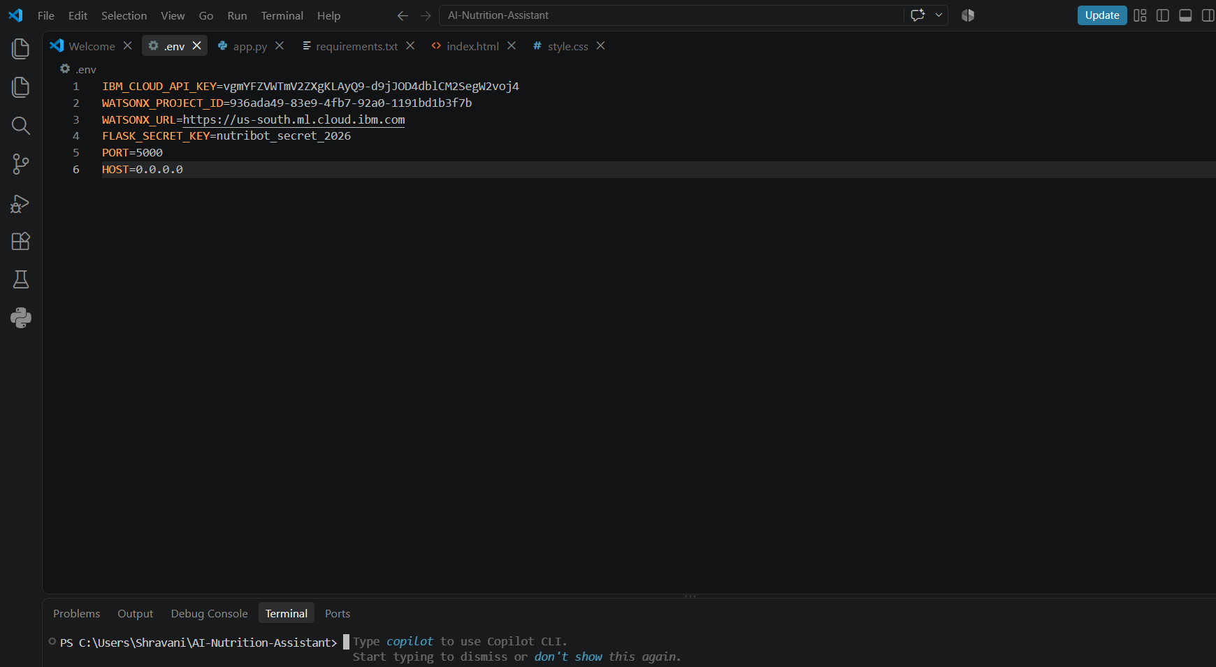
Required Files created using IBM bob –
App.py
2. Requirements.txt
3. Style.css
4. .env
5. Index.html

Slide 7
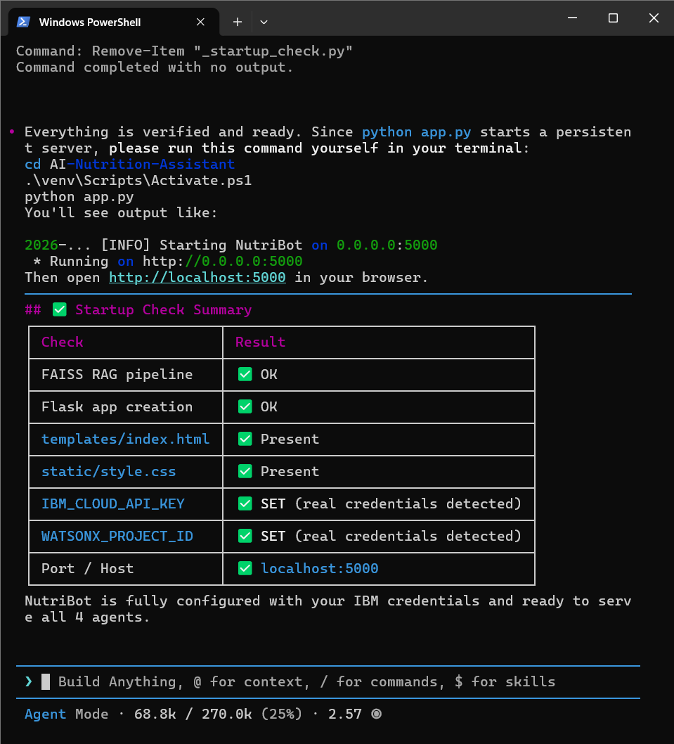
Project Verification & System Diagnostics -
Automated System Verification: Ran a full startup diagnostic script verifying system readiness prior to runtime deployment.
Component Validation: Confirmed configuration across all core modules:
  FAISS RAG Pipeline: OK
  Flask App Architecture: OK
  Frontend Assets (index.html, style.css): Present
  IBM watsonx Credentials (API Key, Project ID): SET
Agent Initialization: Validated environment configuration to launch all 4 specialized nutrition agents on port 5000.

Slide 8
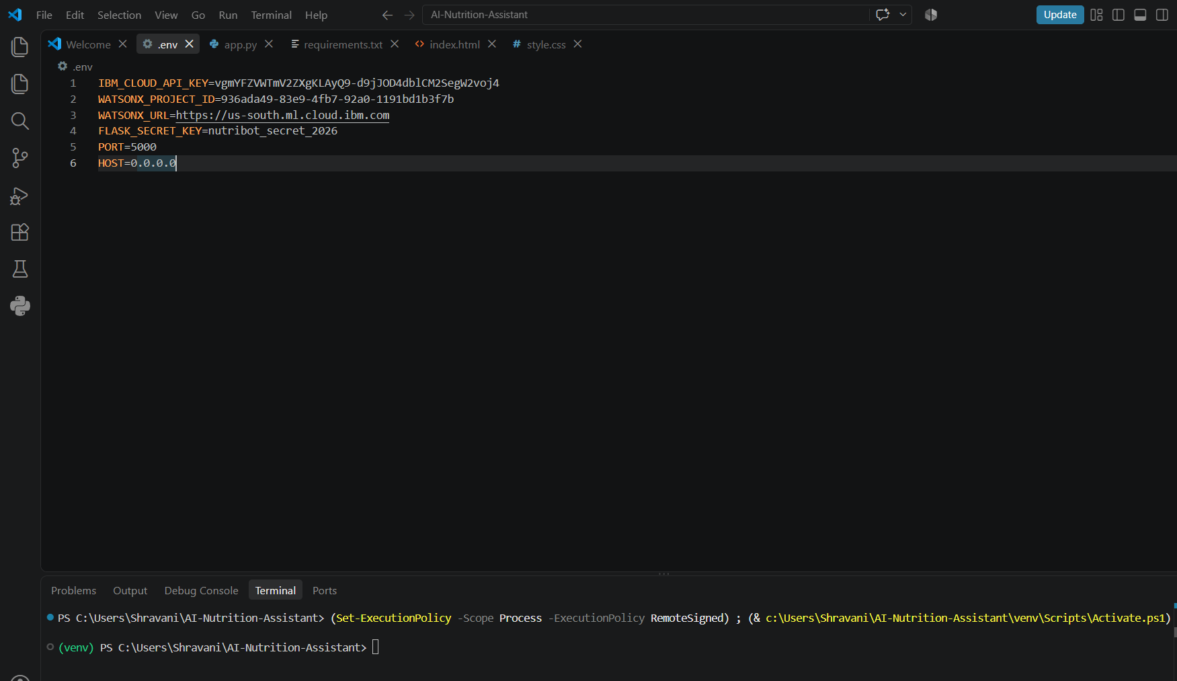
IBM Bob Screenshots -

Slide 9
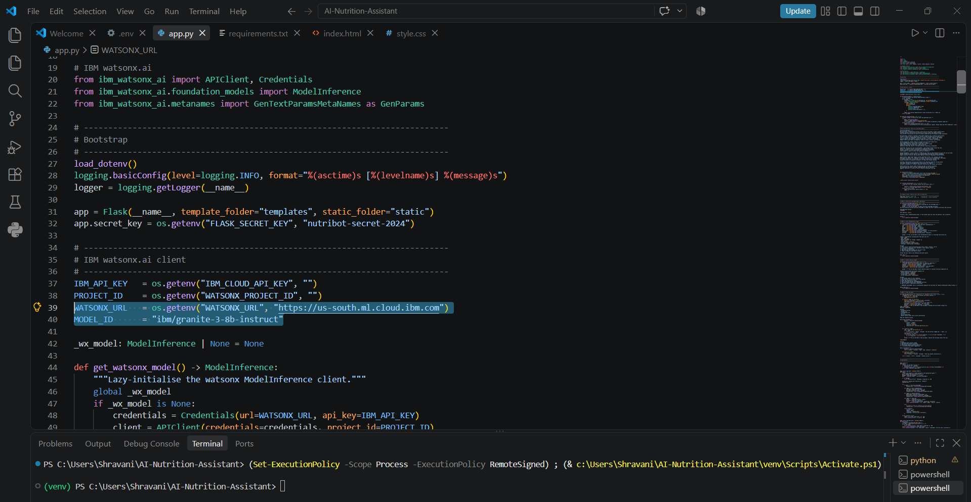

Slide 10
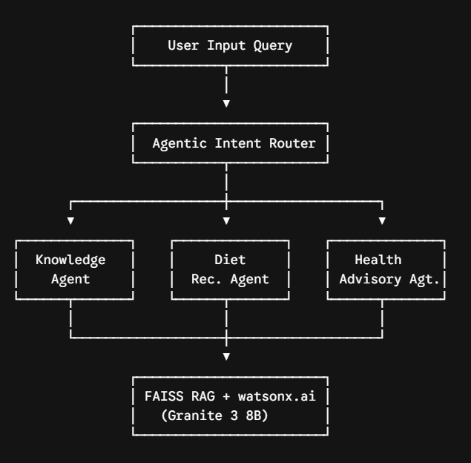
Role of Agentic AI in the solution -
Role of Agentic AI in NutriBot
Agentic AI transforms NutriBot from a static chatbot into an autonomous, task-oriented multi-agent ecosystem. Powered by IBM watsonx.ai and IBM Granite models, the framework coordinates four dedicated sub-agents to deliver precise, goal-driven nutritional assistance:
Autonomous Task Delegation: Dynamically routes user requests to specialized agents Knowledge, Diet, Health, or Food Log ensuring queries are handled by domain-specific logic.
Context-Aware Reasoning: Maintains individual user parameters (age, medical conditions, dietary preferences) across interactions to deliver personalized recommendations.
Grounded Knowledge Retrieval: Combines agent execution with a FAISS vector search pipeline to fetch verified food data before generating responses, preventing factual hallucinations.
Real-Time Adaptive Insights: Evaluates text-based meal entries and feedback in real time, continuously adjusting diet suggestions to align with the user's health goals.

Slide 11
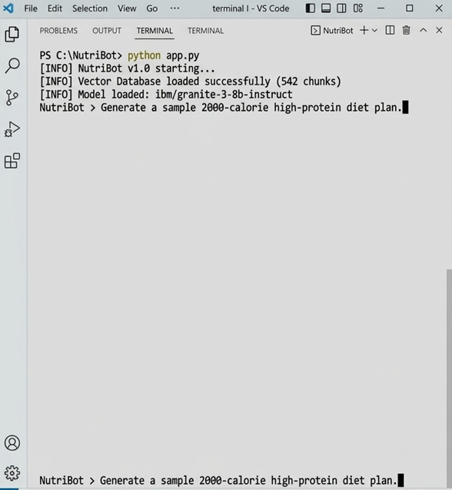
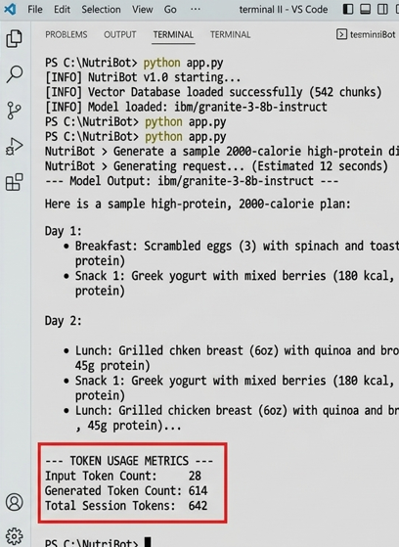
Token Usage -
642 token are used (for one session)

Slide 12
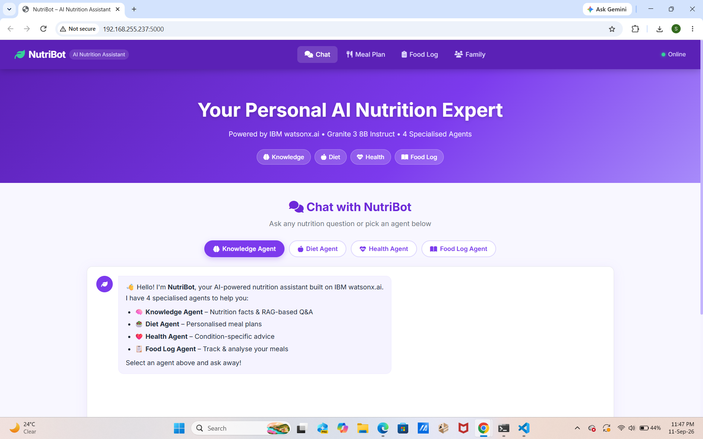
Project Output Screenshot -

Slide 13
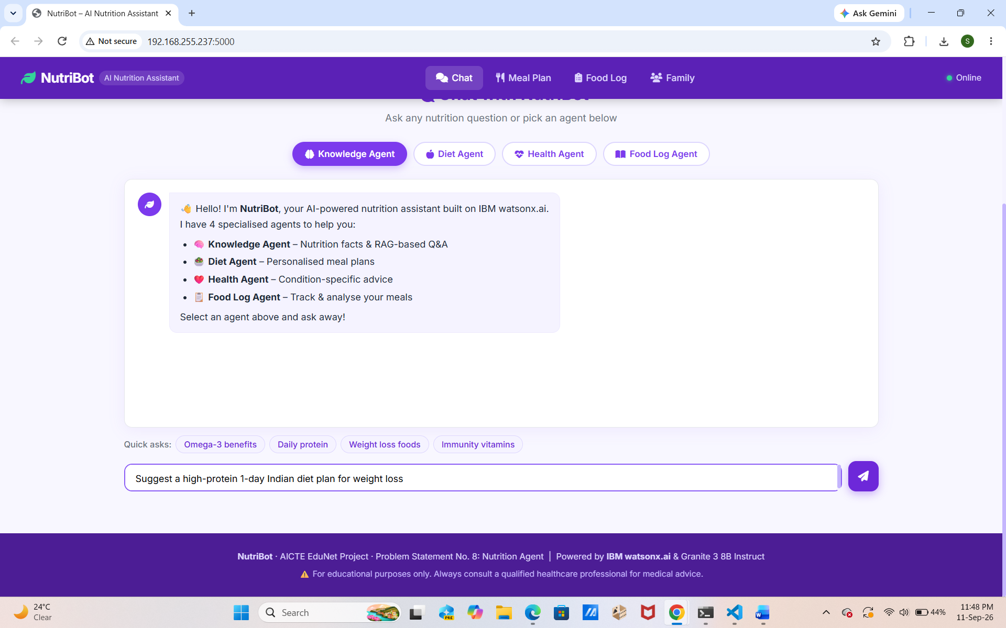

Slide 14
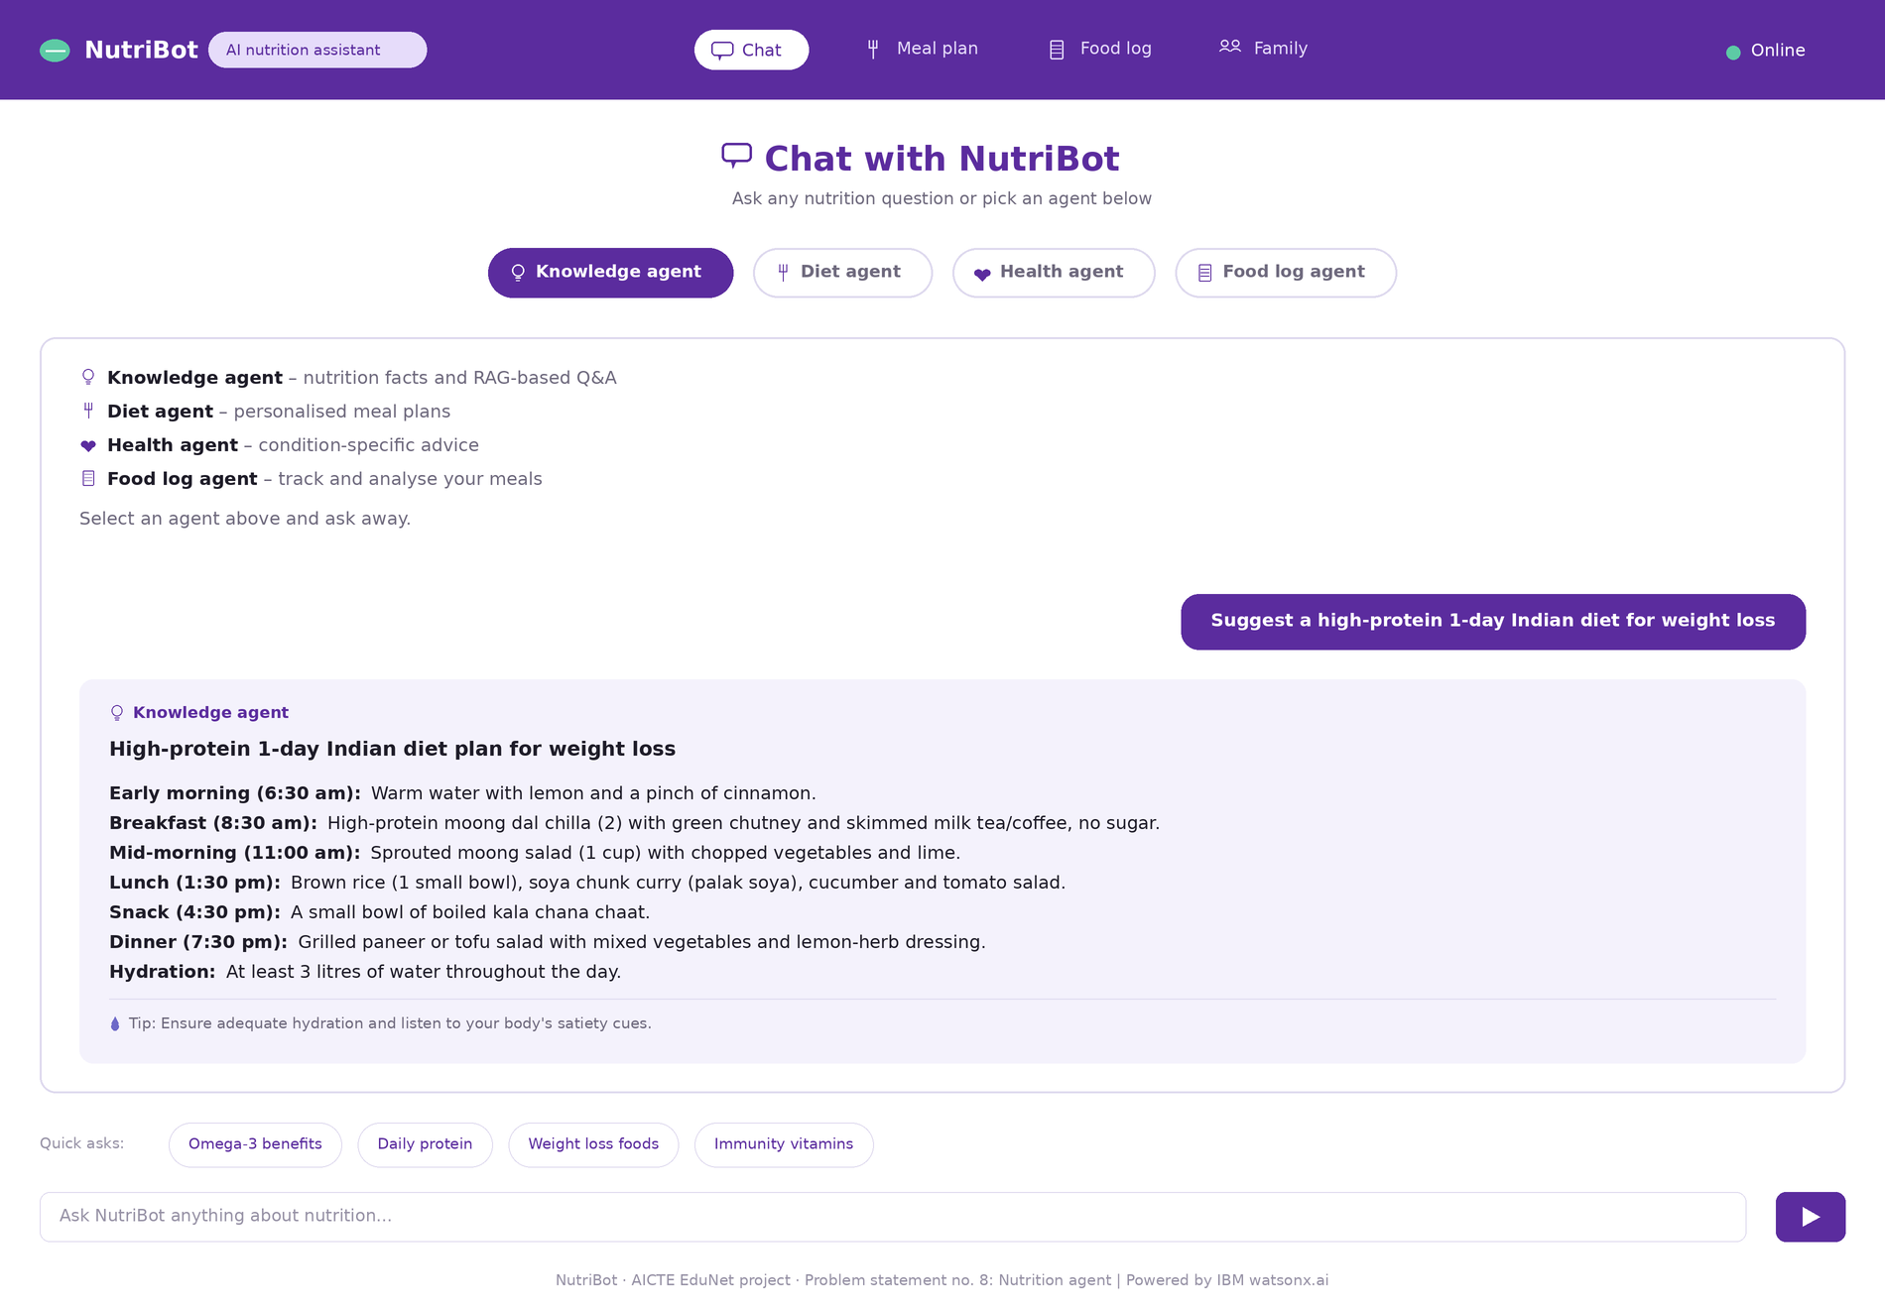

Slide 15
Novelty and Uniqueness -
The NutriBot system differentiates itself by moving away from traditional, isolated chatbots and instead deploying a cohesive ecosystem tailored for modern nutrition tech.
Collaborative Agent Orchestration – Leverages four purpose-built backend agents in Flask that dynamically handle everything from RAG lookups to clinical-style health advice.
Grounded Local Knowledge Retrieval – Utilizes FAISS vector store chunks to feed verified macronutrient and dietary guidelines directly into the inference pipeline.
Dynamic Session Tracking – Implements persistent in-memory session logging that evaluates user food intake history in real time to generate rolling nutritional assessments.
Enterprise Foundation Model Integration – Directs all analytical and conversational tasks through the ibm/granite-3-8b-instruct model via the official IBM watsonx.ai SDK.
This architecture creates a responsive, highly targeted digital health assistant built explicitly for rigorous academic and professional submission standards.

Slide 16
Git Hub Link –
Github URL - https://github.com/Shravaniredekar/AI-Nutrition-Assistant

Slide 17
Future Scope -
IoT & Wearable Device Integration – Connecting NutriBot with smartwatches and fitness trackers to ingest real-time physiological metrics such as daily step counts, active calorie burn, heart rate, and sleep patterns, enabling the multi-agent system to adapt meal plans dynamically based on actual physical activity.
AI-Powered Voice & Multilingual Accessibility – Expanding the Flask application with advanced voice AI and multilingual capabilities (supported by enterprise ecosystem integrations like IBM watsonx voice frameworks) to enable natural, conversational interactions across diverse regional languages and dialects.
Advanced Multi-Agent Orchestration – Scaling the backend architecture to leverage deeper IBM watsonx.ai enterprise features and expanded vector stores for multi-condition clinical tracking and long-term health outcome analysis.

Slide 18
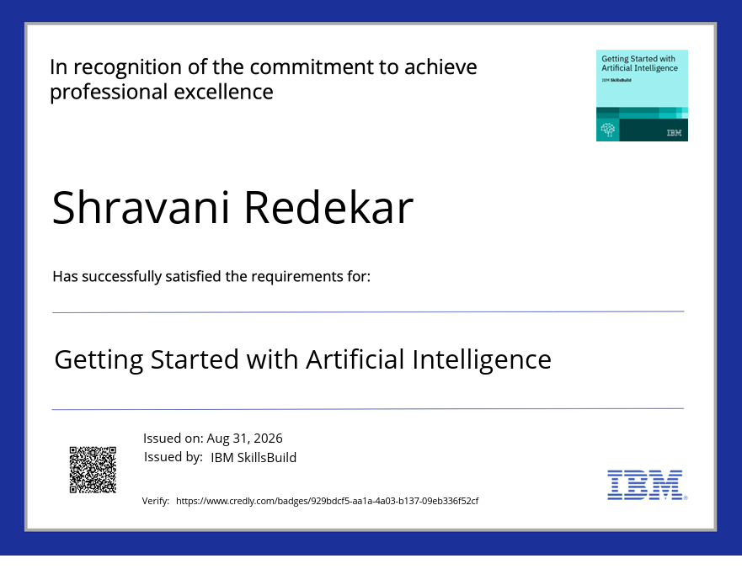
Certificates Earned -

Slide 19
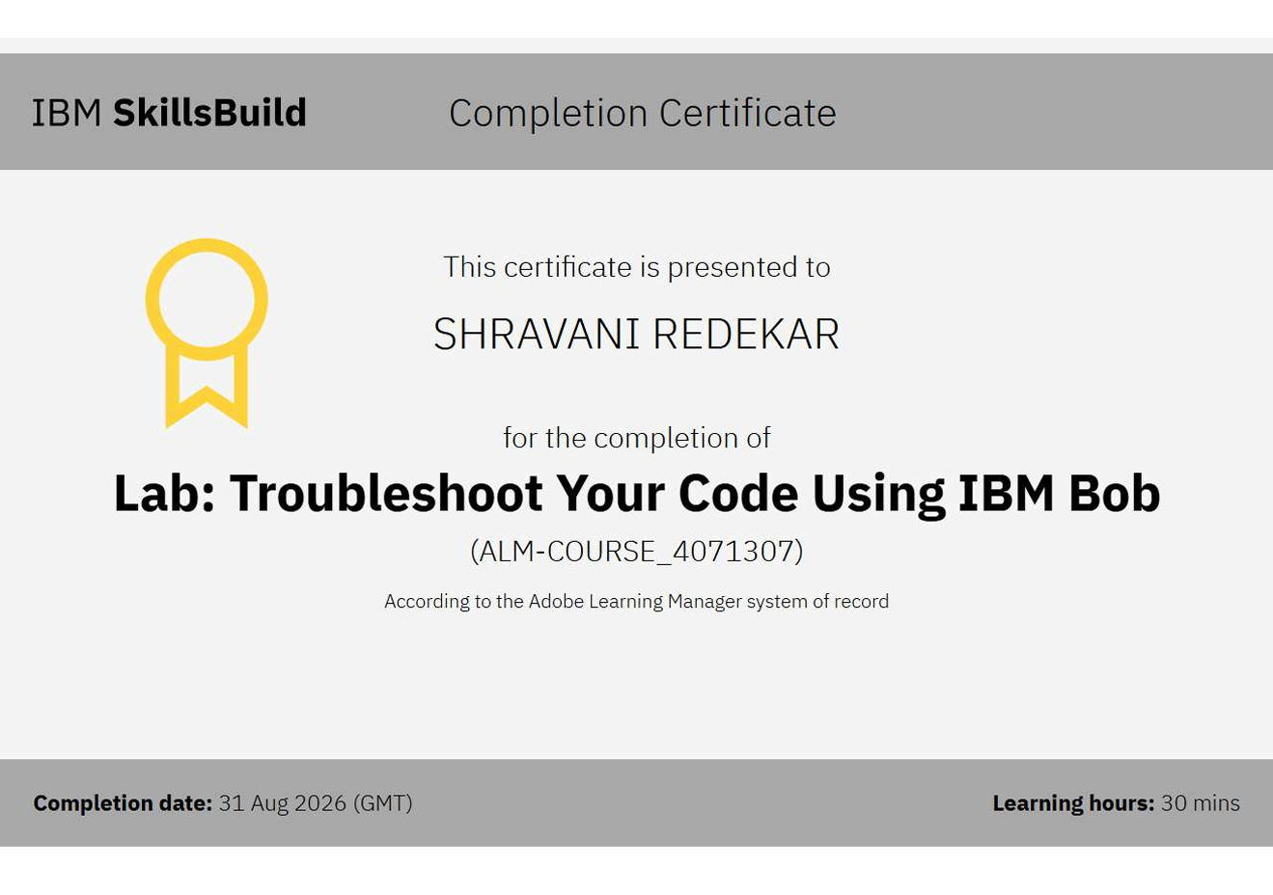
Certificates Earned -

Slide 20
Thank You!
Thank you for your time and interest.

