Slide 1

Project OPI
TEAM
QUANTUM
Problem Statement ID – 1658
Problem Statement Title- Development of a versatile and fast algorithm for the optimal ship routing
Theme- Transportation & Logistics
PS Category- Software.
Team ID -
Team Name – TEAM QUANTUM
Department - Indian National Center for Ocean Information Services (INCOIS)

Slide 2
Ideal Route Solution
TEAM
QUANTUM
Optimization Algorithm: Multi-parameter optimization for fuel efficiency, travel time, comfort, and safety. Dynamic updates based on real-time weather and ship data.
Problem Addressed : Adaptive routing with real-time data integration.
Benefits: Cost reduction, improved safety, and lower environmental impact.
Innovation: Tailored for the Indian Ocean region.
Continuous monitoring with an intuitive user interface.
Our innovative ship routing algorithm enhances maritime navigation by providing three distinct route options for any voyage.
Our algorithm offers three route options:
Blue Path: Optimized standard route.
Green Path: Hazard-avoiding alternative.
Red Path: Risk-prone cautionary route.
Effectiveness of Our Algorithm:
Saves up to 15% fuel per voyage.
Reduces travel time by 10% on average.\
Improves safety, avoiding high-risk areas by 20%.
Conclusion :-
This approach allows captains to select the most appropriate path based on their specific needs, optimizing for factors such as fuel consumption, travel time, and safety.

Slide 3
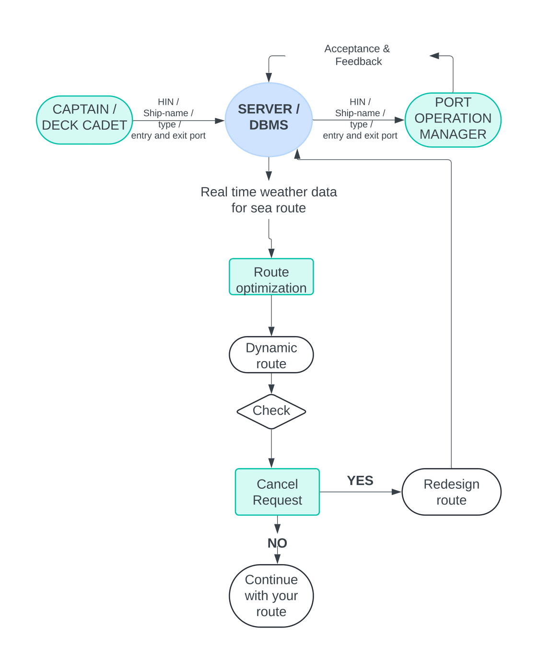
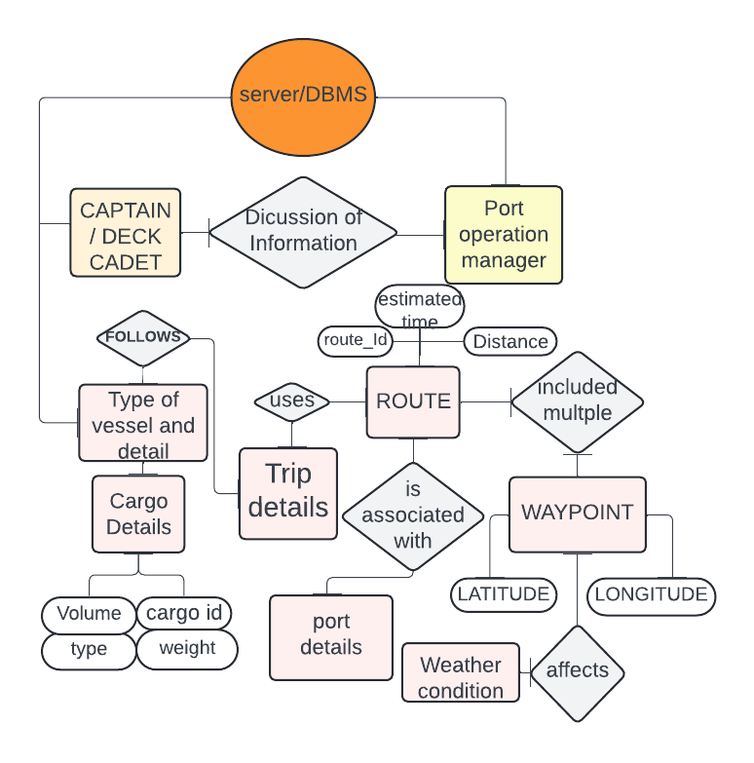







Major Tech Stack Being Used
TEAM
QUANTUM
DFD
ERD

Slide 4


TEAM
QUANTUM
Feasibility and Viability
Fuel Efficiency Optimized Routes : Using favorable currents reduces fuel consumption and lowers costs.
Increased Speed Currents Boost : Favorable currents increase speed, improving delivery times and operational efficiency.
Real-Time Adjustments: Advanced navigation tools optimize routes using weather forecasts and ocean currents, improving speed and fuel efficiency while avoiding storms.
Historical Data: Analyzing past routes helps select the most efficient path between specific ports for optimal journeys.

Slide 5


IMPACT AND BENEFITS
TEAM
QUANTUM
Shipping Companies : Efficient routing lowers fuel costs, operational expenses, and improves scheduling.
Environmental Agencies :Optimized routes minimize environmental impact and emissions.
Insurance Companies : Better routing reduces the risk of accidents and losses.
Fuel Savings: Lower fuel costs.
Reduced Emissions: Greener operations.
Increased Efficiency: Faster deliveries.
Competitive Edge: Stand out with optimized routes.
Regulatory Compliance: Meet maritime laws.

Slide 6
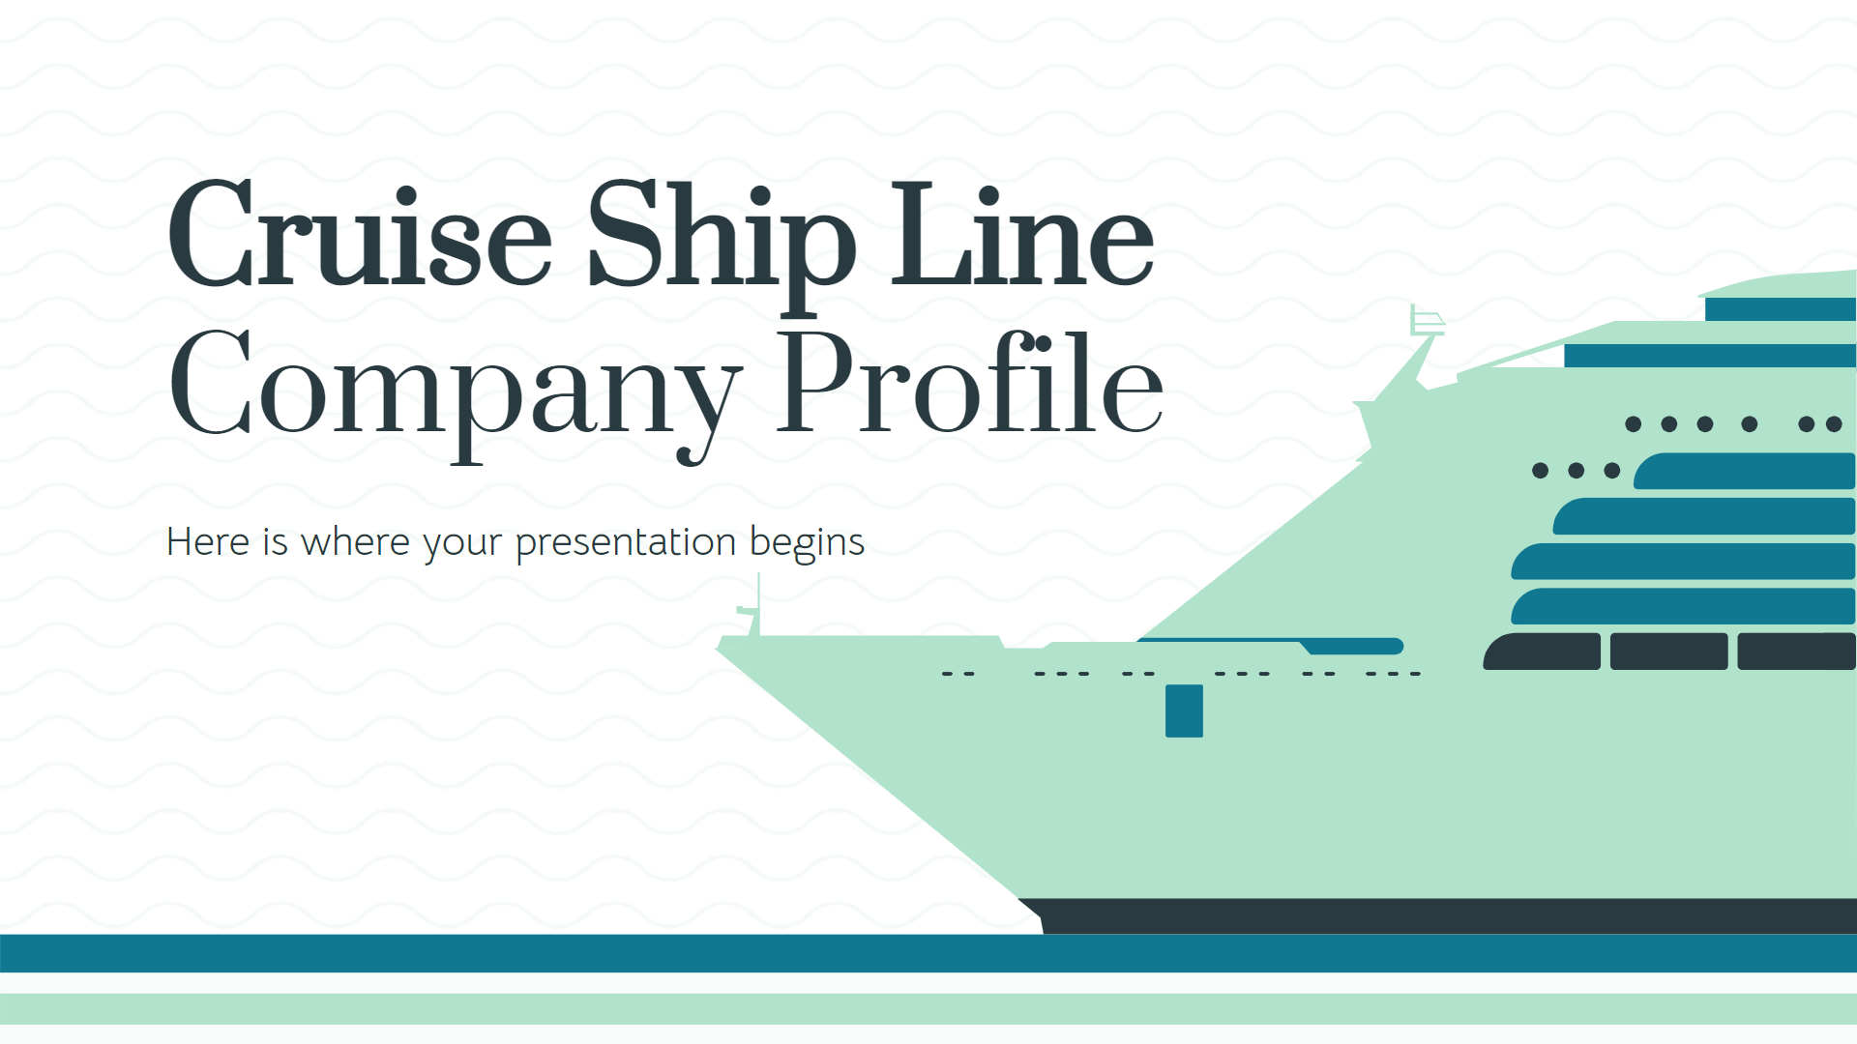

Links and Referal
TEAM
QUANTUM
SOFAR OCEANS :- https://www.sofarocean.com/
ONE OCEAN :- https://www.oneocean.com/
List of Ports in India Data( Source: Ministry of Shipping, India ) :- https://dwiep.ncscm.res.in/images/port.pdf
YOUTUBE :- https://youtu.be/aBEkINl2ed4?si=IerSkD_NygCcjlzt
ROUTING API ( SEA ROUTES) :- https://searoutes.com/routing-api/
OUR WEBSITE (UNDER DEVELOPMENT) :- https://quantum-csbs.github.io/OPI/
Ministry of ports, shipping, and waterways :- https://shipmin.gov.in/
Marine weather API :- https://open-meteo.com/en/docs/marine-weather-api

