Slide 1

Eniac’s discount strategy
Where do we stand? - Where shall we go?
by Chen, Dante, Hanna, Shravanti

Slide 2
Where do we stand?

Slide 3
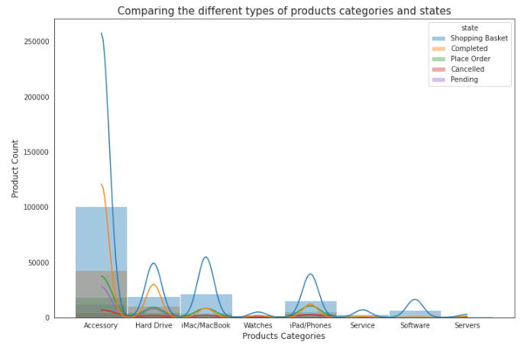
Product Categories
1.Accessories
2.iMac/MacBook
3.Hard Drive
4.ipad/phone
5.Watch
6.Servers
7.Service
8.Software

Slide 4
Revenue and Categories

Slide 5
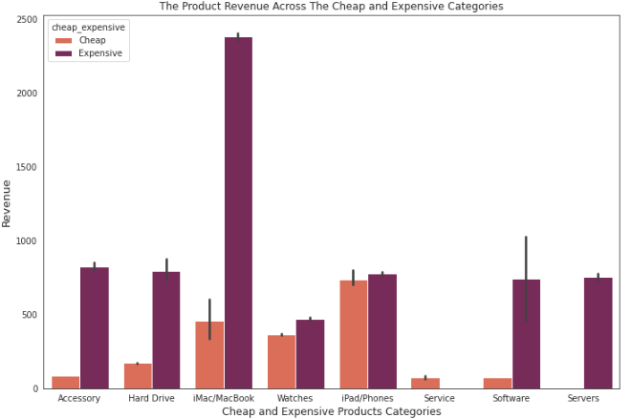
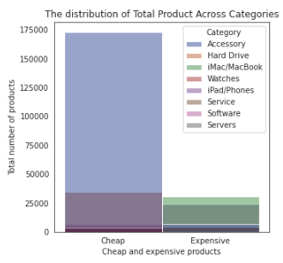
Revenue by Cheap and Expensive products
-76.56% cheap
-23.43 % expensive

Slide 6
Discounts and Categories

Slide 7
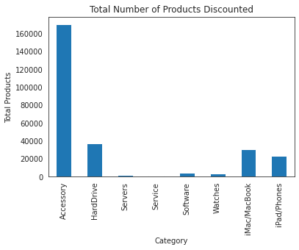
Products considered are those with +ve discount values
Total Discounted Product = 273,270
Absolute mean = 54,78
SD= 140.49 (High volatility)
Is there a difference considering Relative Discount instead?
YES.
The SD exhibits only 2% volatility for the mean.
Mean = 18.2%
SD = 16.3%
Distribution and Statistic of Discount

Slide 8
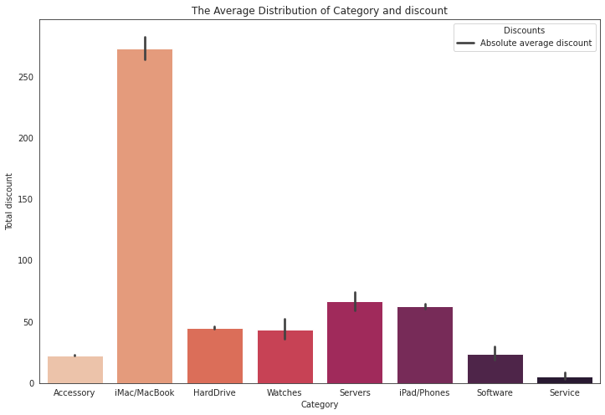
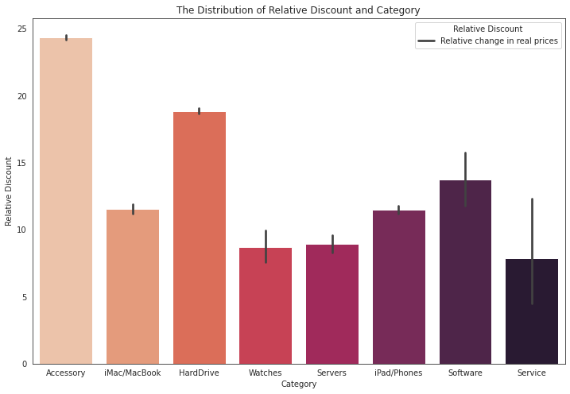
Absolute and Relative Discount by Category
Take out: Discount as percentage of price is higher for Accessories and Hardwares

Slide 9
Sales over Time

Slide 10
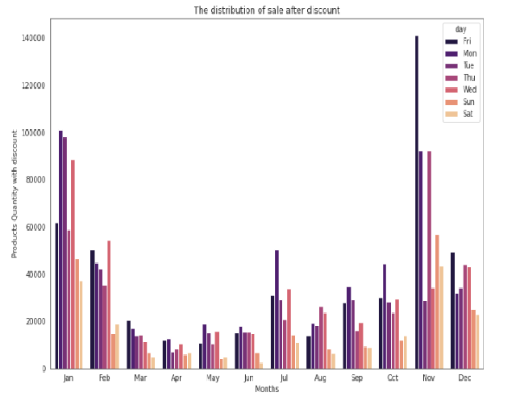
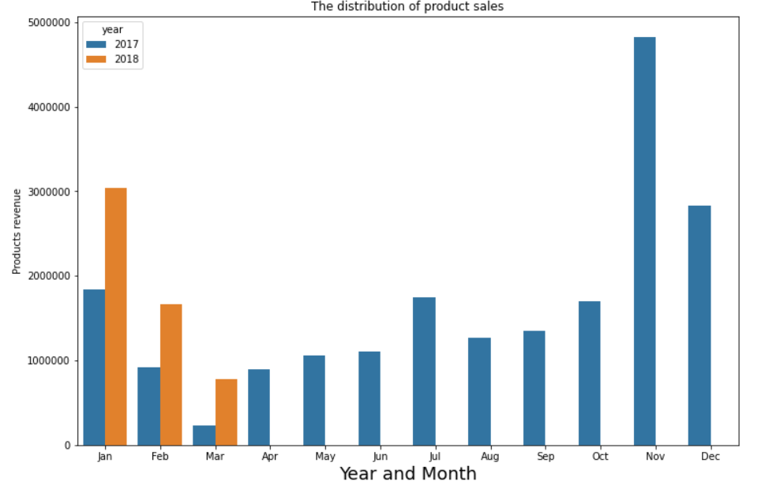
Distribution in months

Slide 11
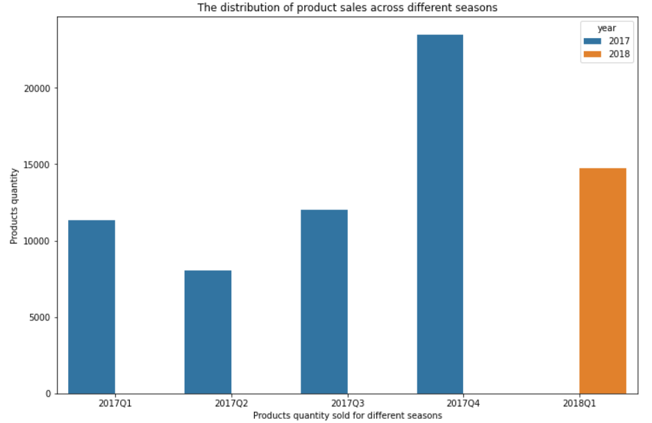
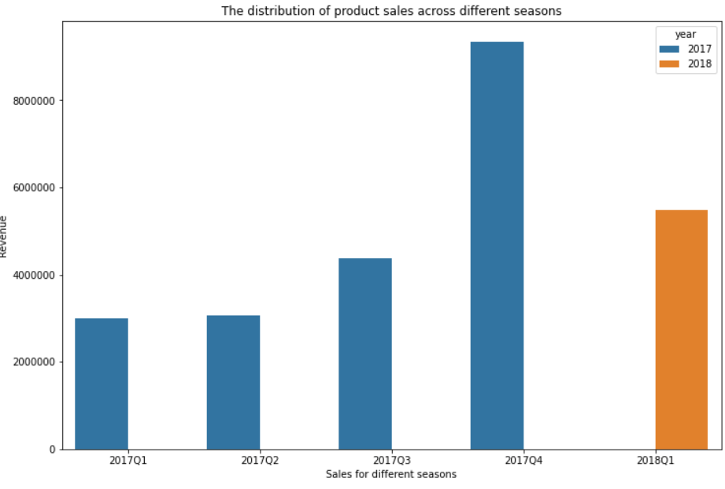
Distribution in seasons

Slide 12
Revenue and Discounts

Slide 13
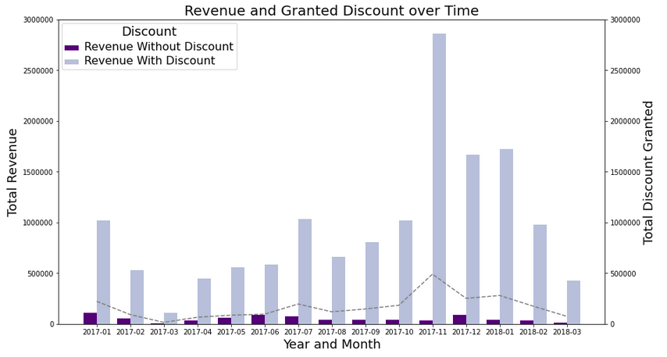
Revenue and Discounts
- - Granted Discount

Slide 14
Where shall we go?

Slide 15
Where shall we go?
Discounts
Yes
Increase discounts for iMacs/MacBooks
Decrease discounts for accessories
Events
Advertising
Target group
Timing and Placing
Events for New Launches
Data Collection
Costs
Single decimal point
List of Categories
Data on dwell time
Data on ads
Survey

Slide 16

Recommendations!
Summer “black friday”.
Efficient advertising.
Increase revenue by discount on selected products.
Add complimentary services or products.
Launch new product in August to then discount at Black Friday/Christmas.

