Slide 1
Data Science Project 1
Shravika Challa
TG87730

Slide 2
Introduction:
Dataset Name: "Electric Vehicle Population Data."
Source: Electric Vehicle Population Data.
Data is taken from data.gov
This project focuses on analyzing electric vehicle data to gain insights into trends and patterns in Washington State.
The aim is to understand the adoption and distribution of electric vehicles and identify factors influencing their popularity.
This project focuses on analyzing electric vehicle data to gain insights into trends and patterns in Washington State.

Slide 3
Overview of Electric Vehicle Data:
Content:
VIN (1-10)
County
City
State
Postal Code
Model Year
Make
Model
Electric Vehicle Type
CAFV Eligibility
Electric Range
Base MSRP
Legislative District
DOL Vehicle ID
Vehicle Location
Electric Utility
2020 Census Tract

Slide 4
Number of Rows: 150482
Number of Columns: 17
Unique Features/Peculiarities:
Geospatial Data:
Contains location-based information such as County, City, State, and Postal Code.
Legislative District Information:
Provides insights into regional policies or preferences.
Clean Alternative Fuel Vehicle (CAFV) Eligibility:
Indicates eligibility for Clean Alternative Fuel Vehicle incentives or benefits.
Legislative districts shape regional policies, incentives, and regulations for clean energy and transportation.
This influences consumer behavior and choices, impacting electric vehicle adoption rates.

Slide 5
Data Cleaning:
Duplicate Removal:
Identified and removed duplicate entries from the dataset to ensure each record is unique.
Handling Missing Values:
Addressed missing values in the dataset by employing various techniques, such as imputation or removal, depending on the specific context.
Standardizing Formats:
Ensured consistency in data formats, including date formats, numerical representations, and categorical variables.
Dealing with Outliers:
Detected and managed outliers, ensuring they did not skew the analysis or affect the accuracy of insights.
Addressing Data Quality Issues:
Resolved any data quality issues, including discrepancies, inaccuracies, or anomalies that could impact the validity of the analysis.

Slide 6
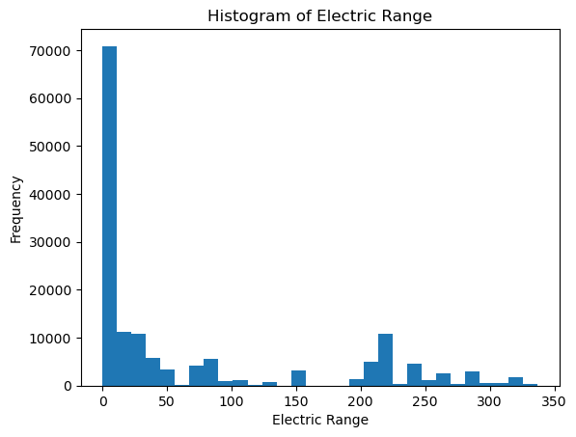
Analysis of Electric Vehicle Adoption: Examined trends in electric vehicle adoption across different regions in Washington State.
Electric range is a key factor for consumers when choosing an electric vehicle.
Manufacturers strive to enhance electric range to stay competitive in the market.

Slide 7
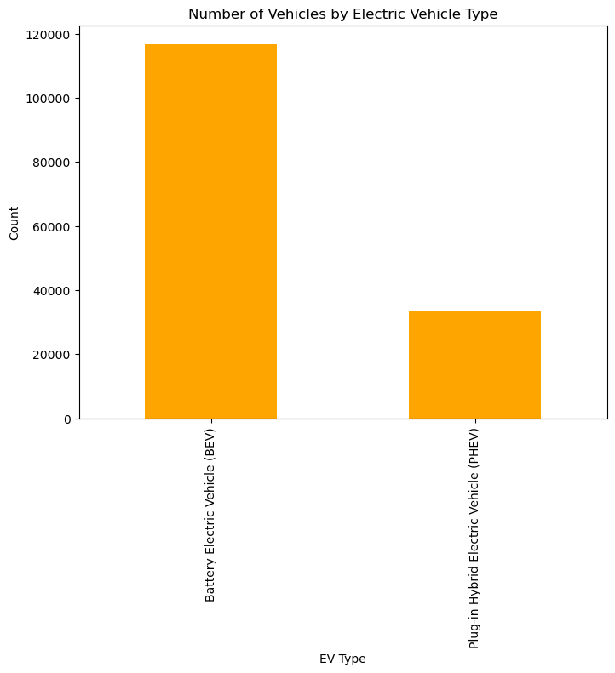
Number of Vehicles by Electric Vehicle Type
Categorized electric vehicles by type (e.g., BEV, PHEV) and quantified the number of vehicles in each category.
Provided valuable insights into the prevalence of different electric vehicle types, informing infrastructure planning and policy decisions.

Slide 8
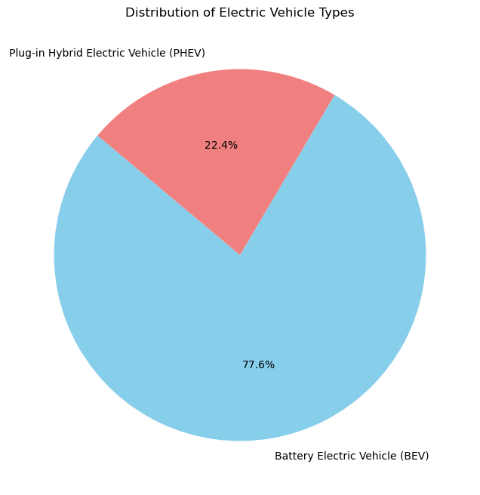
Distribution of electric vehicle types:
The pie chart reveals that Battery Electric Vehicles (BEVs) constitute the majority, comprising approximately 70% of the electric vehicles in the dataset.
Plug-in Hybrid Electric Vehicles (PHEVs) and Hybrid Electric Vehicles (HEVs) together account for the remaining 30%, indicating a comparatively smaller presence in the dataset.

Slide 9
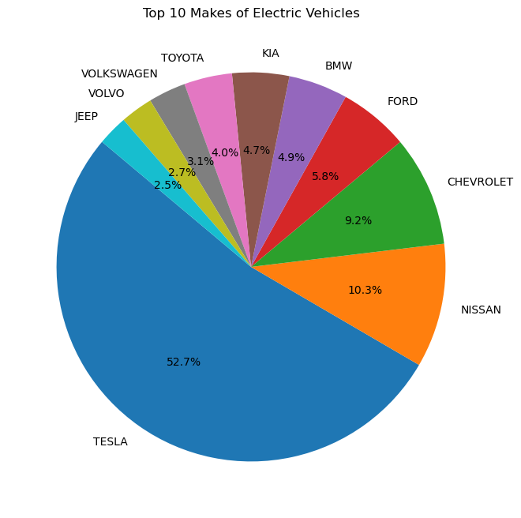
Relationship between Base MSRP and Other Variables:
The dataset exhibits a wide array of electric vehicle manufacturers.
A handful of manufacturers dominate the market, while numerous others contribute to a smaller share.

Slide 10
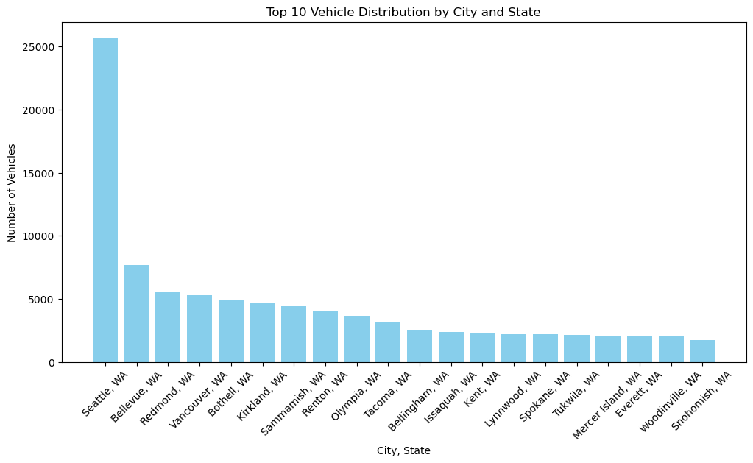
Vehicle distribution by city and state
The bar chart displays the distribution of vehicles across various city-state combinations in Washington State.
Among the top 10 city-state combinations, Seattle, WA has the highest number of registered vehicles, followed by Bellevue, WA.

Slide 11
Missing Data
Charging Infrastructure Details: Location and type of charging stations are absent.
User Reviews and Ratings: Feedback on user experiences is not available.
Environmental Impact Metrics: Emissions reduction data is missing.
Charging Source Composition: Data on electricity sources is not provided.
Owner Demographics: Information about vehicle owners is not included.

Slide 12
Some interesting points…
Regional Adoption Patterns: Variances in electric vehicle popularity by location.
Charging Infrastructure Insights: Accessibility and availability of charging stations.
Policy Impact: Influence of government policies on electric vehicle trends.
Demographic Considerations: Consumer characteristics and preferences.
Market Dynamics: Dominance of specific makes and models.
Environmental Impact: Evaluation of environmental benefits.rmation about vehicle owners is not included.

Slide 13
Shortcomings of the data
1. Limited Vehicle Details: Specifics on features, technology, and performance of vehicle models might be missing, restricting in-depth analysis.
2. Incomplete Environmental Impact Data: Beyond basic emissions reduction, comprehensive environmental impact data may be absent.
3. Irregular Updates: The dataset might not receive regular updates, leading to potentially outdated information.
4. Missing Key Variables: Crucial factors like driver demographics, vehicle conditions, and usage patterns may not be present, limiting the depth of analysis.

Slide 14
Conclusion:
Growing Adoption: The data shows a significant rise in the use of electric vehicles in Washington State in recent years, pointing to a trend in favor of environmentally friendly transportation.
Regional Disparities: Variations in the popularity of electric vehicles can be seen between counties and cities, indicating the need for focused policy and infrastructure improvement.
Opportunities for Improvement: Although the dataset offers insightful information, there are several places where further information or context could improve the study, especially when it comes to comprehending the larger socio-economic and regulatory aspects impacting the adoption of electric vehicles.

