Slide 1
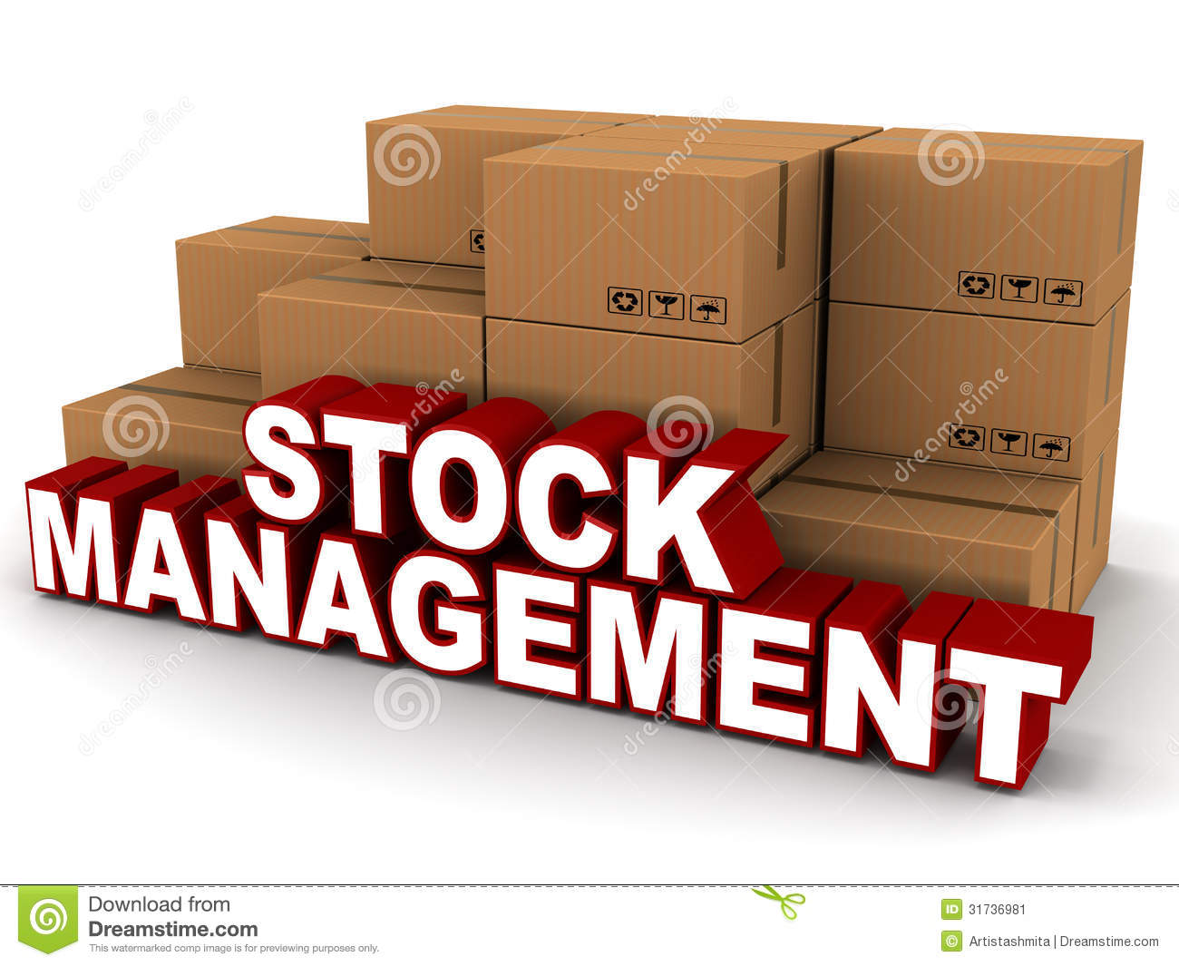
WELCOME TO stock management SYSTEM
BY
P.PRATHYUSHA

Slide 2
Contents
Project Objectives
Problem Statement
Modules
Implementation
Project Work Flow
Technologies Used
Conclusion

Slide 3
Objective
General Objective :To automate the process of Stock Management System & hence minimize errors resulting from manual system operations
There are many goals and focus:
1.Saving time and effort.
2.Eliminate the use of paperwork for transactions.
3.Customer's vision towards the organization.

Slide 4
Problem Statement
Most stock providers still use the old fashion, where they record all the details on the papers. No online service. When a customer wants to know the remaining stock items, he needs to go to in person or contact the provider. Then, the provider representative has to review the customer details manually and calculate the stocks taken. Unfortunately, this method is a waste of time, inaccurate and inefficient.
Stock Management System Application Development is an application where Investor can buy stock and sell stock , and interact with the stock providers through this application.

Slide 5
Modules
There are basically 3 types of users:
Admin
Manager
Investor

Slide 6
Admin
The administrators will be able to perform following functionalities :
User can login
CRUD operation on Company manager user
CRUD operation on Company which will be there in application to buy the stocks
Decide what is the maximum amount one investor can invest in a company
Decide what is the maximum number of stocks one investor can buy

Slide 7
BLOCK DIAGRAM
home
About
Register
Stock Management System
Login

Slide 8
Manager
The Manager can perform following functionalities:
User can login (credentials will be shared by admin)
Can change the password
CRUD operation on stocks

Slide 9
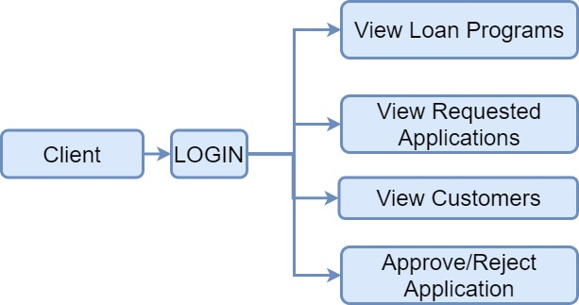
Client job

Slide 10
INVESTOR
Investor will be able to perform following functionalities :
User can register/login
Request for forgot password
Buy stocks
Sell stocks
View all stocks which is bought by the user

Slide 11
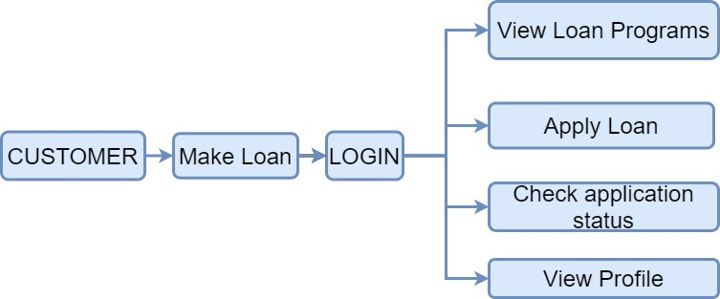
Customer Job

Slide 12
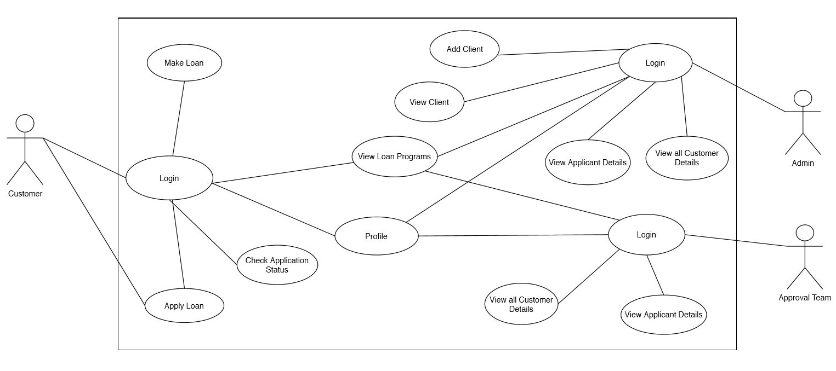
Use-case Diagram

Slide 13
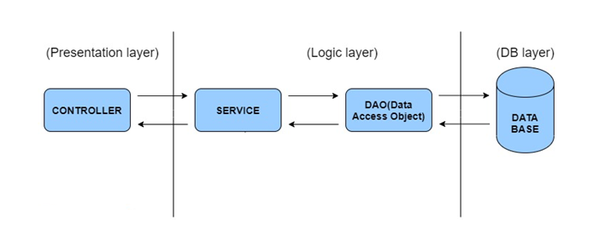
Project Work Flow

Slide 14
IMPLEMENTATION
Implementation of Stock Management System has been done is four Phases.
Java With Collection
JDBC
JPA With Hibernate
Angular With Spring Rest

Slide 15
Conclusion
The Loan Automation Application Software would help boost a lending institution’s customer service in many ways, and make the lending operations more efficient and transparent.
The computational speed, accuracy and storage capabilities of the computer would merge with the creativity and intuition of the human to make it all a success.
The outcome provides a loan automation application that saves paper works throughout the life of the loan, and makes available its design, a guide or foundation towards creation of similar or improved systems.

Slide 16
THANK YOU

