Slide 1

FINAL YEAR MAJOR PROJECT
Department of CSE(Data Science)
Swami Vivekananda Institute of Technology
(Approved by AICTE, New Delhi & Affiliated to JNTUH, Hyderabad)
Mahbub College Campus, Patny centre, S.D Road,
Secunderabad -500003,T.S
2021-2025

Slide 2

ARTIFICIAL INTELLIGENCE CRIME ON OVERVIEW OF MALICIOUS USE AND ABUSE OF AI
Meet The Group:
E. Shravika 21P71A6784
A. Swetha 21P71A6799
K. Vikas Chary 21P71A67B1
M. Venkatesh 22P75A6710
Internal Guide: Mrs. Nazia Shabana

Slide 3
ABSTRACT
Artificial Intelligence (AI) is advancing rapidly, transforming industries but also giving rise to new forms of crime and abuse. AI models are vulnerable to malicious activities, categorized into two main types: malicious abuse and malicious use. Malicious abuse includes integrity attacks, unintended outcomes, algorithmic trading misuse, and membership inference attacks, while malicious use involves social engineering, misinformation, hacking, and autonomous weapons. Identifying these threats is crucial for developing governance strategies to minimize harm. Collaboration among governments, industries, and civil society is essential to strengthen preparedness. Machine learning, a core component of AI, drives data-driven decisions, offering solutions where traditional methods fail, and plays a pivotal role across diverse applications.

Slide 4
INTRODUCTION
Artificial Intelligence (AI) is transforming industries and daily life but also brings serious risks. The malicious use of AI is a growing threat, enabling deception, harm, and manipulation. Criminals exploit AI for cyberattacks, deepfakes, and autonomous weapons. These threats challenge traditional security and raise ethical and legal issues. This project explores how AI is misused in criminal activities. It highlights AI’s dual-use nature—capable of both benefit and harm. Proactive measures are needed to prevent malicious applications. Building resilient AI systems is essential for a safer future.

Slide 5
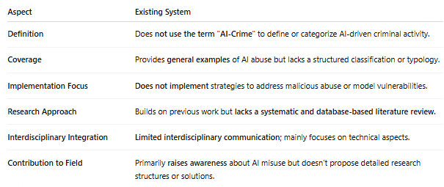
EXISTING SYSTEM

Slide 6
DISADVANTAGES
An existing methodology not proposed the term ``AI-Crime'' to describe the situation in which AI technologies are re-oriented to facilitate criminal activity.
An existing system doesn't implement for MALICIOUS ABUSE OF AI and VULNERABILITIES OF AI MODELS.

Slide 7
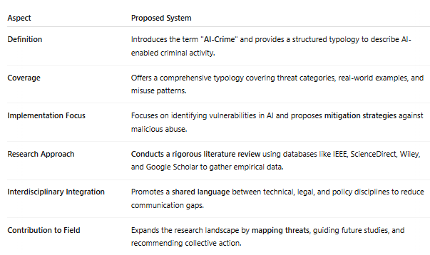
PROPOSED SYSTEM

Slide 8
ADVANTAGES
The system aims to propose a typology of the malicious use and abuse of AI based on empirical evidence and contemporary discourse, analyzing how AI systems are used to compromise confidentiality, integrity, and data availability.
Objectives are limited to identifying essential elements of the malicious use and abuse of AI, and to collect evidence of their use in practice. The compiled data enable further analysis of the possible ways in which AI systems can be exploited for criminal activities.

Slide 9
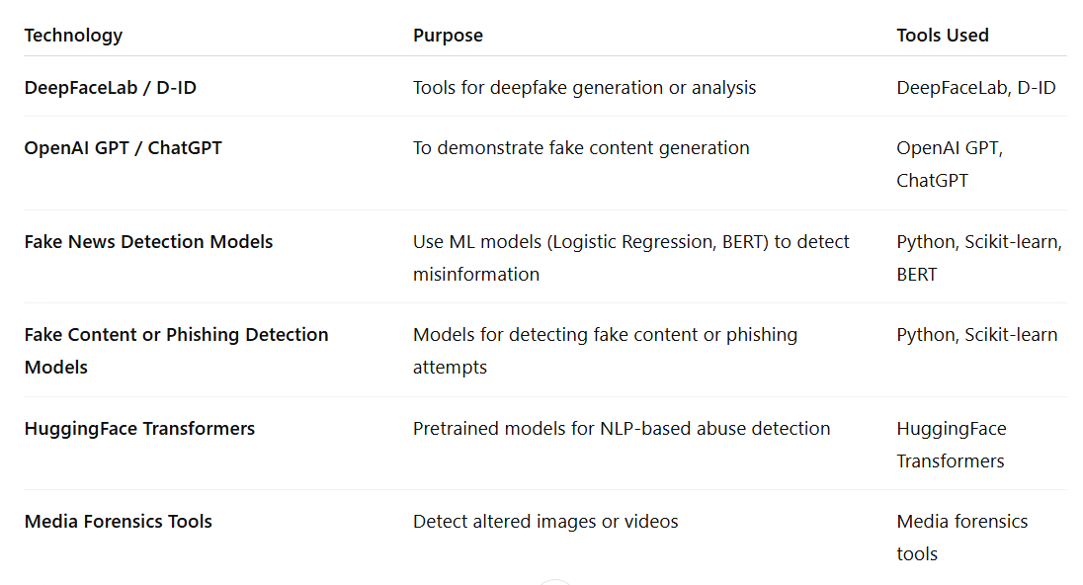
TECHNOLOGIES

Slide 10
SOFTWARE REQUIREMENTS
Operating system : Windows 7 Ultimate.
Coding Language : Python.
Front-End : Python.
Back-End : Django-ORM
Designing : Html, css, javascript.
Data Base : MySQL (WAMP Server).

Slide 11
HARDWARE REQUIREMENTS
Processor : Pentium -IV
RAM : 4 GB (min)
Hard Disk : 20 GB
Key Board : Standard Windows Keyboard
Mouse : Two or Three Button Mouse
Monitor : SVGA

Slide 12
MODULES
TensorFlow: Open-source library by Google for machine learning and deep learning tasks, especially neural networks.
NumPy: Core scientific library for Python that supports high-performance multidimensional arrays and mathematical functions.
Pandas: Library for data manipulation and analysis, offering powerful data structures like DataFrames for handling structured data.

Slide 13
Matplotlib: 2D plotting library for creating static, animated, and interactive visualizations in Python.
Scikit-learn: Machine learning library offering tools for classification, regression, clustering, and more, using a simple API.

Slide 14
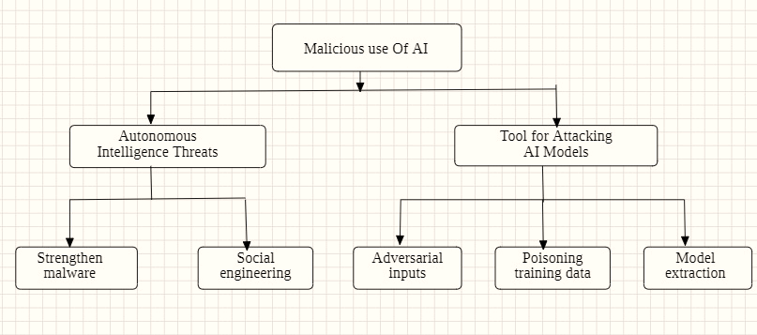
ARCHITECTURE DIAGRAM

Slide 15
UML DIAGRAMS
CLASS DIAGRAM
USE CASE DIAGRAM
SEQUENCE DIAGRAM
ACTIVITY DIAGRAM

Slide 16
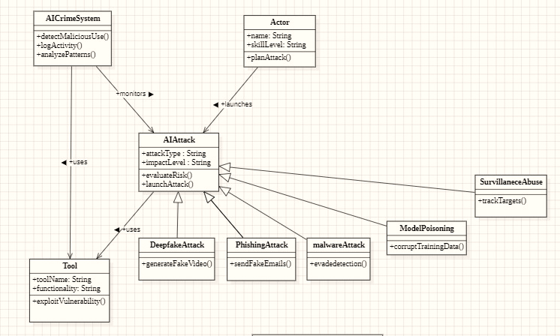
CLASS DIAGRAM

Slide 17
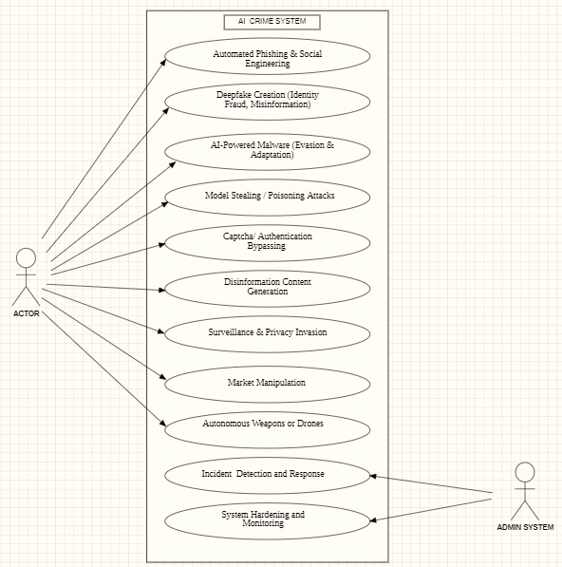
USE CASE DIAGRAM

Slide 18
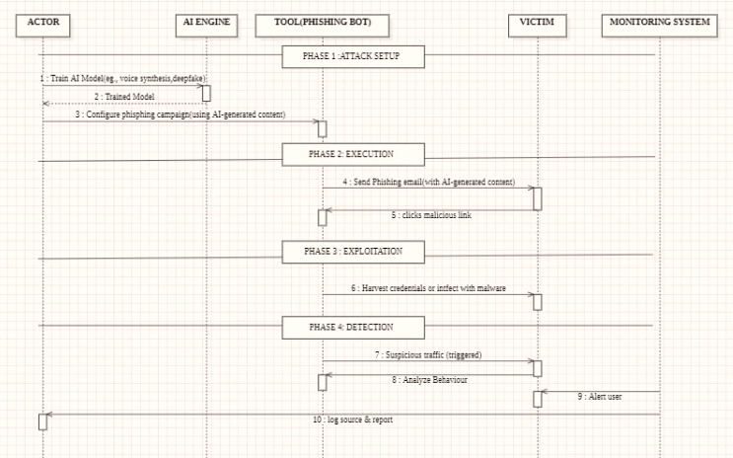
SEQUENCE DIAGRAM

Slide 19
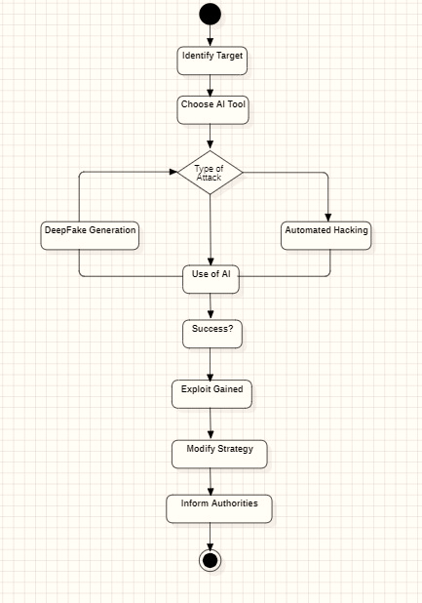
ACTIVITY DIAGRAM

Slide 20
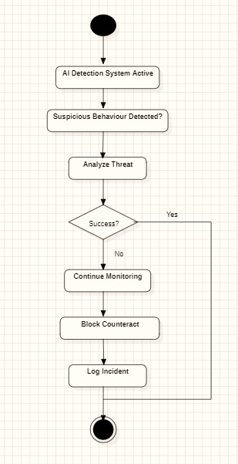

Slide 21
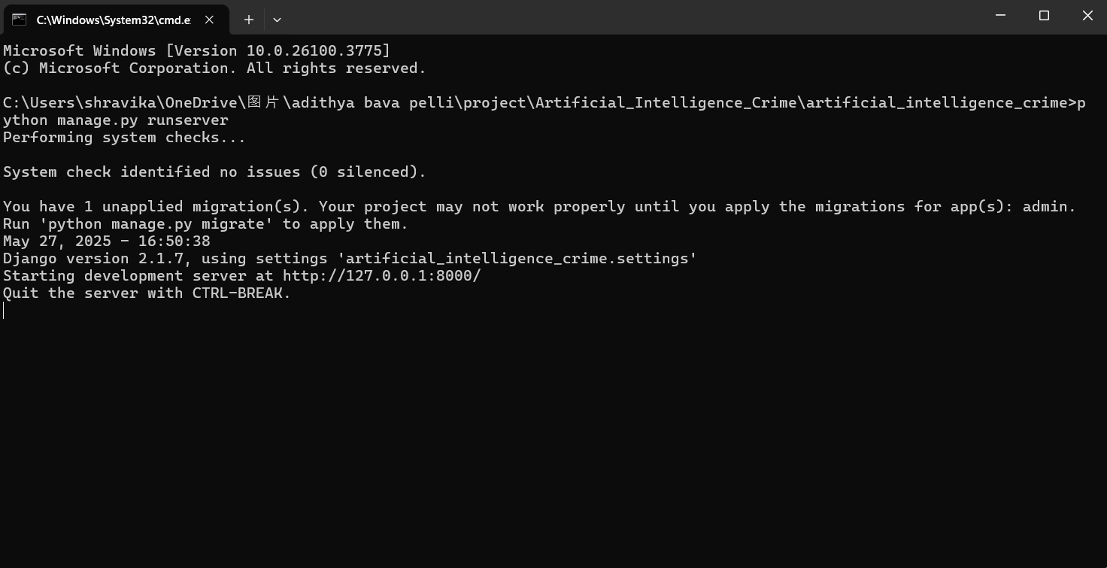
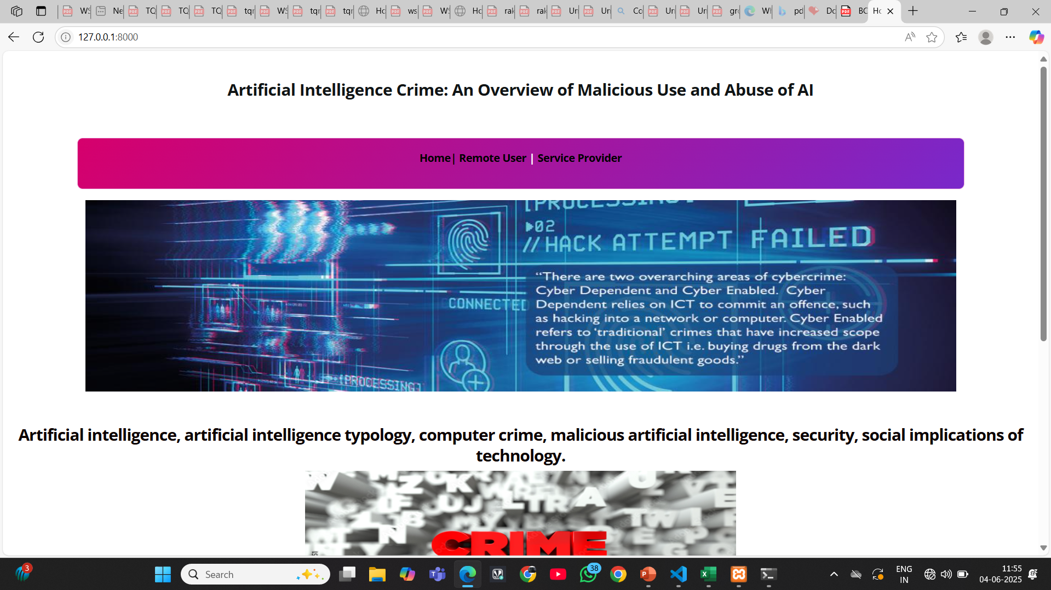

Slide 22
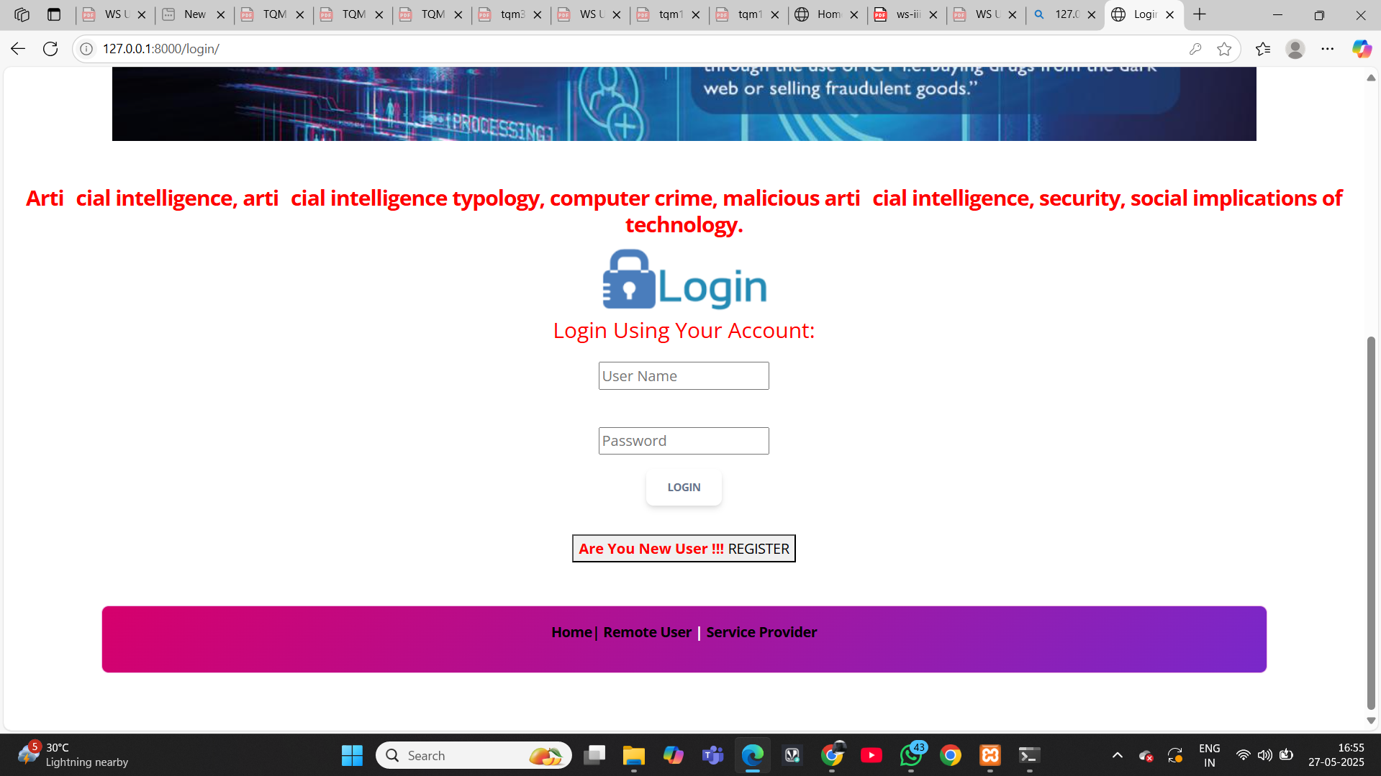
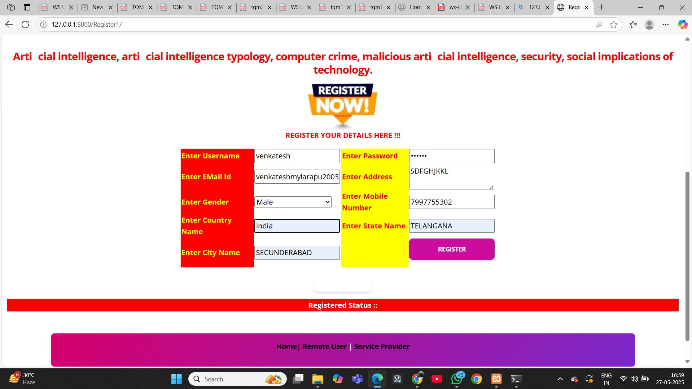

Slide 23
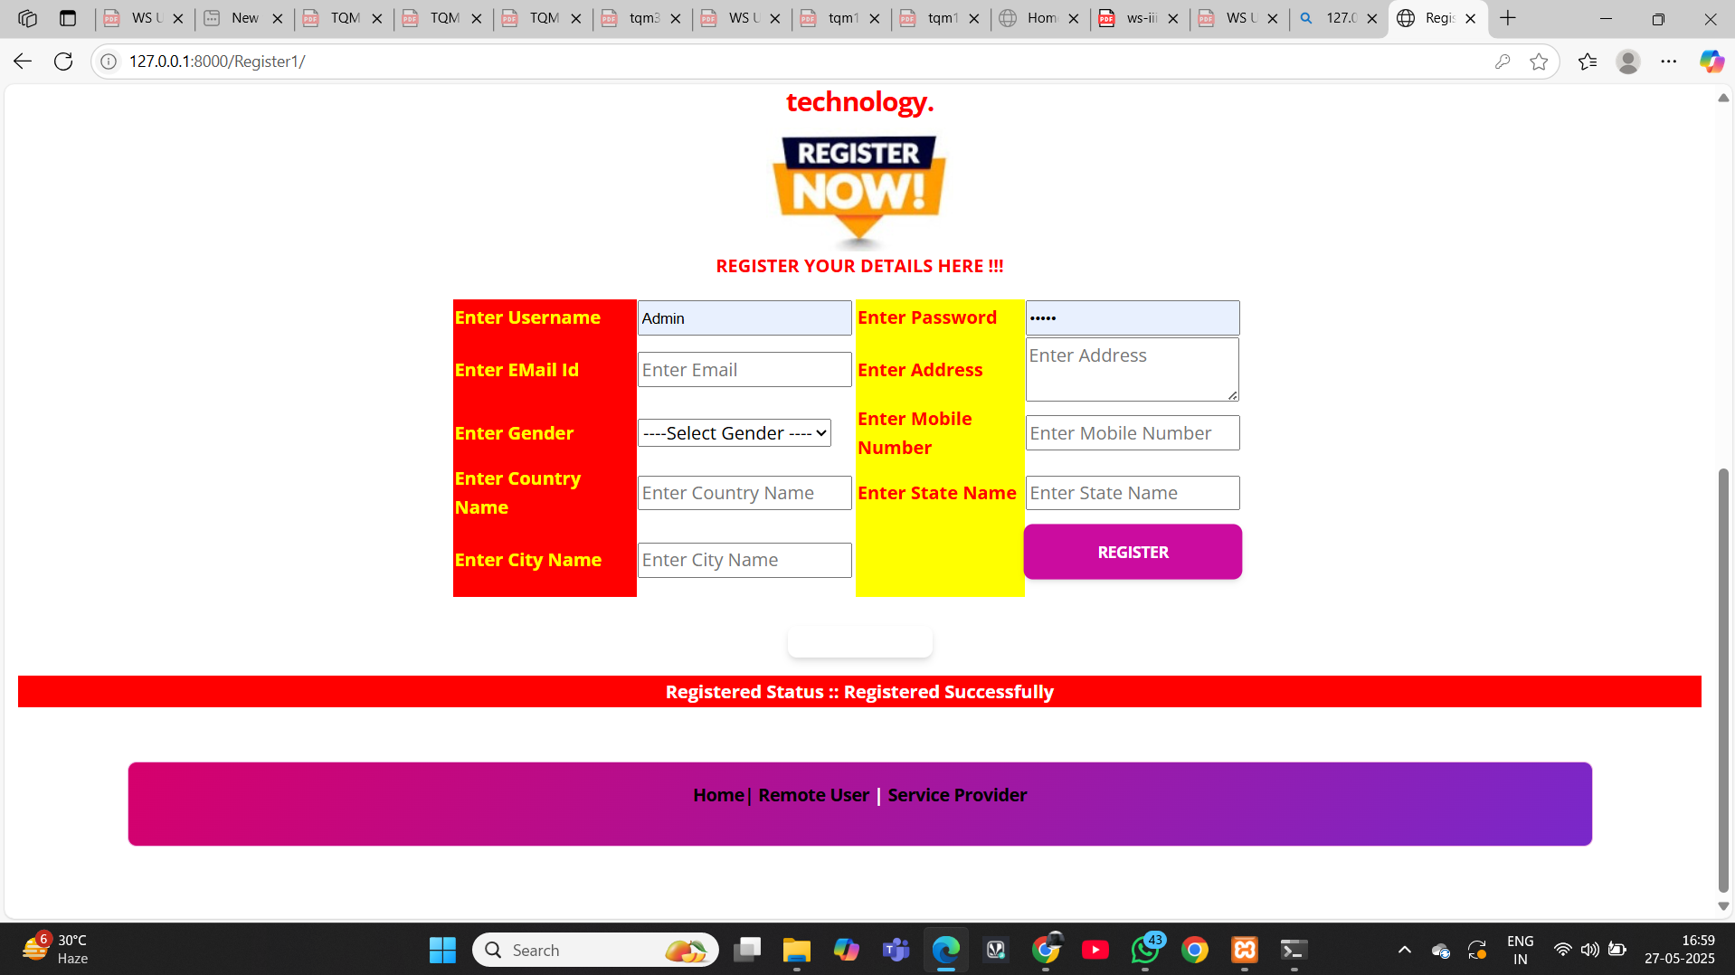


Slide 24
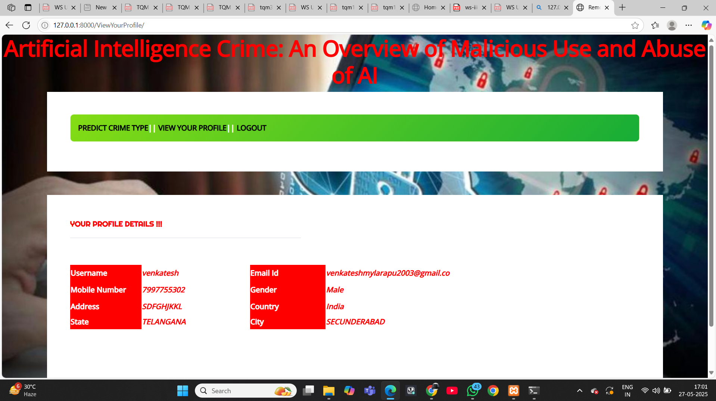
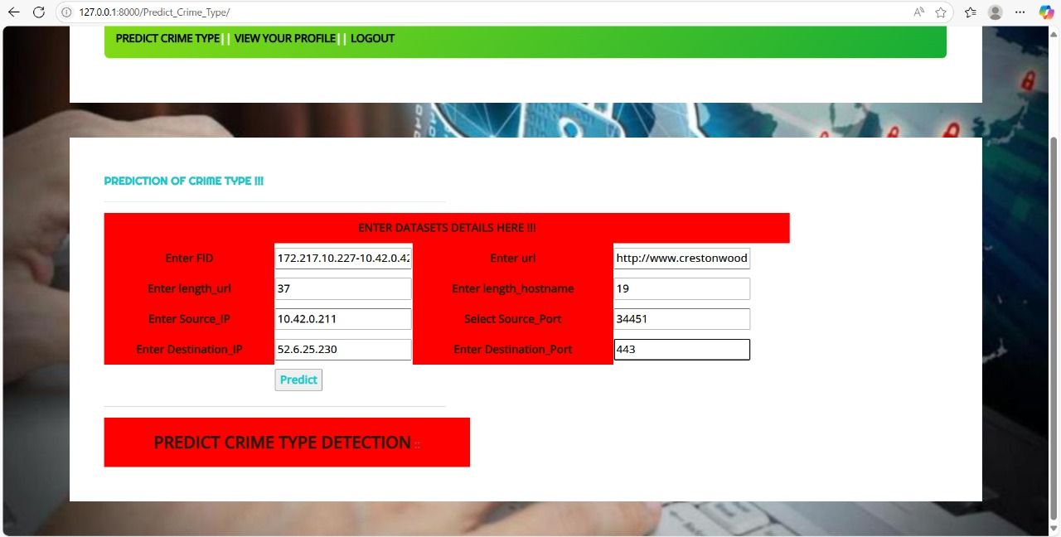


Slide 25

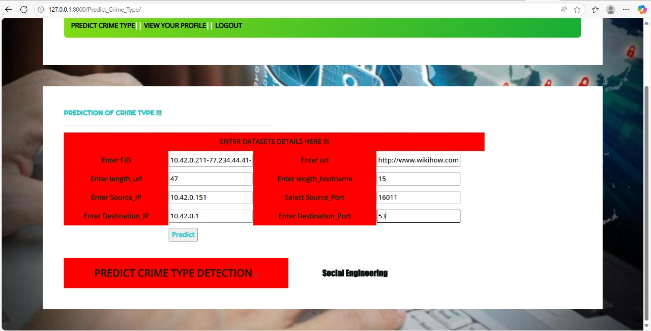

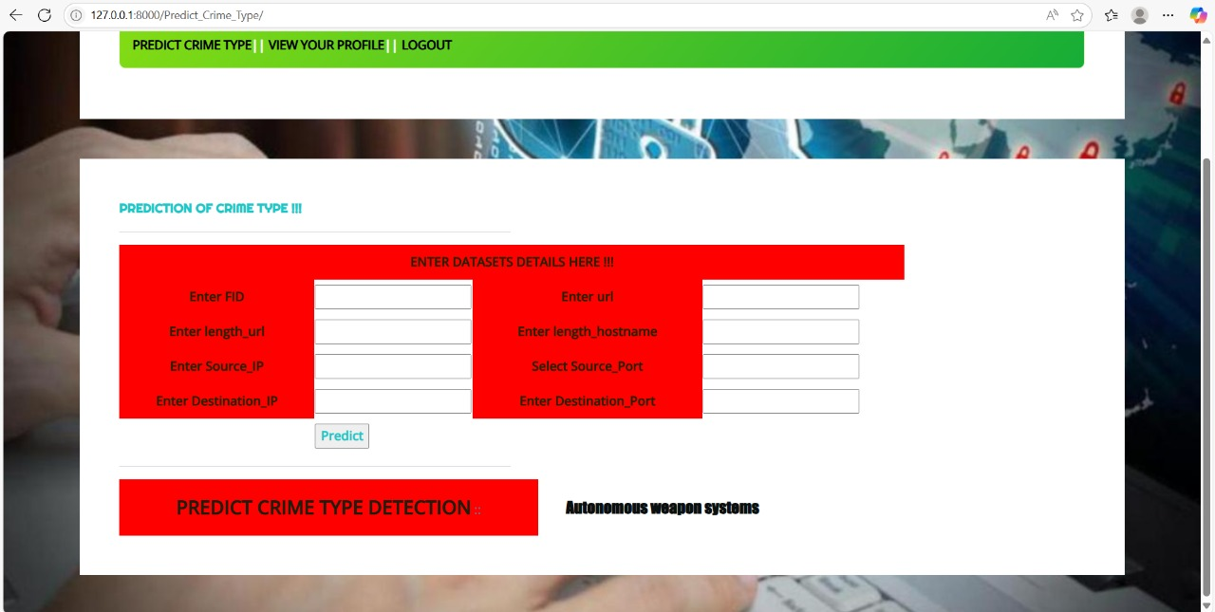

Slide 26

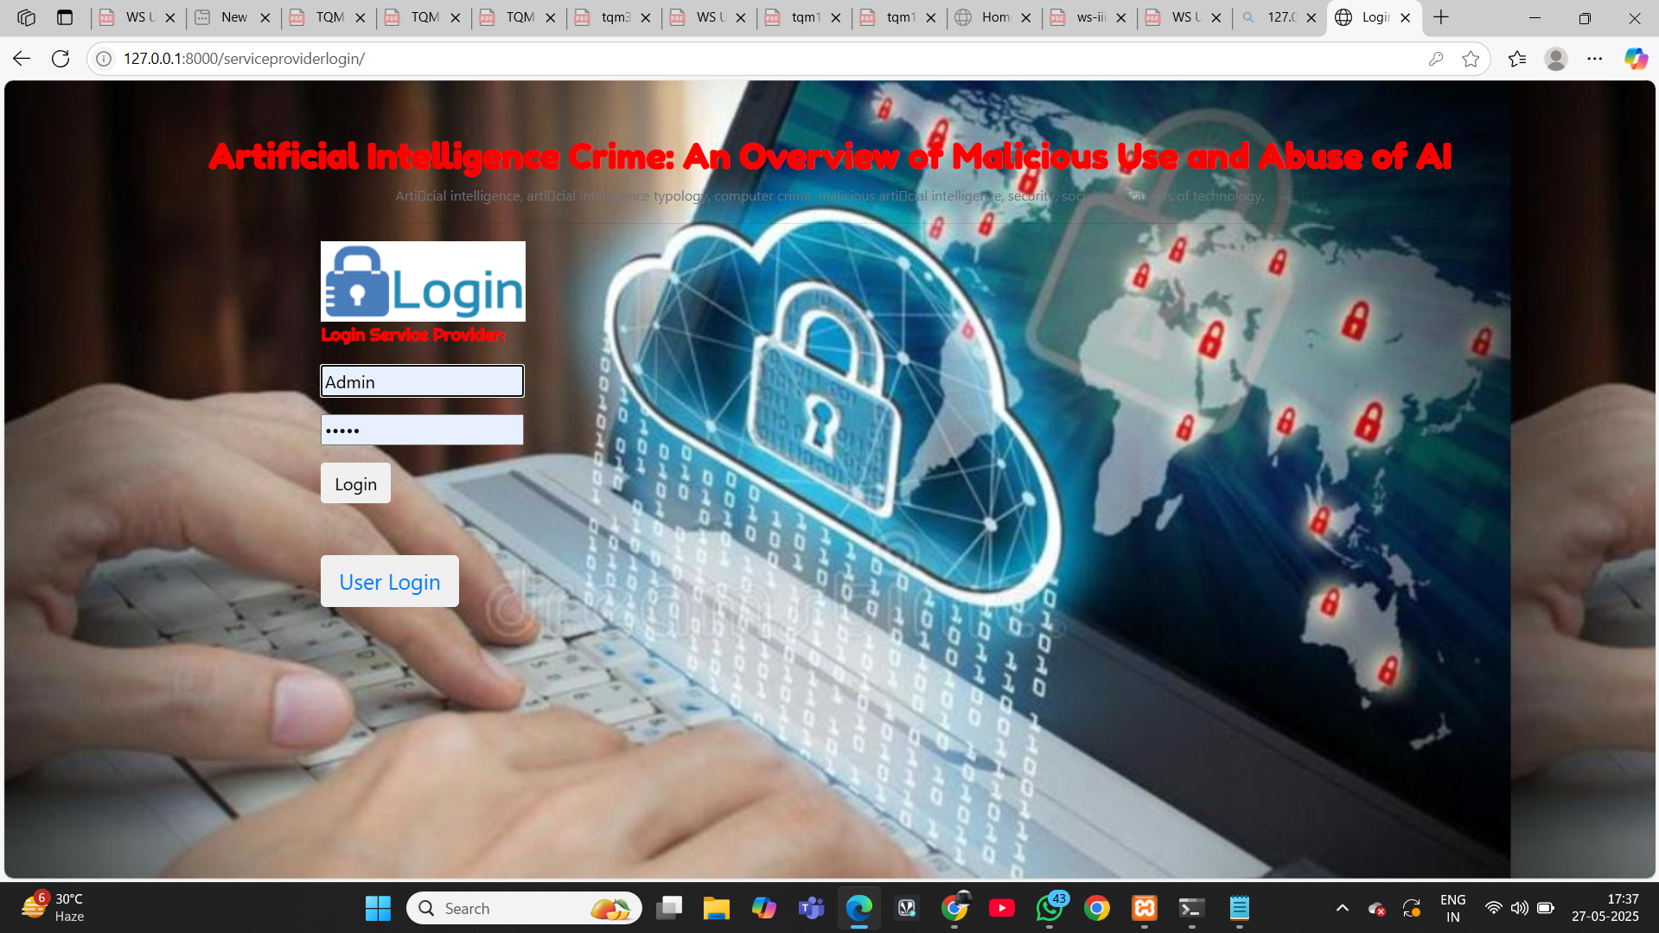


Slide 27
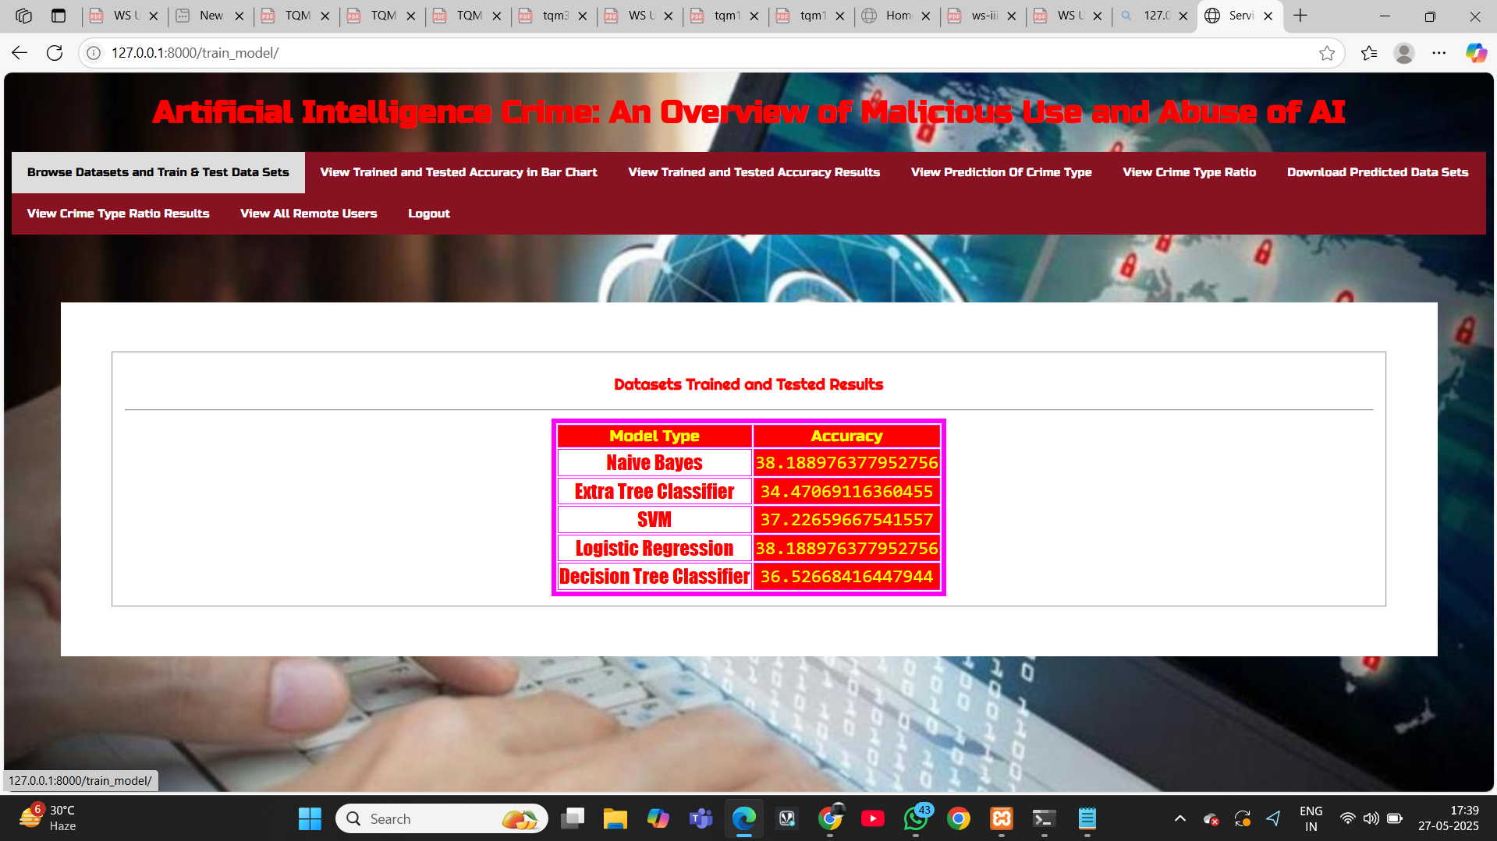
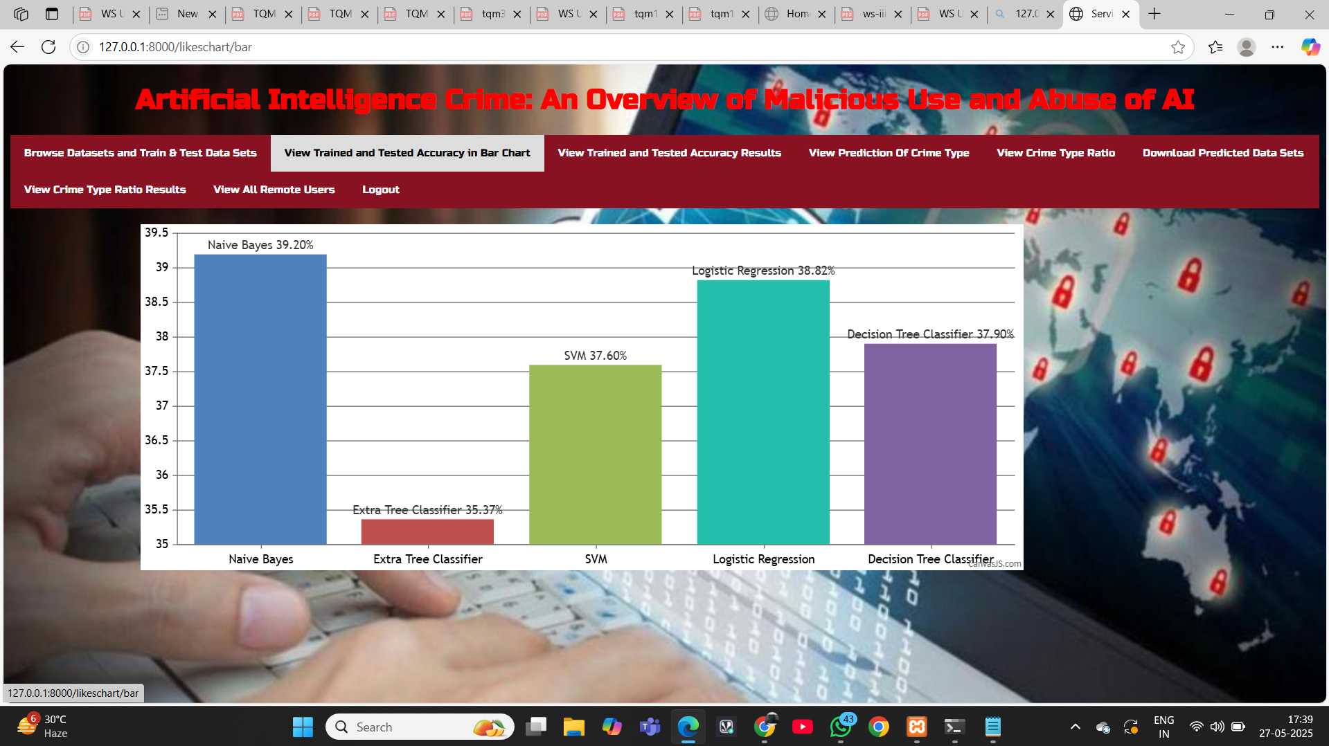

Slide 28
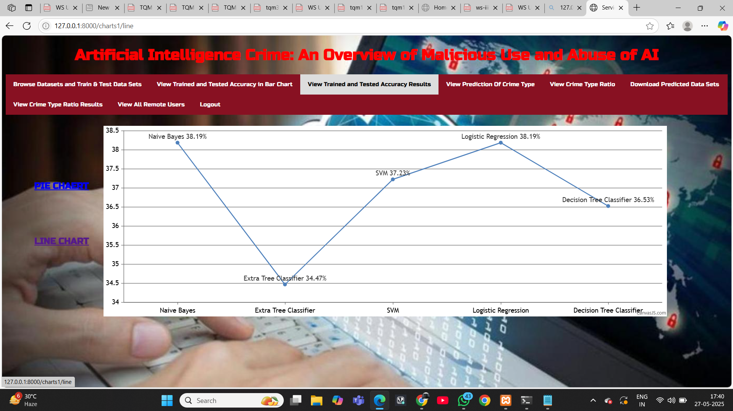
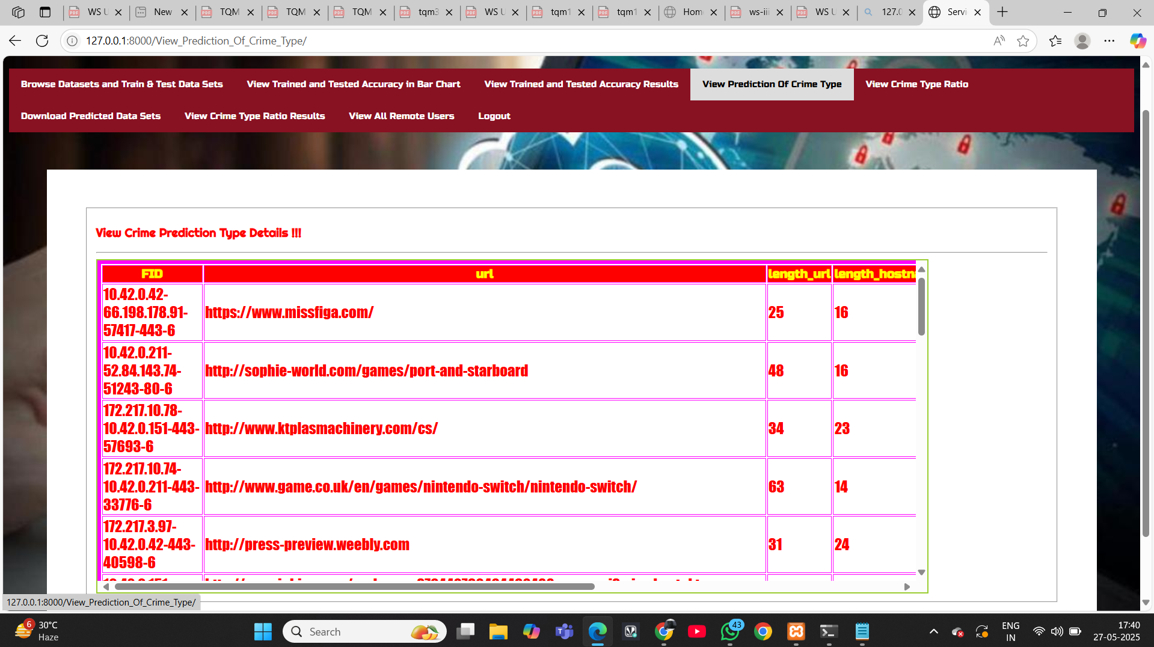

Slide 29
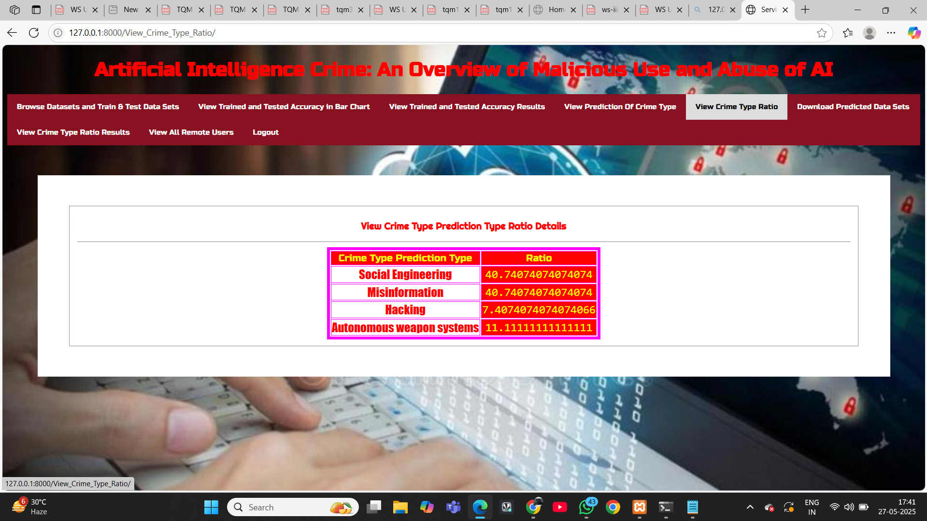
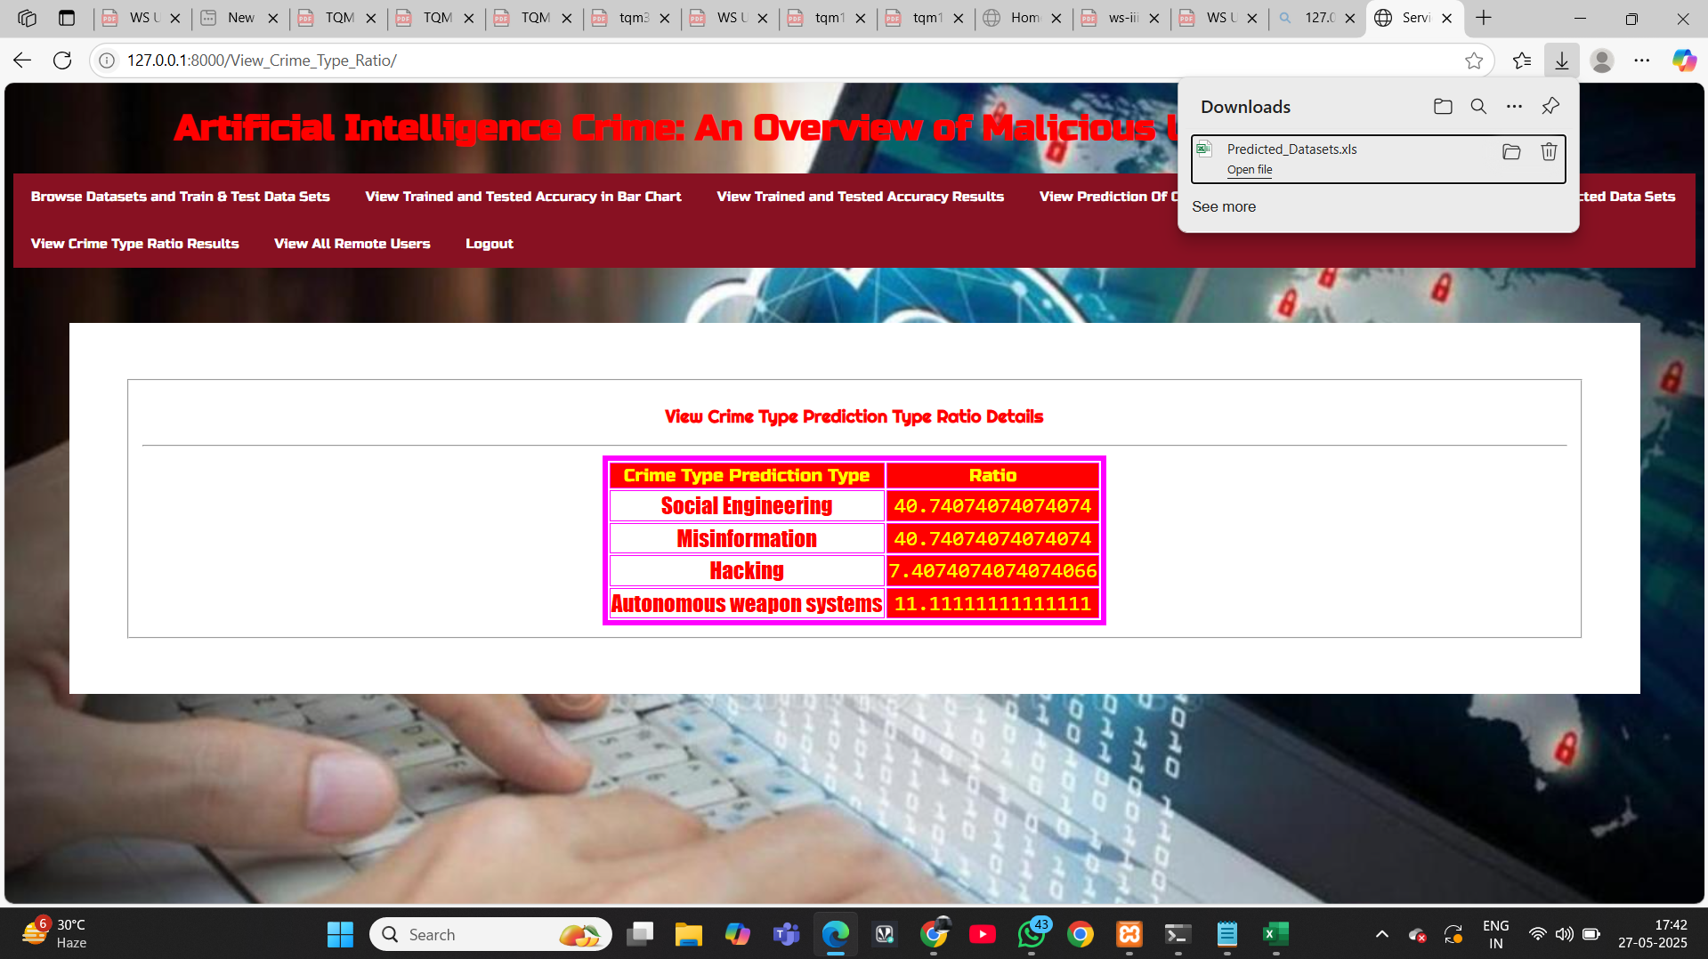

Slide 30
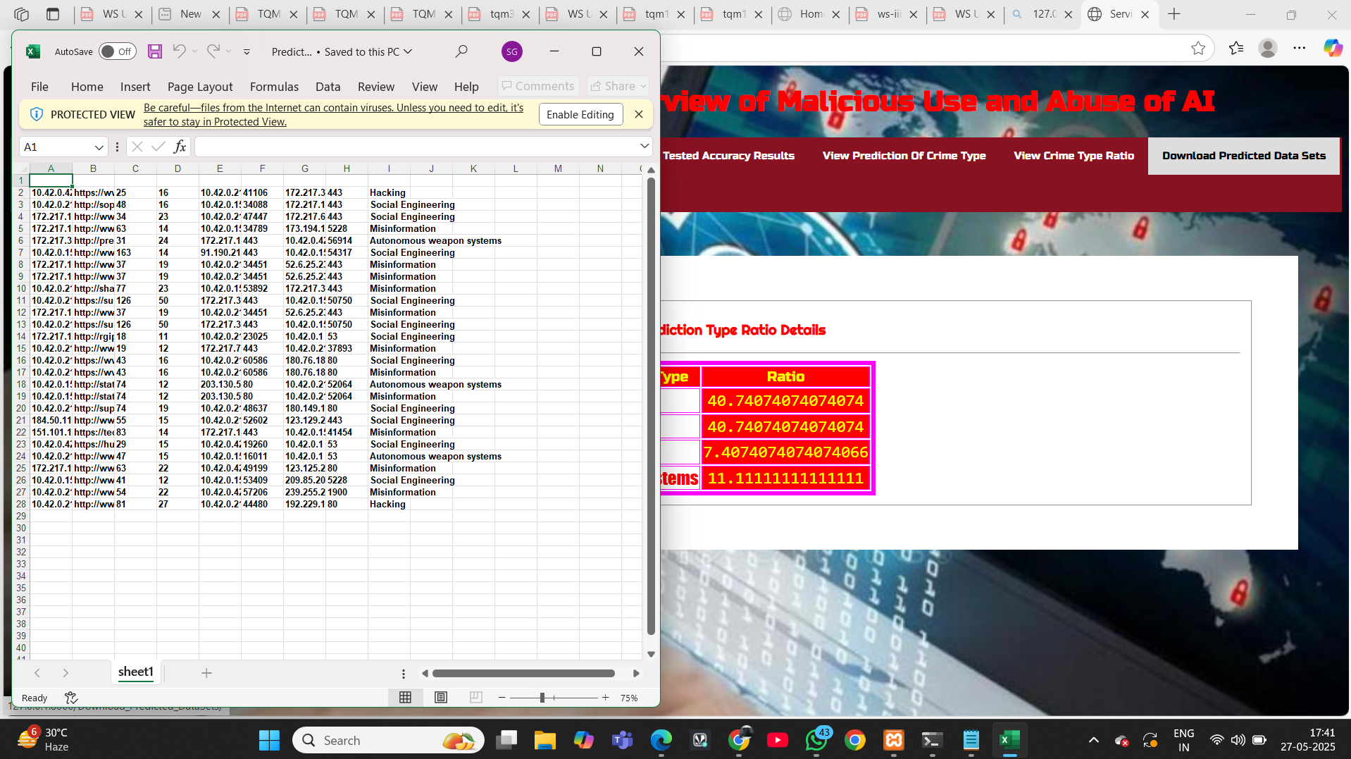
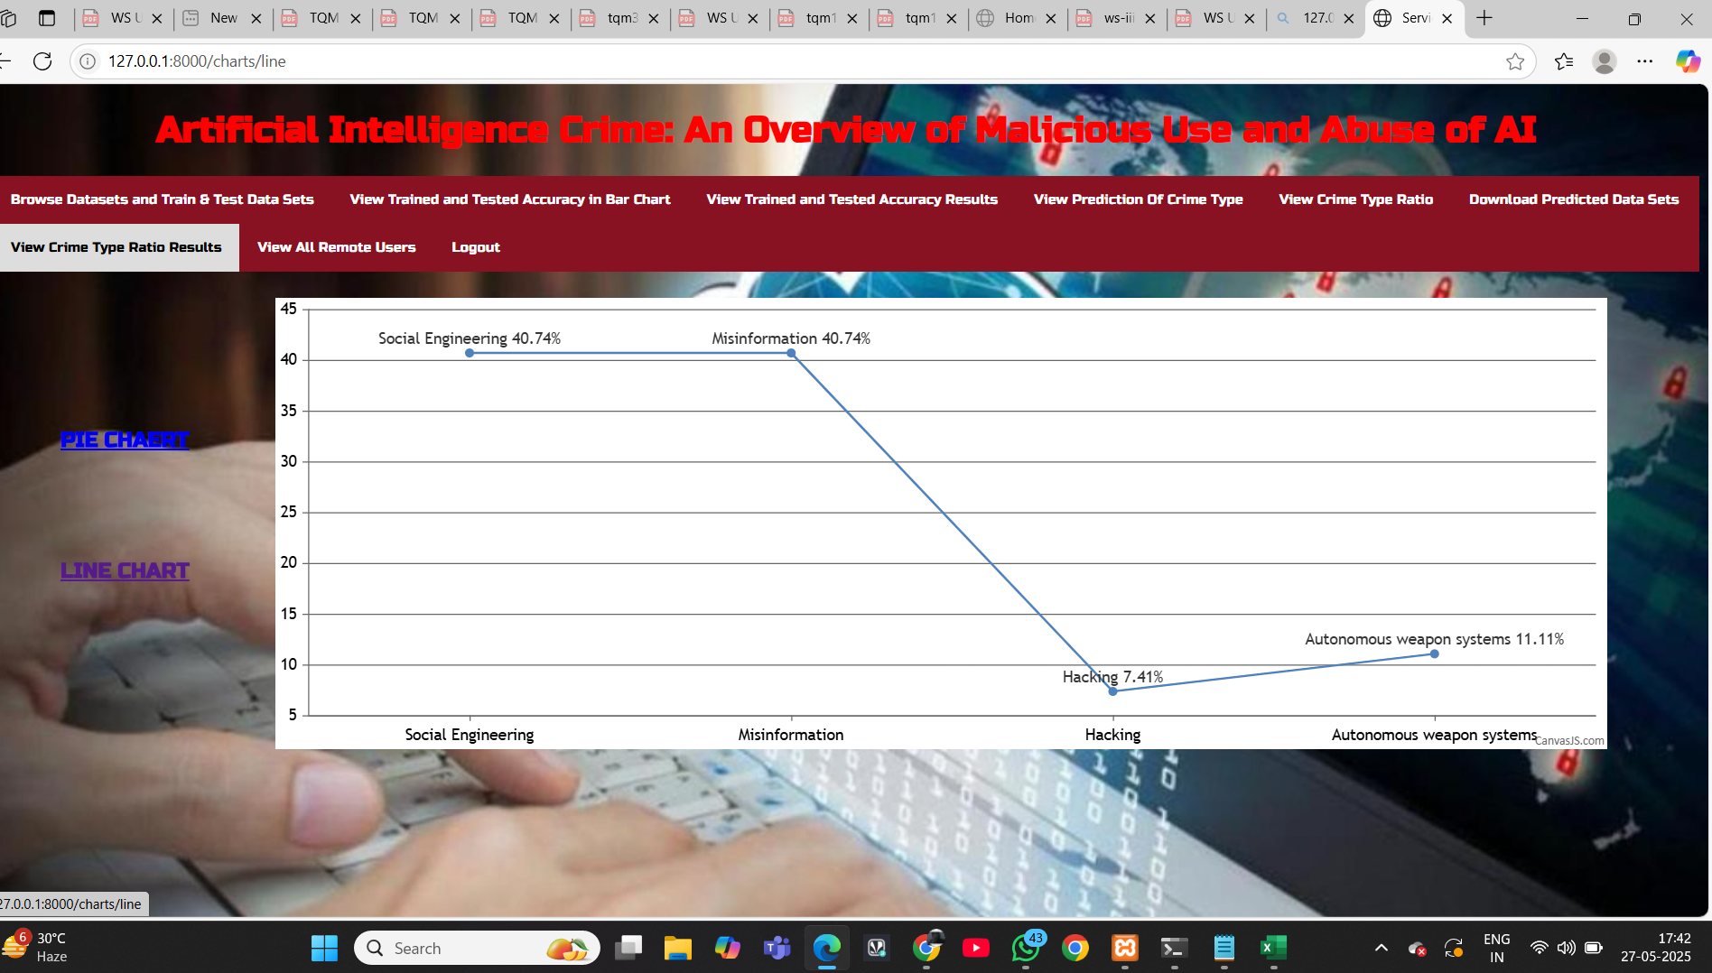

Slide 31
CONCLUSION
AI misuse poses serious digital threats like deepfakes, AI-driven phishing, and autonomous cyberattacks. Existing systems lack the adaptability to counter these. The proposed system uses intelligent algorithms, real-time anomaly detection, and self-learning to identify and stop AI-enabled threats. This approach strengthens cybersecurity by improving detection and reducing response time, ensuring safer and more responsible use of AI technologies.

Slide 32
THANK YOU

