Slide 1
FINAL YEAR PROJECT
Smart
Study
Adaptive Exam Practice &
Interview Preparation Platform
A smarter path from past papers to confident practice.
SUBMISSION PRESENTATION
Shravika Jain · Taniksha Patidar · Siddhi Nagar
Guided by Dr. Hemant Makwana
SMART STUDY

Slide 2
01 / THE CONTEXT
Good preparation should be focused, not repetitive.
Students often have the material—but not an efficient way to turn it into targeted practice.
Past papers stay static
Practice is one-size-fits-all
Feedback can stop at a score
Important themes are hard to spot across multiple papers; manually creating practice takes time.
A fixed question sequence may not respond to what a learner already understands.
Written answers and interview readiness need more useful feedback than right or wrong.
SMART STUDY’S RESPONSE
Convert learning material into a guided loop: discover → practise → reflect → improve.
SMART STUDY · FINAL SUBMISSION
02

Slide 3
02 / THE EXPERIENCE
From uploaded paper to a personal study loop
A single workflow connects source material, AI-assisted preparation, and adaptive practice.
01
02
03
04
PDF
MAP
Q+
IRT
Bring your papers
Find the structure
Build a practice set
Learn at your level
Upload past exam PDFs to a subject workspace.
Extract text, identify topics, and organise the material.
Generate MCQ, written, or mixed-format questions.
Answer, get feedback, and review every saved test later.
Learner stays in control: choose a subject, pick MCQ, subjective or both, and work through a session.
SMART STUDY · FINAL SUBMISSION
03

Slide 4
03 / USE CASES
One platform. Three meaningful practice contexts.
Designed for learners preparing for exams, written assessments, and interviews.
01
02
03
EXAM PREPARATION
WRITTEN-ANSWER PRACTICE
INTERVIEW REHEARSAL
Turn previous papers into fresh, topic-aware practice.
Go beyond multiple choice with evaluated written responses.
Practise subject or engineering-role questions at a chosen level.
Upload a paper → review extracted topics → practise generated questions.
Submit text or an answer PDF → receive a score, feedback and an AI-writing estimate.
Respond in text or dictate an answer; local Whisper transcription is supported.
A learner can move from understanding the material to practising how they will be assessed.
SMART STUDY · FINAL SUBMISSION
04

Slide 5
04 / CONTENT PIPELINE
A practical bridge between old papers and new questions
Question generation can use extracted text and scanned-paper OCR; question types are configurable.
BUILT-IN GUARDRAILS
01
02
03
PDF papers
Text & topics
Question set
1–5 PDFs per generation request
Upload 1–5 papers
Extract / OCR, cluster
MCQ, subjective or both
1–50 questions per request
Saved bank, practised by type
Why this matters
Learners start with familiar course material, while the platform helps make it easier to review recurring topics and generate fresh practice.
Subjective answers: text or PDF
Scanned PDFs can be processed through the ML service OCR endpoint.
SMART STUDY · FINAL SUBMISSION
05

Slide 6
05 / ADAPTIVE QUIZZING
The next question responds to learner performance
The backend uses an IRT-inspired ability estimate to select a question near the learner’s current level.
THE QUIZ LOOP
WHAT THE ENGINE TRACKS
Ability estimate
1
2
3
Updated after each response
Answer
Update ability
Select next
Question difficulty
Compared with current ability
Correct / incorrect
Estimate learner level
Closest difficulty
Session progress
Saved to My tests for review
repeat for the session
Implementation note
The current engine uses a bounded logistic probability model and selects the available question whose difficulty is nearest to estimated ability.
SMART STUDY · FINAL SUBMISSION
06

Slide 7
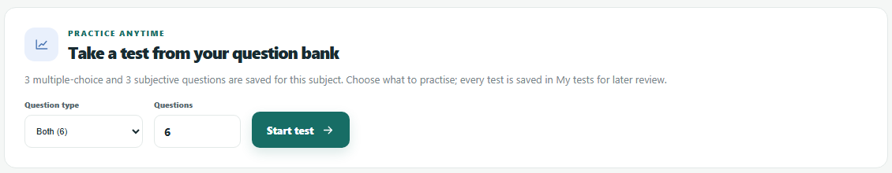
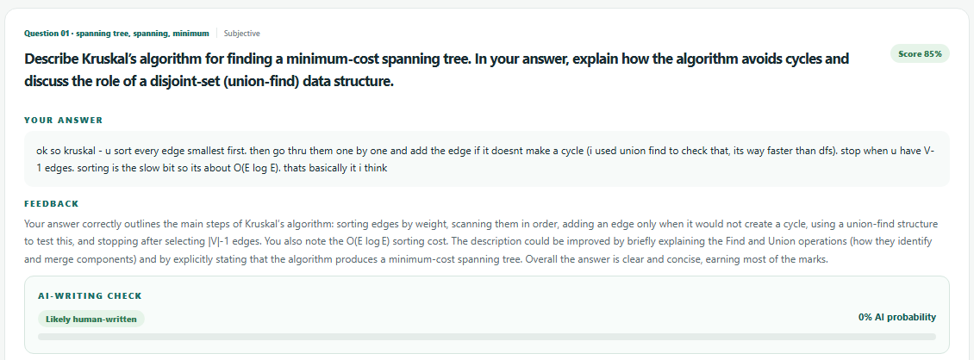
06 / PRACTICE & SELF-REVIEW
Practise by question type, then review every test
Learners choose MCQ, subjective or both from their question bank; every test is saved for self-evaluation.
HOW IT WORKS
Pick MCQ, subjective or both, and the test length
Adaptive difficulty still chooses each next question
My tests lists every attempt with its score and date
Review: your answer, grade, feedback, model answer
Saved per answer
Answer text · score · feedback · AI-writing probability and flag · time answered
SMART STUDY · FINAL SUBMISSION
07

Slide 8
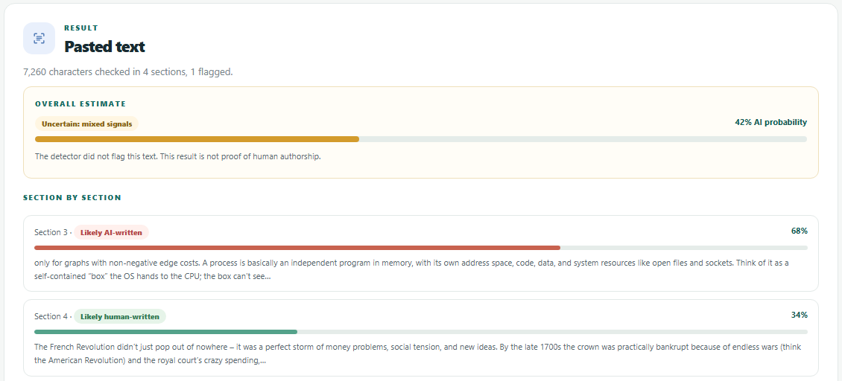
07 / WRITING AUTHENTICITY
An advisory AI-writing check, built in and standalone
Subjective answers get an AI-writing estimate, and learners can check their own notes or essays.
WHERE IT IS USED
Shown with graded answers; never changes the grade
Standalone check: paste text or upload PDF, .txt or .md
Long documents are scored section by section
Only the scores are saved; the text itself is not stored
≥ 60% Likely AI-written
35–60% Uncertain
< 35% Likely human
Advisory only
Detection can be wrong in both directions, so it is never treated as proof of authorship.
SMART STUDY · FINAL SUBMISSION
08

Slide 9
08 / DETECTOR EVALUATION
We tested the detector—and replaced it
8 answers written by gpt-oss:120b and 8 human-written passages, scored at the 0.6 flag threshold.
RESULTS OUT OF 8 TEXTS EACH
WHAT WE CONCLUDED
The previous model flagged none of the 8 AI answers
Fakespot caught the most AI text, with fewer false flags than e5-small
No small open model was reliable, so scores stay advisory
16 texts is an indicative check, not a benchmark
Decision
Switched to fakespot-ai/roberta-base-ai-text-detection-v1, pinned to a fixed model revision.
SMART STUDY · FINAL SUBMISSION
09

Slide 10
09 / BACKEND DEEP DIVE
Spring Boot is the application’s control plane
It owns identity, domain data, quiz orchestration, and the contract between the browser, database, and ML service.
API CONTROLLERS
DOMAIN SERVICES
PERSISTENCE
INTEGRATION
Auth · subjects · topics
Papers · quizzes · tests
Authenticity checks
Interviews
Validation & ownership
Paper / quiz orchestration
Evaluation & test review
Spring Data JPA
Users · subjects · topics
Questions · tests · checks
PostgreSQL data store
ML service via typed HTTP client
PDF text extraction & file storage
JWT-protected user flows · user-scoped records · readable ML errors · no DB connection held during ML calls
SMART STUDY · FINAL SUBMISSION
10

Slide 11
10 / INTELLIGENCE SERVICES
Focused ML capabilities behind a clear service boundary
A separate FastAPI service handles AI-assisted tasks while the backend remains responsible for app workflows.
01
PAPER ANALYSIS
02
QUESTION GENERATION
03
WRITTEN FEEDBACK
Cluster topics with TF-IDF + MiniLM sentence embeddings; find questions repeated across papers.
Create MCQ, subjective, or mixed sets; options are shuffled and duplicates removed.
Grade a subjective response and return a score with feedback.
04
INTERVIEW PRACTICE
05
OCR + VOICE
06
AI-WRITING DETECTION
Generate the next turn for a subject or engineering-role interview.
OCR for scanned PDFs; local CPU Whisper transcription for interview audio.
Fakespot RoBERTa estimate for subjective answers and uploaded material, section by section.
Internal service key on every endpoint except /health; models preload in the background so requests never wait.
SMART STUDY · FINAL SUBMISSION
11

Slide 12
11 / ENGINEERING HARDENING
Running the full stack surfaced real issues—now fixed
End-to-end runs with the real LLM, OCR, Whisper and detector drove these changes.
01
TOPICS BY MEANING
02
ROBUST LLM OUTPUT
03
FAIRER MCQS
MiniLM embeddings join TF-IDF, so reworded questions on one topic group together.
gpt-oss ignored the JSON schema; it is now stated in the prompt and replies are parsed leniently.
Answer options are shuffled; duplicate options and repeated questions are dropped.
04
NON-BLOCKING MODELS
05
SHORT TRANSACTIONS
06
LOCKED-DOWN ML API
Models load in the background; no request waits on a download.
No database connection is held while waiting on ML calls.
The internal key is required on every ML endpoint except /health.
Also fixed: test history stored the correct option instead of the learner’s actual choice.
SMART STUDY · FINAL SUBMISSION
12

Slide 13
12 / SYSTEM ARCHITECTURE
A small, containerised stack with clear responsibilities
Docker Compose brings the frontend, API, ML service, and persistent data stores together.
01 CLIENT
HTTPS/API
02 APPLICATION API
Internal API
03 ML SERVICE
Browser UI
Static app on Nginx
Spring Boot
Auth · business logic · data
FastAPI
Analysis · generation · detection
04 PERSISTENT DATA
DEPLOYMENT & SAFETY
PostgreSQL · uploads · models
Compose · health checks
JWT + internal service key
Runtime secrets and provider credentials are supplied through environment configuration.
SMART STUDY · FINAL SUBMISSION
13

Slide 14
13 / VALIDATION & NEXT STEPS
A testable foundation—and room to grow
59 ML-service tests and 49 backend tests pass, plus end-to-end runs on the Docker stack.
VALIDATION IN PLACE
POSSIBLE NEXT STEPS
Quiz flow, test history and authenticity integration tests
Learner progress and topic mastery dashboards
IRT probability, update, and selection tests
Educator tools for assigning and reviewing practice
ML API, OCR, transcription, analysis and detector tests
Stronger AI-writing detection, evaluated on more data
End-to-end runs with the real LLM, OCR and Whisper
Expanded evaluation of generated questions and feedback
Current scope
A full-stack workflow joining source material, adaptive tests, self-review and interviews.
SMART STUDY · FINAL SUBMISSION
14

Slide 15
PROJECT CREDITS
The people behind Smart Study
PROJECT TEAM
PROJECT GUIDE
Shravika Jain
Roll No.: 23I7166
Name: Dr. Hemant Makwana
01
Department: Information Technology
02
Taniksha Patidar
Roll No.: 23I7173
INSTITUTION DETAILS
03
Siddhi Nagar
Roll No.: 23I7186
Department: Information Technology
Institute of Engineering and Technology,
DAVV, Indore
SMART STUDY · FINAL SUBMISSION
15

Slide 16
THANK YOU
Study smarter.
Prepare with purpose.
Smart Study
Questions & discussion
Adaptive Exam Practice & Interview Preparation Platform
FINAL SUBMISSION
16

