Slide 1
CAPSTONE PROJECT PRESENTATION
Name: Shravya K
Trainer :Javeed Sir
Domain: Java full stack-React.js
Platform: Great Learning

Slide 2

SmartPizza AI – Intelligent Pizza Ordering and Delivery Optimization System
Enhancing pizza delivery with smart AI technology
Notes:
AI-generated content may be incorrect. ---

Slide 3
Project Overview
Notes:
--- This slide references information from the following file: https://wipro365-my.sharepoint.com/personal/sh20696203_wipro_com/Documents/Microsoft%20Copilot%20Chat%20Files/Capstone%20Project%20-%20SmartPizza%20AI%20(JFS%20React).pdf Introduction to SmartPizza AI

Slide 4

Introduction to SmartPizza AI
User-Friendly Ordering
  SmartPizza AI offers an intuitive React-based frontend for browsing menus and placing pizza orders easily.
AI-Powered Recommendations
  The platform uses AI to provide personalized pizza suggestions enhancing customer satisfaction.
Real-Time Delivery Tracking
  Users can track their pizza delivery live, enabling transparency and timely updates.
Admin Analytics Dashboard
  Administrators access detailed analytics to optimize operations and analyze customer behavior effectively.
Notes:
--- This slide references information from the following file: https://wipro365-my.sharepoint.com/personal/sh20696203_wipro_com/Documents/Microsoft%20Copilot%20Chat%20Files/Capstone%20Project%20-%20SmartPizza%20AI%20(JFS%20React).pdf SmartPizza AI is an intelligent, full-stack food ordering and delivery optimization platform designed to modernize the pizza ordering experience. The project integrates a React-based frontend with a robust backend to allow users to browse menus, place orders, receive AI-powered pizza recommendations, and track deliveries in real time. The system also provides administrators with powerful analytics dashboards to manage operations, analyze customer behavior, and optimize delivery performance. By combining AI-driven insights, secure authentication, seamless payment integration, and real-time tracking, SmartPizza AI aims to enhance user satisfaction, operational efficiency, and scalability in a competitive food delivery ecosystem.

Slide 5
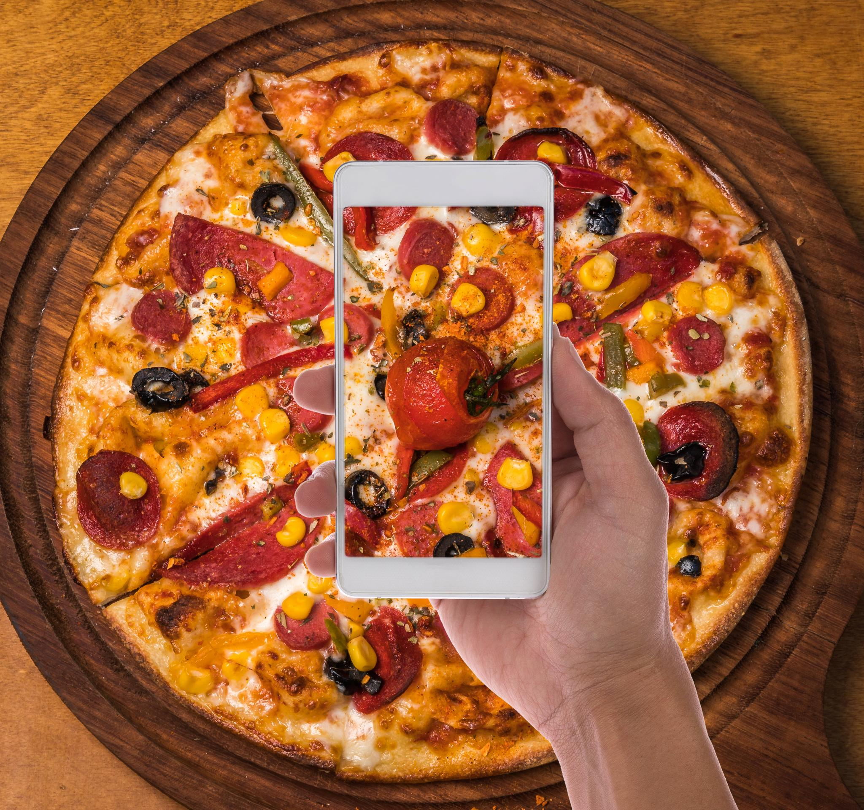
Goals and Scope
Customer Personalization
  SmartPizza AI uses machine learning to analyze customer order history and seasonal trends for personalized pizza suggestions.
Optimized Delivery Efficiency
  The system optimizes delivery routes and predicts accurate ETAs to improve delivery speed and reliability.
Administrative Analytics
  Real-time analytics and revenue tracking provide insights for monitoring delivery performance and supporting scalable operations.
Notes:
--- This slide references information from the following file: https://wipro365-my.sharepoint.com/personal/sh20696203_wipro_com/Documents/Microsoft%20Copilot%20Chat%20Files/Capstone%20Project%20-%20SmartPizza%20AI%20(JFS%20React).pdf The primary objective of SmartPizza AI is to build an AI-enabled pizza delivery ecosystem that delivers personalization, efficiency, and reliability. The project focuses on enabling customers to easily discover pizzas, manage carts, apply offers, and place secure orders. A key goal is to leverage machine learning concepts such as order history analysis and seasonal trends to suggest personalized pizza recommendations. In addition, the system aims to optimize delivery routes and accurately predict ETAs to improve delivery performance. From an administrative perspective, the scope includes real-time analytics, revenue tracking, and delivery performance monitoring, ensuring informed decision-making and scalable operations.

Slide 6
System Architecture
Notes:
--- This slide references information from the following file: https://wipro365-my.sharepoint.com/personal/sh20696203_wipro_com/Documents/Microsoft%20Copilot%20Chat%20Files/Capstone%20Project%20-%20SmartPizza%20AI%20(JFS%20React).pdf High-Level Architecture Flow

Slide 7
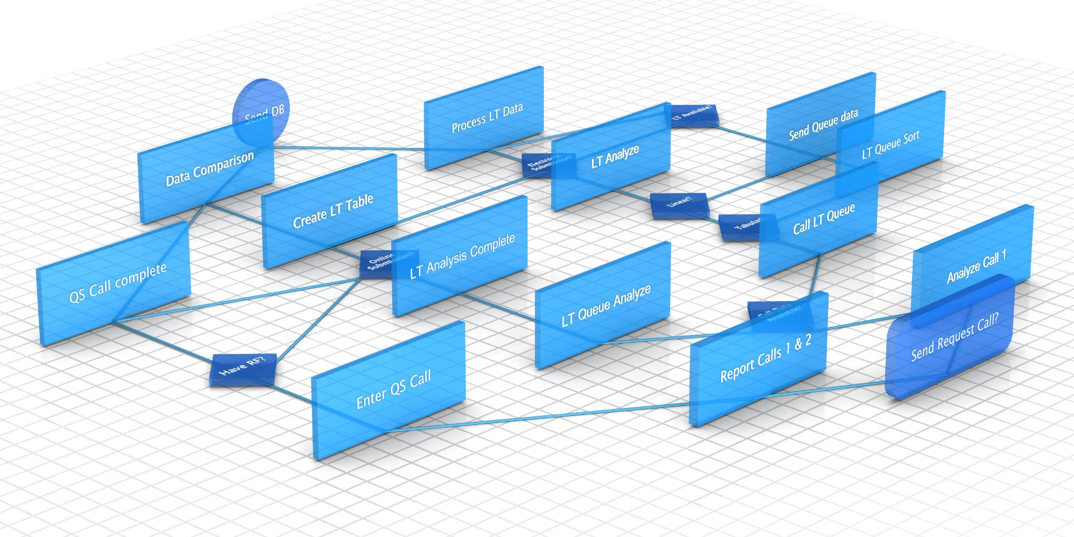
High-Level Architecture
Flow
React Frontend Interface
  The React frontend provides a responsive web interface, enabling users to interact with the system seamlessly on various devices.
Secure Backend Communication
  Backend services communicate securely via REST APIs using JWT authentication to ensure safe data exchange and user verification.
Business Logic and AI
  Backend handles order processing, AI recommendation generation, and delivery optimization, enabling intelligent service management.
Data Storage and Integration
  A relational database ensures data consistency and reliability, while external payment gateways are integrated for smooth transactions.
Notes:
--- This slide references information from the following file: https://wipro365-my.sharepoint.com/personal/sh20696203_wipro_com/Documents/Microsoft%20Copilot%20Chat%20Files/Capstone%20Project%20-%20SmartPizza%20AI%20(JFS%20React).pdf The SmartPizza AI system follows a layered architecture where the React frontend interacts with backend services through REST APIs. Users access the application via a responsive web interface, which communicates securely with the backend using JWT-based authentication. The backend handles business logic such as order processing, AI recommendation generation, and delivery optimization. Data is stored and retrieved from a relational database, ensuring consistency and reliability. External services such as payment gateways are integrated seamlessly. This modular architecture allows independent scaling of frontend, backend, and AI components while maintaining secure and efficient data flow across the system.

Slide 8
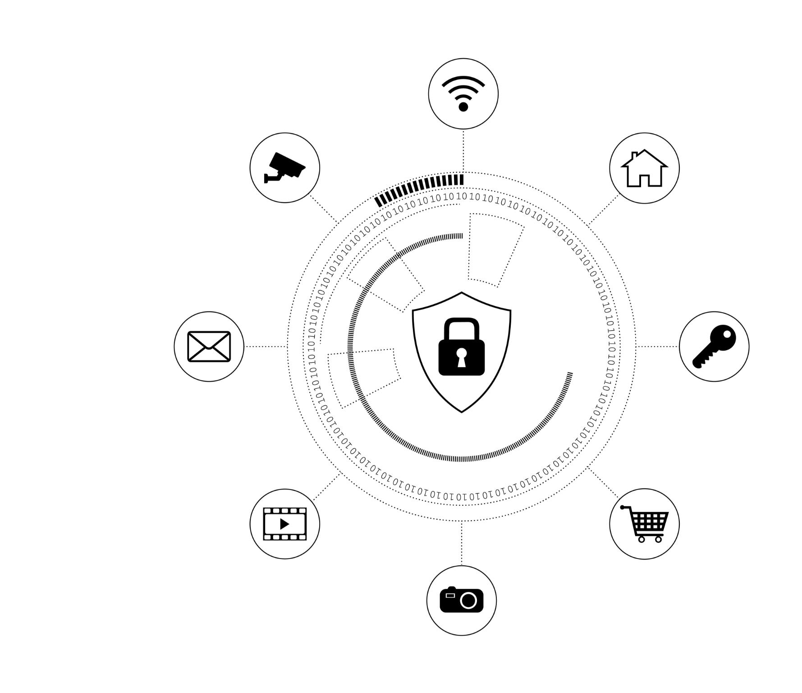
Authentication and User Roles
Secure Authentication
  JWT-based authentication ensures every system request is authorized and sensitive data is protected.
Multiple User Roles
  System supports customers, administrators, and delivery personnel with distinct access rights.
Role-Based Access Control
  Access tailored by role enables customers to order, admins to manage, and delivery to update status.
Notes:
--- This slide references information from the following file: https://wipro365-my.sharepoint.com/personal/sh20696203_wipro_com/Documents/Microsoft%20Copilot%20Chat%20Files/Capstone%20Project%20-%20SmartPizza%20AI%20(JFS%20React).pdf The authentication module is responsible for managing secure access to the system. SmartPizza AI supports multiple user roles, including customers, administrators, and delivery personnel. JWT-based authentication ensures that every request is authorized and validated, protecting sensitive user data and order information. Role-based access control allows customers to place and track orders, admins to manage menus and analytics, and delivery agents to update delivery status. This separation of concerns improves system security while providing a tailored experience for each user type.

Slide 9

Smart Ordering System
Dynamic Interactive Menu
  The system offers a menu that users can filter by category, price, or personal preferences for easy navigation.
Cart Management and Checkout
  Users can add items, adjust quantities, and apply coupons seamlessly during checkout for a smooth ordering experience.
Smart Combo Suggestions
  The system suggests complementary items based on popular combos, encouraging users to explore more options.
Streamlined Order Processing
  The backend ensures accurate and efficient order processing, reducing errors and enhancing user satisfaction.
Notes:
--- This slide references information from the following file: https://wipro365-my.sharepoint.com/personal/sh20696203_wipro_com/Documents/Microsoft%20Copilot%20Chat%20Files/Capstone%20Project%20-%20SmartPizza%20AI%20(JFS%20React).pdf The Smart Ordering System provides users with a dynamic and interactive menu that can be filtered by category, price, or preferences. Users can add pizzas to the cart, adjust quantities, and apply coupons during checkout. The system also introduces smart combo suggestions, encouraging users to explore complementary items based on popular combinations. By streamlining cart management and checkout flows, the ordering module minimizes friction and enhances the overall user experience while ensuring accurate order processing on the backend.

Slide 10
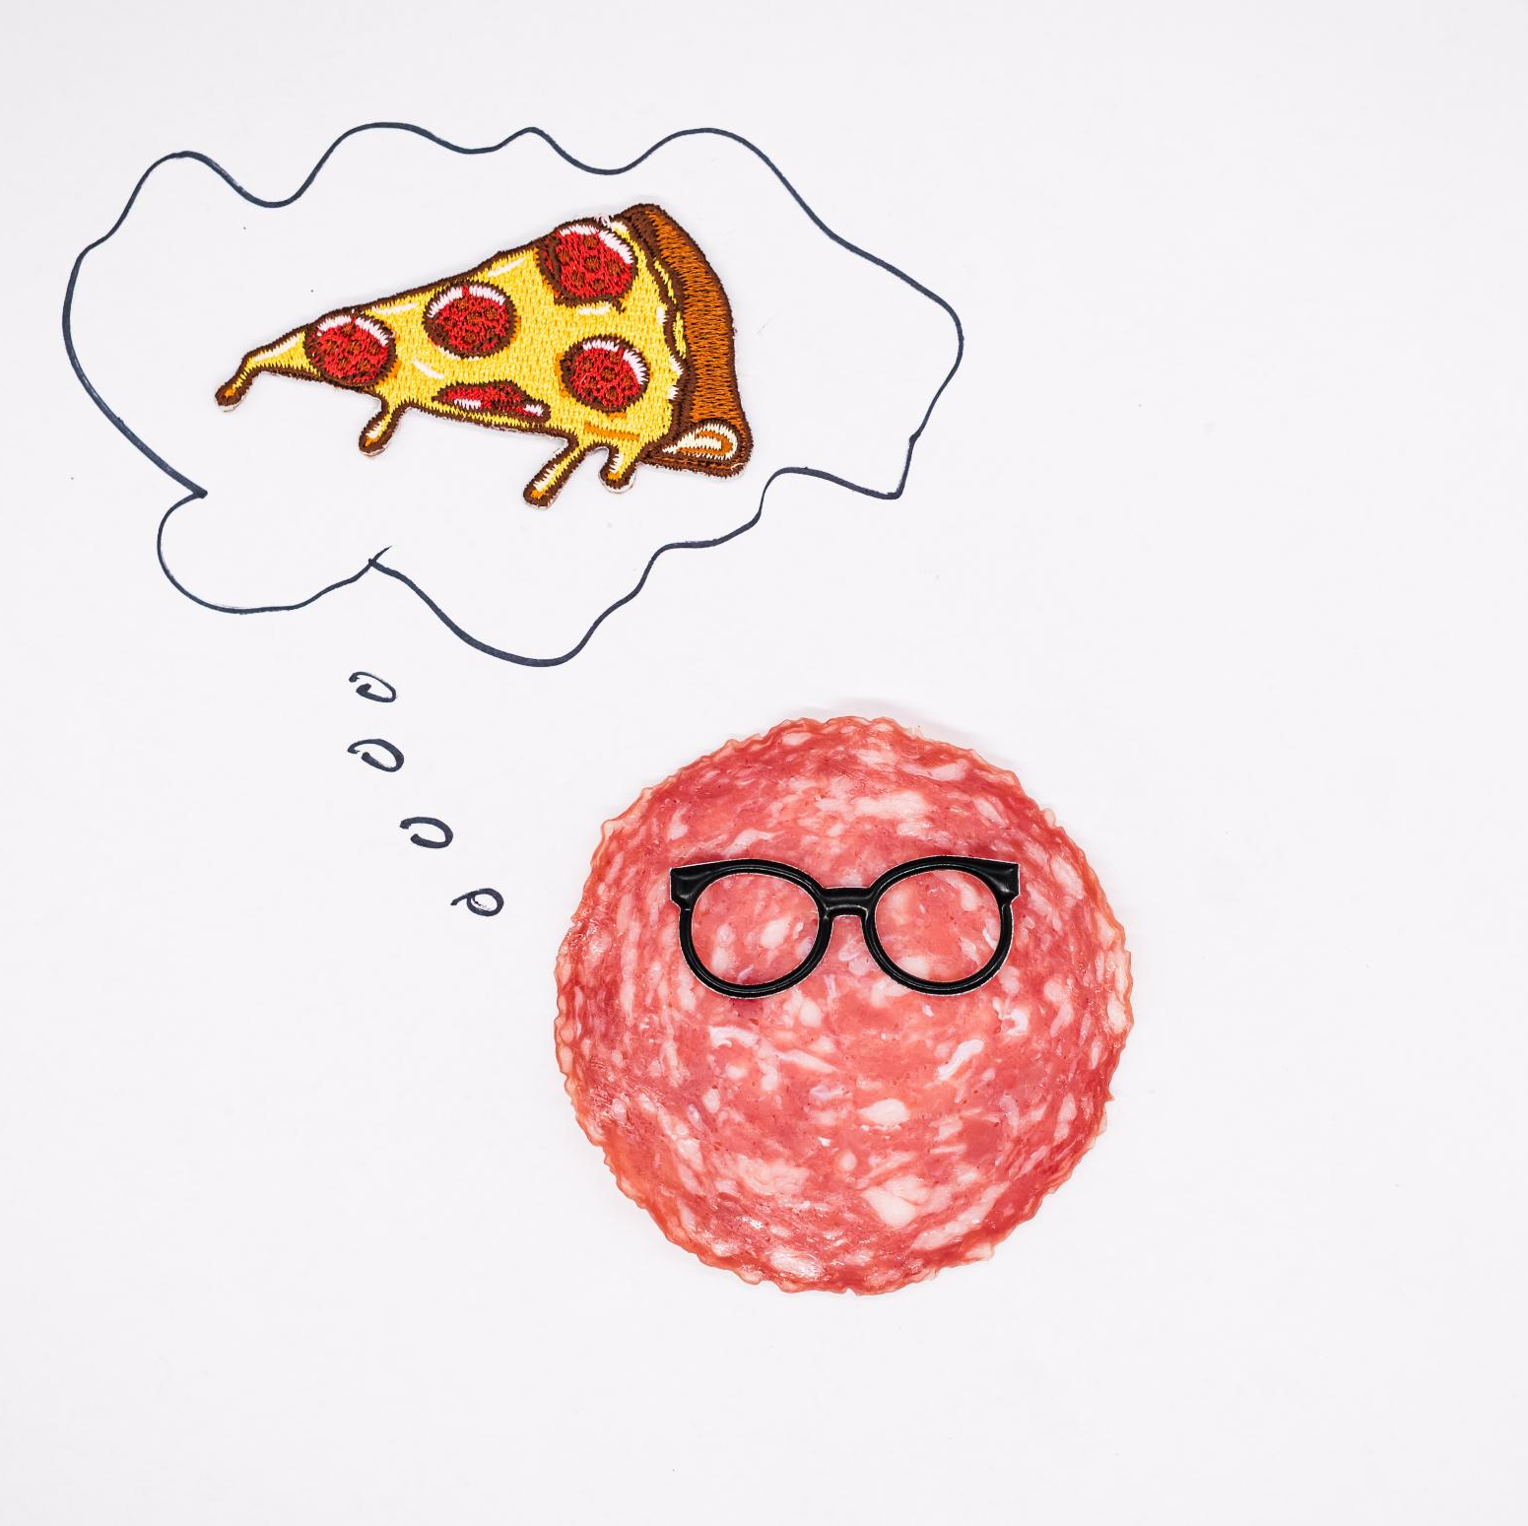
Recommendation Flow Diagram (Conceptual)
User Data Collection
  The engine collects user data including previous orders, purchase frequency, and preferred categories to understand user behavior.
Data Analysis Techniques
  Statistical and rule-based methods analyze the collected data to identify patterns and user preferences.
Personalized Recommendations
  Based on analysis, the engine generates personalized pizza recommendations including seasonal and trending items.
User Engagement Enhancement
  Recommendations are presented during browsing or checkout to enhance engagement and increase average order value.
Notes:
--- This slide references information from the following file: https://wipro365-my.sharepoint.com/personal/sh20696203_wipro_com/Documents/Microsoft%20Copilot%20Chat%20Files/Capstone%20Project%20-%20SmartPizza%20AI%20(JFS%20React).pdf The AI Recommendation Engine operates through a logical flow that begins with collecting user data such as previous orders, frequency of purchases, and preferred categories. This data is then analyzed to identify patterns and preferences using statistical and rule-based techniques. Based on the analysis, the engine generates personalized pizza recommendations, including seasonal or trending items. These recommendations are presented to the user during browsing or checkout, increasing engagement and average order value while delivering a customized dining experience.

Slide 11
Delivery Tracking and Optimization
Notes:
--- This slide references information from the following file: https://wipro365-my.sharepoint.com/personal/sh20696203_wipro_com/Documents/Microsoft%20Copilot%20Chat%20Files/Capstone%20Project%20-%20SmartPizza%20AI%20(JFS%20React).pdf Delivery Flow Diagram (Conceptual)

Slide 12
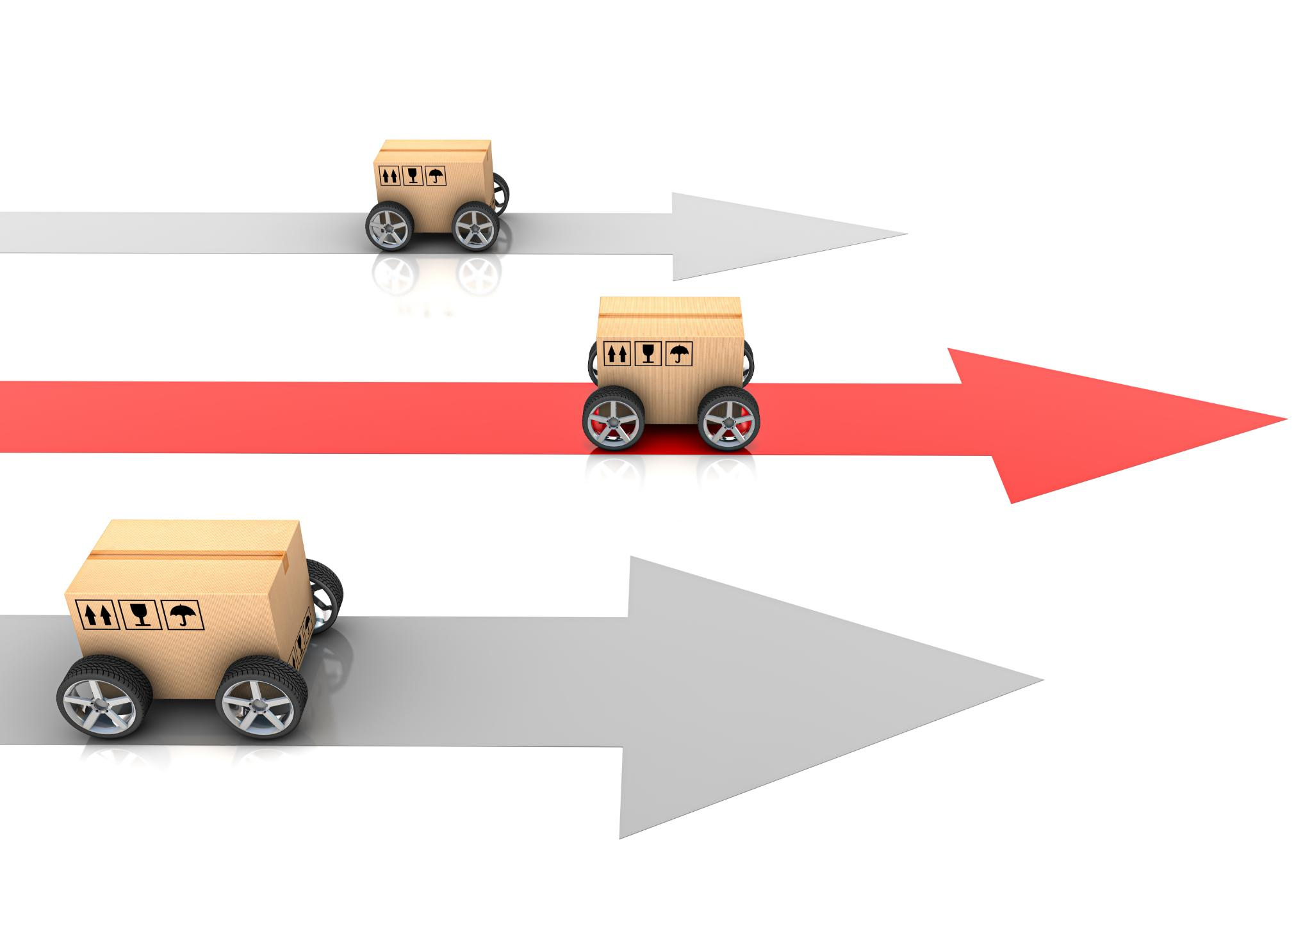
Delivery Flow
Order Assignment
  Once an order is placed, it is assigned promptly to an available delivery agent to ensure timely processing.
Route Optimization
  The system calculates optimal delivery routes using location data to minimize travel time and improve efficiency.
Real-Time Tracking
  Customers can track their deliveries in real time with live status updates, increasing transparency and trust.
ETA Refinement & Monitoring
  ETA predictions are continuously refined during transit, and administrators monitor delivery efficiency to reduce delays.
Notes:
--- This slide references information from the following file: https://wipro365-my.sharepoint.com/personal/sh20696203_wipro_com/Documents/Microsoft%20Copilot%20Chat%20Files/Capstone%20Project%20-%20SmartPizza%20AI%20(JFS%20React).pdf The delivery module manages the complete post-order lifecycle. Once an order is placed, it is assigned to a delivery agent. The system calculates optimal delivery routes using location data to minimize travel time. Customers can track deliveries in real time through live status updates. ETA predictions are continuously refined during transit, improving transparency and trust. This optimized delivery workflow reduces delays, enhances customer satisfaction, and enables administrators to monitor delivery efficiency.

Slide 13
Billing and Payments
Notes:
--- This slide references information from the following file: https://wipro365-my.sharepoint.com/personal/sh20696203_wipro_com/Documents/Microsoft%20Copilot%20Chat%20Files/Capstone%20Project%20-%20SmartPizza%20AI%20(JFS%20React).pdf Secure Payment Processing

Slide 14

Secure Payment Processing
Trusted Payment Gateways
  Integration of reliable third-party payment gateways ensures secure and seamless online transactions.
Payment Module Functions
  Handles tax calculation, invoice generation, and transaction confirmation for efficient payment processing.
Security and Compliance
  Isolation of payment logic and use of industry-standard APIs ensure high security and regulatory compliance.
User and Admin Benefits
  Users enjoy smooth checkout; administrators track revenue and payment statuses reliably via backend systems.
Notes:
--- This slide references information from the following file: https://wipro365-my.sharepoint.com/personal/sh20696203_wipro_com/Documents/Microsoft%20Copilot%20Chat%20Files/Capstone%20Project%20-%20SmartPizza%20AI%20(JFS%20React).pdf SmartPizza AI integrates trusted third-party payment gateways such as Razorpay or Stripe to handle secure online transactions. The payment module manages tax calculation, invoice generation, and transaction confirmation. By isolating payment logic and using industry-standard APIs, the system ensures high security and compliance. Users benefit from a smooth checkout experience, while administrators can reliably track revenue and payment statuses through backend records.

Slide 15
Admin Analytics Dashboard
Notes:
--- This slide references information from the following file: https://wipro365-my.sharepoint.com/personal/sh20696203_wipro_com/Documents/Microsoft%20Copilot%20Chat%20Files/Capstone%20Project%20-%20SmartPizza%20AI%20(JFS%20React).pdf Analytics and Insights

Slide 16
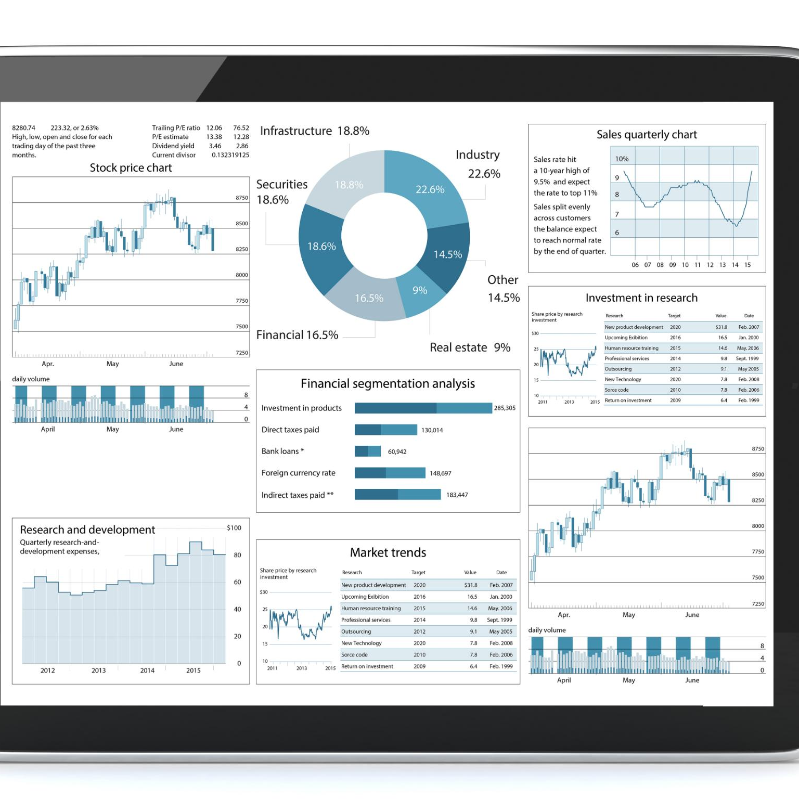
Analytics and Insights
Centralized Metrics Dashboard
  The dashboard consolidates key operational and business metrics into one accessible view for administrators.
Analyzing Trends and Performance
  Administrators analyze revenue trends, order volumes, and delivery performance to gain actionable insights.
Visual Tools for Insights
  Charts and heatmaps identify peak hours and high-demand areas, aiding better resource allocation.
Data-Driven Decision Making
  Insights from analytics enable continuous platform improvement and more efficient resource use.
Notes:
--- This slide references information from the following file: https://wipro365-my.sharepoint.com/personal/sh20696203_wipro_com/Documents/Microsoft%20Copilot%20Chat%20Files/Capstone%20Project%20-%20SmartPizza%20AI%20(JFS%20React).pdf The Admin Analytics Dashboard provides a centralized view of operational and business metrics. Administrators can analyze revenue trends, order volumes, customer behavior patterns, and delivery performance. Visual tools such as charts and heatmaps help identify peak hours and high-demand areas. These insights support data-driven decision-making, enabling continuous improvement of the platform and more efficient resource allocation.

Slide 17
THANK YOU!!

