Slide 1
ATM SIMULATOR
Team members:
RAKSHIKA S – PES2UG20CS264
SHRAVYA U – PES2UG20CS326

Slide 2
FUNCTIONAL REQUIREMENTS
Authentication
Banking transactions
Verify withdrawals and deposits

Slide 3
FEATURES
Create account
Login
Balance inquiry
Cash withdraw
Funds deposit
Change password

Slide 4
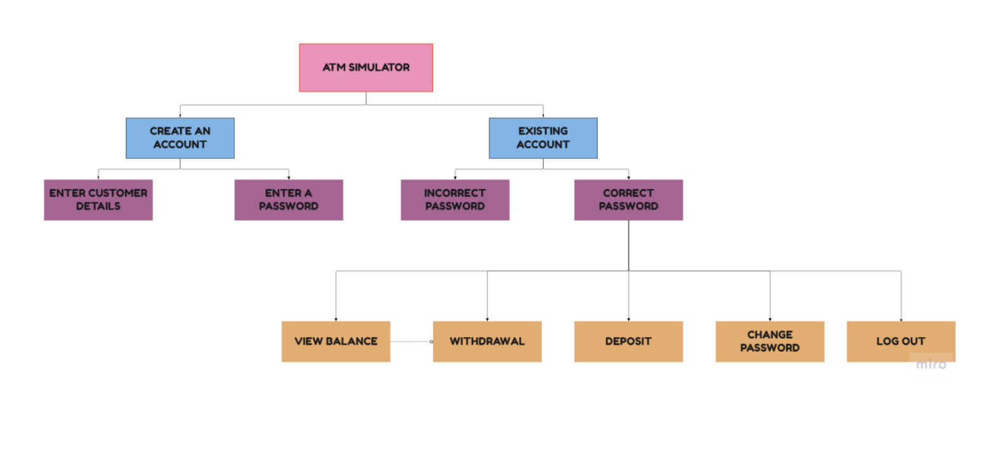

Slide 5
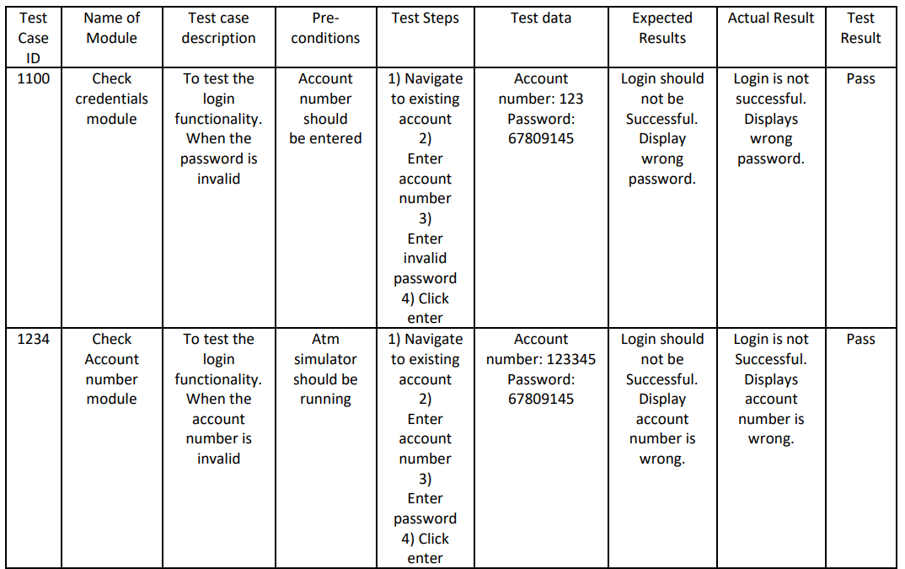
TESTING THE PRODUCT

Slide 6
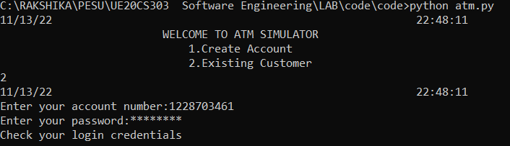

Slide 7
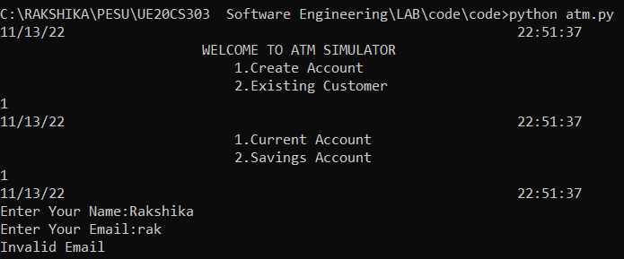

Slide 8
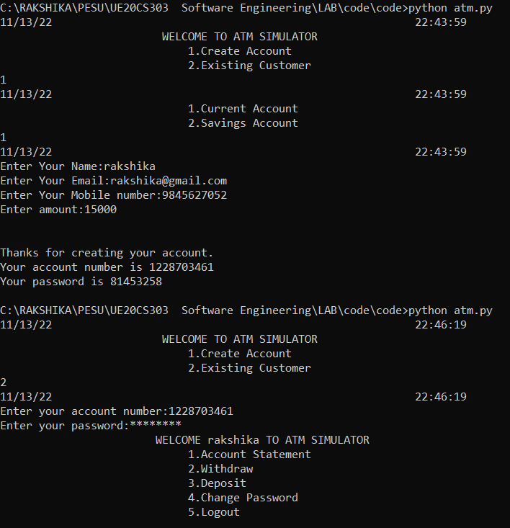
OUTPUTS

Slide 9
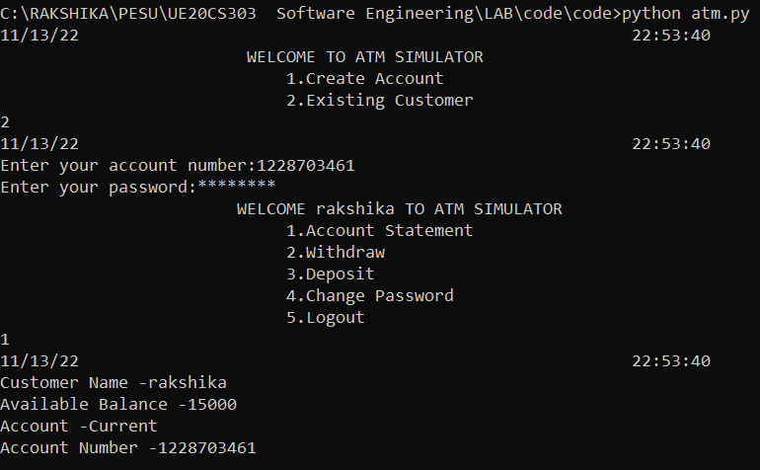

Slide 10
