Slide 1
CBC 2.0 HACKATHON DESIGN SUBMISSION — ROUND 1
DocuSense AI
Intelligent Document Information Extraction & Validation Platform
Problem Statement #3: Automated Document Extraction & Rule Validation
Team Name: CACHE CODE | Target: 18-Hour Working Prototype on CPU Laptop Hardware

Slide 2
CBC 2.0 HACKATHON | DOMAIN: AI & ML
Section A — Problem Definition & Operational Bottlenecks
The Existing Manual Document Problem
• Unstructured Heterogeneity: Organizations process invoices, certificates, and forms with hundreds of non-standard visual layouts.
• High Error Rates: Manual entry yields 3–8% error rates (typos, date format confusion, missing fields).
• Time-Consuming Bottleneck: Operations personnel spend ~10 minutes per document verifying line items and cross-checking data.
• Poor Scan Quality: Low resolution, mobile photo distortions, and noise render primitive OCR systems ineffective.
DocuSense AI Proposed Solution
• Intelligent Automated Processing: End-to-end pipeline covering Upload → Preprocessing → OCR → AI Extraction → Rule Validation → Review.
• Validation-Aware Engine: Instant validation of ISO dates, numeric sanity checks, tax IDs, required fields, and multi-location conflicts.
• Human-in-the-Loop Workflow: Highlights low-confidence scores and validation errors for side-by-side one-click human verification.
• Privacy & Laptop CPU Support: Optimized for lightweight execution without requiring high-cost cloud GPUs.

Slide 3
CBC 2.0 HACKATHON | DOMAIN: AI & ML
Section B — User Roles & End-to-End Journey
User Role | Core Responsibilities | Primary UI View
Document User | Uploads documents, triggers processing jobs, views summary, exports JSON/CSV. | Upload & Ingestion Dashboard
Reviewer / Validator | Inspects low-confidence fields, resolves validation errors & multi-value conflicts. | Side-by-Side Review Canvas
Schema Admin | Defines JSON field schemas, configures validation regex rules, sets thresholds. | Schema & Rule Configurator
End-to-End User Journey (5 Key Stages)
1. Drag & Drop Upload: User drops batch of PDF/PNG files into the dashboard.
2. Automated Ingestion: OpenCV binarizes scan, PaddleOCR parses text layout, system classifies doc type.
3. Rule Validation: Pydantic validator flags invalid formats, missing values, or multi-location value conflicts.
4. Interactive Verification: Reviewer opens side-by-side canvas; SVG overlays highlight bounding boxes on source PDF.
5. Export & Audit Trail: Approved fields saved to SQLite with reviewer timestamp and exported to ERP JSON/CSV.

Slide 4
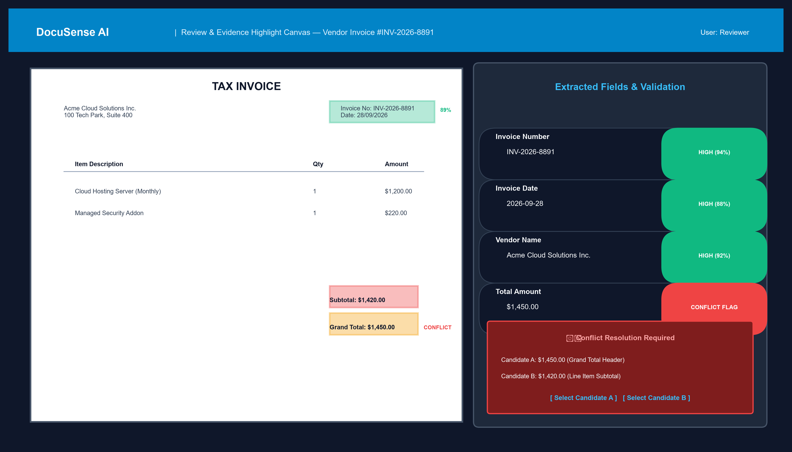
VISUAL INTERFACE & EVIDENCE HIGHLIGHTING
Section C — UI/UX Wireframe & Side-by-Side Canvas

Slide 5
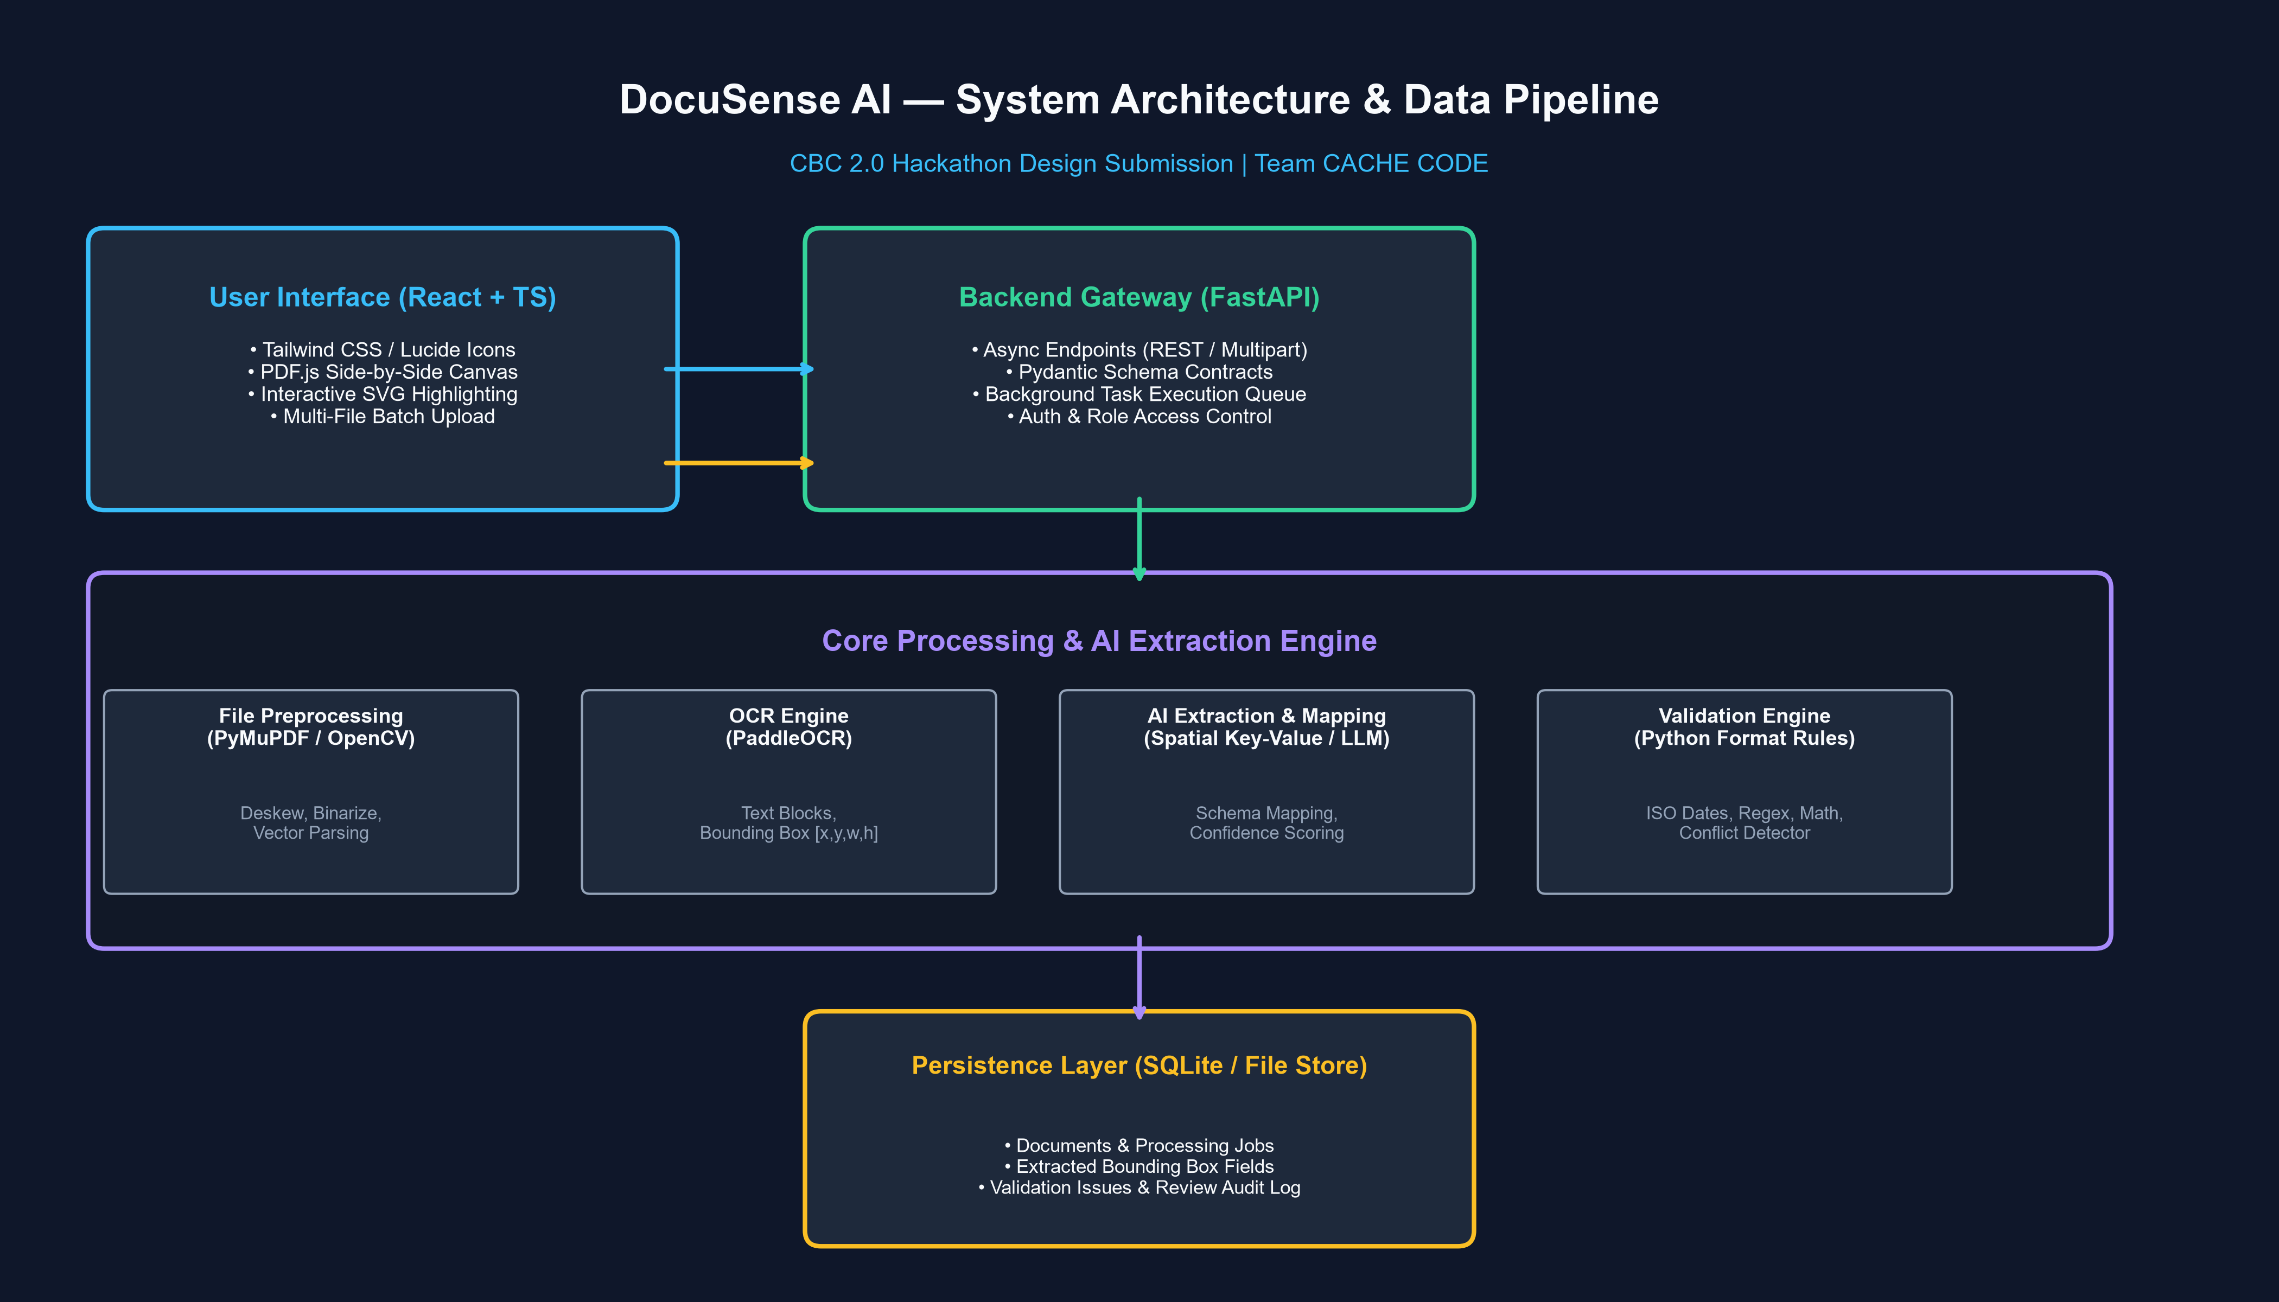
TECHNICAL STACK & COMPONENT RESPONSIBILITIES
Section D — Proposed System Architecture Diagram

Slide 6
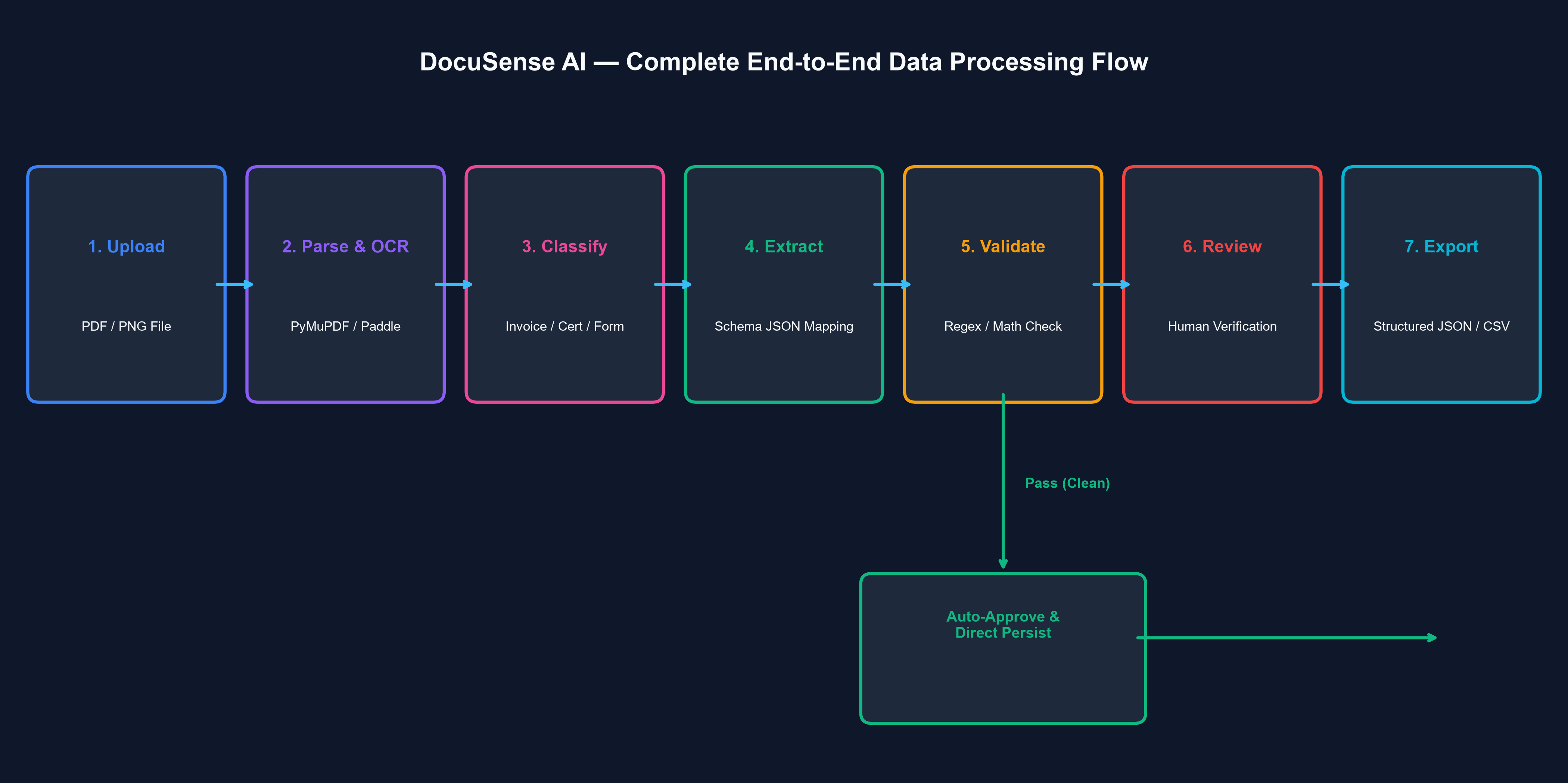
STEP-BY-STEP DATA PROCESSING PIPELINE
Section D (Cont.) — Complete End-to-End Data Processing Flow

Slide 7
CBC 2.0 HACKATHON | DOMAIN: AI & ML
Section E — AI/ML Strategy & Layered Pipeline
Layered AI Extraction Architecture
1. OCR & Layout Analysis (PaddleOCR / PyMuPDF): Parses document geometry into tokens with bounding box coordinates [x, y, w, h] and raw OCR confidence scores.
2. Spatial Anchor Extraction: Locates key text anchors (e.g. 'Invoice Date:', 'Grand Total:') and uses spatial proximity matching (bounding box right/below) to associate values.
3. Zero-Shot LLM Schema Assistance (Optional Cloud API): Converts OCR bounding box tokens into structured JSON fields matching predefined schema definitions when API is accessible.
4. Offline Spatial Heuristic Fallback: If external API is offline/unavailable, automatically runs local regex + spatial proximity heuristics to ensure zero downtime.
5. Confidence Score Calibration Formula: Final Confidence = 0.50*(OCR Confidence) + 0.30*(Spatial Proximity Score) + 0.20*(Validation Rule Signal).

Slide 8
STRUCTURED JSON WITH TRACEABILITY METADATA
Section E (Cont.) — Configurable Schemas & Output JSON
{
"document_id": "doc_9f8b2c1a",
"filename": "vendor_invoice_2026_04.pdf",
"detected_type": "invoice",
"overall_validation_status": "REQUIRES_REVIEW",
"extracted_fields": {
"invoice_number": {
"value": "INV-2026-8891",
"confidence": 0.94,
"validation_status": "VALID",
"evidence": { "page_number": 1, "bbox": [140, 520, 160, 680], "raw_ocr_text": "Invoice No: INV-2026-8891" }
},
"total_amount": {
"value": 1450.00,
"confidence": 0.65,
"validation_status": "CONFLICT_DETECTED",
"validation_message": "Conflicting values found ($1,450.00 vs $1,420.00)",
"conflicting_candidates": [
{ "value": 1450.00, "bbox": [680, 500, 700, 620], "context": "Grand Total: $1,450.00" },
{ "value": 1420.00, "bbox": [520, 500, 540, 620], "context": "Subtotal: $1,420.00" }
]
}
}
}

Slide 9
CBC 2.0 HACKATHON | DOMAIN: AI & ML
Section F — Edge-Case Handling & Mitigation Matrix
Edge Case Scenario | System Detection Method | Automated Pipeline Response | User Experience (UI)
Blurry / Low-Res Scan | OpenCV Laplacian variance < 100.0 | Applies sharpen kernel & contrast fix; flags low confidence | Warning banner: 'Low resolution scan detected'
Missing Required Field | Schema required check fails | Sets status: MISSING; flags doc for review | Red highlight on field with 'Click to Enter'
Invalid Date / Format | Regex / strptime exception | Sets INVALID_FORMAT; retains raw string | Pill alert: 'Unrecognized date format'
Conflicting Multi-Value | Multiple matches with differing values | Stores primary + candidate array with bboxes | Conflict Resolver modal with side-by-side bboxes
Corrupted / Invalid File | PyMuPDF fitz.open() failure | Catches exception; returns HTTP 422 payload | Error card: 'File could not be parsed'

Slide 10
CBC 2.0 HACKATHON | DOMAIN: AI & ML
Section G — Stretch Feature: Evidence-Linked Source Highlighting
Traceable SVG Bounding Box Engine
• Normalized Coordinate Storage: Bounding box pixel values are converted to percentage-based bounding coordinates: [ymin%, xmin%, ymax%, xmax%].
• Interactive Canvas Synchronization: Clicking an extracted field in the right panel auto-scrolls the left PDF canvas and triggers a pulsating SVG outline on the exact source text.
• Color-Coded Status Overlays: Green SVG rectangles represent Valid fields; Red represents Format Errors; Amber represents Conflicting values.
• Fallback Text Anchor Matching: If precise bounding box coordinates are unavailable (e.g. digital PDFs without layout bounding box metadata), the UI highlights the surrounding text anchor snippet inside a preview box.

Slide 11
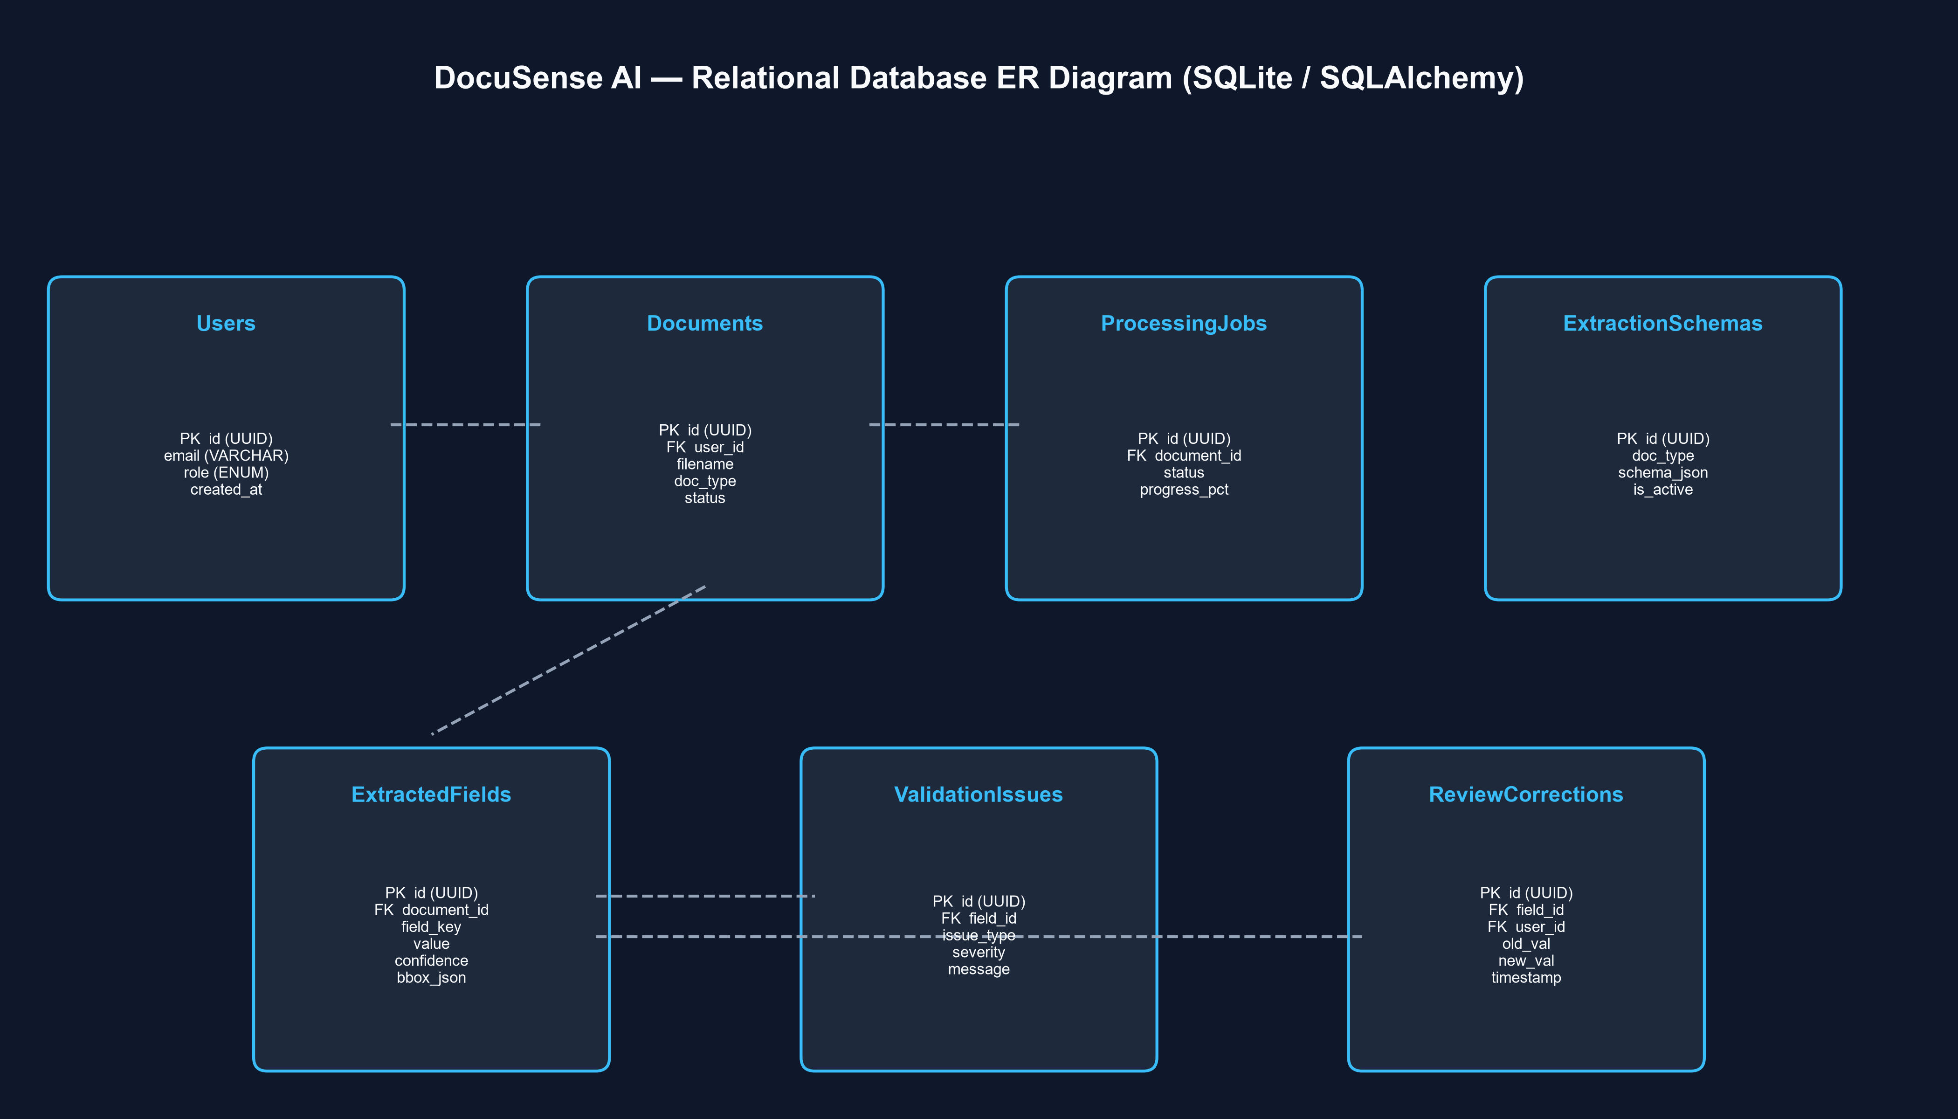
RELATIONAL SCHEMA (SQLITE / SQLALCHEMY)
Section H — Database Design & Relational ER Diagram

Slide 12
CBC 2.0 HACKATHON | DOMAIN: AI & ML
Section J & K — Privacy, Security & Testing Framework
Privacy, Security & Async Architecture
• Async Task Queue: FastAPI BackgroundTasks queue decouples file ingestion from UI gateway.
• PII Encryption: Names, emails, and phone numbers encrypted at rest via AES-256.
• Zero Retention Policy: External API calls enforce zero-data-retention headers.
• Local Offline Mode: 100% offline PaddleOCR + regex mode for sensitive documents.
• Production Path: Upgrade from SQLite to PostgreSQL + S3 + Redis Celery workers.
Testing & Ground-Truth Evaluation
• Evaluation Metrics: Field extraction precision/recall against manually annotated ground-truth dataset (30 documents).
• Latency Target: < 12 seconds per multi-page document on standard laptop CPUs.
• Test Matrix Coverage: Includes clean PDFs, blurry phone photos, missing values, invalid date formats, and conflicting line items.
• Human Correction Rate: Measures time saved by human reviewer during side-by-side verification.

Slide 13
CBC 2.0 HACKATHON | DOMAIN: AI & ML
Section L — 18-Hour Execution Roadmap & Team Responsibilities
Team Member | Core Role | Primary Technical Ownership
Member 1 | AI / OCR Lead | PyMuPDF parsing, PaddleOCR engine, spatial key-value & LLM extraction pipeline.
Member 2 | Backend & DB Lead | FastAPI REST endpoints, SQLite data models, validation engine & job queue.
Member 3 | Frontend Lead | React + TS UI, dashboard, side-by-side SVG overlay canvas & review form.
Member 4 | Integration & QA Lead | End-to-end integration, edge-case test dataset, JSON/CSV exports & pitch demo script.
18-Hour Milestone Timetable
Hours 0-1: Setup & Interface Agreements — Initialize Git, FastAPI scaffold, OpenAPI spec, React Vite project.
Hours 1-5: Parallel Component Build — M1 OCR pipeline, M2 FastAPI & SQLite DB, M3 React canvas UI, M4 test corpus.
Hours 5-9: First Pipeline Integration — Connect upload API to OCR & render extracted fields on UI.
Hours 9-13: Validation & Review Workflow — Integrate format validators, conflict flagger & review form.
Hours 13-15: High-Value Differentiator — Implement SVG evidence bounding box highlighting & canvas auto-scroll.
Hours 15-18: End-to-End Testing & Rehearsal — Run full test matrix, verify exports, freeze code & rehearse pitch.

Slide 14
HACKATHON PITCH & COMPETITIVE ADVANTAGE
Section M & N — Demo Scenario & Unique Value Proposition
3-Minute Live Demo Walkthrough
1. Batch Upload (0:00-0:35): Upload clean invoice, missing date cert & conflicting invoice.
2. Automated Flagging (0:35-1:15): Show dashboard auto-flagging missing date and conflicting total.
3. Evidence Highlighting (1:15-2:05): Click conflicting total; PDF auto-scrolls to highlighted bboxes ($1,450 vs $1,420).
4. One-Click Override (2:05-2:40): Select correct total, fill missing date, click Approve.
5. Export (2:40-3:00): Download clean structured JSON & CSV export.
Unique Value Proposition (UVP)
• Validation-First Architecture: Goes beyond raw OCR text by enforcing automated business rules and format validation.
• Transparent Evidence Highlighting: Eliminates black-box AI errors by linking every value to SVG source bounding boxes.
• Multi-Location Conflict Resolver: Intelligently flags and presents competing candidate values instead of silent overwrites.
• Laptop CPU Optimization: Runs efficiently on standard developer laptops without expensive GPU infrastructure.

