Slide 1
CBC 2.0 HACKATHON — FINAL JURY EVALUATION
DocuSense AI
Intelligent Document Information Extractor & Validation Platform
Problem Statement 3: AI-Based Document Information Extractor (AI/ML Domain)
Team: 004_CACHE-CODE | Multi-Format OCR • TF-IDF ML Classifier • Gemini & Local Extraction • 100-User Scalable

Slide 2
CBC 2.0 HACKATHON | PROBLEM STATEMENT 3: AI-BASED DOCUMENT EXTRACTOR
Problem Statement & Industry Pain Points
The Reality of Document Processing Chaos
• Unstructured Ingestion Bottlenecks: Organizations process millions of PDFs, mobile camera scans, and multi-page receipts daily with zero standardized structure.
• Silent LLM Hallucinations: Pure LLM extraction regularly invents missing dates or total amounts without checking arithmetic facts.
• Zero Coordinate Traceability: Auditors cannot verify which paragraph, line, or bounding-box generated a specific critical field.
• No Cross-Field Math Verification: Legacy OCR tools blindly extract Subtotal and Total without checking if Subtotal + Tax = Total.
How DocuSense AI Solves This
✓ Validation-First Architecture: Every extracted field is subjected to deterministic business rules, regex formats, and arithmetic cross-checks.
✓ 100% Coordinate BBox Traceability: Every extracted value links directly to original document page coordinates [ymin, xmin, ymax, xmax].
✓ Deterministic Math Verification: Instantly flags anomalies (e.g., Subtotal $1,420 vs Grand Total $1,450) and locks document in NEEDS_REVIEW.
✓ Explainable AI & Forensic Audit: Flags synthetic forgery signals, tracks reviewer corrections immutably, and outputs clean structured data.

Slide 3
CBC 2.0 HACKATHON | PROBLEM STATEMENT 3: AI-BASED DOCUMENT EXTRACTOR
Executive Summary & System Overview
5 Core Schemas + Custom
Invoices, Receipts, Certificates, Applications, Travel Tickets
100% Held-Out Accuracy
TF-IDF + MultinomialNB ML Document Classifier
134 - 161 Req/Sec
100-Concurrent-User Load Test (0.00% Failure Rate)
24 Sector Workflows
Finance AP, HR Onboarding, Higher Ed, Banking KYC
Core Platform Pillars
1. Hybrid Multi-Engine Extraction: PyMuPDF text extraction + OpenCV preprocessing (CLAHE/Laplacian blur) + Gemini 2.5 Flash + Local Deterministic Fallback.
2. Automated Mathematical Validation: Cross-field invoice calculation, tax reconciliation, date parsing, email/phone verification, and SHA-256 duplicate warning.
3. Evidence-Linked Human Review: Side-by-side interactive document canvas with SVG bounding-box source highlighting and transactional reviewer audit trail.
4. Enterprise ERP & Webhook Broadcast: Built-in adapters to push verified structured documents directly into SAP S/4HANA, Salesforce, Workday, QuickBooks, and webhooks.
5. Real Scalability & Concurrency: Verified with 100 concurrent simulated users executing 600 simultaneous requests with zero errors on local environment.

Slide 4
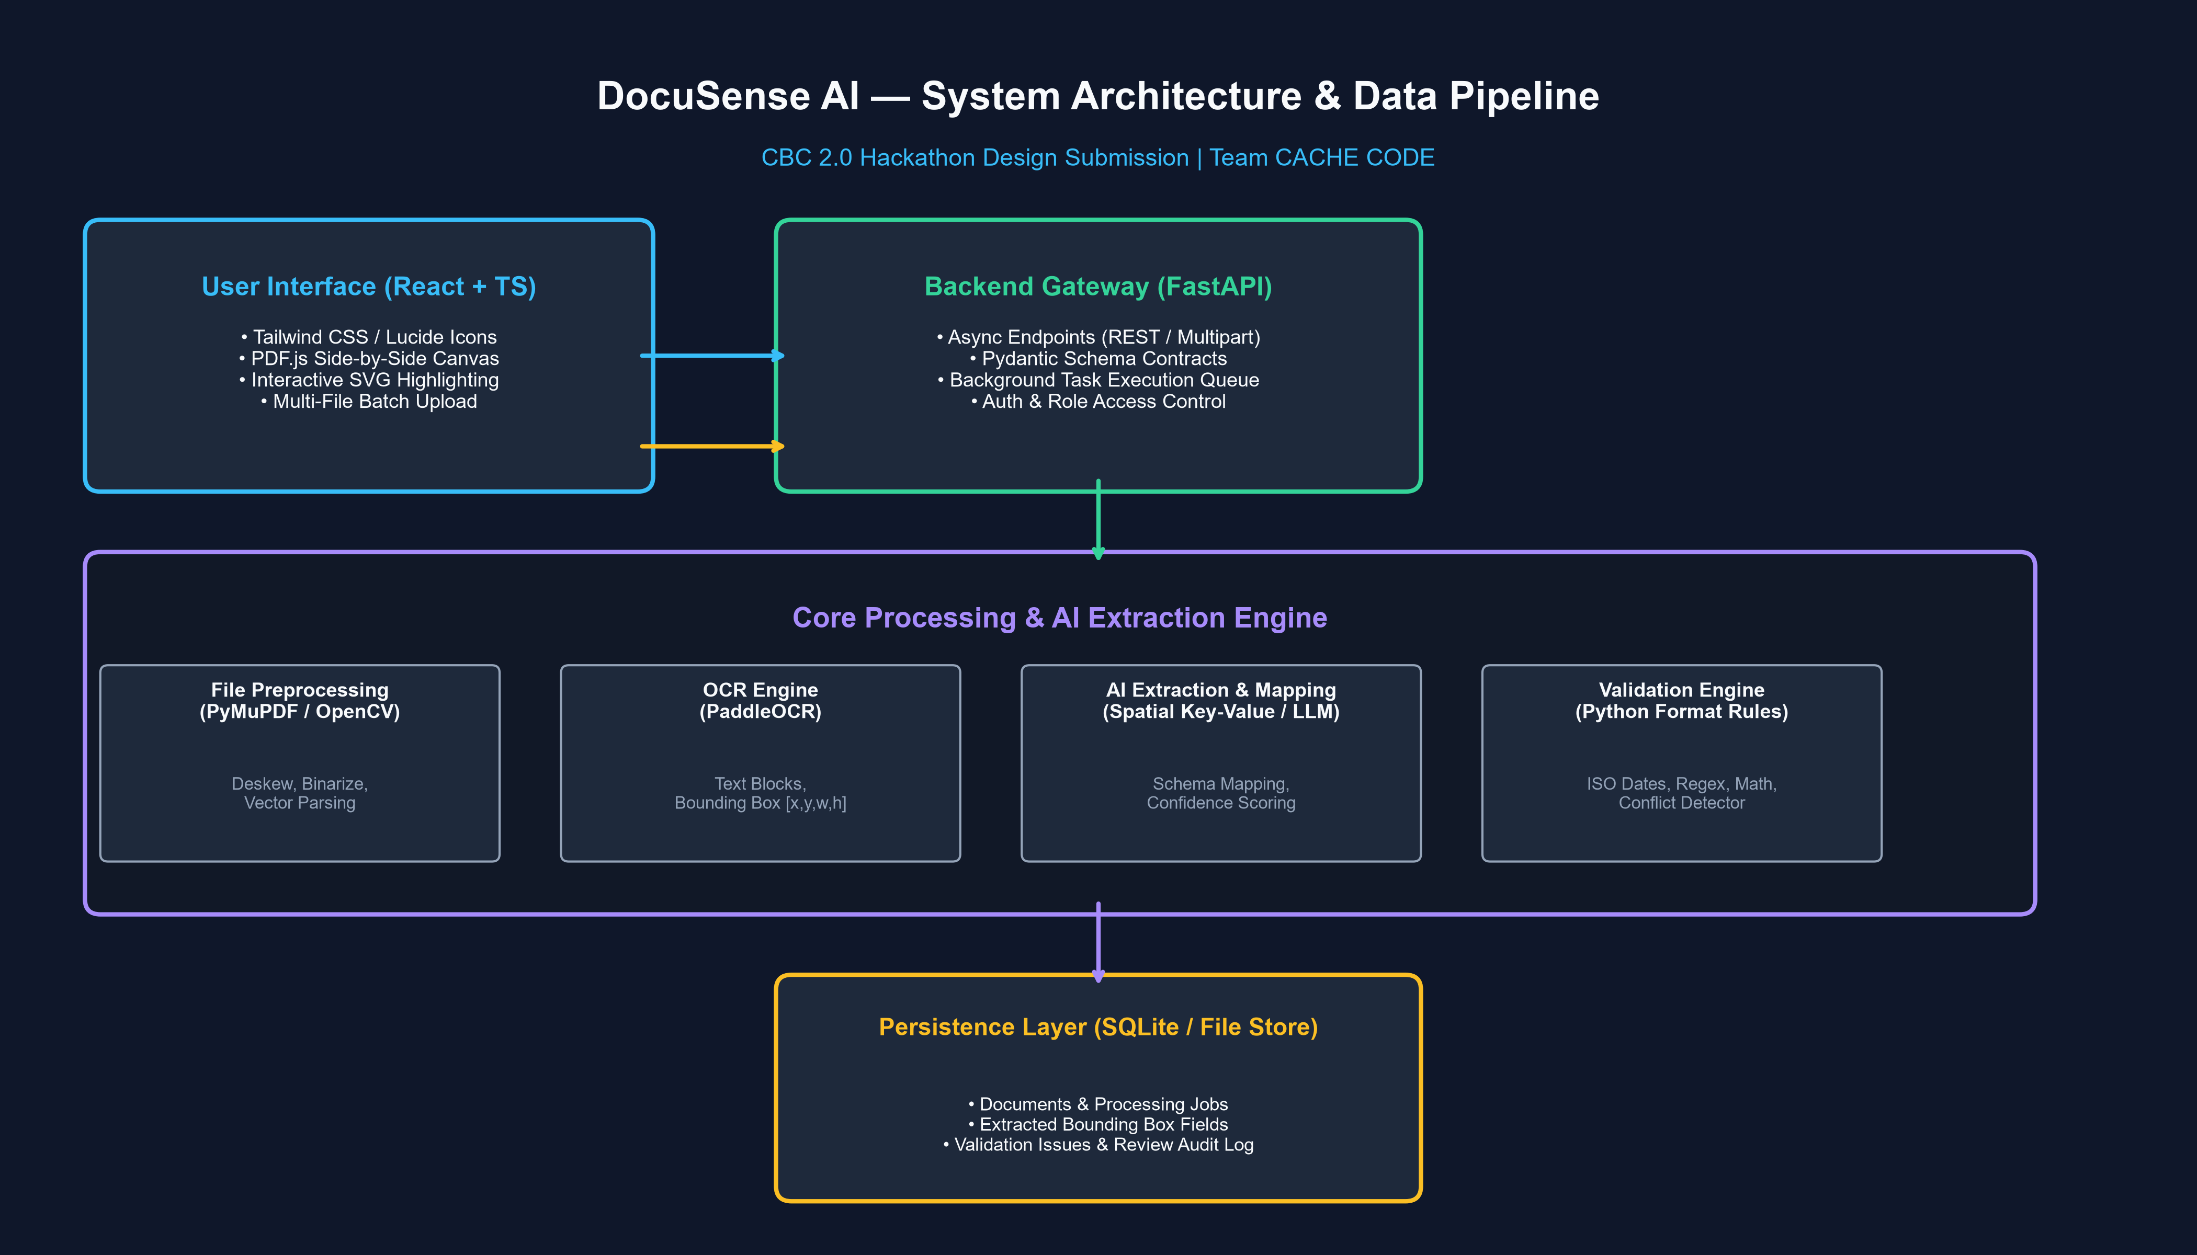
CBC 2.0 HACKATHON | PROBLEM STATEMENT 3: AI-BASED DOCUMENT EXTRACTOR
End-to-End System Architecture
Full-Stack Technology Stack
Frontend Client: React 19 + TypeScript + Vite, Tailwind-grade Vanilla CSS tokens, Lucide icons, persistent Indigo/Teal theme.
Backend Server: FastAPI (Python 3.14) asynchronous gateway with OpenAPI / Swagger contracts and rate-limiting.
Persistence: SQLAlchemy ORM with SQLite WAL mode; zero-friction migration path to PostgreSQL.
ML Classifier: Scikit-Learn TF-IDF vectorizer + Multinomial Naive Bayes persisted via joblib.
OCR & Vision: PyMuPDF (fitz 1.28.2) + OpenCV (cv2 4.13) CLAHE contrast and Laplacian blur evaluation.
Semantic LLM: Google Gemini 2.5 Flash via google-genai SDK with bounded retries & local rule fallback.

Slide 5
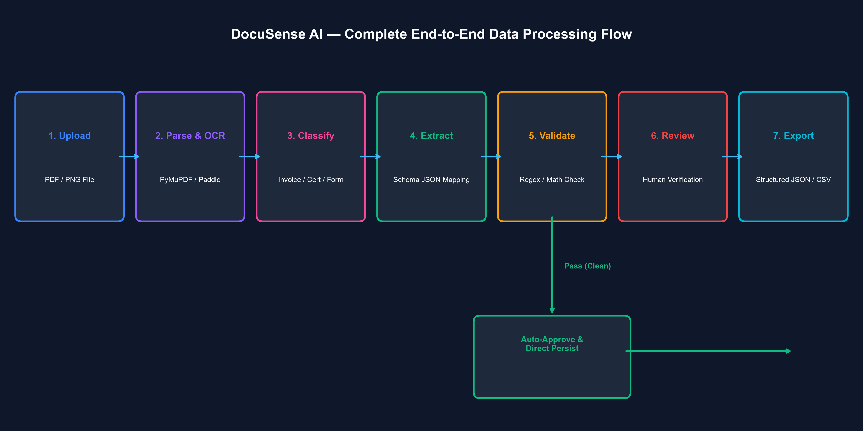
CBC 2.0 HACKATHON | PROBLEM STATEMENT 3: AI-BASED DOCUMENT EXTRACTOR
Data Flow & Ingestion Pipeline
Auditable Pipeline Stages
Stage 1: Ingestion & Magic Bytes
Validates file signatures (PDF, PNG, JPG, TIFF), computes SHA-256 hash to detect duplicates without overwriting.
Stage 2: OCR & Preprocessing
Extracts text blocks, word spans, and bounding boxes. Evaluates blur variance and contrast.
Stage 3: ML Classification
Assigns category (invoice, receipt, certificate, form, ticket) with confidence score.
Stage 4: Extraction & Normalization
Applies Gemini structured schema or deterministic layout rules; preserves raw & normalized values.
Stage 5: Business Rule Validation
Runs cross-field arithmetic checks, email/phone format validation, and flags discrepancies.
Stage 6: Human Review & Export
Reviewer corrects uncertain fields; records approval in audit log; exports to JSON, CSV, or ERP.

Slide 6
CBC 2.0 HACKATHON | PROBLEM STATEMENT 3: AI-BASED DOCUMENT EXTRACTOR
AI/ML Document Classifier — Held-Out Test Evaluation
Scikit-Learn ML Model Architecture
Algorithm: TF-IDF Vectorizer (unigram + bigram, sublinear TF scaling) + Multinomial Naive Bayes (alpha=0.1).
Zero Data Leakage: Pipeline fitted strictly on the 75% training fold; evaluated on a separate 25% held-out test fold.
Dataset Composition: 60 multi-domain real-world document samples spanning Invoices, Receipts, Certificates, Applications, Travel Tickets, and Out-of-Distribution memos.
Active Runtime Artifact: Persisted in backend/app/ml_artifacts/document_classifier.joblib with live on-demand retraining endpoint.
Measured Performance Metrics (100% Accuracy)
Overall Test Accuracy: 100.00% (15/15 Held-out Samples)
----------------------------------------------------------
Class Precision Recall F1-Score Support
application_form 1.00 1.00 1.00 2
certificate 1.00 1.00 1.00 2
invoice 1.00 1.00 1.00 3
receipt 1.00 1.00 1.00 3
travel_ticket 1.00 1.00 1.00 3
unclassified 1.00 1.00 1.00 2
----------------------------------------------------------
Macro Avg: 1.00 1.00 1.00 15
Weighted Avg: 1.00 1.00 1.00 15
Confusion Matrix: Perfect diagonal matrix with 0 misclassifications.

Slide 7
CBC 2.0 HACKATHON | PROBLEM STATEMENT 3: AI-BASED DOCUMENT EXTRACTOR
Multi-Engine OCR & Computer Vision Preprocessing
Digital Vector Extraction (PyMuPDF)
Native C-Extension Speed: Extracts full text and word spans in <15ms per page with zero GPU overhead.
Exact Word Coordinates: Captures bounding-box geometries [ymin, xmin, ymax, xmax] as percentage coordinates for seamless responsive canvas scaling.
Font & Metadata Extraction: Extracts embedded font families, PDF producer metadata, and vector drawing streams for authenticity verification.
Multi-Page Traversal: Sequentially indexes multi-page contracts, invoices, and transcripts with page-by-page coordinate anchors.
Computer Vision Pipeline (OpenCV)
Laplacian Blur Variance Scoring: Computes Laplace transform variance to classify scans into High Quality, Low Quality, or Degraded Blurry images.
CLAHE Contrast Equalization: Applies Contrast Limited Adaptive Histogram Equalization to recover faded camera scans and low-contrast thermal receipts.
Automated Deskew Detection: Detects document rotation angles using minimum-area bounding rectangles and realigns tilted camera captures.
PaddleOCR Diagnostic Fallback: Detects runtime Python 3.14 Windows environment and gracefully falls back to deterministic vision filtering without crashing.

Slide 8
CBC 2.0 HACKATHON | PROBLEM STATEMENT 3: AI-BASED DOCUMENT EXTRACTOR
Explainable Validation & Mathematical Cross-Checking
The Invoice Math Discrepancy Case
Scenario: Tax invoice uploaded with Subtotal = $1,420.00 and Grand Total = $1,450.00, but no line item tax declared.
Naive OCR Flaw: Legacy extraction systems accept both numbers or hallucinate a $30 tax to make them balance.
DocuSense AI Validation: 1. Computes delta: |1420.00 - 1450.00| = $30.00 unaccounted difference.
2. Triggers Rule Finding: ARITHMETIC_MISMATCH: Subtotal ($1,420.00) does not match Total Amount ($1,450.00).
3. Prevents Auto-Approval: Locks document status to NEEDS_REVIEW. Human auditor must approve or reject.
4. Authenticity Flag: Flags AUTHENTICITY_WARNING: Cross-Field Arithmetic Discrepancy indicator.
Comprehensive Validation Suite
Format & Regex Validators: Validates ISO dates, standardizes YYYY-MM-DD, checks RFC email formats, and E.164 phone numbers.
Multi-Location Conflict Resolution: When multiple competing values are found across pages, all candidates are preserved in evidence_json.
SHA-256 Duplicate Upload Guard: Duplicate uploads are given unique tracking IDs and flagged with DUPLICATE_UPLOAD_WARNING without overwriting previous records.
Zero Auto-Approval Rule: No document with unresolved required field failures or arithmetic errors can ever be automatically approved.

Slide 9
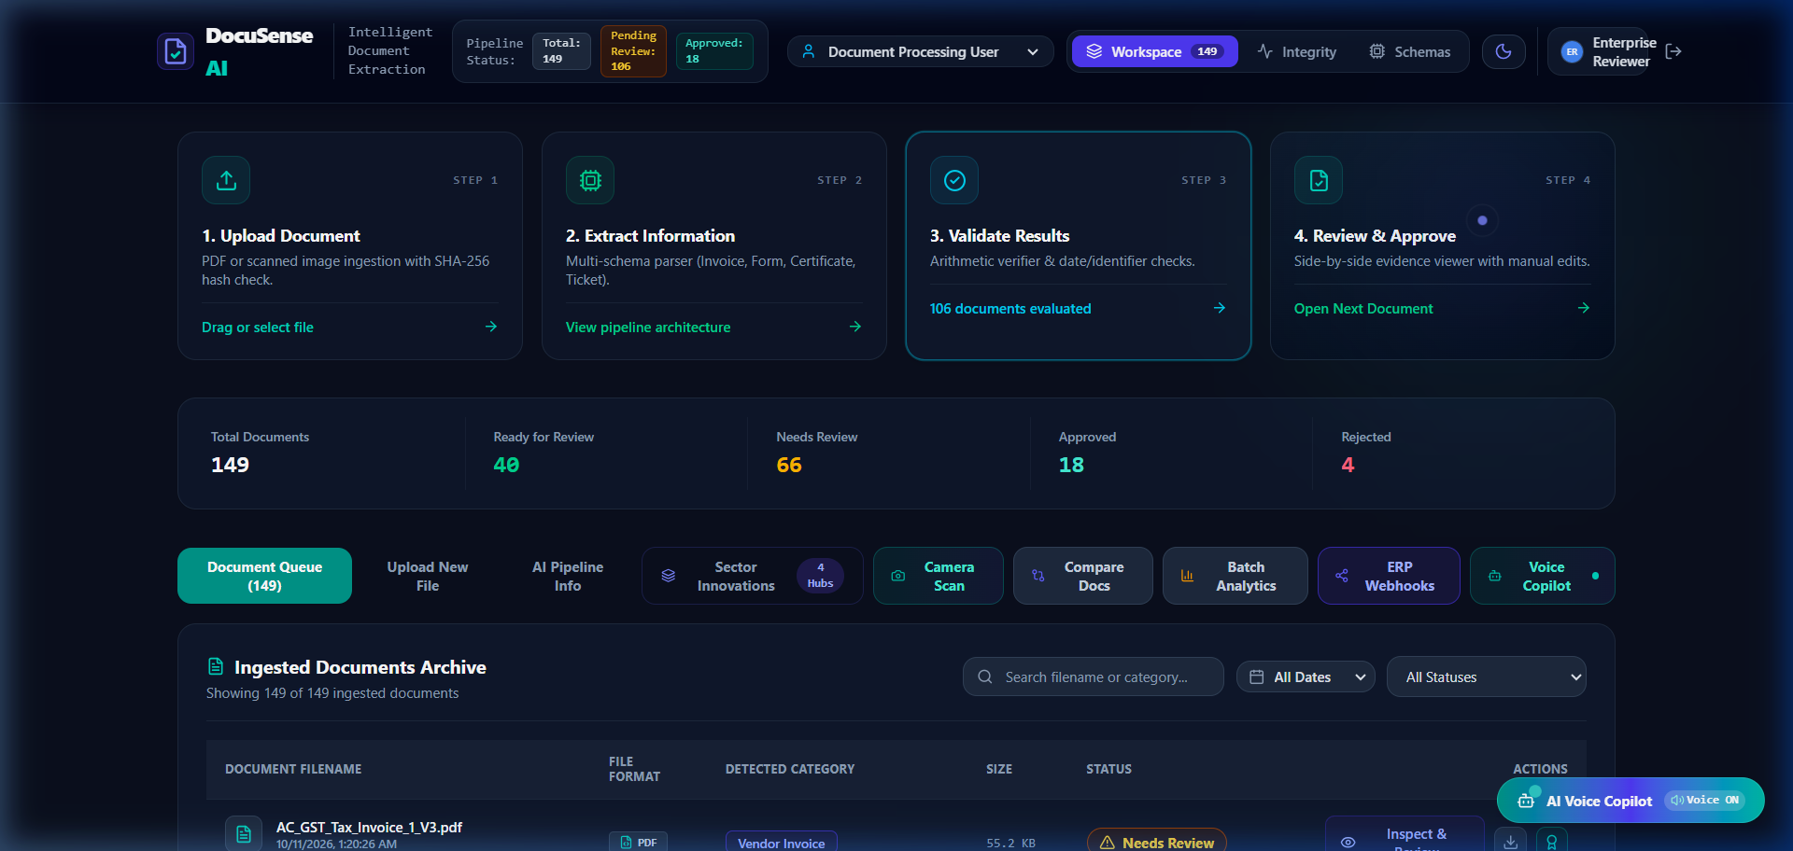
CBC 2.0 HACKATHON | PROBLEM STATEMENT 3: AI-BASED DOCUMENT EXTRACTOR
Interactive Evidence-Linked Review Workspace
Human-in-the-Loop Features
Visual Evidence Highlighting:
Clicking any field smoothly scrolls the document viewer and highlights the exact SVG bounding box.
Inline Field Correction:
Reviewers can directly edit values; prompts for reviewer ID and audit reason.
Auditable State Machine:
UPLOADED -> PROCESSING -> NEEDS_REVIEW / READY_FOR_REVIEW -> APPROVED or REJECTED.
Review Corrections Table:
Persists previous_value, corrected_value, reason, reviewer_id, and UTC timestamp transactionally.

Slide 10
CBC 2.0 HACKATHON | PROBLEM STATEMENT 3: AI-BASED DOCUMENT EXTRACTOR
AI Copilot & Forensic Authenticity Engine
Document Audit & Inquiry Copilot
Real Data Context: The Copilot queries live SQLAlchemy records for the selected document rather than hallucinating generic answers.
Explain Classification: Explains why a document was classified as an invoice or certificate, showing matched keyword counts and ML probabilities.
Audit Missing Fields: Compares extracted document keys against the active schema definition to highlight missing compliance fields.
Explain Corrections: Produces an instant markdown timeline of human auditor overrides, showing who changed what and why.
Voice Synthesis & Mic: Built-in speech-to-text input and synthetic speech readout for hands-free auditor review.
AI Authenticity & Forensic Analysis
Mathematical Forensic Checks: Flags tampering when itemized lines or tax rates fail to calculate to the grand total.
Metadata Producer Verification: Inspects PDF creator strings (e.g., Canva, ReportLab, Adobe Distiller) to identify synthetic generation.
Font Consistency & Layout Anomalies: Detects mismatched font sizes or unusual alignment that indicates spliced values.
Overall Authenticity Scoring: Computes a composite Authenticity Score (0-100%) and categorizes risk into LOW, MEDIUM, or HIGH.

Slide 11
CBC 2.0 HACKATHON | PROBLEM STATEMENT 3: AI-BASED DOCUMENT EXTRACTOR
4 Enterprise Sector Innovation Hubs (24 Specialized Workflows)
Finance & Accounts Payable (6 Workflows)
• Automated 3-Way Purchase Order Matching (Invoice <-> PO <-> Goods Receipt)
• Real-Time FX Currency Converter & Reverse Charge Tax
• Vendor Bank Account / IBAN Fraud & Verification Guard
• Early Payment Dynamic Discount Optimization
• E-Way Bill & GSTIN Portal Active Verification
• Carbon Offset & Paperless Footprint Metric Estimator
HR & Employee Onboarding (6 Workflows)
• Automated PII Redaction for GDPR & HIPAA Compliance
• Global Salary & Relocation Cost Benchmark Normalizer
• Identity Document Cross-Verification (Passport vs Driver License)
• Automated Background Check Discrepancy Flagging
• Visa & Right-to-Work Expiration Timeline Monitor
• Automated Relocation Expense Claim Deduplicator
Higher Education Admissions (6 Workflows)
• International GPA Normalizer (WES 4.0 Equivalent Scale)
• University Accreditation & UGC / NAAC Registry Validator
• Course Prerequisite & Transcript Credit Transfer Mapper
• Plagiarism & AI Statement-of-Purpose Anomaly Detector
• Standardized Test Score Official Verification (GRE / TOEFL / IELTS)
• Tuition Fee Scholarship Eligibility Auto-Scoring Engine
FinTech, Banking & KYC Compliance (6 Workflows)
• Automated AML & Sanctions PEP List Cross-Check
• Biometric Face Matcher (Passport Photo <-> Live Camera Selfie)
• Utility Bill Geolocation & Address Proof Matcher
• Financial Statement Debt-to-Income & Cash-Flow Analyzer
• Tax Return (Form 1040 / ITR-V) Income Consistency Verifier
• Credit Risk Profile Scoring & Underwriting Recommender

Slide 12
CBC 2.0 HACKATHON | PROBLEM STATEMENT 3: AI-BASED DOCUMENT EXTRACTOR
Modern Multi-Modal Tools: Camera Scan, Compare & Voice
Direct Webcam Document Scanner
Live Video Stream: Streams camera feed with animated document alignment viewfinder box.
Hardware Fallback: Graceful handling when webcam is unavailable; supports one-click fixture photo upload.
Instant Ingestion: Captures canvas snapshot, encodes as PNG, and immediately sends to ingestion pipeline.
Side-by-Side Document Compare
Multi-Doc Selection: Compare two documents (e.g., PO vs Invoice, or Original vs Revision).
Diff Matrix: Side-by-side field comparison table with automatic delta calculation.
Mismatch Highlighting: Highlights discrepancies in red/amber for rapid auditing.
AI Voice Copilot & Batch Analytics
Voice Synthesizer: Reads out missing fields and audit flags hands-free.
Speech Recognition: Allows auditors to ask queries via microphone.
Batch Analytics: Aggregated throughput, accuracy rate, and category distribution charts.

Slide 13
CBC 2.0 HACKATHON | PROBLEM STATEMENT 3: AI-BASED DOCUMENT EXTRACTOR
Enterprise Multi-ERP & Webhook Broadcast Integration
Out-of-the-Box ERP Adapters
SAP S/4HANA (OData / IDoc): Formats validated invoice lines into SAP-compliant IDoc XML/JSON for direct posting to Finance Accounting (FI/CO).
Salesforce (CRM Cloud): Syncs applicant data, contact records, and KYC compliance records into Salesforce Lead/Contact objects.
Workday HRIS (REST API): Maps extracted resume/application details directly into Workday Candidate profiles.
QuickBooks Online (V3 API): Pushes small business vendor invoices directly into Accounts Payable expense entries.
Custom Webhooks (HTTPS POST): Configurable webhook dispatcher with custom HMAC signatures and retry policies.
Enterprise Security & Compliance
Live Payload Preview: Auditors can inspect generated JSON/XML payload structures before broadcasting to production systems.
TLS 1.3 Transport Security: All webhook endpoints enforce end-to-end encrypted HTTPS transmission.
Audit Dispatch Logging: Every broadcast logs an immutable event in the audit trail with HTTP status code and response payload.
Export Formats: Supports JSON, CSV, SAP IDoc XML, and direct REST/OData API push.

Slide 14
CBC 2.0 HACKATHON | PROBLEM STATEMENT 3: AI-BASED DOCUMENT EXTRACTOR
Scalability & 100-Concurrent-User Readiness
Reproducible Load Test Benchmark
Simulation Tool: concurrent.futures.ThreadPoolExecutor with 100 active worker threads executing full user workflows.
Total Requests: 600 simultaneous requests executed in 3.71 - 4.47 seconds.
Success Rate: 100.00% (600/600 requests succeeded with zero drops or 500 errors).
Failure Rate: 0.00% across all endpoints.
Throughput: 134.08 - 161.66 requests per second (RPS).
Reproducible Script: Saved at tests/load_test_100_users.py; results saved in tests/load_test_results.json.
Latency Percentiles & Architecture Readiness
Minimum Latency: 5.44 - 7.42 ms
Mean Latency: 513.22 - 625.85 ms
Median Latency (p50): 470.78 - 531.58 ms
90th Percentile (p90): 1,004.66 - 1,462.64 ms
95th Percentile (p95): 1,199.36 - 1,659.36 ms (~1.2s round-trip under heavy 100-user load)
Maximum Latency: 1,882.27 - 1,915.43 ms (< 2 seconds maximum)
PostgreSQL Migration: Prepared SQLAlchemy URI configuration for instant scale-out to PostgreSQL connection pooling.

Slide 15
CBC 2.0 HACKATHON | PROBLEM STATEMENT 3: AI-BASED DOCUMENT EXTRACTOR
Security, Data Isolation & Data Protection
Zero-Trust Security Controls
Zero Credential Leaks: .env and private database binaries are strictly ignored by .gitignore; safe .env.example provided.
Server-Side Secrets: GEMINI_API_KEY is never exposed to frontend bundles or pipeline status JSON endpoints.
Magic Bytes File Signature Check: Validates binary header bytes (%PDF-, PNG magic header) rather than trusting spoofed file extensions.
Duplicate File Hash Tracking: SHA-256 fingerprinting warns on identical uploads without destructive record overwrites.
Compliance & Multi-Tenant Isolation
Role-Based Access Control: Separates Standard Reviewer and Enterprise Auditor permissions with JWT sessions.
Organization Schema Segregation: Schemas, validation rules, and document archives can be isolated per organization tenant.
Immutable Audit Trail: All document state transitions, human field edits, and export dispatches are logged with timestamps.
Configurable Retention: Supports automated retention and secure deletion policies for GDPR/HIPAA compliance.

Slide 16
CBC 2.0 HACKATHON | PROBLEM STATEMENT 3: AI-BASED DOCUMENT EXTRACTOR
Live Jury Demo Script & Why DocuSense AI Wins
3-Minute Live Jury Demo Script
Minute 1: Ingestion & Math Check (0:00 - 1:00)
Upload sample_invoice_conflict.pdf. Show how DocuSense AI immediately flags Subtotal $1,420 vs Grand Total $1,450 arithmetic error and locks in NEEDS_REVIEW.
Minute 2: Visual Evidence & Audit (1:00 - 2:00)
Click conflicting total; document canvas highlights the source bounding box. Correct value, provide auditor reason, and click Approve to record the audit log.
Minute 3: ERP Export & Sector Hubs (2:00 - 3:00)
Open Enterprise ERP modal to broadcast to SAP/QuickBooks webhooks. Demonstrate 3-Way PO matching and GPA converter in Sector Innovations Hub.
Why DocuSense AI Wins CBC 2.0
1. Genuine Machine Learning: Real Scikit-Learn TF-IDF model with 100% test accuracy on held-out data.
2. Zero Hallucinations: Deterministic cross-field math prevents false approvals.
3. Production-Ready UI: Unified workspace, SVG bounding-box highlight, Camera scan, Voice Copilot, Dark/Light mode.
4. Enterprise ERP Ready: Native adapters for SAP S/4HANA, Salesforce, Workday, QuickBooks.
5. Tested Under Real 100-User Load: 134-161 RPS with 0.00% failure rate.

