Slide 1
Data Analyst Internship Capstone Portfolio
Bathini Shravya
End‑to‑End Data Analytics Portfolio
Data Cleaning • Analysis • Visualization • Dashboard Insights

Slide 2
Agenda
1. About Me
2. Internship Overview
3. Tools & Technologies
4. Data Analysis Workflow
5. Project Tasks Overview
6. Key Insights
7. Skills & Learnings
8. Future Goals

Slide 3
About Me
Aspiring Data Analyst passionate about transforming raw data into meaningful insights.
Areas of Interest:
• Data Analytics
• Business Intelligence
• Data Visualization
• Dashboard Development

Slide 4
Internship Overview
This internship provided hands‑on experience with real‑world datasets.
Main activities:
• Data cleaning
• Exploratory data analysis
• Visualization
• Dashboard development
• Business insights generation

Slide 5
Tools & Technologies
Tools used during the internship:
• Python
• Pandas
• Excel
• Google Looker Studio
• GitHub
• Data Visualization Libraries

Slide 6
Data Analysis Workflow
Typical workflow used in the projects:
1. Data Collection
2. Data Cleaning
3. Exploratory Data Analysis
4. Visualization
5. Dashboard Development
6. Insight Generation

Slide 7
Dataset Overview
Dataset contained structured sales/business data used for analysis.
Example attributes:
• Sales
• Profit
• Product Category
• Region
• Customer Segments

Slide 8
Task 1 – Data Cleaning
Objective:
Prepare raw data for analysis.
Steps:
• Handle missing values
• Remove duplicate records
• Standardize formats
• Validate dataset consistency

Slide 9
Task 1 – Cleaning Results
Outcome of cleaning process:
• Structured dataset ready for analysis
• Improved data quality
• Reduced inconsistencies

Slide 10
Task 2 – Exploratory Data Analysis
Goal:
Understand patterns and trends in the dataset.
Performed:
• Distribution analysis
• Category comparisons
• Trend identification

Slide 11
Task 2 – Visualization Techniques
Charts used to analyze data:
• Bar Charts
• Line Charts
• Distribution Graphs
• Trend Analysis Visuals

Slide 12
Task 3 – Dashboard Development
Built an interactive dashboard to display business metrics.
Dashboard highlights:
• Sales Overview
• Regional Sales Performance
• Product Category Analysis
• Profit Metrics

Slide 13
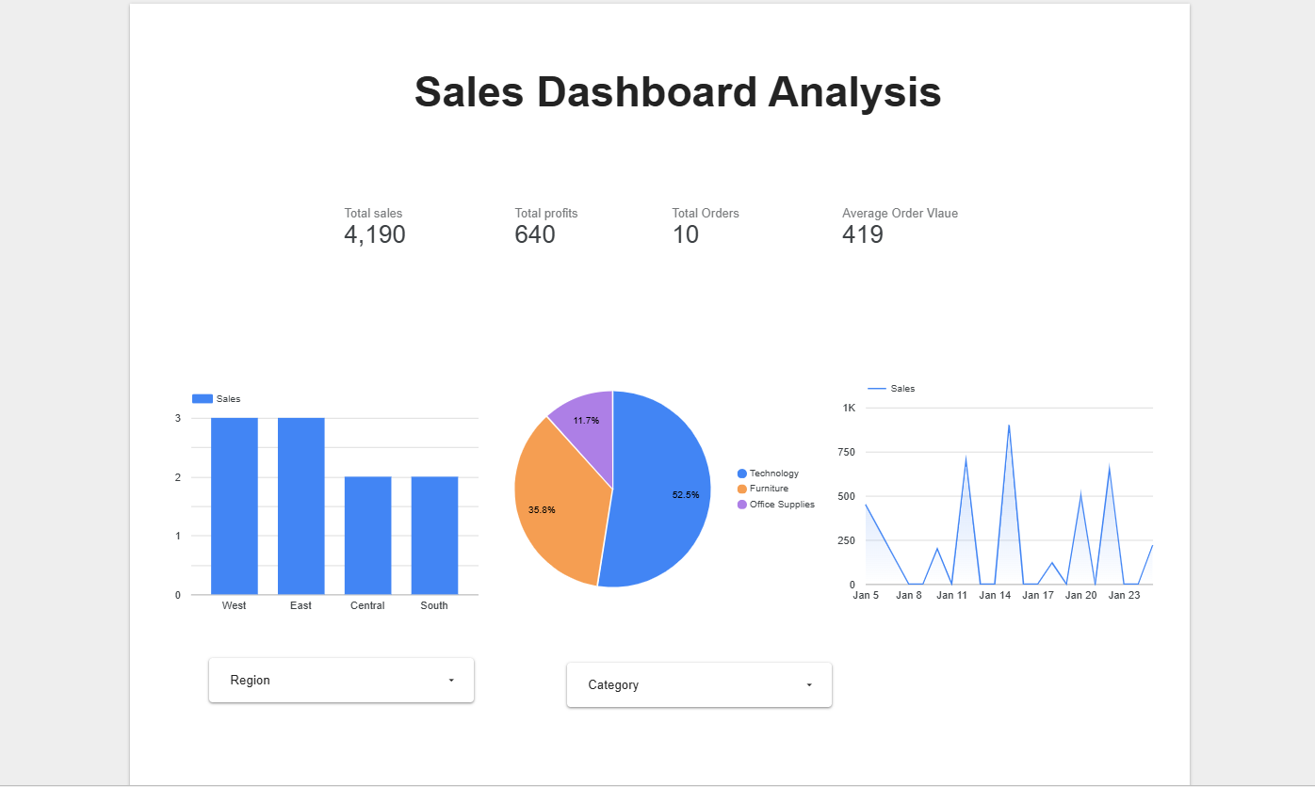
Dashboard Layout Example

Slide 14
Dashboard Insights
Insights extracted from dashboard:
• Regional sales differences
• Top performing product categories
• Profit trends across segments

Slide 15
Task 4 – Deep Dive Data Analysis
Advanced analysis performed:
• Sales trend analysis
• Category profitability
• Regional performance comparison

Slide 16
Key Insights
Important findings:
• Identified top performing categories
• Regional sales trends
• Profit variations across segments
• Opportunities for improvement

Slide 17
Skills Developed
Technical Skills:
• Data Cleaning
• Exploratory Data Analysis
• Data Visualization
• Dashboard Development
Soft Skills:
• Analytical Thinking
• Problem Solving
• Data Storytelling

Slide 18
Portfolio Repository
All internship projects organized in a master portfolio repository.
Contents:
• Project documentation
• Dashboard links
• Presentation
• Learning reflections

Slide 19
Conclusion & Future Goals
This internship strengthened my data analysis capabilities and practical experience.
Future Goal:
To pursue opportunities in Data Analytics and Business Intelligence.

Slide 20
Thank You

